Slide 1
Module 0: Course Introduction and Exam Orientation
What the exam is: 60 items, 120 minutes, a scaled score of 720 to
Course module · exam orientation and review
Claude Associate Foundations Exam Prep Masterclass
Module 0
Notes:
Welcome to Module zero: Course Introduction and Exam Orientation. This module covers exam orientation and the course map.
Each part of this module comes from the study notes of the same name, so you can read the notes after you watch.

Slide 2
What You Will Learn
Module 0
What the exam is: 60 items, 120 minutes, a scaled score of 720 to pass
The seven domains, their weights and the 30 objectives behind them
The minimally qualified candidate the exam is written for
The decision rules that explain most correct answers
How the course is built and how to use it
Claude Associate Foundations Exam Prep | for the CCAO-F exam
Module 0: Course Introduction and Exam Orientation
2 / 19
Notes:
By the end of this module you will be able to do five things.
What the exam is: sixty items, one hundred twenty minutes, a scaled score of seven hundred twenty to pass.
The seven domains, their weights and the thirty objectives behind them.
The minimally qualified candidate the exam is written for.
The decision rules that explain most correct answers.
How the course is built and how to use it.

Slide 3
Case Check-In: Cedarbrook Outfitters
Module 0
CASE CHECK-IN · Cedarbrook Outfitters
Throughout the course you follow Cedarbrook Outfitters, a fictional outdoor-gear retailer
Its operations, marketing and customer-care teams adopt Claude for reports, campaign copy, reply drafts and planning
Each module solves one problem the teams meet; the questions use the same style as the exam
Claude Associate Foundations Exam Prep | for the CCAO-F exam
Module 0: Course Introduction and Exam Orientation
3 / 19
Notes:
Our running case is Cedarbrook Outfitters. Cedarbrook Outfitters.
Throughout the course you follow Cedarbrook Outfitters, a fictional outdoor-gear retailer.
Its operations, marketing and customer-care teams adopt Claude for reports, campaign copy, reply drafts and planning.
Each module solves one problem the teams meet; the questions use the same style as the exam.

Slide 4
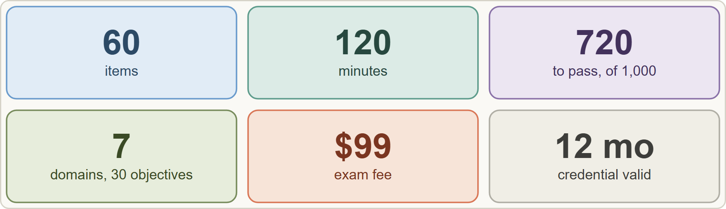
The Exam at a Glance
Module 0
The CCAO-F exam at a glance: 60 items, 120 minutes, scaled score 100 to 1,000 with 720 to pass, 7 domains, USD 99, valid 12 months
Claude Associate Foundations Exam Prep | for the CCAO-F exam
Module 0: Course Introduction and Exam Orientation
4 / 19
Notes:
The Exam at a Glance.
The figure shows this: The C C A O F exam at a glance: sixty items, one hundred twenty minutes, scaled score one hundred to one thousand with seven hundred twenty to pass, seven domains, U S D ninety-nine, valid twelve months.

Slide 5
The Exam at a Glance, continued
DATES
Module 0
Fact | Value (guide v1.0, July 2026)
Credential / code | Claude Associate – Foundations / CCAO-F
Items | 60, multiple choice and multiple response; each item says how many answers to select
Time | 120 minutes (2 minutes per item)
Passing score | 720 on a scaled range of 100 to 1,000 (criterion-referenced: a fixed standard, not a ranking)
Fee | USD 99 per attempt
Delivery | Proctored by Pearson VUE: online or at a test center
Validity | 12 months from the date the credential is awarded; on-time renewal is a free, non-proctored assessment
Claude Associate Foundations Exam Prep | for the CCAO-F exam
Module 0: Course Introduction and Exam Orientation
5 / 19
Notes:
The Exam at a Glance, continued.
Credential or code. Claude Associate to Foundations or C C A O F.
Items. sixty, multiple choice and multiple response; each item says how many answers to select.
Time. one hundred twenty minutes (two minutes per item).
Passing score. seven hundred twenty on a scaled range of one hundred to one thousand (criterion-referenced: a fixed standard, not a ranking).
Fee. U S D ninety-nine per attempt.
Delivery. Proctored by Pearson V U E: online or at a test center.
Validity. twelve months from the date the credential is awarded; on-time renewal is a free, non-proctored assessment.

Slide 6
The Exam at a Glance, continued
DATES
Module 0
Fact | Value (guide v1.0, July 2026)
Retakes | Wait 14 days after the first failed attempt, 30 after the second, 90 after the third; at most 4 attempts in a rolling 12 months; limits are per exam
Prerequisites | None are required; regular hands-on use of Claude is recommended; no software or API experience is needed
Score report | Pass or fail, the scaled score, and the percent correct per domain (domain figures do not decide pass or fail)
EXAM TIP For a multiple-response item the stem says how many answers to select: read that number first, then choose exactly that many.
Claude Associate Foundations Exam Prep | for the CCAO-F exam
Module 0: Course Introduction and Exam Orientation
6 / 19
Notes:
The Exam at a Glance, continued.
Retakes. Wait fourteen days after the first failed attempt, thirty after the second, ninety after the third; at most four attempts in a rolling twelve months; limits are per exam.
Prerequisites. None are required; regular hands-on use of Claude is recommended; no software or A P I (application programming interface) experience is needed.
Score report. Pass or fail, the scaled score, and the percent correct per domain (domain figures do not decide pass or fail).
Exam tip: For a multiple-response item the stem says how many answers to select: read that number first, then choose exactly that many.

Slide 7
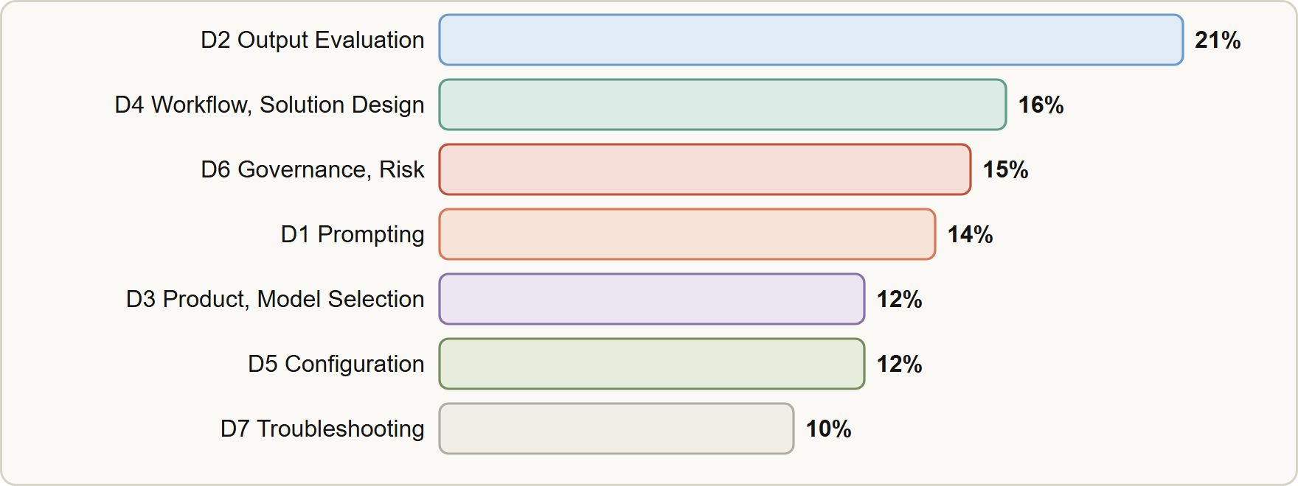
The Seven Domains
Module 0
Domain weights: D2 Output Evaluation and Validation 21, D4 Workflow Integration and Solution Design 16, D6 Governance, Risk and Responsible Use 15, D1 Prompting and Task Execution 14, D3 Product and Model Selection 12, D5 Configuration and Knowledge Management 12, D7 Troubleshooting and Optimization 10
Claude Associate Foundations Exam Prep | for the CCAO-F exam
Module 0: Course Introduction and Exam Orientation
7 / 19
Notes:
The Seven Domains.
The figure shows this: Domain weights: D two Output Evaluation and Validation twenty-one, D four Workflow Integration and Solution Design sixteen, D six Governance, Risk and Responsible Use fifteen, D one Prompting and Task Execution fourteen, D three Product and Model Selection twelve, D five Configuration and Knowledge Management twelve, D seven Troubleshooting and Optimization ten.

Slide 8
The Seven Domains, continued
Module 0
Domain | Weight | What it asks you to do | Modules
D2 Output Evaluation and Validation | 21% | Check accuracy and completeness; spot hallucinations, inconsistencies and bias; fact-check; know when a human must review; edit and adapt; choose output formats | 3 to 5
D4 Workflow Integration and Solution Design | 16% | Analyze requirements; research and plan; support design; fit Claude into workflows; explain value and limits | 9, 10
D6 Governance, Risk, and Responsible Use | 15% | Appropriate and inappropriate uses; data sensitivity and privacy; organizational policy; ethics | 13, 14
Claude Associate Foundations Exam Prep | for the CCAO-F exam
Module 0: Course Introduction and Exam Orientation
8 / 19
Notes:
The Seven Domains, continued.
D two Output Evaluation and Validation. Weight: twenty-one percent. What it asks you to do: Check accuracy and completeness; spot hallucinations, inconsistencies and bias; fact-check; know when a human must review; edit and adapt; choose output formats. Modules: three to five.
D four Workflow Integration and Solution Design. Weight: sixteen percent. What it asks you to do: Analyze requirements; research and plan; support design; fit Claude into workflows; explain value and limits. Modules: nine, ten.
D six Governance, Risk, and Responsible Use. Weight: fifteen percent. What it asks you to do: Appropriate and inappropriate uses; data sensitivity and privacy; organizational policy; ethics. Modules: thirteen, fourteen.

Slide 9
The Seven Domains, continued
Module 0
Domain | Weight | What it asks you to do | Modules
D1 Prompting and Task Execution | 14% | Write effective prompts; decompose tasks; iterate; adapt to the task type | 1, 2
D3 Product and Model Selection | 12% | Choose features; tell Haiku, Sonnet and Opus apart; manage context and memory | 6 to 8
D5 Configuration and Knowledge Management | 12% | Configure Projects; manage knowledge and connectors; write system-level instructions; keep them current | 11, 12
D7 Troubleshooting and Optimization | 10% | Diagnose weak prompts and poor outputs; adjust on feedback; optimize workflows | 15, 16
Claude Associate Foundations Exam Prep | for the CCAO-F exam
Module 0: Course Introduction and Exam Orientation
9 / 19
Notes:
The Seven Domains, continued.
D one Prompting and Task Execution. Weight: fourteen percent. What it asks you to do: Write effective prompts; decompose tasks; iterate; adapt to the task type. Modules: one, two.
D three Product and Model Selection. Weight: twelve percent. What it asks you to do: Choose features; tell Haiku, Sonnet and Opus apart; manage context and memory. Modules: six to eight.
D five Configuration and Knowledge Management. Weight: twelve percent. What it asks you to do: Configure Projects; manage knowledge and connectors; write system-level instructions; keep them current. Modules: eleven, twelve.
D seven Troubleshooting and Optimization. Weight: ten percent. What it asks you to do: Diagnose weak prompts and poor outputs; adjust on feedback; optimize workflows. Modules: fifteen, sixteen.

Slide 10
The Seven Domains, continued
Module 0
Of 60 items, about 13 come from D2, 10 from D4, 9 from D6, 8 from D1, 7 each from D3 and D5, and 6 from D7.
Weights are the approximate share of scored items. Items are written against the 30 objectives listed in the guide.
Study order by value: D2 first, then D4, D6 and D1. Every domain is at least 10%, so none can be skipped.
EXAM TIP No domain is small. The weakest domain on your practice results is the cheapest place to gain points.
Claude Associate Foundations Exam Prep | for the CCAO-F exam
Module 0: Course Introduction and Exam Orientation
10 / 19
Notes:
The Seven Domains, continued.
Of sixty items, about thirteen come from D two, ten from D four, nine from D six, eight from D one, seven each from D three and D five, and six from D seven.
Weights are the approximate share of scored items. Items are written against the thirty objectives listed in the guide.
Study order by value: D two first, then D four, D six and D one. Every domain is at least ten percent, so none can be skipped.
Exam tip: No domain is small. The weakest domain on your practice results is the cheapest place to gain points.

Slide 11
The Minimally Qualified Candidate
Module 0
The minimally qualified candidate (MQC) can:
turn a business goal into a clear, structured prompt, and break big requests into steps
check Claude's output for accuracy, completeness and bias before anyone relies on it
choose the right feature (chat, search, Research, Projects, Artifacts) and the right model for the job
configure a Project with instructions and knowledge, and connect tools such as Google Drive
protect sensitive data and follow the organization's AI policy
fix weak outputs and tune workflows
recognize limits and escalate technical work to Developers and Architects
Claude Associate Foundations Exam Prep | for the CCAO-F exam
Module 0: Course Introduction and Exam Orientation
11 / 19
Notes:
The Minimally Qualified Candidate.
The minimally qualified candidate (M Q C) can.
turn a business goal into a clear, structured prompt, and break big requests into steps.
check Claude's output for accuracy, completeness and bias before anyone relies on it.
choose the right feature (chat, search, Research, Projects, Artifacts) and the right model for the job.
configure a Project with instructions and knowledge, and connect tools such as Google Drive.
protect sensitive data and follow the organization's A I policy.
fix weak outputs and tune workflows.
recognize limits and escalate technical work to Developers and Architects.

Slide 12
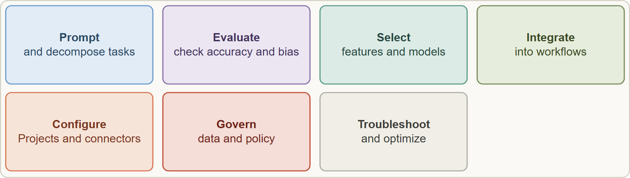
The Minimally Qualified Candidate, continued
Module 0
The minimally qualified candidate prompts, evaluates, selects, integrates, configures, governs and troubleshoots Claude in everyday work
Claude Associate Foundations Exam Prep | for the CCAO-F exam
Module 0: Course Introduction and Exam Orientation
12 / 19
Notes:
The Minimally Qualified Candidate, continued.
The figure shows this: The minimally qualified candidate prompts, evaluates, selects, integrates, configures, governs and troubleshoots Claude in everyday work.

Slide 13
Ten Decision Rules the Questions Reward
Module 0
Most items describe a business situation and ask for the best action. The best answer usually follows one of these rules. Each later module shows them at work.
Claude Associate Foundations Exam Prep | for the CCAO-F exam
Module 0: Course Introduction and Exam Orientation
13 / 19
Notes:
Ten Decision Rules the Questions Reward.
Most items describe a business situation and ask for the best action. The best answer usually follows one of these rules. Each later module shows them at work.

Slide 14
Ten Decision Rules the Questions Reward, continued
Module 0
# | Rule | Typical wrong answers
1 | Verify facts, numbers and citations against an authoritative source before sharing | "Claude sounded confident", "ask Claude to rate itself"
2 | Be specific: goal, audience, context, format and constraints in the prompt | A vague one-line request, or "just retry"
3 | Break complex work into steps and review each | One giant prompt with no review
4 | Match the model and effort to the task: lighter for routine and high-volume, stronger for hard reasoning | "Always the biggest model", "never use Research"
Claude Associate Foundations Exam Prep | for the CCAO-F exam
Module 0: Course Introduction and Exam Orientation
14 / 19
Notes:
Ten Decision Rules the Questions Reward, continued.
one. Rule: Verify facts, numbers and citations against an authoritative source before sharing. Typical wrong answers: "Claude sounded confident", "ask Claude to rate itself".
two. Rule: Be specific: goal, audience, context, format and constraints in the prompt. Typical wrong answers: A vague one-line request, or "just retry".
three. Rule: Break complex work into steps and review each. Typical wrong answers: One giant prompt with no review.
four. Rule: Match the model and effort to the task: lighter for routine and high-volume, stronger for hard reasoning. Typical wrong answers: "Always the biggest model", "never use Research".

Slide 15
Ten Decision Rules the Questions Reward, continued
Module 0
# | Rule | Typical wrong answers
5 | Use the lightest feature that fits: chat for quick, web search for current facts, Research for deep reports | Research for a one-line fact
6 | Put standing context in a Project (instructions and knowledge), not in every prompt | Pasting the same background each time
7 | Protect sensitive data: remove or anonymize identifiers; follow policy; use approved tools | "Tell Claude not to retain it", uploading as-is
8 | Keep a qualified human in the loop for high-stakes or regulated decisions | Letting Claude decide alone
Claude Associate Foundations Exam Prep | for the CCAO-F exam
Module 0: Course Introduction and Exam Orientation
15 / 19
Notes:
Ten Decision Rules the Questions Reward, continued.
five. Rule: Use the lightest feature that fits: chat for quick, web search for current facts, Research for deep reports. Typical wrong answers: Research for a one-line fact.
six. Rule: Put standing context in a Project (instructions and knowledge), not in every prompt. Typical wrong answers: Pasting the same background each time.
seven. Rule: Protect sensitive data: remove or anonymize identifiers; follow policy; use approved tools. Typical wrong answers: "Tell Claude not to retain it", uploading as-is.
eight. Rule: Keep a qualified human in the loop for high-stakes or regulated decisions. Typical wrong answers: Letting Claude decide alone.

Slide 16
Ten Decision Rules the Questions Reward, continued
Module 0
# | Rule | Typical wrong answers
9 | Start a fresh chat or summarize when a conversation gets long or drifts | Piling on more messages
10 | Escalate technical, integration or architecture work to Developers or Architects | Improvising an API integration
EXAM TIP When two options both work, prefer the one that verifies, protects data, fits the task and keeps a person accountable.
Claude Associate Foundations Exam Prep | for the CCAO-F exam
Module 0: Course Introduction and Exam Orientation
16 / 19
Notes:
Ten Decision Rules the Questions Reward, continued.
nine. Rule: Start a fresh chat or summarize when a conversation gets long or drifts. Typical wrong answers: Piling on more messages.
ten. Rule: Escalate technical, integration or architecture work to Developers or Architects. Typical wrong answers: Improvising an A P I integration.
Exam tip: When two options both work, prefer the one that verifies, protects data, fits the task and keeps a person accountable.

Slide 17
How to Use This Course
Module 0
Order: read modules 1 to 16 in order (they follow the domains), then module 17 (recap) and 18 (technique).
Each module has the objectives it covers, a case, tables, figures, Exam tips, scenario questions with explanations and a Quick Reference Card.
Practice on the real product. The guide recommends building a Project with instructions and knowledge and evaluating outputs for accuracy and bias. Do the small exercises as you read.
Claude Associate Foundations Exam Prep | for the CCAO-F exam
Module 0: Course Introduction and Exam Orientation
17 / 19
Notes:
How to Use This Course.
Order: read modules one to sixteen in order (they follow the domains), then module seventeen (recap) and eighteen (technique).
Each module has the objectives it covers, a case, tables, figures, Exam tips, scenario questions with explanations and a Quick Reference Card.
Practice on the real product. The guide recommends building a Project with instructions and knowledge and evaluating outputs for accuracy and bias. Do the small exercises as you read.

Slide 18
How to Use This Course, continued
Module 0
Product details change fast. Boxes marked show current behavior (plan limits, menu names, model lineup). On the exam, answer by the principle and check the Help Center for current details.
Independence. This course is independent study material; it is not affiliated with, endorsed by or sponsored by Anthropic or Pearson VUE. Read the official exam guide, the Certification Terms and Conditions and the Exam Policy before you register.
Claude Associate Foundations Exam Prep | for the CCAO-F exam
Module 0: Course Introduction and Exam Orientation
18 / 19
Notes:
How to Use This Course, continued.
Product details change fast. Boxes marked show current behavior (plan limits, menu names, model lineup). On the exam, answer by the principle and check the Help Center for current details.
Independence. This course is independent study material; it is not affiliated with, endorsed by or sponsored by Anthropic or Pearson V U E. Read the official exam guide, the Certification Terms and Conditions and the Exam Policy before you register.

Slide 19
Module Recap
Module 0
1
Exam
2
Domains
3
Objectives
CCAO-F; 60 items; 120 min; pass 720 of 1,000; USD 99; valid 12 months
D2 21 · D4 16 · D6 15 · D1 14 · D3 12 · D5 12 · D7 10
30 in all
4
Prerequisites
5
Retakes
6
Ten rules
None required; hands-on Claude use recommended; no API skills needed
14, 30, 90 days; max 4 per rolling 12 months
Verify · be specific · decompose · match model and effort · lightest feature · Project for standing context · protect data · human in the loop · restart or summarize · escalate
Claude Associate Foundations Exam Prep | for the CCAO-F exam
Module 0: Course Introduction and Exam Orientation
19 / 19
Notes:
Here is the recap.
Exam: C C A O F; sixty items; one hundred twenty min; pass seven hundred twenty of one thousand; U S D ninety-nine; valid twelve months.
Domains: D two twenty-one, D four sixteen, D six fifteen, D one fourteen, D three twelve, D five twelve, D seven ten.
Objectives: thirty in all.
Prerequisites: None required; hands-on Claude use recommended; no A P I skills needed.
Retakes: fourteen, thirty, ninety days; max four per rolling twelve months.
Ten rules: Verify, be specific, decompose, match model and effort, lightest feature, Project for standing context, protect data, human in the loop, restart or summarize, escalate.
In the next module, we continue the course.

