Slide 1
Module 4: Fact-Checking, Validation and Human Review
The main fact-checking techniques: primary sources, grounding, cross-checking, recalculation, sampling
Domain 2 · Output Evaluation and Validation
Claude Associate Foundations Exam Prep Masterclass
Module 4
Notes:
Welcome to Module four: Fact-Checking, Validation and Human Review. This module covers fact-checking, validation and human review.
Each part of this module comes from the study notes of the same name, so you can read the notes after you watch.

Slide 2
What You Will Learn
Module 4
The main fact-checking techniques: primary sources, grounding, cross-checking, recalculation, sampling
How to use web search and citations safely
How much checking an output needs, based on stakes
When a human must review before anything is sent, published or decided
Claude Associate Foundations Exam Prep | for the CCAO-F exam
Module 4: Fact-Checking, Validation and Human Review
2 / 25
Notes:
By the end of this module you will be able to do four things.
The main fact-checking techniques: primary sources, grounding, cross-checking, recalculation, sampling.
How to use web search and citations safely.
How much checking an output needs, based on stakes.
When a human must review before anything is sent, published or decided.

Slide 3
Case Check-In: Cedarbrook's Press Release
Module 4
CASE CHECK-IN · Cedarbrook Outfitters
Communications asks Claude to draft a release on the company's carbon-reduction results
The draft contains three statistics and a quote attributed to an industry body
Before publishing, the team traces each number to the sustainability report and each quote to the original
Claude Associate Foundations Exam Prep | for the CCAO-F exam
Module 4: Fact-Checking, Validation and Human Review
3 / 25
Notes:
Our running case is Cedarbrook Outfitters. Cedarbrook's Press Release.
Communications asks Claude to draft a release on the company's carbon-reduction results.
The draft contains three statistics and a quote attributed to an industry body.
Before publishing, the team traces each number to the sustainability report and each quote to the original.

Slide 4
Fact-Checking Techniques
Module 4
Technique | How it works | Best for
Check the primary source | Open the official document, regulation, dataset or website and compare | Citations, legal and policy statements, quotes
Ground Claude in your documents | Upload or paste the source and tell Claude to answer only from it and to quote the supporting lines | Summaries and Q&A on known material
Ask for sources, then check them | Request links or titles; open them yourself; a source Claude cannot supply is a red flag | Research claims
Cross-check with independent sources | Confirm key facts in two or more trustworthy places | Statistics, market facts, dates
Claude Associate Foundations Exam Prep | for the CCAO-F exam
Module 4: Fact-Checking, Validation and Human Review
4 / 25
Notes:
Fact-Checking Techniques.
Check the primary source. How it works: Open the official document, regulation, dataset or website and compare. Best for: Citations, legal and policy statements, quotes.
Ground Claude in your documents. How it works: Upload or paste the source and tell Claude to answer only from it and to quote the supporting lines. Best for: Summaries and Q and A on known material.
Ask for sources, then check them. How it works: Request links or titles; open them yourself; a source Claude cannot supply is a red flag. Best for: Research claims.
Cross-check with independent sources. How it works: Confirm key facts in two or more trustworthy places. Best for: Statistics, market facts, dates.

Slide 5
Fact-Checking Techniques, continued
Module 4
Technique | How it works | Best for
Recalculate | Redo totals and percentages from the raw data in a spreadsheet | Numbers and tables
Spot-check a sample | Check a random subset of items against the source; widen if errors appear | Long lists, bulk summaries
Test the artifact | Run the formula, script or macro on sample data with a known answer | Technical outputs
Second pair of eyes | A colleague or subject-matter expert reviews | High-stakes content
Claude Associate Foundations Exam Prep | for the CCAO-F exam
Module 4: Fact-Checking, Validation and Human Review
5 / 25
Notes:
Fact-Checking Techniques, continued.
Recalculate. How it works: Redo totals and percentages from the raw data in a spreadsheet. Best for: Numbers and tables.
Spot-check a sample. How it works: Check a random subset of items against the source; widen if errors appear. Best for: Long lists, bulk summaries.
Test the artifact. How it works: Run the formula, script or macro on sample data with a known answer. Best for: Technical outputs.
Second pair of eyes. How it works: A colleague or subject-matter expert reviews. Best for: High-stakes content.

Slide 6
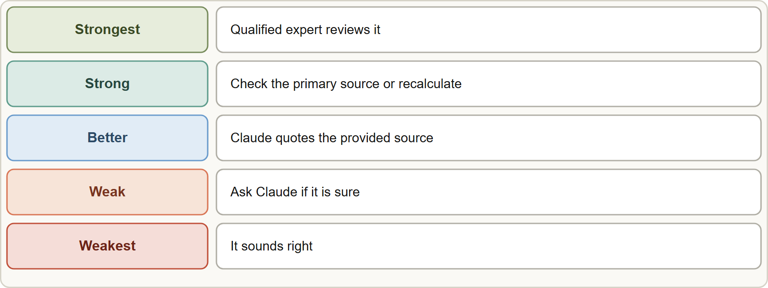
Fact-Checking Techniques, continued
Module 4
Asking Claude "are you sure?" is not verification: it may repeat the error or change a correct answer.
Asking Claude to find problems in its own draft is a useful first pass, but not a substitute for your check against a source.
Asking Claude "are you sure?" is not verification: it may repeat the error or change a correct answer.
Asking Claude to find problems in its own draft is a useful first pass, but not a substitute for your check against a source.
Claude Associate Foundations Exam Prep | for the CCAO-F exam
Module 4: Fact-Checking, Validation and Human Review
6 / 25
Notes:
Fact-Checking Techniques, continued.
The figure shows this: A ladder of verification strength: sounds right is weakest; checking a primary source and expert review are strongest.
Asking Claude "are you sure?" is not verification: it may repeat the error or change a correct answer.
Asking Claude to find problems in its own draft is a useful first pass, but not a substitute for your check against a source.

Slide 7
Fact-Checking Techniques, continued
Module 4
Quote-first prompting: "First extract the exact lines that answer the question, then answer." This makes unsupported claims easier to spot.
Allow "I don't know": tell Claude it may answer "the document does not say" instead of guessing.
EXAM TIP The strongest checks go outside Claude: an authoritative source, a recalculation, a test run or a qualified person.
Claude Associate Foundations Exam Prep | for the CCAO-F exam
Module 4: Fact-Checking, Validation and Human Review
7 / 25
Notes:
Fact-Checking Techniques, continued.
Quote-first prompting: "First extract the exact lines that answer the question, then answer." This makes unsupported claims easier to spot.
Allow "I don't know": tell Claude it may answer "the document does not say" instead of guessing.
Exam tip: The strongest checks go outside Claude: an authoritative source, a recalculation, a test run or a qualified person.

Slide 8
Using Web Search and Citations
Module 4
With web search on, Claude grounds answers in live web content and gives citations and source links. A visible indicator shows when it is searching.
Review the cited sources. The Help Center warns that original sites may hold context or detail not in Claude's synthesis, and that answer quality depends on the sources it used.
Ask for multiple sources and verify important information against authoritative ones.
Prefer primary and official sources (regulators, standards bodies, the company itself) over blogs.
Dates matter: check how recent a source is.
Claude Associate Foundations Exam Prep | for the CCAO-F exam
Module 4: Fact-Checking, Validation and Human Review
8 / 25
Notes:
Using Web Search and Citations.
With web search on, Claude grounds answers in live web content and gives citations and source links. A visible indicator shows when it is searching.
Review the cited sources. The Help Center warns that original sites may hold context or detail not in Claude's synthesis, and that answer quality depends on the sources it used.
Ask for multiple sources and verify important information against authoritative ones.
Prefer primary and official sources (regulators, standards bodies, the company itself) over blogs.
Dates matter: check how recent a source is.

Slide 9
Using Web Search and Citations, continued
Module 4
Include "search the web" in the prompt to make sure it searches, or tell it not to when you want it to use only your documents.
Research mode produces a longer report with citations; the same rule applies: open the sources for the claims you will rely on.
Claude Associate Foundations Exam Prep | for the CCAO-F exam
Module 4: Fact-Checking, Validation and Human Review
9 / 25
Notes:
Using Web Search and Citations, continued.
Include "search the web" in the prompt to make sure it searches, or tell it not to when you want it to use only your documents.
Research mode produces a longer report with citations; the same rule applies: open the sources for the claims you will rely on.

Slide 10
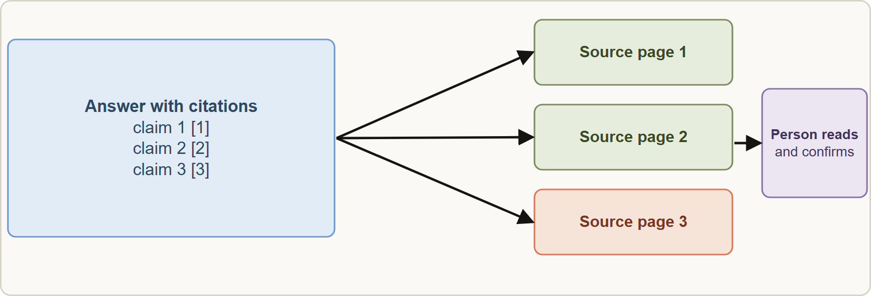
Using Web Search and Citations, continued
Module 4
Citations make checking possible: follow them to the source and confirm the claim
EXAM TIP A cited answer is easier to verify, not already verified. The step that counts is that a person reads the source.
Claude Associate Foundations Exam Prep | for the CCAO-F exam
Module 4: Fact-Checking, Validation and Human Review
10 / 25
Notes:
Using Web Search and Citations, continued.
The figure shows this: Citations make checking possible: follow them to the source and confirm the claim.
Exam tip: A cited answer is easier to verify, not already verified. The step that counts is that a person reads the source.

Slide 11
How Much Checking Is Enough?
Module 4
Factor | Lower risk | Higher risk
Stakes | Internal brainstorm | Legal, medical, financial, safety, people decisions
Audience | You alone | Customers, regulators, the public, the board
Reversibility | Easy to fix | Sent, published, filed, paid
Source reliability | You provided and trust the source | Claude answered from memory
Novelty | Routine, repeated task with a proven prompt | New topic or unfamiliar domain
Match the depth of review to the risk.
Claude Associate Foundations Exam Prep | for the CCAO-F exam
Module 4: Fact-Checking, Validation and Human Review
11 / 25
Notes:
How Much Checking Is Enough?
Match the depth of review to the risk.
Stakes. Lower risk: Internal brainstorm. Higher risk: Legal, medical, financial, safety, people decisions.
Audience. Lower risk: You alone. Higher risk: Customers, regulators, the public, the board.
Reversibility. Lower risk: Easy to fix. Higher risk: Sent, published, filed, paid.
Source reliability. Lower risk: You provided and trust the source. Higher risk: Claude answered from memory.
Novelty. Lower risk: Routine, repeated task with a proven prompt. Higher risk: New topic or unfamiliar domain.

Slide 12
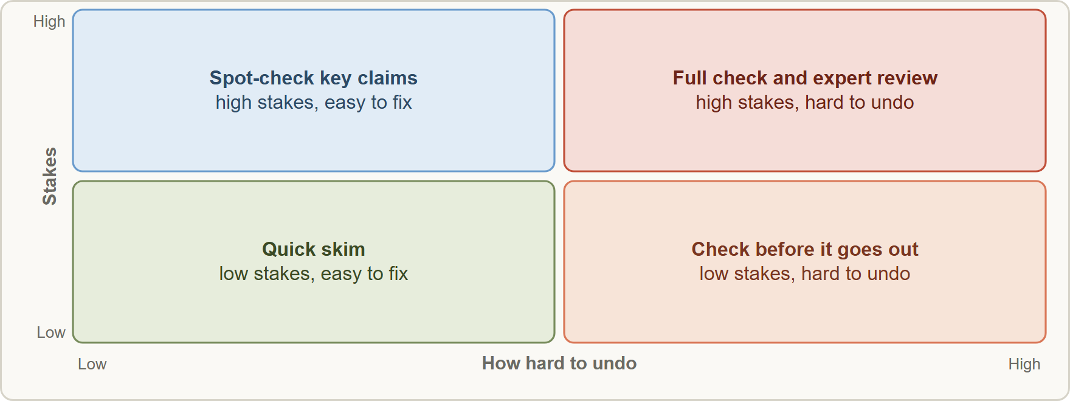
How Much Checking Is Enough?, continued
Module 4
Low stakes and reversible (a brainstorm list): a quick read.
Medium (an internal report): spot-check the key figures.
High and hard to undo (a regulatory filing, a customer-facing claim, a contract summary): check every claim and add expert review.
Low stakes and reversible (a brainstorm list): a quick read.
Medium (an internal report): spot-check the key figures.
High and hard to undo (a regulatory filing, a customer-facing claim, a contract summary): check every claim and add expert review.
Claude Associate Foundations Exam Prep | for the CCAO-F exam
Module 4: Fact-Checking, Validation and Human Review
12 / 25
Notes:
How Much Checking Is Enough?, continued.
The figure shows this: Review depth grows with stakes and with how hard the output is to undo.
Low stakes and reversible (a brainstorm list): a quick read.
Medium (an internal report): spot-check the key figures.
High and hard to undo (a regulatory filing, a customer-facing claim, a contract summary): check every claim and add expert review.

Slide 13
When Human Review Is Required
Module 4
A qualified human must review before use when:
The output supports legal, medical, financial, safety or compliance decisions
It affects people: hiring, promotion, credit, benefits, grades, access to services
It will be published or sent externally under the company's name
It involves regulated or sensitive data (Module 13)
The action is irreversible or costly (payments, deletions, sending to many customers)
Claude's answer is uncertain, contradictory or outside the checker's expertise
Organizational policy says so
Claude Associate Foundations Exam Prep | for the CCAO-F exam
Module 4: Fact-Checking, Validation and Human Review
13 / 25
Notes:
When Human Review Is Required.
A qualified human must review before use when.
The output supports legal, medical, financial, safety or compliance decisions.
It affects people: hiring, promotion, credit, benefits, grades, access to services.
It will be published or sent externally under the company's name.
It involves regulated or sensitive data (Module thirteen).
The action is irreversible or costly (payments, deletions, sending to many customers).
Claude's answer is uncertain, contradictory or outside the checker's expertise.
Organizational policy says so.

Slide 14
When Human Review Is Required, continued
Module 4
Anthropic's Usage Policy lists high-risk uses (legal, medical, finance, credit, insurance, housing, employment, education, public benefits). For these a qualified human-in-the-loop must meaningfully review the recommendation before it is delivered or acted on and must be able to change it, and the affected person must be told AI was involved.
The human must be qualified: a lawyer reviews legal text, an accountant reviews financial figures. Skimming is not review.
Document how AI was used and who reviewed the result.
Keep the person accountable: Claude drafts; the human owns the decision.
EXAM TIP In scenarios about regulated advice, people decisions or external publication, the right answer includes review by a qualified person before use, never "send it, Claude is usually right".
Claude Associate Foundations Exam Prep | for the CCAO-F exam
Module 4: Fact-Checking, Validation and Human Review
14 / 25
Notes:
When Human Review Is Required, continued.
Anthropic's Usage Policy lists high-risk uses (legal, medical, finance, credit, insurance, housing, employment, education, public benefits). For these a qualified human-in-the-loop must meaningfully review the recommendation before it is delivered or acted on and must be able to change it, and the affected person must be told A I was involved.
The human must be qualified: a lawyer reviews legal text, an accountant reviews financial figures. Skimming is not review.
Document how A I was used and who reviewed the result.
Keep the person accountable: Claude drafts; the human owns the decision.
Exam tip: In scenarios about regulated advice, people decisions or external publication, the right answer includes review by a qualified person before use, never "send it, Claude is usually right".

Slide 15
Module Recap
Module 4
1
Strongest checks
2
Weak checks
3
Grounding
Primary source · recalculation · test run · qualified reviewer
"Are you sure?" · polish · self-rated confidence
Answer only from the provided source; quote lines; allow "not covered"
4
Web search
5
Depth
6
Human review needed
Citations help; open the sources; prefer primary and recent
Scale with stakes, audience, reversibility, source reliability, novelty
Legal, medical, financial, safety, people decisions, external publication, regulated data, irreversible actions, policy
7
High-risk uses
8
Accountability
Qualified human reviews and can change it; tell affected people AI was involved
Claude drafts; a named person decides
Claude Associate Foundations Exam Prep | for the CCAO-F exam
Module 4: Fact-Checking, Validation and Human Review
15 / 25
Notes:
Here is the recap.
Strongest checks: Primary source, recalculation, test run, qualified reviewer.
Weak checks: "Are you sure?", polish, self-rated confidence.
Grounding: Answer only from the provided source; quote lines; allow "not covered".
Web search: Citations help; open the sources; prefer primary and recent.
Depth: Scale with stakes, audience, reversibility, source reliability, novelty.
Human review needed: Legal, medical, financial, safety, people decisions, external publication, regulated data, irreversible actions, policy.
High-risk uses: Qualified human reviews and can change it; tell affected people A I was involved.
Accountability: Claude drafts; a named person decides.

Slide 16
Practice Question 1
Module 4
Q1
A press release draft contains a statistic and a quote attributed to a trade body. What is the best validation?
A
Reword the quote so that it sounds more natural and fits the tone of the release
B
Publish the release now and correct the figures later if anyone complains about them
C
Trace the statistic and the quote to the original sources before publishing
D
Ask Claude whether it is sure
Claude Associate Foundations Exam Prep | for the CCAO-F exam
Module 4: Fact-Checking, Validation and Human Review
16 / 25
Notes:
Question one.
A press release draft contains a statistic and a quote attributed to a trade body. What is the best validation?
The four options are on the screen.
[PAUSE 12]
The answer is C. Verify claims against the original sources, especially for external publication.

Slide 17
Practice Question 2
Module 4
Q2
Which prompt best reduces unsupported claims when summarizing an uploaded policy?
A
"Summarize this policy."
B
"Answer only from the policy, quote the lines you used, and say if it does not cover a point."
C
"Summarize this and be confident."
D
"Summarize this using everything you know about the topic, not only what the policy says, please."
Claude Associate Foundations Exam Prep | for the CCAO-F exam
Module 4: Fact-Checking, Validation and Human Review
17 / 25
Notes:
Question two.
Which prompt best reduces unsupported claims when summarizing an uploaded policy?
The four options are on the screen.
[PAUSE 12]
The answer is B. Grounding in the document, quoting and allowing "not covered" make errors visible.

Slide 18
Practice Question 3
Module 4
Q3
An associate asks Claude "are you sure?" and Claude says yes. What does that prove?
A
Nothing reliable; the claim still needs to be checked against a source
B
The answer is complete
C
The answer is verified
D
The answer is unbiased
Claude Associate Foundations Exam Prep | for the CCAO-F exam
Module 4: Fact-Checking, Validation and Human Review
18 / 25
Notes:
Question three.
An associate asks Claude "are you sure?" and Claude says yes. What does that prove?
The four options are on the screen.
[PAUSE 12]
The answer is A. Self-reported certainty is not a validation method, so the claim still has to be checked against an independent source.

Slide 19
Practice Question 4
Module 4
Q4
Claude's web-search answer includes citations. What is the best next step for a claim you will rely on?
A
Delete the citations to save space
B
Open the cited source and confirm the claim and its date
C
Assume the citations make it correct
D
Ask Claude to search again
Claude Associate Foundations Exam Prep | for the CCAO-F exam
Module 4: Fact-Checking, Validation and Human Review
19 / 25
Notes:
Question four.
Claude's web-search answer includes citations. What is the best next step for a claim you will rely on?
The four options are on the screen.
[PAUSE 12]
The answer is B. Citations make verification possible; a person must follow them.

Slide 20
Practice Question 5
Module 4
Q5
Which output needs the deepest review?
A
A list of ten possible team-lunch themes for the next monthly meeting
B
A brainstorm of hashtag ideas
C
A draft agenda for an internal stand-up meeting that will not leave the team
D
A summary of a customer contract to be sent to the client
Claude Associate Foundations Exam Prep | for the CCAO-F exam
Module 4: Fact-Checking, Validation and Human Review
20 / 25
Notes:
Question five.
Which output needs the deepest review?
The four options are on the screen.
[PAUSE 12]
The answer is D. External, contract-related content carries high stakes and is hard to undo.

Slide 21
Practice Question 6
Module 4
Q6
Which TWO situations require review by a qualified human before use? (Select TWO.)
A
Drafting a casual internal thank-you note
B
Screening job applicants where the output would drive rejection decisions
C
Brainstorming event names
D
Summarizing medical guidance that staff will use with patients
E
Reformatting a to-do list
Claude Associate Foundations Exam Prep | for the CCAO-F exam
Module 4: Fact-Checking, Validation and Human Review
21 / 25
Notes:
Question six. Select two.
Which two situations require review by a qualified human before use?
The five options are on the screen.
[PAUSE 15]
The answers are B and D. Medical guidance and employment decisions are high-risk uses that need a qualified human reviewer.

Slide 22
Practice Question 7
Module 4
Q7
Claude produces a spreadsheet formula for commission calculations. What is the best validation?
A
Apply it to the full payroll file immediately
B
Ask Claude to explain the formula in more detail and skip testing
C
Trust it, as formulas are always right
D
Test it on sample rows where the correct result is known
Claude Associate Foundations Exam Prep | for the CCAO-F exam
Module 4: Fact-Checking, Validation and Human Review
22 / 25
Notes:
Question seven.
Claude produces a spreadsheet formula for commission calculations. What is the best validation?
The four options are on the screen.
[PAUSE 12]
The answer is D. Test technical outputs on known cases before real use.

Slide 23
Practice Question 8
Module 4
Q8
Why should a human reviewer of a legal summary be qualified?
A
Because company rules say that any employee in the department may review legal text
B
To make the review take longer so that the work looks careful and thorough to managers
C
Because Claude cannot summarize law
D
Because meaningful review needs the expertise to spot errors that look plausible
Claude Associate Foundations Exam Prep | for the CCAO-F exam
Module 4: Fact-Checking, Validation and Human Review
23 / 25
Notes:
Question eight.
Why should a human reviewer of a legal summary be qualified?
The four options are on the screen.
[PAUSE 12]
The answer is D. Review is only meaningful when the reviewer can recognize substantive errors.

Slide 24
Practice Question 9
Module 4
Q9
A team uses Claude to draft decision letters about benefits. What does the Usage Policy expect?
A
A qualified human reviews before delivery, and the affected people are told AI was involved
B
Review only when the letter is rejected
C
Disclosure only if requested
D
No human involvement and no disclosure
Claude Associate Foundations Exam Prep | for the CCAO-F exam
Module 4: Fact-Checking, Validation and Human Review
24 / 25
Notes:
Question nine.
A team uses Claude to draft decision letters about benefits. What does the Usage Policy expect?
The four options are on the screen.
[PAUSE 12]
The answer is A. High-risk uses need human-in-the-loop review and disclosure that A I was involved.

Slide 25
Answers at a Glance
Module 4
Question | Answer | Why
Q1 | C | Verify claims against the original sources
Q2 | B | Grounding in the document
Q3 | A | Self-reported certainty is not a validation method
Q4 | B | Citations make verification possible
Q5 | D | External, contract-related content carries high stakes and is hard
Q6 | B, D | Medical guidance and employment decisions are high-risk uses that
Q7 | D | Test technical outputs on known cases before real use
Q8 | D | Review is only meaningful when the reviewer can recognize
Q9 | A | High-risk uses need human-in-the-loop review and disclosure that AI
Claude Associate Foundations Exam Prep | for the CCAO-F exam
Module 4: Fact-Checking, Validation and Human Review
25 / 25
Notes:
Here are all nine answers. Question one: C. Question two: B. Question three: A. Question four: B. Question five: D. Question six: B and D. Question seven: D. Question eight: D. Question nine: A.
In the next module, we continue the course.

