Slide 1
Module 5: Editing, Adapting, Organizing and Choosing Output Formats
How to edit and adapt Claude's output for a specific audience
Domain 2 · Output Evaluation and Validation
Claude Associate Foundations Exam Prep Masterclass
Module 5
Notes:
Welcome to Module five: Editing, Adapting, Organizing and Choosing Output Formats. This module covers editing, adapting, organizing and choosing output formats.
Each part of this module comes from the study notes of the same name, so you can read the notes after you watch.

Slide 2
What You Will Learn
Module 5
How to edit and adapt Claude's output for a specific audience
How to compare versions and refine them
How to organize and curate information
How to choose the right output format: inline, artifact, file or structured data
Claude Associate Foundations Exam Prep | for the CCAO-F exam
Module 5
2 / 24
Notes:
By the end of this module you will be able to do four things.
How to edit and adapt Claude's output for a specific audience.
How to compare versions and refine them.
How to organize and curate information.
How to choose the right output format: inline, artifact, file or structured data.

Slide 3
Case Check-In: Cedarbrook's One Message, Three Readers
Module 5
CASE CHECK-IN · Cedarbrook Outfitters
The operations lead has a technical note: a warehouse system change delays shipments by two days
It must go to warehouse staff, customer-care agents and customers
Claude adapts the same facts into three versions: an operational checklist, a talking-points sheet and a short, friendly notice
Claude Associate Foundations Exam Prep | for the CCAO-F exam
Module 5
3 / 24
Notes:
Our running case is Cedarbrook Outfitters. Cedarbrook's One Message, Three Readers.
The operations lead has a technical note: a warehouse system change delays shipments by two days.
It must go to warehouse staff, customer-care agents and customers.
Claude adapts the same facts into three versions: an operational checklist, a talking-points sheet and a short, friendly notice.

Slide 4
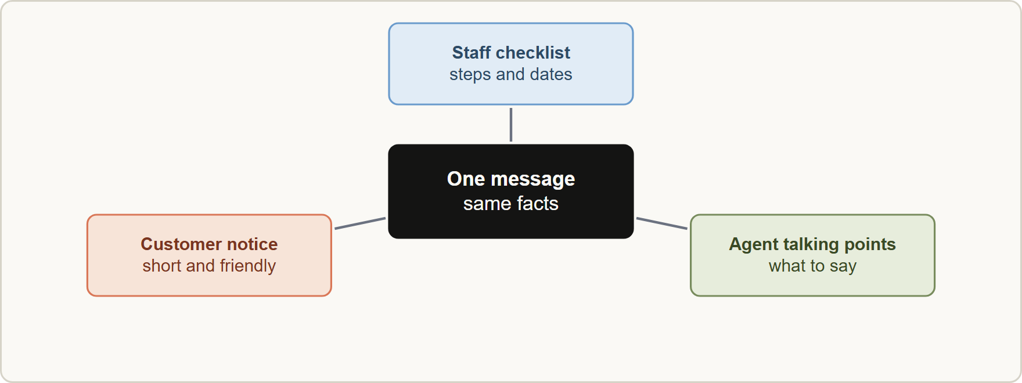
Edit and Adapt for the Audience
Module 5
Adapting one message for three audiences: the facts stay the same while tone, detail and format change
Claude Associate Foundations Exam Prep | for the CCAO-F exam
Module 5
4 / 24
Notes:
Edit and Adapt for the Audience.
The figure shows this: Adapting one message for three audiences: the facts stay the same while tone, detail and format change.

Slide 5
Edit and Adapt for the Audience, continued
Module 5
What to adapt | Examples of instructions
Tone | "Friendly and apologetic", "formal and concise", "neutral and factual"
Reading level | "Plain language for a general reader", "explain terms for a new hire"
Length | "100 words", "one page", "three bullets"
Detail | "Executive summary only", "include the full steps"
Structure | "Headline plus three bullets", "numbered procedure", "table"
Language and region | "Translate to Spanish, US retail style"; native speakers should review important translations
Voice | "Match the style of this example" or a saved style
Keep facts fixed and change delivery. Ask Claude to list any facts it changed so you can confirm nothing was altered.
Claude Associate Foundations Exam Prep | for the CCAO-F exam
Module 5
5 / 24
Notes:
Edit and Adapt for the Audience, continued.
Tone. "Friendly and apologetic", "formal and concise", "neutral and factual".
Reading level. "Plain language for a general reader", "explain terms for a new hire".
Length. "one hundred words", "one page", "three bullets".
Detail. "Executive summary only", "include the full steps".
Structure. "Headline plus three bullets", "numbered procedure", "table".
Language and region. "Translate to Spanish, U S retail style"; native speakers should review important translations.
Voice. "Match the style of this example" or a saved style.
Keep facts fixed and change delivery. Ask Claude to list any facts it changed so you can confirm nothing was altered.

Slide 6
Edit and Adapt for the Audience, continued
Module 5
Edit like an editor: read for accuracy first, then clarity, then tone. Use targeted instructions ("cut the second paragraph by half").
In an artifact such as a document, highlight a passage and ask Claude to edit just that part so the rest stays untouched.
Compare versions side by side: ask for two variants, a table of differences, or "which is more suitable for X and why". You choose.
You own the final text. Claude's output is a draft; keep your voice and responsibility.
EXAM TIP Adapting means same facts, different delivery. If the facts change between versions, that is an error to catch, not an adaptation.
Claude Associate Foundations Exam Prep | for the CCAO-F exam
Module 5
6 / 24
Notes:
Edit and Adapt for the Audience, continued.
Edit like an editor: read for accuracy first, then clarity, then tone. Use targeted instructions ("cut the second paragraph by half").
In an artifact such as a document, highlight a passage and ask Claude to edit just that part so the rest stays untouched.
Compare versions side by side: ask for two variants, a table of differences, or "which is more suitable for X and why". You choose.
You own the final text. Claude's output is a draft; keep your voice and responsibility.
Exam tip: Adapting means same facts, different delivery. If the facts change between versions, that is an error to catch, not an adaptation.

Slide 7
Organize and Curate Information
Module 5
Need | Ask Claude to | Output
Make sense of notes | Group by theme; pull out decisions, risks, actions | Headed summary or table
Compare options | Build a comparison on stated criteria | Table with a row per option
Sort and label | Categorize feedback, tickets, survey comments | Table with a category column
Remove duplicates and clutter | Merge duplicates, drop irrelevant items, keep sources | Clean list
Prioritize | Rank by your criteria (impact, effort, urgency) and show the reasoning | Ranked list
Extract fields | Pull names, dates, amounts from documents | Table or CSV-style list
Claude is strong at turning messy material into usable structure.
Claude Associate Foundations Exam Prep | for the CCAO-F exam
Module 5
7 / 24
Notes:
Organize and Curate Information.
Claude is strong at turning messy material into usable structure.
Make sense of notes. Ask Claude to: Group by theme; pull out decisions, risks, actions. Output: Headed summary or table.
Compare options. Ask Claude to: Build a comparison on stated criteria. Output: Table with a row per option.
Sort and label. Ask Claude to: Categorize feedback, tickets, survey comments. Output: Table with a category column.
Remove duplicates and clutter. Ask Claude to: Merge duplicates, drop irrelevant items, keep sources. Output: Clean list.
Prioritize. Ask Claude to: Rank by your criteria (impact, effort, urgency) and show the reasoning. Output: Ranked list.
Extract fields. Ask Claude to: Pull names, dates, amounts from documents. Output: Table or C S V-style list.

Slide 8
Organize and Curate Information, continued
Module 5
Need | Ask Claude to | Output
Create a knowledge base | Turn FAQs and policies into a clean, consistent document | Document for a Project (Module 11)
Curate means choose and shape, not just collect: decide what the reader needs, cut the rest, and cite the source of each item.
For extraction and sorting, spot-check rows against the originals, because a missed or misread row is easy to overlook (Module 4).
Claude Associate Foundations Exam Prep | for the CCAO-F exam
Module 5
8 / 24
Notes:
Organize and Curate Information, continued.
Create a knowledge base. Ask Claude to: Turn F A Q s and policies into a clean, consistent document. Output: Document for a Project (Module eleven).
Curate means choose and shape, not just collect: decide what the reader needs, cut the rest, and cite the source of each item.
For extraction and sorting, spot-check rows against the originals, because a missed or misread row is easy to overlook (Module four).

Slide 9
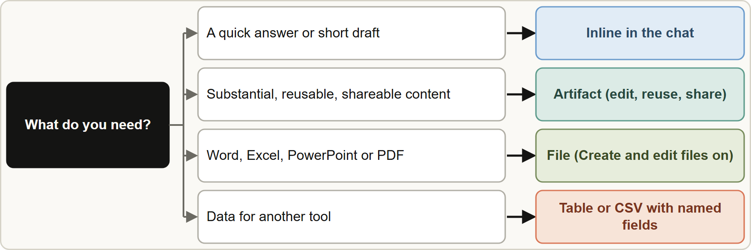
Choosing the Output Format
Module 5
Choosing an output format: inline for quick answers, an artifact for substantial reusable content, a file for Office or PDF, structured data for reuse
Claude Associate Foundations Exam Prep | for the CCAO-F exam
Module 5
9 / 24
Notes:
Choosing the Output Format.
The figure shows this: Choosing an output format: inline for quick answers, an artifact for substantial reusable content, a file for Office or P D F, structured data for reuse.

Slide 10
Choosing the Output Format, continued
Module 5
Format | Use when | Notes
Inline (in the chat) | A quick answer, a short draft, an explanation | Fast; disappears into the thread
Artifact | Substantial, self-contained content you will edit, reuse or share: documents, slides, designs, small interactive tools, dashboards, diagrams | Opens beside the chat; lives in the Artifacts tab; editable; private by default; share on purpose
File (Excel, Word, PowerPoint, PDF) | You need a standard file for colleagues or other tools | Needs Create and edit files (code execution) turned on; download or save to Drive
Claude Associate Foundations Exam Prep | for the CCAO-F exam
Module 5
10 / 24
Notes:
Choosing the Output Format, continued.
Inline (in the chat). Use when: A quick answer, a short draft, an explanation. Notes: Fast; disappears into the thread.
Artifact. Use when: Substantial, self-contained content you will edit, reuse or share: documents, slides, designs, small interactive tools, dashboards, diagrams. Notes: Opens beside the chat; lives in the Artifacts tab; editable; private by default; share on purpose.
File (Excel, Word, Power Point, P D F). Use when: You need a standard file for colleagues or other tools. Notes: Needs Create and edit files (code execution) turned on; download or save to Drive.

Slide 11
Choosing the Output Format, continued
Module 5
Format | Use when | Notes
Structured data | The output will feed another tool or sheet: table, CSV, list with fixed fields, JSON-like format | State the exact columns or fields
Claude tends to create an artifact when content is significant and self-contained (roughly over 15 lines), likely to be edited or reused, understandable without the chat and worth coming back to.
Artifact types and templates include Docs, Slides, Design, Dashboards (beta) and small interactive tools. Docs export to Word, PDF, Markdown or Google Docs; decks export to PowerPoint or PDF; designs to PDF, PowerPoint or HTML.
Claude Associate Foundations Exam Prep | for the CCAO-F exam
Module 5
11 / 24
Notes:
Choosing the Output Format, continued.
Structured data. Use when: The output will feed another tool or sheet: table, C S V, list with fixed fields, Jason (Java Script Object Notation)-like format. Notes: State the exact columns or fields.
Claude tends to create an artifact when content is significant and self-contained (roughly over fifteen lines), likely to be edited or reused, understandable without the chat and worth coming back to.
Artifact types and templates include Docs, Slides, Design, Dashboards (beta) and small interactive tools. Docs export to Word, P D F, Markdown or Google Docs; decks export to Power Point or P D F; designs to P D F, Power Point or H T M L.

Slide 12
Choosing the Output Format, continued
Module 5
Artifacts start private. Sharing controls who can open them. Treat artifacts from unknown sources with caution because they bring someone else's code into your chat.
An artifact error can be sent back with "Try fixing with Claude"; success is not guaranteed.
AI-powered artifacts (small apps that call Claude) use the viewer's own Claude account and plan limits.
Artifacts can store data (personal or shared, text only, small limit). Check whether storage is shared before putting sensitive information in.
For structured data, name the format and fields: "Return a table with columns Name, Date, Amount, Source" and then check the rows.
EXAM TIP "Which format?" questions turn on reuse and audience. Reusable, editable, shareable content: artifact or file. One-off answer: inline. Data for another tool: structured.
Claude Associate Foundations Exam Prep | for the CCAO-F exam
Module 5
12 / 24
Notes:
Choosing the Output Format, continued.
Artifacts start private. Sharing controls who can open them. Treat artifacts from unknown sources with caution because they bring someone else's code into your chat.
An artifact error can be sent back with "Try fixing with Claude"; success is not guaranteed.
A I-powered artifacts (small apps that call Claude) use the viewer's own Claude account and plan limits.
Artifacts can store data (personal or shared, text only, small limit). Check whether storage is shared before putting sensitive information in.
For structured data, name the format and fields: "Return a table with columns Name, Date, Amount, Source" and then check the rows.
Exam tip: "Which format?" questions turn on reuse and audience. Reusable, editable, shareable content: artifact or file. One-off answer: inline. Data for another tool: structured.

Slide 13
Choosing the Output Format, continued
Module 5
EXAM TIP A targeted edit of one passage beats regenerating the whole document: it keeps what is good and saves usage.
Claude Associate Foundations Exam Prep | for the CCAO-F exam
Module 5
13 / 24
Notes:
Choosing the Output Format, continued.
Exam tip: A targeted edit of one passage beats regenerating the whole document: it keeps what is good and saves usage.

Slide 14
Module Recap
Module 5
1
Adapt
2
Edit
3
Compare
Same facts; change tone, level, length, detail, structure, language
Accuracy first, then clarity, then tone; highlight a part to edit only that part
Ask for variants or a difference table; you choose
4
Organize
5
Inline
6
Artifact
Group, compare, sort, dedupe, prioritize, extract; cite sources; spot-check
Quick answers and short drafts
Substantial, self-contained, reusable; Artifacts tab; private by default; export to Word, PDF, PowerPoint
7
File
8
Structured data
9
Caution
Office or PDF files; needs Create and edit files turned on
Name columns or fields; verify rows
Untrusted artifacts; shared storage and sensitive data
Claude Associate Foundations Exam Prep | for the CCAO-F exam
Module 5
14 / 24
Notes:
Here is the recap.
Adapt: Same facts; change tone, level, length, detail, structure, language.
Edit: Accuracy first, then clarity, then tone; highlight a part to edit only that part.
Compare: Ask for variants or a difference table; you choose.
Organize: Group, compare, sort, dedupe, prioritize, extract; cite sources; spot-check.
Inline: Quick answers and short drafts.
Artifact: Substantial, self-contained, reusable; Artifacts tab; private by default; export to Word, P D F, Power Point.
File: Office or P D F files; needs Create and edit files turned on.
Structured data: Name columns or fields; verify rows.
Caution: Untrusted artifacts; shared storage and sensitive data.

Slide 15
Practice Question 1
Module 5
Q1
A coordinator must send the same shipping delay notice to warehouse staff and to customers. What is the best approach?
A
Send the same technical note to both groups unchanged and let each reader work out what matters
B
Write different facts for each group
C
Ask Claude to adapt the same facts for each audience, then check that the facts did not change
D
Ask Claude to write only the customer version
Claude Associate Foundations Exam Prep | for the CCAO-F exam
Module 5
15 / 24
Notes:
Question one.
A coordinator must send the same shipping delay notice to warehouse staff and to customers. What is the best approach?
The four options are on the screen.
[PAUSE 12]
The answer is C. Adapt tone and detail while keeping facts constant, and verify nothing was altered.

Slide 16
Practice Question 2
Module 5
Q2
A manager has a 20-page product guide and wants a reusable, editable one-page summary to share with the sales team. Which output fits best?
A
A voice message
B
A plain text list with no structure that is pasted into an email thread
C
An inline reply that disappears into the chat once the conversation moves on
D
An artifact or a document file that the team can edit and reuse
Claude Associate Foundations Exam Prep | for the CCAO-F exam
Module 5
16 / 24
Notes:
Question two.
A manager has a twenty-page product guide and wants a reusable, editable one-page summary to share with the sales team. Which output fits best?
The four options are on the screen.
[PAUSE 12]
The answer is D. Substantial, reusable, shareable content suits an artifact or a file.

Slide 17
Practice Question 3
Module 5
Q3
An analyst needs customer feedback categorized so it can be pasted into a spreadsheet. Which instruction helps most?
A
"Give me your general impressions of the feedback and what stood out most to you overall."
B
"Return a table with columns Comment, Category, Sentiment, and the comment ID for each row."
C
"Write a story about the feedback."
D
"Summarize the feedback."
Claude Associate Foundations Exam Prep | for the CCAO-F exam
Module 5
17 / 24
Notes:
Question three.
An analyst needs customer feedback categorized so it can be pasted into a spreadsheet. Which instruction helps most?
The four options are on the screen.
[PAUSE 12]
The answer is B. Structured data needs stated fields; I Ds make spot-checking possible.

Slide 18
Practice Question 4
Module 5
Q4
A user wants to change only the second paragraph of a document Claude produced in an artifact. What is the efficient way?
A
Regenerate the whole document and hope the rest is unchanged
B
Delete the artifact and create a brand new one from the original request
C
Highlight the paragraph and ask Claude to edit just that part
D
Open a new chat and start over, pasting in everything that was produced so far
Claude Associate Foundations Exam Prep | for the CCAO-F exam
Module 5
18 / 24
Notes:
Question four.
A user wants to change only the second paragraph of a document Claude produced in an artifact. What is the efficient way?
The four options are on the screen.
[PAUSE 12]
The answer is C. Targeted editing leaves the rest of the artifact untouched.

Slide 19
Practice Question 5
Module 5
Q5
Artifacts are shared with whom by default?
A
Anyone with the chat link
B
All team members
C
The whole internet, because artifacts are published by default
D
Nobody; artifacts start private and sharing is a choice
Claude Associate Foundations Exam Prep | for the CCAO-F exam
Module 5
19 / 24
Notes:
Question five.
Artifacts are shared with whom by default?
The four options are on the screen.
[PAUSE 12]
The answer is D. Artifacts start private; sharing controls who can open them.

Slide 20
Practice Question 6
Module 5
Q6
Which TWO are good reasons to choose an artifact over an inline answer? (Select TWO.)
A
The content must disappear after the chat
B
The content is a yes-or-no answer
C
The content will be edited, reused or shared
D
The content is substantial and self-contained
E
The content is a short one-sentence reply
Claude Associate Foundations Exam Prep | for the CCAO-F exam
Module 5
20 / 24
Notes:
Question six. Select two.
Which two are good reasons to choose an artifact over an inline answer?
The five options are on the screen.
[PAUSE 15]
The answers are C and D. Artifacts suit significant, self-contained content that people will edit, reuse or share.

Slide 21
Practice Question 7
Module 5
Q7
Claude rewrote a policy summary for customers and the refund window changed from 30 to 14 days. What does this show?
A
A sign that the policy changed
B
A factual error introduced during adaptation that must be corrected
C
Good adaptation of tone
D
Normal variation in format
Claude Associate Foundations Exam Prep | for the CCAO-F exam
Module 5
21 / 24
Notes:
Question seven.
Claude rewrote a policy summary for customers and the refund window changed from thirty to fourteen days. What does this show?
The four options are on the screen.
[PAUSE 12]
The answer is B. Adapting changes tone and detail only, so a changed refund window is an error introduced during rewriting and must be corrected.

Slide 22
Practice Question 8
Module 5
Q8
A team wants to pull supplier names, dates and amounts out of 40 invoices into a table. What should they do after Claude returns the table?
A
Spot-check rows against the original invoices
B
Ask Claude if it is sure
C
Delete the originals
D
Use it directly in accounting without any further checking
Claude Associate Foundations Exam Prep | for the CCAO-F exam
Module 5
22 / 24
Notes:
Question eight.
A team wants to pull supplier names, dates and amounts out of forty invoices into a table. What should they do after Claude returns the table?
The four options are on the screen.
[PAUSE 12]
The answer is A. Extraction can miss or misread items, so compare a sample with the source.

Slide 23
Practice Question 9
Module 5
Q9
An artifact built by a colleague asks you to run it. What caution applies?
A
None at all; artifacts are always safe to run, whoever created them and however they were shared
B
Disable your account first
C
Treat artifacts from unknown sources with caution, because you bring their code into your chat
D
Only run it on mobile
Claude Associate Foundations Exam Prep | for the CCAO-F exam
Module 5
23 / 24
Notes:
Question nine.
An artifact built by a colleague asks you to run it. What caution applies?
The four options are on the screen.
[PAUSE 12]
The answer is C. Check the source before using an artifact from someone you do not know.

Slide 24
Answers at a Glance
Module 5
Question | Answer | Why
Q1 | C | Adapt tone and detail while keeping facts constant
Q2 | D | Substantial, reusable, shareable content suits an artifact or a
Q3 | B | Structured data needs stated fields
Q4 | C | Targeted editing leaves the rest of the artifact untouched
Q5 | D | Artifacts start private; sharing controls who can open them
Q6 | C, D | Artifacts suit significant, self-contained content that people will edit
Q7 | B | Adapting changes tone and detail only
Q8 | A | Extraction can miss or misread items
Q9 | C | Check the source before using an artifact from someone
Claude Associate Foundations Exam Prep | for the CCAO-F exam
Module 5
24 / 24
Notes:
Here are all nine answers. Question one: C. Question two: D. Question three: B. Question four: C. Question five: D. Question six: C and D. Question seven: B. Question eight: A. Question nine: C.
In the next module, we continue the course.

