Slide 1
Module 6: Claude Features: Chat, Search, Thinking, Research, Files and Artifacts
The main features of Claude and what each is for
Domain 3 · Product and Model Selection
Claude Associate Foundations Exam Prep Masterclass
Module 6 · Part 1
Notes:
Welcome to Module six: Claude Features: Chat, Search, Thinking, Research, Files and Artifacts. This module covers claude features: chat, search, thinking, research, files and artifacts.
Each part of this module comes from the study notes of the same name, so you can read the notes after you watch.

Slide 2
What You Will Learn
Part 1
The main features of Claude and what each is for
How to choose the lightest feature that fits the task
The difference between web search, extended thinking and Research
What you can do with files, Projects, Artifacts, Skills and connectors
Claude Associate Foundations Exam Prep | for the CCAO-F exam
Module 6
2 / 27
Notes:
By the end of this module you will be able to do four things.
The main features of Claude and what each is for.
How to choose the lightest feature that fits the task.
The difference between web search, extended thinking and Research.
What you can do with files, Projects, Artifacts, Skills and connectors.

Slide 3
Case Check-In: Cedarbrook's Monday Requests
Part 1
CASE CHECK-IN · Cedarbrook Outfitters
Customer care wants a quick reply draft
Finance wants a board-ready analysis of regional returns from a spreadsheet
Marketing wants a competitor price scan with sources
Operations wants a standing assistant that knows the packing procedures
Each request needs a different feature
Claude Associate Foundations Exam Prep | for the CCAO-F exam
Module 6
3 / 27
Notes:
Our running case is Cedarbrook Outfitters. Cedarbrook's Monday Requests.
Customer care wants a quick reply draft.
Finance wants a board-ready analysis of regional returns from a spreadsheet.
Marketing wants a competitor price scan with sources.
Operations wants a standing assistant that knows the packing procedures.
Each request needs a different feature.

Slide 4
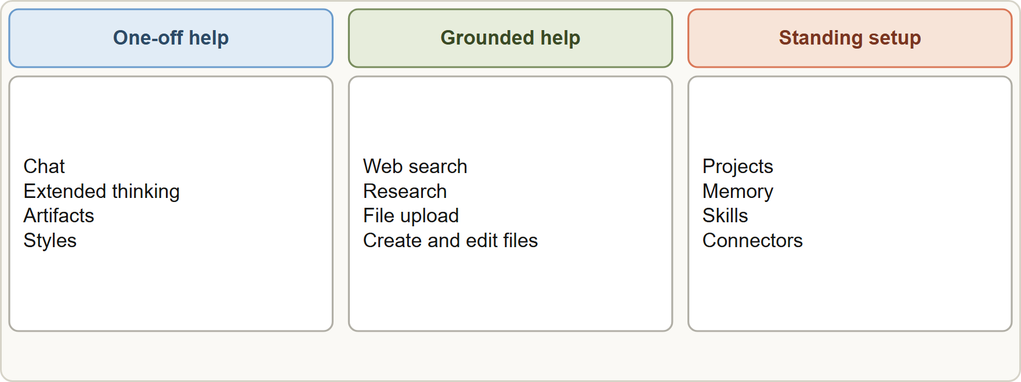
The Feature Map
Part 1
Claude features grouped by purpose: one-off help in chat, grounded help with search, Research and files, and standing setup with Projects, Skills and connectors
Claude Associate Foundations Exam Prep | for the CCAO-F exam
Module 6
4 / 27
Notes:
The Feature Map.
The figure shows this: Claude features grouped by purpose: one-off help in chat, grounded help with search, Research and files, and standing setup with Projects, Skills and connectors.

Slide 5
The Feature Map, continued
Part 1
Feature | What it does | Use it for
Chat | Conversation with Claude | Drafting, explaining, brainstorming, quick edits
Web search | Looks up live web content; gives citations | Simple, current facts needing one or two lookups
Extended thinking | Claude reasons through the problem before answering | Hard reasoning with no need for recent web data: math, logic, debugging, multi-angle analysis
Research | Multi-step investigation across the web and your connected tools; produces a cited report | Comprehensive gathering (about five or more lookups, a few minutes)
File upload | Reads PDF, DOCX, CSV, TXT, XLSX and more, plus images | Summaries, analysis and Q&A on your documents
Claude Associate Foundations Exam Prep | for the CCAO-F exam
Module 6
5 / 27
Notes:
The Feature Map, continued.
Chat. What it does: Conversation with Claude. Use it for: Drafting, explaining, brainstorming, quick edits.
Web search. What it does: Looks up live web content; gives citations. Use it for: Simple, current facts needing one or two lookups.
Extended thinking. What it does: Claude reasons through the problem before answering. Use it for: Hard reasoning with no need for recent web data: math, logic, debugging, multi-angle analysis.
Research. What it does: Multi-step investigation across the web and your connected tools; produces a cited report. Use it for: Comprehensive gathering (about five or more lookups, a few minutes).
File upload. What it does: Reads P D F, D O C X, C S V, T X T, X L S X and more, plus images. Use it for: Summaries, analysis and Q and A on your documents.

Slide 6
The Feature Map, continued
Part 1
Feature | What it does | Use it for
Create and edit files | Builds Excel, Word, PowerPoint and PDF files in a sandbox | Reports, slide decks, spreadsheets, charts
Artifacts | Side-panel content you can edit, reuse and share | Documents, slides, dashboards, small tools
Projects | A workspace with instructions and knowledge for many chats | Recurring work needing the same background (Module 11)
Memory and chat search | Remembers context across chats; finds past chats | Continuity (Module 8)
Skills | Reusable procedures Claude loads when relevant | Repeatable tasks with a set method (Module 12)
Claude Associate Foundations Exam Prep | for the CCAO-F exam
Module 6
6 / 27
Notes:
The Feature Map, continued.
Create and edit files. What it does: Builds Excel, Word, Power Point and P D F files in a sandbox. Use it for: Reports, slide decks, spreadsheets, charts.
Artifacts. What it does: Side-panel content you can edit, reuse and share. Use it for: Documents, slides, dashboards, small tools.
Projects. What it does: A workspace with instructions and knowledge for many chats. Use it for: Recurring work needing the same background (Module eleven).
Memory and chat search. What it does: Remembers context across chats; finds past chats. Use it for: Continuity (Module eight).
Skills. What it does: Reusable procedures Claude loads when relevant. Use it for: Repeatable tasks with a set method (Module twelve).

Slide 7
The Feature Map, continued
Part 1
Feature | What it does | Use it for
Connectors | Link Claude to apps such as Google Drive, Gmail, Slack | Working with your own data and tools (Module 12)
EXAM TIP Choose the lightest feature that fits the task. Research for a one-line fact, or plain chat for a competitor report, are both mismatches.
Claude Associate Foundations Exam Prep | for the CCAO-F exam
Module 6
7 / 27
Notes:
The Feature Map, continued.
Connectors. What it does: Link Claude to apps such as Google Drive, Gmail, Slack. Use it for: Working with your own data and tools (Module twelve).
Exam tip: Choose the lightest feature that fits the task. Research for a one-line fact, or plain chat for a competitor report, are both mismatches.

Slide 8
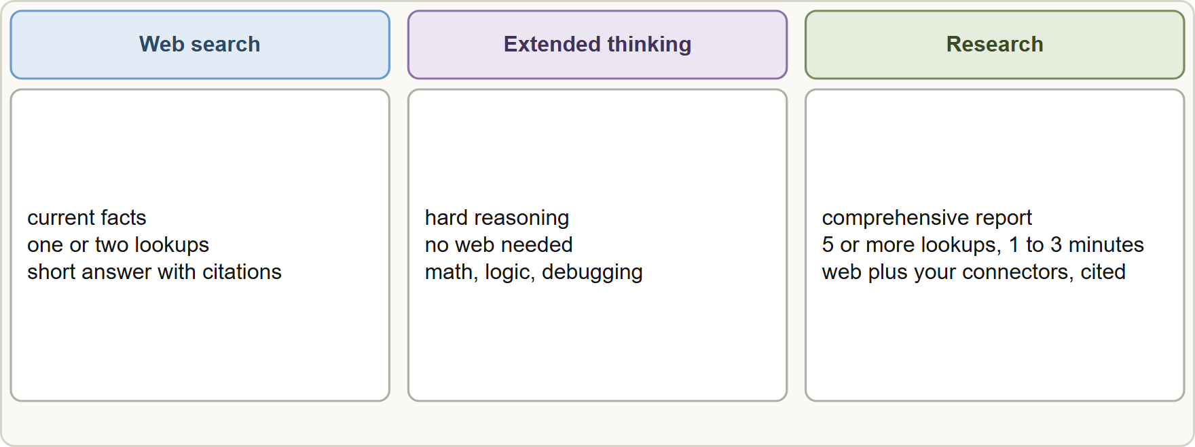
Search, Thinking and Research
Part 1
Web search for quick current facts, extended thinking for hard reasoning, Research for comprehensive cited reports
Claude Associate Foundations Exam Prep | for the CCAO-F exam
Module 6
8 / 27
Notes:
Search, Thinking and Research.
The figure shows this: Web search for quick current facts, extended thinking for hard reasoning, Research for comprehensive cited reports.

Slide 9
Search, Thinking and Research, continued
Part 1
 | Web search | Extended thinking | Research
Best for | A current fact: news, a price, company info | Complex reasoning without needing the web | Deep, multi-source investigation
Typical effort | One or two tool calls | Claude thinks longer before answering | Five or more lookups, about 1 to 3 minutes
Output | Short answer with citations | A reasoned answer | A longer report with citations
Sources | Web | Your prompt and what Claude knows | Web plus your connected tools (for example Google Workspace)
Claude Associate Foundations Exam Prep | for the CCAO-F exam
Module 6
9 / 27
Notes:
Search, Thinking and Research, continued.
Best for. Web search: A current fact: news, a price, company info. Extended thinking: Complex reasoning without needing the web. Research: Deep, multi-source investigation.
Typical effort. Web search: One or two tool calls. Extended thinking: Claude thinks longer before answering. Research: Five or more lookups, about one to three minutes.
Output. Web search: Short answer with citations. Extended thinking: A reasoned answer. Research: A longer report with citations.
Sources. Web search: Web. Extended thinking: Your prompt and what Claude knows. Research: Web plus your connected tools (for example Google Workspace).

Slide 10
Search, Thinking and Research, continued
Part 1
 | Web search | Extended thinking | Research
Examples | "What is the current return window at a rival?" | "Optimize this packing schedule", "find the logic error in this formula" | "Compare five rivals' pricing and warranty terms and recommend a position"
Web search must be available to Claude; on Team and Enterprise plans an owner enables it for the workspace first. On some versions Claude decides when to search; you can always say "search the web" or "do not search".
Claude Associate Foundations Exam Prep | for the CCAO-F exam
Module 6
10 / 27
Notes:
Search, Thinking and Research, continued.
Examples. Web search: "What is the current return window at a rival?". Extended thinking: "Optimize this packing schedule", "find the logic error in this formula". Research: "Compare five rivals' pricing and warranty terms and recommend a position".
Web search must be available to Claude; on Team and Enterprise plans an owner enables it for the workspace first. On some versions Claude decides when to search; you can always say "search the web" or "do not search".

Slide 11
Search, Thinking and Research, continued
Part 1
Research is a paid-plan feature; it uses more of your usage limit because it retrieves many sources. On mobile it may search only the web and skip connectors.
Research plus thinking: thinking plans the approach and Research carries out the gathering.
For all three, verify what you will rely on (Module 4).
EXAM TIP Key words: "current fact" points to web search; "reason through" or "complex logic" points to extended thinking; "comprehensive report with sources" points to Research.
Claude Associate Foundations Exam Prep | for the CCAO-F exam
Module 6
11 / 27
Notes:
Search, Thinking and Research, continued.
Research is a paid-plan feature; it uses more of your usage limit because it retrieves many sources. On mobile it may search only the web and skip connectors.
Research plus thinking: thinking plans the approach and Research carries out the gathering.
For all three, verify what you will rely on (Module four).
Exam tip: Key words: "current fact" points to web search; "reason through" or "complex logic" points to extended thinking; "comprehensive report with sources" points to Research.

Slide 12
Files, Projects, Artifacts and More
Part 1
File upload. Supported documents include PDF, DOCX, CSV, TXT, HTML, ODT, RTF, EPUB, JSON and XLSX; images include JPEG, PNG, GIF and WebP. In a chat: up to 20 files, 500 MB each; PDFs up to 1,000 pages (100 pages or fewer: text and visuals are analyzed; 101 to 1,000: text only). Split very large documents. Non-PDF documents yield text only, so embedded images are not read.
Claude Associate Foundations Exam Prep | for the CCAO-F exam
Module 6
12 / 27
Notes:
Files, Projects, Artifacts and More.
File upload. Supported documents include P D F, D O C X, C S V, T X T, H T M L, O D T, R T F, E P U B, Jason (Java Script Object Notation) and X L S X; images include J P E G, P N G, G I F and Web P. In a chat: up to twenty files, five hundred megabytes each; P D F s up to one thousand pages (one hundred pages or fewer: text and visuals are analyzed; one hundred one to one thousand: text only). Split very large documents. Non-P D F documents yield text only, so embedded images are not read.

Slide 13
Files, Projects, Artifacts and More, continued
Part 1
Create and edit files. With Create and edit files (code execution) on, Claude builds Excel, Word, PowerPoint and PDF files, writes scripts and makes charts in a private sandbox. Files can be downloaded or saved to Google Drive (about 30 MB). File creation uses more of your usage limit.
Artifacts. For substantial, reusable content such as documents, slides, designs and small tools (Module 5).
Projects. Standing instructions plus a knowledge base for related chats. Prefer a Project over re-pasting the same background (Module 11).
Claude Associate Foundations Exam Prep | for the CCAO-F exam
Module 6
13 / 27
Notes:
Files, Projects, Artifacts and More, continued.
Create and edit files. With Create and edit files (code execution) on, Claude builds Excel, Word, Power Point and P D F files, writes scripts and makes charts in a private sandbox. Files can be downloaded or saved to Google Drive (about thirty megabytes). File creation uses more of your usage limit.
Artifacts. For substantial, reusable content such as documents, slides, designs and small tools (Module five).
Projects. Standing instructions plus a knowledge base for related chats. Prefer a Project over re-pasting the same background (Module eleven).

Slide 14
Files, Projects, Artifacts and More, continued
Part 2
Skills. Folders of instructions loaded only when relevant; ideal for a repeatable method such as "our report format" (Module 12).
Connectors. Give Claude access to Google Drive, Gmail, Calendar and other services within your permissions (Module 12).
Images. Claude can read images, charts and screenshots. It does not create photos or illustrations like an image generator; it can build diagrams and charts.
Names, plan availability and limits move quickly. The principle holds: match the feature to the need.
Claude Associate Foundations Exam Prep | for the CCAO-F exam
Module 6
14 / 27
Notes:
Files, Projects, Artifacts and More, continued.
Skills. Folders of instructions loaded only when relevant; ideal for a repeatable method such as "our report format" (Module twelve).
Connectors. Give Claude access to Google Drive, Gmail, Calendar and other services within your permissions (Module twelve).
Images. Claude can read images, charts and screenshots. It does not create photos or illustrations like an image generator; it can build diagrams and charts.
Names, plan availability and limits move quickly. The principle holds: match the feature to the need.

Slide 15
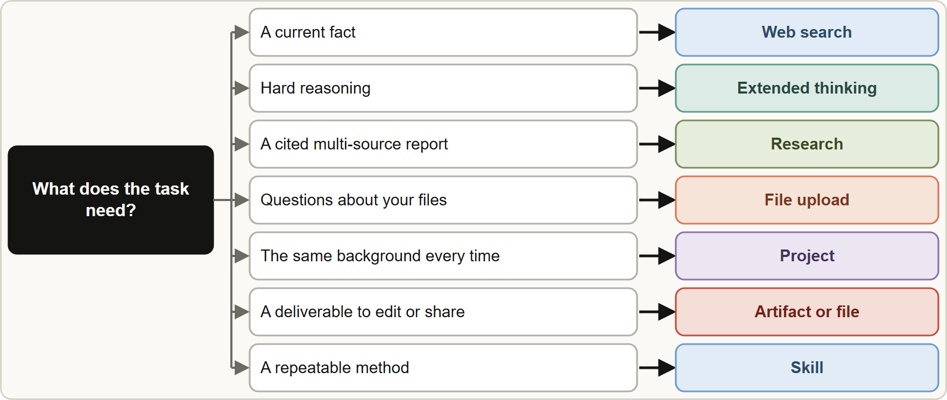
A Feature Chooser
Part 2
A feature chooser: current facts to web search, hard reasoning to extended thinking, comprehensive report to Research, your files to upload, repeated context to a Project, reusable output to an artifact, repeatable method to a Skill
Claude Associate Foundations Exam Prep | for the CCAO-F exam
Module 6
15 / 27
Notes:
A Feature Chooser.
The figure shows this: A feature chooser: current facts to web search, hard reasoning to extended thinking, comprehensive report to Research, your files to upload, repeated context to a Project, reusable output to an artifact, repeatable method to a Skill.

Slide 16
A Feature Chooser, continued
Part 2
If the request is... | Choose
A quick draft or explanation | Chat
A single current fact | Web search
A hard logic or math problem | Extended thinking (and verify)
A cited, multi-source report | Research
Questions about your documents | File upload (or a Project)
The same background every week | Project
A deliverable people will edit or share | Artifact or file
The same method every time | Skill
Data in Drive or Gmail | Connector
EXAM TIP Connectors, web search and Research widen what Claude can see and use more of your limit, so turn on only what the task needs.
Claude Associate Foundations Exam Prep | for the CCAO-F exam
Module 6
16 / 27
Notes:
A Feature Chooser, continued.
A quick draft or explanation. Chat.
A single current fact. Web search.
A hard logic or math problem. Extended thinking (and verify).
A cited, multi-source report. Research.
Questions about your documents. File upload (or a Project).
The same background every week. Project.
A deliverable people will edit or share. Artifact or file.
The same method every time. Skill.
Data in Drive or Gmail. Connector.
Exam tip: Connectors, web search and Research widen what Claude can see and use more of your limit, so turn on only what the task needs.

Slide 17
Module Recap
Part 2
1
Principle
2
Web search
3
Extended thinking
Lightest feature that fits
Current facts; one or two lookups; citations
Hard reasoning; no web needed
4
Research
5
Files
6
Create files
Five or more lookups, about 1 to 3 minutes; cited report; web plus connectors; paid plans
Up to 20 per chat, 500 MB each
Excel, Word, PowerPoint, PDF; Create and edit files must be on
7
Artifacts
8
Projects
9
Skills
Reusable, editable, shareable content
Standing instructions and knowledge
Repeatable procedures loaded when relevant
10
Images
Reads images; does not generate photos
Claude Associate Foundations Exam Prep | for the CCAO-F exam
Module 6
17 / 27
Notes:
Here is the recap.
Principle: Lightest feature that fits.
Web search: Current facts; one or two lookups; citations.
Extended thinking: Hard reasoning; no web needed.
Research: Five or more lookups, about one to three minutes; cited report; web plus connectors; paid plans.
Files: Up to twenty per chat, five hundred megabytes each.
Create files: Excel, Word, Power Point, P D F; Create and edit files must be on.
Artifacts: Reusable, editable, shareable content.
Projects: Standing instructions and knowledge.
Skills: Repeatable procedures loaded when relevant.
Images: Reads images; does not generate photos.

Slide 18
Practice Question 1
Part 2
Q1
A marketer needs the current published price of one competitor product. Which feature fits best?
A
Web search in a normal chat
B
A Project with 50 files
C
Research, to produce a long report
D
Create a Skill
Claude Associate Foundations Exam Prep | for the CCAO-F exam
Module 6
18 / 27
Notes:
Question one.
A marketer needs the current published price of one competitor product. Which feature fits best?
The four options are on the screen.
[PAUSE 12]
The answer is A. A simple current fact needs one or two lookups.

Slide 19
Practice Question 2
Part 2
Q2
A strategist wants a comprehensive, cited comparison of five rivals' pricing, warranty and shipping terms. Which feature fits best?
A
Plain chat with no tools
B
Memory
C
Research
D
An image upload
Claude Associate Foundations Exam Prep | for the CCAO-F exam
Module 6
19 / 27
Notes:
Question two.
A strategist wants a comprehensive, cited comparison of five rivals' pricing, warranty and shipping terms. Which feature fits best?
The four options are on the screen.
[PAUSE 12]
The answer is C. Research handles multi-step, multi-source investigation with a cited report.

Slide 20
Practice Question 3
Part 2
Q3
An analyst must find the logic error in a complicated discount rule that needs no outside data. Which feature helps most?
A
Extended thinking
B
Web search
C
Research
D
A connector
Claude Associate Foundations Exam Prep | for the CCAO-F exam
Module 6
20 / 27
Notes:
Question three.
An analyst must find the logic error in a complicated discount rule that needs no outside data. Which feature helps most?
The four options are on the screen.
[PAUSE 12]
The answer is A. Hard reasoning with no need for current web facts is the use case for extended thinking.

Slide 21
Practice Question 4
Part 2
Q4
A team lead pastes the same 800-word brand-voice guide at the start of every chat. What is the better setup?
A
Keep pasting it at the start of every new chat as before
B
Ask Claude to remember it by chance
C
Put it in a Project's instructions or knowledge
D
Email it to Claude
Claude Associate Foundations Exam Prep | for the CCAO-F exam
Module 6
21 / 27
Notes:
Question four.
A team lead pastes the same eight hundred-word brand-voice guide at the start of every chat. What is the better setup?
The four options are on the screen.
[PAUSE 12]
The answer is C. Standing context that is needed again and again belongs in a Project, so every chat starts with the same background without pasting.

Slide 22
Practice Question 5
Part 2
Q5
A user uploads a 1,500-page PDF and sees a "file too large" error. What should they do?
A
Split it into smaller sections under the page limit
B
Turn off Research
C
Change the model
D
Retry the same file several times until the error clears
Claude Associate Foundations Exam Prep | for the CCAO-F exam
Module 6
22 / 27
Notes:
Question five.
A user uploads a one thousand five hundred-page P D F and sees a "file too large" error. What should they do?
The four options are on the screen.
[PAUSE 12]
The answer is A. P D F s over one thousand pages cannot be uploaded; split large documents.

Slide 23
Practice Question 6
Part 2
Q6
Which TWO tasks are best done with Create and edit files? (Select TWO.)
A
Building an Excel workbook with charts from sales data
B
Producing a PowerPoint deck from meeting notes
C
Looking up today's weather
D
Answering a yes-or-no question
E
Searching past chats
Claude Associate Foundations Exam Prep | for the CCAO-F exam
Module 6
23 / 27
Notes:
Question six. Select two.
Which two tasks are best done with Create and edit files?
The five options are on the screen.
[PAUSE 15]
The answers are A and B. File creation builds Office and P D F files from your material.

Slide 24
Practice Question 7
Part 2
Q7
A manager asks Claude to paint a realistic photo of a tent in the mountains. What is true?
A
Claude can generate realistic photos only when Research mode is switched on and a connector is added
B
Claude generates photos like a dedicated image tool
C
Claude does not generate photos like an image tool, but it can read images and build diagrams
D
Claude only works with text
Claude Associate Foundations Exam Prep | for the CCAO-F exam
Module 6
24 / 27
Notes:
Question seven.
A manager asks Claude to paint a realistic photo of a tent in the mountains. What is true?
The four options are on the screen.
[PAUSE 12]
The answer is C. Image generation is not a Claude capability; reading images and building diagrams is.

Slide 25
Practice Question 8
Part 2
Q8
Which request is the poorest match to Research?
A
A multi-source summary of regulations that affect packaging
B
A cited competitor landscape for a board paper
C
A report that combines web findings with Google Drive documents
D
What time does the store down the road close?
Claude Associate Foundations Exam Prep | for the CCAO-F exam
Module 6
25 / 27
Notes:
Question eight.
Which request is the poorest match to Research?
The four options are on the screen.
[PAUSE 12]
The answer is D. A quick lookup does not need a multi-minute investigation.

Slide 26
Practice Question 9
Part 2
Q9
Why might a team limit the use of Research and file creation on busy days?
A
They cost the same as a single short message in an ordinary chat
B
They consume more of the usage limit than ordinary chat
C
They are banned on weekdays so that capacity is kept for other users of the service
D
They only work at night
Claude Associate Foundations Exam Prep | for the CCAO-F exam
Module 6
26 / 27
Notes:
Question nine.
Why might a team limit the use of Research and file creation on busy days?
The four options are on the screen.
[PAUSE 12]
The answer is B. Multi-step tools and file creation use more of your allowance.

Slide 27
Answers at a Glance
Part 2
Question | Answer | Why
Q1 | A | A simple current fact needs one or two lookups
Q2 | C | Research handles multi-step, multi-source investigation with a cited report
Q3 | A | Hard reasoning with no need for current web facts
Q4 | C | Standing context that is needed again and again belongs
Q5 | A | PDFs over 1,000 pages cannot be uploaded
Q6 | A, B | File creation builds Office and PDF files from your
Q7 | C | Image generation is not a Claude capability
Q8 | D | A quick lookup does not need a multi-minute investigation
Q9 | B | Multi-step tools and file creation use more of your
Claude Associate Foundations Exam Prep | for the CCAO-F exam
Module 6
27 / 27
Notes:
Here are all nine answers. Question one: A. Question two: C. Question three: A. Question four: C. Question five: A. Question six: A and B. Question seven: C. Question eight: D. Question nine: B.
In the next module, we continue the course.

