Slide 1
Module 7: Choosing a Model and Effort: Haiku, Sonnet, Opus
The Claude model families: Haiku, Sonnet, Opus (and the newer top tier)
Domain 3 · Product and Model Selection
Claude Associate Foundations Exam Prep Masterclass
Module 7
Notes:
Welcome to Module seven: Choosing a Model and Effort: Haiku, Sonnet, Opus. This module covers choosing a model and effort.
Each part of this module comes from the study notes of the same name, so you can read the notes after you watch.

Slide 2
What You Will Learn
Module 7
The Claude model families: Haiku, Sonnet, Opus (and the newer top tier)
How models differ in capability, speed and cost
How to match a model to a task
What effort and thinking settings change, and when to raise or lower them
Claude Associate Foundations Exam Prep | for the CCAO-F exam
Module 7
2 / 22
Notes:
By the end of this module you will be able to do four things.
The Claude model families: Haiku, Sonnet, Opus (and the newer top tier).
How models differ in capability, speed and cost.
How to match a model to a task.
What effort and thinking settings change, and when to raise or lower them.

Slide 3
Case Check-In: Cedarbrook's Reply Queue
Module 7
CASE CHECK-IN · Cedarbrook Outfitters
Customer care sends hundreds of short reply drafts a day
Strategy needs a deep analysis of a new market once a quarter
Using the most powerful model for the replies wastes time and usage; using a light model for the strategy risks shallow reasoning
Claude Associate Foundations Exam Prep | for the CCAO-F exam
Module 7
3 / 22
Notes:
Our running case is Cedarbrook Outfitters. Cedarbrook's Reply Queue.
Customer care sends hundreds of short reply drafts a day.
Strategy needs a deep analysis of a new market once a quarter.
Using the most powerful model for the replies wastes time and usage; using a light model for the strategy risks shallow reasoning.

Slide 4
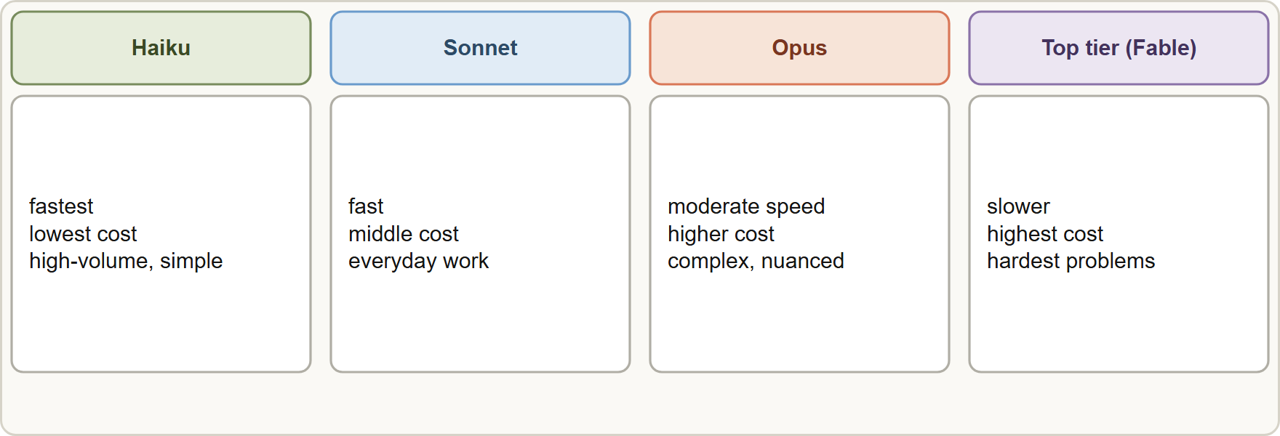
The Model Families
Module 7
Model families trade capability against speed and cost: Haiku is fastest and lowest cost, Sonnet balances speed and intelligence, Opus is more capable and slower
Claude Associate Foundations Exam Prep | for the CCAO-F exam
Module 7
4 / 22
Notes:
The Model Families.
The figure shows this: Model families trade capability against speed and cost: Haiku is fastest and lowest cost, Sonnet balances speed and intelligence, Opus is more capable and slower.

Slide 5
The Model Families, continued
Module 7
Family | Positioning (docs) | Speed | Relative cost | Typical business use
Haiku | High-volume, latency-sensitive tasks such as classification, extraction and routing | Fastest | Lowest | Short reply drafts, sorting tickets, tagging feedback, quick extraction
Sonnet | Best combination of speed and intelligence | Fast | Middle | Everyday drafting, analysis, summaries, most daily work
Opus | Long-running, demanding knowledge work, more capable | Moderate (slower) | Higher | Complex analysis, long documents, difficult reasoning
Fable (newer top tier) | Demanding reasoning and long-horizon work | Slower | Highest | The hardest problems
Claude Associate Foundations Exam Prep | for the CCAO-F exam
Module 7
5 / 22
Notes:
The Model Families, continued.
Haiku. Positioning (docs): High-volume, latency-sensitive tasks such as classification, extraction and routing. Speed: Fastest. Relative cost: Lowest. Typical business use: Short reply drafts, sorting tickets, tagging feedback, quick extraction.
Sonnet. Positioning (docs): Best combination of speed and intelligence. Speed: Fast. Relative cost: Middle. Typical business use: Everyday drafting, analysis, summaries, most daily work.
Opus. Positioning (docs): Long-running, demanding knowledge work, more capable. Speed: Moderate (slower). Relative cost: Higher. Typical business use: Complex analysis, long documents, difficult reasoning.
Fable (newer top tier). Positioning (docs): Demanding reasoning and long-horizon work. Speed: Slower. Relative cost: Highest. Typical business use: The hardest problems.

Slide 6
The Model Families, continued
Module 7
Every family offers the same basics (text and image input, large context window); they differ in depth of reasoning, speed and cost.
Models are released in generations (for example 5.5). Newer versions are generally stronger. Names and numbers change often [Verify live]; the tiering idea (light, balanced, powerful) is what the exam tests.
Training knowledge has a cutoff date for every model; current events need web search (Module 3).
Claude Associate Foundations Exam Prep | for the CCAO-F exam
Module 7
6 / 22
Notes:
The Model Families, continued.
Every family offers the same basics (text and image input, large context window); they differ in depth of reasoning, speed and cost.
Models are released in generations (for example five point five). Newer versions are generally stronger. Names and numbers change often; the tiering idea (light, balanced, powerful) is what the exam tests.
Training knowledge has a cutoff date for every model; current events need web search (Module three).

Slide 7
The Model Families, continued
Module 7
In the app, open the model picker next to the send button. You can switch model at any point; the change applies from the next response. Admins on Team and Enterprise plans can turn models off for some roles.
EXAM TIP Think in three words: Haiku = fast and cheap, Sonnet = balanced, Opus = most capable and slower. The best answer matches the family to the task, not "always the biggest".
Claude Associate Foundations Exam Prep | for the CCAO-F exam
Module 7
7 / 22
Notes:
The Model Families, continued.
In the app, open the model picker next to the send button. You can switch model at any point; the change applies from the next response. Admins on Team and Enterprise plans can turn models off for some roles.
Exam tip: Think in three words: Haiku equals fast and cheap, Sonnet equals balanced, Opus equals most capable and slower. The best answer matches the family to the task, not "always the biggest".

Slide 8
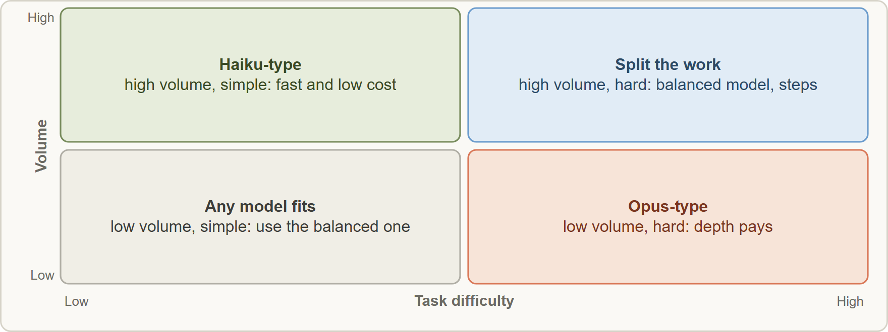
Aligning Model to Task
Module 7
Matching model to task: high-volume simple tasks suit Haiku, everyday work suits Sonnet, hard low-volume tasks suit Opus
Claude Associate Foundations Exam Prep | for the CCAO-F exam
Module 7
8 / 22
Notes:
Aligning Model to Task.
The figure shows this: Matching model to task: high-volume simple tasks suit Haiku, everyday work suits Sonnet, hard low-volume tasks suit Opus.

Slide 9
Aligning Model to Task, continued
Module 7
Task | Better fit | Why
Hundreds of short replies, tags or categories | Haiku | Speed and cost matter more than deep reasoning
Everyday drafting, summaries, spreadsheets, meeting notes | Sonnet | Strong quality at good speed
Complex multi-document analysis, nuanced writing, difficult logic | Opus (or the top tier) | Depth of reasoning pays off
A first try on a new task type | Start with the balanced model, then move up or down | Test before committing
Claude Associate Foundations Exam Prep | for the CCAO-F exam
Module 7
9 / 22
Notes:
Aligning Model to Task, continued.
Hundreds of short replies, tags or categories. Better fit: Haiku. Why: Speed and cost matter more than deep reasoning.
Everyday drafting, summaries, spreadsheets, meeting notes. Better fit: Sonnet. Why: Strong quality at good speed.
Complex multi-document analysis, nuanced writing, difficult logic. Better fit: Opus (or the top tier). Why: Depth of reasoning pays off.
A first try on a new task type. Better fit: Start with the balanced model, then move up or down. Why: Test before committing.

Slide 10
Aligning Model to Task, continued
Module 7
Start light, step up when needed. If the output is shallow, wrong or ignores constraints even with a clear prompt, try a stronger model. If a task is easy and quality is already fine, a lighter one saves time and usage.
Always the biggest model is a trap: it is slower and uses your limit faster. Always the smallest is also a trap: hard reasoning may fail.
Try the same prompt on two models for a representative sample and compare quality, speed and usage.
Claude Associate Foundations Exam Prep | for the CCAO-F exam
Module 7
10 / 22
Notes:
Aligning Model to Task, continued.
Start light, step up when needed. If the output is shallow, wrong or ignores constraints even with a clear prompt, try a stronger model. If a task is easy and quality is already fine, a lighter one saves time and usage.
Always the biggest model is a trap: it is slower and uses your limit faster. Always the smallest is also a trap: hard reasoning may fail.
Try the same prompt on two models for a representative sample and compare quality, speed and usage.

Slide 11
Aligning Model to Task, continued
Module 7
Quality, speed and cost are linked. More capable models and higher effort mean slower replies and faster use of your usage limit.
Match the model to the stakes, but remember: a stronger model still needs verification (Module 4).
EXAM TIP Scenario keywords: "high volume", "short", "simple", "fast", "low cost" point to the light model; "complex", "deep", "nuanced", "long documents" point to the most capable one.
Claude Associate Foundations Exam Prep | for the CCAO-F exam
Module 7
11 / 22
Notes:
Aligning Model to Task, continued.
Quality, speed and cost are linked. More capable models and higher effort mean slower replies and faster use of your usage limit.
Match the model to the stakes, but remember: a stronger model still needs verification (Module four).
Exam tip: Scenario keywords: "high volume", "short", "simple", "fast", "low cost" point to the light model; "complex", "deep", "nuanced", "long documents" point to the most capable one.

Slide 12
Effort and Thinking
Module 7
Setting | What it does | When to use
Effort: low or medium | Less thinking; faster; stretches usage | Routine tasks
Effort: high | Best overall balance of quality and speed | Everyday default for many models
Effort: extra high or max | More thorough; slower; more usage | The hardest analysis and correctness-critical work
Thinking (extended thinking) | Claude plans and explores approaches before answering | Math, multi-step reasoning, complex planning
Besides the model, the app lets you control how hard Claude thinks.
Effort and thinking are separate settings and can be combined. Some newer models always think, so you lower effort instead of turning thinking off.
Claude Associate Foundations Exam Prep | for the CCAO-F exam
Module 7
12 / 22
Notes:
Effort and Thinking.
Besides the model, the app lets you control how hard Claude thinks.
Effort: low or medium. What it does: Less thinking; faster; stretches usage. When to use: Routine tasks.
Effort: high. What it does: Best overall balance of quality and speed. When to use: Everyday default for many models.
Effort: extra high or max. What it does: More thorough; slower; more usage. When to use: The hardest analysis and correctness-critical work.
Thinking (extended thinking). What it does: Claude plans and explores approaches before answering. When to use: Math, multi-step reasoning, complex planning.
Effort and thinking are separate settings and can be combined. Some newer models always think, so you lower effort instead of turning thinking off.

Slide 13
Effort and Thinking, continued
Module 7
Higher effort = more thorough but slower and it reaches your usage limit sooner.
Defaults suit most tasks. Simple questions and general writing do not need extra effort. Raise it for math and proofs, detailed document analysis, comprehensive plans and multi-step technical problems.
Clear prompts matter more than raising effort: a vague prompt at max effort is still vague.
The thought summary can be expanded above the answer; you can read how Claude approached the task, but verify the result anyway.
Claude Associate Foundations Exam Prep | for the CCAO-F exam
Module 7
13 / 22
Notes:
Effort and Thinking, continued.
Higher effort equals more thorough but slower and it reaches your usage limit sooner.
Defaults suit most tasks. Simple questions and general writing do not need extra effort. Raise it for math and proofs, detailed document analysis, comprehensive plans and multi-step technical problems.
Clear prompts matter more than raising effort: a vague prompt at max effort is still vague.
The thought summary can be expanded above the answer; you can read how Claude approached the task, but verify the result anyway.

Slide 14
Cost and Speed in Practice
Module 7
Paid plans have a five-hour session limit and weekly limits; model, effort, conversation length, tools and attachments all affect how fast you use them (Module 16).
To stretch usage: use a lighter model or lower effort for routine tasks, turn off thinking where a toggle exists, batch similar requests, and remove tools you do not need.
A teamwide pattern works well: a light model for high-volume drafting, the balanced one for daily work, the most capable one reserved for the hard problems.
EXAM TIP A vague prompt on a bigger model is still vague: fix the prompt and the setting before paying for more capability.
Claude Associate Foundations Exam Prep | for the CCAO-F exam
Module 7
14 / 22
Notes:
Cost and Speed in Practice.
Paid plans have a five-hour session limit and weekly limits; model, effort, conversation length, tools and attachments all affect how fast you use them (Module sixteen).
To stretch usage: use a lighter model or lower effort for routine tasks, turn off thinking where a toggle exists, batch similar requests, and remove tools you do not need.
A teamwide pattern works well: a light model for high-volume drafting, the balanced one for daily work, the most capable one reserved for the hard problems.
Exam tip: A vague prompt on a bigger model is still vague: fix the prompt and the setting before paying for more capability.

Slide 15
Module Recap
Module 7
1
Haiku
2
Sonnet
3
Opus
Fastest, lowest cost; high-volume, simple, latency-sensitive
Balanced speed and intelligence; everyday work
Most capable of the three; slower, higher cost; complex work
4
Top tier (Fable)
5
Rule
6
Effort
Hardest reasoning; slowest, highest cost
Start with the balanced model; step up or down by evidence
Low and medium routine; high balanced; extra high and max for hardest work
7
Thinking
8
Trap
9
Always
Plans before answering; separate from effort; some models always think
"Always biggest" and "always smallest"
Verify output regardless of model
Claude Associate Foundations Exam Prep | for the CCAO-F exam
Module 7
15 / 22
Notes:
Here is the recap.
Haiku: Fastest, lowest cost; high-volume, simple, latency-sensitive.
Sonnet: Balanced speed and intelligence; everyday work.
Opus: Most capable of the three; slower, higher cost; complex work.
Top tier (Fable): Hardest reasoning; slowest, highest cost.
Rule: Start with the balanced model; step up or down by evidence.
Effort: Low and medium routine; high balanced; extra high and max for hardest work.
Thinking: Plans before answering; separate from effort; some models always think.
Trap: "Always biggest" and "always smallest".
Always: Verify output regardless of model.

Slide 16
Practice Question 1
Module 7
Q1
Customer care needs hundreds of short reply drafts a day where speed and cost matter most. Which choice fits best?
A
A faster, lower-cost model suited to simple, high-volume tasks
B
The most capable model for every reply
C
No model; write each reply manually
D
Research mode for every reply
Claude Associate Foundations Exam Prep | for the CCAO-F exam
Module 7
16 / 22
Notes:
Question one.
Customer care needs hundreds of short reply drafts a day where speed and cost matter most. Which choice fits best?
The four options are on the screen.
[PAUSE 12]
The answer is A. Light, fast, low-cost models fit high-volume, straightforward work, because fast replies at low cost count for more here than depth of analysis.

Slide 17
Practice Question 2
Module 7
Q2
A strategist must analyze five long reports and produce nuanced recommendations once a quarter. Which choice fits best?
A
A model chosen at random, because all models perform about the same
B
The lightest model with the lowest effort, to keep the cost of the analysis down
C
A more capable model, possibly with higher effort or thinking
D
No model, only web search
Claude Associate Foundations Exam Prep | for the CCAO-F exam
Module 7
17 / 22
Notes:
Question two.
A strategist must analyze five long reports and produce nuanced recommendations once a quarter. Which choice fits best?
The four options are on the screen.
[PAUSE 12]
The answer is C. Complex, low-volume work with nuanced conclusions justifies the depth of a more capable model, even though it is slower.

Slide 18
Practice Question 3
Module 7
Q3
Which description matches Sonnet?
A
Fastest and lowest cost, for the simplest high-volume tasks
B
A balanced combination of speed and intelligence for everyday work
C
Only for image tasks
D
The slowest and the most expensive of all the model families that exist
Claude Associate Foundations Exam Prep | for the CCAO-F exam
Module 7
18 / 22
Notes:
Question three.
Which description matches Sonnet?
The four options are on the screen.
[PAUSE 12]
The answer is B. Sonnet sits in the middle: strong, fast, general purpose.

Slide 19
Practice Question 4
Module 7
Q4
A user sets maximum effort for a simple formatting request and the reply is slow and uses much of their limit. What is the best lesson?
A
Max effort is always better, whatever the task happens to be and however simple
B
Formatting is not possible
C
Effort has no effect on usage or on how long the replies take to arrive
D
Simple tasks do not need extra effort; match effort to the task
Claude Associate Foundations Exam Prep | for the CCAO-F exam
Module 7
19 / 22
Notes:
Question four.
A user sets maximum effort for a simple formatting request and the reply is slow and uses much of their limit. What is the best lesson?
The four options are on the screen.
[PAUSE 12]
The answer is D. Higher effort is slower and consumes more usage; defaults suit routine tasks.

Slide 20
Practice Question 5
Module 7
Q5
Which TWO statements about model selection are correct? (Select TWO.)
A
Trying the same prompt on two models can help you decide
B
The most capable model is always the right choice
C
The right model depends on task complexity, volume, speed and cost
D
A stronger model removes the need to verify output
E
Model choice has no effect on speed
Claude Associate Foundations Exam Prep | for the CCAO-F exam
Module 7
20 / 22
Notes:
Question five. Select two.
Which two statements about model selection are correct?
The five options are on the screen.
[PAUSE 15]
The answers are A and C. Matching and testing are the practices; capability never removes verification.

Slide 21
Practice Question 6
Module 7
Q6
A vague prompt gets a weak answer on a light model. What is the best first step?
A
Switch to the most expensive model right away, because the model is certainly the cause of the weak result
B
Give up
C
Improve the prompt with context, format and constraints, then re-test and step up only if needed
D
Turn off all features
Claude Associate Foundations Exam Prep | for the CCAO-F exam
Module 7
21 / 22
Notes:
Question six.
A vague prompt gets a weak answer on a light model. What is the best first step?
The four options are on the screen.
[PAUSE 12]
The answer is C. A clear prompt is often the cheapest improvement; escalate the model if needed.

Slide 22
Answers at a Glance
Module 7
Question | Answer | Why
Q1 | A | Light, fast, low-cost models fit high-volume, straightforward work, because fast replies at low cost
Q2 | C | Complex, low-volume work with nuanced conclusions justifies the depth of a more capable model
Q3 | B | Sonnet sits in the middle: strong, fast, general purpose
Q4 | D | Higher effort is slower and consumes more usage
Q5 | A, C | Matching and testing are the practices
Q6 | C | A clear prompt is often the cheapest improvement
Claude Associate Foundations Exam Prep | for the CCAO-F exam
Module 7
22 / 22
Notes:
Here are all six answers. Question one: A. Question two: C. Question three: B. Question four: D. Question five: A and C. Question six: C.
In the next module, we continue the course.

