Slide 1
Module 8: Context Limits and Memory: Restart, Summarize or Persist
What the context window is and why long chats degrade
Domain 3 · Product and Model Selection
Claude Associate Foundations Exam Prep Masterclass
Module 8
Notes:
Welcome to Module eight: Context Limits and Memory: Restart, Summarize or Persist. This module covers context limits and memory.
Each part of this module comes from the study notes of the same name, so you can read the notes after you watch.

Slide 2
What You Will Learn
Module 8
What the context window is and why long chats degrade
The difference between length limits and usage limits
When to restart, summarize or persist
How memory, chat search and Projects carry context, and how to control them
Claude Associate Foundations Exam Prep | for the CCAO-F exam
Module 8
2 / 24
Notes:
By the end of this module you will be able to do four things.
What the context window is and why long chats degrade.
The difference between length limits and usage limits.
When to restart, summarize or persist.
How memory, chat search and Projects carry context, and how to control them.

Slide 3
Case Check-In: Cedarbrook's Marathon Chat
Module 8
CASE CHECK-IN · Cedarbrook Outfitters
A planner works on the holiday-season plan in one chat for three days
Early decisions get forgotten, the answers repeat themselves, and finally Claude warns that the message will exceed the length limit
Claude Associate Foundations Exam Prep | for the CCAO-F exam
Module 8
3 / 24
Notes:
Our running case is Cedarbrook Outfitters. Cedarbrook's Marathon Chat.
A planner works on the holiday-season plan in one chat for three days.
Early decisions get forgotten, the answers repeat themselves, and finally Claude warns that the message will exceed the length limit.

Slide 4
The Context Window
Module 8
The context window is everything Claude can consider in one chat: your messages, its replies, uploaded files, tool results and instructions. It is finite.
Length limit = how long a single conversation can get. The newest models on paid plans support very large windows (up to about 1 million tokens; others 500K or 200K); part of the window is reserved for the reply.
Claude Associate Foundations Exam Prep | for the CCAO-F exam
Module 8
4 / 24
Notes:
The Context Window.
The context window is everything Claude can consider in one chat: your messages, its replies, uploaded files, tool results and instructions. It is finite.
Length limit equals how long a single conversation can get. The newest models on paid plans support very large windows (up to about one million tokens; others five hundred thousand or two hundred thousand); part of the window is reserved for the reply.

Slide 5
The Context Window, continued
Module 8
Usage limit = how much you can use Claude over time (a five-hour session limit and weekly limits on paid plans). The two are different: a short chat can hit a usage limit, and a long chat can hit a length limit.
Automatic context management (with code execution on): when a chat nears the limit, Claude summarizes earlier messages so the chat can continue; your full history stays available. Longer chats still use more of your usage limit.
What fills the window: long chats, large attachments, many tool results, and every connector's tool definitions.
Claude Associate Foundations Exam Prep | for the CCAO-F exam
Module 8
5 / 24
Notes:
The Context Window, continued.
Usage limit equals how much you can use Claude over time (a five-hour session limit and weekly limits on paid plans). The two are different: a short chat can hit a usage limit, and a long chat can hit a length limit.
Automatic context management (with code execution on): when a chat nears the limit, Claude summarizes earlier messages so the chat can continue; your full history stays available. Longer chats still use more of your usage limit.
What fills the window: long chats, large attachments, many tool results, and every connector's tool definitions.

Slide 6
The Context Window, continued
Module 8
Symptoms of a crowded context: forgotten early instructions, contradictions, repetition, slower and weaker answers, the error "Your message will exceed the length limit for this chat".
EXAM TIP A long chat that has drifted is fixed by managing the context (restart with a summary), not by repeating the same request or hoping for a bigger window.
Claude Associate Foundations Exam Prep | for the CCAO-F exam
Module 8
6 / 24
Notes:
The Context Window, continued.
Symptoms of a crowded context: forgotten early instructions, contradictions, repetition, slower and weaker answers, the error "Your message will exceed the length limit for this chat".
Exam tip: A long chat that has drifted is fixed by managing the context (restart with a summary), not by repeating the same request or hoping for a bigger window.

Slide 7
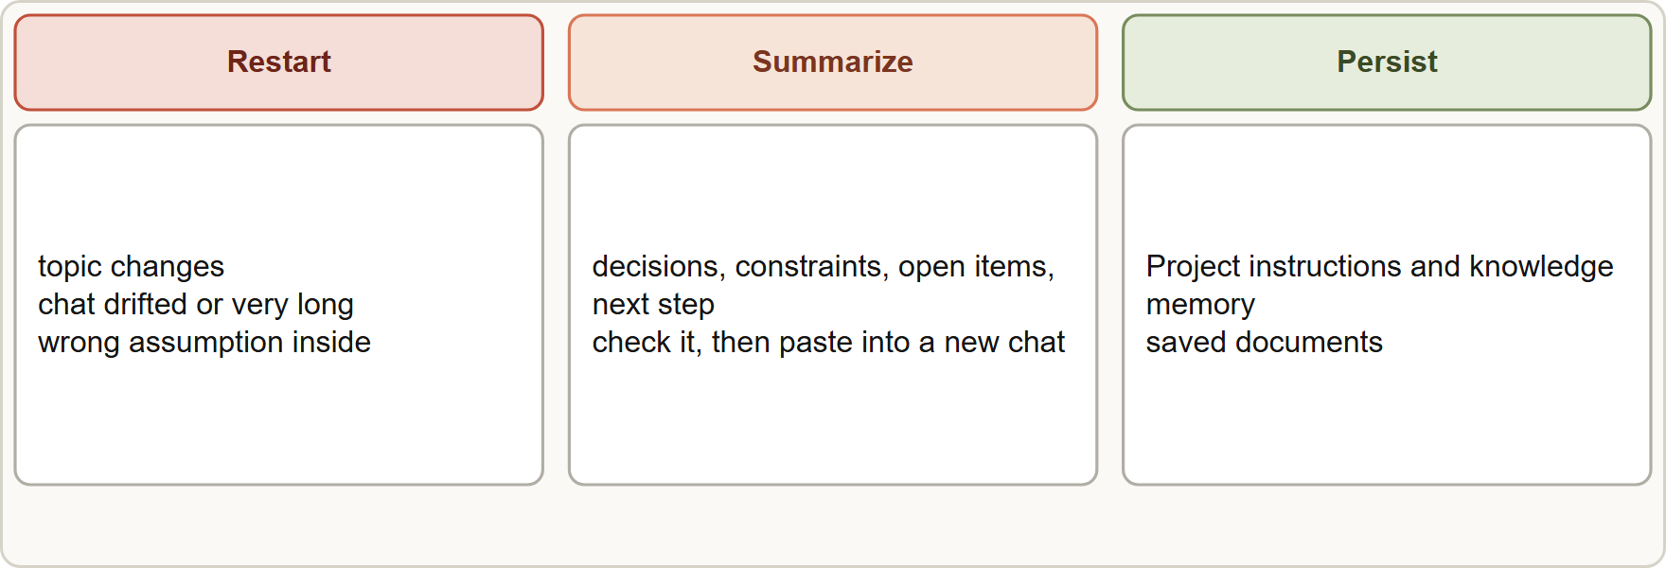
Restart, Summarize or Persist
Module 8
Restart when a chat has drifted or the topic changes, summarize to carry decisions forward, persist what you will need again in Projects, memory or saved documents
Claude Associate Foundations Exam Prep | for the CCAO-F exam
Module 8
7 / 24
Notes:
Restart, Summarize or Persist.
The figure shows this: Restart when a chat has drifted or the topic changes, summarize to carry decisions forward, persist what you will need again in Projects, memory or saved documents.

Slide 8
Restart, Summarize or Persist, continued
Module 8
Choice | Use when | How
Restart (new chat) | The topic changes; the chat is very long, drifted or built on a wrong assumption; you hit a length limit | Open a new chat; paste only what is needed
Summarize | You want to keep decisions but shed the bulk | Ask Claude: "Summarize decisions, open questions and key facts so I can continue in a new chat"; check the summary, then paste it into the new chat
Claude Associate Foundations Exam Prep | for the CCAO-F exam
Module 8
8 / 24
Notes:
Restart, Summarize or Persist, continued.
Restart (new chat). Use when: The topic changes; the chat is very long, drifted or built on a wrong assumption; you hit a length limit. How: Open a new chat; paste only what is needed.
Summarize. Use when: You want to keep decisions but shed the bulk. How: Ask Claude: "Summarize decisions, open questions and key facts so I can continue in a new chat"; check the summary, then paste it into the new chat.

Slide 9
Restart, Summarize or Persist, continued
Module 8
Choice | Use when | How
Persist | You will need the same facts repeatedly | Put them in a Project (instructions and knowledge), memory, an artifact or a saved document; do not rely on one long thread
A handoff summary should list decisions made, constraints, definitions, open items and the next step. Review it: summaries can drop numbers and commitments.
Persist the stable, summarize the changing. Brand voice and policy go in a Project; the state of today's task goes in a short summary.
Starting fresh also cuts usage: a shorter chat costs less per message.
Claude Associate Foundations Exam Prep | for the CCAO-F exam
Module 8
9 / 24
Notes:
Restart, Summarize or Persist, continued.
Persist. Use when: You will need the same facts repeatedly. How: Put them in a Project (instructions and knowledge), memory, an artifact or a saved document; do not rely on one long thread.
A handoff summary should list decisions made, constraints, definitions, open items and the next step. Review it: summaries can drop numbers and commitments.
Persist the stable, summarize the changing. Brand voice and policy go in a Project; the state of today's task goes in a short summary.
Starting fresh also cuts usage: a shorter chat costs less per message.

Slide 10
Restart, Summarize or Persist, continued
Module 8
Editing an earlier message creates a separate branch, so you can try another direction without losing the first.
Claude Associate Foundations Exam Prep | for the CCAO-F exam
Module 8
10 / 24
Notes:
Restart, Summarize or Persist, continued.
Editing an earlier message creates a separate branch, so you can try another direction without losing the first.

Slide 11
Memory and Chat Search
Module 8
Feature | What it does | Controls
Memory | Claude stores useful facts as individual topics (role, projects, preferences, ongoing work) and uses them in later chats | On by default for Free, Pro, Max and Ultra; pause (stop using and creating), reset (delete all, cannot be undone), edit or delete topics in Settings, or ask Claude to forget something
Chat search (paid plans) | Finds relevant past chats when you ask "What did we decide about X?" | Turn off "Search and reference chats" in Settings
Claude Associate Foundations Exam Prep | for the CCAO-F exam
Module 8
11 / 24
Notes:
Memory and Chat Search.
Memory. What it does: Claude stores useful facts as individual topics (role, projects, preferences, ongoing work) and uses them in later chats. Controls: On by default for Free, Pro, Max and Ultra; pause (stop using and creating), reset (delete all, cannot be undone), edit or delete topics in Settings, or ask Claude to forget something.
Chat search (paid plans). What it does: Finds relevant past chats when you ask "What did we decide about X?". Controls: Turn off "Search and reference chats" in Settings.

Slide 12
Memory and Chat Search, continued
Module 8
Feature | What it does | Controls
Project memory | Each Project has its own memory, separate from other Projects | "Use account memory" off on the Project page fully separates it; deleted with the Project
Memory off for one chat | Start a chat without memory | Turn off Memory in the "+" menu before the first message; it cannot be changed afterward; the chat stays in history
Claude Associate Foundations Exam Prep | for the CCAO-F exam
Module 8
12 / 24
Notes:
Memory and Chat Search, continued.
Project memory. What it does: Each Project has its own memory, separate from other Projects. Controls: "Use account memory" off on the Project page fully separates it; deleted with the Project.
Memory off for one chat. What it does: Start a chat without memory. Controls: Turn off Memory in the " plus " menu before the first message; it cannot be changed afterward; the chat stays in history.

Slide 13
Memory and Chat Search, continued
Module 8
Feature | What it does | Controls
Incognito chat | A temporary chat: not saved to history, not used for memory, not used for model training | Ghost icon; outside Projects only; kept for 30 days by default for safety even though hidden; cannot be reopened after closing
Claude Associate Foundations Exam Prep | for the CCAO-F exam
Module 8
13 / 24
Notes:
Memory and Chat Search, continued.
Incognito chat. What it does: A temporary chat: not saved to history, not used for memory, not used for model training. Controls: Ghost icon; outside Projects only; kept for thirty days by default for safety even though hidden; cannot be reopened after closing.

Slide 14
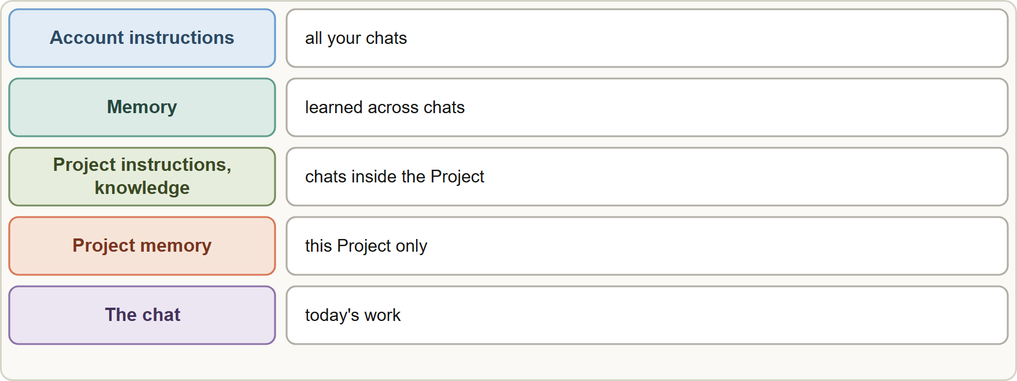
Memory and Chat Search, continued
Module 8
What memory keeps: your role and projects, working preferences, people and places in your work, technical preferences.
Sensitive topics (for example health, politics, religion) are off by default in memory. You can opt in; turning it off later removes saved sensitive items.
What memory keeps: your role and projects, working preferences, people and places in your work, technical preferences.
Sensitive topics (for example health, politics, religion) are off by default in memory. You can opt in; turning it off later removes saved sensitive items.
Claude Associate Foundations Exam Prep | for the CCAO-F exam
Module 8
14 / 24
Notes:
Memory and Chat Search, continued.
The figure shows this: Layers of context: account instructions and memory apply broadly; Project instructions, knowledge and memory apply inside a Project; the chat holds today's work.
What memory keeps: your role and projects, working preferences, people and places in your work, technical preferences.
Sensitive topics (for example health, politics, religion) are off by default in memory. You can opt in; turning it off later removes saved sensitive items.

Slide 15
Memory and Chat Search, continued
Module 8
Never saved, even on request: government ID numbers, criminal history, financial account numbers, immigration status.
Deleting a conversation does not delete the memories made from it. Delete the memory topic itself.
Memory carries over; do not rely on it for facts you must always have. For must-have rules, put them in Project instructions (Module 11).
On Team and Enterprise, owners control whether memory is available but cannot read individual users' memories; turning memory off for the organization deletes everyone's memory.
Import and export of memory from other assistants is possible but experimental; memory focuses on work-related topics.
Claude Associate Foundations Exam Prep | for the CCAO-F exam
Module 8
15 / 24
Notes:
Memory and Chat Search, continued.
Never saved, even on request: government I D numbers, criminal history, financial account numbers, immigration status.
Deleting a conversation does not delete the memories made from it. Delete the memory topic itself.
Memory carries over; do not rely on it for facts you must always have. For must-have rules, put them in Project instructions (Module eleven).
On Team and Enterprise, owners control whether memory is available but cannot read individual users' memories; turning memory off for the organization deletes everyone's memory.
Import and export of memory from other assistants is possible but experimental; memory focuses on work-related topics.

Slide 16
Memory and Chat Search, continued
Module 8
In Projects, large knowledge uses RAG: Claude retrieves only the relevant parts, so a Project can hold up to about 10 times more than fits in context (paid plans).
EXAM TIP "Persist" answers use Projects, memory or saved documents; "restart" answers apply when a thread has drifted or grown huge; "summarize" is the bridge between them. Incognito is for privacy from your own history, not for exemption from company policy.
Claude Associate Foundations Exam Prep | for the CCAO-F exam
Module 8
16 / 24
Notes:
Memory and Chat Search, continued.
In Projects, large knowledge uses R A G: Claude retrieves only the relevant parts, so a Project can hold up to about ten times more than fits in context (paid plans).
Exam tip: "Persist" answers use Projects, memory or saved documents; "restart" answers apply when a thread has drifted or grown huge; "summarize" is the bridge between them. Incognito is for privacy from your own history, not for exemption from company policy.
Exam tip: A new chat is not a failure: restart with a short summary when a thread has drifted, and keep stable facts in a Project.

Slide 17
Module Recap
Module 8
1
Context window
2
Length vs usage
3
Auto management
Everything Claude considers in a chat; finite
Length = one conversation; usage = over time (five-hour and weekly)
Older messages summarized near the limit; more usage
4
Restart
5
Summarize
6
Persist
Topic change, drift, wrong assumption, very long chat
Decisions, constraints, open items, next step; check it
Projects, memory, artifacts, saved documents
7
Memory
8
Project memory
9
Incognito
On by default (individual plans); pause, reset, edit, per-chat off
Separate per Project
Not saved, no memory, no training; outside Projects; kept 30 days
10
Sensitive topics
Off by default; some items never saved
Claude Associate Foundations Exam Prep | for the CCAO-F exam
Module 8
17 / 24
Notes:
Here is the recap.
Context window: Everything Claude considers in a chat; finite.
Length versus usage: Length equals one conversation; usage equals over time (five-hour and weekly).
Auto management: Older messages summarized near the limit; more usage.
Restart: Topic change, drift, wrong assumption, very long chat.
Summarize: Decisions, constraints, open items, next step; check it.
Persist: Projects, memory, artifacts, saved documents.
Memory: On by default (individual plans); pause, reset, edit, per-chat off.
Project memory: Separate per Project.
Incognito: Not saved, no memory, no training; outside Projects; kept thirty days.
Sensitive topics: Off by default; some items never saved.

Slide 18
Practice Question 1
Module 8
Q1
A planner's three-day chat now forgets early decisions and repeats itself. What is the best action?
A
Delete the account and create a fresh one so that the memory starts again from nothing at all
B
Turn off memory
C
Keep adding messages
D
Ask Claude for a summary of decisions and open items, check it, and continue in a new chat
Claude Associate Foundations Exam Prep | for the CCAO-F exam
Module 8
18 / 24
Notes:
Question one.
A planner's three-day chat now forgets early decisions and repeats itself. What is the best action?
The four options are on the screen.
[PAUSE 12]
The answer is D. Summarizing and restarting sheds the clutter while keeping the decisions.

Slide 19
Practice Question 2
Module 8
Q2
A team repeats the same 20-page brand guide in every chat. What is the best way to persist it?
A
Ask Claude to recall it from the last chat
B
Print it
C
Add it to a Project's knowledge and instructions
D
Paste it again each time
Claude Associate Foundations Exam Prep | for the CCAO-F exam
Module 8
19 / 24
Notes:
Question two.
A team repeats the same twenty-page brand guide in every chat. What is the best way to persist it?
The four options are on the screen.
[PAUSE 12]
The answer is C. Stable reference material that is needed repeatedly belongs in a Project's knowledge, not in a long chat that will be lost.

Slide 20
Practice Question 3
Module 8
Q3
What is the difference between a length limit and a usage limit?
A
A length limit applies to the whole company at once, while a usage limit applies only to single files
B
They are the same
C
A length limit applies to one conversation's context; a usage limit applies to your use over time
D
A usage limit applies only to files
Claude Associate Foundations Exam Prep | for the CCAO-F exam
Module 8
20 / 24
Notes:
Question three.
What is the difference between a length limit and a usage limit?
The four options are on the screen.
[PAUSE 12]
The answer is C. Length is per conversation; usage is over time (five-hour and weekly limits on paid plans).

Slide 21
Practice Question 4
Module 8
Q4
An employee wants a one-off chat that is not saved to history or memory and not used for training. Which feature fits?
A
A new Project
B
An incognito chat (outside a Project)
C
Chat search through your older conversations
D
Pause memory in Settings
Claude Associate Foundations Exam Prep | for the CCAO-F exam
Module 8
21 / 24
Notes:
Question four.
An employee wants a one-off chat that is not saved to history or memory and not used for training. Which feature fits?
The four options are on the screen.
[PAUSE 12]
The answer is B. Incognito chats are temporary, not saved to history or memory, and not used for training.

Slide 22
Practice Question 5
Module 8
Q5
A user deletes a conversation that contained a personal detail Claude had saved as memory. What is true?
A
The memory is moved to a Project automatically once the conversation is deleted
B
The memory is shared with the team
C
The memory topic can remain and should be deleted from the memory settings
D
The memory is deleted automatically together with the conversation that it came from
Claude Associate Foundations Exam Prep | for the CCAO-F exam
Module 8
22 / 24
Notes:
Question five.
A user deletes a conversation that contained a personal detail Claude had saved as memory. What is true?
The four options are on the screen.
[PAUSE 12]
The answer is C. Deleting a chat does not delete the memories generated from it.

Slide 23
Practice Question 6
Module 8
Q6
Which TWO belong in "persist" rather than in a chat? (Select TWO.)
A
The brand voice guide used weekly
B
A one-time question about lunch
C
The standard return-policy wording that agents use daily
D
A draft that you will discard
E
Today's rough brainstorm that will not be reused
Claude Associate Foundations Exam Prep | for the CCAO-F exam
Module 8
23 / 24
Notes:
Question six. Select two.
Which two belong in "persist" rather than in a chat?
The five options are on the screen.
[PAUSE 15]
The answers are A and C. Reused reference material goes into a Project or saved document.

Slide 24
Answers at a Glance
Module 8
Question | Answer | Why
Q1 | D | Summarizing and restarting sheds the clutter while keeping the decisions
Q2 | C | Stable reference material that is needed repeatedly belongs in a Project's knowledge
Q3 | C | Length is per conversation
Q4 | B | Incognito chats are temporary
Q5 | C | Deleting a chat does not delete the memories generated from it
Q6 | A, C | Reused reference material goes into a Project or saved document
Claude Associate Foundations Exam Prep | for the CCAO-F exam
Module 8
24 / 24
Notes:
Here are all six answers. Question one: D. Question two: C. Question three: C. Question four: B. Question five: C. Question six: A and C.
In the next module, we continue the course.

