Slide 1
Module 9: Requirements, Research, Planning and Process Optimization
How to use Claude to analyze requirements and clarify a request before work starts
Domain 4 · Workflow Integration and Solution Design
Claude Associate Foundations Exam Prep Masterclass
Module 9
Notes:
Welcome to Module nine: Requirements, Research, Planning and Process Optimization. This module covers requirements, research, planning and process optimization.
Each part of this module comes from the study notes of the same name, so you can read the notes after you watch.

Slide 2
What You Will Learn
Module 9
How to use Claude to analyze requirements and clarify a request before work starts
How to identify good use cases for Claude and screen out poor ones
How to use Claude for research and planning
How to improve a process step by step and measure the result
Claude Associate Foundations Exam Prep | for the CCAO-F exam
Module 9
2 / 29
Notes:
By the end of this module you will be able to do four things.
How to use Claude to analyze requirements and clarify a request before work starts.
How to identify good use cases for Claude and screen out poor ones.
How to use Claude for research and planning.
How to improve a process step by step and measure the result.

Slide 3
Case Check-In: Cedarbrook's Returns Overhaul
Module 9
CASE CHECK-IN · Cedarbrook Outfitters
Customer care says: "Returns take too long and customers complain."
The project manager asks Claude to turn the complaint into requirements: who is affected, what "too long" means, what must not change, and what success looks like
The result is a short requirements list and eight open questions to take to stakeholders
Claude Associate Foundations Exam Prep | for the CCAO-F exam
Module 9
3 / 29
Notes:
Our running case is Cedarbrook Outfitters. Cedarbrook's Returns Overhaul.
Customer care says: "Returns take too long and customers complain.".
The project manager asks Claude to turn the complaint into requirements: who is affected, what "too long" means, what must not change, and what success looks like.
The result is a short requirements list and eight open questions to take to stakeholders.

Slide 4
Analyzing Requirements
Module 9
Claude can help you move from a vague wish to a clear, testable requirement.
Claude Associate Foundations Exam Prep | for the CCAO-F exam
Module 9
4 / 29
Notes:
Analyzing Requirements.
Claude can help you move from a vague wish to a clear, testable requirement.

Slide 5
Analyzing Requirements, continued
Module 9
Use Claude to | Example prompt
Clarify the goal | "Restate this request in one sentence and list what is unclear"
List stakeholders and needs | "Who is affected by a returns change? What does each need?"
Turn notes into requirements | "From these interview notes, list functional needs, constraints and assumptions"
Write user stories and acceptance criteria | "Write stories in the form 'As a ..., I want ..., so that ...' with pass/fail criteria"
Find gaps and conflicts | "Which requirements conflict or are ambiguous?"
Prepare questions | "List the questions I should ask the warehouse manager"
Claude Associate Foundations Exam Prep | for the CCAO-F exam
Module 9
5 / 29
Notes:
Analyzing Requirements, continued.
Clarify the goal. "Restate this request in one sentence and list what is unclear".
List stakeholders and needs. "Who is affected by a returns change? What does each need?".
Turn notes into requirements. "From these interview notes, list functional needs, constraints and assumptions".
Write user stories and acceptance criteria. "Write stories in the form 'As a..., I want..., so that...' with pass or fail criteria".
Find gaps and conflicts. "Which requirements conflict or are ambiguous?".
Prepare questions. "List the questions I should ask the warehouse manager".

Slide 6
Analyzing Requirements, continued
Module 9
Use Claude to | Example prompt
Spot risks | "What could go wrong, and what would we see first?"
Ask Claude to separate facts you gave from assumptions it made. Review and correct the assumptions.
Requirements belong to the stakeholders, not to Claude. Claude drafts and challenges; people confirm.
Measure success with numbers: "reduce average return processing from 9 days to 4".
EXAM TIP Analyzing requirements with Claude means clarifying, structuring and surfacing gaps, then validating with people. It does not mean Claude decides what the business needs.
Claude Associate Foundations Exam Prep | for the CCAO-F exam
Module 9
6 / 29
Notes:
Analyzing Requirements, continued.
Spot risks. "What could go wrong, and what would we see first?".
Ask Claude to separate facts you gave from assumptions it made. Review and correct the assumptions.
Requirements belong to the stakeholders, not to Claude. Claude drafts and challenges; people confirm.
Measure success with numbers: "reduce average return processing from nine days to four".
Exam tip: Analyzing requirements with Claude means clarifying, structuring and surfacing gaps, then validating with people. It does not mean Claude decides what the business needs.

Slide 7
Identifying Good Use Cases
Module 9
Not every task suits Claude. Screen candidates on value, fit and risk.
Claude Associate Foundations Exam Prep | for the CCAO-F exam
Module 9
7 / 29
Notes:
Identifying Good Use Cases.
Not every task suits Claude. Screen candidates on value, fit and risk.

Slide 8
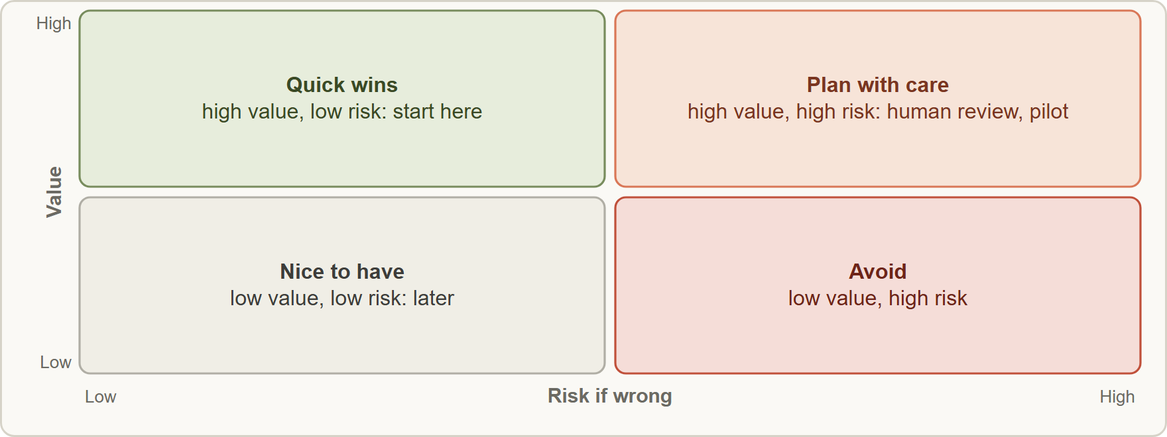
Identifying Good Use Cases, continued
Module 9
Screening use cases by value and risk: start with high-value, low-risk quick wins; plan carefully for high-value, high-risk; avoid low-value, high-risk
Claude Associate Foundations Exam Prep | for the CCAO-F exam
Module 9
8 / 29
Notes:
Identifying Good Use Cases, continued.
The figure shows this: Screening use cases by value and risk: start with high-value, low-risk quick wins; plan carefully for high-value, high-risk; avoid low-value, high-risk.

Slide 9
Identifying Good Use Cases, continued
Module 9
Strong fit for Claude | Weak fit or needs care
Text-heavy work: drafting, summarizing, classifying, rewriting | Tasks needing exact, auditable calculation without verification
Repetitive tasks with a clear pattern | Decisions with legal, medical or financial consequences made by Claude alone
Tasks where a person reviews the result | Sensitive data that policy does not allow in the tool (Module 13)
Work that is slow because of reading and writing | Tasks needing real-time systems or actions Claude is not connected to
Brainstorming and planning support | Tasks where an error would be unnoticed and costly
Claude Associate Foundations Exam Prep | for the CCAO-F exam
Module 9
9 / 29
Notes:
Identifying Good Use Cases, continued.
Text-heavy work: drafting, summarizing, classifying, rewriting. Tasks needing exact, auditable calculation without verification.
Repetitive tasks with a clear pattern. Decisions with legal, medical or financial consequences made by Claude alone.
Tasks where a person reviews the result. Sensitive data that policy does not allow in the tool (Module thirteen).
Work that is slow because of reading and writing. Tasks needing real-time systems or actions Claude is not connected to.
Brainstorming and planning support. Tasks where an error would be unnoticed and costly.

Slide 10
Identifying Good Use Cases, continued
Module 9
Ask: How much time does it take now? How often? What is the cost of a mistake? Who reviews? Is the data allowed?
Start with low-risk, high-value use cases, learn from them and expand.
Keep a human in the loop wherever errors matter.
Not every problem is an AI problem: sometimes a simpler fix (a template, a checklist) works better.
Claude Associate Foundations Exam Prep | for the CCAO-F exam
Module 9
10 / 29
Notes:
Identifying Good Use Cases, continued.
Ask: How much time does it take now? How often? What is the cost of a mistake? Who reviews? Is the data allowed?
Start with low-risk, high-value use cases, learn from them and expand.
Keep a human in the loop wherever errors matter.
Not every problem is an A I problem: sometimes a simpler fix (a template, a checklist) works better.

Slide 11
Research and Planning
Module 9
Research. Choose the tool by the question (Module 6): web search for a quick fact, Research for a comprehensive cited report. For good results:
State the question, scope, time frame and audience
Ask for sources and disagreements between sources
Separate findings from recommendations
Verify the key claims in the cited sources (Module 4)
Planning. Claude is a strong drafting partner for plans.
Claude Associate Foundations Exam Prep | for the CCAO-F exam
Module 9
11 / 29
Notes:
Research and Planning.
Research. Choose the tool by the question (Module six): web search for a quick fact, Research for a comprehensive cited report. For good results.
State the question, scope, time frame and audience.
Ask for sources and disagreements between sources.
Separate findings from recommendations.
Verify the key claims in the cited sources (Module four).
Planning. Claude is a strong drafting partner for plans.

Slide 12
Research and Planning, continued
Module 9
Plan element | Ask Claude for | You check
Scope and goals | Objectives, in-scope and out-of-scope | Matches the sponsor's intent
Work breakdown | Phases, tasks, dependencies | Nothing missing; realistic order
Timeline | Milestones with durations | Durations against real capacity
Roles | A RACI chart | Real people and authority
Risks | Risks, likelihood, impact, mitigation | Missed risks specific to your context
Communication | Update cadence and messages | Fit with your organization
Claude does not know your team's capacity, politics or hidden constraints unless you tell it. Provide them, then review the plan.
Ask for options with trade-offs, not only one plan.
Claude Associate Foundations Exam Prep | for the CCAO-F exam
Module 9
12 / 29
Notes:
Research and Planning, continued.
Scope and goals. Ask Claude for: Objectives, in-scope and out-of-scope. You check: Matches the sponsor's intent.
Work breakdown. Ask Claude for: Phases, tasks, dependencies. You check: Nothing missing; realistic order.
Timeline. Ask Claude for: Milestones with durations. You check: Durations against real capacity.
Roles. Ask Claude for: A R A C I chart. You check: Real people and authority.
Risks. Ask Claude for: Risks, likelihood, impact, mitigation. You check: Missed risks specific to your context.
Communication. Ask Claude for: Update cadence and messages. You check: Fit with your organization.
Claude does not know your team's capacity, politics or hidden constraints unless you tell it. Provide them, then review the plan.
Ask for options with trade-offs, not only one plan.

Slide 13
Research and Planning, continued
Module 9
Treat the output as a first draft that you refine with the team.
Claude Associate Foundations Exam Prep | for the CCAO-F exam
Module 9
13 / 29
Notes:
Research and Planning, continued.
Treat the output as a first draft that you refine with the team.

Slide 14
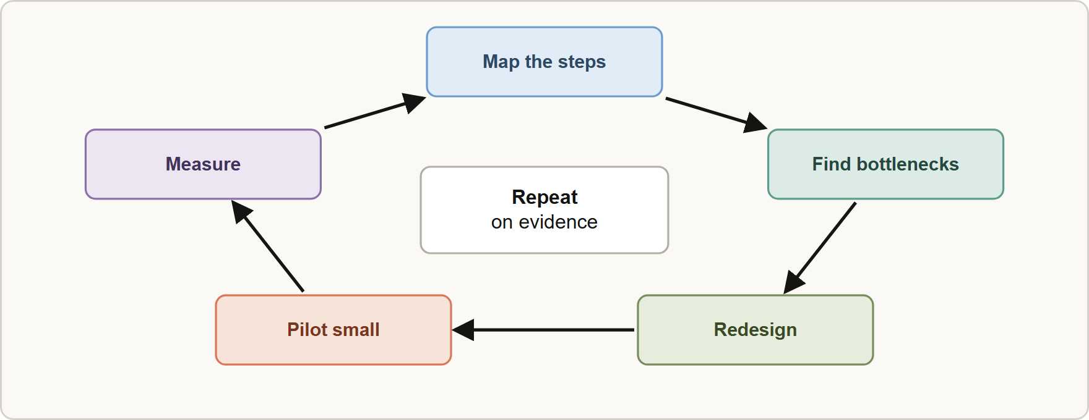
Process Optimization
Module 9
Improving a process with Claude: map the current steps, find bottlenecks, redesign, pilot on a small scale, measure and repeat
Claude Associate Foundations Exam Prep | for the CCAO-F exam
Module 9
14 / 29
Notes:
Process Optimization.
The figure shows this: Improving a process with Claude: map the current steps, find bottlenecks, redesign, pilot on a small scale, measure and repeat.

Slide 15
Process Optimization, continued
Module 9
Step | How Claude helps | Cedarbrook example
1. Map | Turn a description or SOP into a step list or flow | Returns: receive, inspect, decide, refund, restock
2. Find bottlenecks | Spot waits, rework, hand-offs, manual copying | Refund decisions wait for a manager's email
3. Redesign | Propose changes: templates, checklists, automation of drafting, clearer rules | A decision checklist plus reply templates
4. Pilot | Draft a test plan and success measures | One warehouse for two weeks
5. Measure | Help analyze before/after data and write up results | Days to refund, error rate, customer satisfaction
Claude Associate Foundations Exam Prep | for the CCAO-F exam
Module 9
15 / 29
Notes:
Process Optimization, continued.
one. Map. How Claude helps: Turn a description or S O P into a step list or flow. Cedarbrook example: Returns: receive, inspect, decide, refund, restock.
two. Find bottlenecks. How Claude helps: Spot waits, rework, hand-offs, manual copying. Cedarbrook example: Refund decisions wait for a manager's email.
three. Redesign. How Claude helps: Propose changes: templates, checklists, automation of drafting, clearer rules. Cedarbrook example: A decision checklist plus reply templates.
four. Pilot. How Claude helps: Draft a test plan and success measures. Cedarbrook example: One warehouse for two weeks.
five. Measure. How Claude helps: Help analyze before or after data and write up results. Cedarbrook example: Days to refund, error rate, customer satisfaction.

Slide 16
Process Optimization, continued
Module 9
Optimize a measurable process: choose KPIs before you start (time, cost, error rate, satisfaction).
Claude can augment a step (draft the reply) or redesign the flow (remove an approval) (Module 10).
Try changes small first (a pilot), keep humans in review, and expand only on evidence.
EXAM TIP Requirements are confirmed by stakeholders, not by Claude: the output is a draft with its assumptions listed for people to check.
Claude Associate Foundations Exam Prep | for the CCAO-F exam
Module 9
16 / 29
Notes:
Process Optimization, continued.
Optimize a measurable process: choose K P I s before you start (time, cost, error rate, satisfaction).
Claude can augment a step (draft the reply) or redesign the flow (remove an approval) (Module ten).
Try changes small first (a pilot), keep humans in review, and expand only on evidence.
Exam tip: Requirements are confirmed by stakeholders, not by Claude: the output is a draft with its assumptions listed for people to check.
Exam tip: Start with use cases where value is high and risk is low, and keep a person in review wherever errors matter.

Slide 17
Module Recap
Module 9
1
Requirements
2
Facts vs assumptions
3
Use-case screen
Clarify, structure, find gaps, then validate with people
Value · fit · risk; start with low-risk, high-value
Ask Claude to separate them; correct the assumptions
4
Strong fit
5
Weak fit
6
Research
Text-heavy, repetitive, reviewed by a person
High-stakes alone, disallowed data, real-time systems, unnoticed costly errors
Question, scope, sources; verify claims
7
Planning
8
Process cycle
9
Measures
Claude drafts; you add real capacity and constraints; ask for options
Map · find bottlenecks · redesign · pilot · measure
Choose KPIs before the change
Claude Associate Foundations Exam Prep | for the CCAO-F exam
Module 9
17 / 29
Notes:
Here is the recap.
Requirements: Clarify, structure, find gaps, then validate with people.
Facts versus assumptions: Ask Claude to separate them; correct the assumptions.
Use-case screen: Value, fit, risk; start with low-risk, high-value.
Strong fit: Text-heavy, repetitive, reviewed by a person.
Weak fit: High-stakes alone, disallowed data, real-time systems, unnoticed costly errors.
Research: Question, scope, sources; verify claims.
Planning: Claude drafts; you add real capacity and constraints; ask for options.
Process cycle: Map, find bottlenecks, redesign, pilot, measure.
Measures: Choose K P I s before the change.

Slide 18
Practice Question 1
Module 9
Q1
A manager says "Returns take too long." What is the best first use of Claude?
A
Ask it to redesign the whole customer-care department and write the announcement of the new structure
B
Ask it to write a press release
C
Ask it to decide the new policy
D
Ask it to turn the complaint into clear requirements, assumptions and questions for stakeholders
Claude Associate Foundations Exam Prep | for the CCAO-F exam
Module 9
18 / 29
Notes:
Question one.
A manager says "Returns take too long." What is the best first use of Claude?
The four options are on the screen.
[PAUSE 12]
The answer is D. Clarifying and structuring the need comes first; people then validate it.

Slide 19
Practice Question 2
Module 9
Q2
Which task is the strongest candidate for Claude?
A
Producing a legally binding contract for a supplier and sending it out with no review at all
B
Drafting and categorizing hundreds of routine replies that agents review before sending
C
Controlling a warehouse robot in real time
D
Making final credit decisions about customers
Claude Associate Foundations Exam Prep | for the CCAO-F exam
Module 9
19 / 29
Notes:
Question two.
Which task is the strongest candidate for Claude?
The four options are on the screen.
[PAUSE 12]
The answer is B. Text-heavy, repetitive work with human review is a strong fit.

Slide 20
Practice Question 3
Module 9
Q3
A team wants to start using Claude. Which first use case is wisest?
A
Low-risk and high-value, such as summarizing meeting notes
B
High-risk and high-value, such as automating regulated advice
C
Low-value and high-risk
D
Whichever is most complicated
Claude Associate Foundations Exam Prep | for the CCAO-F exam
Module 9
20 / 29
Notes:
Question three.
A team wants to start using Claude. Which first use case is wisest?
The four options are on the screen.
[PAUSE 12]
The answer is A. Start with quick wins, learn, and expand carefully.

Slide 21
Practice Question 4
Module 9
Q4
Claude proposes a project plan with a four-week timeline. What should the project manager do?
A
Check durations and dependencies against real capacity and constraints, then refine with the team
B
Remove all risks from the plan
C
Ask Claude to promise the dates
D
Adopt it as is
Claude Associate Foundations Exam Prep | for the CCAO-F exam
Module 9
21 / 29
Notes:
Question four.
Claude proposes a project plan with a four-week timeline. What should the project manager do?
The four options are on the screen.
[PAUSE 12]
The answer is A. Claude lacks your team's real capacity and hidden constraints.

Slide 22
Practice Question 5
Module 9
Q5
For a comprehensive, cited competitor landscape, which approach fits?
A
A single web search on the topic, followed by a short summary of the first page
B
Memory
C
Research, then verification of key claims in the sources
D
Extended thinking only, with no web access and no sources at all
Claude Associate Foundations Exam Prep | for the CCAO-F exam
Module 9
22 / 29
Notes:
Question five.
For a comprehensive, cited competitor landscape, which approach fits?
The four options are on the screen.
[PAUSE 12]
The answer is C. Research gathers multi-source, cited findings; verify the claims you rely on.

Slide 23
Practice Question 6
Module 9
Q6
Which TWO belong at the start of a process-improvement effort? (Select TWO.)
A
Map the current steps
B
Skip baseline data
C
Remove all reviews
D
Roll out the new process to everyone at once
E
Choose measures such as time and error rate
Claude Associate Foundations Exam Prep | for the CCAO-F exam
Module 9
23 / 29
Notes:
Question six. Select two.
Which two belong at the start of a process-improvement effort?
The five options are on the screen.
[PAUSE 15]
The answers are A and E. Map the process and set the measures before changing anything.

Slide 24
Practice Question 7
Module 9
Q7
Why ask Claude to separate your facts from its assumptions when drafting requirements?
A
To make the document longer and to give it a more professional and impressive look
B
So that you can verify and correct the assumptions with stakeholders
C
Because facts are not needed
D
Because assumptions are always right and need no checking by anyone at all
Claude Associate Foundations Exam Prep | for the CCAO-F exam
Module 9
24 / 29
Notes:
Question seven.
Why ask Claude to separate your facts from its assumptions when drafting requirements?
The four options are on the screen.
[PAUSE 12]
The answer is B. Hidden assumptions are a main source of requirement errors.

Slide 25
Practice Question 8
Module 9
Q8
A team wants to test a redesigned returns checklist. What is a sensible next step?
A
Ask Claude to declare it a success
B
Switch the whole company at once
C
Run a small pilot with defined success measures
D
Wait a year
Claude Associate Foundations Exam Prep | for the CCAO-F exam
Module 9
25 / 29
Notes:
Question eight.
A team wants to test a redesigned returns checklist. What is a sensible next step?
The four options are on the screen.
[PAUSE 12]
The answer is C. A small pilot with defined success measures shows whether the change works before the whole company depends on it.

Slide 26
Practice Question 9
Module 9
Q9
Which factor makes a use case a poor fit for unsupervised Claude?
A
The work is repetitive
B
A mistake would be costly and unlikely to be noticed
C
The task is text-based
D
A person reviews every output
Claude Associate Foundations Exam Prep | for the CCAO-F exam
Module 9
26 / 29
Notes:
Question nine.
Which factor makes a use case a poor fit for unsupervised Claude?
The four options are on the screen.
[PAUSE 12]
The answer is B. High-cost, unnoticed errors need human review or a different approach.

Slide 27
Practice Question 10
Module 9
Q10
Why provide your own constraints (budget, deadlines, policy) when asking for a plan?
A
They are always ignored
B
They make the plan less accurate
C
Claude cannot read them
D
Claude cannot know them unless you state them, and the plan will fit better with them
Claude Associate Foundations Exam Prep | for the CCAO-F exam
Module 9
27 / 29
Notes:
Question ten.
Why provide your own constraints (budget, deadlines, policy) when asking for a plan?
The four options are on the screen.
[PAUSE 12]
The answer is D. Claude cannot know your budget, deadlines or policies unless you state them, and a plan that ignores them will not be realistic.

Slide 28
Practice Question 11
Module 9
Q11
An operations lead wants to replace a manual approval step with Claude's decision on refunds of any size. What is the best response?
A
Use Claude to draft recommendations and keep a person approving larger or unusual refunds
B
Remove the refund policy
C
Hide the change from staff
D
Do it immediately, because Claude applies the refund rules more consistently than the staff do
Claude Associate Foundations Exam Prep | for the CCAO-F exam
Module 9
28 / 29
Notes:
Question eleven.
An operations lead wants to replace a manual approval step with Claude's decision on refunds of any size. What is the best response?
The four options are on the screen.
[PAUSE 12]
The answer is A. Keep a human accountable where decisions have financial and customer impact.

Slide 29
Answers at a Glance
Module 9
Question | Answer | Why
Q1 | D | Clarifying and structuring the need comes first
Q2 | B | Text-heavy, repetitive work with human review is a
Q3 | A | Start with quick wins, learn, and expand carefully
Q4 | A | Claude lacks your team's real capacity and hidden
Q5 | C | Research gathers multi-source, cited findings
Q6 | A, E | Map the process and set the measures before
Q7 | B | Hidden assumptions are a main source of requirement
Q8 | C | A small pilot with defined success measures shows
Q9 | B | High-cost, unnoticed errors need human review or a
Q10 | D | Claude cannot know your budget
Q11 | A | Keep a human accountable where decisions have financial
Claude Associate Foundations Exam Prep | for the CCAO-F exam
Module 9
29 / 29
Notes:
Here are all eleven answers. Question one: D. Question two: B. Question three: A. Question four: A. Question five: C. Question six: A and E. Question seven: B. Question eight: C. Question nine: B. Question ten: D. Question eleven: A.
In the next module, we continue the course.

