Slide 1
Module 10: Solution Design, Workflow Integration and Stakeholder Communication
How Claude supports design, build and iteration of a solution
Domain 4 · Workflow Integration and Solution Design
Claude Associate Foundations Exam Prep Masterclass
Module 10 · Part 1
Notes:
Welcome to Module ten: Solution Design, Workflow Integration and Stakeholder Communication. This module covers solution design, workflow integration and stakeholder communication.
Each part of this module comes from the study notes of the same name, so you can read the notes after you watch.

Slide 2
What You Will Learn
Part 1
How Claude supports design, build and iteration of a solution
How to fit Claude into an existing workflow: augment a step or redesign the flow
Patterns that work: draft and review, triage, extract, summarize
When to escalate to Developers or Architects
How to communicate value and limits honestly to stakeholders
Claude Associate Foundations Exam Prep | for the CCAO-F exam
Module 10
2 / 30
Notes:
By the end of this module you will be able to do five things.
How Claude supports design, build and iteration of a solution.
How to fit Claude into an existing workflow: augment a step or redesign the flow.
Patterns that work: draft and review, triage, extract, summarize.
When to escalate to Developers or Architects.
How to communicate value and limits honestly to stakeholders.

Slide 3
Case Check-In: Cedarbrook's Onboarding Kit
Part 1
CASE CHECK-IN · Cedarbrook Outfitters
HR wants a new-hire onboarding kit: checklist, welcome email series, an FAQ and a short interactive quiz
The HR lead uses Claude to draft the structure, build an artifact quiz, test it with sample answers, and revise after feedback from two managers
Claude Associate Foundations Exam Prep | for the CCAO-F exam
Module 10
3 / 30
Notes:
Our running case is Cedarbrook Outfitters. Cedarbrook's Onboarding Kit.
H R wants a new-hire onboarding kit: checklist, welcome email series, an F A Q and a short interactive quiz.
The H R lead uses Claude to draft the structure, build an artifact quiz, test it with sample answers, and revise after feedback from two managers.

Slide 4
Supporting Solution Design and Iteration
Part 1
Phase | How Claude helps | Your role
Design | Options with trade-offs, outlines, mock-ups, process diagrams, templates | Choose, adapt to your context
Build | Draft documents, forms, spreadsheets with formulas, slide decks, simple interactive artifacts | Review, test, own the result
Test | Sample inputs, edge cases, checklists, "what could go wrong" lists | Run the tests; judge the outcomes
Iterate | Revise from feedback; compare versions; track changes in a summary | Collect real user feedback
Document | Instructions, FAQs, handover notes | Confirm accuracy
Prototype fast, validate with users. A quick artifact or draft is a conversation starter, not a finished product.
Claude Associate Foundations Exam Prep | for the CCAO-F exam
Module 10
4 / 30
Notes:
Supporting Solution Design and Iteration.
Design. How Claude helps: Options with trade-offs, outlines, mock-ups, process diagrams, templates. Your role: Choose, adapt to your context.
Build. How Claude helps: Draft documents, forms, spreadsheets with formulas, slide decks, simple interactive artifacts. Your role: Review, test, own the result.
Test. How Claude helps: Sample inputs, edge cases, checklists, "what could go wrong" lists. Your role: Run the tests; judge the outcomes.
Iterate. How Claude helps: Revise from feedback; compare versions; track changes in a summary. Your role: Collect real user feedback.
Document. How Claude helps: Instructions, F A Q s, handover notes. Your role: Confirm accuracy.
Prototype fast, validate with users. A quick artifact or draft is a conversation starter, not a finished product.

Slide 5
Supporting Solution Design and Iteration, continued
Part 1
Small, simple solutions (templates, checklists, spreadsheets, Projects, simple artifacts) are the Associate's territory.
For anything that needs code in production, API calls, databases or system integration, escalate (section 4).
Claude Associate Foundations Exam Prep | for the CCAO-F exam
Module 10
5 / 30
Notes:
Supporting Solution Design and Iteration, continued.
Small, simple solutions (templates, checklists, spreadsheets, Projects, simple artifacts) are the Associate's territory.
For anything that needs code in production, A P I (application programming interface) calls, databases or system integration, escalate (section four).

Slide 6
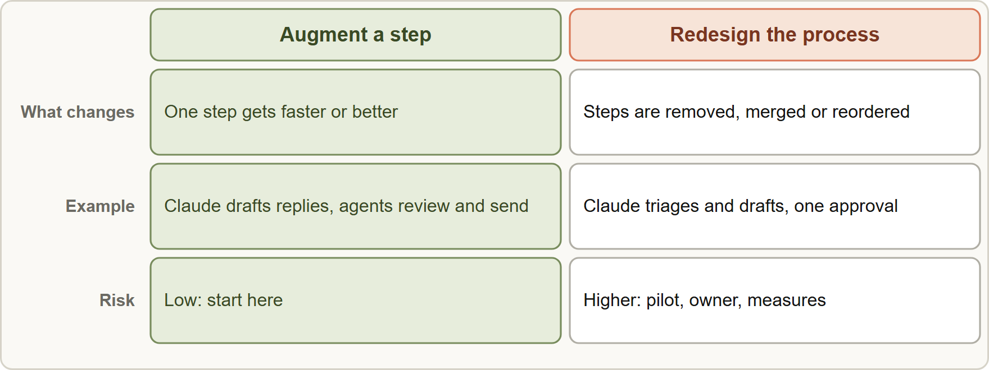
Fitting Claude into a Workflow
Part 1
Augment a step to speed up one task inside the current process, or redesign the process around what Claude does well
Claude Associate Foundations Exam Prep | for the CCAO-F exam
Module 10
6 / 30
Notes:
Fitting Claude into a Workflow.
The figure shows this: Augment a step to speed up one task inside the current process, or redesign the process around what Claude does well.

Slide 7
Fitting Claude into a Workflow, continued
Part 1
Approach | What changes | Example | Risk
Augment | One step gets faster or better; the process stays | Agents get draft replies from Claude and send after review | Low
Redesign | Steps are removed, merged or reordered | Instead of 5 hand-offs, Claude triages and drafts, a person approves once | Higher: needs a pilot and clear ownership
Workflow patterns that work:
Claude Associate Foundations Exam Prep | for the CCAO-F exam
Module 10
7 / 30
Notes:
Fitting Claude into a Workflow, continued.
Augment. What changes: One step gets faster or better; the process stays. Example: Agents get draft replies from Claude and send after review. Risk: Low.
Redesign. What changes: Steps are removed, merged or reordered. Example: Instead of five hand-offs, Claude triages and drafts, a person approves once. Risk: Higher: needs a pilot and clear ownership.
Workflow patterns that work.

Slide 8
Fitting Claude into a Workflow, continued
Part 1
Pattern | Flow
Draft and review | Claude drafts; a person edits and approves
Triage and route | Claude classifies and tags; a person handles the exceptions
Extract and structure | Claude pulls fields from documents; a person spot-checks
Summarize and decide | Claude summarizes long inputs; a person decides
Research and brief | Claude gathers and cites; a person verifies and concludes
Building blocks inside Claude: Projects (standing instructions and knowledge), Skills (repeatable methods), connectors (Google Drive, Gmail, Slack and others), artifacts (shareable outputs), memory (continuity) (Modules 11 and 12).
Make it stick:
Claude Associate Foundations Exam Prep | for the CCAO-F exam
Module 10
8 / 30
Notes:
Fitting Claude into a Workflow, continued.
Draft and review. Claude drafts; a person edits and approves.
Triage and route. Claude classifies and tags; a person handles the exceptions.
Extract and structure. Claude pulls fields from documents; a person spot-checks.
Summarize and decide. Claude summarizes long inputs; a person decides.
Research and brief. Claude gathers and cites; a person verifies and concludes.
Building blocks inside Claude: Projects (standing instructions and knowledge), Skills (repeatable methods), connectors (Google Drive, Gmail, Slack and others), artifacts (shareable outputs), memory (continuity) (Modules eleven and twelve).
Make it stick.

Slide 9
Fitting Claude into a Workflow, continued
Part 1
Name an owner for the prompt, the Project and the quality of the results
Write down when to use Claude and when not to
Keep review steps where errors matter
Share the prompts and Projects so everyone gets consistent results
Train the team (examples, do's and don'ts, how to verify)
Track KPIs (time saved, error rate, satisfaction) and review them
EXAM TIP The safe answer for integration: start with augmentation and a human review, pilot, measure, then redesign where evidence supports it.
Claude Associate Foundations Exam Prep | for the CCAO-F exam
Module 10
9 / 30
Notes:
Fitting Claude into a Workflow, continued.
Name an owner for the prompt, the Project and the quality of the results.
Write down when to use Claude and when not to.
Keep review steps where errors matter.
Share the prompts and Projects so everyone gets consistent results.
Train the team (examples, do's and don'ts, how to verify).
Track K P I s (time saved, error rate, satisfaction) and review them.
Exam tip: The safe answer for integration: start with augmentation and a human review, pilot, measure, then redesign where evidence supports it.

Slide 10
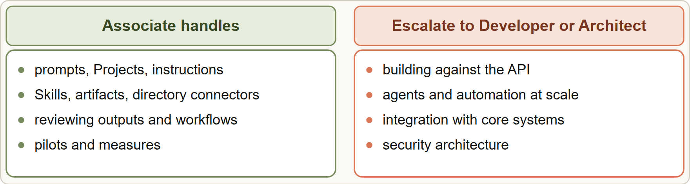
Know the Boundary: When to Escalate
Part 1
The Associate builds with the product's own features and escalates API, agent and architecture work to Developers and Architects
Claude Associate Foundations Exam Prep | for the CCAO-F exam
Module 10
10 / 30
Notes:
Know the Boundary: When to Escalate.
The figure shows this: The Associate builds with the product's own features and escalates A P I, agent and architecture work to Developers and Architects.

Slide 11
Know the Boundary: When to Escalate, continued
Part 1
An Associate handles | Escalate to a Developer or Architect
Prompts, Projects, instructions, knowledge | Building against the API, code that calls Claude
Skills, artifacts, connectors from the directory | Agents, automated multi-step pipelines, scheduled jobs at scale
Reviewing outputs and workflows | Integrations with core systems and databases
Pilots and measures | Security architecture, access control, data-residency design
Policy-compliant daily use | Enterprise-scale deployment design and evaluation frameworks
The exam guide says plainly that Associates recognize limitations and escalate more complex or technical work.
Escalate when the solution needs custom code, automation without a human, large data volumes, or security and compliance design.
Claude Associate Foundations Exam Prep | for the CCAO-F exam
Module 10
11 / 30
Notes:
Know the Boundary: When to Escalate, continued.
Prompts, Projects, instructions, knowledge. Building against the A P I, code that calls Claude.
Skills, artifacts, connectors from the directory. Agents, automated multi-step pipelines, scheduled jobs at scale.
Reviewing outputs and workflows. Integrations with core systems and databases.
Pilots and measures. Security architecture, access control, data-residency design.
Policy-compliant daily use. Enterprise-scale deployment design and evaluation frameworks.
The exam guide says plainly that Associates recognize limitations and escalate more complex or technical work.
Escalate when the solution needs custom code, automation without a human, large data volumes, or security and compliance design.

Slide 12
Know the Boundary: When to Escalate, continued
Part 1
Bring a clear brief: the business goal, the current process, the data involved, volumes, risks and success measures.
Claude Associate Foundations Exam Prep | for the CCAO-F exam
Module 10
12 / 30
Notes:
Know the Boundary: When to Escalate, continued.
Bring a clear brief: the business goal, the current process, the data involved, volumes, risks and success measures.

Slide 13
Communicating Value and Limits
Part 1
Stakeholders need an honest picture: neither hype nor fear.
Claude Associate Foundations Exam Prep | for the CCAO-F exam
Module 10
13 / 30
Notes:
Communicating Value and Limits.
Stakeholders need an honest picture: neither hype nor fear.

Slide 14
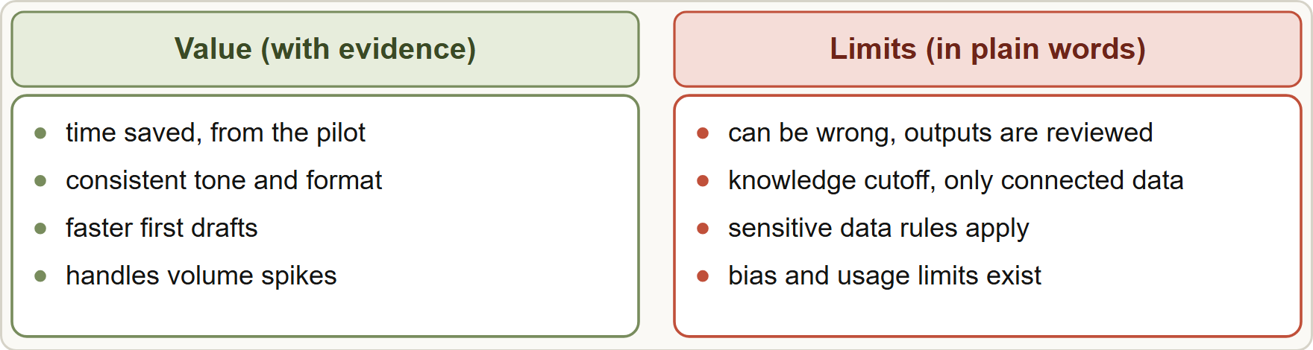
Communicating Value and Limits, continued
Part 1
Communicate value with evidence and limits with plain words: use a pilot result to support both
Claude Associate Foundations Exam Prep | for the CCAO-F exam
Module 10
14 / 30
Notes:
Communicating Value and Limits, continued.
The figure shows this: Communicate value with evidence and limits with plain words: use a pilot result to support both.

Slide 15
Communicating Value and Limits, continued
Part 1
Say about value | Say about limits
Time saved on drafting, summarizing, analysis (use pilot numbers) | Claude can be wrong or invent details; outputs are reviewed
Consistency of tone and format with Projects and Skills | It has a knowledge cutoff and only the tools and data you connect
Faster first drafts, so people spend time on judgment | Sensitive data rules apply; not every task is allowed
Scale: handles volume spikes | Bias can appear; people decisions need human oversight
Learning curve is short for common tasks | Usage limits and costs exist; effort and model choices matter
Claude Associate Foundations Exam Prep | for the CCAO-F exam
Module 10
15 / 30
Notes:
Communicating Value and Limits, continued.
Time saved on drafting, summarizing, analysis (use pilot numbers). Claude can be wrong or invent details; outputs are reviewed.
Consistency of tone and format with Projects and Skills. It has a knowledge cutoff and only the tools and data you connect.
Faster first drafts, so people spend time on judgment. Sensitive data rules apply; not every task is allowed.
Scale: handles volume spikes. Bias can appear; people decisions need human oversight.
Learning curve is short for common tasks. Usage limits and costs exist; effort and model choices matter.

Slide 16
Communicating Value and Limits, continued
Part 1
Tailor the message: executives want outcomes, risk and cost; managers want workload and quality; staff want how it changes their job and what stays human; compliance wants data handling and review.
Back claims with evidence from a pilot, not vendor promises: "In the pilot, reply drafting time fell from 6 to 2 minutes; 4% of drafts needed corrections of facts."
Never promise that Claude is always accurate, replaces staff review, or can do things it is not connected to do.
Be open about what is still unknown and how you will learn it.
Claude Associate Foundations Exam Prep | for the CCAO-F exam
Module 10
16 / 30
Notes:
Communicating Value and Limits, continued.
Tailor the message: executives want outcomes, risk and cost; managers want workload and quality; staff want how it changes their job and what stays human; compliance wants data handling and review.
Back claims with evidence from a pilot, not vendor promises: "In the pilot, reply drafting time fell from six to two minutes; four percent of drafts needed corrections of facts.".
Never promise that Claude is always accurate, replaces staff review, or can do things it is not connected to do.
Be open about what is still unknown and how you will learn it.

Slide 17
Communicating Value and Limits, continued
Part 2
Show how people stay accountable: who reviews, who approves, who owns the policy.
EXAM TIP The best stakeholder message is balanced, evidence-based and specific: real benefits, real limits, a review plan and a next step.
Claude Associate Foundations Exam Prep | for the CCAO-F exam
Module 10
17 / 30
Notes:
Communicating Value and Limits, continued.
Show how people stay accountable: who reviews, who approves, who owns the policy.
Exam tip: The best stakeholder message is balanced, evidence-based and specific: real benefits, real limits, a review plan and a next step.
Exam tip: Pilot, measure, then scale: evidence from a small trial beats a promise, and any step Claude cannot do alone is a job for a Developer.

Slide 18
Module Recap
Part 2
1
Design and iterate
2
Augment vs redesign
3
Patterns
Draft and review · triage and route · extract and structure · summarize and decide · research and brief
Claude drafts options, prototypes, tests; you validate with users
Augment a step (low risk) · redesign the flow (pilot first)
4
Make it stick
5
Escalate
6
Brief
Owner · when-to-use rules · reviews · shared Projects · training · KPIs
API integration, agents, automation at scale, systems integration, security architecture
Goal · process · data · volumes · risks · measures
7
Message
8
Never promise
Evidence-based value + plain limits + review plan + next step
Perfect accuracy; replacing review; connections that do not exist
Claude Associate Foundations Exam Prep | for the CCAO-F exam
Module 10
18 / 30
Notes:
Here is the recap.
Design and iterate: Claude drafts options, prototypes, tests; you validate with users.
Augment versus redesign: Augment a step (low risk), redesign the flow (pilot first).
Patterns: Draft and review, triage and route, extract and structure, summarize and decide, research and brief.
Make it stick: Owner, when-to-use rules, reviews, shared Projects, training, K P I s.
Escalate: A P I integration, agents, automation at scale, systems integration, security architecture.
Brief: Goal, process, data, volumes, risks, measures.
Message: Evidence-based value plus plain limits plus review plan plus next step.
Never promise: Perfect accuracy; replacing review; connections that do not exist.

Slide 19
Practice Question 1
Part 2
Q1
Customer care agents currently write every reply from scratch. What is the lowest-risk way to bring Claude into this workflow?
A
Remove the review step and send Claude's replies automatically
B
Ban Claude
C
Let Claude draft replies that agents review and send
D
Replace the agents
Claude Associate Foundations Exam Prep | for the CCAO-F exam
Module 10
19 / 30
Notes:
Question one.
Customer care agents currently write every reply from scratch. What is the lowest-risk way to bring Claude into this workflow?
The four options are on the screen.
[PAUSE 12]
The answer is C. Augmenting with a draft-and-review step is low risk and quick to pilot.

Slide 20
Practice Question 2
Part 2
Q2
A manager wants Claude connected directly to the order database through custom code, with scheduled automatic updates. What should the Associate do?
A
Ignore the request
B
Escalate to a Claude Developer or Architect with a clear brief
C
Build it themselves
D
Ask Claude to write the code and run it unreviewed in production
Claude Associate Foundations Exam Prep | for the CCAO-F exam
Module 10
20 / 30
Notes:
Question two.
A manager wants Claude connected directly to the order database through custom code, with scheduled automatic updates. What should the Associate do?
The four options are on the screen.
[PAUSE 12]
The answer is B. A P I integration and automation at scale belong to Developers and Architects.

Slide 21
Practice Question 3
Part 2
Q3
Which message to the leadership team is best?
A
"We do not know anything yet."
B
"In our pilot, drafting time fell by two thirds; about 4% of drafts needed fact fixes, so we keep a review step."
C
"Claude is always accurate and will soon replace the review process, so reviewers can be moved to other work."
D
"Claude cannot be trusted."
Claude Associate Foundations Exam Prep | for the CCAO-F exam
Module 10
21 / 30
Notes:
Question three.
Which message to the leadership team is best?
The four options are on the screen.
[PAUSE 12]
The answer is B. Specific evidence plus an honest limit and a control.

Slide 22
Practice Question 4
Part 2
Q4
What is the main difference between augmenting and redesigning a workflow?
A
Redesigning never needs a pilot
B
Augmenting improves a step inside the current process; redesigning removes, merges or reorders steps
C
Augmenting changes the whole process from the first day; redesigning changes only a single step in it
D
There is no difference
Claude Associate Foundations Exam Prep | for the CCAO-F exam
Module 10
22 / 30
Notes:
Question four.
What is the main difference between augmenting and redesigning a workflow?
The four options are on the screen.
[PAUSE 12]
The answer is B. Augmentation keeps the process; redesign reshapes it and needs more care.

Slide 23
Practice Question 5
Part 2
Q5
An HR lead builds a quiz artifact with Claude. What is the right next step?
A
Test it with sample answers and real users, and revise from feedback
B
Delete the testing steps because they slow the prototype down and add little value
C
Publish it company-wide immediately so that everyone can start using it this week
D
Assume it works
Claude Associate Foundations Exam Prep | for the CCAO-F exam
Module 10
23 / 30
Notes:
Question five.
An H R lead builds a quiz artifact with Claude. What is the right next step?
The four options are on the screen.
[PAUSE 12]
The answer is A. A prototype is a conversation starter, so it is tested with sample answers and real users and revised before wider use.

Slide 24
Practice Question 6
Part 2
Q6
Which TWO are good practices when rolling Claude into a team workflow? (Select TWO.)
A
Keep review steps where errors matter
B
Give everyone a different private prompt style
C
Hide limits from staff
D
Avoid tracking results
E
Name an owner for the prompts, the Project and the quality
Claude Associate Foundations Exam Prep | for the CCAO-F exam
Module 10
24 / 30
Notes:
Question six. Select two.
Which two are good practices when rolling Claude into a team workflow?
The five options are on the screen.
[PAUSE 15]
The answers are A and E. Naming an owner and keeping review steps where errors matter keep quality accountable as more people start using Claude.

Slide 25
Practice Question 7
Part 2
Q7
Which statement about talking to compliance stakeholders is best?
A
Avoid mentioning data handling because it will only worry the compliance team unnecessarily
B
Explain what data goes into Claude, which policy applies, and who reviews outputs
C
Promise that decisions will be made automatically so that compliance has nothing left to review
D
Say Claude never makes mistakes
Claude Associate Foundations Exam Prep | for the CCAO-F exam
Module 10
25 / 30
Notes:
Question seven.
Which statement about talking to compliance stakeholders is best?
The four options are on the screen.
[PAUSE 12]
The answer is B. Compliance wants to know what data enters Claude, which policy applies and who reviews outputs, not a promise of perfection.

Slide 26
Practice Question 8
Part 2
Q8
Which workflow is a good "triage and route" example?
A
Claude tags incoming support tickets by topic and urgency, and people handle the exceptions
B
Claude approves every refund request on its own and informs the customer by email without any review
C
Claude chooses suppliers alone
D
Claude signs contracts
Claude Associate Foundations Exam Prep | for the CCAO-F exam
Module 10
26 / 30
Notes:
Question eight.
Which workflow is a good "triage and route" example?
The four options are on the screen.
[PAUSE 12]
The answer is A. Classification with human exception handling is a safe and valuable pattern.

Slide 27
Practice Question 9
Part 2
Q9
A team cannot tell whether Claude helps. What should they do?
A
Choose KPIs (time, error rate, satisfaction), run a pilot and compare with the baseline
B
Ask Claude to say yes, because Claude is the best judge of whether Claude has helped anybody
C
Guess
D
Stop measuring
Claude Associate Foundations Exam Prep | for the CCAO-F exam
Module 10
27 / 30
Notes:
Question nine.
A team cannot tell whether Claude helps. What should they do?
The four options are on the screen.
[PAUSE 12]
The answer is A. Only measured evidence from a pilot compared with a baseline can show whether Claude actually helps, rather than opinions or guesses.

Slide 28
Practice Question 10
Part 2
Q10
Which request should an Associate escalate?
A
Improve a prompt for meeting notes so that it produces cleaner action lists every time
B
Design secure access between Claude and several internal systems
C
Build a Project with brand instructions
D
Create a checklist
Claude Associate Foundations Exam Prep | for the CCAO-F exam
Module 10
28 / 30
Notes:
Question ten.
Which request should an Associate escalate?
The four options are on the screen.
[PAUSE 12]
The answer is B. Secure integration across several internal systems with access controls is architecture work for a Developer or Architect, not an Associate task.

Slide 29
Practice Question 11
Part 2
Q11
What belongs in a good brief when escalating to a Developer?
A
Nothing at all; the developers already know the whole context and the history of the process
B
Only "make it work"
C
A request to guess the budget
D
The business goal, current process, data involved, volumes, risks and success measures
Claude Associate Foundations Exam Prep | for the CCAO-F exam
Module 10
29 / 30
Notes:
Question eleven.
What belongs in a good brief when escalating to a Developer?
The four options are on the screen.
[PAUSE 12]
The answer is D. A clear brief lets the technical team design the right solution.

Slide 30
Answers at a Glance
Part 2
Question | Answer | Why
Q1 | C | Augmenting with a draft-and-review step is low risk
Q2 | B | API integration and automation at scale belong to
Q3 | B | Specific evidence plus an honest limit and a
Q4 | B | Augmentation keeps the process
Q5 | A | A prototype is a conversation starter
Q6 | A, E | Naming an owner and keeping review steps where
Q7 | B | Compliance wants to know what data enters Claude
Q8 | A | Classification with human exception handling is a safe
Q9 | A | Only measured evidence from a pilot compared with
Q10 | B | Secure integration across several internal systems with access
Q11 | D | A clear brief lets the technical team design
Claude Associate Foundations Exam Prep | for the CCAO-F exam
Module 10
30 / 30
Notes:
Here are all eleven answers. Question one: C. Question two: B. Question three: B. Question four: B. Question five: A. Question six: A and E. Question seven: B. Question eight: A. Question nine: A. Question ten: B. Question eleven: D.
In the next module, we continue the course.

