Slide 1
Module 11: Projects: Instructions and Knowledge
What a Project is and what it contains
Domain 5 · Configuration and Knowledge Management
Claude Associate Foundations Exam Prep Masterclass
Module 11
Notes:
Welcome to Module eleven: Projects: Instructions and Knowledge. This module covers projects: instructions and knowledge.
Each part of this module comes from the study notes of the same name, so you can read the notes after you watch.

Slide 2
What You Will Learn
Module 11
What a Project is and what it contains
How to write effective project instructions (system-level instructions)
How to choose and organize knowledge
How RAG extends a Project's capacity
How Projects differ from account instructions, memory and Skills
Claude Associate Foundations Exam Prep | for the CCAO-F exam
Module 11: Projects: Instructions and Knowledge
2 / 27
Notes:
By the end of this module you will be able to do five things.
What a Project is and what it contains.
How to write effective project instructions (system-level instructions).
How to choose and organize knowledge.
How R A G extends a Project's capacity.
How Projects differ from account instructions, memory and Skills.

Slide 3
Case Check-In: Cedarbrook's Customer-Care Project
Module 11
CASE CHECK-IN · Cedarbrook Outfitters
Customer care creates a Project named "Care Replies"
Its instructions set the brand voice, the escalation rules and the refund policy summary
Its knowledge holds the returns policy, product FAQs and approved reply examples
Every agent who opens a chat in the Project gets the same background, with no pasting
Claude Associate Foundations Exam Prep | for the CCAO-F exam
Module 11: Projects: Instructions and Knowledge
3 / 27
Notes:
Our running case is Cedarbrook Outfitters. Cedarbrook's Customer-Care Project.
Customer care creates a Project named "Care Replies".
Its instructions set the brand voice, the escalation rules and the refund policy summary.
Its knowledge holds the returns policy, product F A Q s and approved reply examples.
Every agent who opens a chat in the Project gets the same background, with no pasting.

Slide 4
What a Project Is
Module 11
A Project is a self-contained workspace with its own chat history, instructions and knowledge base. Everything in it is available to every chat inside it.
Claude Associate Foundations Exam Prep | for the CCAO-F exam
Module 11: Projects: Instructions and Knowledge
4 / 27
Notes:
What a Project Is.
A Project is a self-contained workspace with its own chat history, instructions and knowledge base. Everything in it is available to every chat inside it.

Slide 5
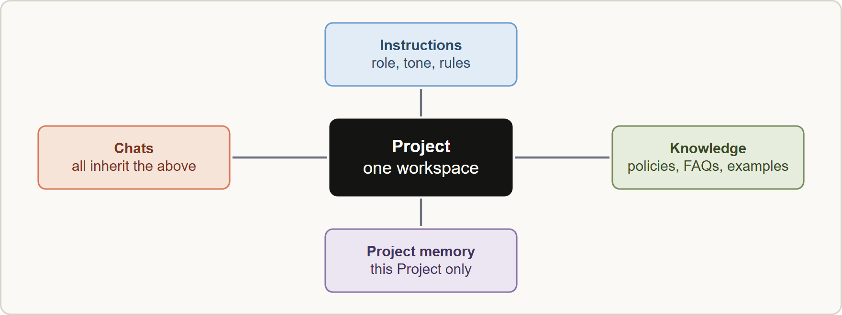
What a Project Is, continued
Module 11
A Project holds instructions, knowledge and its own memory, and every chat inside it uses them
Claude Associate Foundations Exam Prep | for the CCAO-F exam
Module 11: Projects: Instructions and Knowledge
5 / 27
Notes:
What a Project Is, continued.
The figure shows this: A Project holds instructions, knowledge and its own memory, and every chat inside it uses them.

Slide 6
What a Project Is, continued
Module 11
Part | What it is | Typical content
Project instructions | Standing guidance applied to all chats in the Project | Role, audience, tone, format, rules, how to handle uncertainty
Knowledge | Uploaded files and text Claude can use as background | Policies, FAQs, product sheets, style guides, templates, examples
Chats | Conversations that inherit the above | Daily tasks
Project memory | Memory kept for this Project only | Learned preferences of this work
Projects are available to all users, including free accounts, with a limit of five Projects on free plans.
Claude Associate Foundations Exam Prep | for the CCAO-F exam
Module 11: Projects: Instructions and Knowledge
6 / 27
Notes:
What a Project Is, continued.
Project instructions. What it is: Standing guidance applied to all chats in the Project. Typical content: Role, audience, tone, format, rules, how to handle uncertainty.
Knowledge. What it is: Uploaded files and text Claude can use as background. Typical content: Policies, F A Q s, product sheets, style guides, templates, examples.
Chats. What it is: Conversations that inherit the above. Typical content: Daily tasks.
Project memory. What it is: Memory kept for this Project only. Typical content: Learned preferences of this work.
Projects are available to all users, including free accounts, with a limit of five Projects on free plans.

Slide 7
What a Project Is, continued
Module 11
Why use a Project: consistency, no re-pasting, shared context for a team, and less usage because project content is cached and reused.
Team and Enterprise: Projects can be shared with specific people or the organization. Can view = see contents and chat but not edit; Can edit = change instructions and knowledge and manage members. Owners can turn sharing off.
EXAM TIP If the same background is needed again and again, the answer is a Project (instructions plus knowledge), not longer prompts.
Claude Associate Foundations Exam Prep | for the CCAO-F exam
Module 11: Projects: Instructions and Knowledge
7 / 27
Notes:
What a Project Is, continued.
Why use a Project: consistency, no re-pasting, shared context for a team, and less usage because project content is cached and reused.
Team and Enterprise: Projects can be shared with specific people or the organization. Can view equals see contents and chat but not edit; Can edit equals change instructions and knowledge and manage members. Owners can turn sharing off.
Exam tip: If the same background is needed again and again, the answer is a Project (instructions plus knowledge), not longer prompts.

Slide 8
Writing Effective Instructions
Module 11
Project instructions work like a briefing for a new colleague who starts every chat with no memory. They are the "system-level" layer: they apply before your message.
Claude Associate Foundations Exam Prep | for the CCAO-F exam
Module 11: Projects: Instructions and Knowledge
8 / 27
Notes:
Writing Effective Instructions.
Project instructions work like a briefing for a new colleague who starts every chat with no memory. They are the "system-level" layer: they apply before your message.

Slide 9
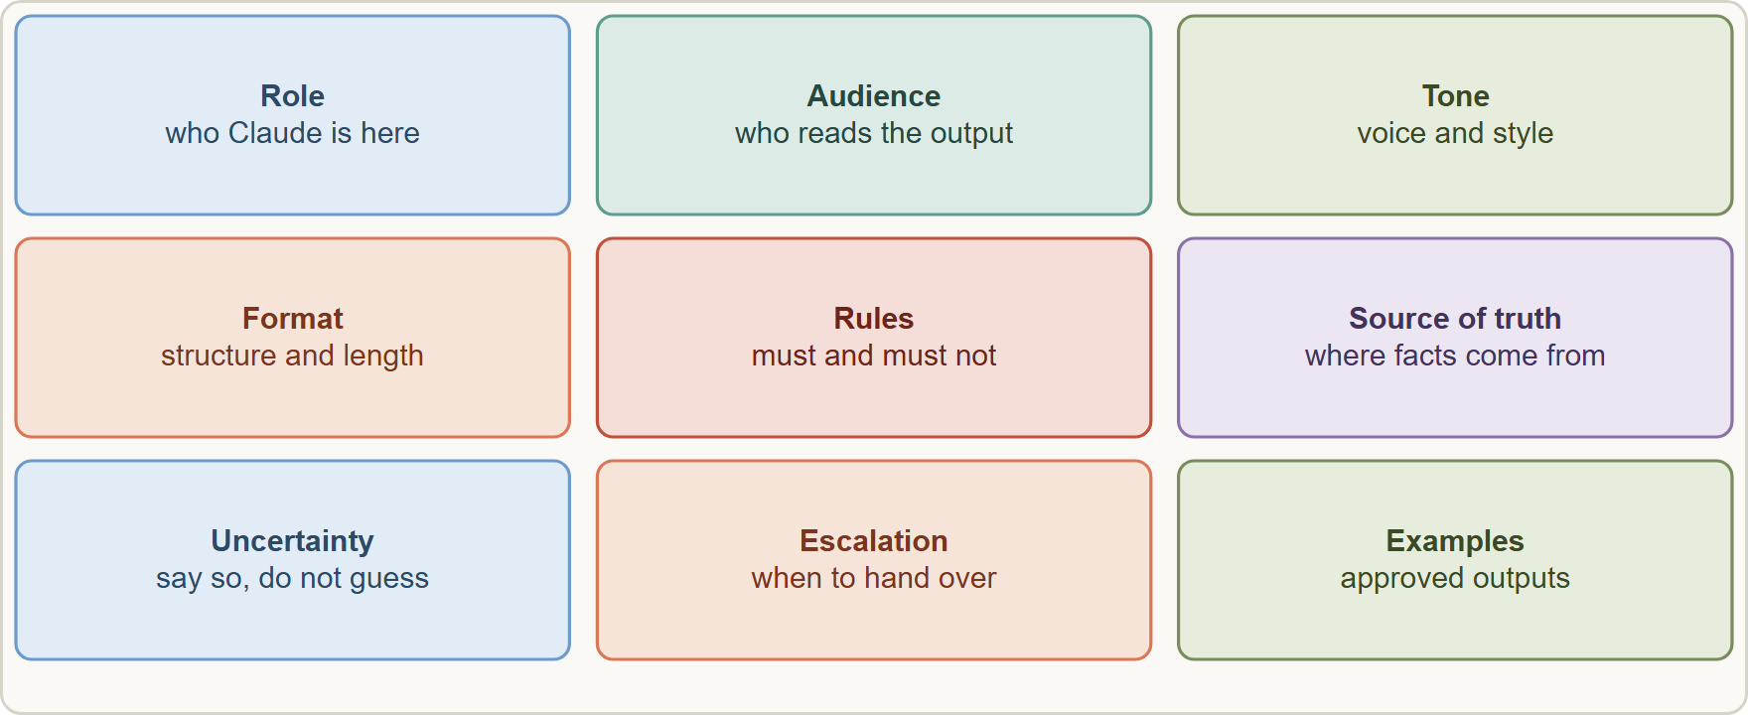
Writing Effective Instructions, continued
Module 11
A strong instruction set names the role, audience, goals, tone, format, rules, how to handle uncertainty, when to escalate, and gives examples
Claude Associate Foundations Exam Prep | for the CCAO-F exam
Module 11: Projects: Instructions and Knowledge
9 / 27
Notes:
Writing Effective Instructions, continued.
The figure shows this: A strong instruction set names the role, audience, goals, tone, format, rules, how to handle uncertainty, when to escalate, and gives examples.

Slide 10
Writing Effective Instructions, continued
Module 11
Part | What to write | Example
Role and purpose | Who Claude is here and for what | "You help Cedarbrook customer-care agents draft replies to customers"
Audience | Who reads the output | "Customers aged 25 to 65, non-technical"
Tone and style | Voice with a short example | "Warm, direct, no jargon; see example replies in knowledge"
Format | Structure and length | "Under 120 words; greeting, answer, next step"
Rules | Must and must not | "Never promise refunds over $200; never share other customers' data"
Source of truth | Where facts come from | "Use the returns policy file; if it is silent, say so"
Claude Associate Foundations Exam Prep | for the CCAO-F exam
Module 11: Projects: Instructions and Knowledge
10 / 27
Notes:
Writing Effective Instructions, continued.
Role and purpose. What to write: Who Claude is here and for what. Example: "You help Cedarbrook customer-care agents draft replies to customers".
Audience. What to write: Who reads the output. Example: "Customers aged twenty-five to sixty-five, non-technical".
Tone and style. What to write: Voice with a short example. Example: "Warm, direct, no jargon; see example replies in knowledge".
Format. What to write: Structure and length. Example: "Under one hundred twenty words; greeting, answer, next step".
Rules. What to write: Must and must not. Example: "Never promise refunds over two hundred dollars; never share other customers' data".
Source of truth. What to write: Where facts come from. Example: "Use the returns policy file; if it is silent, say so".

Slide 11
Writing Effective Instructions, continued
Module 11
Part | What to write | Example
Uncertainty | What to do when unsure | "Say you are not sure and recommend a supervisor"
Escalation | When to hand over | "Complaints about safety go to a manager immediately"
Examples | One or two good outputs | "See the three approved replies in knowledge"
Good practice
Be specific and explain why ("Keep replies short because agents read them on a phone")
Use clear sections or bullet points, not one long paragraph
Keep instructions short and focused: long instructions use up context; put task-specific instructions in the chat instead
State what Claude should do when information is missing
Claude Associate Foundations Exam Prep | for the CCAO-F exam
Module 11: Projects: Instructions and Knowledge
11 / 27
Notes:
Writing Effective Instructions, continued.
Uncertainty. What to write: What to do when unsure. Example: "Say you are not sure and recommend a supervisor".
Escalation. What to write: When to hand over. Example: "Complaints about safety go to a manager immediately".
Examples. What to write: One or two good outputs. Example: "See the three approved replies in knowledge".
Good practice.
Be specific and explain why ("Keep replies short because agents read them on a phone").
Use clear sections or bullet points, not one long paragraph.
Keep instructions short and focused: long instructions use up context; put task-specific instructions in the chat instead.
State what Claude should do when information is missing.

Slide 12
Writing Effective Instructions, continued
Module 11
Test with real examples, including awkward ones; revise after seeing results
Version and date the instructions and name an owner (Module 12)
Do not place sensitive data, passwords or personal details in instructions or knowledge unless policy allows it (Module 13)
EXAM TIP Strong instructions state role, audience, format, rules, source of truth, uncertainty behavior and escalation. A one-line "be helpful" is a weak answer.
Claude Associate Foundations Exam Prep | for the CCAO-F exam
Module 11: Projects: Instructions and Knowledge
12 / 27
Notes:
Writing Effective Instructions, continued.
Test with real examples, including awkward ones; revise after seeing results.
Version and date the instructions and name an owner (Module twelve).
Do not place sensitive data, passwords or personal details in instructions or knowledge unless policy allows it (Module thirteen).
Exam tip: Strong instructions state role, audience, format, rules, source of truth, uncertainty behavior and escalation. A one-line "be helpful" is a weak answer.

Slide 13
Choosing and Organizing Knowledge
Module 11
Upload what Claude needs repeatedly: policies, FAQs, product sheets, style guides, templates, examples of good outputs.
Quality over quantity. Out-of-date, duplicated or contradictory files confuse answers. Remove files you no longer need.
Use clear, descriptive filenames (for example, Returns-Policy-current.pdf) and group related documents in the same Project.
Reference documents by name in your questions: "According to the Returns Policy, ..."
Limits: project files are limited to about 30 MB each, with text extracted (except for PDFs that include visuals). Total content must fit the context window unless RAG is on.
Claude Associate Foundations Exam Prep | for the CCAO-F exam
Module 11: Projects: Instructions and Knowledge
13 / 27
Notes:
Choosing and Organizing Knowledge.
Upload what Claude needs repeatedly: policies, F A Q s, product sheets, style guides, templates, examples of good outputs.
Quality over quantity. Out-of-date, duplicated or contradictory files confuse answers. Remove files you no longer need.
Use clear, descriptive filenames (for example, Returns-Policy-current.pdf) and group related documents in the same Project.
Reference documents by name in your questions: "According to the Returns Policy,...".
Limits: project files are limited to about thirty megabytes each, with text extracted (except for P D F s that include visuals). Total content must fit the context window unless R A G is on.

Slide 14
Choosing and Organizing Knowledge, continued
Module 11
Google Docs from Drive can be added to a Project and stay in sync (private Projects) (Module 12).
Files in the Project are cached; reuse costs less usage. Caches expire after inactivity.
Retrieval augmented generation (RAG)
Claude Associate Foundations Exam Prep | for the CCAO-F exam
Module 11: Projects: Instructions and Knowledge
14 / 27
Notes:
Choosing and Organizing Knowledge, continued.
Google Docs from Drive can be added to a Project and stay in sync (private Projects) (Module twelve).
Files in the Project are cached; reuse costs less usage. Caches expire after inactivity.
Retrieval augmented generation (R A G).

Slide 15
Choosing and Organizing Knowledge, continued
Module 11
Feature | Detail
What it does | When knowledge nears the context limit, Claude retrieves only the relevant parts with a project knowledge search tool instead of loading everything
Capacity | Up to about 10 times more content
Availability | Paid plans; automatic; shown by an indicator
Control | You cannot switch it manually; Claude uses in-context processing when possible
Quality | Designed to keep response quality and speed
Best practices | Upload relevant content upfront, clear filenames, related documents together, reference documents by name
Claude Associate Foundations Exam Prep | for the CCAO-F exam
Module 11: Projects: Instructions and Knowledge
15 / 27
Notes:
Choosing and Organizing Knowledge, continued.
What it does. When knowledge nears the context limit, Claude retrieves only the relevant parts with a project knowledge search tool instead of loading everything.
Capacity. Up to about ten times more content.
Availability. Paid plans; automatic; shown by an indicator.
Control. You cannot switch it manually; Claude uses in-context processing when possible.
Quality. Designed to keep response quality and speed.
Best practices. Upload relevant content upfront, clear filenames, related documents together, reference documents by name.

Slide 16
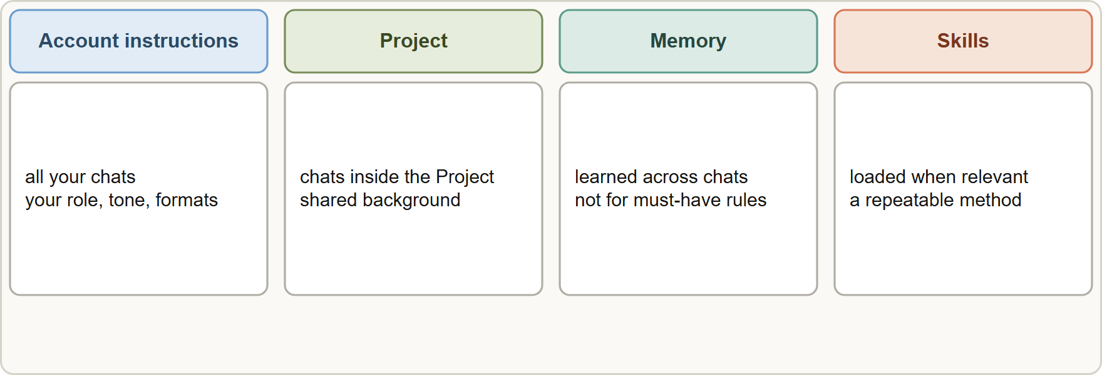
Projects Compared with Other Context Tools
Module 11
Account instructions apply everywhere, Project instructions only inside the Project, memory learns from chats, and Skills load only when a task needs them
Claude Associate Foundations Exam Prep | for the CCAO-F exam
Module 11: Projects: Instructions and Knowledge
16 / 27
Notes:
Projects Compared with Other Context Tools.
The figure shows this: Account instructions apply everywhere, Project instructions only inside the Project, memory learns from chats, and Skills load only when a task needs them.

Slide 17
Projects Compared with Other Context Tools, continued
Module 11
Tool | Scope | Best for
Instructions for Claude (account) | All your chats | Personal preferences: your role, tone, formats
Project instructions and knowledge | Chats inside that Project | A body of work with shared background
Memory | Learned across chats (separate per Project) | Continuity; not for must-have rules
Skills | Loaded only when relevant | A repeatable method or format (Module 12)
Styles | The tone and format of replies | Writing style
EXAM TIP Put standing context in the Project and keep the instructions short and specific; move one-off details into the chat.
Claude Associate Foundations Exam Prep | for the CCAO-F exam
Module 11: Projects: Instructions and Knowledge
17 / 27
Notes:
Projects Compared with Other Context Tools, continued.
Instructions for Claude (account). Scope: All your chats. Best for: Personal preferences: your role, tone, formats.
Project instructions and knowledge. Scope: Chats inside that Project. Best for: A body of work with shared background.
Memory. Scope: Learned across chats (separate per Project). Best for: Continuity; not for must-have rules.
Skills. Scope: Loaded only when relevant. Best for: A repeatable method or format (Module twelve).
Styles. Scope: The tone and format of replies. Best for: Writing style.
Exam tip: Put standing context in the Project and keep the instructions short and specific; move one-off details into the chat.

Slide 18
Module Recap
Module 11
1
Project
2
Free plan
3
Instructions
Workspace with instructions, knowledge, chats and its own memory
Up to five Projects
Role · audience · tone · format · rules · source of truth · uncertainty · escalation · examples
4
Style of instructions
5
Knowledge
6
RAG
Current, clean, clearly named, grouped; remove stale files; about 30 MB per file
Automatic on paid plans near the limit; up to about 10x; retrieves relevant parts
Specific, explain why, sectioned, short; test and revise
7
Sharing
8
Do not store
9
Compare
Team and Enterprise: Can view vs Can edit
Sensitive personal data or secrets unless policy allows
Account instructions (all chats) · Project (inside) · memory (learned) · Skills (when relevant)
Claude Associate Foundations Exam Prep | for the CCAO-F exam
Module 11: Projects: Instructions and Knowledge
18 / 27
Notes:
Here is the recap.
Project: Workspace with instructions, knowledge, chats and its own memory.
Free plan: Up to five Projects.
Instructions: Role, audience, tone, format, rules, source of truth, uncertainty, escalation, examples.
Style of instructions: Specific, explain why, sectioned, short; test and revise.
Knowledge: Current, clean, clearly named, grouped; remove stale files; about thirty megabytes per file.
R A G: Automatic on paid plans near the limit; up to about ten times; retrieves relevant parts.
Sharing: Team and Enterprise: Can view versus Can edit.
Do not store: Sensitive personal data or secrets unless policy allows.
Compare: Account instructions (all chats), Project (inside), memory (learned), Skills (when relevant).

Slide 19
Practice Question 1
Module 11
Q1
Customer care agents paste the same policy summary into every chat. What is the best fix?
A
Create a Project with the policy in knowledge and the rules in instructions
B
Email the policy to Claude
C
Use a shorter policy
D
Keep pasting it
Claude Associate Foundations Exam Prep | for the CCAO-F exam
Module 11: Projects: Instructions and Knowledge
19 / 27
Notes:
Question one.
Customer care agents paste the same policy summary into every chat. What is the best fix?
The four options are on the screen.
[PAUSE 12]
The answer is A. A Project provides standing instructions and knowledge to every chat.

Slide 20
Practice Question 2
Module 11
Q2
Which Project instruction is most effective?
A
You draft replies for Cedarbrook agents in a warm, direct tone, under 120 words, using the Returns Policy file; if it does not cover a point, say so.
B
Answer every question that customers ask, in as much detail as possible, and never tell them that you are unsure or that something is not covered by the policy.
C
"Be helpful."
D
"Never refuse anything."
Claude Associate Foundations Exam Prep | for the CCAO-F exam
Module 11: Projects: Instructions and Knowledge
20 / 27
Notes:
Question two.
Which Project instruction is most effective?
The four options are on the screen.
[PAUSE 12]
The answer is A. It states role, tone, format, source of truth and uncertainty behavior.

Slide 21
Practice Question 3
DATES
Module 11
Q3
A Project contains an outdated 2023 policy next to the current one, and answers sometimes contradict each other. What should the owner do?
A
Tell Claude to ignore all of the policies and answer from general knowledge instead
B
Add a third copy of the policy file so that Claude has more versions to choose from
C
Delete the Project
D
Remove or replace the outdated file and keep clear, current filenames
Claude Associate Foundations Exam Prep | for the CCAO-F exam
Module 11: Projects: Instructions and Knowledge
21 / 27
Notes:
Question three.
A Project contains an outdated two thousand twenty-three policy next to the current one, and answers sometimes contradict each other. What should the owner do?
The four options are on the screen.
[PAUSE 12]
The answer is D. Out-of-date or conflicting knowledge produces inconsistent answers, so the owner should keep only the current, clearly named version.

Slide 22
Practice Question 4
Module 11
Q4
A Project's knowledge is large and nears the context limit. On a paid plan, what happens?
A
Uploads stop permanently and the Project can no longer accept any new files, instructions or members at all
B
RAG can turn on automatically, retrieving only the relevant parts and holding up to about 10 times more
C
The Project closes
D
Claude deletes files
Claude Associate Foundations Exam Prep | for the CCAO-F exam
Module 11: Projects: Instructions and Knowledge
22 / 27
Notes:
Question four.
A Project's knowledge is large and nears the context limit. On a paid plan, what happens?
The four options are on the screen.
[PAUSE 12]
The answer is B. Retrieval augmented generation turns on automatically on paid plans and retrieves only the relevant parts, extending capacity by about ten times.

Slide 23
Practice Question 5
Module 11
Q5
Which statement about project instructions versus account instructions is correct?
A
Account instructions only work in Projects
B
Project instructions apply to every chat in your account, and account instructions apply only inside Projects
C
They are identical
D
Project instructions apply to chats inside that Project; account instructions apply to all your chats
Claude Associate Foundations Exam Prep | for the CCAO-F exam
Module 11: Projects: Instructions and Knowledge
23 / 27
Notes:
Question five.
Which statement about project instructions versus account instructions is correct?
The four options are on the screen.
[PAUSE 12]
The answer is D. Account instructions apply to all your chats, while project instructions apply only inside that Project, so scope is the difference.

Slide 24
Practice Question 6
Module 11
Q6
Which TWO should NOT be stored in Project instructions or knowledge without approval? (Select TWO.)
A
Brand tone guidelines
B
Customer personal data covered by privacy policy
C
Approved reply examples
D
Return policy summary
E
Passwords or API keys
Claude Associate Foundations Exam Prep | for the CCAO-F exam
Module 11: Projects: Instructions and Knowledge
24 / 27
Notes:
Question six. Select two.
Which two should not be stored in Project instructions or knowledge without approval?
The five options are on the screen.
[PAUSE 15]
The answers are B and E. Personal data and secrets do not belong there unless policy explicitly allows it.

Slide 25
Practice Question 7
Module 11
Q7
A teammate with "Can view" access to a shared Project tries to change the instructions. What happens?
A
They cannot; "Can edit" access is needed to modify instructions and knowledge
B
They can edit freely
C
The Project is deleted
D
Instructions are changed automatically
Claude Associate Foundations Exam Prep | for the CCAO-F exam
Module 11: Projects: Instructions and Knowledge
25 / 27
Notes:
Question seven.
A teammate with "Can view" access to a shared Project tries to change the instructions. What happens?
The four options are on the screen.
[PAUSE 12]
The answer is A. Can view lets people read and chat, not edit.

Slide 26
Practice Question 8
Module 11
Q8
Why keep Project instructions short and move task-specific details into the chat?
A
Claude dislikes long text and will stop reading instructions after a few lines
B
Instructions are ignored when they have headings or bullet points in them
C
Chats cannot be long
D
Long instructions use up context and can crowd out the task
Claude Associate Foundations Exam Prep | for the CCAO-F exam
Module 11: Projects: Instructions and Knowledge
26 / 27
Notes:
Question eight.
Why keep Project instructions short and move task-specific details into the chat?
The four options are on the screen.
[PAUSE 12]
The answer is D. Concise, focused instructions save context and usage, while task-specific details can be given in the chat where they are needed.

Slide 27
Answers at a Glance
Module 11
Question | Answer | Why
Q1 | A | A Project provides standing instructions and knowledge to every chat
Q2 | A | It states role, tone, format, source of truth and uncertainty behavior
Q3 | D | Out-of-date or conflicting knowledge produces inconsistent answers
Q4 | B | Retrieval augmented generation turns on automatically on paid plans and retrieves
Q5 | D | Account instructions apply to all your chats
Q6 | B, E | Personal data and secrets do not belong there unless policy explicitly
Q7 | A | Can view lets people read and chat, not edit
Q8 | D | Concise, focused instructions save context and usage, while task-specific details can
Claude Associate Foundations Exam Prep | for the CCAO-F exam
Module 11: Projects: Instructions and Knowledge
27 / 27
Notes:
Here are all eight answers. Question one: A. Question two: A. Question three: D. Question four: B. Question five: D. Question six: B and E. Question seven: A. Question eight: D.
In the next module, we continue the course.

