Slide 1
Module 12: Connectors, Skills and Keeping Configurations Current
What connectors are and what Google Drive, Gmail and Calendar connectors can do
Domain 5 · Configuration and Knowledge Management
Claude Associate Foundations Exam Prep Masterclass
Module 12 · Part 1
Notes:
Welcome to Module twelve: Connectors, Skills and Keeping Configurations Current. This module covers connectors, skills and keeping configurations current.
Each part of this module comes from the study notes of the same name, so you can read the notes after you watch.

Slide 2
What You Will Learn
Part 1
What connectors are and what Google Drive, Gmail and Calendar connectors can do
The difference between web connectors, desktop extensions and custom connectors
How permissions and approvals protect you
What Skills are and when to use them
How to maintain and update Projects, knowledge and instructions over time
Claude Associate Foundations Exam Prep | for the CCAO-F exam
Module 12
2 / 30
Notes:
By the end of this module you will be able to do five things.
What connectors are and what Google Drive, Gmail and Calendar connectors can do.
The difference between web connectors, desktop extensions and custom connectors.
How permissions and approvals protect you.
What Skills are and when to use them.
How to maintain and update Projects, knowledge and instructions over time.

Slide 3
Case Check-In: Cedarbrook's Weekly Digest
Part 1
CASE CHECK-IN · Cedarbrook Outfitters
A project manager wants Claude to read the latest planning documents in Google Drive, check the calendar for next week's deadlines and draft an email digest
Pasting each document is slow and the files change daily; a connector brings the live content into the chat
Claude Associate Foundations Exam Prep | for the CCAO-F exam
Module 12
3 / 30
Notes:
Our running case is Cedarbrook Outfitters. Cedarbrook's Weekly Digest.
A project manager wants Claude to read the latest planning documents in Google Drive, check the calendar for next week's deadlines and draft an email digest.
Pasting each document is slow and the files change daily; a connector brings the live content into the chat.

Slide 4
Connectors
Part 1
A connector lets Claude access your apps and services, retrieve data and, with approval, take actions. Claude works within your own permissions: it can only reach content you could open yourself.
Claude Associate Foundations Exam Prep | for the CCAO-F exam
Module 12
4 / 30
Notes:
Connectors.
A connector lets Claude access your apps and services, retrieve data and, with approval, take actions. Claude works within your own permissions: it can only reach content you could open yourself.

Slide 5
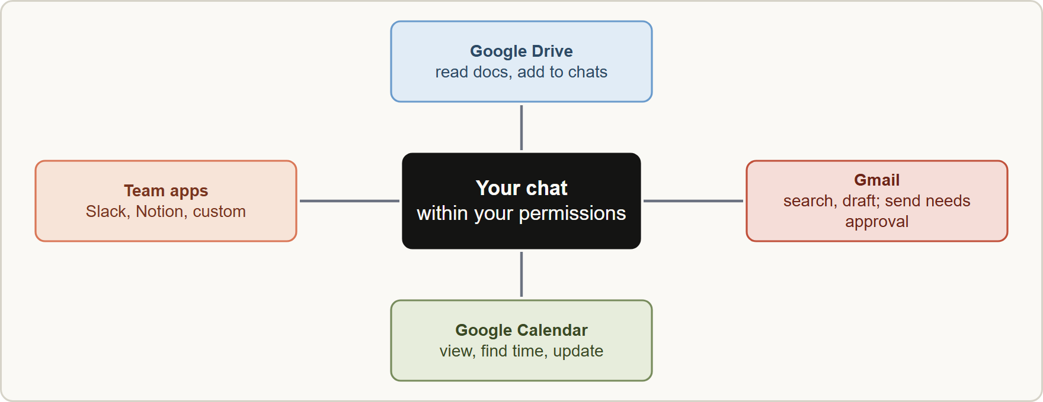
Connectors, continued
Part 1
Connectors give Claude access to your apps within your permissions, with approvals for actions that change things
Claude Associate Foundations Exam Prep | for the CCAO-F exam
Module 12
5 / 30
Notes:
Connectors, continued.
The figure shows this: Connectors give Claude access to your apps within your permissions, with approvals for actions that change things.

Slide 6
Connectors, continued
Part 1
Type | What it is | Where it runs
Web (remote) connectors | Cloud services you sign into: Google Workspace, Slack, Notion, GitHub, company apps | In the cloud; works on web, desktop and mobile; the default choice
Desktop extensions | Tools that run on your computer | Claude Desktop only; for local files, local databases, OS-level access
Custom connectors | Any service that supports MCP, added by URL | Needs a public address; only connect servers you trust; Free plans may have only one
Google Workspace connectors
Claude Associate Foundations Exam Prep | for the CCAO-F exam
Module 12
6 / 30
Notes:
Connectors, continued.
Web (remote) connectors. What it is: Cloud services you sign into: Google Workspace, Slack, Notion, Git Hub, company apps. Where it runs: In the cloud; works on web, desktop and mobile; the default choice.
Desktop extensions. What it is: Tools that run on your computer. Where it runs: Claude Desktop only; for local files, local databases, O S-level access.
Custom connectors. What it is: Any service that supports M C P (Model Context Protocol), added by U R L (uniform resource locator). Where it runs: Needs a public address; only connect servers you trust; Free plans may have only one.
Google Workspace connectors.

Slide 7
Connectors, continued
Part 1
Connector | Claude can | Needs approval by default
Gmail | Search and read email, draft, manage labels; attachments: metadata only | Send, reply, forward
Google Calendar | View events, find free time, create and update events, respond to invitations | Changes to events (per your settings)
Google Drive | Search and read Docs, Sheets, Slides, PDFs; add Docs to chats and (private) Projects; save generated files | Share, move, trash
Each action requires your explicit approval by default; users can disable individual tools; admins on Team and Enterprise decide what can run without approval.
Responses cite the emails, events or documents used.
Claude Associate Foundations Exam Prep | for the CCAO-F exam
Module 12
7 / 30
Notes:
Connectors, continued.
Gmail. Claude can: Search and read email, draft, manage labels; attachments: metadata only. Needs approval by default: Send, reply, forward.
Google Calendar. Claude can: View events, find free time, create and update events, respond to invitations. Needs approval by default: Changes to events (per your settings).
Google Drive. Claude can: Search and read Docs, Sheets, Slides, P D F s; add Docs to chats and (private) Projects; save generated files. Needs approval by default: Share, move, trash.
Each action requires your explicit approval by default; users can disable individual tools; admins on Team and Enterprise decide what can run without approval.
Responses cite the emails, events or documents used.

Slide 8
Connectors, continued
Part 1
Added Google Docs sync: if the document changes, the chat or Project sees the update.
Data handling: retrieved data is tied to its chat and is deleted with the chat; Anthropic does not train its models on Gmail, Drive or Calendar connector data; data is encrypted.
Team and Enterprise: an owner must enable a connector for the organization, but each user still signs in individually; owners can set tool actions to Always allow, Needs approval or Blocked.
EXAM TIP A connector gives Claude your access, not extra access. If you cannot open a file, neither can Claude; and actions that send or change things ask for approval first.
Claude Associate Foundations Exam Prep | for the CCAO-F exam
Module 12
8 / 30
Notes:
Connectors, continued.
Added Google Docs sync: if the document changes, the chat or Project sees the update.
Data handling: retrieved data is tied to its chat and is deleted with the chat; Anthropic does not train its models on Gmail, Drive or Calendar connector data; data is encrypted.
Team and Enterprise: an owner must enable a connector for the organization, but each user still signs in individually; owners can set tool actions to Always allow, Needs approval or Blocked.
Exam tip: A connector gives Claude your access, not extra access. If you cannot open a file, neither can Claude; and actions that send or change things ask for approval first.

Slide 9
Managing Connectors and Knowledge Well
Part 1
Task | How
Add | Customize > Connectors, or the "+" menu in a chat; review the access requested; sign in
Turn on per chat | Use the toggles in the Connectors menu; only enable what the task needs
Tool access mode | Auto (default: Claude loads what it needs), Always available (all connectors loaded; for fewer than 10 you use constantly), On demand (loaded when needed; for 10 or more)
Reduce clutter | Each connector uses conversation space and usage; turn off what you do not need
Remove | Disconnect services you no longer use
Fix a broken link | Disconnect and reconnect from Customize > Connectors
Claude Associate Foundations Exam Prep | for the CCAO-F exam
Module 12
9 / 30
Notes:
Managing Connectors and Knowledge Well.
Add. Customize greater than Connectors, or the " plus " menu in a chat; review the access requested; sign in.
Turn on per chat. Use the toggles in the Connectors menu; only enable what the task needs.
Tool access mode. Auto (default: Claude loads what it needs), Always available (all connectors loaded; for fewer than ten you use constantly), On demand (loaded when needed; for ten or more).
Reduce clutter. Each connector uses conversation space and usage; turn off what you do not need.
Remove. Disconnect services you no longer use.
Fix a broken link. Disconnect and reconnect from Customize greater than Connectors.

Slide 10
Managing Connectors and Knowledge Well, continued
Part 1
Task | How
Check approvals | Read the approval request before accepting an action that sends, shares or deletes
 | Uploaded file
Freshness | A snapshot at upload time
Control | You decide exactly what Claude sees
Best for | Stable documents (policies, guides)
Risk | Goes stale
Uploaded knowledge versus a connector
Do not connect sources you do not need. Broader access means more places for sensitive data to enter a chat (Module 13).
Claude Associate Foundations Exam Prep | for the CCAO-F exam
Module 12
10 / 30
Notes:
Managing Connectors and Knowledge Well, continued.
Check approvals. Read the approval request before accepting an action that sends, shares or deletes.
Uploaded knowledge versus a connector.
Freshness. Uploaded file: A snapshot at upload time. Connector (live source): Current content (synced Docs).
Control. Uploaded file: You decide exactly what Claude sees. Connector (live source): Claude can search what you can access.
Best for. Uploaded file: Stable documents (policies, guides). Connector (live source): Frequently changing documents, email and calendar.
Risk. Uploaded file: Goes stale. Connector (live source): Broad access: keep scope narrow.
Do not connect sources you do not need. Broader access means more places for sensitive data to enter a chat (Module thirteen).

Slide 11
Managing Connectors and Knowledge Well, continued
Part 1
Research can use enabled connectors without asking each time; on mobile it may skip them. Check which are on.
Shared chats that use connector content may be restricted by the organization's settings.
Claude Associate Foundations Exam Prep | for the CCAO-F exam
Module 12
11 / 30
Notes:
Managing Connectors and Knowledge Well, continued.
Research can use enabled connectors without asking each time; on mobile it may skip them. Check which are on.
Shared chats that use connector content may be restricted by the organization's settings.

Slide 12
Skills
Part 1
Skills are folders of instructions, scripts and resources that Claude loads dynamically for specialized tasks. They teach Claude a repeatable method, such as "build our weekly report in the company format".
Claude Associate Foundations Exam Prep | for the CCAO-F exam
Module 12
12 / 30
Notes:
Skills.
Skills are folders of instructions, scripts and resources that Claude loads dynamically for specialized tasks. They teach Claude a repeatable method, such as "build our weekly report in the company format".

Slide 13
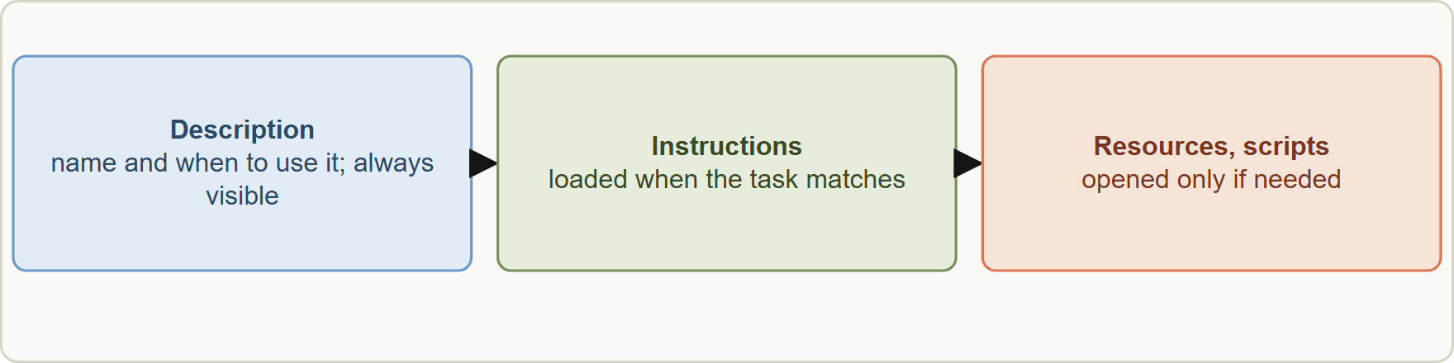
Skills, continued
Part 1
A skill is a folder with a short description that is always visible; the instructions and resources load only when a task needs them
Claude Associate Foundations Exam Prep | for the CCAO-F exam
Module 12
13 / 30
Notes:
Skills, continued.
The figure shows this: A skill is a folder with a short description that is always visible; the instructions and resources load only when a task needs them.

Slide 14
Skills, continued
Part 1
Point | Detail
Progressive loading | Claude sees the short description first and loads the full instructions and files only when relevant, which prevents context overload
Types | Anthropic skills (built-in: Excel, Word, PowerPoint, PDF), custom skills (your own), organization skills (provisioned by Team/Enterprise owners), partner skills
Requirement | Code execution / Create and edit files must be on
Creating | A folder with a skill file that starts with a name and a description (what it does and when to use it); optional extra files; zip it (folder name matches skill name) and upload in Customize > Skills
Claude Associate Foundations Exam Prep | for the CCAO-F exam
Module 12
14 / 30
Notes:
Skills, continued.
Progressive loading. Claude sees the short description first and loads the full instructions and files only when relevant, which prevents context overload.
Types. Anthropic skills (built-in: Excel, Word, Power Point, P D F), custom skills (your own), organization skills (provisioned by Team or Enterprise owners), partner skills.
Requirement. Code execution or Create and edit files must be on.
Creating. A folder with a skill file that starts with a name and a description (what it does and when to use it); optional extra files; zip it (folder name matches skill name) and upload in Customize greater than Skills.

Slide 15
Skills, continued
Part 1
Point | Detail
Good skills | One specific repeatable task, clear instructions, examples, a precise description
Sharing | Custom skills stay private until shared; Team and Enterprise can share or publish with review
Security | Install skills only from trusted sources; review bundled scripts; never put passwords or keys in a skill
 | Gives Claude
Project | Static background knowledge and instructions
Skill | A procedure for a task
Connector | Access to data and tools
Skills vs Projects vs connectors
EXAM TIP Background facts live in a Project; a repeatable method lives in a Skill; live data and actions come through a connector.
Claude Associate Foundations Exam Prep | for the CCAO-F exam
Module 12
15 / 30
Notes:
Skills, continued.
Good skills. One specific repeatable task, clear instructions, examples, a precise description.
Sharing. Custom skills stay private until shared; Team and Enterprise can share or publish with review.
Security. Install skills only from trusted sources; review bundled scripts; never put passwords or keys in a skill.
Skills versus Projects versus connectors.
Project. Gives Claude: Static background knowledge and instructions. Loaded: Always, inside the Project.
Skill. Gives Claude: A procedure for a task. Loaded: Only when relevant, anywhere.
Connector. Gives Claude: Access to data and tools. Loaded: When enabled for the chat.
Exam tip: Background facts live in a Project; a repeatable method lives in a Skill; live data and actions come through a connector.

Slide 16
Keeping Configurations Current
Part 2
Configurations decay: policies change, products launch, people leave. Maintain them like any shared document.
Claude Associate Foundations Exam Prep | for the CCAO-F exam
Module 12
16 / 30
Notes:
Keeping Configurations Current.
Configurations decay: policies change, products launch, people leave. Maintain them like any shared document.

Slide 17
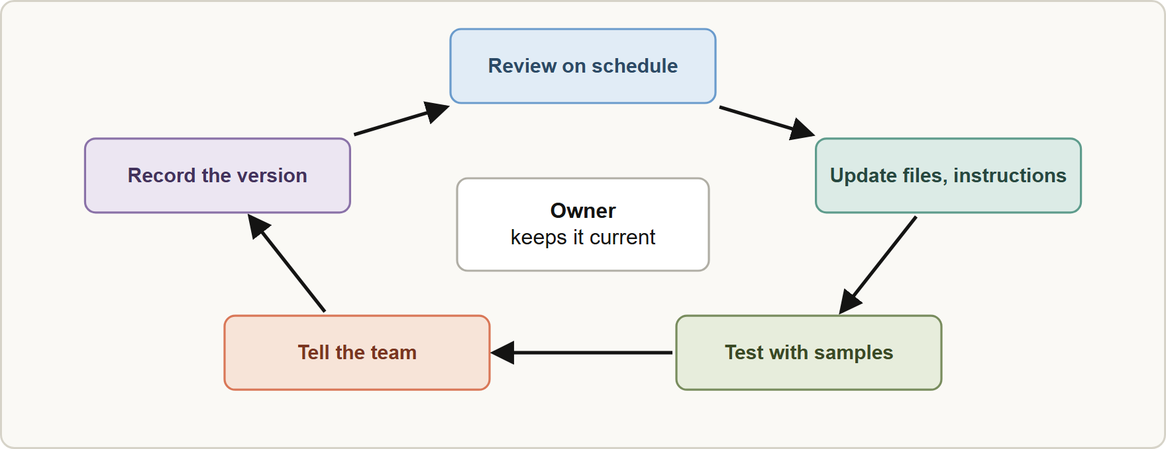
Keeping Configurations Current, continued
Part 2
Keep configurations current: review on a schedule, update, test, inform the team and record the version
Claude Associate Foundations Exam Prep | for the CCAO-F exam
Module 12
17 / 30
Notes:
Keeping Configurations Current, continued.
The figure shows this: Keep configurations current: review on a schedule, update, test, inform the team and record the version.

Slide 18
Keeping Configurations Current, continued
Part 2
Practice | What to do
Name an owner | One person is responsible for each Project, skill and shared prompt
Review on a schedule | For example monthly or whenever a policy changes
Replace, don't pile up | Remove old files; keep one current version; use dates or versions in filenames
Test after changes | Re-run 5 to 10 sample questions, including tricky ones, and compare
Inform the team | Tell users what changed and why; share new best practices
Version and log | Keep a short change log of instructions and knowledge
Claude Associate Foundations Exam Prep | for the CCAO-F exam
Module 12
18 / 30
Notes:
Keeping Configurations Current, continued.
Name an owner. One person is responsible for each Project, skill and shared prompt.
Review on a schedule. For example monthly or whenever a policy changes.
Replace, don't pile up. Remove old files; keep one current version; use dates or versions in filenames.
Test after changes. Re-run five to ten sample questions, including tricky ones, and compare.
Inform the team. Tell users what changed and why; share new best practices.
Version and log. Keep a short change log of instructions and knowledge.

Slide 19
Keeping Configurations Current, continued
Part 2
Practice | What to do
Watch the signals | Complaints, wrong answers and drift tell you what to fix (Module 15)
Mind access | Remove people who left; check sharing levels; review connector scopes
Know where facts live | One source of truth, referenced by the Project, not copied in many places
When a policy changes, update the knowledge and the instructions that mention it, then test.
Features and names change; check the Release notes and Help Center for new capabilities and changes.
If an answer cites an outdated rule, first suspect stale knowledge, then conflicting files, then unclear instructions.
EXAM TIP A connector gives Claude your access, so keep the scope narrow, read approval requests, and disconnect what you no longer use.
Claude Associate Foundations Exam Prep | for the CCAO-F exam
Module 12
19 / 30
Notes:
Keeping Configurations Current, continued.
Watch the signals. Complaints, wrong answers and drift tell you what to fix (Module fifteen).
Mind access. Remove people who left; check sharing levels; review connector scopes.
Know where facts live. One source of truth, referenced by the Project, not copied in many places.
When a policy changes, update the knowledge and the instructions that mention it, then test.
Features and names change; check the Release notes and Help Center for new capabilities and changes.
If an answer cites an outdated rule, first suspect stale knowledge, then conflicting files, then unclear instructions.
Exam tip: A connector gives Claude your access, so keep the scope narrow, read approval requests, and disconnect what you no longer use.

Slide 20
Module Recap
Part 2
1
Connectors
2
Types
3
Google
Claude uses your permissions; approvals for sending, sharing, changing
Web (default) · desktop extensions (local) · custom (MCP, trusted only)
Gmail (attachment metadata only) · Calendar · Drive (docs sync)
4
Data
5
Admins
6
Tool access
Tied to the chat; deleted with it; no training on connector data
Owner enables; each user signs in; Always allow / Needs approval / Blocked
Auto · Always available (fewer than 10) · On demand (10 or more)
7
Skills
8
Compare
9
Maintain
Folders of instructions; load when relevant; need code execution; trusted sources only
Project = background · Skill = procedure · Connector = live data and actions
Owner · schedule · replace stale files · test · tell the team · version
Claude Associate Foundations Exam Prep | for the CCAO-F exam
Module 12
20 / 30
Notes:
Here is the recap.
Connectors: Claude uses your permissions; approvals for sending, sharing, changing.
Types: Web (default), desktop extensions (local), custom (M C P, trusted only).
Google: Gmail (attachment metadata only), Calendar, Drive (docs sync).
Data: Tied to the chat; deleted with it; no training on connector data.
Admins: Owner enables; each user signs in; Always allow or Needs approval or Blocked.
Tool access: Auto, Always available (fewer than ten), On demand (ten or more).
Skills: Folders of instructions; load when relevant; need code execution; trusted sources only.
Compare: Project equals background, Skill equals procedure, Connector equals live data and actions.
Maintain: Owner, schedule, replace stale files, test, tell the team, version.

Slide 21
Practice Question 1
Part 2
Q1
A project manager wants Claude to work with the latest versions of Google Docs that change daily. Which approach fits best?
A
Use the Google Drive connector (or add the Google Docs so they stay in sync)
B
Upload a copy of each document once and never update it afterward, since uploads sync by themselves
C
Paste the documents into every chat
D
Ask Claude to remember them
Claude Associate Foundations Exam Prep | for the CCAO-F exam
Module 12
21 / 30
Notes:
Question one.
A project manager wants Claude to work with the latest versions of Google Docs that change daily. Which approach fits best?
The four options are on the screen.
[PAUSE 12]
The answer is A. A connector reaches current content; static uploads go stale.

Slide 22
Practice Question 2
Part 2
Q2
What can Claude access through the Gmail connector?
A
Only email you have permission to access, and sending requires your approval by default
B
Email content only if you forward it manually, and only the messages that you have already read
C
Any mailbox in the company
D
Everyone's drafts
Claude Associate Foundations Exam Prep | for the CCAO-F exam
Module 12
22 / 30
Notes:
Question two.
What can Claude access through the Gmail connector?
The four options are on the screen.
[PAUSE 12]
The answer is A. Connectors operate within your own permissions, with approval for actions such as sending.

Slide 23
Practice Question 3
Part 2
Q3
A team has twelve connectors enabled and chats hit length limits. What is the best adjustment?
A
Turn off connectors that are not needed and consider on-demand tool access
B
Enable more connectors
C
Delete the Projects
D
Ask Claude to ignore them
Claude Associate Foundations Exam Prep | for the CCAO-F exam
Module 12
23 / 30
Notes:
Question three.
A team has twelve connectors enabled and chats hit length limits. What is the best adjustment?
The four options are on the screen.
[PAUSE 12]
The answer is A. Each connector uses conversation space; keep only what the task needs.

Slide 24
Practice Question 4
Part 2
Q4
Which item belongs in a Skill rather than a Project?
A
The brand logo
B
A repeatable procedure for building the weekly report in the standard format
C
A list of staff birthdays
D
The company's return policy document
Claude Associate Foundations Exam Prep | for the CCAO-F exam
Module 12
24 / 30
Notes:
Question four.
Which item belongs in a Skill rather than a Project?
The four options are on the screen.
[PAUSE 12]
The answer is B. A skill packages a procedure that loads only when relevant.

Slide 25
Practice Question 5
Part 2
Q5
A shared Skill comes from an unknown website. What should you do before enabling it?
A
Enable it immediately
B
Review its files and scripts and use it only if the source is trusted
C
Add your passwords to it
D
Share it with the team first
Claude Associate Foundations Exam Prep | for the CCAO-F exam
Module 12
25 / 30
Notes:
Question five.
A shared Skill comes from an unknown website. What should you do before enabling it?
The four options are on the screen.
[PAUSE 12]
The answer is B. Skills can include scripts; install only from trusted sources and review them.

Slide 26
Practice Question 6
Part 2
Q6
Which TWO are good practices for keeping a Project current? (Select TWO.)
A
Test with sample questions after each update
B
Keep all old versions in knowledge for reference
C
Hide changes from the team
D
Replace outdated files with the current version
E
Never change the instructions
Claude Associate Foundations Exam Prep | for the CCAO-F exam
Module 12
26 / 30
Notes:
Question six. Select two.
Which two are good practices for keeping a Project current?
The five options are on the screen.
[PAUSE 15]
The answers are A and D. Replacing stale material and testing with sample questions after each change keep a Project accurate as policies and products change.

Slide 27
Practice Question 7
Part 2
Q7
After the return window changed from 30 to 14 days, the assistant still says 30. What is the most likely cause?
A
Memory is full and has to be reset before Claude can use the new return window
B
The model is too large and has to be replaced by a smaller one before it can learn
C
Outdated knowledge or a conflicting file or instruction still mentions 30 days
D
Claude is broken
Claude Associate Foundations Exam Prep | for the CCAO-F exam
Module 12
27 / 30
Notes:
Question seven.
After the return window changed from thirty to fourteen days, the assistant still says thirty. What is the most likely cause?
The four options are on the screen.
[PAUSE 12]
The answer is C. When an answer cites an outdated rule, first check the knowledge files and instructions for the old value before suspecting the model.

Slide 28
Practice Question 8
Part 2
Q8
An owner enabled the Google Drive connector for the organization. A new employee opens Claude. What is true?
A
The employee has automatic access to everything that the organization stores in its Drive accounts
B
The employee must still sign in individually and sees only what their own account can access
C
The connector works without sign-in
D
The employee can see other users' files
Claude Associate Foundations Exam Prep | for the CCAO-F exam
Module 12
28 / 30
Notes:
Question eight.
An owner enabled the Google Drive connector for the organization. A new employee opens Claude. What is true?
The four options are on the screen.
[PAUSE 12]
The answer is B. Owners enable connectors, but each user authenticates and keeps their own permissions.

Slide 29
Practice Question 9
Part 2
Q9
Which source is a desktop extension best suited to?
A
A cloud service with a public sign-in
B
A mobile-only app
C
A website
D
A tool that runs on your own computer, such as local files
Claude Associate Foundations Exam Prep | for the CCAO-F exam
Module 12
29 / 30
Notes:
Question nine.
Which source is a desktop extension best suited to?
The four options are on the screen.
[PAUSE 12]
The answer is D. Desktop extensions run on your computer through Claude Desktop, which suits local files and tools that have no cloud version.

Slide 30
Answers at a Glance
Part 2
Question | Answer | Why
Q1 | A | A connector reaches current content
Q2 | A | Connectors operate within your own permissions
Q3 | A | Each connector uses conversation space
Q4 | B | A skill packages a procedure that loads only when
Q5 | B | Skills can include scripts
Q6 | A, D | Replacing stale material and testing with sample questions after
Q7 | C | When an answer cites an outdated rule
Q8 | B | Owners enable connectors, but each user authenticates and keeps
Q9 | D | Desktop extensions run on your computer through Claude Desktop
Claude Associate Foundations Exam Prep | for the CCAO-F exam
Module 12
30 / 30
Notes:
Here are all nine answers. Question one: A. Question two: A. Question three: A. Question four: B. Question five: B. Question six: A and D. Question seven: C. Question eight: B. Question nine: D.
In the next module, we continue the course.

