Slide 1
Module 13: Appropriate Use, Data Sensitivity and Privacy
Which uses of Claude are appropriate, need extra controls, or are not allowed
Domain 6 · Governance, Risk, and Responsible Use
Claude Associate Foundations Exam Prep Masterclass
Module 13 · Part 1
Notes:
Welcome to Module thirteen: Appropriate Use, Data Sensitivity and Privacy. This module covers appropriate use, data sensitivity and privacy.
Each part of this module comes from the study notes of the same name, so you can read the notes after you watch.

Slide 2
What You Will Learn
Part 1
Which uses of Claude are appropriate, need extra controls, or are not allowed
How to classify data and decide what may go into Claude
How to protect privacy: minimize, anonymize, use approved tools and settings
What regulation means for everyday use
Claude Associate Foundations Exam Prep | for the CCAO-F exam
Module 13: Appropriate Use, Data Sensitivity and Privacy
2 / 29
Notes:
By the end of this module you will be able to do four things.
Which uses of Claude are appropriate, need extra controls, or are not allowed.
How to classify data and decide what may go into Claude.
How to protect privacy: minimize, anonymize, use approved tools and settings.
What regulation means for everyday use.

Slide 3
Case Check-In: Cedarbrook's Three Requests
Part 1
CASE CHECK-IN · Cedarbrook Outfitters
Marketing wants Claude to draft a spring campaign
HR wants Claude to rank candidates and send rejections
Finance wants Claude to check a file of raw payment-card details for errors
The first is fine; the second needs a person to decide; the third should not happen as asked
Claude Associate Foundations Exam Prep | for the CCAO-F exam
Module 13: Appropriate Use, Data Sensitivity and Privacy
3 / 29
Notes:
Our running case is Cedarbrook Outfitters. Cedarbrook's Three Requests.
Marketing wants Claude to draft a spring campaign.
H R wants Claude to rank candidates and send rejections.
Finance wants Claude to check a file of raw payment-card details for errors.
The first is fine; the second needs a person to decide; the third should not happen as asked.

Slide 4
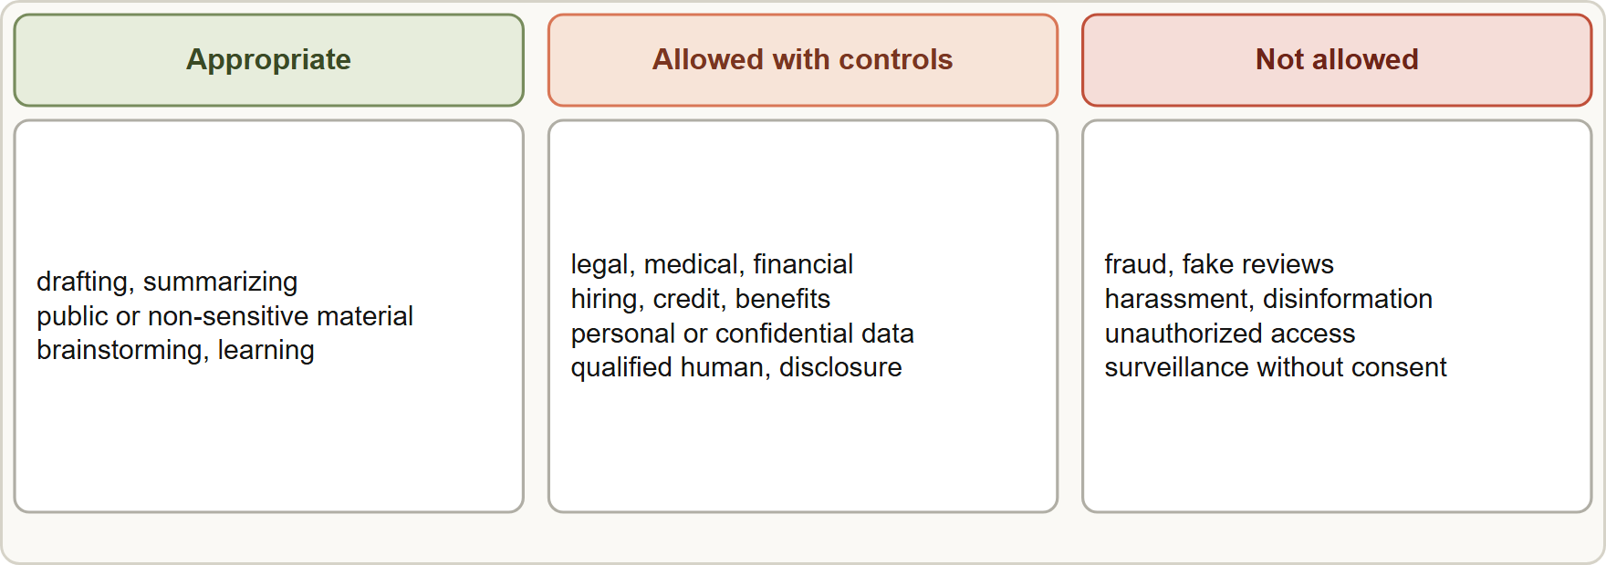
Appropriate and Inappropriate Use Cases
Part 1
Use cases fall into three zones: appropriate, allowed with controls and human review, and not allowed
Claude Associate Foundations Exam Prep | for the CCAO-F exam
Module 13: Appropriate Use, Data Sensitivity and Privacy
4 / 29
Notes:
Appropriate and Inappropriate Use Cases.
The figure shows this: Use cases fall into three zones: appropriate, allowed with controls and human review, and not allowed.

Slide 5
Appropriate and Inappropriate Use Cases, continued
Part 1
Zone | Examples | What to do
Appropriate | Drafting, summarizing public or non-sensitive material, brainstorming, formatting, learning, planning | Use normally; still check accuracy
Allowed with controls | High-risk areas: legal, medical, financial, credit, insurance, housing, employment, education, public benefits; any work with personal or confidential data | Qualified human reviews before delivery or action; tell affected people AI was involved; follow policy; minimize data
Claude Associate Foundations Exam Prep | for the CCAO-F exam
Module 13: Appropriate Use, Data Sensitivity and Privacy
5 / 29
Notes:
Appropriate and Inappropriate Use Cases, continued.
Appropriate. Examples: Drafting, summarizing public or non-sensitive material, brainstorming, formatting, learning, planning. What to do: Use normally; still check accuracy.
Allowed with controls. Examples: High-risk areas: legal, medical, financial, credit, insurance, housing, employment, education, public benefits; any work with personal or confidential data. What to do: Qualified human reviews before delivery or action; tell affected people A I was involved; follow policy; minimize data.

Slide 6
Appropriate and Inappropriate Use Cases, continued
Part 1
Zone | Examples | What to do
Not allowed | Anything that breaks the law or Anthropic's Usage Policy: fraud, phishing, harassment, disinformation, fake reviews, unauthorized access, weapons, sexually explicit content, surveillance or tracking people without consent, misuse of others' private data | Do not do it; report concerns to your policy owner
The Usage Policy also covers deception: artificial activity (sockpuppets, astroturfing, fake reviews), impersonation, and false election or medical claims.
High-risk decisions about people need a human who can change the result; Claude's output is advice, not the decision.
Consumer-facing chatbots must make clear that the user is dealing with AI.
Claude Associate Foundations Exam Prep | for the CCAO-F exam
Module 13: Appropriate Use, Data Sensitivity and Privacy
6 / 29
Notes:
Appropriate and Inappropriate Use Cases, continued.
Not allowed. Examples: Anything that breaks the law or Anthropic's Usage Policy: fraud, phishing, harassment, disinformation, fake reviews, unauthorized access, weapons, sexually explicit content, surveillance or tracking people without consent, misuse of others' private data. What to do: Do not do it; report concerns to your policy owner.
The Usage Policy also covers deception: artificial activity (sockpuppets, astroturfing, fake reviews), impersonation, and false election or medical claims.
High-risk decisions about people need a human who can change the result; Claude's output is advice, not the decision.
Consumer-facing chatbots must make clear that the user is dealing with A I.

Slide 7
Appropriate and Inappropriate Use Cases, continued
Part 1
Ask: Is the purpose lawful and ethical? Is the data allowed? What if the output is wrong? Who is accountable?
EXAM TIP Sort scenarios into the three zones. Legal, medical, hiring, credit and similar decisions are allowed only with qualified human review and disclosure; deception and unauthorized access are not allowed.
Claude Associate Foundations Exam Prep | for the CCAO-F exam
Module 13: Appropriate Use, Data Sensitivity and Privacy
7 / 29
Notes:
Appropriate and Inappropriate Use Cases, continued.
Ask: Is the purpose lawful and ethical? Is the data allowed? What if the output is wrong? Who is accountable?
Exam tip: Sort scenarios into the three zones. Legal, medical, hiring, credit and similar decisions are allowed only with qualified human review and disclosure; deception and unauthorized access are not allowed.

Slide 8
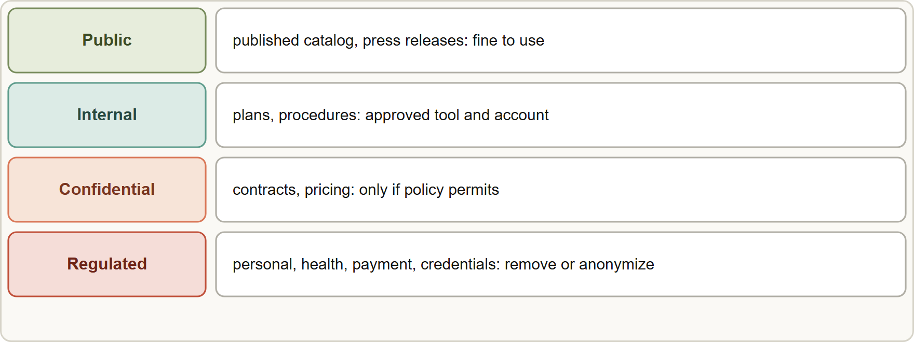
Data Sensitivity
Part 1
A traffic-light view of data sensitivity: public is fine, internal needs the approved tool, confidential and regulated data needs policy approval or must be removed
Claude Associate Foundations Exam Prep | for the CCAO-F exam
Module 13: Appropriate Use, Data Sensitivity and Privacy
8 / 29
Notes:
Data Sensitivity.
The figure shows this: A traffic-light view of data sensitivity: public is fine, internal needs the approved tool, confidential and regulated data needs policy approval or must be removed.

Slide 9
Data Sensitivity, continued
Part 1
Class | Examples | Rule of thumb
Public | Published catalog, press releases | Fine to use
Internal | Draft plans, internal procedures, non-sensitive metrics | Use with approved tools and accounts per policy
Confidential | Contracts, unreleased products, pricing strategy, source code, trade secrets | Only if policy permits and the tool and plan are approved; limit scope
Regulated / sensitive | Personal data (PII): names with account numbers, addresses, IDs; health data (PHI); payment card data; financial account numbers; children's data; credentials and passwords | Do not paste unless policy and the contract explicitly allow it; otherwise remove or anonymize
Claude Associate Foundations Exam Prep | for the CCAO-F exam
Module 13: Appropriate Use, Data Sensitivity and Privacy
9 / 29
Notes:
Data Sensitivity, continued.
Public. Examples: Published catalog, press releases. Rule of thumb: Fine to use.
Internal. Examples: Draft plans, internal procedures, non-sensitive metrics. Rule of thumb: Use with approved tools and accounts per policy.
Confidential. Examples: Contracts, unreleased products, pricing strategy, source code, trade secrets. Rule of thumb: Only if policy permits and the tool and plan are approved; limit scope.
Regulated or sensitive. Examples: Personal data (P I I): names with account numbers, addresses, I Ds; health data (P H I); payment card data; financial account numbers; children's data; credentials and passwords. Rule of thumb: Do not paste unless policy and the contract explicitly allow it; otherwise remove or anonymize.

Slide 10
Data Sensitivity, continued
Part 1
Principles
Data minimization: share only what the task needs.
Anonymize or redact identifiers before upload (replace names with IDs like "Customer 17"; remove account numbers, emails, phone numbers).
Never put passwords, keys or secrets in prompts, Projects, skills or artifacts.
Follow your organization's policy first. Product settings do not override company rules.
Think about third parties: customer, patient and colleague data belongs to people who did not consent to your use.
EXAM TIP When a scenario shows personal data and a restrictive policy, the best answer is to remove or anonymize the identifiers (or use an approved, covered setup) before using Claude. "Tell Claude not to keep it" or "it's only internal" does not satisfy the policy.
Claude Associate Foundations Exam Prep | for the CCAO-F exam
Module 13: Appropriate Use, Data Sensitivity and Privacy
10 / 29
Notes:
Data Sensitivity, continued.
Principles.
Data minimization: share only what the task needs.
Anonymize or redact identifiers before upload (replace names with I Ds like "Customer seventeen"; remove account numbers, emails, phone numbers).
Never put passwords, keys or secrets in prompts, Projects, skills or artifacts.
Follow your organization's policy first. Product settings do not override company rules.
Think about third parties: customer, patient and colleague data belongs to people who did not consent to your use.
Exam tip: When a scenario shows personal data and a restrictive policy, the best answer is to remove or anonymize the identifiers (or use an approved, covered setup) before using Claude. "Tell Claude not to keep it" or "it's only internal" does not satisfy the policy.

Slide 11
Privacy Controls in the Product
Part 1
Topic | What to know
Model training (consumer plans) | On Free, Pro and Max, chats may be used to improve models if you allow it (a Model Improvement setting under privacy settings), or if flagged for safety review; incognito chats are never used. Check the setting yourself
Commercial plans | Team, Enterprise and the API are governed by commercial terms; Anthropic does not train on customer content from these by default. A data processing addendum and, for health data, a business associate agreement for eligible commercial customers are separate contracts
Claude Associate Foundations Exam Prep | for the CCAO-F exam
Module 13: Appropriate Use, Data Sensitivity and Privacy
11 / 29
Notes:
Privacy Controls in the Product.
Model training (consumer plans). On Free, Pro and Max, chats may be used to improve models if you allow it (a Model Improvement setting under privacy settings), or if flagged for safety review; incognito chats are never used. Check the setting yourself.
Commercial plans. Team, Enterprise and the A P I (application programming interface) are governed by commercial terms; Anthropic does not train on customer content from these by default. A data processing addendum and, for health data, a business associate agreement for eligible commercial customers are separate contracts.

Slide 12
Privacy Controls in the Product, continued
Part 1
Topic | What to know
Work vs personal accounts | Use the company-approved account for work data; do not use a personal account for company information
Incognito chat | Not saved to history or memory; but it is still subject to retention for safety (30 days) and to company policy
Memory | Sensitive topics are off by default; some items are never saved; review and delete memory; Team and Enterprise owners cannot read individual memories
Claude Associate Foundations Exam Prep | for the CCAO-F exam
Module 13: Appropriate Use, Data Sensitivity and Privacy
12 / 29
Notes:
Privacy Controls in the Product, continued.
Work versus personal accounts. Use the company-approved account for work data; do not use a personal account for company information.
Incognito chat. Not saved to history or memory; but it is still subject to retention for safety (thirty days) and to company policy.
Memory. Sensitive topics are off by default; some items are never saved; review and delete memory; Team and Enterprise owners cannot read individual memories.

Slide 13
Privacy Controls in the Product, continued
Part 1
Topic | What to know
Shared chats | Sharing creates a link anyone can open; attached files and raw tool data are not included; unshare in Settings; on Team and Enterprise sharing stays inside the organization
Artifacts | Private by default; check whether shared storage is used before entering sensitive information; do not run untrusted artifacts
Connectors | Claude sees only what you can access; keep connected sources narrow; approvals before sending or sharing; connector data is not used for training
Claude Associate Foundations Exam Prep | for the CCAO-F exam
Module 13: Appropriate Use, Data Sensitivity and Privacy
13 / 29
Notes:
Privacy Controls in the Product, continued.
Shared chats. Sharing creates a link anyone can open; attached files and raw tool data are not included; unshare in Settings; on Team and Enterprise sharing stays inside the organization.
Artifacts. Private by default; check whether shared storage is used before entering sensitive information; do not run untrusted artifacts.
Connectors. Claude sees only what you can access; keep connected sources narrow; approvals before sending or sharing; connector data is not used for training.

Slide 14
Privacy Controls in the Product, continued
Part 1
Topic | What to know
Files and code execution | Instructions hidden in untrusted files or sites (prompt injection) could try to make Claude leak conversation data; monitor actions; use files from trusted sources
Web search and fetch | Claude may use your approximate location; it reads public pages; do not paste confidential text into a search
Feedback | Thumbs up or down can store the whole conversation for review and analysis (up to five years, delinked from your ID)
Claude Associate Foundations Exam Prep | for the CCAO-F exam
Module 13: Appropriate Use, Data Sensitivity and Privacy
14 / 29
Notes:
Privacy Controls in the Product, continued.
Files and code execution. Instructions hidden in untrusted files or sites (prompt injection) could try to make Claude leak conversation data; monitor actions; use files from trusted sources.
Web search and fetch. Claude may use your approximate location; it reads public pages; do not paste confidential text into a search.
Feedback. Thumbs up or down can store the whole conversation for review and analysis (up to five years, delinked from your I D).

Slide 15
Regulation and Everyday Use
Part 1
Regulations (for example GDPR and similar privacy laws, HIPAA for health data, rules for payment card data, sector rules, AI laws) apply to how data about people is processed, no matter which tool you use.
The associate's job is not to interpret law but to recognize when regulated data or a high-risk decision is involved, follow the organization's policy, and ask Legal, Privacy or Security when unsure.
Be aware of data residency, retention and contract terms for the account you use; these differ between consumer and commercial plans and across cloud options.
Claude Associate Foundations Exam Prep | for the CCAO-F exam
Module 13: Appropriate Use, Data Sensitivity and Privacy
15 / 29
Notes:
Regulation and Everyday Use.
Regulations (for example G D P R and similar privacy laws, H I P A A for health data, rules for payment card data, sector rules, A I laws) apply to how data about people is processed, no matter which tool you use.
The associate's job is not to interpret law but to recognize when regulated data or a high-risk decision is involved, follow the organization's policy, and ask Legal, Privacy or Security when unsure.
Be aware of data residency, retention and contract terms for the account you use; these differ between consumer and commercial plans and across cloud options.

Slide 16
Regulation and Everyday Use, continued
Part 2
AI-generated content marking: Claude outputs may carry invisible watermarks or content credentials; a mark is a signal, not proof, and a missing mark proves nothing.
Keep a record of how AI was used on important work.
Claude Associate Foundations Exam Prep | for the CCAO-F exam
Module 13: Appropriate Use, Data Sensitivity and Privacy
16 / 29
Notes:
Regulation and Everyday Use, continued.
A I-generated content marking: Claude outputs may carry invisible watermarks or content credentials; a mark is a signal, not proof, and a missing mark proves nothing.
Keep a record of how A I was used on important work.

Slide 17
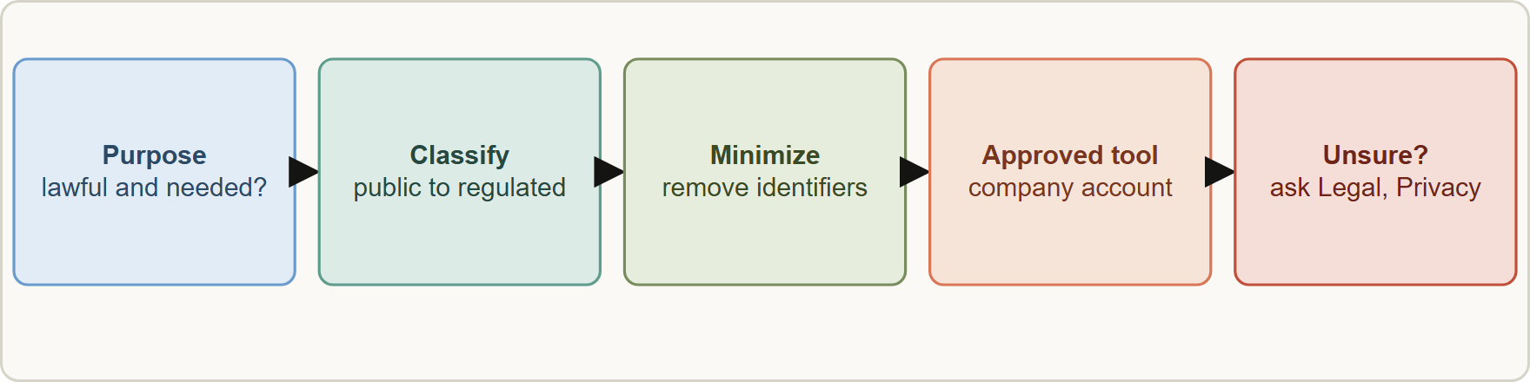
Regulation and Everyday Use, continued
Part 2
Before sharing data with Claude: check purpose, classify the data, minimize or anonymize, use the approved tool and account, and ask Legal or Privacy when unsure
EXAM TIP Sort every scenario into appropriate, allowed with controls, or not allowed, then check the data class before you share anything.
Claude Associate Foundations Exam Prep | for the CCAO-F exam
Module 13: Appropriate Use, Data Sensitivity and Privacy
17 / 29
Notes:
Regulation and Everyday Use, continued.
The figure shows this: Before sharing data with Claude: check purpose, classify the data, minimize or anonymize, use the approved tool and account, and ask Legal or Privacy when unsure.
Exam tip: Sort every scenario into appropriate, allowed with controls, or not allowed, then check the data class before you share anything.

Slide 18
Module Recap
Part 2
1
Three zones
2
High-risk areas
3
Not allowed
Appropriate · allowed with controls and human review · not allowed
Legal, medical, financial, credit, insurance, housing, employment, education, public benefits
Fraud, fake reviews, harassment, disinformation, unauthorized access, surveillance without consent
4
Data classes
5
Rules
6
Not a control
Public · internal · confidential · regulated (PII, PHI, payment, credentials)
Minimize · anonymize or redact · never share secrets · policy first
"Don't retain this" instruction · incognito alone · "it's internal"
7
Accounts
8
Sharing
9
Prompt injection
Company-approved account for work data; commercial terms for business data
Link = anyone can view; unshare in Settings
Untrusted files and sites can carry instructions; monitor
10
Regulation
Recognize, follow policy, ask Legal, Privacy or Security
Claude Associate Foundations Exam Prep | for the CCAO-F exam
Module 13: Appropriate Use, Data Sensitivity and Privacy
18 / 29
Notes:
Here is the recap.
Three zones: Appropriate, allowed with controls and human review, not allowed.
High-risk areas: Legal, medical, financial, credit, insurance, housing, employment, education, public benefits.
Not allowed: Fraud, fake reviews, harassment, disinformation, unauthorized access, surveillance without consent.
Data classes: Public, internal, confidential, regulated (P I I, P H I, payment, credentials).
Rules: Minimize, anonymize or redact, never share secrets, policy first.
Not a control: "Don't retain this" instruction, incognito alone, "it's internal".
Accounts: Company-approved account for work data; commercial terms for business data.
Sharing: Link equals anyone can view; unshare in Settings.
Prompt injection: Untrusted files and sites can carry instructions; monitor.
Regulation: Recognize, follow policy, ask Legal, Privacy or Security.

Slide 19
Practice Question 1
Part 2
Q1
A store manager wants Claude to find the busiest delivery hours from an export of orders that lists each customer's full name, home address and phone number. Company policy restricts personal data in AI tools. What is the best action?
A
Give up on the analysis
B
Strip or replace the personal columns with order numbers, then analyze the reduced data
C
Upload the export as it is because the findings stay inside the company
D
Upload the export and add a line asking Claude to forget it afterward
Claude Associate Foundations Exam Prep | for the CCAO-F exam
Module 13: Appropriate Use, Data Sensitivity and Privacy
19 / 29
Notes:
Question one.
A store manager wants Claude to find the busiest delivery hours from an export of orders that lists each customer's full name, home address and phone number. Company policy restricts personal data in A I tools. What is the best action?
The four options are on the screen.
[PAUSE 12]
The answer is B. Removing the identifiers keeps the analysis possible and satisfies the policy; the other options either breach it or abandon the task unnecessarily.

Slide 20
Practice Question 2
Part 2
Q2
Which request should be refused or stopped?
A
Drafting a campaign plan for the spring catalog with the marketing team
B
Brainstorming product names
C
Summarizing a public report for colleagues who need the key figures quickly
D
Writing fake five-star reviews under invented customer names
Claude Associate Foundations Exam Prep | for the CCAO-F exam
Module 13: Appropriate Use, Data Sensitivity and Privacy
20 / 29
Notes:
Question two.
Which request should be refused or stopped?
The four options are on the screen.
[PAUSE 12]
The answer is D. Fake reviews are deceptive artificial activity and violate the Usage Policy.

Slide 21
Practice Question 3
Part 2
Q3
HR wants Claude to rank applicants and automatically reject the bottom half. What is the best response?
A
Allow it, because ranking candidates is only a routine task that Claude does faster and more fairly than any person
B
Hide AI use from applicants
C
Let Claude decide faster
D
Use Claude only to support review, keep a qualified person deciding, and tell applicants AI was involved
Claude Associate Foundations Exam Prep | for the CCAO-F exam
Module 13: Appropriate Use, Data Sensitivity and Privacy
21 / 29
Notes:
Question three.
H R wants Claude to rank applicants and automatically reject the bottom half. What is the best response?
The four options are on the screen.
[PAUSE 12]
The answer is D. Employment is a high-risk area that needs a human decision-maker and disclosure.

Slide 22
Practice Question 4
Part 2
Q4
A consultant uses a personal free account to analyze a client's confidential contract. What is the main concern?
A
Free accounts are far too fast, which makes it impossible for anyone to review the contract carefully
B
A personal account may lack the commercial terms and controls that client data requires
C
The contract is too short
D
Contracts cannot be summarized
Claude Associate Foundations Exam Prep | for the CCAO-F exam
Module 13: Appropriate Use, Data Sensitivity and Privacy
22 / 29
Notes:
Question four.
A consultant uses a personal free account to analyze a client's confidential contract. What is the main concern?
The four options are on the screen.
[PAUSE 12]
The answer is B. Use the approved account and follow policy for confidential data.

Slide 23
Practice Question 5
Part 2
Q5
An employee puts a customer's home address into an incognito chat, thinking that makes it private. What is true?
A
Incognito deletes the data instantly
B
Incognito sends the data to the customer
C
Incognito removes all policy obligations
D
Incognito keeps the chat out of history and memory, but company policy and retention rules still apply
Claude Associate Foundations Exam Prep | for the CCAO-F exam
Module 13: Appropriate Use, Data Sensitivity and Privacy
23 / 29
Notes:
Question five.
An employee puts a customer's home address into an incognito chat, thinking that makes it private. What is true?
The four options are on the screen.
[PAUSE 12]
The answer is D. Incognito is not an exemption from policy; chats are still retained for safety for a period.

Slide 24
Practice Question 6
Part 2
Q6
Which TWO are good privacy habits when using Claude at work? (Select TWO.)
A
Assume everything is private
B
Redact or anonymize personal identifiers
C
Share only the data the task needs
D
Use a personal account for client work
E
Paste passwords so Claude can log in
Claude Associate Foundations Exam Prep | for the CCAO-F exam
Module 13: Appropriate Use, Data Sensitivity and Privacy
24 / 29
Notes:
Question six. Select two.
Which two are good privacy habits when using Claude at work?
The five options are on the screen.
[PAUSE 15]
The answers are B and C. Sharing only the data a task needs and redacting personal identifiers are the core privacy practices for everyday work with Claude.

Slide 25
Practice Question 7
Part 2
Q7
What does sharing a chat by link do?
A
Deletes the chat
B
Emails it to Anthropic
C
Creates a snapshot that anyone with the link can view, so avoid sharing sensitive content
D
Keeps the chat private to you, because only people you invite by name can ever open the link
Claude Associate Foundations Exam Prep | for the CCAO-F exam
Module 13: Appropriate Use, Data Sensitivity and Privacy
25 / 29
Notes:
Question seven.
What does sharing a chat by link do?
The four options are on the screen.
[PAUSE 12]
The answer is C. Shared chats are viewable by anyone with the link (on commercial plans, sharing stays within the organization).

Slide 26
Practice Question 8
Part 2
Q8
A document from an unknown website contains hidden text telling Claude to send the conversation to a web address. What is this?
A
A billing message
B
A prompt injection attempt: use trusted sources and stop Claude if it acts unexpectedly
C
A helpful feature that lets documents tell Claude what to do with the rest of the conversation
D
A formatting error
Claude Associate Foundations Exam Prep | for the CCAO-F exam
Module 13: Appropriate Use, Data Sensitivity and Privacy
26 / 29
Notes:
Question eight.
A document from an unknown website contains hidden text telling Claude to send the conversation to a web address. What is this?
The four options are on the screen.
[PAUSE 12]
The answer is B. Untrusted files can contain instructions that try to misuse Claude.

Slide 27
Practice Question 9
Part 2
Q9
Which statement about regulated data is best?
A
Users should recognize regulated data and high-risk decisions, follow policy, and ask Legal or Privacy when unsure
B
Product settings override company policy
C
Regulations do not apply to AI tools
D
Interpreting the law is the job of every single user, who must decide alone whether a given rule applies to the task
Claude Associate Foundations Exam Prep | for the CCAO-F exam
Module 13: Appropriate Use, Data Sensitivity and Privacy
27 / 29
Notes:
Question nine.
Which statement about regulated data is best?
The four options are on the screen.
[PAUSE 12]
The answer is A. Users are not expected to interpret law; they recognize regulated data and high-risk decisions, follow policy and ask Legal or Privacy.

Slide 28
Practice Question 10
Part 2
Q10
Which data class can usually be used freely in Claude?
A
Customer payment card numbers
B
A published product catalog
C
Unreleased pricing strategy
D
Employee health records
Claude Associate Foundations Exam Prep | for the CCAO-F exam
Module 13: Appropriate Use, Data Sensitivity and Privacy
28 / 29
Notes:
Question ten.
Which data class can usually be used freely in Claude?
The four options are on the screen.
[PAUSE 12]
The answer is B. Public information is low risk; the others need controls or must not be used.

Slide 29
Answers at a Glance
Part 2
Question | Answer | Why
Q1 | B | Removing the identifiers keeps the analysis possible and
Q2 | D | Fake reviews are deceptive artificial activity and violate
Q3 | D | Employment is a high-risk area that needs a
Q4 | B | Use the approved account and follow policy for
Q5 | D | Incognito is not an exemption from policy
Q6 | B, C | Sharing only the data a task needs and
Q7 | C | Shared chats are viewable by anyone with the
Q8 | B | Untrusted files can contain instructions that try to
Q9 | A | Users are not expected to interpret law
Q10 | B | Public information is low risk
Claude Associate Foundations Exam Prep | for the CCAO-F exam
Module 13: Appropriate Use, Data Sensitivity and Privacy
29 / 29
Notes:
Here are all ten answers. Question one: B. Question two: D. Question three: D. Question four: B. Question five: D. Question six: B and C. Question seven: C. Question eight: B. Question nine: A. Question ten: B.
In the next module, we continue the course.

