Slide 1
Module 15: Diagnosing and Fixing Poor Outputs
A method to diagnose a weak output: observe, isolate, change one thing, test
Domain 7 · Troubleshooting and Optimization
Claude Associate Foundations Exam Prep Masterclass
Module 15
Notes:
Welcome to Module fifteen: Diagnosing and Fixing Poor Outputs. This module covers diagnosing and fixing poor outputs.
Each part of this module comes from the study notes of the same name, so you can read the notes after you watch.

Slide 2
What You Will Learn
Module 15
A method to diagnose a weak output: observe, isolate, change one thing, test
A symptom to cause to fix table for the most common problems
How to troubleshoot features, files and errors
How to use feedback to adjust your approach
Claude Associate Foundations Exam Prep | for the CCAO-F exam
Module 15: Diagnosing and Fixing Poor Outputs
2 / 24
Notes:
By the end of this module you will be able to do four things.
A method to diagnose a weak output: observe, isolate, change one thing, test.
A symptom to cause to fix table for the most common problems.
How to troubleshoot features, files and errors.
How to use feedback to adjust your approach.

Slide 3
Case Check-In: Cedarbrook's Disappointing Replies
Module 15
CASE CHECK-IN · Cedarbrook Outfitters
Care agents complain that Claude's reply drafts are too long, too stiff and sometimes quote the wrong policy
The team lead does not rewrite everything. They collect five bad examples, find the pattern and change one thing at a time
Claude Associate Foundations Exam Prep | for the CCAO-F exam
Module 15: Diagnosing and Fixing Poor Outputs
3 / 24
Notes:
Our running case is Cedarbrook Outfitters. Cedarbrook's Disappointing Replies.
Care agents complain that Claude's reply drafts are too long, too stiff and sometimes quote the wrong policy.
The team lead does not rewrite everything. They collect five bad examples, find the pattern and change one thing at a time.

Slide 4
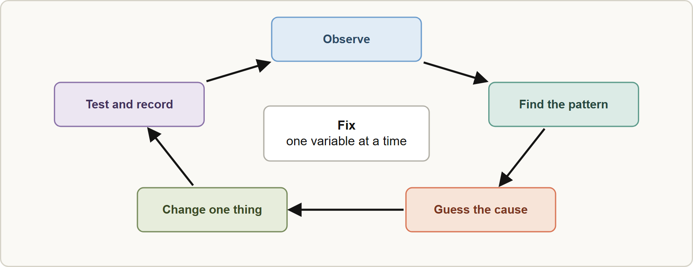
A Diagnostic Method
Module 15
Observe: what exactly is wrong? Save the prompt and the bad output.
Find the pattern: is it every time, or only for some inputs? Compare good and bad cases.
Hypothesize the cause: missing context, unclear instruction, conflicting rules, wrong feature, stale knowledge, wrong model, or a limit.
Observe: what exactly is wrong? Save the prompt and the bad output.
Find the pattern: is it every time, or only for some inputs? Compare good and bad cases.
Hypothesize the cause: missing context, unclear instruction, conflicting rules, wrong feature, stale knowledge, wrong model, or a limit.
Claude Associate Foundations Exam Prep | for the CCAO-F exam
Module 15: Diagnosing and Fixing Poor Outputs
4 / 24
Notes:
A Diagnostic Method.
The figure shows this: Diagnose in a loop: observe the symptom, find the pattern, guess the cause, change one thing, test and record.
Observe: what exactly is wrong? Save the prompt and the bad output.
Find the pattern: is it every time, or only for some inputs? Compare good and bad cases.
Hypothesize the cause: missing context, unclear instruction, conflicting rules, wrong feature, stale knowledge, wrong model, or a limit.

Slide 5
A Diagnostic Method, continued
Module 15
Change one thing: a clearer instruction, an example, a source file, a different feature or model.
Test on the same inputs and compare. Keep what works; log it.
Changing many things at once hides which change helped.
Test on several cases, including awkward ones, not only the one that failed.
EXAM TIP The expected approach is systematic and minimal: diagnose the cause, change one variable, retest. Starting over completely, or switching to the biggest model first, is usually not the best answer.
Claude Associate Foundations Exam Prep | for the CCAO-F exam
Module 15: Diagnosing and Fixing Poor Outputs
5 / 24
Notes:
A Diagnostic Method, continued.
Change one thing: a clearer instruction, an example, a source file, a different feature or model.
Test on the same inputs and compare. Keep what works; log it.
Changing many things at once hides which change helped.
Test on several cases, including awkward ones, not only the one that failed.
Exam tip: The expected approach is systematic and minimal: diagnose the cause, change one variable, retest. Starting over completely, or switching to the biggest model first, is usually not the best answer.

Slide 6
Symptoms, Causes and Fixes
Module 15
Symptom | Likely cause | Fix
Generic or vague answer | Missing goal, audience, context | Add purpose, audience, facts, an example (Module 1)
Wrong format or length | Format not specified | State structure, word count, fields; give an example
Ignores a rule | Rule buried, vague, conflicting, or too many rules | Put it clearly and early; explain why; remove conflicts; shorten the list
Invented facts or sources | No source provided; Claude fills gaps | Provide the source; ask to quote it; allow "not covered"; verify (Modules 3 and 4)
Outdated information | Knowledge cutoff | Use web search; check dates
Claude Associate Foundations Exam Prep | for the CCAO-F exam
Module 15: Diagnosing and Fixing Poor Outputs
6 / 24
Notes:
Symptoms, Causes and Fixes.
Generic or vague answer. Likely cause: Missing goal, audience, context. Fix: Add purpose, audience, facts, an example (Module one).
Wrong format or length. Likely cause: Format not specified. Fix: State structure, word count, fields; give an example.
Ignores a rule. Likely cause: Rule buried, vague, conflicting, or too many rules. Fix: Put it clearly and early; explain why; remove conflicts; shorten the list.
Invented facts or sources. Likely cause: No source provided; Claude fills gaps. Fix: Provide the source; ask to quote it; allow "not covered"; verify (Modules three and four).
Outdated information. Likely cause: Knowledge cutoff. Fix: Use web search; check dates.

Slide 7
Symptoms, Causes and Fixes, continued
Module 15
Symptom | Likely cause | Fix
Forgets earlier instructions; repeats itself | Long, drifted context | Summarize and restart; move standing rules into a Project (Modules 8 and 11)
Inconsistent tone across outputs | No voice reference | Add examples, a style or Project instructions
Shallow reasoning on a hard task | Task too big for one step, or light model or low effort | Break into steps; use thinking; try a stronger model or higher effort
Misreads a document | Poor file type, scanned pages, large file | Check file type and limits; split; ask for quotes; try text version
Claude Associate Foundations Exam Prep | for the CCAO-F exam
Module 15: Diagnosing and Fixing Poor Outputs
7 / 24
Notes:
Symptoms, Causes and Fixes, continued.
Forgets earlier instructions; repeats itself. Likely cause: Long, drifted context. Fix: Summarize and restart; move standing rules into a Project (Modules eight and eleven).
Inconsistent tone across outputs. Likely cause: No voice reference. Fix: Add examples, a style or Project instructions.
Shallow reasoning on a hard task. Likely cause: Task too big for one step, or light model or low effort. Fix: Break into steps; use thinking; try a stronger model or higher effort.
Misreads a document. Likely cause: Poor file type, scanned pages, large file. Fix: Check file type and limits; split; ask for quotes; try text version.

Slide 8
Symptoms, Causes and Fixes, continued
Module 15
Symptom | Likely cause | Fix
Spreadsheet or script fails | Untested output, wrong tool version | Test on a sample; give the exact error message back to Claude; state your tool and version
Claims it did something it could not (sent an email, saved a file) | No integration exists | Check the destination; enable the connector or do the step yourself
Links do not work | Produced from memory | Open every link; ask for sources and verify
Refuses a legitimate request | Wording looks like a prohibited request, or context is missing | Explain the legitimate purpose and context; rephrase; if truly restricted, follow policy
Claude Associate Foundations Exam Prep | for the CCAO-F exam
Module 15: Diagnosing and Fixing Poor Outputs
8 / 24
Notes:
Symptoms, Causes and Fixes, continued.
Spreadsheet or script fails. Likely cause: Untested output, wrong tool version. Fix: Test on a sample; give the exact error message back to Claude; state your tool and version.
Claims it did something it could not (sent an email, saved a file). Likely cause: No integration exists. Fix: Check the destination; enable the connector or do the step yourself.
Links do not work. Likely cause: Produced from memory. Fix: Open every link; ask for sources and verify.
Refuses a legitimate request. Likely cause: Wording looks like a prohibited request, or context is missing. Fix: Explain the legitimate purpose and context; rephrase; if truly restricted, follow policy.

Slide 9
Symptoms, Causes and Fixes, continued
Module 15
Symptom | Likely cause | Fix
Biased or one-sided | Leading prompt or skewed data | Ask for balance; neutral wording; check data (Module 3)
Too slow / limit reached | Heavy tools, high effort, long chat | Lower effort, lighter model, new chat (Module 16)
Claude Associate Foundations Exam Prep | for the CCAO-F exam
Module 15: Diagnosing and Fixing Poor Outputs
9 / 24
Notes:
Symptoms, Causes and Fixes, continued.
Biased or one-sided. Likely cause: Leading prompt or skewed data. Fix: Ask for balance; neutral wording; check data (Module three).
Too slow or limit reached. Likely cause: Heavy tools, high effort, long chat. Fix: Lower effort, lighter model, new chat (Module sixteen).

Slide 10
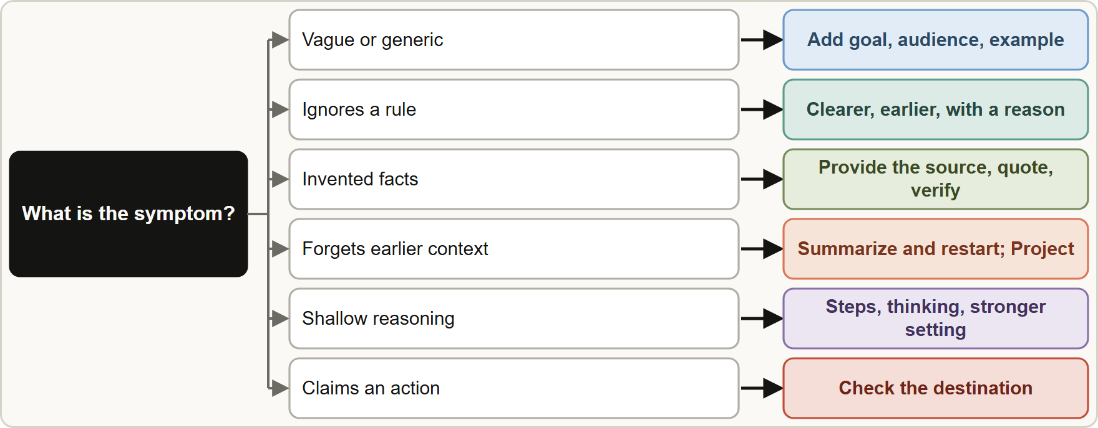
Symptoms, Causes and Fixes, continued
Module 15
A symptom-to-fix chooser: vague answers need context, ignored rules need clearer instructions, invented facts need sources, forgotten context needs a restart or a Project, shallow reasoning needs steps or a stronger setting
Claude Associate Foundations Exam Prep | for the CCAO-F exam
Module 15: Diagnosing and Fixing Poor Outputs
10 / 24
Notes:
Symptoms, Causes and Fixes, continued.
The figure shows this: A symptom-to-fix chooser: vague answers need context, ignored rules need clearer instructions, invented facts need sources, forgotten context needs a restart or a Project, shallow reasoning needs steps or a stronger setting.

Slide 11
Feature, File and Error Problems
Module 15
Problem | Check
Web search not used | Is it available and on? Say "search the web"; on Team and Enterprise the owner must enable it
Research seems inactive | Prompt directly: "please use the research tool"; web search must be on; on mobile connectors are skipped
Skill not applied | Skills need code execution on; toggle the skill on; the description must say when to use it; be explicit in the request
Skills section greyed out | Code execution (Create and edit files) is off for you or your organization
Spreadsheet (XLSX) upload fails | XLSX needs code execution and file creation turned on
Claude Associate Foundations Exam Prep | for the CCAO-F exam
Module 15: Diagnosing and Fixing Poor Outputs
11 / 24
Notes:
Feature, File and Error Problems.
Web search not used. Is it available and on? Say "search the web"; on Team and Enterprise the owner must enable it.
Research seems inactive. Prompt directly: "please use the research tool"; web search must be on; on mobile connectors are skipped.
Skill not applied. Skills need code execution on; toggle the skill on; the description must say when to use it; be explicit in the request.
Skills section greyed out. Code execution (Create and edit files) is off for you or your organization.
Spreadsheet (X L S X) upload fails. X L S X needs code execution and file creation turned on.

Slide 12
Feature, File and Error Problems, continued
Module 15
Problem | Check
File too large or too long | Chat limits: 500 MB per file, 20 files, PDFs up to 1,000 pages; split documents
Connector not pulling data | Reconnect from Customize > Connectors; confirm you have access; use web or Desktop (not mobile) for Research with connectors
"Message will exceed the length limit" | Attach fewer or smaller files, split or summarize, or start a new chat
"Approaching" or "reached" usage limit | Wait for the five-hour or weekly reset, reduce usage, or use credits if enabled
"Due to unexpected capacity constraints" | System-wide demand, not your fault; wait a few minutes and retry
Claude Associate Foundations Exam Prep | for the CCAO-F exam
Module 15: Diagnosing and Fixing Poor Outputs
12 / 24
Notes:
Feature, File and Error Problems, continued.
File too large or too long. Chat limits: five hundred megabytes per file, twenty files, P D F s up to one thousand pages; split documents.
Connector not pulling data. Reconnect from Customize greater than Connectors; confirm you have access; use web or Desktop (not mobile) for Research with connectors.
"Message will exceed the length limit". Attach fewer or smaller files, split or summarize, or start a new chat.
"Approaching" or "reached" usage limit. Wait for the five-hour or weekly reset, reduce usage, or use credits if enabled.
"Due to unexpected capacity constraints". System-wide demand, not your fault; wait a few minutes and retry.

Slide 13
Feature, File and Error Problems, continued
Module 15
Problem | Check
Login error | Turn off VPN and extensions, clear cache and cookies, check the status page
Output blocked by content filtering | Rephrase the request; check it is within the Usage Policy
Claude Associate Foundations Exam Prep | for the CCAO-F exam
Module 15: Diagnosing and Fixing Poor Outputs
13 / 24
Notes:
Feature, File and Error Problems, continued.
Login error. Turn off V P N and extensions, clear cache and cookies, check the status page.
Output blocked by content filtering. Rephrase the request; check it is within the Usage Policy.

Slide 14
Using Feedback and Results
Module 15
Collect feedback from users: what failed, how often, in what situation. Use real examples, not impressions.
Thumbs-down a bad response to report it; it helps improve the product but does not fix your prompt.
Adjust the layer where the cause lies: prompt (wording), Project (instructions, knowledge), skill (method), model or effort, feature (search, Research, files), or process (add a review step).
Measure before and after: error rate, time to finish, satisfaction (Module 16).
Share what you learn: update the prompt library and instructions so others benefit.
Claude Associate Foundations Exam Prep | for the CCAO-F exam
Module 15: Diagnosing and Fixing Poor Outputs
14 / 24
Notes:
Using Feedback and Results.
Collect feedback from users: what failed, how often, in what situation. Use real examples, not impressions.
Thumbs-down a bad response to report it; it helps improve the product but does not fix your prompt.
Adjust the layer where the cause lies: prompt (wording), Project (instructions, knowledge), skill (method), model or effort, feature (search, Research, files), or process (add a review step).
Measure before and after: error rate, time to finish, satisfaction (Module sixteen).
Share what you learn: update the prompt library and instructions so others benefit.

Slide 15
Using Feedback and Results, continued
Module 15
Know when to stop or escalate: if the same task fails after clear prompts, correct knowledge and a stronger model, the task may be a poor fit, or it may need a Developer's help (Module 10).
EXAM TIP Change one thing at a time and retest: changing everything at once hides what worked.
Claude Associate Foundations Exam Prep | for the CCAO-F exam
Module 15: Diagnosing and Fixing Poor Outputs
15 / 24
Notes:
Using Feedback and Results, continued.
Know when to stop or escalate: if the same task fails after clear prompts, correct knowledge and a stronger model, the task may be a poor fit, or it may need a Developer's help (Module ten).
Exam tip: Change one thing at a time and retest: changing everything at once hides what worked.
Exam tip: If Claude says it did something (sent, saved, booked), check the destination before you trust it.

Slide 16
Module Recap
Module 15
1
Method
2
Generic output
3
Ignored rule
Observe · pattern · cause · change one thing · test · record
Add context, audience, example
Clearer, earlier, with a reason; fewer rules
4
Invented facts
5
Forgetful
6
Tone drift
Provide the source; quote; allow "not covered"; verify
Summarize and restart; Project for standing rules
Examples, style, Project instructions
7
Shallow reasoning
8
Claimed actions
9
Feature fails
Steps, thinking, stronger model or effort
Check the destination; enable the connector or do it yourself
Check the toggle, plan, code execution, limits, description
10
Feedback
Use real examples; adjust the right layer; measure; share lessons
Claude Associate Foundations Exam Prep | for the CCAO-F exam
Module 15: Diagnosing and Fixing Poor Outputs
16 / 24
Notes:
Here is the recap.
Method: Observe, pattern, cause, change one thing, test, record.
Generic output: Add context, audience, example.
Ignored rule: Clearer, earlier, with a reason; fewer rules.
Invented facts: Provide the source; quote; allow "not covered"; verify.
Forgetful: Summarize and restart; Project for standing rules.
Tone drift: Examples, style, Project instructions.
Shallow reasoning: Steps, thinking, stronger model or effort.
Claimed actions: Check the destination; enable the connector or do it yourself.
Feature fails: Check the toggle, plan, code execution, limits, description.
Feedback: Use real examples; adjust the right layer; measure; share lessons.

Slide 17
Practice Question 1
Module 15
Q1
A team's reply drafts keep running too long. What is the best first change?
A
Turn off all features
B
Switch to the largest model, since a bigger model always follows length instructions without being told
C
Specify the length and structure (under 120 words: greeting, answer, next step) and give an example
D
Start every chat from scratch
Claude Associate Foundations Exam Prep | for the CCAO-F exam
Module 15: Diagnosing and Fixing Poor Outputs
17 / 24
Notes:
Question one.
A team's reply drafts keep running too long. What is the best first change?
The four options are on the screen.
[PAUSE 12]
The answer is C. Format and length problems usually come from an unspecified format; fix the prompt first.

Slide 18
Practice Question 2
Module 15
Q2
Claude keeps quoting the wrong return window. The Project contains two policy versions. What should the owner do?
A
Remove the outdated file so only the current policy remains, then retest
B
Add a third version of the policy file so that Claude can compare all three versions
C
Delete the instructions and let Claude work out the correct return window by itself
D
Tell Claude to guess
Claude Associate Foundations Exam Prep | for the CCAO-F exam
Module 15: Diagnosing and Fixing Poor Outputs
18 / 24
Notes:
Question two.
Claude keeps quoting the wrong return window. The Project contains two policy versions. What should the owner do?
The four options are on the screen.
[PAUSE 12]
The answer is A. Conflicting knowledge is a likely cause; fix the source and test.

Slide 19
Practice Question 3
Module 15
Q3
An analyst changes the model, the prompt, the files and the settings all at once, and the output improves. What is the weakness of this approach?
A
It is too fast
B
It uses too little usage
C
They cannot tell which change helped, so the result is hard to reproduce or explain
D
None
Claude Associate Foundations Exam Prep | for the CCAO-F exam
Module 15: Diagnosing and Fixing Poor Outputs
19 / 24
Notes:
Question three.
An analyst changes the model, the prompt, the files and the settings all at once, and the output improves. What is the weakness of this approach?
The four options are on the screen.
[PAUSE 12]
The answer is C. Change one variable at a time to learn what works.

Slide 20
Practice Question 4
Module 15
Q4
Claude says it emailed a supplier, but no email integration is connected. What is the best response?
A
Delete the chat
B
Verify, send the email yourself or set up the approved connector, and treat the claim as unreliable
C
Assume the supplier received it, because Claude would not state that an email was sent unless it was
D
Ask Claude to repeat the claim
Claude Associate Foundations Exam Prep | for the CCAO-F exam
Module 15: Diagnosing and Fixing Poor Outputs
20 / 24
Notes:
Question four.
Claude says it emailed a supplier, but no email integration is connected. What is the best response?
The four options are on the screen.
[PAUSE 12]
The answer is B. Claude can overstate its abilities; check the destination.

Slide 21
Practice Question 5
Module 15
Q5
A custom skill is installed but Claude never uses it. What should you check first?
A
The color of the skill icon
B
Whether the skill is switched on, code execution is enabled, and its description says when to use it
C
Whether you are on mobile
D
Whether the model name contains the word "skill", because only those models can use skills at all in the app
Claude Associate Foundations Exam Prep | for the CCAO-F exam
Module 15: Diagnosing and Fixing Poor Outputs
21 / 24
Notes:
Question five.
A custom skill is installed but Claude never uses it. What should you check first?
The four options are on the screen.
[PAUSE 12]
The answer is B. A skill that is off, a disabled code execution setting or a vague description are the documented reasons Claude does not use it.

Slide 22
Practice Question 6
Module 15
Q6
Which TWO are good responses to a long chat that has started to contradict itself? (Select TWO.)
A
Move standing rules into a Project's instructions
B
Ask for a summary of decisions and continue in a new chat
C
Keep adding messages
D
Remove the rules entirely
E
Ask for the same answer repeatedly
Claude Associate Foundations Exam Prep | for the CCAO-F exam
Module 15: Diagnosing and Fixing Poor Outputs
22 / 24
Notes:
Question six. Select two.
Which two are good responses to a long chat that has started to contradict itself?
The five options are on the screen.
[PAUSE 15]
The answers are A and B. Restart with a summary and persist the rules properly.

Slide 23
Practice Question 7
Module 15
Q7
A spreadsheet formula from Claude returns an error in Google Sheets. What is the best next step?
A
Apply it to all of the data anyway, because the error probably affects only a few rows and Sheets will skip them
B
Paste the exact error message and a data sample back to Claude, state the tool, and test the fix on a few rows
C
Abandon formulas
D
Ask for a longer explanation
Claude Associate Foundations Exam Prep | for the CCAO-F exam
Module 15: Diagnosing and Fixing Poor Outputs
23 / 24
Notes:
Question seven.
A spreadsheet formula from Claude returns an error in Google Sheets. What is the best next step?
The four options are on the screen.
[PAUSE 12]
The answer is B. Give Claude the evidence and test the fix on a small sample.

Slide 24
Answers at a Glance
Module 15
Question | Answer | Why
Q1 | C | Format and length problems usually come from an unspecified format
Q2 | A | Conflicting knowledge is a likely cause
Q3 | C | Change one variable at a time to learn what works
Q4 | B | Claude can overstate its abilities
Q5 | B | A skill that is off
Q6 | A, B | Restart with a summary and persist the rules properly
Q7 | B | Give Claude the evidence and test the fix on a small sample
Claude Associate Foundations Exam Prep | for the CCAO-F exam
Module 15: Diagnosing and Fixing Poor Outputs
24 / 24
Notes:
Here are all seven answers. Question one: C. Question two: A. Question three: C. Question four: B. Question five: B. Question six: A and B. Question seven: B.
In the next module, we continue the course.

