Slide 1
Module 16: Optimizing Workflows, Usage and Cost
What efficiency and effectiveness mean for a Claude workflow
Domain 7 · Troubleshooting and Optimization
Claude Associate Foundations Exam Prep Masterclass
Module 16
Notes:
Welcome to Module sixteen: Optimizing Workflows, Usage and Cost. This module covers optimizing workflows, usage and cost.
Each part of this module comes from the study notes of the same name, so you can read the notes after you watch.

Slide 2
What You Will Learn
Module 16
What efficiency and effectiveness mean for a Claude workflow
How to save time and usage with prompts, Projects, models and settings
How to standardize and share what works
How to measure and improve over time
Claude Associate Foundations Exam Prep | for the CCAO-F exam
Module 16: Optimizing Workflows, Usage and Cost
2 / 23
Notes:
By the end of this module you will be able to do four things.
What efficiency and effectiveness mean for a Claude workflow.
How to save time and usage with prompts, Projects, models and settings.
How to standardize and share what works.
How to measure and improve over time.

Slide 3
Case Check-In: Cedarbrook's Monthly Report
Module 16
CASE CHECK-IN · Cedarbrook Outfitters
Finance spends two days a month building the sales report: pulling numbers, writing commentary, formatting slides
After optimization the team uses one Project, a saved method for the report format, a lighter model for the commentary draft and one review pass; the work takes half a day, and the number of corrections falls
Claude Associate Foundations Exam Prep | for the CCAO-F exam
Module 16: Optimizing Workflows, Usage and Cost
3 / 23
Notes:
Our running case is Cedarbrook Outfitters. Cedarbrook's Monthly Report.
Finance spends two days a month building the sales report: pulling numbers, writing commentary, formatting slides.
After optimization the team uses one Project, a saved method for the report format, a lighter model for the commentary draft and one review pass; the work takes half a day, and the number of corrections falls.

Slide 4
Efficiency and Effectiveness
Module 16
Efficiency = the same result with less time, effort and usage.
Effectiveness = a better result: accurate, useful, on-brand, accepted by the reader.
Optimize both. A fast but wrong report is not an improvement, and a perfect report that takes five days is not either.
Optimize where it matters: frequent tasks, slow tasks, error-prone tasks.
Claude Associate Foundations Exam Prep | for the CCAO-F exam
Module 16: Optimizing Workflows, Usage and Cost
4 / 23
Notes:
Efficiency and Effectiveness.
Efficiency equals the same result with less time, effort and usage.
Effectiveness equals a better result: accurate, useful, on-brand, accepted by the reader.
Optimize both. A fast but wrong report is not an improvement, and a perfect report that takes five days is not either.
Optimize where it matters: frequent tasks, slow tasks, error-prone tasks.

Slide 5
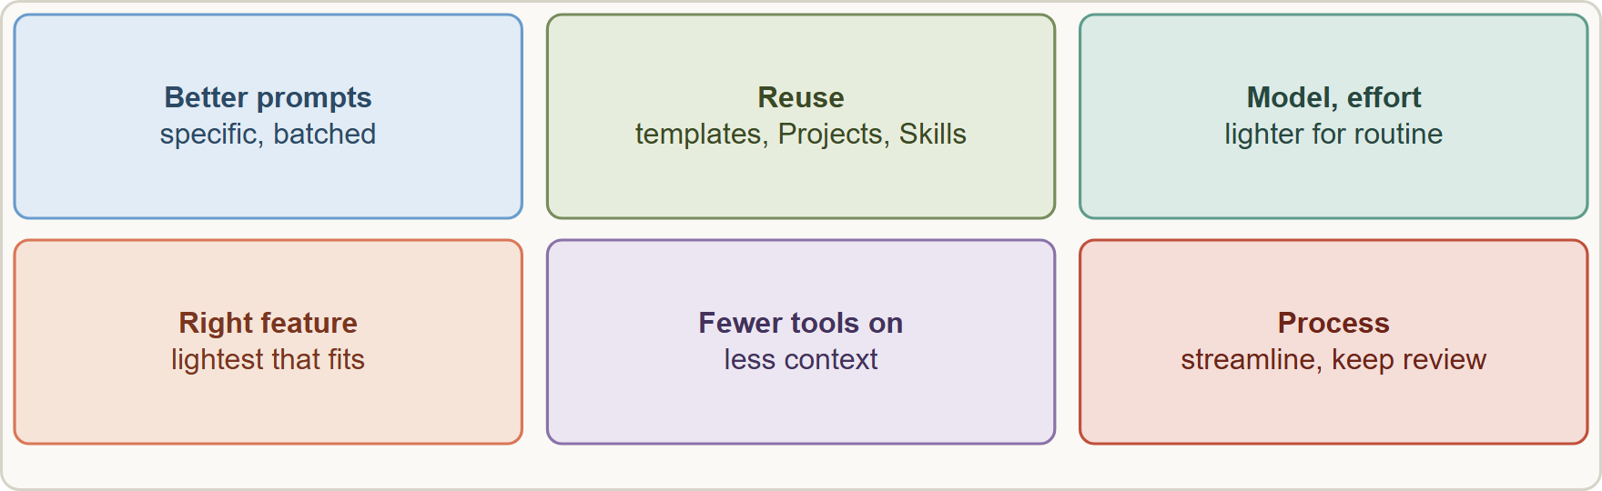
Efficiency and Effectiveness, continued
Module 16
Levers for optimization: better prompts, Projects and Skills, model and effort choice, the right features, and a streamlined process with review
Claude Associate Foundations Exam Prep | for the CCAO-F exam
Module 16: Optimizing Workflows, Usage and Cost
5 / 23
Notes:
Efficiency and Effectiveness, continued.
The figure shows this: Levers for optimization: better prompts, Projects and Skills, model and effort choice, the right features, and a streamlined process with review.

Slide 6
The Main Levers
Module 16
Lever | What to do | Why it helps
Better prompts | Specific goal, audience, format; examples; batch related requests into one message | Fewer rounds; less usage
Reuse | Save good prompts in a prompt library; use Projects and Skills for recurring work | Consistency; no re-typing; shared knowledge
Project knowledge | Upload reference documents once; project content is cached and counts less when reused | Fewer tokens per question
Right model | Lighter model for routine and high-volume tasks; stronger for hard work (Module 7) | Speed and usage savings
Right effort | Lower effort for routine tasks; higher only for complex ones | Faster; stretches usage limits
Claude Associate Foundations Exam Prep | for the CCAO-F exam
Module 16: Optimizing Workflows, Usage and Cost
6 / 23
Notes:
The Main Levers.
Better prompts. What to do: Specific goal, audience, format; examples; batch related requests into one message. Why it helps: Fewer rounds; less usage.
Reuse. What to do: Save good prompts in a prompt library; use Projects and Skills for recurring work. Why it helps: Consistency; no re-typing; shared knowledge.
Project knowledge. What to do: Upload reference documents once; project content is cached and counts less when reused. Why it helps: Fewer tokens per question.
Right model. What to do: Lighter model for routine and high-volume tasks; stronger for hard work (Module seven). Why it helps: Speed and usage savings.
Right effort. What to do: Lower effort for routine tasks; higher only for complex ones. Why it helps: Faster; stretches usage limits.

Slide 7
The Main Levers, continued
Module 16
Lever | What to do | Why it helps
Right feature | Chat for light tasks; web search for facts; Research only for deep work | Avoids expensive over-tooling
Fewer tools on | Turn off connectors and web search you do not need ("tools and connectors are token-intensive") | More room in the context; less usage
Short chats | Start fresh for new topics; summarize long threads (Module 8) | Shorter context, lower usage, better focus
Lean instructions | Keep Project instructions short; put task-specific details in the chat | Less context overhead
Targeted edits | Edit one section instead of regenerating everything | Saves time and usage
Claude Associate Foundations Exam Prep | for the CCAO-F exam
Module 16: Optimizing Workflows, Usage and Cost
7 / 23
Notes:
The Main Levers, continued.
Right feature. What to do: Chat for light tasks; web search for facts; Research only for deep work. Why it helps: Avoids expensive over-tooling.
Fewer tools on. What to do: Turn off connectors and web search you do not need ("tools and connectors are token-intensive"). Why it helps: More room in the context; less usage.
Short chats. What to do: Start fresh for new topics; summarize long threads (Module eight). Why it helps: Shorter context, lower usage, better focus.
Lean instructions. What to do: Keep Project instructions short; put task-specific details in the chat. Why it helps: Less context overhead.
Targeted edits. What to do: Edit one section instead of regenerating everything. Why it helps: Saves time and usage.

Slide 8
The Main Levers, continued
Module 16
Lever | What to do | Why it helps
Process design | Remove unnecessary hand-offs; add review where errors matter; draft-and-review patterns (Module 10) | Faster and safer
Usage factors: message length, attachment size, conversation length, tools (Research, web search), model choice, effort level, artifact creation and multi-step tasks such as file creation. Caches expire after inactivity, so the first message after a long break costs more.
Claude Associate Foundations Exam Prep | for the CCAO-F exam
Module 16: Optimizing Workflows, Usage and Cost
8 / 23
Notes:
The Main Levers, continued.
Process design. What to do: Remove unnecessary hand-offs; add review where errors matter; draft-and-review patterns (Module ten). Why it helps: Faster and safer.
Usage factors: message length, attachment size, conversation length, tools (Research, web search), model choice, effort level, artifact creation and multi-step tasks such as file creation. Caches expire after inactivity, so the first message after a long break costs more.

Slide 9
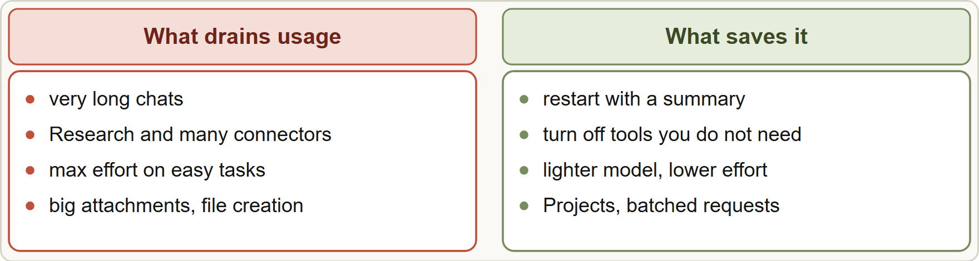
The Main Levers, continued
Module 16
Where usage goes and how to save it: long chats, heavy tools, max effort and big attachments cost the most; restart, trim tools, lower effort and batch requests save the most
EXAM TIP Efficiency answers pick the lighter, reusable, batched option (a Project, a lighter model for routine work, fewer tools, a new short chat), and keep quality checks in place.
Claude Associate Foundations Exam Prep | for the CCAO-F exam
Module 16: Optimizing Workflows, Usage and Cost
9 / 23
Notes:
The Main Levers, continued.
The figure shows this: Where usage goes and how to save it: long chats, heavy tools, max effort and big attachments cost the most; restart, trim tools, lower effort and batch requests save the most.
Exam tip: Efficiency answers pick the lighter, reusable, batched option (a Project, a lighter model for routine work, fewer tools, a new short chat), and keep quality checks in place.

Slide 10
Standardize and Share What Works
Module 16
Turn successful prompts into templates with blanks (audience, topic, key facts).
Put the team's voice, rules and reference documents in a shared Project (Team and Enterprise allow sharing with view or edit rights).
Package a repeatable method as a Skill.
Write a short SOP: when to use Claude for this task, the steps, who reviews, what to check.
Keep an owner and a version; review monthly.
Train colleagues with real examples of good and bad outputs.
Claude Associate Foundations Exam Prep | for the CCAO-F exam
Module 16: Optimizing Workflows, Usage and Cost
10 / 23
Notes:
Standardize and Share What Works.
Turn successful prompts into templates with blanks (audience, topic, key facts).
Put the team's voice, rules and reference documents in a shared Project (Team and Enterprise allow sharing with view or edit rights).
Package a repeatable method as a Skill.
Write a short S O P: when to use Claude for this task, the steps, who reviews, what to check.
Keep an owner and a version; review monthly.
Train colleagues with real examples of good and bad outputs.

Slide 11
Standardize and Share What Works, continued
Module 16
Without standardization | With standardization
Every person writes their own prompt | Shared template and Project
Quality depends on the person | Consistent baseline
Fixes stay in one head | Lessons shared and recorded
Claude Associate Foundations Exam Prep | for the CCAO-F exam
Module 16: Optimizing Workflows, Usage and Cost
11 / 23
Notes:
Standardize and Share What Works, continued.
Every person writes their own prompt. Shared template and Project.
Quality depends on the person. Consistent baseline.
Fixes stay in one head. Lessons shared and recorded.

Slide 12
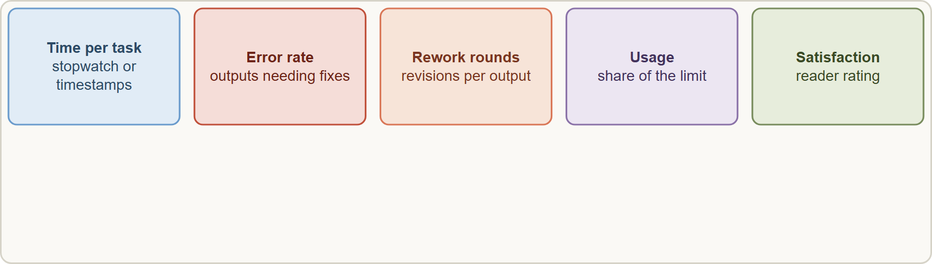
Measure and Improve
Module 16
Measure before and after: time per task, error rate, rework rounds and satisfaction show whether the change worked
Claude Associate Foundations Exam Prep | for the CCAO-F exam
Module 16: Optimizing Workflows, Usage and Cost
12 / 23
Notes:
Measure and Improve.
The figure shows this: Measure before and after: time per task, error rate, rework rounds and satisfaction show whether the change worked.

Slide 13
Measure and Improve, continued
Module 16
KPI | How to measure | Target example
Time per task | Stopwatch or ticket timestamps | Report in 4 hours, not 16
Error rate | Share of outputs needing factual corrections | Under 5%
Rework rounds | Average number of revisions | 1 or 2
Usage | Share of the session or weekly limit used | Under planned budget
Satisfaction | Reader or colleague rating | At least 4 of 5
Baseline: measure the current way.
Change one thing.
Pilot with a few users.
Compare against the baseline.
Keep or revert; roll out if it works.
Repeat, because tools, policies and needs change.
Claude Associate Foundations Exam Prep | for the CCAO-F exam
Module 16: Optimizing Workflows, Usage and Cost
13 / 23
Notes:
Measure and Improve, continued.
Time per task. How to measure: Stopwatch or ticket timestamps. Target example: Report in four hours, not sixteen.
Error rate. How to measure: Share of outputs needing factual corrections. Target example: Under five percent.
Rework rounds. How to measure: Average number of revisions. Target example: one or two.
Usage. How to measure: Share of the session or weekly limit used. Target example: Under planned budget.
Satisfaction. How to measure: Reader or colleague rating. Target example: At least four of five.
Baseline: measure the current way.
Change one thing.
Pilot with a few users.
Compare against the baseline.
Keep or revert; roll out if it works.
Repeat, because tools, policies and needs change.

Slide 14
Measure and Improve, continued
Module 16
Watch quality as well as speed: a quicker draft with more factual errors is not an improvement.
Check in regularly on settings and knowledge so the gains do not decay (Module 12).
EXAM TIP Efficiency without quality checks is not optimization: measure speed and error rate.
Claude Associate Foundations Exam Prep | for the CCAO-F exam
Module 16: Optimizing Workflows, Usage and Cost
14 / 23
Notes:
Measure and Improve, continued.
Watch quality as well as speed: a quicker draft with more factual errors is not an improvement.
Check in regularly on settings and knowledge so the gains do not decay (Module twelve).
Exam tip: Efficiency without quality checks is not optimization: measure speed and error rate.
Exam tip: Reuse beats re-typing: Projects, Skills and templates save time and usage and keep results consistent.

Slide 15
Module Recap
Module 16
1
Goal
2
Prompts
3
Reuse
Efficiency (less time and usage) and effectiveness (better results)
Specific, reused, batched
Prompt library · Projects · Skills
4
Model and effort
5
Tools
6
Chats
Lighter and lower for routine; stronger and higher for hard
Turn off connectors and search you do not need
Short and focused; restart with a summary
7
Cache
8
Standardize
9
Measure
Saves usage while active; expires after inactivity
Templates · shared Project · SOP · owner · training
Baseline · change one thing · pilot · compare · keep or revert
10
KPIs
Time · error rate · rework rounds · usage · satisfaction
Claude Associate Foundations Exam Prep | for the CCAO-F exam
Module 16: Optimizing Workflows, Usage and Cost
15 / 23
Notes:
Here is the recap.
Goal: Efficiency (less time and usage) and effectiveness (better results).
Prompts: Specific, reused, batched.
Reuse: Prompt library, Projects, Skills.
Model and effort: Lighter and lower for routine; stronger and higher for hard.
Tools: Turn off connectors and search you do not need.
Chats: Short and focused; restart with a summary.
Cache: Saves usage while active; expires after inactivity.
Standardize: Templates, shared Project, S O P, owner, training.
Measure: Baseline, change one thing, pilot, compare, keep or revert.
K P I s: Time, error rate, rework rounds, usage, satisfaction.

Slide 16
Practice Question 1
Module 16
Q1
A team sends dozens of short, similar customer replies every day and keeps hitting its usage limit. Which change helps most?
A
Make every chat as long as possible
B
Use the most capable model at the highest effort, since quality should never be traded for usage
C
Add every connector
D
Use a lighter model with lower effort, with a Project that holds the reply rules
Claude Associate Foundations Exam Prep | for the CCAO-F exam
Module 16: Optimizing Workflows, Usage and Cost
16 / 23
Notes:
Question one.
A team sends dozens of short, similar customer replies every day and keeps hitting its usage limit. Which change helps most?
The four options are on the screen.
[PAUSE 12]
The answer is D. Routine, high-volume work suits a lighter setup and shared context.

Slide 17
Practice Question 2
Module 16
Q2
A manager wants quicker monthly reporting. What should come first?
A
Remove review steps
B
Switch tools randomly
C
Ask Claude to promise faster results
D
Measure the current time and error rate, then change one element and compare
Claude Associate Foundations Exam Prep | for the CCAO-F exam
Module 16: Optimizing Workflows, Usage and Cost
17 / 23
Notes:
Question two.
A manager wants quicker monthly reporting. What should come first?
The four options are on the screen.
[PAUSE 12]
The answer is D. Measuring the current time and error rate first gives a baseline, so one change at a time can be compared fairly against it.

Slide 18
Practice Question 3
Module 16
Q3
Which action reduces unnecessary usage?
A
Starting very long chats for everything so that no context is ever lost
B
Keeping many connectors on in every chat so Claude always has everything within reach
C
Always selecting maximum effort
D
Turning off connectors and web search that the task does not need
Claude Associate Foundations Exam Prep | for the CCAO-F exam
Module 16: Optimizing Workflows, Usage and Cost
18 / 23
Notes:
Question three.
Which action reduces unnecessary usage?
The four options are on the screen.
[PAUSE 12]
The answer is D. Tools and connectors consume context and usage, so turning off the ones a task does not need reduces unnecessary consumption.

Slide 19
Practice Question 4
Module 16
Q4
A user returns to a Project after a long break, and the first message seems to use more of the limit. Why?
A
Projects are broken after a long break and have to be recreated before the usage meter behaves normally
B
The model changed
C
Project content is cached, and the cache expires after inactivity, so the content counts in full again
D
Memory is full
Claude Associate Foundations Exam Prep | for the CCAO-F exam
Module 16: Optimizing Workflows, Usage and Cost
19 / 23
Notes:
Question four.
A user returns to a Project after a long break, and the first message seems to use more of the limit. Why?
The four options are on the screen.
[PAUSE 12]
The answer is C. Caching saves usage while active; it lapses after inactivity.

Slide 20
Practice Question 5
Module 16
Q5
Which TWO help standardize good results across a team? (Select TWO.)
A
Letting each person improvise
B
Avoiding documentation
C
Hiding the best prompts
D
A shared Project with instructions and approved knowledge
E
A shared template in a prompt library
Claude Associate Foundations Exam Prep | for the CCAO-F exam
Module 16: Optimizing Workflows, Usage and Cost
20 / 23
Notes:
Question five. Select two.
Which two help standardize good results across a team?
The five options are on the screen.
[PAUSE 15]
The answers are D and E. Shared templates and a shared Project with approved knowledge spread what works, so quality does not depend on one person.

Slide 21
Practice Question 6
Module 16
Q6
Draft time fell by half, but factual corrections doubled. What does this show?
A
A measurement error that can be ignored, because the figures will even out again next month
B
A clear success
C
The model is too small, so the team should switch to the largest model and stop reviewing drafts
D
Efficiency improved while accuracy got worse, so the process needs a better check or prompt
Claude Associate Foundations Exam Prep | for the CCAO-F exam
Module 16: Optimizing Workflows, Usage and Cost
21 / 23
Notes:
Question six.
Draft time fell by half, but factual corrections doubled. What does this show?
The four options are on the screen.
[PAUSE 12]
The answer is D. Speed improved but accuracy got worse, so effectiveness fell; the process needs a better check or a clearer prompt.

Slide 22
Practice Question 7
Module 16
Q7
Which is the most efficient way to change one paragraph in a long document artifact?
A
Highlight the paragraph and ask Claude to edit just that part
B
Start a new chat and re-upload all of the source material from scratch
C
Delete the artifact
D
Regenerate the entire document from the start and compare it with the old version
Claude Associate Foundations Exam Prep | for the CCAO-F exam
Module 16: Optimizing Workflows, Usage and Cost
22 / 23
Notes:
Question seven.
Which is the most efficient way to change one paragraph in a long document artifact?
The four options are on the screen.
[PAUSE 12]
The answer is A. Highlighting the paragraph and asking for an edit of just that part saves time and usage and leaves the rest untouched.

Slide 23
Answers at a Glance
Module 16
Question | Answer | Why
Q1 | D | Routine, high-volume work suits a lighter setup and shared context
Q2 | D | Measuring the current time and error rate first gives a baseline
Q3 | D | Tools and connectors consume context and usage
Q4 | C | Caching saves usage while active
Q5 | D, E | Shared templates and a shared Project with approved knowledge spread what works
Q6 | D | Speed improved but accuracy got worse, so effectiveness fell
Q7 | A | Highlighting the paragraph and asking for an edit of just that part
Claude Associate Foundations Exam Prep | for the CCAO-F exam
Module 16: Optimizing Workflows, Usage and Cost
23 / 23
Notes:
Here are all seven answers. Question one: D. Question two: D. Question three: D. Question four: C. Question five: D and E. Question six: D. Question seven: A.
In the next module, we continue the course.

