Slide 1
Module 0: Course Introduction and Exam Orientation
What the DEA-C01 exam asks, how it is scored and how to book it
Course module · exam orientation and review
Data Engineer Associate Exam Prep Masterclass
Module 0
Notes:
Welcome to Module zero: Course Introduction and Exam Orientation. This module covers exam orientation and course map.
Each part of this module comes from the study notes of the same name, so you can read the notes after you watch.

Slide 2
What You Will Learn
Module 0
What the DEA-C01 exam asks, how it is scored and how to book it
The four domains, their weights and the 17 task statements that this course follows
The kind of question to expect: a data requirement, and the service or setting that fits it best
How the course is built: summaries, a running case, figures, exam tips and practice questions
A study plan and the ground rules for using official sources
--
Data Engineer Associate Exam Prep Masterclass | for the AWS DEA-C01 exam
Module 0: Course Introduction and Exam Orientation
2 / 18
Notes:
By the end of this module you will be able to do six things.
What the dea-C one exam asks, how it is scored and how to book it.
The four domains, their weights and the seventeen task statements that this course follows.
The kind of question to expect: a data requirement, and the service or setting that fits it best.
How the course is built: summaries, a running case, figures, exam tips and practice questions.
A study plan and the ground rules for using official sources.
--.

Slide 3
Case Check-In: Meet Kestrel Freight
Module 0
CASE CHECK-IN · Kestrel Freight
Trucks send position and temperature readings every few seconds
Warehouses drop order files into storage every night
Customers expect live tracking and correct invoices
Auditors expect to know who saw which data
Your job: build the pipeline, one decision at a time
Data Engineer Associate Exam Prep Masterclass | for the AWS DEA-C01 exam
Module 0: Course Introduction and Exam Orientation
3 / 18
Notes:
Our running case is Kestrel Freight. Meet Kestrel Freight.
Trucks send position and temperature readings every few seconds.
Warehouses drop order files into storage every night.
Customers expect live tracking and correct invoices.
Auditors expect to know who saw which data.
Your job: build the pipeline, one decision at a time.

Slide 4
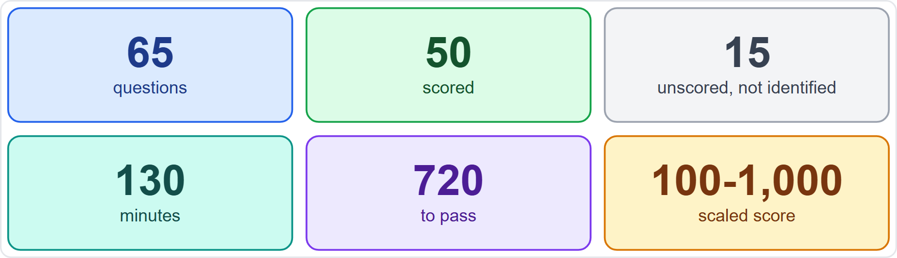
The numbers
VERIFY LIVE
Module 0
As of 7 November 2026: check the AWS page for the current value
As of 7 November 2026: check the AWS page for the current value
Data Engineer Associate Exam Prep Masterclass | for the AWS DEA-C01 exam
Module 0: Course Introduction and Exam Orientation
4 / 18
Notes:
The numbers.
The figure shows this: Sixty-five questions of which fifty are scored and fifteen are not, one hundred thirty minutes, a pass mark of seven hundred twenty on a scale of one hundred to one thousand.
This fact moves with the A W S pages, so check the current value before you rely on it.

Slide 5
The numbers, continued
VERIFY LIVE
Module 0
Item | Fact
Questions | 65: 50 scored and 15 unscored (the unscored ones are not marked)
Time | 130 minutes (about 2 minutes a question)
Result | A scaled score from 100 to 1,000; 720 passes; the result is pass or fail
Scoring model | Compensatory: you pass the exam as a whole, not each section
Unanswered | Counted as wrong; there is no penalty for guessing
Fee and format | USD 150; Pearson VUE test center or online proctored; valid 3 years (as of 7 November 2026)
As of 7 November 2026: check the AWS page for the current value
EXAM TIP Never leave a question blank: a guess costs nothing and a blank always scores zero.
Data Engineer Associate Exam Prep Masterclass | for the AWS DEA-C01 exam
Module 0: Course Introduction and Exam Orientation
5 / 18
Notes:
The numbers, continued.
Questions. sixty-five: fifty scored and fifteen unscored (the unscored ones are not marked).
Time. one hundred thirty minutes (about two minutes a question).
Result. A scaled score from one hundred to one thousand; seven hundred twenty passes; the result is pass or fail.
Scoring model. Compensatory: you pass the exam as a whole, not each section.
Unanswered. Counted as wrong; there is no penalty for guessing.
Fee and format. U S D one hundred fifty; Pearson V U E test center or online proctored; valid three years (as of seven November two thousand twenty-six).
Exam tip: Never leave a question blank: a guess costs nothing and a blank always scores zero.
This fact moves with the A W S pages, so check the current value before you rely on it.

Slide 6
Two kinds of question
Module 0
Multiple choice: one correct answer and three distractors
Multiple response: two or more correct answers out of five or more options; the question says how many to select
Distractors are plausible: services that are real and sometimes useful, but not the best fit for the stated requirement
EXAM TIP On multiple response, every correct option must be chosen and no wrong one; read the count in the question ("Select TWO") before you read the options.
Data Engineer Associate Exam Prep Masterclass | for the AWS DEA-C01 exam
Module 0: Course Introduction and Exam Orientation
6 / 18
Notes:
Two kinds of question.
Multiple choice: one correct answer and three distractors.
Multiple response: two or more correct answers out of five or more options; the question says how many to select.
Distractors are plausible: services that are real and sometimes useful, but not the best fit for the stated requirement.
Exam tip: On multiple response, every correct option must be chosen and no wrong one; read the count in the question ("Select two") before you read the options.

Slide 7
Who the exam is for
Module 0
The guide describes a candidate with 2 to 3 years of data engineering experience and 1 to 2 years of hands-on AWS experience. The exam validates that you can implement data pipelines and monitor, troubleshoot and optimize their cost and performance by best practices.
Out of scope for the candidate (so not tested): performing ML training and inference, language-specific syntax, and drawing business conclusions from data.
EXAM TIP Questions are about choosing and configuring AWS services for a data requirement, not about writing code. Learn what each service is for, what makes it fit, and what makes it a wrong answer.
Data Engineer Associate Exam Prep Masterclass | for the AWS DEA-C01 exam
Module 0: Course Introduction and Exam Orientation
7 / 18
Notes:
Who the exam is for.
The guide describes a candidate with two to three years of data engineering experience and one to two years of hands-on A W S experience. The exam validates that you can implement data pipelines and monitor, troubleshoot and optimize their cost and performance by best practices.
Out of scope for the candidate (so not tested): performing M L (machine learning) training and inference, language-specific syntax, and drawing business conclusions from data.
Exam tip: Questions are about choosing and configuring A W S services for a data requirement, not about writing code. Learn what each service is for, what makes it fit, and what makes it a wrong answer.

Slide 8
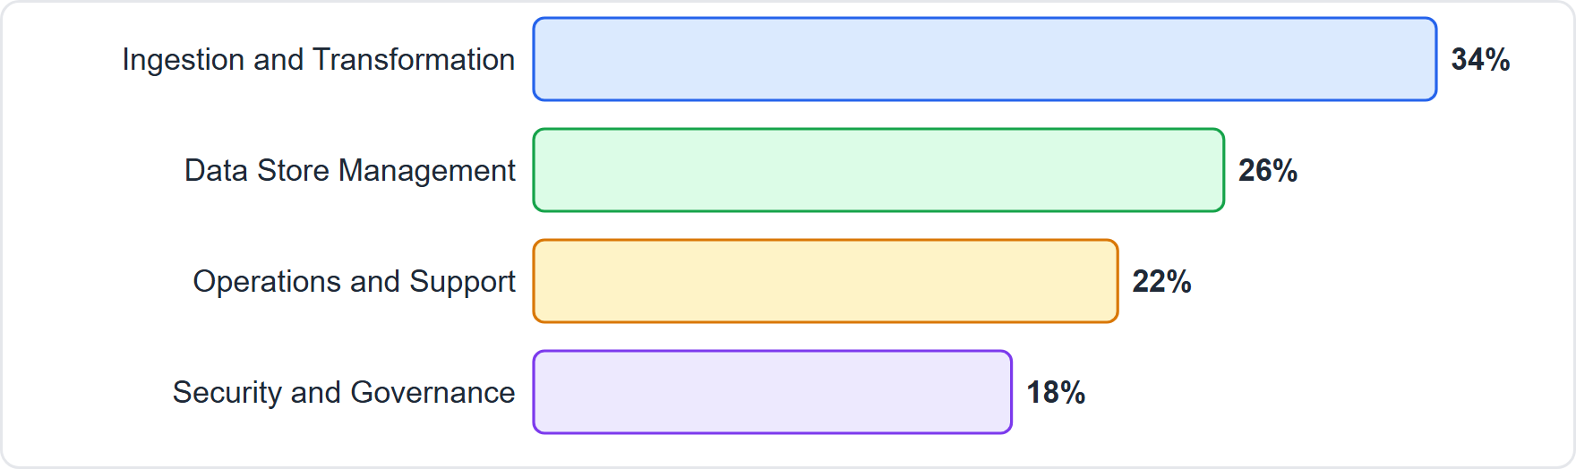
Four Domains, Seventeen Task Statements
Module 0
The four exam domains and their weights: Ingestion and Transformation 34 percent, Data Store Management 26, Operations and Support 22, Security and Governance 18
Data Engineer Associate Exam Prep Masterclass | for the AWS DEA-C01 exam
Module 0: Course Introduction and Exam Orientation
8 / 18
Notes:
Four Domains, Seventeen Task Statements.
The figure shows this: The four exam domains and their weights: Ingestion and Transformation thirty-four percent, Data Store Management twenty-six, Operations and Support twenty-two, Security and Governance eighteen.

Slide 9
Four Domains, Seventeen Task Statements, continued
Module 0
Domain | Weight | Task statements
1 Data Ingestion and Transformation | 34% | 1.1 Perform data ingestion · 1.2 Transform and process data · 1.3 Orchestrate data pipelines · 1.4 Apply programming concepts
2 Data Store Management | 26% | 2.1 Choose a data store · 2.2 Understand data cataloging systems · 2.3 Manage the lifecycle of data · 2.4 Design data models and schema evolution
3 Data Operations and Support | 22% | 3.1 Automate data processing · 3.2 Analyze data · 3.3 Maintain and monitor data pipelines · 3.4 Ensure data quality
Data Engineer Associate Exam Prep Masterclass | for the AWS DEA-C01 exam
Module 0: Course Introduction and Exam Orientation
9 / 18
Notes:
Four Domains, Seventeen Task Statements, continued.
one Data Ingestion and Transformation. Weight: thirty-four percent. Task statements: one point one Perform data ingestion · one point two Transform and process data · one point three Orchestrate data pipelines · one point four Apply programming concepts.
two Data Store Management. Weight: twenty-six percent. Task statements: two point one Choose a data store · two point two Understand data cataloging systems · two point three Manage the lifecycle of data · two point four Design data models and schema evolution.
three Data Operations and Support. Weight: twenty-two percent. Task statements: three point one Automate data processing · three point two Analyze data · three point three Maintain and monitor data pipelines · three point four Ensure data quality.

Slide 10
Four Domains, Seventeen Task Statements, continued
Module 0
Domain | Weight | Task statements
4 Data Security and Governance | 18% | 4.1 Apply authentication mechanisms · 4.2 Apply authorization mechanisms · 4.3 Ensure data encryption and masking · 4.4 Prepare logs for audit · 4.5 Understand data privacy and governance
The guide lists 120 skills under the 17 task statements; this course covers every one of them and nothing else
Domain 1 is the biggest: about one question in three is about ingesting, transforming, orchestrating or coding a pipeline
The guide is not exhaustive and is updated; AWS publishes changes about one month before the exam reflects them
EXAM TIP Spend time in proportion to the weights, but do not skip the small domain: security and governance questions are short and often decided by one setting.
Data Engineer Associate Exam Prep Masterclass | for the AWS DEA-C01 exam
Module 0: Course Introduction and Exam Orientation
10 / 18
Notes:
Four Domains, Seventeen Task Statements, continued.
four Data Security and Governance. Weight: eighteen percent. Task statements: four point one Apply authentication mechanisms · four point two Apply authorization mechanisms · four point three Ensure data encryption and masking · four point four Prepare logs for audit · four point five Understand data privacy and governance.
The guide lists one hundred twenty skills under the seventeen task statements; this course covers every one of them and nothing else.
Domain one is the biggest: about one question in three is about ingesting, transforming, orchestrating or coding a pipeline.
The guide is not exhaustive and is updated; A W S publishes changes about one month before the exam reflects them.
Exam tip: Spend time in proportion to the weights, but do not skip the small domain: security and governance questions are short and often decided by one setting.

Slide 11
What changed in guide version 1.1
DATES
Module 0
Published 12 December 2025; the older knowledge and skills lists were merged into one list of skills per task
New skills: integrating large language models (LLMs) for data processing, open table formats such as Apache Iceberg, vector index types (HNSW, IVF) and vectorization, business data catalogs in Amazon SageMaker Catalog, SageMaker Unified Studio domains and projects, and governance frameworks and data sharing patterns
Data Engineer Associate Exam Prep Masterclass | for the AWS DEA-C01 exam
Module 0: Course Introduction and Exam Orientation
11 / 18
Notes:
What changed in guide version one point one.
Published twelve December two thousand twenty-five; the older knowledge and skills lists were merged into one list of skills per task.
New skills: integrating large language models (L L M s) for data processing, open table formats such as Apache Iceberg, vector index types (H N S W, I V F (inverted file)) and vectorization, business data catalogs in Amazon SageMaker Catalog, SageMaker Unified Studio domains and projects, and governance frameworks and data sharing patterns.

Slide 12
What changed in guide version 1.1, continued
DATES
Module 0
Services added to the in-scope list: Amazon Aurora, Amazon Q, Amazon Bedrock, Amazon Kendra, AWS Data Exchange and Amazon S3 Tables; removed: AWS Cloud9, AWS CodeCommit and AWS Schema Conversion Tool as listed services (the skill list still names AWS SCT and AWS DMS Schema Conversion)
EXAM TIP Older study material may miss the vector, Iceberg, LLM and SageMaker Catalog topics. They are in this course because they are in the current guide.
Data Engineer Associate Exam Prep Masterclass | for the AWS DEA-C01 exam
Module 0: Course Introduction and Exam Orientation
12 / 18
Notes:
What changed in guide version one point one, continued.
Services added to the in-scope list: Amazon Aurora, Amazon Q, Amazon Bedrock, Amazon Kendra, A W S Data Exchange and Amazon S three Tables; removed: A W S Cloud nine, A W S CodeCommit and A W S Schema Conversion Tool as listed services (the skill list still names A W S S C T (Schema Conversion Tool) and A W S D M S (Database Migration Service) Schema Conversion).
Exam tip: Older study material may miss the vector, Iceberg, L L M (large language model) and SageMaker Catalog topics. They are in this course because they are in the current guide.

Slide 13
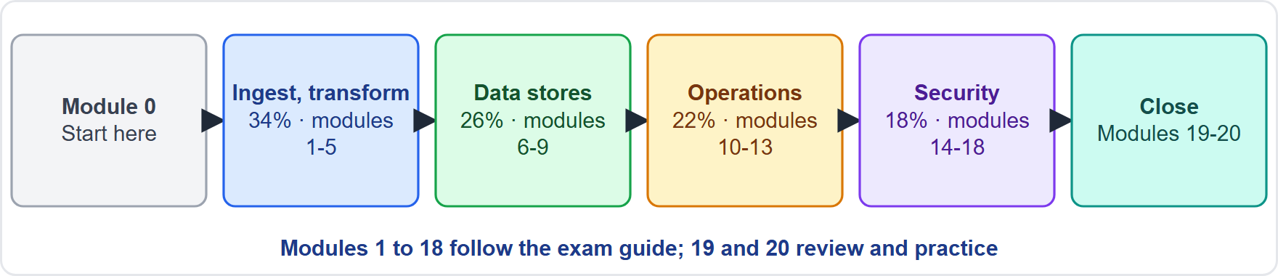
How This Course Works
Module 0
Modules 1 to 18 follow the exam guide: one module per task statement (task 1.1 has two)
Module 19 is a quick reference with a service chooser; module 20 covers exam technique and a final week
Modules 1 to 18 follow the exam guide: one module per task statement (task 1.1 has two)
Module 19 is a quick reference with a service chooser; module 20 covers exam technique and a final week
Data Engineer Associate Exam Prep Masterclass | for the AWS DEA-C01 exam
Module 0: Course Introduction and Exam Orientation
13 / 18
Notes:
How This Course Works.
The figure shows this: Course map: module zero starts the course, then four domain groups hold modules one to five, six to nine, ten to thirteen and fourteen to eighteen, and modules nineteen and twenty close with a recap and exam technique.
Modules one to eighteen follow the exam guide: one module per task statement (task one point one has two).
Module nineteen is a quick reference with a service chooser; module twenty covers exam technique and a final week.

Slide 14
How This Course Works, continued
Module 0
Every content module has: what you will learn, a Kestrel Freight case, the content with tables and figures, exam tips, practice questions with explanations, and a quick reference card
Kestrel Freight is a fictional freight and logistics company; its truck telemetry, shipment orders and customer data grow into a data platform, one decision per module. It is fictional and not a real company
Data Engineer Associate Exam Prep Masterclass | for the AWS DEA-C01 exam
Module 0: Course Introduction and Exam Orientation
14 / 18
Notes:
How This Course Works, continued.
Every content module has: what you will learn, a Kestrel Freight case, the content with tables and figures, exam tips, practice questions with explanations, and a quick reference card.
Kestrel Freight is a fictional freight and logistics company; its truck telemetry, shipment orders and customer data grow into a data platform, one decision per module. It is fictional and not a real company.

Slide 15
Labels you will see
Module 0
: AWS changes this often; the item carries an "As of" date, and you should read the AWS page before you rely on it
: a service or feature has a new name, and older questions may use the old one (for example Amazon Kinesis Data Firehose is now Amazon Data Firehose)
: taught for understanding, not named in the exam guide
: a date that matters for the exam
Data Engineer Associate Exam Prep Masterclass | for the AWS DEA-C01 exam
Module 0: Course Introduction and Exam Orientation
15 / 18
Notes:
Labels you will see.
: A W S changes this often; the item carries an "As of" date, and you should read the A W S page before you rely on it.
: a service or feature has a new name, and older questions may use the old one (for example Amazon Kinesis Data Firehose is now Amazon Data Firehose).
: taught for understanding, not named in the exam guide.
: a date that matters for the exam.

Slide 16
Study Plan and Ground Rules
Module 0
Study one module, then do its questions; read the quick reference card last
Cover every task statement: the guide does not weight them separately
Compare look-alike services: most wrong answers are real services that fit a different requirement (for example Kinesis Data Streams and Amazon Data Firehose, Athena and Redshift, Glue and EMR)
Read the requirement words: near real time, lowest cost, least operational overhead, serverless, exactly once, schema-on-read decide the answer
Use the last week for the recap module, the service chooser and exam technique
Data Engineer Associate Exam Prep Masterclass | for the AWS DEA-C01 exam
Module 0: Course Introduction and Exam Orientation
16 / 18
Notes:
Study Plan and Ground Rules.
Study one module, then do its questions; read the quick reference card last.
Cover every task statement: the guide does not weight them separately.
Compare look-alike services: most wrong answers are real services that fit a different requirement (for example Kinesis Data Streams and Amazon Data Firehose, Athena and Redshift, Glue and E M R (Elastic MapReduce)).
Read the requirement words: near real time, lowest cost, least operational overhead, serverless, exactly once, schema-on-read decide the answer.
Use the last week for the recap module, the service chooser and exam technique.

Slide 17
Study Plan and Ground Rules, continued
Module 0
Independence: this course is independent and educational; it is not affiliated with, endorsed or sponsored by Amazon Web Services, and it shows no AWS logos. The AWS exam guide and documentation outrank this course on every fact and rule
EXAM TIP Before you book, read AWS's current exam guide and certification page; fees, languages and rules change.
Data Engineer Associate Exam Prep Masterclass | for the AWS DEA-C01 exam
Module 0: Course Introduction and Exam Orientation
17 / 18
Notes:
Study Plan and Ground Rules, continued.
Independence: this course is independent and educational; it is not affiliated with, endorsed or sponsored by Amazon Web Services, and it shows no A W S logos. The A W S exam guide and documentation outrank this course on every fact and rule.
Exam tip: Before you book, read A W S's current exam guide and certification page; fees, languages and rules change.

Slide 18
Module Recap
DATES
Module 0
1
Exam
2
Scoring
3
Domains
65 questions (50 scored, 15 unscored), 130 minutes, 720 of 1,000 to pass, multiple choice and multiple response
Compensatory; blank is wrong; guess when unsure
Ingestion and Transformation 34%, Data Store Management 26%, Operations and Support 22%, Security and Governance 18%
4
Task statements
5
Guide version
6
Out of scope
17, with 120 skills; this course covers each once
1.1, 12 December 2025: adds LLMs, vectors, Iceberg, SageMaker Catalog
ML training and inference, language syntax, business conclusions
7
Method
Read the requirement words; compare look-alike services; trust AWS documentation over any course
Data Engineer Associate Exam Prep Masterclass | for the AWS DEA-C01 exam
Module 0: Course Introduction and Exam Orientation
18 / 18
Notes:
Here is the recap.
Exam: sixty-five questions (fifty scored, fifteen unscored), one hundred thirty minutes, seven hundred twenty of one thousand to pass, multiple choice and multiple response.
Scoring: Compensatory; blank is wrong; guess when unsure.
Domains: Ingestion and Transformation thirty-four percent, Data Store Management twenty-six percent, Operations and Support twenty-two percent, Security and Governance eighteen percent.
Task statements: seventeen, with one hundred twenty skills; this course covers each once.
Guide version: one point one, twelve December two thousand twenty-five: adds L L M s, vectors, Iceberg, SageMaker Catalog.
Out of scope: M L training and inference, language syntax, business conclusions.
Method: Read the requirement words; compare look-alike services; trust A W S documentation over any course.
In the next module, we continue the course.

