Slide 1
Module 13: Ensure Data Quality
Run data quality checks while processing data (for example empty fields)
Domain 3 · Data Operations and Support · Task statement 3.4
Data Engineer Associate Exam Prep Masterclass
Module 13 · Part 1
Notes:
Welcome to Module thirteen: Ensure Data Quality. This module covers the task statement: ensure data quality.
Each part of this module comes from the study notes of the same name, so you can read the notes after you watch.

Slide 2
What You Will Learn
Part 1
Run data quality checks while processing data (for example empty fields)
Define data quality rules with AWS Glue DataBrew (and AWS Glue Data Quality)
Investigate data consistency
Describe data sampling techniques
Implement mechanisms for data skew
--
Data Engineer Associate Exam Prep Masterclass | for the AWS DEA-C01 exam
Module 13: Ensure Data Quality
2 / 29
Notes:
By the end of this module you will be able to do six things.
Run data quality checks while processing data (for example empty fields).
Define data quality rules with A W S Glue DataBrew (and A W S Glue Data Quality).
Investigate data consistency.
Describe data sampling techniques.
Implement mechanisms for data skew.
--.

Slide 3
Case Check-In: Kestrel Freight Trusts Its Numbers
Part 1
CASE CHECK-IN · Kestrel Freight
An invoice run billed a customer twice because of duplicate orders
Some trucks report temperature as −999 and some weights as zero
Yesterday's file was half the usual size and nobody noticed
Your job: catch bad data before it reaches reports
Data Engineer Associate Exam Prep Masterclass | for the AWS DEA-C01 exam
Module 13: Ensure Data Quality
3 / 29
Notes:
Our running case is Kestrel Freight. Kestrel Freight Trusts Its Numbers.
An invoice run billed a customer twice because of duplicate orders.
Some trucks report temperature as −nine hundred ninety-nine and some weights as zero.
Yesterday's file was half the usual size and nobody noticed.
Your job: catch bad data before it reaches reports.

Slide 4
Dimensions of Data Quality
Part 1
Dimension | Question | Example check
Completeness | Is anything missing? | shipment_id is never null; at least 95% of customer_id filled
Uniqueness | Are there duplicates? | shipment_id unique
Validity | Does it fit the allowed format, type or range? | Weight between 0 and 40,000 kg; date format; allowed status values
Accuracy | Does it match reality? | Delivered count equals the count in the source system
Consistency | Do related values agree across fields, tables or systems? | Delivery date is not before pickup date; source and target totals match
Timeliness (freshness) | Is it recent enough? | Latest record is less than 2 hours old
Data Engineer Associate Exam Prep Masterclass | for the AWS DEA-C01 exam
Module 13: Ensure Data Quality
4 / 29
Notes:
Dimensions of Data Quality.
Completeness. Question: Is anything missing? Example check: shipment id is never null; at least ninety-five percent of customer id filled.
Uniqueness. Question: Are there duplicates? Example check: shipment id unique.
Validity. Question: Does it fit the allowed format, type or range? Example check: Weight between zero and forty thousand kg; date format; allowed status values.
Accuracy. Question: Does it match reality? Example check: Delivered count equals the count in the source system.
Consistency. Question: Do related values agree across fields, tables or systems? Example check: Delivery date is not before pickup date; source and target totals match.
Timeliness (freshness). Question: Is it recent enough? Example check: Latest record is less than two hours old.

Slide 5
Dimensions of Data Quality, continued
Part 1
Dimension | Question | Example check
Integrity | Do references resolve? | Every customer_id exists in the customer table
Volume | Is the amount normal? | Row count within ±20% of the usual
EXAM TIP Match the problem to the dimension: nulls → completeness, duplicates → uniqueness, out-of-range → validity, source ≠ target → consistency, late data → timeliness.
Data Engineer Associate Exam Prep Masterclass | for the AWS DEA-C01 exam
Module 13: Ensure Data Quality
5 / 29
Notes:
Dimensions of Data Quality, continued.
Integrity. Question: Do references resolve? Example check: Every customer id exists in the customer table.
Volume. Question: Is the amount normal? Example check: Row count within plus or minus twenty percent of the usual.
Exam tip: Match the problem to the dimension: nulls to completeness, duplicates to uniqueness, out-of-range to validity, source ≠ target to consistency, late data to timeliness.

Slide 6
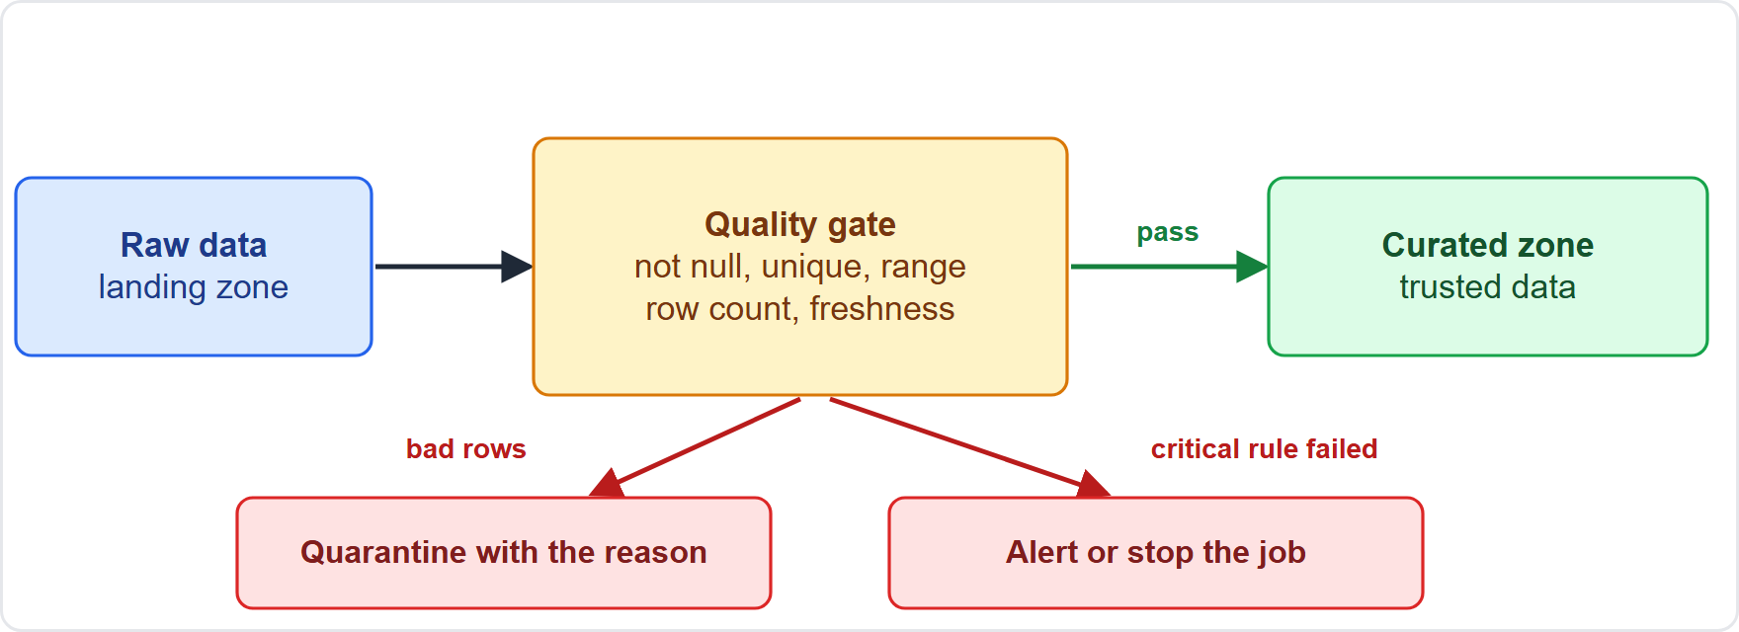
Running Checks While Processing
Part 1
Check early and during processing, not only at the end: at ingestion, after each transformation, and before publishing
Where to run checks:
Check early and during processing, not only at the end: at ingestion, after each transformation, and before publishing
Where to run checks:
Data Engineer Associate Exam Prep Masterclass | for the AWS DEA-C01 exam
Module 13: Ensure Data Quality
6 / 29
Notes:
Running Checks While Processing.
The figure shows this: Quality gates in a pipeline: checks run while data is processed, good records continue to the curated zone, bad records are quarantined, and a failed gate raises an alert or stops the job.
Check early and during processing, not only at the end: at ingestion, after each transformation, and before publishing.
Where to run checks.

Slide 7
Running Checks While Processing, continued
Part 1
Where | How
AWS Glue ETL jobs | AWS Glue Data Quality (the EvaluateDataQuality transform with a ruleset) or Spark code (filter, counts, null checks)
AWS Glue Data Catalog tables | Glue Data Quality rulesets run on a schedule or on demand against a table
AWS Glue DataBrew | Rulesets and profile jobs (visual)
AWS Lambda | Small, event-driven validation of an arriving file
Athena / Redshift SQL | Set-based checks (COUNT, WHERE col IS NULL, GROUP BY ... HAVING COUNT(*) > 1)
Streaming | Flink or Lambda validate records; bad records go to a dead-letter destination
Data Engineer Associate Exam Prep Masterclass | for the AWS DEA-C01 exam
Module 13: Ensure Data Quality
7 / 29
Notes:
Running Checks While Processing, continued.
A W S Glue E T L (extract, transform, load) jobs. A W S Glue Data Quality (the EvaluateDataQuality transform with a ruleset) or Spark code (filter, counts, null checks).
A W S Glue Data Catalog tables. Glue Data Quality rulesets run on a schedule or on demand against a table.
A W S Glue DataBrew. Rulesets and profile jobs (visual).
A W S Lambda. Small, event-driven validation of an arriving file.
Athena or Redshift S Q L. Set-based checks (count, where col is null, group by... having count() greater than one).
Streaming. Flink or Lambda validate records; bad records go to a dead-letter destination.

Slide 8
Running Checks While Processing, continued
Part 1
What to do with a failure (choose by severity):; Fail the job and alert (a critical rule broke); Quarantine the bad records to a rejected S3 prefix or DLQ with the reason, and continue with the good ones; Fix automatically (default values, standardization) and log the change; Alert only (a warning rule)
Examples of checks: empty fields, schema match, data types, ranges, uniqueness, referential integrity, row counts, freshness
Data Engineer Associate Exam Prep Masterclass | for the AWS DEA-C01 exam
Module 13: Ensure Data Quality
8 / 29
Notes:
Running Checks While Processing, continued.
What to do with a failure (choose by severity):; Fail the job and alert (a critical rule broke); Quarantine the bad records to a rejected S three prefix or D L Q (dead-letter queue) with the reason, and continue with the good ones; Fix automatically (default values, standardization) and log the change; Alert only (a warning rule).
Examples of checks: empty fields, schema match, data types, ranges, uniqueness, referential integrity, row counts, freshness.

Slide 9
AWS Glue Data Quality
Part 1
Define rules in DQDL (Data Quality Definition Language), evaluate them in ETL jobs or on catalog tables, get a quality score and rule-by-rule results (to the console, S3, CloudWatch and EventBridge)
Built on the open-source Deequ; Glue can recommend rules from the data
Data Engineer Associate Exam Prep Masterclass | for the AWS DEA-C01 exam
Module 13: Ensure Data Quality
9 / 29
Notes:
A W S Glue Data Quality.
Define rules in D Q D L (Data Quality Definition Language) (Data Quality Definition Language), evaluate them in E T L jobs or on catalog tables, get a quality score and rule-by-rule results (to the console, S three, CloudWatch and EventBridge).
Built on the open-source Deequ; Glue can recommend rules from the data.

Slide 10
AWS Glue Data Quality, continued
Part 1
TEXT
Rules = [
IsComplete "shipment_id",
Uniqueness "shipment_id" > 0.99,
ColumnValues "weight_kg" between 0 and 40000,
ColumnValues "status" in ["PICKED","IN_TRANSIT","DELIVERED"],
RowCount > 1000
]
Example from the study note (names are examples)
EXAM TIP "Stop the job or route bad rows to a quarantine when required fields are empty" → Glue Data Quality rules in the job, with bad records written to a rejected location and an alert.
Data Engineer Associate Exam Prep Masterclass | for the AWS DEA-C01 exam
Module 13: Ensure Data Quality
10 / 29
Notes:
A W S Glue Data Quality, continued.
The example is on the screen; read it line by line when you study.
Exam tip: "Stop the job or route bad rows to a quarantine when required fields are empty" to Glue Data Quality rules in the job, with bad records written to a rejected location and an alert.

Slide 11
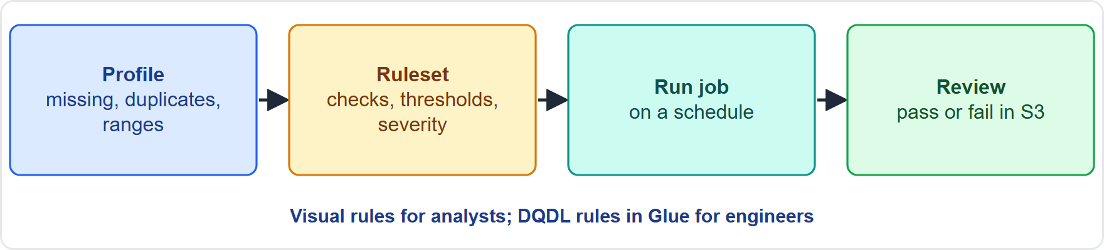
Defining Data Quality Rules with DataBrew
Part 1
AWS Glue DataBrew profiles data and applies data quality rules without code
Profile job: computes statistics per column: missing values, distinct count, duplicates, min, max, mean, distribution, correlations, outliers
AWS Glue DataBrew profiles data and applies data quality rules without code
Profile job: computes statistics per column: missing values, distinct count, duplicates, min, max, mean, distribution, correlations, outliers
Data Engineer Associate Exam Prep Masterclass | for the AWS DEA-C01 exam
Module 13: Ensure Data Quality
11 / 29
Notes:
Defining Data Quality Rules with DataBrew.
The figure shows this: DataBrew data quality rules: profile a dataset, define a ruleset of checks and thresholds, run a profile job, and review the validation results.
A W S Glue DataBrew profiles data and applies data quality rules without code.
Profile job: computes statistics per column: missing values, distinct count, duplicates, min, max, mean, distribution, correlations, outliers.

Slide 12
Defining Data Quality Rules with DataBrew, continued
Part 1
Ruleset: a named set of rules attached to a dataset; each rule has checks (conditions on a column or the whole dataset), thresholds (for example fail if more than 5% missing) and a severity
Typical checks: column is not null, values within a range or list, column value matches a pattern, uniqueness, row count, column statistics, data type
Validation results (pass or fail per rule) are written to S3, and a failed ruleset can stop or alert the pipeline; run on a schedule
Data Engineer Associate Exam Prep Masterclass | for the AWS DEA-C01 exam
Module 13: Ensure Data Quality
12 / 29
Notes:
Defining Data Quality Rules with DataBrew, continued.
Ruleset: a named set of rules attached to a dataset; each rule has checks (conditions on a column or the whole dataset), thresholds (for example fail if more than five percent missing) and a severity.
Typical checks: column is not null, values within a range or list, column value matches a pattern, uniqueness, row count, column statistics, data type.
Validation results (pass or fail per rule) are written to S three, and a failed ruleset can stop or alert the pipeline; run on a schedule.

Slide 13
Defining Data Quality Rules with DataBrew, continued
Part 1
Pick the tool: DataBrew for visual, analyst-owned rules; Glue Data Quality (DQDL) for engineer-owned rules inside jobs and catalogs
Data Engineer Associate Exam Prep Masterclass | for the AWS DEA-C01 exam
Module 13: Ensure Data Quality
13 / 29
Notes:
Defining Data Quality Rules with DataBrew, continued.
Pick the tool: DataBrew for visual, analyst-owned rules; Glue Data Quality (D Q D L) for engineer-owned rules inside jobs and catalogs.

Slide 14
Investigating Data Consistency
Part 1
Consistency means the same facts agree across fields, records, tables and systems, and over time
Investigate with:; Profiling (DataBrew profile job): duplicates, missing values, correlations, odd distributions; Reconciliation queries: compare counts, sums, min and max (or hashes) between source and target; Cross-field rules: delivered_date >= pickup_date; totals equal the sum of lines; Referential checks: orphan keys with a left join; Glue Data Quality dataset checks: compare two datasets; AWS DMS data validation: compares rows in source and target after a migration or replication and reports mismatches
Data Engineer Associate Exam Prep Masterclass | for the AWS DEA-C01 exam
Module 13: Ensure Data Quality
14 / 29
Notes:
Investigating Data Consistency.
Consistency means the same facts agree across fields, records, tables and systems, and over time.
Investigate with:; Profiling (DataBrew profile job): duplicates, missing values, correlations, odd distributions; Reconciliation queries: compare counts, sums, min and max (or hashes) between source and target; Cross-field rules: delivered date greater than equals pickup date; totals equal the sum of lines; Referential checks: orphan keys with a left join; Glue Data Quality dataset checks: compare two datasets; A W S D M S (Database Migration Service) data validation: compares rows in source and target after a migration or replication and reports mismatches.

Slide 15
Investigating Data Consistency, continued
Part 1
System-level consistency to know:; Amazon S3 provides strong read-after-write consistency for object writes, overwrites and deletes and for listings; DynamoDB: reads are eventually consistent by default; request a strongly consistent read when you must see the latest write (not available on global secondary indexes); transactions give all-or-nothing writes; Distributed pipelines: at-least-once delivery causes duplicates, so idempotent writes and de-duplication keep data consistent; Apache Iceberg and transactions give atomic commits to lake tables
Fixing inconsistency: find the source of truth, correct upstream, reprocess (idempotently), add a rule so it is caught next time
EXAM TIP "After migrating, prove source and target match" → AWS DMS data validation (plus row-count and checksum comparisons).
Data Engineer Associate Exam Prep Masterclass | for the AWS DEA-C01 exam
Module 13: Ensure Data Quality
15 / 29
Notes:
Investigating Data Consistency, continued.
System-level consistency to know:; Amazon S three provides strong read-after-write consistency for object writes, overwrites and deletes and for listings; DynamoDB: reads are eventually consistent by default; request a strongly consistent read when you must see the latest write (not available on global secondary indexes); transactions give all-or-nothing writes; Distributed pipelines: at-least-once delivery causes duplicates, so idempotent writes and de-duplication keep data consistent; Apache Iceberg and transactions give atomic commits to lake tables.
Fixing inconsistency: find the source of truth, correct upstream, reprocess (idempotently), add a rule so it is caught next time.
Exam tip: "After migrating, prove source and target match" to A W S D M S data validation (plus row-count and checksum comparisons).

Slide 16
Data Sampling Techniques
Part 1
Sampling takes a subset of data to profile, test or check it quickly and cheaply instead of scanning everything
Techniques:
Data Engineer Associate Exam Prep Masterclass | for the AWS DEA-C01 exam
Module 13: Ensure Data Quality
16 / 29
Notes:
Data Sampling Techniques.
Sampling takes a subset of data to profile, test or check it quickly and cheaply instead of scanning everything.
Techniques.

Slide 17
Data Sampling Techniques, continued
Part 2
Technique | How | Use it when
Simple random | Every row has equal chance | General profiling; avoids bias
Systematic | Every n-th row | Ordered data, fast and simple (watch for hidden patterns)
Stratified | Sample within each group (route, region) in proportion | Rare groups must be represented
Cluster | Pick whole groups (a partition or file) at random | Cheap when reading whole files
Reservoir | Keep a fixed-size random sample of a stream of unknown length | Streaming data
First-N (head) | Take the first rows | Quick look only: may be biased
Data Engineer Associate Exam Prep Masterclass | for the AWS DEA-C01 exam
Module 13: Ensure Data Quality
17 / 29
Notes:
Data Sampling Techniques, continued.
Simple random. How: Every row has equal chance. Use it when: General profiling; avoids bias.
Systematic. How: Every n-th row. Use it when: Ordered data, fast and simple (watch for hidden patterns).
Stratified. How: Sample within each group (route, region) in proportion. Use it when: Rare groups must be represented.
Cluster. How: Pick whole groups (a partition or file) at random. Use it when: Cheap when reading whole files.
Reservoir. How: Keep a fixed-size random sample of a stream of unknown length. Use it when: Streaming data.
First-N (head). How: Take the first rows. Use it when: Quick look only: may be biased.

Slide 18
Data Sampling Techniques, continued
Part 2
In AWS: DataBrew profile jobs can use the full dataset or a sample (for example the first N rows or a random N rows); Athena TABLESAMPLE and Spark sample() for random subsets; Glue Data Quality and Spark jobs can run on a sample to save cost
Cautions: a sample can miss rare errors and can be biased; use bigger or stratified samples for rare events and run full checks for critical rules
Data Engineer Associate Exam Prep Masterclass | for the AWS DEA-C01 exam
Module 13: Ensure Data Quality
18 / 29
Notes:
Data Sampling Techniques, continued.
In A W S: DataBrew profile jobs can use the full dataset or a sample (for example the first N rows or a random N rows); Athena T A B L E S A M P L E and Spark sample() for random subsets; Glue Data Quality and Spark jobs can run on a sample to save cost.
Cautions: a sample can miss rare errors and can be biased; use bigger or stratified samples for rare events and run full checks for critical rules.

Slide 19
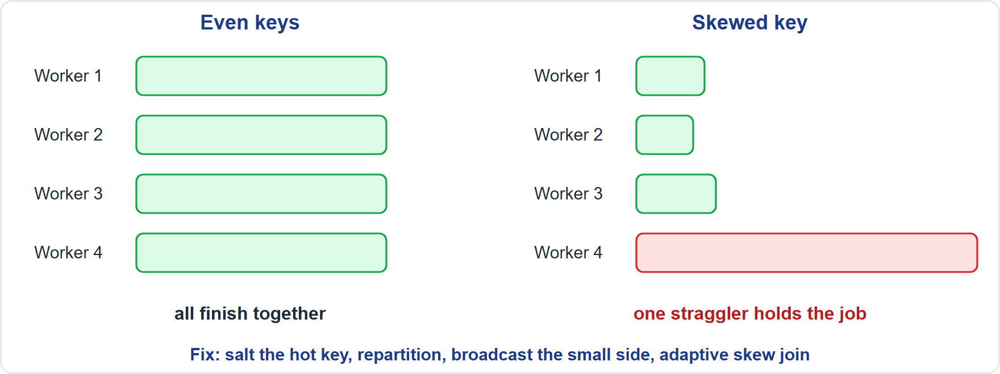
Data Skew
Part 2
Data skew = values are not evenly spread: one key holds a large share of the rows, so one partition, node, shard or task does most of the work (a straggler) or runs out of memory
Data skew = values are not evenly spread: one key holds a large share of the rows, so one partition, node, shard or task does most of the work (a straggler) or runs out of memory
Data Engineer Associate Exam Prep Masterclass | for the AWS DEA-C01 exam
Module 13: Ensure Data Quality
19 / 29
Notes:
Data Skew.
The figure shows this: Data skew: an uneven key distribution gives one worker most of the work, so the job waits for that straggler; salting or repartitioning spreads the load.
Data skew equals values are not evenly spread: one key holds a large share of the rows, so one partition, node, shard or task does most of the work (a straggler) or runs out of memory.

Slide 20
Data Skew, continued
Part 2
Symptoms: one task much slower in the Spark UI; one Kinesis shard or DynamoDB partition throttled while others idle; one Redshift slice holds many more rows; out-of-memory on one executor
Mechanisms to handle skew:
Data Engineer Associate Exam Prep Masterclass | for the AWS DEA-C01 exam
Module 13: Ensure Data Quality
20 / 29
Notes:
Data Skew, continued.
Symptoms: one task much slower in the Spark U I; one Kinesis shard or DynamoDB partition throttled while others idle; one Redshift slice holds many more rows; out-of-memory on one executor.
Mechanisms to handle skew.

Slide 21
Data Skew, continued
Part 2
Where | Fix
Spark (Glue, EMR) | Salting: add a random suffix to the hot key, aggregate in two steps; repartition on a better key; broadcast the small side of a join; enable adaptive query execution skew-join handling; filter hot or null keys and process them separately
Redshift | Choose a distribution key with many distinct, evenly used values; use EVEN or AUTO; check skew in table information views; avoid a key with many nulls
DynamoDB | High-cardinality partition key, or a suffix (write sharding) for very hot keys; spread keys
Data Engineer Associate Exam Prep Masterclass | for the AWS DEA-C01 exam
Module 13: Ensure Data Quality
21 / 29
Notes:
Data Skew, continued.
Spark (Glue, E M R (Elastic MapReduce)). Salting: add a random suffix to the hot key, aggregate in two steps; repartition on a better key; broadcast the small side of a join; enable adaptive query execution skew-join handling; filter hot or null keys and process them separately.
Redshift. Choose a distribution key with many distinct, evenly used values; use even or auto; check skew in table information views; avoid a key with many nulls.
DynamoDB. High-cardinality partition key, or a suffix (write sharding) for very hot keys; spread keys.

Slide 22
Data Skew, continued
Part 2
Where | Fix
Kinesis / Kafka | Partition key with many values; add a random suffix for hot keys; split the hot shard or use on-demand
S3 / Athena | Partition by a balanced column; avoid a few giant partitions; compact small files
EXAM TIP "One task runs for hours while the rest finish in seconds after a join on customer_id, and one customer has most rows" → data skew: salt the key, broadcast, or enable adaptive skew handling.
Data Engineer Associate Exam Prep Masterclass | for the AWS DEA-C01 exam
Module 13: Ensure Data Quality
22 / 29
Notes:
Data Skew, continued.
Kinesis or Kafka. Partition key with many values; add a random suffix for hot keys; split the hot shard or use on-demand.
S three or Athena. Partition by a balanced column; avoid a few giant partitions; compact small files.
Exam tip: "One task runs for hours while the rest finish in seconds after a join on customer id, and one customer has most rows" to data skew: salt the key, broadcast, or enable adaptive skew handling.

Slide 23
Module Recap
Part 2
1
Dimensions
2
Checks in processing
3
DQDL
Completeness, uniqueness, validity, accuracy, consistency, timeliness, integrity, volume
Rules = [ IsComplete "col", Uniqueness "col" > 0.99, ColumnValues "col" between a and b, RowCount > n ]; built on Deequ; score and results to S3/CloudWatch/EventBridge
Early and repeated
4
DataBrew
5
Consistency
6
Sampling
Profile job (missing, duplicates, distribution, outliers), ruleset with checks, thresholds, severity, validation results in S3
Profile, reconcile counts/sums/hashes, cross-field and referential rules, DMS data validation; S3 strong consistency
Random, systematic, stratified, cluster, reservoir (streams), first-N (biased); Athena TABLESAMPLE, Spark sample()
7
Skew
One hot key → straggler
Data Engineer Associate Exam Prep Masterclass | for the AWS DEA-C01 exam
Module 13: Ensure Data Quality
23 / 29
Notes:
Here is the recap.
Dimensions: Completeness, uniqueness, validity, accuracy, consistency, timeliness, integrity, volume.
Checks in processing: Early and repeated.
D Q D L: Rules equals [ IsComplete "col", Uniqueness "col" greater than zero point nine nine, ColumnValues "col" between a and b, RowCount greater than n ]; built on Deequ; score and results to S three or CloudWatch or EventBridge.
DataBrew: Profile job (missing, duplicates, distribution, outliers), ruleset with checks, thresholds, severity, validation results in S three.
Consistency: Profile, reconcile counts or sums or hashes, cross-field and referential rules, D M S data validation; S three strong consistency.
Sampling: Random, systematic, stratified, cluster, reservoir (streams), first-N (biased); Athena T A B L E S A M P L E, Spark sample().
Skew: One hot key to straggler.

Slide 24
Practice Question 1
Part 2
Q1
During an AWS Glue job the team must stop processing and alert when required fields such as shipment_id are empty, and route other invalid records for review. What is the best design?
A
Ignore the null values in the job and fix the data next month
B
Glue Data Quality rules in the job, bad records written to a rejected S3 prefix, and an alert on failure
C
Convert all the input files to CSV before the job reads them
D
Increase the number of DPUs so that the job finishes before checks
Data Engineer Associate Exam Prep Masterclass | for the AWS DEA-C01 exam
Module 13: Ensure Data Quality
24 / 29
Notes:
Question one.
During an A W S Glue job the team must stop processing and alert when required fields such as shipment id are empty, and route other invalid records for review. What is the best design?
The four options are on the screen.
[PAUSE 12]
The answer is B. Quality rules in the job detect problems early, quarantining isolates bad records with the reason, and alerts notify the team.

Slide 25
Practice Question 2
Part 2
Q2
Analysts without coding skills want to define data quality checks such as "no more than 5% missing values in the weight column" and review pass or fail results. Which service should they use?
A
AWS Glue DataBrew rulesets and profile jobs
B
Amazon Kinesis Data Streams with a validating consumer
C
AWS CloudTrail trails with data events turned on
D
Amazon Macie jobs that scan the files for personal data
Data Engineer Associate Exam Prep Masterclass | for the AWS DEA-C01 exam
Module 13: Ensure Data Quality
25 / 29
Notes:
Question two.
Analysts without coding skills want to define data quality checks such as "no more than five percent missing values in the weight column" and review pass or fail results. Which service should they use?
The four options are on the screen.
[PAUSE 12]
The answer is A. DataBrew provides visual data quality rules with thresholds and validation results without code.

Slide 26
Practice Question 3
Part 2
Q3
After a database migration the team must confirm that the rows in the target match the source. Which TWO actions help? (Select TWO.)
A
Delete the source before checking
B
Compare row counts and checksums between source and target
C
Increase the replication instance size only
D
Enable AWS DMS data validation on the task
E
Disable CDC
Data Engineer Associate Exam Prep Masterclass | for the AWS DEA-C01 exam
Module 13: Ensure Data Quality
26 / 29
Notes:
Question three. Select two.
After a database migration the team must confirm that the rows in the target match the source. Which two actions help?
The five options are on the screen.
[PAUSE 15]
The answers are B and D. D M S data validation compares source and target rows, and count and checksum comparisons confirm consistency. The other actions do not verify data.

Slide 27
Practice Question 4
Part 2
Q4
A join on customer_id makes one Spark task run for hours because a single customer has most of the rows. Which TWO actions reduce the problem? (Select TWO.)
A
Write the output as many more small files
B
Turn off partitioning of the input
C
Remove the join and keep both tables unsorted
D
Enable adaptive query execution skew-join handling
E
Salt the hot key and aggregate in two steps
Data Engineer Associate Exam Prep Masterclass | for the AWS DEA-C01 exam
Module 13: Ensure Data Quality
27 / 29
Notes:
Question four. Select two.
A join on customer id makes one Spark task run for hours because a single customer has most of the rows. Which two actions reduce the problem?
The five options are on the screen.
[PAUSE 15]
The answers are D and E. Uneven key distribution is data skew; salting the hot key and adaptive skew-join handling spread the work across tasks. Small files, no partitioning and dropping the join do not fix the imbalance.

Slide 28
Practice Question 5
Part 2
Q5
A team wants to profile a very large dataset quickly and cheaply and make sure rare categories are represented. Which sampling technique is best?
A
Take the first 1,000 rows
B
Stratified sampling within each category
C
Take every row
D
Systematic sampling of every 1,000,000th row
Data Engineer Associate Exam Prep Masterclass | for the AWS DEA-C01 exam
Module 13: Ensure Data Quality
28 / 29
Notes:
Question five.
A team wants to profile a very large dataset quickly and cheaply and make sure rare categories are represented. Which sampling technique is best?
The four options are on the screen.
[PAUSE 12]
The answer is B. Stratified sampling samples within each group, so rare categories are represented; the first rows can be biased.

Slide 29
Answers at a Glance
Part 2
Question | Answer | Why
Q1 | B | Quality rules in the job detect problems early
Q2 | A | DataBrew provides visual data quality rules with thresholds and validation results without code
Q3 | B, D | DMS data validation compares source and target rows
Q4 | D, E | Uneven key distribution is data skew
Q5 | B | Stratified sampling samples within each group, so rare categories are represented
Data Engineer Associate Exam Prep Masterclass | for the AWS DEA-C01 exam
Module 13: Ensure Data Quality
29 / 29
Notes:
Here are all five answers. Question one: B. Question two: A. Question three: B and D. Question four: D and E. Question five: B.
In the next module, we continue the course.

