Slide 1
Module 14: Authentication Mechanisms
Update VPC security groups so only the right sources reach data stores
Domain 4 · Data Security and Governance · Task statement 4.1
Data Engineer Associate Exam Prep Masterclass
Module 14 · Part 1
Notes:
Welcome to Module fourteen: Authentication Mechanisms. This module covers the task statement: apply authentication mechanisms.
Each part of this module comes from the study notes of the same name, so you can read the notes after you watch.

Slide 2
What You Will Learn
Part 1
Update VPC security groups so only the right sources reach data stores
Create and update IAM groups, roles, endpoints and services
Create and rotate credentials with AWS Secrets Manager
Set up IAM roles for Lambda, API Gateway, the AWS CLI and CloudFormation
Apply IAM policies to roles, endpoints and services (S3 Access Points, AWS PrivateLink)
Describe managed versus unmanaged services
Data Engineer Associate Exam Prep Masterclass | for the AWS DEA-C01 exam
Module 14: Authentication Mechanisms
2 / 29
Notes:
By the end of this module you will be able to do six things.
Update V P C (Virtual Private Cloud) security groups so only the right sources reach data stores.
Create and update I A M (Identity and Access Management) groups, roles, endpoints and services.
Create and rotate credentials with A W S Secrets Manager.
Set up I A M roles for Lambda, A P I Gateway, the A W S C L I (command line interface) and CloudFormation.
Apply I A M policies to roles, endpoints and services (S three Access Points, A W S PrivateLink).
Describe managed versus unmanaged services.

Slide 3
Case Check-In: Kestrel Freight Locks the Doors
Part 1
CASE CHECK-IN · Kestrel Freight
The Redshift cluster is reachable from the whole internet
A Glue job cannot connect to the billing database
An analyst keeps a database password in a script
Your job: authenticate every caller and open only the paths that are needed
Data Engineer Associate Exam Prep Masterclass | for the AWS DEA-C01 exam
Module 14: Authentication Mechanisms
3 / 29
Notes:
Our running case is Kestrel Freight. Kestrel Freight Locks the Doors.
The Redshift cluster is reachable from the whole internet.
A Glue job cannot connect to the billing database.
An analyst keeps a database password in a script.
Your job: authenticate every caller and open only the paths that are needed.

Slide 4
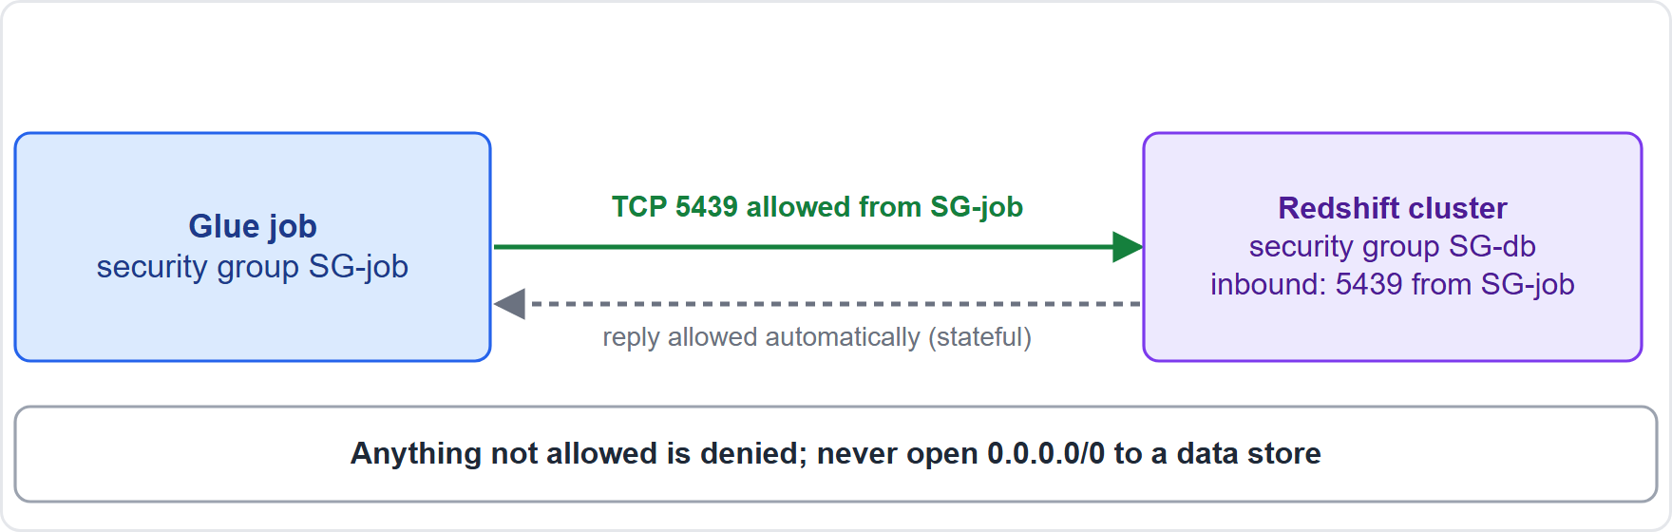
Network Access: VPC Security Groups
Part 1
A security group is a virtual firewall at the resource level (network interface): allow rules only, stateful (return traffic is allowed automatically), default deny for inbound
A security group is a virtual firewall at the resource level (network interface): allow rules only, stateful (return traffic is allowed automatically), default deny for inbound
Data Engineer Associate Exam Prep Masterclass | for the AWS DEA-C01 exam
Module 14: Authentication Mechanisms
4 / 29
Notes:
Network Access: V P C Security Groups.
The figure shows this: Security groups: a stateful firewall on the resource; allow rules only; reference another security group as the source; return traffic is automatic.
A security group is a virtual firewall at the resource level (network interface): allow rules only, stateful (return traffic is allowed automatically), default deny for inbound.

Slide 5
Network Access: VPC Security Groups, continued
Part 1
Update rules to least access: allow only the needed port and source: Redshift 5439, PostgreSQL 5432, MySQL 3306, HTTPS 443; use another security group as the source (for example the Glue job's) instead of an IP range; never open `0.0.0.0/0` to a data store
Glue, EMR and Lambda in a VPC: Glue connections use security groups with a self-referencing inbound rule (the group allows traffic from itself) so the job's workers can talk to each other
Network ACLs are stateless subnet-level filters (allow and deny rules) and are not the main control for data stores
Data Engineer Associate Exam Prep Masterclass | for the AWS DEA-C01 exam
Module 14: Authentication Mechanisms
5 / 29
Notes:
Network Access: V P C Security Groups, continued.
Update rules to least access: allow only the needed port and source: Redshift five four three nine, PostgreSQL five four three two, MySQL three three zero six, H T T P S four hundred forty-three; use another security group as the source (for example the Glue job's) instead of an I P range; never open zero point zero.zero point zero or zero to a data store.
Glue, E M R (Elastic MapReduce) and Lambda in a V P C: Glue connections use security groups with a self-referencing inbound rule (the group allows traffic from itself) so the job's workers can talk to each other.
Network A C L s (access control list) are stateless subnet-level filters (allow and deny rules) and are not the main control for data stores.

Slide 6
Network Access: VPC Security Groups, continued
Part 1
Private connectivity: VPC endpoints (below) keep traffic off the internet; place data stores in private subnets
EXAM TIP "Allow a Glue job to reach a private database" → a database security group rule that allows the job's security group (and the right port), not a public IP range.
Data Engineer Associate Exam Prep Masterclass | for the AWS DEA-C01 exam
Module 14: Authentication Mechanisms
6 / 29
Notes:
Network Access: V P C Security Groups, continued.
Private connectivity: V P C endpoints (below) keep traffic off the internet; place data stores in private subnets.
Exam tip: "Allow a Glue job to reach a private database" to a database security group rule that allows the job's security group (and the right port), not a public I P range.

Slide 7
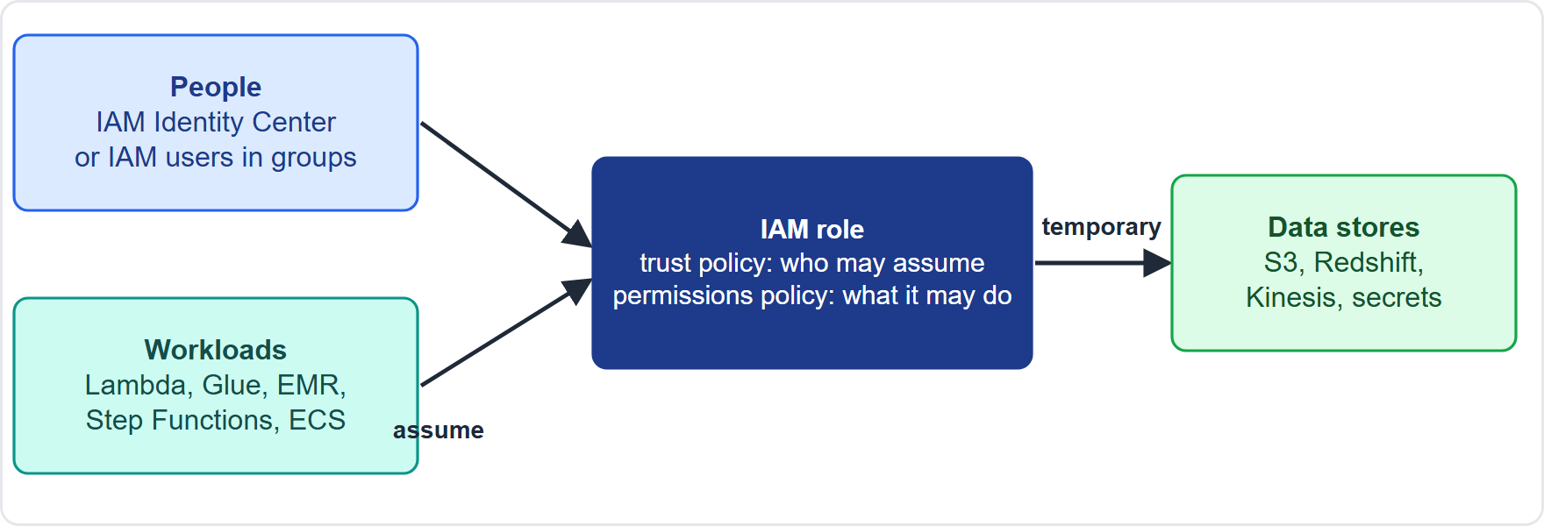
IAM Identities: Groups, Roles, Endpoints and Services
Part 1
Who is calling: people use IAM Identity Center or IAM users in groups; services and workloads assume IAM roles with a trust policy and temporary credentials
Data Engineer Associate Exam Prep Masterclass | for the AWS DEA-C01 exam
Module 14: Authentication Mechanisms
7 / 29
Notes:
I A M Identities: Groups, Roles, Endpoints and Services.
The figure shows this: Who is calling: people use I A M Identity Center or I A M users in groups; services and workloads assume I A M roles with a trust policy and temporary credentials.

Slide 8
IAM Identities: Groups, Roles, Endpoints and Services, continued
Part 1
Identity | Use | Remember
IAM user | A person or app with long-term credentials | Avoid for workloads; use MFA
IAM group | Collection of users sharing permissions | Attach policies to the group, not each user
IAM role | An identity with no long-term credentials that a trusted entity assumes to get temporary credentials | Preferred for services, applications and cross-account access
Trust policy | Who may assume the role | Separate from the permissions policy (what the role may do)
Service-linked role | A role predefined for an AWS service | Created and managed by the service
Data Engineer Associate Exam Prep Masterclass | for the AWS DEA-C01 exam
Module 14: Authentication Mechanisms
8 / 29
Notes:
I A M Identities: Groups, Roles, Endpoints and Services, continued.
I A M user. Use: A person or app with long-term credentials. Remember: Avoid for workloads; use M F A (multi-factor authentication).
I A M group. Use: Collection of users sharing permissions. Remember: Attach policies to the group, not each user.
I A M role. Use: An identity with no long-term credentials that a trusted entity assumes to get temporary credentials. Remember: Preferred for services, applications and cross-account access.
Trust policy. Use: Who may assume the role. Remember: Separate from the permissions policy (what the role may do).
Service-linked role. Use: A role predefined for an A W S service. Remember: Created and managed by the service.

Slide 9
IAM Identities: Groups, Roles, Endpoints and Services, continued
Part 1
Identity | Use | Remember
Federation (IAM Identity Center) | People sign in with corporate identities and get temporary role access | Best for human access to many accounts
Data Engineer Associate Exam Prep Masterclass | for the AWS DEA-C01 exam
Module 14: Authentication Mechanisms
9 / 29
Notes:
I A M Identities: Groups, Roles, Endpoints and Services, continued.
Federation (I A M Identity Center). Use: People sign in with corporate identities and get temporary role access. Remember: Best for human access to many accounts.

Slide 10
IAM roles for services and tools
Part 1
Caller | Role setup
AWS Lambda | An execution role (trust: lambda.amazonaws.com) with permissions to the data stores and CloudWatch Logs
AWS Glue jobs and crawlers | A Glue service role that can read the sources, write the targets, use the Data Catalog and the temp bucket
Amazon API Gateway | IAM authorization for callers; an integration role so the API can call Lambda, Step Functions or other services
AWS CLI and SDKs | Assume a role (named profile, IAM Identity Center sign-in, or environment) to get temporary credentials; never embed long-term keys
Data Engineer Associate Exam Prep Masterclass | for the AWS DEA-C01 exam
Module 14: Authentication Mechanisms
10 / 29
Notes:
I A M roles for services and tools.
A W S Lambda. An execution role (trust: lambda.amazonaws.com) with permissions to the data stores and CloudWatch Logs.
A W S Glue jobs and crawlers. A Glue service role that can read the sources, write the targets, use the Data Catalog and the temp bucket.
Amazon A P I Gateway. I A M authorization for callers; an integration role so the A P I can call Lambda, Step Functions or other services.
A W S C L I and S D K s (software development kit). Assume a role (named profile, I A M Identity Center sign-in, or environment) to get temporary credentials; never embed long-term keys.

Slide 11
IAM roles for services and tools, continued
Part 1
Caller | Role setup
AWS CloudFormation | A service role that CloudFormation assumes to create resources, so deployers need fewer direct permissions
Amazon EC2 / ECS / EKS | Instance profile or task / pod role
Redshift, EMR, Step Functions, SageMaker | Roles attached to the cluster or state machine (for example the Redshift IAM role used by COPY, UNLOAD and Spectrum)
Cross-account access: the data owner's role trusts the other account; the caller assumes the role (STS `AssumeRole`)
Data Engineer Associate Exam Prep Masterclass | for the AWS DEA-C01 exam
Module 14: Authentication Mechanisms
11 / 29
Notes:
I A M roles for services and tools, continued.
A W S CloudFormation. A service role that CloudFormation assumes to create resources, so deployers need fewer direct permissions.
Amazon E C two (Elastic Compute Cloud) or E C S (Elastic Container Service) or E K S (Elastic Kubernetes Service). Instance profile or task or pod role.
Redshift, E M R, Step Functions, SageMaker. Roles attached to the cluster or state machine (for example the Redshift I A M role used by copy, unload and Spectrum).
Cross-account access: the data owner's role trusts the other account; the caller assumes the role (S T S (Security Token Service) AssumeRole).

Slide 12
Endpoints
Part 1
A VPC endpoint lets resources in your VPC reach AWS services privately: gateway endpoints (S3 and DynamoDB; a route table entry; no extra charge) and interface endpoints (AWS PrivateLink: an elastic network interface with a private IP for many services, including your own)
Update endpoints to add services, route tables, subnets and security groups, and endpoint policies
EXAM TIP "A Lambda function needs to read S3 and write Kinesis without long-term keys" → an IAM execution role with those permissions. "Keep S3 traffic off the internet" → a gateway VPC endpoint.
Data Engineer Associate Exam Prep Masterclass | for the AWS DEA-C01 exam
Module 14: Authentication Mechanisms
12 / 29
Notes:
Endpoints.
A V P C endpoint lets resources in your V P C reach A W S services privately: gateway endpoints (S three and DynamoDB; a route table entry; no extra charge) and interface endpoints (A W S PrivateLink: an elastic network interface with a private I P for many services, including your own).
Update endpoints to add services, route tables, subnets and security groups, and endpoint policies.
Exam tip: "A Lambda function needs to read S three and write Kinesis without long-term keys" to an I A M execution role with those permissions. "Keep S three traffic off the internet" to a gateway V P C endpoint.

Slide 13
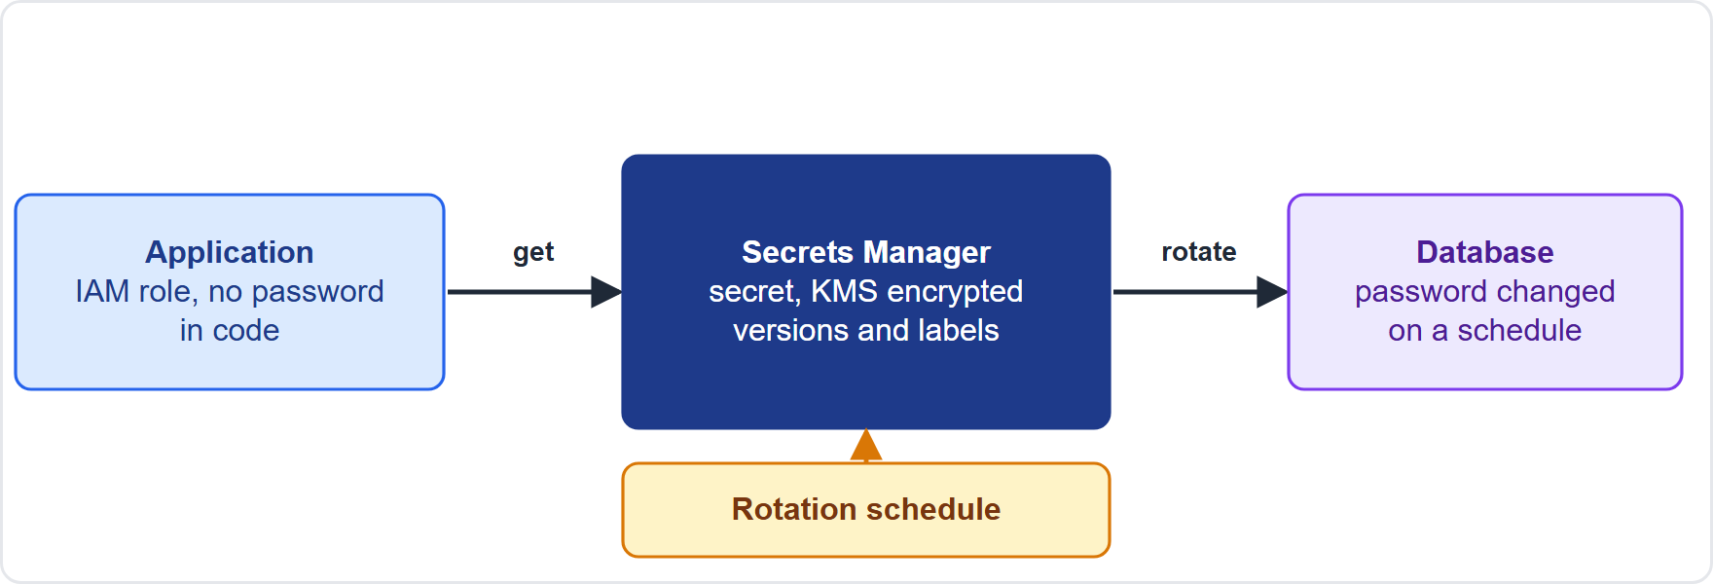
Secrets: Creating and Rotating Credentials
Part 1
AWS Secrets Manager stores, retrieves and rotates database credentials, API keys and tokens; secrets are encrypted with AWS KMS; access is controlled by IAM
Applications fetch the secret at run time, so no password lives in code, job parameters or configuration files
AWS Secrets Manager stores, retrieves and rotates database credentials, API keys and tokens; secrets are encrypted with AWS KMS; access is controlled by IAM
Applications fetch the secret at run time, so no password lives in code, job parameters or configuration files
Data Engineer Associate Exam Prep Masterclass | for the AWS DEA-C01 exam
Module 14: Authentication Mechanisms
13 / 29
Notes:
Secrets: Creating and Rotating Credentials.
The figure shows this: A W S Secrets Manager: applications fetch credentials at run time with an I A M role; rotation changes the password in both the secret and the database on a schedule.
A W S Secrets Manager stores, retrieves and rotates database credentials, A P I keys and tokens; secrets are encrypted with A W S K M S (Key Management Service); access is controlled by I A M.
Applications fetch the secret at run time, so no password lives in code, job parameters or configuration files.

Slide 14
Secrets: Creating and Rotating Credentials, continued
Part 1
Rotation: automatic rotation on a schedule (rate() or cron()); managed rotation (no Lambda to write) for Amazon RDS and Aurora master user credentials and the Redshift admin password; other secrets use a Lambda rotation function (created from a template or your own) that must reach both Secrets Manager and the database over the network
Rotation steps (create new secret version, set it in the database, test, finish) keep the old version available until the switch, so applications do not break
Data Engineer Associate Exam Prep Masterclass | for the AWS DEA-C01 exam
Module 14: Authentication Mechanisms
14 / 29
Notes:
Secrets: Creating and Rotating Credentials, continued.
Rotation: automatic rotation on a schedule (rate() or cron()); managed rotation (no Lambda to write) for Amazon R D S (Relational Database Service) and Aurora master user credentials and the Redshift admin password; other secrets use a Lambda rotation function (created from a template or your own) that must reach both Secrets Manager and the database over the network.
Rotation steps (create new secret version, set it in the database, test, finish) keep the old version available until the switch, so applications do not break.

Slide 15
Secrets: Creating and Rotating Credentials, continued
Part 1
AWS Systems Manager Parameter Store also holds configuration and secrets (SecureString, encrypted with KMS) but has no built-in rotation (Module 15)
Glue connections and Redshift can reference a secret instead of a password
EXAM TIP "Rotate the RDS password automatically and have applications keep working" → Secrets Manager rotation (managed for RDS and Aurora).
Data Engineer Associate Exam Prep Masterclass | for the AWS DEA-C01 exam
Module 14: Authentication Mechanisms
15 / 29
Notes:
Secrets: Creating and Rotating Credentials, continued.
A W S Systems Manager Parameter Store also holds configuration and secrets (SecureString, encrypted with K M S) but has no built-in rotation (Module fifteen).
Glue connections and Redshift can reference a secret instead of a password.
Exam tip: "Rotate the R D S password automatically and have applications keep working" to Secrets Manager rotation (managed for R D S and Aurora).

Slide 16
Applying IAM Policies to Roles, Endpoints and Services
Part 2
Identity-based policy
Resource-based policy
VPC endpoint policy
attached to a user, group or role; says what it may do
attached to a resource (S3 bucket, KMS key, SQS queue, Lambda function, secret); names a principal (including other accounts)
a resource policy on the endpoint that limits which principals and actions can use it (for example only your bucket)
Data Engineer Associate Exam Prep Masterclass | for the AWS DEA-C01 exam
Module 14: Authentication Mechanisms
16 / 29
Notes:
Applying I A M Policies to Roles, Endpoints and Services.
Identity-based policy: attached to a user, group or role; says what it may do.
Resource-based policy: attached to a resource (S three bucket, K M S key, S Q S (Simple Queue Service) queue, Lambda function, secret); names a principal (including other accounts).
V P C endpoint policy: a resource policy on the endpoint that limits which principals and actions can use it (for example only your bucket).

Slide 17
Applying IAM Policies to Roles, Endpoints and Services, continued
Part 2
Amazon S3 Access Points: named network endpoints for a bucket, each with its own access point policy (and optionally restricted to one VPC): they simplify permissions for shared datasets (give each team or application its own access point instead of one huge bucket policy)
AWS PrivateLink: private connectivity to a service (AWS, a partner or your own) over interface endpoints, no internet gateway, NAT or public IP; combine with endpoint policies
Evaluation: an explicit deny wins; otherwise something must allow; same-account access needs an allow in either the identity or the resource policy, cross-account needs both (Module 15)
Data Engineer Associate Exam Prep Masterclass | for the AWS DEA-C01 exam
Module 14: Authentication Mechanisms
17 / 29
Notes:
Applying I A M Policies to Roles, Endpoints and Services, continued.
Amazon S three Access Points: named network endpoints for a bucket, each with its own access point policy (and optionally restricted to one V P C): they simplify permissions for shared datasets (give each team or application its own access point instead of one huge bucket policy).
A W S PrivateLink: private connectivity to a service (A W S, a partner or your own) over interface endpoints, no internet gateway, N A T (network address translation) or public I P; combine with endpoint policies.
Evaluation: an explicit deny wins; otherwise something must allow; same-account access needs an allow in either the identity or the resource policy, cross-account needs both (Module fifteen).

Slide 18
Applying IAM Policies to Roles, Endpoints and Services, continued
Part 2
Condition keys such as aws:SourceVpce (the endpoint) and aws:PrincipalOrgID restrict access to a VPC endpoint or your organization
EXAM TIP "Allow only requests from the company's VPC endpoint to read a bucket" → a bucket policy (or access point policy) with an `aws:SourceVpce` condition, plus the endpoint.
Data Engineer Associate Exam Prep Masterclass | for the AWS DEA-C01 exam
Module 14: Authentication Mechanisms
18 / 29
Notes:
Applying I A M Policies to Roles, Endpoints and Services, continued.
Condition keys such as the source V P C endpoint condition (the endpoint) and the principal organization I D condition restrict access to a V P C endpoint or your organization.
Exam tip: "Allow only requests from the company's V P C endpoint to read a bucket" to a bucket policy (or access point policy) with an the source V P C endpoint condition condition, plus the endpoint.

Slide 19
Managed versus Unmanaged Services
Part 2
 | Managed services | Unmanaged (self-managed) services
Examples | RDS, Aurora, Redshift, DynamoDB, Glue, Athena, EMR Serverless, MSK, OpenSearch Service | A database installed on EC2, a self-built Kafka or Hadoop cluster
AWS manages | Hardware, host and often the engine software, patching, backups, high availability, scaling options | Only the underlying infrastructure
You manage | Data, access control, network settings, configuration, encryption choices | The operating system, patches, engine upgrades, backups, high availability, security hardening
Trade-off | Less operational work; less control | Full control; much more work and risk
Data Engineer Associate Exam Prep Masterclass | for the AWS DEA-C01 exam
Module 14: Authentication Mechanisms
19 / 29
Notes:
Managed versus Unmanaged Services.
Examples. Managed services: R D S, Aurora, Redshift, DynamoDB, Glue, Athena, E M R Serverless, M S K (Managed Streaming for Apache Kafka), OpenSearch Service. Unmanaged (self-managed) services: A database installed on E C two, a self-built Kafka or Hadoop cluster.
A W S manages. Managed services: Hardware, host and often the engine software, patching, backups, high availability, scaling options. Unmanaged (self-managed) services: Only the underlying infrastructure.
You manage. Managed services: Data, access control, network settings, configuration, encryption choices. Unmanaged (self-managed) services: The operating system, patches, engine upgrades, backups, high availability, security hardening.
Trade-off. Managed services: Less operational work; less control. Unmanaged (self-managed) services: Full control; much more work and risk.

Slide 20
Managed versus Unmanaged Services, continued
Part 2
This is the shared responsibility model: AWS secures the cloud; you secure what you put in it; the more managed the service, the more AWS handles
Prefer managed (or serverless) services for least operational overhead and built-in security features such as automatic patching, backups and encryption
EXAM TIP "Least operational overhead" almost always points to a managed or serverless service.
Data Engineer Associate Exam Prep Masterclass | for the AWS DEA-C01 exam
Module 14: Authentication Mechanisms
20 / 29
Notes:
Managed versus Unmanaged Services, continued.
This is the shared responsibility model: A W S secures the cloud; you secure what you put in it; the more managed the service, the more A W S handles.
Prefer managed (or serverless) services for least operational overhead and built-in security features such as automatic patching, backups and encryption.
Exam tip: "Least operational overhead" almost always points to a managed or serverless service.

Slide 21
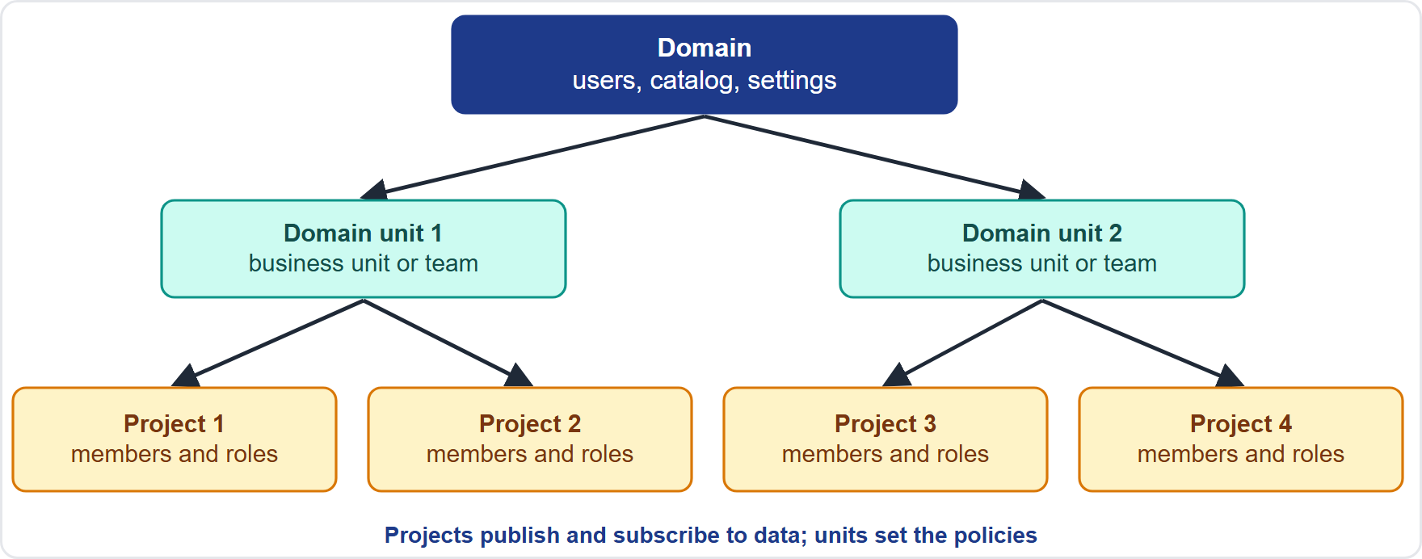
SageMaker Unified Studio: Domains, Domain Units and Projects
VERIFY LIVE
Part 2
Amazon SageMaker Unified Studio is a single workspace for data, analytics and AI (notebooks, SQL, visual ETL, catalog, and generative AI help)
As of 7 November 2026: check the AWS page for the current value
Amazon SageMaker Unified Studio is a single workspace for data, analytics and AI (notebooks, SQL, visual ETL, catalog, and generative AI help)
As of 7 November 2026: check the AWS page for the current value
Data Engineer Associate Exam Prep Masterclass | for the AWS DEA-C01 exam
Module 14: Authentication Mechanisms
21 / 29
Notes:
SageMaker Unified Studio: Domains, Domain Units and Projects.
The figure shows this: SageMaker Unified Studio structure: a domain at the top, domain units for business units or teams, and projects as the collaboration boundary where members work with data and tools.
Amazon SageMaker Unified Studio is a single workspace for data, analytics and A I (artificial intelligence) (notebooks, S Q L, visual E T L (extract, transform, load), catalog, and generative A I help).
This fact moves with the A W S pages, so check the current value before you rely on it.

Slide 22
SageMaker Unified Studio: Domains, Domain Units and Projects, continued
VERIFY LIVE
Part 2
Domain
Domain units
As of 7 November 2026
the top-level container for an organization's users, groups, projects, catalog and settings; an administrator creates it and manages who can sign in (for example through IAM Identity Center)
hierarchy under a domain to model business units or teams; owners set policies for the projects in their unit; if none exist, everything sits at the root domain
check the AWS page for the current value
Data Engineer Associate Exam Prep Masterclass | for the AWS DEA-C01 exam
Module 14: Authentication Mechanisms
22 / 29
Notes:
SageMaker Unified Studio: Domains, Domain Units and Projects, continued.
Domain: the top-level container for an organization's users, groups, projects, catalog and settings; an administrator creates it and manages who can sign in (for example through I A M Identity Center).
Domain units: hierarchy under a domain to model business units or teams; owners set policies for the projects in their unit; if none exist, everything sits at the root domain.
This fact moves with the A W S pages, so check the current value before you rely on it.

Slide 23
SageMaker Unified Studio: Domains, Domain Units and Projects, continued
VERIFY LIVE
Part 2
Projects: the collaboration boundary where members work on a business use case with shared data, compute and tools; members have roles (owner, contributor) and access depends on authorization policies
Why it matters for security: who may create projects, who is a member, and which data a project may see are controlled at these levels, and the business catalog (Module 7) and data sharing (Module 18) follow the same structure
As of 7 November 2026: check the AWS page for the current value
EXAM TIP "Separate teams or business units with their own policies and projects inside one governed workspace" → SageMaker Unified Studio domain units and projects.
Data Engineer Associate Exam Prep Masterclass | for the AWS DEA-C01 exam
Module 14: Authentication Mechanisms
23 / 29
Notes:
SageMaker Unified Studio: Domains, Domain Units and Projects, continued.
Projects: the collaboration boundary where members work on a business use case with shared data, compute and tools; members have roles (owner, contributor) and access depends on authorization policies.
Why it matters for security: who may create projects, who is a member, and which data a project may see are controlled at these levels, and the business catalog (Module seven) and data sharing (Module eighteen) follow the same structure.
Exam tip: "Separate teams or business units with their own policies and projects inside one governed workspace" to SageMaker Unified Studio domain units and projects.
This fact moves with the A W S pages, so check the current value before you rely on it.

Slide 24
Module Recap
Part 2
1
Security groups
2
IAM identities
3
Role setups
Stateful, allow-only, default deny inbound; allow specific port and source security group
Roles (temporary credentials, trust + permissions policy) for services; groups for users; IAM Identity Center for people
Lambda execution role, Glue service role, API Gateway integration role and IAM auth, CLI assume role/SSO, CloudFormation service role, Redshift/EMR/Step Functions roles
4
Endpoints
5
Secrets Manager
6
Policies
Gateway (S3, DynamoDB; route table; free) vs interface/PrivateLink (ENI, private IP); endpoint policies
Stores/rotates credentials, KMS encrypted; managed rotation for RDS/Aurora master and Redshift admin
Identity vs resource vs endpoint policy; S3 Access Points (own policy, optional VPC-only); PrivateLink
Data Engineer Associate Exam Prep Masterclass | for the AWS DEA-C01 exam
Module 14: Authentication Mechanisms
24 / 29
Notes:
Here is the recap.
Security groups: Stateful, allow-only, default deny inbound; allow specific port and source security group.
I A M identities: Roles (temporary credentials, trust plus permissions policy) for services; groups for users; I A M Identity Center for people.
Role setups: Lambda execution role, Glue service role, A P I Gateway integration role and I A M auth, C L I assume role or S S O (single sign-on), CloudFormation service role, Redshift or E M R or Step Functions roles.
Endpoints: Gateway (S three, DynamoDB; route table; free) versus interface or PrivateLink (E N I, private I P); endpoint policies.
Secrets Manager: Stores or rotates credentials, K M S encrypted; managed rotation for R D S or Aurora master and Redshift admin.
Policies: Identity versus resource versus endpoint policy; S three Access Points (own policy, optional V P C-only); PrivateLink.

Slide 25
Practice Question 1
Part 2
Q1
A Glue job runs in a VPC and must connect to a private Amazon Redshift cluster. What is the most secure network setting?
A
Allow 0.0.0.0/0 on port 5439 in the Redshift security group so that every client can connect
B
In the Redshift security group, allow inbound TCP 5439 from the Glue job's security group
C
Make the Redshift cluster publicly accessible and let the job reach it through its public address
D
Disable the security group on the cluster's network interface
Data Engineer Associate Exam Prep Masterclass | for the AWS DEA-C01 exam
Module 14: Authentication Mechanisms
25 / 29
Notes:
Question one.
A Glue job runs in a V P C and must connect to a private Amazon Redshift cluster. What is the most secure network setting?
The four options are on the screen.
[PAUSE 12]
The answer is B. Referencing the job's security group as the source opens only the needed port to only that resource.

Slide 26
Practice Question 2
Part 2
Q2
The database password for an Amazon RDS instance must be rotated automatically without breaking applications, and the team does not want to write code. What should be used?
A
A Systems Manager Parameter Store String parameter
B
AWS Secrets Manager with managed rotation
C
A password in an S3 object
D
A manually updated environment variable
Data Engineer Associate Exam Prep Masterclass | for the AWS DEA-C01 exam
Module 14: Authentication Mechanisms
26 / 29
Notes:
Question two.
The database password for an Amazon R D S instance must be rotated automatically without breaking applications, and the team does not want to write code. What should be used?
The four options are on the screen.
[PAUSE 12]
The answer is B. Secrets Manager rotates R D S and Aurora master credentials on a schedule with managed rotation, and applications fetch the current secret at run time.

Slide 27
Practice Question 3
Part 2
Q3
Which description of managed versus unmanaged services is correct?
A
With a managed database service AWS patches the engine and runs backups and failover; the customer manages data and access
B
With a database on EC2 AWS patches the database engine for the customer
C
Managed services remove all of the customer's security responsibility
D
Unmanaged services give the least operational overhead of all options
Data Engineer Associate Exam Prep Masterclass | for the AWS DEA-C01 exam
Module 14: Authentication Mechanisms
27 / 29
Notes:
Question three.
Which description of managed versus unmanaged services is correct?
The four options are on the screen.
[PAUSE 12]
The answer is A. Managed services shift infrastructure and software maintenance to A W S; the customer is still responsible for data, access and configuration.

Slide 28
Practice Question 4
Part 2
Q4
Several teams share one SageMaker Unified Studio domain. The company wants each business unit to set its own policies for who can create projects. Which feature provides this?
A
Domain units
B
A single root project
C
S3 lifecycle rules
D
Security groups
Data Engineer Associate Exam Prep Masterclass | for the AWS DEA-C01 exam
Module 14: Authentication Mechanisms
28 / 29
Notes:
Question four.
Several teams share one SageMaker Unified Studio domain. The company wants each business unit to set its own policies for who can create projects. Which feature provides this?
The four options are on the screen.
[PAUSE 12]
The answer is A. Domain units model business-unit hierarchies, and their owners set policies for the projects in their unit.

Slide 29
Answers at a Glance
Part 2
Question | Answer | Why
Q1 | B | Referencing the job's security group as the source opens only the needed port to
Q2 | B | Secrets Manager rotates RDS and Aurora master credentials on a schedule with managed rotation
Q3 | A | Managed services shift infrastructure and software maintenance to AWS
Q4 | A | Domain units model business-unit hierarchies
Data Engineer Associate Exam Prep Masterclass | for the AWS DEA-C01 exam
Module 14: Authentication Mechanisms
29 / 29
Notes:
Here are all four answers. Question one: B. Question two: B. Question three: A. Question four: A.
In the next module, we continue the course.

