Slide 1
Module 16: Encryption and Masking
Mask and anonymize data according to compliance laws or company policy
Domain 4 · Data Security and Governance · Task statement 4.3
Data Engineer Associate Exam Prep Masterclass
Module 16 · Part 1
Notes:
Welcome to Module sixteen: Encryption and Masking. This module covers the task statement: ensure data encryption and masking.
Each part of this module comes from the study notes of the same name, so you can read the notes after you watch.

Slide 2
What You Will Learn
Part 1
Mask and anonymize data according to compliance laws or company policy
Use encryption keys (AWS KMS) to encrypt and decrypt data
Configure encryption across AWS account boundaries
Enable encryption in transit or before transit
--
Data Engineer Associate Exam Prep Masterclass | for the AWS DEA-C01 exam
Module 16: Encryption and Masking
2 / 24
Notes:
By the end of this module you will be able to do five things.
Mask and anonymize data according to compliance laws or company policy.
Use encryption keys (A W S K M S (Key Management Service)) to encrypt and decrypt data.
Configure encryption across A W S account boundaries.
Enable encryption in transit or before transit.
--.

Slide 3
Case Check-In: Kestrel Freight Protects Customer Data
Part 1
CASE CHECK-IN · Kestrel Freight
Test teams need realistic data but not real names and phone numbers
Analysts need trends by customer, but not who the customer is
A privacy law limits how personal data may be stored and shared
Your job: keep the value of the data and remove the risk
Data Engineer Associate Exam Prep Masterclass | for the AWS DEA-C01 exam
Module 16: Encryption and Masking
3 / 24
Notes:
Our running case is Kestrel Freight. Kestrel Freight Protects Customer Data.
Test teams need realistic data but not real names and phone numbers.
Analysts need trends by customer, but not who the customer is.
A privacy law limits how personal data may be stored and shared.
Your job: keep the value of the data and remove the risk.

Slide 4
Masking and Anonymization
Part 1
Technique | What it does | Reversible? | Use it for
Masking (static) | Replaces values with fake or partial ones (****-1234) in a copy | No | Test and development data
Dynamic masking | Hides or partly shows values at query time by role; stored data unchanged | Yes (for authorized roles) | Redshift dynamic data masking
Redaction | Removes the value | No | Free text, logs
Hashing | One-way fingerprint of a value; the same input gives the same hash | No | Joining on a masked key, matching without revealing
Data Engineer Associate Exam Prep Masterclass | for the AWS DEA-C01 exam
Module 16: Encryption and Masking
4 / 24
Notes:
Masking and Anonymization.
Masking (static). What it does: Replaces values with fake or partial ones (-one thousand two hundred thirty-four) in a copy. Reversible?: No. Use it for: Test and development data.
Dynamic masking. What it does: Hides or partly shows values at query time by role; stored data unchanged. Reversible?: Yes (for authorized roles). Use it for: Redshift dynamic data masking.
Redaction. What it does: Removes the value. Reversible?: No. Use it for: Free text, logs.
Hashing. What it does: One-way fingerprint of a value; the same input gives the same hash. Reversible?: No. Use it for: Joining on a masked key, matching without revealing.

Slide 5
Masking and Anonymization, continued
Part 1
Technique | What it does | Reversible? | Use it for
Tokenization | Replaces the value with a token; the real value lives in a secure vault | Yes, with the vault | Payment data, IDs
Pseudonymization | Replaces identifiers with a pseudonym; a key or table can re-identify | Yes | Analytics that must link records
Anonymization | Irreversibly removes the link to a person (generalize, aggregate, suppress, add noise) | No | Sharing data publicly; data that falls outside privacy law when truly anonymous
Generalization | Reduce precision (age 34 → 30–39, full address → region) | No | Statistics
Data Engineer Associate Exam Prep Masterclass | for the AWS DEA-C01 exam
Module 16: Encryption and Masking
5 / 24
Notes:
Masking and Anonymization, continued.
Tokenization. What it does: Replaces the value with a token; the real value lives in a secure vault. Reversible?: Yes, with the vault. Use it for: Payment data, I Ds.
Pseudonymization. What it does: Replaces identifiers with a pseudonym; a key or table can re-identify. Reversible?: Yes. Use it for: Analytics that must link records.
Anonymization. What it does: Irreversibly removes the link to a person (generalize, aggregate, suppress, add noise). Reversible?: No. Use it for: Sharing data publicly; data that falls outside privacy law when truly anonymous.
Generalization. What it does: Reduce precision (age thirty-four to thirty to thirty-nine, full address to region). Reversible?: No. Use it for: Statistics.

Slide 6
Masking and Anonymization, continued
Part 1
Pseudonymized data is still personal data under many laws (for example the GDPR) because it can be re-identified; truly anonymized data is not
Choose by need: analysis needs joins → hash or pseudonym; testing → static mask; role-based viewing → dynamic masking or column permissions; sharing externally → anonymize
Data Engineer Associate Exam Prep Masterclass | for the AWS DEA-C01 exam
Module 16: Encryption and Masking
6 / 24
Notes:
Masking and Anonymization, continued.
Pseudonymized data is still personal data under many laws (for example the G D P R (General Data Protection Regulation)) because it can be re-identified; truly anonymized data is not.
Choose by need: analysis needs joins to hash or pseudonym; testing to static mask; role-based viewing to dynamic masking or column permissions; sharing externally to anonymize.

Slide 7
AWS tools
Part 1
Need | Tool
Find personal data | Amazon Macie (S3), Glue detect-PII transform, Amazon Comprehend (text)
Mask or hash columns in a pipeline | AWS Glue DataBrew (mask, hash, encrypt, shuffle, substitute), AWS Glue ETL (PII detection and redaction), Lambda
Show masked values to some users | Redshift dynamic data masking, Lake Formation column and row filters (Module 15), views
Protect model prompts and outputs | Amazon Bedrock Guardrails (filters sensitive information)
EXAM TIP "Give developers realistic test data with no real personal data" → mask or substitute in a copy (DataBrew or Glue). "Show the last four digits to support staff only" → dynamic data masking.
Data Engineer Associate Exam Prep Masterclass | for the AWS DEA-C01 exam
Module 16: Encryption and Masking
7 / 24
Notes:
A W S tools.
Find personal data. Amazon Macie (S three), Glue detect-P I I (personally identifiable information) transform, Amazon Comprehend (text).
Mask or hash columns in a pipeline. A W S Glue DataBrew (mask, hash, encrypt, shuffle, substitute), A W S Glue E T L (extract, transform, load) (P I I detection and redaction), Lambda.
Show masked values to some users. Redshift dynamic data masking, Lake Formation column and row filters (Module fifteen), views.
Protect model prompts and outputs. Amazon Bedrock Guardrails (filters sensitive information).
Exam tip: "Give developers realistic test data with no real personal data" to mask or substitute in a copy (DataBrew or Glue). "Show the last four digits to support staff only" to dynamic data masking.

Slide 8
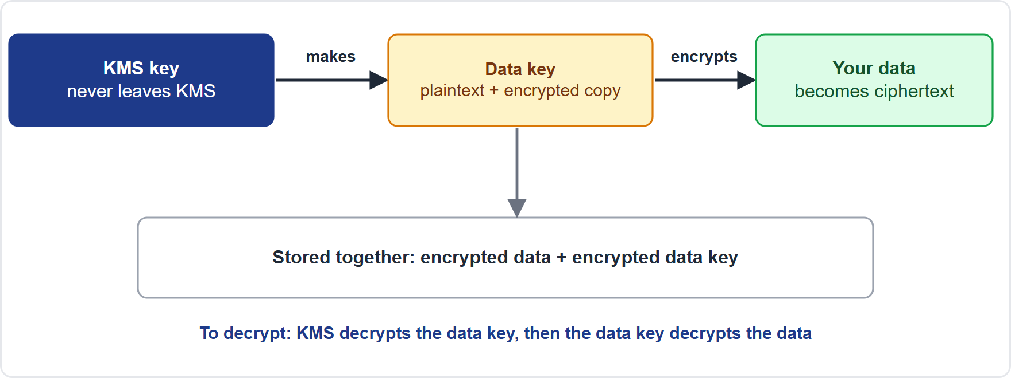
Encryption Keys with AWS KMS
Part 1
AWS Key Management Service (KMS) creates and controls encryption keys; keys never leave KMS unencrypted; every use is logged in CloudTrail
Key types:
AWS Key Management Service (KMS) creates and controls encryption keys; keys never leave KMS unencrypted; every use is logged in CloudTrail
Key types:
Data Engineer Associate Exam Prep Masterclass | for the AWS DEA-C01 exam
Module 16: Encryption and Masking
8 / 24
Notes:
Encryption Keys with A W S K M S.
The figure shows this: Envelope encryption: a data key encrypts the data, and a K M S key encrypts the data key; the encrypted data key is stored with the data and only K M S can decrypt it.
A W S Key Management Service (K M S) creates and controls encryption keys; keys never leave K M S unencrypted; every use is logged in CloudTrail.
Key types.

Slide 9
Encryption Keys with AWS KMS, continued
Part 1
Type | Who manages | Notes
AWS owned key | AWS (not visible) | Free; no control or audit
AWS managed key (aws/s3, aws/redshift...) | AWS for your account | Rotated every year; fixed key policy
Customer managed key (CMK) | You | Your key policy, rotation choice, can be used across accounts, can be disabled or scheduled for deletion; charged per key
Symmetric keys (one key to encrypt and decrypt, default) and asymmetric keys (public and private pair: signing and encryption outside AWS)
Data Engineer Associate Exam Prep Masterclass | for the AWS DEA-C01 exam
Module 16: Encryption and Masking
9 / 24
Notes:
Encryption Keys with A W S K M S, continued.
A W S owned key. Who manages: A W S (not visible). Notes: Free; no control or audit.
A W S managed key (aws or S three, aws or redshift...). Who manages: A W S for your account. Notes: Rotated every year; fixed key policy.
Customer managed key (C M K). Who manages: You. Notes: Your key policy, rotation choice, can be used across accounts, can be disabled or scheduled for deletion; charged per key.
Symmetric keys (one key to encrypt and decrypt, default) and asymmetric keys (public and private pair: signing and encryption outside A W S).

Slide 10
Encryption Keys with AWS KMS, continued
Part 1
Envelope encryption: KMS encrypts only small data keys (GenerateDataKey); the data key encrypts the large data; this is how S3, EBS, Redshift and others use KMS
Access control: the key policy is the primary control (IAM policies work only if the key policy allows IAM); grants give temporary, specific permission to AWS services; permissions are separate for `kms:Encrypt`, `kms:Decrypt`, `kms:GenerateDataKey`
Rotation: for customer managed keys, automatic rotation (every 365 days by default, with a custom period option, plus on-demand rotation) keeps the same key ID; old key material is kept so old data stays readable
Data Engineer Associate Exam Prep Masterclass | for the AWS DEA-C01 exam
Module 16: Encryption and Masking
10 / 24
Notes:
Encryption Keys with A W S K M S, continued.
Envelope encryption: K M S encrypts only small data keys (GenerateDataKey); the data key encrypts the large data; this is how S three, E B S (Elastic Block Store), Redshift and others use K M S.
Access control: the key policy is the primary control (I A M policies work only if the key policy allows I A M (Identity and Access Management)); grants give temporary, specific permission to A W S services; permissions are separate for kms:Encrypt, kms:Decrypt, kms:GenerateDataKey.
Rotation: for customer managed keys, automatic rotation (every three hundred sixty-five days by default, with a custom period option, plus on-demand rotation) keeps the same key I D; old key material is kept so old data stays readable.

Slide 11
Encryption Keys with AWS KMS, continued
Part 1
Deletion: a waiting period of 7 to 30 days before a key is deleted; data encrypted under a deleted key is unrecoverable
Data Engineer Associate Exam Prep Masterclass | for the AWS DEA-C01 exam
Module 16: Encryption and Masking
11 / 24
Notes:
Encryption Keys with A W S K M S, continued.
Deletion: a waiting period of seven to thirty days before a key is deleted; data encrypted under a deleted key is unrecoverable.

Slide 12
Encryption at rest in the data services
Part 1
Service | At rest
Amazon S3 | SSE-S3 on every new object by default; SSE-KMS (your key, audit trail; bucket keys cut KMS request cost); DSSE-KMS (two layers); SSE-C (your key, supplied per request; disabled by default on new buckets); client-side
Amazon Redshift | KMS-encrypted clusters and snapshots (Redshift Serverless is always encrypted)
Amazon RDS / Aurora | KMS, chosen at creation (to encrypt an unencrypted database, copy a snapshot with encryption and restore)
Amazon DynamoDB | Always encrypted at rest; choose AWS owned, AWS managed or customer managed key
AWS Glue | Security configurations encrypt S3 targets, CloudWatch logs and job bookmarks
Data Engineer Associate Exam Prep Masterclass | for the AWS DEA-C01 exam
Module 16: Encryption and Masking
12 / 24
Notes:
Encryption at rest in the data services.
Amazon S three. S S E (server-side encryption)-S three on every new object by default; S S E-K M S (your key, audit trail; bucket keys cut K M S request cost); D S S E (dual-layer server-side encryption)-K M S (two layers); S S E-C (your key, supplied per request; disabled by default on new buckets ); client-side.
Amazon Redshift. K M S-encrypted clusters and snapshots (Redshift Serverless is always encrypted).
Amazon R D S (Relational Database Service) or Aurora. K M S, chosen at creation (to encrypt an unencrypted database, copy a snapshot with encryption and restore).
Amazon DynamoDB. Always encrypted at rest; choose A W S owned, A W S managed or customer managed key.
A W S Glue. Security configurations encrypt S three targets, CloudWatch logs and job bookmarks.

Slide 13
Encryption at rest in the data services, continued
Part 1
Service | At rest
Kinesis Data Streams / Firehose | Server-side encryption with KMS
Amazon EMR | Security configuration: at-rest (S3 EMRFS, local disks, EBS) and in-transit options
Athena | Encrypt query results in S3 per workgroup
Amazon EBS / EFS | KMS
EXAM TIP "Control the key, audit every use, and be able to disable access quickly" → SSE-KMS with a customer managed key. "Cut the KMS request cost of an S3-heavy pipeline" → S3 Bucket Keys.
Data Engineer Associate Exam Prep Masterclass | for the AWS DEA-C01 exam
Module 16: Encryption and Masking
13 / 24
Notes:
Encryption at rest in the data services, continued.
Kinesis Data Streams or Firehose. Server-side encryption with K M S.
Amazon E M R (Elastic MapReduce). Security configuration: at-rest (S three E M R F S (E M R File System), local disks, E B S) and in-transit options.
Athena. Encrypt query results in S three per workgroup.
Amazon E B S or E F S (Elastic File System). K M S.
Exam tip: "Control the key, audit every use, and be able to disable access quickly" to S S E-K M S with a customer managed key. "Cut the K M S request cost of an S three-heavy pipeline" to S three Bucket Keys.

Slide 14
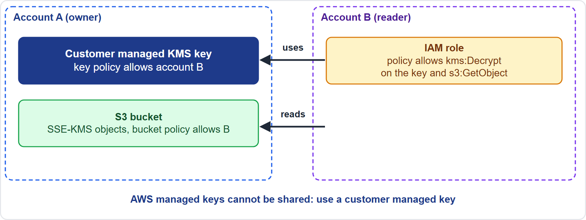
Encryption across Account Boundaries
Part 2
Two permissions are needed: the key policy (in the key's account) must allow the other account (or role), and an IAM policy in the other account must allow its role to use that key
Two permissions are needed: the key policy (in the key's account) must allow the other account (or role), and an IAM policy in the other account must allow its role to use that key
Data Engineer Associate Exam Prep Masterclass | for the AWS DEA-C01 exam
Module 16: Encryption and Masking
14 / 24
Notes:
Encryption across Account Boundaries.
The figure shows this: Cross-account encryption needs permission on both sides: the key policy in the owner account must allow the other account, and an I A M policy in the other account must allow its role to use the key.
Two permissions are needed: the key policy (in the key's account) must allow the other account (or role), and an I A M policy in the other account must allow its role to use that key.

Slide 15
Encryption across Account Boundaries, continued
Part 2
Use a customer managed key for anything shared: AWS managed keys and AWS owned keys cannot be shared with another account
Data Engineer Associate Exam Prep Masterclass | for the AWS DEA-C01 exam
Module 16: Encryption and Masking
15 / 24
Notes:
Encryption across Account Boundaries, continued.
Use a customer managed key for anything shared: A W S managed keys and A W S owned keys cannot be shared with another account.

Slide 16
Encryption across Account Boundaries, continued
Part 2
Typical cases:; S3 objects encrypted with SSE-KMS read by another account: bucket policy (or access point) allows the principal and the key policy allows kms:Decrypt; Sharing an encrypted RDS or Redshift snapshot: encrypt with a customer managed key, share the snapshot, and share the key with the other account; the recipient copies the snapshot and re-encrypts with its own key; Lake Formation or Redshift data sharing across accounts: grant on the data and allow the key; Replication to another account or Region: allow KMS on both keys
Data Engineer Associate Exam Prep Masterclass | for the AWS DEA-C01 exam
Module 16: Encryption and Masking
16 / 24
Notes:
Encryption across Account Boundaries, continued.
Typical cases:; S three objects encrypted with S S E-K M S read by another account: bucket policy (or access point) allows the principal and the key policy allows kms:Decrypt; Sharing an encrypted R D S or Redshift snapshot: encrypt with a customer managed key, share the snapshot, and share the key with the other account; the recipient copies the snapshot and re-encrypts with its own key; Lake Formation or Redshift data sharing across accounts: grant on the data and allow the key; Replication to another account or Region: allow K M S on both keys.

Slide 17
Encryption across Account Boundaries, continued
Part 2
Grants and conditions: use `kms:ViaService` (only through S3), encryption context, and organization conditions to limit use
EXAM TIP "Another account cannot read objects in a shared bucket that use SSE-KMS" → add the account to the CMK's key policy and `kms:Decrypt` to its role; an AWS managed key cannot be shared.
Data Engineer Associate Exam Prep Masterclass | for the AWS DEA-C01 exam
Module 16: Encryption and Masking
17 / 24
Notes:
Encryption across Account Boundaries, continued.
Grants and conditions: use kms:ViaService (only through S three), encryption context, and organization conditions to limit use.
Exam tip: "Another account cannot read objects in a shared bucket that use S S E-K M S" to add the account to the C M K (customer managed key)'s key policy and kms:Decrypt to its role; an A W S managed key cannot be shared.

Slide 18
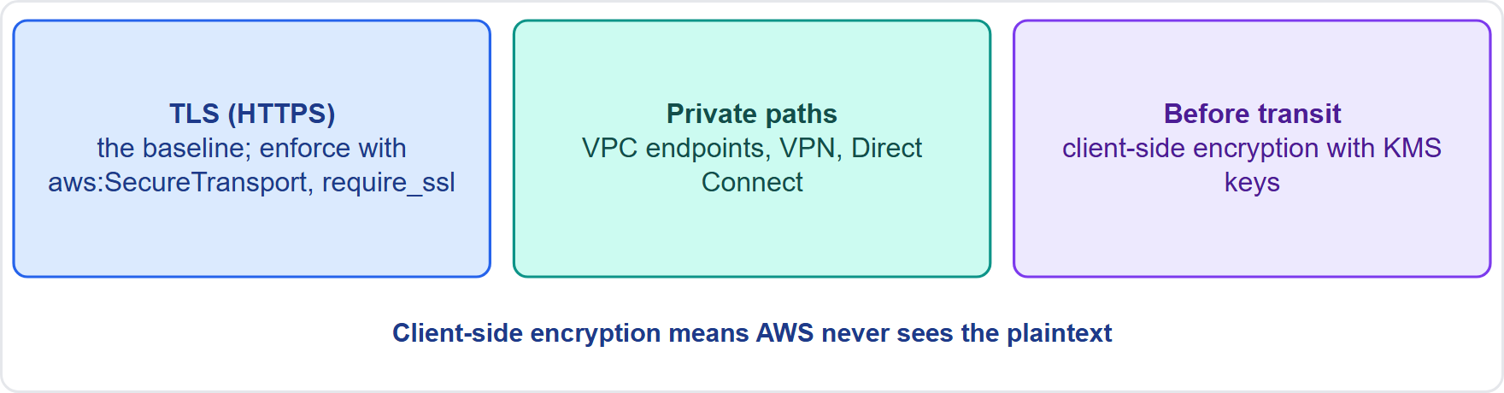
Encryption in Transit or Before Transit
Part 2
In transit = while moving: use TLS (HTTPS); AWS service APIs use TLS; enforce it:; S3: a bucket policy that denies requests when `aws:SecureTransport` is false (and can require a minimum TLS version); Redshift: set `require_ssl` in the parameter group; RDS/Aurora: require SSL (for example `rds.force_ssl` for PostgreSQL); Kafka (MSK) and Kinesis: TLS in transit; EMR: in-transit encryption options; API Gateway and load balancers: HTTPS with ACM certificates
In transit = while moving: use TLS (HTTPS); AWS service APIs use TLS; enforce it:; S3: a bucket policy that denies requests when `aws:SecureTransport` is false (and can require a minimum TLS version); Redshift: set `require_ssl` in the parameter group; RDS/Aurora: require SSL (for example `rds.force_ssl` for PostgreSQL); Kafka (MSK) and Kinesis: TLS in transit; EMR: in-transit encryption options; API Gateway and load balancers: HTTPS with ACM certificates
Data Engineer Associate Exam Prep Masterclass | for the AWS DEA-C01 exam
Module 16: Encryption and Masking
18 / 24
Notes:
Encryption in Transit or Before Transit.
The figure shows this: Protecting data in motion: T L S to the service, private network paths, and client-side encryption before the data leaves the source so only ciphertext travels.
In transit equals while moving: use T L S (H T T P S); A W S service A P I s use T L S; enforce it:; S three: a bucket policy that denies requests when the secure transport condition is false (and can require a minimum T L S version); Redshift: set require ssl in the parameter group; R D S or Aurora: require S S L (for example rds.force ssl for PostgreSQL); Kafka (M S K) and Kinesis: T L S in transit; E M R: in-transit encryption options; A P I Gateway and load balancers: H T T P S with A C M (A W S Certificate Manager) certificates.

Slide 19
Encryption in Transit or Before Transit, continued
Part 2
Private paths reduce exposure: VPC endpoints and PrivateLink, Site-to-Site VPN (IPsec), Direct Connect (private, encrypt with VPN or MACsec if required)
Before transit (client-side encryption): encrypt on the source before sending, so only ciphertext travels and is stored; the service never sees plaintext: AWS Encryption SDK, S3 encryption client, DynamoDB encryption client; keys come from KMS (GenerateDataKey)
Choose: TLS is the baseline; client-side encryption for the highest control (AWS cannot read the data) at the cost of key handling and less service-side processing (the service cannot query encrypted values)
EXAM TIP "Make sure no one can upload or read over HTTP" → bucket policy denying `aws:SecureTransport = false`. "AWS must never see plaintext" → client-side encryption.
Data Engineer Associate Exam Prep Masterclass | for the AWS DEA-C01 exam
Module 16: Encryption and Masking
19 / 24
Notes:
Encryption in Transit or Before Transit, continued.
Private paths reduce exposure: V P C (Virtual Private Cloud) endpoints and PrivateLink, Site-to-Site V P N (virtual private network) (IPsec), Direct Connect (private, encrypt with V P N or MACsec if required).
Before transit (client-side encryption): encrypt on the source before sending, so only ciphertext travels and is stored; the service never sees plaintext: A W S Encryption S D K (software development kit), S three encryption client, DynamoDB encryption client; keys come from K M S (GenerateDataKey).
Choose: T L S is the baseline; client-side encryption for the highest control (A W S cannot read the data) at the cost of key handling and less service-side processing (the service cannot query encrypted values).
Exam tip: "Make sure no one can upload or read over H T T P" to bucket policy denying the secure transport condition equals false. "A W S must never see plaintext" to client-side encryption.

Slide 20
Module Recap
Part 2
1
Masking techniques
2
Tools
3
KMS keys
Macie / Glue detect-PII / Comprehend to find; DataBrew / Glue to mask
AWS owned, AWS managed (yearly rotation, fixed policy), customer managed (your policy, rotation, shareable, 7–30 day deletion wait)
Static mask (copy), dynamic mask (query time, by role), redact, hash (one-way), tokenize (vault), pseudonymize (reversible
4
KMS access
5
At rest
6
Cross-account
Key policy first; IAM works only if the key policy allows it; grants for services; kms:Encrypt/Decrypt/GenerateDataKey
S3 SSE-S3 default, SSE-KMS (+ bucket keys), DSSE-KMS, SSE-C
Customer managed key; key policy + IAM policy; AWS managed keys cannot be shared
7
In transit
TLS everywhere; `aws:SecureTransport`, Redshift `require_ssl`, RDS force SSL; VPC endpoints / VPN / Direct Connect (+MACsec)
Data Engineer Associate Exam Prep Masterclass | for the AWS DEA-C01 exam
Module 16: Encryption and Masking
20 / 24
Notes:
Here is the recap.
Masking techniques: Static mask (copy), dynamic mask (query time, by role), redact, hash (one-way), tokenize (vault), pseudonymize (reversible.
Tools: Macie or Glue detect-P I I or Comprehend to find; DataBrew or Glue to mask.
K M S keys: A W S owned, A W S managed (yearly rotation, fixed policy), customer managed (your policy, rotation, shareable, seven to thirty day deletion wait).
K M S access: Key policy first; I A M works only if the key policy allows it; grants for services; kms:Encrypt or Decrypt or GenerateDataKey.
At rest: S three S S E-S three default, S S E-K M S ( plus bucket keys), D S S E-K M S, S S E-C.
Cross-account: Customer managed key; key policy plus I A M policy; A W S managed keys cannot be shared.
In transit: T L S everywhere; the secure transport condition, Redshift require ssl, R D S force S S L; V P C endpoints or V P N or Direct Connect ( plus MACsec).

Slide 21
Practice Question 1
Part 2
Q1
Kestrel Freight's developers need realistic test data without any real customer names or phone numbers. What is the best approach?
A
Copy the production data to the test account without any change
B
Give the developers read access to the production tables directly
C
Encrypt the production data with SSE-S3 and share the encrypted files
D
Create a masked or substituted copy of the data with Glue DataBrew or a Glue job
Data Engineer Associate Exam Prep Masterclass | for the AWS DEA-C01 exam
Module 16: Encryption and Masking
21 / 24
Notes:
Question one.
Kestrel Freight's developers need realistic test data without any real customer names or phone numbers. What is the best approach?
The four options are on the screen.
[PAUSE 12]
The answer is D. Static masking or substitution in a copy keeps realistic structure while removing personal data. Encryption does not remove personal data from authorized readers.

Slide 22
Practice Question 2
Part 2
Q2
An S3 bucket in account A holds objects encrypted with SSE-KMS under a customer managed key. A role in account B cannot read them even though the bucket policy allows it. Which TWO actions fix this? (Select TWO.)
A
Add account B (or its role) to the KMS key policy
B
Remove encryption from the bucket
C
Switch the objects to an AWS managed key and share it
D
Disable CloudTrail
E
Allow kms:Decrypt on that key in the role's IAM policy in account B
Data Engineer Associate Exam Prep Masterclass | for the AWS DEA-C01 exam
Module 16: Encryption and Masking
22 / 24
Notes:
Question two. Select two.
An S three bucket in account A holds objects encrypted with S S E-K M S under a customer managed key. A role in account B cannot read them even though the bucket policy allows it. Which two actions fix this?
The five options are on the screen.
[PAUSE 15]
The answers are A and E. Cross-account K M S use needs permission in the key policy and in the caller's I A M policy. A W S managed keys cannot be shared.

Slide 23
Practice Question 3
Part 2
Q3
A team must ensure that no client can send or retrieve S3 data over unencrypted connections. What should be configured?
A
A bucket policy that denies requests when aws:SecureTransport is false
B
S3 Versioning enabled with MFA delete on the bucket and a lifecycle rule for old versions
C
An S3 Lifecycle rule that expires objects that are not encrypted
D
S3 Replication to a second bucket in the same Region
Data Engineer Associate Exam Prep Masterclass | for the AWS DEA-C01 exam
Module 16: Encryption and Masking
23 / 24
Notes:
Question three.
A team must ensure that no client can send or retrieve S three data over unencrypted connections. What should be configured?
The four options are on the screen.
[PAUSE 12]
The answer is A. The the secure transport condition condition identifies requests made over H T T P, which the policy denies.

Slide 24
Answers at a Glance
Part 2
Question | Answer | Why
Q1 | D | Static masking or substitution in a copy keeps realistic structure while removing personal data
Q2 | A, E | Cross-account KMS use needs permission in the key policy and in the caller's IAM
Q3 | A | The aws:SecureTransport condition identifies requests made over HTTP, which the policy denies
Data Engineer Associate Exam Prep Masterclass | for the AWS DEA-C01 exam
Module 16: Encryption and Masking
24 / 24
Notes:
Here are all three answers. Question one: D. Question two: A and E. Question three: A.
In the next module, we continue the course.

