Slide 1
Module 17: Prepare Logs for Audit
Use AWS CloudTrail to track API calls
Domain 4 · Data Security and Governance · Task statement 4.4
Data Engineer Associate Exam Prep Masterclass
Module 17 · Part 1
Notes:
Welcome to Module seventeen: Prepare Logs for Audit. This module covers the task statement: prepare logs for audit.
Each part of this module comes from the study notes of the same name, so you can read the notes after you watch.

Slide 2
What You Will Learn
Part 1
Use AWS CloudTrail to track API calls
Use Amazon CloudWatch Logs to store application logs
Use AWS CloudTrail Lake for centralized logging queries
Analyze logs with Athena, CloudWatch Logs Insights and Amazon OpenSearch Service
Integrate AWS services for logging, including Amazon EMR for large volumes of logs
--
Data Engineer Associate Exam Prep Masterclass | for the AWS DEA-C01 exam
Module 17: Prepare Logs for Audit
2 / 26
Notes:
By the end of this module you will be able to do six things.
Use A W S CloudTrail to track A P I calls.
Use Amazon CloudWatch Logs to store application logs.
Use A W S CloudTrail Lake for centralized logging queries.
Analyze logs with Athena, CloudWatch Logs Insights and Amazon OpenSearch Service.
Integrate A W S services for logging, including Amazon E M R (Elastic MapReduce) for large volumes of logs.
--.

Slide 3
Case Check-In: Kestrel Freight Faces an Audit
Part 1
CASE CHECK-IN · Kestrel Freight
An auditor asks: who read the customer table last March, and who changed the bucket policy?
Logs are scattered: some in S3, some in CloudWatch, some in application files
Retention is inconsistent, and one team deleted logs to save cost
Your job: make the logs complete, protected, searchable and retained
Data Engineer Associate Exam Prep Masterclass | for the AWS DEA-C01 exam
Module 17: Prepare Logs for Audit
3 / 26
Notes:
Our running case is Kestrel Freight. Kestrel Freight Faces an Audit.
An auditor asks: who read the customer table last March, and who changed the bucket policy?
Logs are scattered: some in S three, some in CloudWatch, some in application files.
Retention is inconsistent, and one team deleted logs to save cost.
Your job: make the logs complete, protected, searchable and retained.

Slide 4
Audit Logs: What an Auditor Needs
Part 1
Audit question | Evidence | AWS source
Who called which API, when, from where? | API activity | AWS CloudTrail
Who read or wrote which object or item? | Data-plane activity | CloudTrail data events, S3 server access logs, database audit logs
What did the application or job do? | Application and job logs | CloudWatch Logs
What changed in the configuration? | Configuration history | AWS Config (Module 18)
What network traffic occurred? | Flow records | VPC Flow Logs
A good audit log is complete (the right events are on), accurate (not altered), retained (for the required period), protected (restricted access), and searchable (queryable on demand).
EXAM TIP Auditors ask who, what, when: CloudTrail answers it for API calls; data events are needed for object-level access and are off by default.
Data Engineer Associate Exam Prep Masterclass | for the AWS DEA-C01 exam
Module 17: Prepare Logs for Audit
4 / 26
Notes:
Audit Logs: What an Auditor Needs.
Who called which A P I, when, from where? Evidence: A P I activity. A W S source: A W S CloudTrail.
Who read or wrote which object or item? Evidence: Data-plane activity. A W S source: CloudTrail data events, S three server access logs, database audit logs.
What did the application or job do? Evidence: Application and job logs. A W S source: CloudWatch Logs.
What changed in the configuration? Evidence: Configuration history. A W S source: A W S Config (Module eighteen).
What network traffic occurred? Evidence: Flow records. A W S source: V P C (Virtual Private Cloud) Flow Logs.
A good audit log is complete (the right events are on), accurate (not altered), retained (for the required period), protected (restricted access), and searchable (queryable on demand).
Exam tip: Auditors ask who, what, when: CloudTrail answers it for A P I calls; data events are needed for object-level access and are off by default.

Slide 5
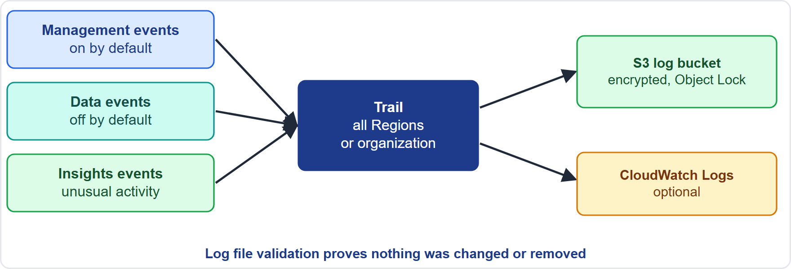
AWS CloudTrail: Tracking API Calls
Part 1
Event types: management events (control plane such as creating or deleting resources and changing policies; recorded by default), data events (S3 object-level, Lambda invocations, DynamoDB item-level and more; off by default, extra cost), Insights events (unusual API activity), and network activity events
Event types: management events (control plane such as creating or deleting resources and changing policies; recorded by default), data events (S3 object-level, Lambda invocations, DynamoDB item-level and more; off by default, extra cost), Insights events (unusual API activity), and network activity events
Data Engineer Associate Exam Prep Masterclass | for the AWS DEA-C01 exam
Module 17: Prepare Logs for Audit
5 / 26
Notes:
A W S CloudTrail: Tracking A P I Calls.
The figure shows this: A CloudTrail trail records events and delivers log files to an S three bucket and optionally to CloudWatch Logs; log file validation shows the files were not altered.
Event types: management events (control plane such as creating or deleting resources and changing policies; recorded by default), data events (S three object-level, Lambda invocations, DynamoDB item-level and more; off by default, extra cost), Insights events (unusual A P I activity), and network activity events.

Slide 6
AWS CloudTrail: Tracking API Calls, continued
Part 1
Event history: the console shows the last 90 days of management events per Region for free; it is not enough for audits
Trails: a trail delivers events continuously to an S3 bucket (and optionally CloudWatch Logs and EventBridge): create a multi-Region trail, and an organization trail to cover every account in AWS Organizations
Data Engineer Associate Exam Prep Masterclass | for the AWS DEA-C01 exam
Module 17: Prepare Logs for Audit
6 / 26
Notes:
A W S CloudTrail: Tracking A P I Calls, continued.
Event history: the console shows the last ninety days of management events per Region for free; it is not enough for audits.
Trails: a trail delivers events continuously to an S three bucket (and optionally CloudWatch Logs and EventBridge): create a multi-Region trail, and an organization trail to cover every account in A W S Organizations.

Slide 7
AWS CloudTrail: Tracking API Calls, continued
Part 1
Protect the logs: deliver to a dedicated, encrypted S3 bucket (ideally in a separate log-archive account), restrict and deny deletes, use S3 Object Lock or versioning, and turn on log file validation (digest files with hashes and signatures show no log file was changed or removed)
Delivery time: events typically arrive in about five minutes (not guaranteed)
Data events for audits: enable them on the sensitive buckets, tables and functions (selectors let you scope them to avoid cost)
EXAM TIP "Prove who read objects in a sensitive bucket" → CloudTrail data events on that bucket, delivered to a protected S3 bucket with log file validation.
Data Engineer Associate Exam Prep Masterclass | for the AWS DEA-C01 exam
Module 17: Prepare Logs for Audit
7 / 26
Notes:
A W S CloudTrail: Tracking A P I Calls, continued.
Protect the logs: deliver to a dedicated, encrypted S three bucket (ideally in a separate log-archive account), restrict and deny deletes, use S three Object Lock or versioning, and turn on log file validation (digest files with hashes and signatures show no log file was changed or removed).
Delivery time: events typically arrive in about five minutes (not guaranteed).
Data events for audits: enable them on the sensitive buckets, tables and functions (selectors let you scope them to avoid cost).
Exam tip: "Prove who read objects in a sensitive bucket" to CloudTrail data events on that bucket, delivered to a protected S three bucket with log file validation.

Slide 8
CloudWatch Logs for Application Logs
Part 1
CloudWatch Logs stores application and job logs from Lambda, Glue, ECS, EMR, MWAA, Step Functions and EC2 (agent); organize log groups by application and environment
Data Engineer Associate Exam Prep Masterclass | for the AWS DEA-C01 exam
Module 17: Prepare Logs for Audit
8 / 26
Notes:
CloudWatch Logs for Application Logs.
CloudWatch Logs stores application and job logs from Lambda, Glue, E C S (Elastic Container Service), E M R, M W A A (Managed Workflows for Apache Airflow), Step Functions and E C two (agent); organize log groups by application and environment.

Slide 9
CloudWatch Logs for Application Logs, continued
Part 1
For audit use:; Write structured logs with who, what, when, run ID and record counts (never secrets or raw personal data); Set retention to meet policy (the default is never expire, which is costly but safe; too short loses evidence); Encrypt the log group with KMS and restrict access with IAM; Send a copy to S3 for long-term storage: export tasks or subscription filters through Firehose; Data protection policies can find and mask sensitive data in logs
Data Engineer Associate Exam Prep Masterclass | for the AWS DEA-C01 exam
Module 17: Prepare Logs for Audit
9 / 26
Notes:
CloudWatch Logs for Application Logs, continued.
For audit use:; Write structured logs with who, what, when, run I D and record counts (never secrets or raw personal data); Set retention to meet policy (the default is never expire, which is costly but safe; too short loses evidence); Encrypt the log group with K M S (Key Management Service) and restrict access with I A M (Identity and Access Management); Send a copy to S three for long-term storage: export tasks or subscription filters through Firehose; Data protection policies can find and mask sensitive data in logs.

Slide 10
CloudWatch Logs for Application Logs, continued
Part 1
CloudWatch Logs and CloudTrail can be combined: send a trail to CloudWatch Logs to alarm on sensitive API calls (Module 12)
Data Engineer Associate Exam Prep Masterclass | for the AWS DEA-C01 exam
Module 17: Prepare Logs for Audit
10 / 26
Notes:
CloudWatch Logs for Application Logs, continued.
CloudWatch Logs and CloudTrail can be combined: send a trail to CloudWatch Logs to alarm on sensitive A P I calls (Module twelve).

Slide 11
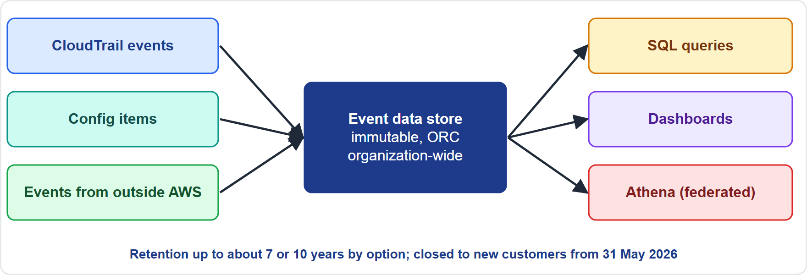
AWS CloudTrail Lake: Centralized Queries
VERIFY LIVE · DATES
Part 1
AWS CloudTrail Lake lets you run SQL queries directly on events without building your own S3 and Athena setup
As of 7 November 2026: check the AWS page for the current value
AWS CloudTrail Lake lets you run SQL queries directly on events without building your own S3 and Athena setup
As of 7 November 2026: check the AWS page for the current value
Data Engineer Associate Exam Prep Masterclass | for the AWS DEA-C01 exam
Module 17: Prepare Logs for Audit
11 / 26
Notes:
A W S CloudTrail Lake: Centralized Queries.
The figure shows this: CloudTrail Lake: an event data store collects events, you query them with S Q L, view dashboards, and can federate the store to Athena through the Glue Data Catalog.
A W S CloudTrail Lake lets you run S Q L queries directly on events without building your own S three and Athena setup.
This fact moves with the A W S pages, so check the current value before you rely on it.

Slide 12
AWS CloudTrail Lake: Centralized Queries, continued
VERIFY LIVE · DATES
Part 1
Event data stores: immutable collections of events, converted to Apache ORC (columnar); each store holds one event category: CloudTrail events (management, data, network activity), Insights events, AWS Config configuration items, AWS Audit Manager evidence, or events from outside AWS (ingested with `PutAuditEvents` through a channel)
Centralize: an organization event data store collects events from all accounts and Regions; queries can join several stores; a resource policy gives cross-account access
As of 7 November 2026: check the AWS page for the current value
Data Engineer Associate Exam Prep Masterclass | for the AWS DEA-C01 exam
Module 17: Prepare Logs for Audit
12 / 26
Notes:
A W S CloudTrail Lake: Centralized Queries, continued.
Event data stores: immutable collections of events, converted to Apache O R C (Optimized Row Columnar) (columnar); each store holds one event category: CloudTrail events (management, data, network activity), Insights events, A W S Config configuration items, A W S Audit Manager evidence, or events from outside A W S (ingested with PutAuditEvents through a channel).
Centralize: an organization event data store collects events from all accounts and Regions; queries can join several stores; a resource policy gives cross-account access.
This fact moves with the A W S pages, so check the current value before you rely on it.

Slide 13
AWS CloudTrail Lake: Centralized Queries, continued
VERIFY LIVE · DATES
Part 1
Retention (set by the pricing option): up to 3,653 days (about 10 years) with one-year extendable retention pricing, or up to 2,557 days (about 7 years) with seven-year retention pricing
Queries: SQL (Trino SELECT syntax) with saved queries, sample queries, natural-language query generation, results kept for seven days and savable to S3; dashboards (managed, custom, highlights); you pay per data scanned
Compared with Event history: Lake spans accounts and Regions, many attributes, and long retention
As of 7 November 2026: check the AWS page for the current value
Data Engineer Associate Exam Prep Masterclass | for the AWS DEA-C01 exam
Module 17: Prepare Logs for Audit
13 / 26
Notes:
A W S CloudTrail Lake: Centralized Queries, continued.
Retention (set by the pricing option): up to three thousand six hundred fifty-three days (about ten years) with one-year extendable retention pricing, or up to two thousand five hundred fifty-seven days (about seven years) with seven-year retention pricing.
Queries: S Q L (Trino select syntax) with saved queries, sample queries, natural-language query generation, results kept for seven days and savable to S three; dashboards (managed, custom, highlights); you pay per data scanned.
Compared with Event history: Lake spans accounts and Regions, many attributes, and long retention.
This fact moves with the A W S pages, so check the current value before you rely on it.

Slide 14
AWS CloudTrail Lake: Centralized Queries, continued
VERIFY LIVE · DATES
Part 2
Federation
Encryption
federate an event data store so Athena can query it through the Glue Data Catalog
events are encrypted by default, or with your KMS key (cannot be changed later)
Availability
As of 7 November 2026
CloudTrail Lake stops accepting new customers from 31 May 2026; existing customers continue. For new setups the usual alternative is a trail to S3 queried with Athena (below)
check the AWS page for the current value
Data Engineer Associate Exam Prep Masterclass | for the AWS DEA-C01 exam
Module 17: Prepare Logs for Audit
14 / 26
Notes:
A W S CloudTrail Lake: Centralized Queries, continued.
Federation: federate an event data store so Athena can query it through the Glue Data Catalog.
Encryption: events are encrypted by default, or with your K M S key (cannot be changed later).
Availability: CloudTrail Lake stops accepting new customers from thirty-one May two thousand twenty-six; existing customers continue. For new setups the usual alternative is a trail to S three queried with Athena (below).
This fact moves with the A W S pages, so check the current value before you rely on it.

Slide 15
AWS CloudTrail Lake: Centralized Queries, continued
VERIFY LIVE · DATES
Part 2
 | Trail to S3 + Athena | CloudTrail Lake
Setup | Build it yourself (bucket, table, partitions) | Managed event data store and SQL
Cost shape | S3 storage + Athena per data scanned | Ingestion and storage fees + query per data scanned
Retention | As long as you keep the files | Up to about 7 or 10 years by option
Multi-account | Organization trail to one bucket | Organization event data store
Best for | Cheap, flexible, long-term archive | Fast, centralized, managed audit queries
As of 7 November 2026: check the AWS page for the current value
EXAM TIP "Centralized SQL queries over CloudTrail events from many accounts, with no infrastructure to build" → CloudTrail Lake (organization event data store).
Data Engineer Associate Exam Prep Masterclass | for the AWS DEA-C01 exam
Module 17: Prepare Logs for Audit
15 / 26
Notes:
A W S CloudTrail Lake: Centralized Queries, continued.
Setup. Trail to S three plus Athena: Build it yourself (bucket, table, partitions). CloudTrail Lake: Managed event data store and S Q L.
Cost shape. Trail to S three plus Athena: S three storage plus Athena per data scanned. CloudTrail Lake: Ingestion and storage fees plus query per data scanned.
Retention. Trail to S three plus Athena: As long as you keep the files. CloudTrail Lake: Up to about seven or ten years by option.
Multi-account. Trail to S three plus Athena: Organization trail to one bucket. CloudTrail Lake: Organization event data store.
Best for. Trail to S three plus Athena: Cheap, flexible, long-term archive. CloudTrail Lake: Fast, centralized, managed audit queries.
Exam tip: "Centralized S Q L queries over CloudTrail events from many accounts, with no infrastructure to build" to CloudTrail Lake (organization event data store).
This fact moves with the A W S pages, so check the current value before you rely on it.

Slide 16
Analyzing Logs
Part 2
Tool | Use it for | Notes
Amazon Athena | SQL on logs in S3 (CloudTrail, S3 access logs, ELB, VPC Flow Logs, exported CloudWatch logs) | Create the table (CloudTrail has a ready-made table template), partition by date or use partition projection, store logs as Parquet for cost; pay per data scanned
CloudWatch Logs Insights | Interactive queries on log groups in CloudWatch | fields, filter, stats, sort, limit, parse; best for recent logs
Amazon OpenSearch Service | Near-real-time search, correlation and dashboards | Ingest with Firehose or CloudWatch subscription filters
Data Engineer Associate Exam Prep Masterclass | for the AWS DEA-C01 exam
Module 17: Prepare Logs for Audit
16 / 26
Notes:
Analyzing Logs.
Amazon Athena. Use it for: S Q L on logs in S three (CloudTrail, S three access logs, E L B (Elastic Load Balancing), V P C Flow Logs, exported CloudWatch logs). Notes: Create the table (CloudTrail has a ready-made table template), partition by date or use partition projection, store logs as Parquet for cost; pay per data scanned.
CloudWatch Logs Insights. Use it for: Interactive queries on log groups in CloudWatch. Notes: fields, filter, stats, sort, limit, parse; best for recent logs.
Amazon OpenSearch Service. Use it for: Near-real-time search, correlation and dashboards. Notes: Ingest with Firehose or CloudWatch subscription filters.

Slide 17
Analyzing Logs, continued
Part 2
Tool | Use it for | Notes
Amazon EMR | Very large volumes and custom processing of logs | Spark parses, enriches and writes Parquet back to S3
Data Engineer Associate Exam Prep Masterclass | for the AWS DEA-C01 exam
Module 17: Prepare Logs for Audit
17 / 26
Notes:
Analyzing Logs, continued.
Amazon E M R. Use it for: Very large volumes and custom processing of logs. Notes: Spark parses, enriches and writes Parquet back to S three.

Slide 18
Analyzing Logs, continued
Part 2
SQL
-- Athena: who deleted tables in the last day (CloudTrail table)
SELECT useridentity.arn, eventname, eventtime, sourceipaddress
FROM cloudtrail_logs
ORDER BY eventtime DESC;
Example from the study note (names are examples)
Data Engineer Associate Exam Prep Masterclass | for the AWS DEA-C01 exam
Module 17: Prepare Logs for Audit
18 / 26
Notes:
Analyzing Logs, continued.
The example is on the screen; read it line by line when you study.

Slide 19
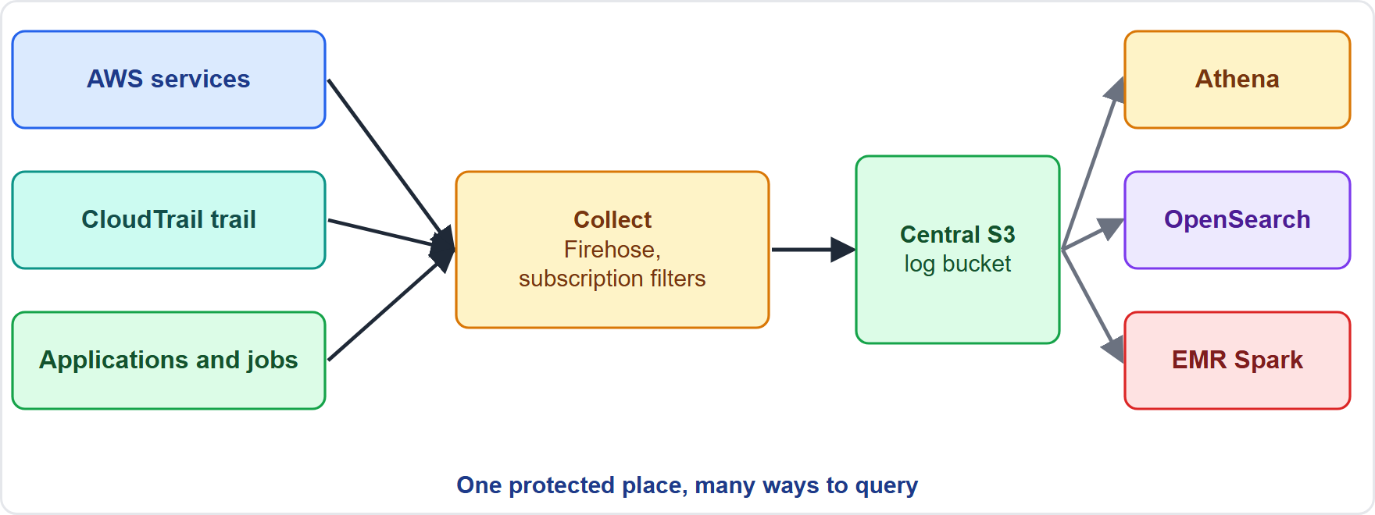
Integrating Services for Logging at Scale
Part 2
Collect: CloudTrail trail → S3; CloudWatch Logs subscription filter → Kinesis Data Streams or Data Firehose → S3 or OpenSearch; S3 server access logs, ELB and CloudFront logs, VPC Flow Logs → S3 or CloudWatch Logs; Glue and EMR logs → CloudWatch Logs and S3
Collect: CloudTrail trail → S3; CloudWatch Logs subscription filter → Kinesis Data Streams or Data Firehose → S3 or OpenSearch; S3 server access logs, ELB and CloudFront logs, VPC Flow Logs → S3 or CloudWatch Logs; Glue and EMR logs → CloudWatch Logs and S3
Data Engineer Associate Exam Prep Masterclass | for the AWS DEA-C01 exam
Module 17: Prepare Logs for Audit
19 / 26
Notes:
Integrating Services for Logging at Scale.
The figure shows this: A central logging design: services and CloudTrail write logs, Firehose and subscription filters collect them into a central S three log bucket, and Athena, OpenSearch and E M R analyze them.
Collect: CloudTrail trail to S three; CloudWatch Logs subscription filter to Kinesis Data Streams or Data Firehose to S three or OpenSearch; S three server access logs, E L B and CloudFront logs, V P C Flow Logs to S three or CloudWatch Logs; Glue and E M R logs to CloudWatch Logs and S three.

Slide 20
Integrating Services for Logging at Scale, continued
Part 2
Centralize in one log bucket or account with encryption, retention and restricted access; use AWS Organizations features (organization trails, centralized logging patterns)
Large volumes: EMR (Spark) or Glue parse, filter, enrich and convert to partitioned Parquet, so Athena queries are cheap and fast; Firehose can convert to Parquet and partition on delivery
Amazon EMR in particular: EMR can write its own logs to S3 (log URI) and process large log datasets from other services
Data Engineer Associate Exam Prep Masterclass | for the AWS DEA-C01 exam
Module 17: Prepare Logs for Audit
20 / 26
Notes:
Integrating Services for Logging at Scale, continued.
Centralize in one log bucket or account with encryption, retention and restricted access; use A W S Organizations features (organization trails, centralized logging patterns).
Large volumes: E M R (Spark) or Glue parse, filter, enrich and convert to partitioned Parquet, so Athena queries are cheap and fast; Firehose can convert to Parquet and partition on delivery.
Amazon E M R in particular: E M R can write its own logs to S three (log U R I (Uniform Resource Identifier)) and process large log datasets from other services.

Slide 21
Integrating Services for Logging at Scale, continued
Part 2
Govern the logs themselves: log access to the logs (who read the audit trail), alarm on changes to trails and log groups, and test restores and queries before an audit
EXAM TIP "Terabytes of application logs must be parsed and made queryable cheaply" → an EMR or Glue Spark job that writes partitioned Parquet to S3, queried with Athena.
Data Engineer Associate Exam Prep Masterclass | for the AWS DEA-C01 exam
Module 17: Prepare Logs for Audit
21 / 26
Notes:
Integrating Services for Logging at Scale, continued.
Govern the logs themselves: log access to the logs (who read the audit trail), alarm on changes to trails and log groups, and test restores and queries before an audit.
Exam tip: "Terabytes of application logs must be parsed and made queryable cheaply" to an E M R or Glue Spark job that writes partitioned Parquet to S three, queried with Athena.

Slide 22
Module Recap
Part 2
1
CloudTrail
2
Protect logs
3
CloudWatch Logs
Management events (on by default), data events (off by default; S3 objects, Lambda, DynamoDB), Insights
Separate log-archive account, encrypted bucket, restricted/deny delete, Object Lock, versioning
Log groups, retention (default never expire), KMS, export / subscription → S3, Logs Insights, data protection policies
4
CloudTrail Lake
5
Analysis
6
Integration
Event data stores (ORC, immutable), SQL (Trino), organization store, retention up to 7 or 10 years by pricing option, dashboards, federate to Athena
Athena (SQL on S3, partition/Parquet), Logs Insights, OpenSearch (search, dashboards), EMR/Glue Spark (huge volumes → Parquet)
Subscription filters / Firehose → S3 or OpenSearch, trail → S3, central log bucket/account, Firehose converts to Parquet
Data Engineer Associate Exam Prep Masterclass | for the AWS DEA-C01 exam
Module 17: Prepare Logs for Audit
22 / 26
Notes:
Here is the recap.
CloudTrail: Management events (on by default), data events (off by default; S three objects, Lambda, DynamoDB), Insights.
Protect logs: Separate log-archive account, encrypted bucket, restricted or deny delete, Object Lock, versioning.
CloudWatch Logs: Log groups, retention (default never expire), K M S, export or subscription to S three, Logs Insights, data protection policies.
CloudTrail Lake: Event data stores (O R C, immutable), S Q L (Trino), organization store, retention up to seven or ten years by pricing option, dashboards, federate to Athena.
Analysis: Athena (S Q L on S three, partition or Parquet), Logs Insights, OpenSearch (search, dashboards), E M R or Glue Spark (huge volumes to Parquet).
Integration: Subscription filters or Firehose to S three or OpenSearch, trail to S three, central log bucket or account, Firehose converts to Parquet.

Slide 23
Practice Question 1
Part 2
Q1
An auditor asks who downloaded objects from a sensitive S3 bucket during the last year. Which preparation provides this evidence?
A
CloudTrail management events only, delivered to CloudWatch Logs
B
The 90-day CloudTrail event history in the console
C
CloudTrail data events for that bucket, delivered by a trail to a protected S3 bucket
D
S3 Lifecycle rules that keep a record of each transition
Data Engineer Associate Exam Prep Masterclass | for the AWS DEA-C01 exam
Module 17: Prepare Logs for Audit
23 / 26
Notes:
Question one.
An auditor asks who downloaded objects from a sensitive S three bucket during the last year. Which preparation provides this evidence?
The four options are on the screen.
[PAUSE 12]
The answer is C. Object-level reads are data events, which are off by default and must be enabled; a trail retains them beyond the ninety-day event history.

Slide 24
Practice Question 2
DATES
Part 2
Q2
A security team needs centralized SQL queries over CloudTrail events from all accounts in an organization, with no infrastructure to build and retention of several years. Which option fits?
A
Amazon CloudWatch metrics filtered by account and Region
B
Amazon S3 Inventory reports for the log buckets of each account
C
Amazon Macie sensitive data discovery jobs on the log buckets
D
CloudTrail Lake with an organization event data store
Data Engineer Associate Exam Prep Masterclass | for the AWS DEA-C01 exam
Module 17: Prepare Logs for Audit
24 / 26
Notes:
Question two.
A security team needs centralized S Q L queries over CloudTrail events from all accounts in an organization, with no infrastructure to build and retention of several years. Which option fits?
The four options are on the screen.
[PAUSE 12]
The answer is D. CloudTrail Lake stores events in managed event data stores that can span an organization and be queried with S Q L; note that Lake is closed to new customers from thirty-one May two thousand twenty-six, so a trail to S three queried with Athena is the alternative for new setups.

Slide 25
Practice Question 3
Part 2
Q3
An organization generates terabytes of application logs per day that must be parsed and enriched before analysis. Which approach is most appropriate?
A
Open each log file in a text editor and search for the errors
B
Store the logs in the environment variables of a Lambda function
C
Send every log line to an Amazon SNS topic and read the emails
D
Parse the logs with an EMR or Glue Spark job, write partitioned Parquet to S3, and query with Athena
Data Engineer Associate Exam Prep Masterclass | for the AWS DEA-C01 exam
Module 17: Prepare Logs for Audit
25 / 26
Notes:
Question three.
An organization generates terabytes of application logs per day that must be parsed and enriched before analysis. Which approach is most appropriate?
The four options are on the screen.
[PAUSE 12]
The answer is D. Spark on E M R or Glue handles very large volumes and produces partitioned columnar data that Athena can query cheaply.

Slide 26
Answers at a Glance
Part 2
Question | Answer | Why
Q1 | C | Object-level reads are data events, which are off by default and must be enabled
Q2 | D | CloudTrail Lake stores events in managed event data stores that can span an organization
Q3 | D | Spark on EMR or Glue handles very large volumes and produces partitioned columnar data
Data Engineer Associate Exam Prep Masterclass | for the AWS DEA-C01 exam
Module 17: Prepare Logs for Audit
26 / 26
Notes:
Here are all three answers. Question one: C. Question two: D. Question three: D.
In the next module, we continue the course.

