Slide 1
Module 18: Data Privacy and Governance
Grant permissions for data sharing, for example Amazon Redshift data sharing
Domain 4 · Data Security and Governance · Task statement 4.5
Data Engineer Associate Exam Prep Masterclass
Module 18 · Part 1
Notes:
Welcome to Module eighteen: Data Privacy and Governance. This module covers the task statement: understand data privacy and governance.
Each part of this module comes from the study notes of the same name, so you can read the notes after you watch.

Slide 2
What You Will Learn
Part 1
Grant permissions for data sharing, for example Amazon Redshift data sharing
Identify PII with Amazon Macie together with AWS Lake Formation
Prevent backups and replication of data to disallowed Regions
View configuration changes with AWS Config
Maintain data sovereignty
Manage data access through Amazon SageMaker Catalog projects
Data Engineer Associate Exam Prep Masterclass | for the AWS DEA-C01 exam
Module 18: Data Privacy and Governance
2 / 30
Notes:
By the end of this module you will be able to do six things.
Grant permissions for data sharing, for example Amazon Redshift data sharing.
Identify P I I (personally identifiable information) with Amazon Macie together with A W S Lake Formation.
Prevent backups and replication of data to disallowed Regions.
View configuration changes with A W S Config.
Maintain data sovereignty.
Manage data access through Amazon SageMaker Catalog projects.

Slide 3
Case Check-In: Kestrel Freight Shares Data Safely
Part 1
CASE CHECK-IN · Kestrel Freight
The analytics account wants the billing warehouse without copying it
A partner should see delivery statuses, but no customer names
A regulator limits where data may be stored
Your job: share the right data, to the right people, in the right places
Data Engineer Associate Exam Prep Masterclass | for the AWS DEA-C01 exam
Module 18: Data Privacy and Governance
3 / 30
Notes:
Our running case is Kestrel Freight. Kestrel Freight Shares Data Safely.
The analytics account wants the billing warehouse without copying it.
A partner should see delivery statuses, but no customer names.
A regulator limits where data may be stored.
Your job: share the right data, to the right people, in the right places.

Slide 4
Granting Permissions for Data Sharing
Part 1
Way to share | How it works | Remember
Amazon Redshift data sharing | A producer cluster or Serverless workgroup creates a datashare (schemas, tables, views, functions); consumers (other clusters, workgroups, accounts, Regions) query it live with their own compute | No copy, no ETL; data is current and transactionally consistent; consumers get read access; works with RA3 and Serverless; admins grant and authorize the share (and AWS Data Exchange can publish datashares to subscribers)
Data Engineer Associate Exam Prep Masterclass | for the AWS DEA-C01 exam
Module 18: Data Privacy and Governance
4 / 30
Notes:
Granting Permissions for Data Sharing.
Amazon Redshift data sharing. How it works: A producer cluster or Serverless workgroup creates a datashare (schemas, tables, views, functions); consumers (other clusters, workgroups, accounts, Regions) query it live with their own compute. Remember: No copy, no E T L (extract, transform, load); data is current and transactionally consistent; consumers get read access; works with R A three and Serverless; admins grant and authorize the share (and A W S Data Exchange can publish datashares to subscribers).

Slide 5
Granting Permissions for Data Sharing, continued
Part 1
Way to share | How it works | Remember
AWS Lake Formation cross-account sharing | Grant database, table, column or row permissions to another account, an organization or its roles; recipients create resource links and query with Athena, Redshift Spectrum or EMR | Fine-grained (columns, rows, LF-tags); permissions managed centrally; uses AWS RAM underneath
Amazon S3 sharing | Bucket or access point policies, cross-account roles, S3 Replication, presigned URLs | Coarser (object level); simplest for files; remember KMS key access (Module 16)
AWS Data Exchange | Find, subscribe to and publish third-party datasets (to S3, Redshift and more) | For external sharing and data products
Data Engineer Associate Exam Prep Masterclass | for the AWS DEA-C01 exam
Module 18: Data Privacy and Governance
5 / 30
Notes:
Granting Permissions for Data Sharing, continued.
A W S Lake Formation cross-account sharing. How it works: Grant database, table, column or row permissions to another account, an organization or its roles; recipients create resource links and query with Athena, Redshift Spectrum or E M R (Elastic MapReduce). Remember: Fine-grained (columns, rows, L F (Lake Formation)-tags); permissions managed centrally; uses A W S R A M underneath.
Amazon S three sharing. How it works: Bucket or access point policies, cross-account roles, S three Replication, presigned U R L s. Remember: Coarser (object level); simplest for files; remember K M S (Key Management Service) key access (Module sixteen).
A W S Data Exchange. How it works: Find, subscribe to and publish third-party datasets (to S three, Redshift and more). Remember: For external sharing and data products.

Slide 6
Granting Permissions for Data Sharing, continued
Part 1
Way to share | How it works | Remember
Amazon SageMaker Catalog | Publish assets and approve subscriptions between projects | Business-driven sharing (section 7)
Share by view or column list, not the whole table, to hide sensitive columns
Principle of least privilege applies to sharing: named consumers, read-only, purpose-limited, time-boxed, logged (CloudTrail)
EXAM TIP "Share live warehouse data with another account's Redshift without copying it" → Redshift data sharing (datashares). "Share lake tables with column and row limits" → Lake Formation cross-account grants.
Data Engineer Associate Exam Prep Masterclass | for the AWS DEA-C01 exam
Module 18: Data Privacy and Governance
6 / 30
Notes:
Granting Permissions for Data Sharing, continued.
Amazon SageMaker Catalog. How it works: Publish assets and approve subscriptions between projects. Remember: Business-driven sharing (section seven).
Share by view or column list, not the whole table, to hide sensitive columns.
Principle of least privilege applies to sharing: named consumers, read-only, purpose-limited, time-boxed, logged (CloudTrail).
Exam tip: "Share live warehouse data with another account's Redshift without copying it" to Redshift data sharing (datashares). "Share lake tables with column and row limits" to Lake Formation cross-account grants.

Slide 7
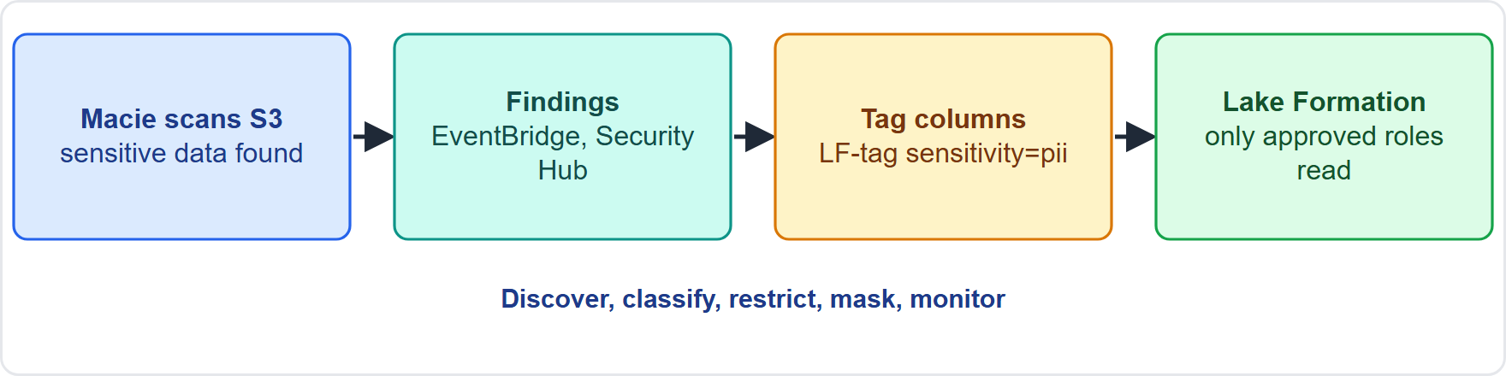
Identifying PII with Amazon Macie and Lake Formation
Part 1
PII (personally identifiable information) is data that identifies a person: names, addresses, phone numbers, national IDs, financial and health data
PII (personally identifiable information) is data that identifies a person: names, addresses, phone numbers, national IDs, financial and health data
Data Engineer Associate Exam Prep Masterclass | for the AWS DEA-C01 exam
Module 18: Data Privacy and Governance
7 / 30
Notes:
Identifying P I I with Amazon Macie and Lake Formation.
The figure shows this: Finding and protecting P I I: Macie discovers sensitive data in S three, findings are used to tag tables and columns in the Data Catalog, and Lake Formation tag-based access control limits who can see them.
P I I (personally identifiable information) is data that identifies a person: names, addresses, phone numbers, national I Ds, financial and health data.

Slide 8
Identifying PII with Amazon Macie and Lake Formation, continued
Part 1
Amazon Macie discovers and reports sensitive data in Amazon S3 using machine learning and pattern matching:; Managed data identifiers (names, addresses, credit card and bank numbers, national IDs, credentials) and custom data identifiers (your own regular expressions); Automated sensitive data discovery (continuous sampling across your buckets) and sensitive data discovery jobs (scheduled or one-time, on chosen buckets); Findings go to the console, Amazon EventBridge and AWS Security Hub; it also reports bucket inventory and policy problems (public, unencrypted, shared)
Data Engineer Associate Exam Prep Masterclass | for the AWS DEA-C01 exam
Module 18: Data Privacy and Governance
8 / 30
Notes:
Identifying P I I with Amazon Macie and Lake Formation, continued.
Amazon Macie discovers and reports sensitive data in Amazon S three using machine learning and pattern matching:; Managed data identifiers (names, addresses, credit card and bank numbers, national I Ds, credentials) and custom data identifiers (your own regular expressions); Automated sensitive data discovery (continuous sampling across your buckets) and sensitive data discovery jobs (scheduled or one-time, on chosen buckets); Findings go to the console, Amazon EventBridge and A W S Security Hub; it also reports bucket inventory and policy problems (public, unencrypted, shared).

Slide 9
Identifying PII with Amazon Macie and Lake Formation, continued
Part 1
With AWS Lake Formation: use Macie's results to tag the affected tables and columns (for example an LF-tag `sensitivity = pii`) and then grant or deny access by tag, so only authorized roles see PII columns, and new tagged data is protected automatically (Module 15)
Other PII tools: the AWS Glue detect-PII transform (find and redact in a pipeline), Amazon Comprehend (PII in text), Redshift dynamic data masking and DataBrew masking (Module 16)
Process: discover → classify (tag) → restrict (permissions) → mask or minimize → monitor
EXAM TIP "Find personal data in S3 buckets and restrict who can read it" → Amazon Macie for discovery, then Lake Formation tag-based access control.
Data Engineer Associate Exam Prep Masterclass | for the AWS DEA-C01 exam
Module 18: Data Privacy and Governance
9 / 30
Notes:
Identifying P I I with Amazon Macie and Lake Formation, continued.
With A W S Lake Formation: use Macie's results to tag the affected tables and columns (for example an L F-tag sensitivity equals pii) and then grant or deny access by tag, so only authorized roles see P I I columns, and new tagged data is protected automatically (Module fifteen).
Other P I I tools: the A W S Glue detect-P I I transform (find and redact in a pipeline), Amazon Comprehend (P I I in text), Redshift dynamic data masking and DataBrew masking (Module sixteen).
Process: discover to classify (tag) to restrict (permissions) to mask or minimize to monitor.
Exam tip: "Find personal data in S three buckets and restrict who can read it" to Amazon Macie for discovery, then Lake Formation tag-based access control.

Slide 10
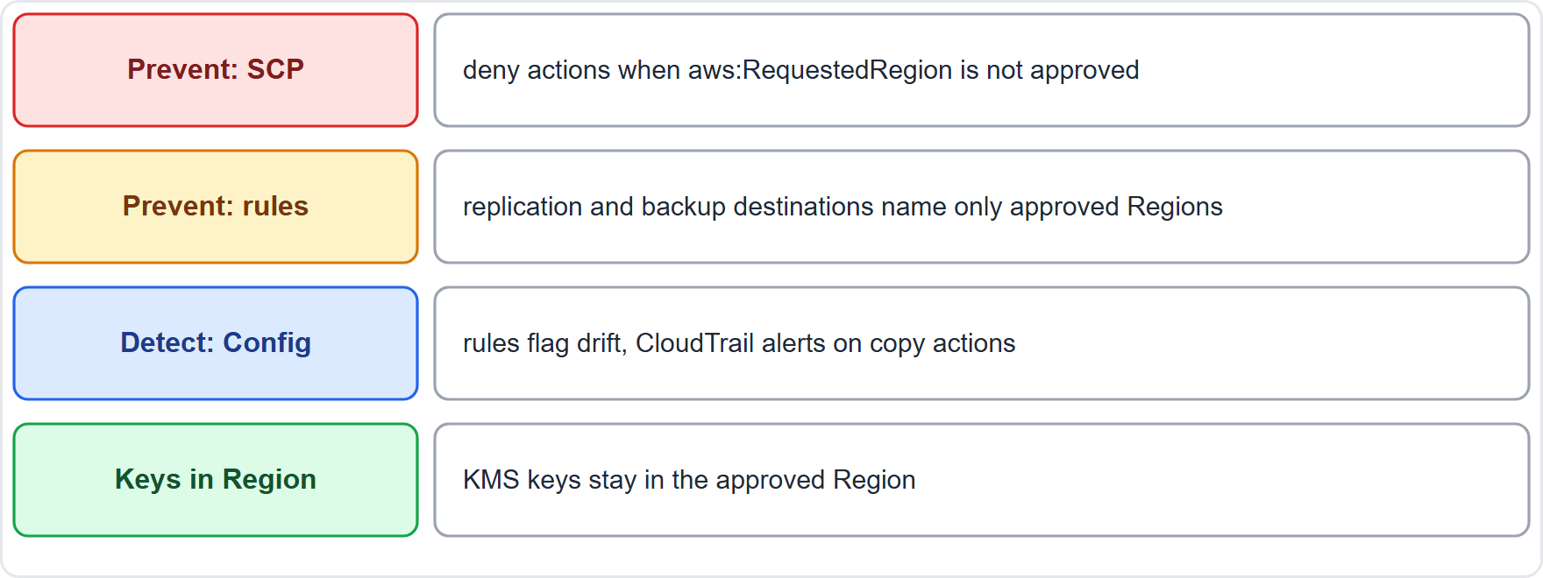
Preventing Backups and Replication to Disallowed Regions
Part 1
Data stays in a Region unless you move it, but replication, cross-Region copies and global features can move it: S3 Replication, DynamoDB global tables, RDS and Redshift cross-Region snapshot copy, AWS Backup cross-Region copy, Aurora Global Database, ECR and AMI copies
Data stays in a Region unless you move it, but replication, cross-Region copies and global features can move it: S3 Replication, DynamoDB global tables, RDS and Redshift cross-Region snapshot copy, AWS Backup cross-Region copy, Aurora Global Database, ECR and AMI copies
Data Engineer Associate Exam Prep Masterclass | for the AWS DEA-C01 exam
Module 18: Data Privacy and Governance
10 / 30
Notes:
Preventing Backups and Replication to Disallowed Regions.
The figure shows this: Keeping data in approved Regions: an S C P (service control policy) denies requests in other Regions, replication and backup rules name only approved destinations, and A W S Config rules report violations.
Data stays in a Region unless you move it, but replication, cross-Region copies and global features can move it: S three Replication, DynamoDB global tables, R D S (Relational Database Service) and Redshift cross-Region snapshot copy, A W S Backup cross-Region copy, Aurora Global Database, E C R (Elastic Container Registry) and A M I (Amazon Machine Image) copies.

Slide 11
Preventing Backups and Replication to Disallowed Regions, continued
Part 1
Preventive controls:; Service control policies (SCPs) in AWS Organizations that deny actions when `aws:RequestedRegion` is not in the approved list (with exceptions for global services); IAM policies and permissions boundaries with the same Region condition; S3: replication rules only to approved destination buckets; bucket policies and IAM that deny s3:ReplicateObject to other Regions; AWS Backup: backup plans and vault access policies that allow copies only to approved vaults and Regions; AWS Control Tower data residency guardrails and disabling unused Regions (opt-in Regions stay off); KMS keys in the allowed Region (avoid multi-Region keys that replicate key material elsewhere)
Data Engineer Associate Exam Prep Masterclass | for the AWS DEA-C01 exam
Module 18: Data Privacy and Governance
11 / 30
Notes:
Preventing Backups and Replication to Disallowed Regions, continued.
Preventive controls:; Service control policies (S C P s) in A W S Organizations that deny actions when the requested Region condition is not in the approved list (with exceptions for global services); I A M (Identity and Access Management) policies and permissions boundaries with the same Region condition; S three: replication rules only to approved destination buckets; bucket policies and I A M that deny S three replicate object to other Regions; A W S Backup: backup plans and vault access policies that allow copies only to approved vaults and Regions; A W S Control Tower data residency guardrails and disabling unused Regions (opt-in Regions stay off); K M S keys in the allowed Region (avoid multi-Region keys that replicate key material elsewhere).

Slide 12
Preventing Backups and Replication to Disallowed Regions, continued
Part 1
Detective controls: AWS Config rules and conformance packs (for example S3 replication to unapproved Regions, unencrypted or public resources), CloudTrail alerts on replication, copy and global table actions
Test the guardrail: try an action in a blocked Region and confirm it is denied
EXAM TIP "Make sure no one can replicate or back up data outside the EU" → an SCP that denies actions outside approved Regions, plus replication and backup rules that name only approved destinations.
Data Engineer Associate Exam Prep Masterclass | for the AWS DEA-C01 exam
Module 18: Data Privacy and Governance
12 / 30
Notes:
Preventing Backups and Replication to Disallowed Regions, continued.
Detective controls: A W S Config rules and conformance packs (for example S three replication to unapproved Regions, unencrypted or public resources), CloudTrail alerts on replication, copy and global table actions.
Test the guardrail: try an action in a blocked Region and confirm it is denied.
Exam tip: "Make sure no one can replicate or back up data outside the E U" to an S C P that denies actions outside approved Regions, plus replication and backup rules that name only approved destinations.

Slide 13
Viewing Configuration Changes with AWS Config
Part 1
AWS Config records the configuration of AWS resources and how it changes over time (a configuration item per change, with relationships between resources)
Uses: a timeline of what changed and when for a bucket, security group, database or role; compliance against rules; troubleshooting and audits
Rules: managed rules (for example s3-bucket-public-read-prohibited, encrypted-volumes, rds-storage-encrypted) and custom rules (Lambda or Guard); evaluated on change or on a schedule; conformance packs bundle rules and remediation
Remediation: automatic or manual fixes through AWS Systems Manager Automation
Data Engineer Associate Exam Prep Masterclass | for the AWS DEA-C01 exam
Module 18: Data Privacy and Governance
13 / 30
Notes:
Viewing Configuration Changes with A W S Config.
A W S Config records the configuration of A W S resources and how it changes over time (a configuration item per change, with relationships between resources).
Uses: a timeline of what changed and when for a bucket, security group, database or role; compliance against rules; troubleshooting and audits.
Rules: managed rules (for example S three bucket public read prohibited, encrypted-volumes, rds-storage-encrypted) and custom rules (Lambda or Guard); evaluated on change or on a schedule; conformance packs bundle rules and remediation.
Remediation: automatic or manual fixes through A W S Systems Manager Automation.

Slide 14
Viewing Configuration Changes with AWS Config, continued
Part 1
Scope and delivery: aggregators collect multiple accounts and Regions; configuration snapshots and history are delivered to S3; notifications go to SNS and EventBridge; advanced queries use SQL across resources
Config vs CloudTrail: Config shows the state of a resource and its history; CloudTrail shows who made the API call: use both for an audit trail
EXAM TIP "What was the configuration of the bucket policy last week, and is it compliant?" → AWS Config (timeline and rules). "Who changed it?" → CloudTrail.
Data Engineer Associate Exam Prep Masterclass | for the AWS DEA-C01 exam
Module 18: Data Privacy and Governance
14 / 30
Notes:
Viewing Configuration Changes with A W S Config, continued.
Scope and delivery: aggregators collect multiple accounts and Regions; configuration snapshots and history are delivered to S three; notifications go to S N S (Simple Notification Service) and EventBridge; advanced queries use S Q L across resources.
Config versus CloudTrail: Config shows the state of a resource and its history; CloudTrail shows who made the A P I call: use both for an audit trail.
Exam tip: "What was the configuration of the bucket policy last week, and is it compliant?" to A W S Config (timeline and rules). "Who changed it?" to CloudTrail.

Slide 15
Data Sovereignty
Part 2
Data residency = where data is stored; data sovereignty = the data is subject to the laws of the country where it is located (and who can compel access)
Why it matters: privacy and sector laws (for example GDPR, public-sector and health rules) may require data to stay in a country or region, limit transfers, and require local control of keys
Data Engineer Associate Exam Prep Masterclass | for the AWS DEA-C01 exam
Module 18: Data Privacy and Governance
15 / 30
Notes:
Data Sovereignty.
Data residency equals where data is stored; data sovereignty equals the data is subject to the laws of the country where it is located (and who can compel access).
Why it matters: privacy and sector laws (for example G D P R (General Data Protection Regulation), public-sector and health rules) may require data to stay in a country or region, limit transfers, and require local control of keys.

Slide 16
Data Sovereignty, continued
Part 2
How to maintain it on AWS:; Choose the Region that satisfies the law and create resources only there; Restrict Regions with SCPs and Control Tower guardrails; do not enable other Regions; Keep copies, backups, logs and analytics in-Region (cross-Region features off or limited; Section 4); Control encryption keys: KMS keys in-Region, customer managed keys, optionally CloudHSM or external key store; Tag and classify data by residency requirement and enforce with LF-tags and Config rules; Document and audit where data lives and flows (lineage, Config, CloudTrail); Check provider options for sovereign or isolated environments if the law requires them
Data Engineer Associate Exam Prep Masterclass | for the AWS DEA-C01 exam
Module 18: Data Privacy and Governance
16 / 30
Notes:
Data Sovereignty, continued.
How to maintain it on A W S:; Choose the Region that satisfies the law and create resources only there; Restrict Regions with S C P s and Control Tower guardrails; do not enable other Regions; Keep copies, backups, logs and analytics in-Region (cross-Region features off or limited; Section four); Control encryption keys: K M S keys in-Region, customer managed keys, optionally CloudHSM or external key store; Tag and classify data by residency requirement and enforce with L F-tags and Config rules; Document and audit where data lives and flows (lineage, Config, CloudTrail); Check provider options for sovereign or isolated environments if the law requires them.

Slide 17
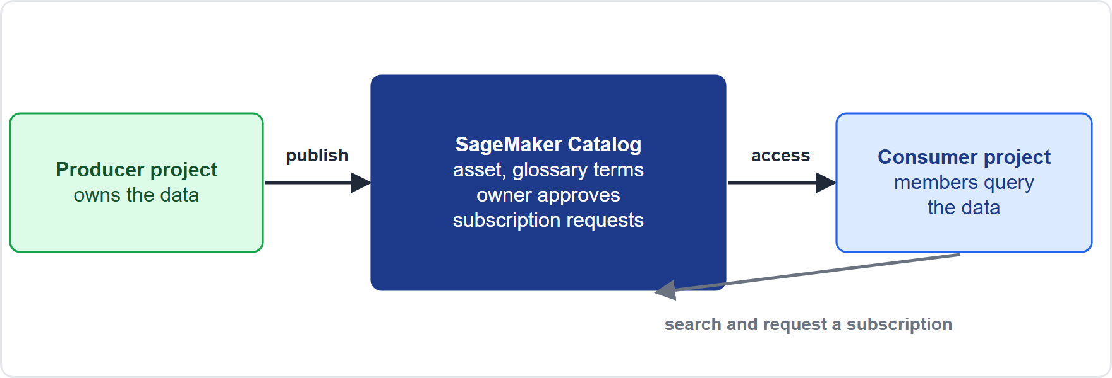
SageMaker Catalog Projects and Data Access
VERIFY LIVE
Part 2
In Amazon SageMaker Unified Studio, data access is managed by project (Module 14): a project is the unit that publishes data and subscribes to data
As of 7 November 2026: check the AWS page for the current value
In Amazon SageMaker Unified Studio, data access is managed by project (Module 14): a project is the unit that publishes data and subscribes to data
As of 7 November 2026: check the AWS page for the current value
Data Engineer Associate Exam Prep Masterclass | for the AWS DEA-C01 exam
Module 18: Data Privacy and Governance
17 / 30
Notes:
SageMaker Catalog Projects and Data Access.
The figure shows this: Business-driven sharing: a producer project publishes an asset, a consumer project finds it and requests a subscription, the owner approves, and the consumer project's members get access.
In Amazon SageMaker Unified Studio, data access is managed by project (Module fourteen): a project is the unit that publishes data and subscribes to data.
This fact moves with the A W S pages, so check the current value before you rely on it.

Slide 18
SageMaker Catalog Projects and Data Access, continued
VERIFY LIVE
Part 2
Producer project
Consumer project
As of 7 November 2026
brings data in (for example Glue Data Catalog tables, Redshift tables, S3 data), adds business metadata (glossary terms, descriptions), and publishes assets to the catalog
searches the catalog, requests a subscription to an asset with a reason, and, once approved by the owner or steward, its members can query the data in their tools
check the AWS page for the current value
Data Engineer Associate Exam Prep Masterclass | for the AWS DEA-C01 exam
Module 18: Data Privacy and Governance
18 / 30
Notes:
SageMaker Catalog Projects and Data Access, continued.
Producer project: brings data in (for example Glue Data Catalog tables, Redshift tables, S three data), adds business metadata (glossary terms, descriptions), and publishes assets to the catalog.
Consumer project: searches the catalog, requests a subscription to an asset with a reason, and, once approved by the owner or steward, its members can query the data in their tools.
This fact moves with the A W S pages, so check the current value before you rely on it.

Slide 19
SageMaker Catalog Projects and Data Access, continued
VERIFY LIVE
Part 2
Under the hood
Governance benefits
As of 7 November 2026
grants are created for the project's role (through Lake Formation or Redshift sharing), so access is scoped to the project, can be revoked, and is audited
business owners approve access, access follows the project and its members, everything is cataloged and logged
check the AWS page for the current value
EXAM TIP "Teams must request access to published datasets, owners approve, and access is limited to the requesting project" → SageMaker Catalog publish and subscribe with projects.
Data Engineer Associate Exam Prep Masterclass | for the AWS DEA-C01 exam
Module 18: Data Privacy and Governance
19 / 30
Notes:
SageMaker Catalog Projects and Data Access, continued.
Under the hood: grants are created for the project's role (through Lake Formation or Redshift sharing), so access is scoped to the project, can be revoked, and is audited.
Governance benefits: business owners approve access, access follows the project and its members, everything is cataloged and logged.
Exam tip: "Teams must request access to published datasets, owners approve, and access is limited to the requesting project" to SageMaker Catalog publish and subscribe with projects.
This fact moves with the A W S pages, so check the current value before you rely on it.

Slide 20
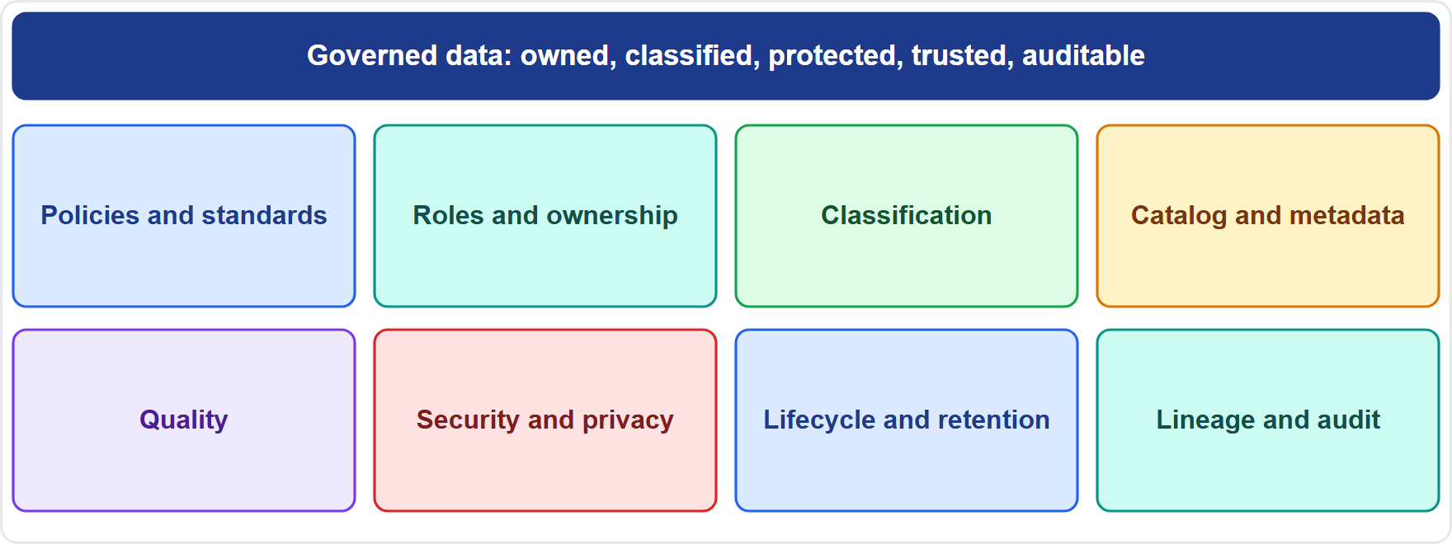
Governance Frameworks and Data Sharing Patterns
Part 2
A data governance framework: policies and standards, roles and ownership, classification, catalog and metadata, quality, security and privacy, lifecycle and retention, lineage and audit
Data Engineer Associate Exam Prep Masterclass | for the AWS DEA-C01 exam
Module 18: Data Privacy and Governance
20 / 30
Notes:
Governance Frameworks and Data Sharing Patterns.
The figure shows this: A data governance framework: policies and standards, roles and ownership, classification, catalog and metadata, quality, security and privacy, lifecycle and retention, lineage and audit.

Slide 21
Governance framework: what it contains
Part 2
Part | What it covers
Policies and standards | Rules for data use, retention, sharing, naming
Roles | Data owner (accountable), steward (maintains quality and definitions), custodian (technical operation), consumer
Classification | Public, internal, confidential, restricted (PII, financial)
Catalog and metadata | Technical and business catalogs, glossary (Module 7)
Quality | Rules, monitoring, ownership (Module 13)
Security and privacy | Authentication, authorization, encryption, masking, privacy law compliance (Modules 14–16)
Lifecycle | Retention, archive, deletion (Module 8)
Lineage and audit | Where data came from and who used it (Modules 9 and 17)
Metrics and compliance | Measure adoption, quality, incidents; report
Data Engineer Associate Exam Prep Masterclass | for the AWS DEA-C01 exam
Module 18: Data Privacy and Governance
21 / 30
Notes:
Governance framework: what it contains.
Policies and standards. Rules for data use, retention, sharing, naming.
Roles. Data owner (accountable), steward (maintains quality and definitions), custodian (technical operation), consumer.
Classification. Public, internal, confidential, restricted (P I I, financial).
Catalog and metadata. Technical and business catalogs, glossary (Module seven).
Quality. Rules, monitoring, ownership (Module thirteen).
Security and privacy. Authentication, authorization, encryption, masking, privacy law compliance (Modules fourteen to sixteen).
Lifecycle. Retention, archive, deletion (Module eight).
Lineage and audit. Where data came from and who used it (Modules nine and seventeen).
Metrics and compliance. Measure adoption, quality, incidents; report.

Slide 22
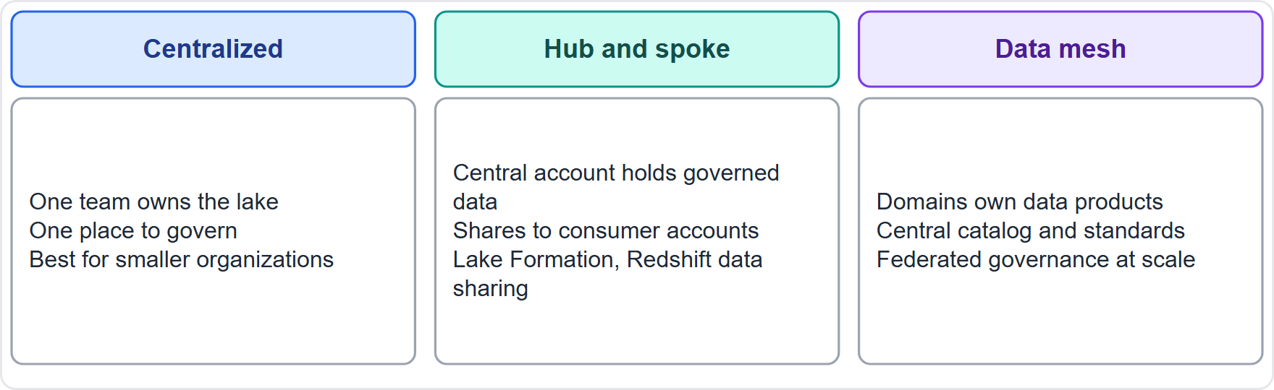
Data sharing patterns
Part 2
Data sharing patterns: centralized lake, hub and spoke across accounts, and data mesh with domain-owned data products and federated governance
Data Engineer Associate Exam Prep Masterclass | for the AWS DEA-C01 exam
Module 18: Data Privacy and Governance
22 / 30
Notes:
Data sharing patterns.
The figure shows this: Data sharing patterns: centralized lake, hub and spoke across accounts, and data mesh with domain-owned data products and federated governance.

Slide 23
Data sharing patterns, continued
Part 2
Pattern | Idea | Fits when
Centralized | One team and one lake own, store and serve the data | Small organization, strong central team
Hub and spoke (cross-account sharing) | A central account holds governed data and shares it to consumer accounts (Lake Formation, Redshift data sharing, RAM) | Many consumers, central control
Data mesh | Domains own and publish data products; central platform provides catalog, standards and federated governance | Large organization, domain expertise, scale
External sharing | AWS Data Exchange or controlled copies and APIs | Partners and customers
EXAM TIP A governance question is usually about who owns the data, how it is classified, who may use it, and how that is proven: choose the answer that assigns ownership, classifies, catalogs, restricts, and audits.
Data Engineer Associate Exam Prep Masterclass | for the AWS DEA-C01 exam
Module 18: Data Privacy and Governance
23 / 30
Notes:
Data sharing patterns, continued.
Centralized. Idea: One team and one lake own, store and serve the data. Fits when: Small organization, strong central team.
Hub and spoke (cross-account sharing). Idea: A central account holds governed data and shares it to consumer accounts (Lake Formation, Redshift data sharing, R A M). Fits when: Many consumers, central control.
Data mesh. Idea: Domains own and publish data products; central platform provides catalog, standards and federated governance. Fits when: Large organization, domain expertise, scale.
External sharing. Idea: A W S Data Exchange or controlled copies and A P I s. Fits when: Partners and customers.
Exam tip: A governance question is usually about who owns the data, how it is classified, who may use it, and how that is proven: choose the answer that assigns ownership, classifies, catalogs, restricts, and audits.

Slide 24
Module Recap
Part 2
1
Redshift data sharing
2
Lake Formation sharing
3
Macie
Discovers sensitive data in S3 (managed + custom identifiers, automated discovery, jobs); findings to EventBridge/Security Hub
Live, no copy, producer/consumer, own compute, read access, cross-account and cross-Region, RA3/Serverless, publish via Data Exchange
Cross-account grants to tables/columns/rows/LF-tags; RAM; resource links
4
Region control
5
AWS Config
6
Sovereignty
SCP deny with `aws:RequestedRegion`, replication/backup destinations, Control Tower guardrails, in-Region KMS, Config rules
Resource configuration history, rules (managed/custom), conformance packs, aggregators, remediation (Systems Manager); CloudTrail = who
Residency vs sovereignty; Region choice, SCPs, in-Region copies and keys, classification tags, documented flows
7
SageMaker Catalog
Projects publish and subscribe; owner approves; project-scoped, revocable, audited access
Data Engineer Associate Exam Prep Masterclass | for the AWS DEA-C01 exam
Module 18: Data Privacy and Governance
24 / 30
Notes:
Here is the recap.
Redshift data sharing: Live, no copy, producer or consumer, own compute, read access, cross-account and cross-Region, R A three or Serverless, publish via Data Exchange.
Lake Formation sharing: Cross-account grants to tables or columns or rows or L F-tags; R A M; resource links.
Macie: Discovers sensitive data in S three (managed plus custom identifiers, automated discovery, jobs); findings to EventBridge or Security Hub.
Region control: S C P deny with the requested Region condition, replication or backup destinations, Control Tower guardrails, in-Region K M S, Config rules.
A W S Config: Resource configuration history, rules (managed or custom), conformance packs, aggregators, remediation (Systems Manager); CloudTrail equals who.
Sovereignty: Residency versus sovereignty; Region choice, S C P s, in-Region copies and keys, classification tags, documented flows.
SageMaker Catalog: Projects publish and subscribe; owner approves; project-scoped, revocable, audited access.

Slide 25
Practice Question 1
Part 2
Q1
Kestrel Freight's analytics account needs to query the billing warehouse in another account's Amazon Redshift without copying the data. Which feature fits?
A
Nightly UNLOAD and COPY
B
Redshift data sharing
C
AWS DMS full load
D
S3 Glacier
Data Engineer Associate Exam Prep Masterclass | for the AWS DEA-C01 exam
Module 18: Data Privacy and Governance
25 / 30
Notes:
Question one.
Kestrel Freight's analytics account needs to query the billing warehouse in another account's Amazon Redshift without copying the data. Which feature fits?
The four options are on the screen.
[PAUSE 12]
The answer is B. A datashare lets consumers query live producer data with their own compute, with no copy or E T L.

Slide 26
Practice Question 2
Part 2
Q2
A company must find personal data stored in many S3 buckets and then limit who can read the tagged columns in lake tables. Which combination fits?
A
AWS Config alone, with rules that look for personal data in objects
B
Amazon Macie for discovery and Lake Formation tag-based access control for restriction
C
Amazon CloudFront signed URLs for the buckets that hold personal data
D
Amazon Kinesis Data Streams with a consumer that scans each record
Data Engineer Associate Exam Prep Masterclass | for the AWS DEA-C01 exam
Module 18: Data Privacy and Governance
26 / 30
Notes:
Question two.
A company must find personal data stored in many S three buckets and then limit who can read the tagged columns in lake tables. Which combination fits?
The four options are on the screen.
[PAUSE 12]
The answer is B. Macie discovers sensitive data in S three, and Lake Formation L F-tags grant or deny access by sensitivity.

Slide 27
Practice Question 3
Part 2
Q3
A regulation requires that customer data and its backups never leave the EU. Which TWO controls help enforce this? (Select TWO.)
A
An SCP that denies actions when aws:RequestedRegion is not an approved EU Region
B
Disable CloudTrail
C
Replication and backup rules whose destinations are only approved EU Regions
D
Enable S3 Transfer Acceleration
E
Use multi-Region KMS keys in every Region
Data Engineer Associate Exam Prep Masterclass | for the AWS DEA-C01 exam
Module 18: Data Privacy and Governance
27 / 30
Notes:
Question three. Select two.
A regulation requires that customer data and its backups never leave the E U. Which two controls help enforce this?
The five options are on the screen.
[PAUSE 15]
The answers are A and C. An S C P blocks use of other Regions, and replication and backup destinations restricted to approved Regions prevent copies leaving. Multi-Region keys and global acceleration move or expose more.

Slide 28
Practice Question 4
Part 2
Q4
A security team needs to see how a security group and an S3 bucket policy changed over the last month and whether they comply with company rules. Which service provides the configuration timeline and compliance?
A
Amazon Athena
B
AWS Config
C
AWS Glue
D
Amazon SQS
Data Engineer Associate Exam Prep Masterclass | for the AWS DEA-C01 exam
Module 18: Data Privacy and Governance
28 / 30
Notes:
Question four.
A security team needs to see how a security group and an S three bucket policy changed over the last month and whether they comply with company rules. Which service provides the configuration timeline and compliance?
The four options are on the screen.
[PAUSE 12]
The answer is B. A W S Config records resource configuration history and evaluates it against rules.

Slide 29
Practice Question 5
Part 2
Q5
A large company wants each business domain to own and publish its own data products while a central team provides the catalog, standards and governance. Which pattern is this?
A
Data mesh
B
A single centralized lake owned by one team
C
A spreadsheet export process
D
Hub and spoke with no domain ownership
Data Engineer Associate Exam Prep Masterclass | for the AWS DEA-C01 exam
Module 18: Data Privacy and Governance
29 / 30
Notes:
Question five.
A large company wants each business domain to own and publish its own data products while a central team provides the catalog, standards and governance. Which pattern is this?
The four options are on the screen.
[PAUSE 12]
The answer is A. A data mesh has domain-owned data products with federated governance and a shared catalog.

Slide 30
Answers at a Glance
Part 2
Question | Answer | Why
Q1 | B | A datashare lets consumers query live producer data with their own compute
Q2 | B | Macie discovers sensitive data in S3
Q3 | A, C | An SCP blocks use of other Regions
Q4 | B | AWS Config records resource configuration history and evaluates it against rules
Q5 | A | A data mesh has domain-owned data products with federated governance and a shared catalog
Data Engineer Associate Exam Prep Masterclass | for the AWS DEA-C01 exam
Module 18: Data Privacy and Governance
30 / 30
Notes:
Here are all five answers. Question one: B. Question two: B. Question three: A and C. Question four: B. Question five: A.
In the next module, we continue the course.

