Slide 1
Module 2: How Generative AI Models Work
Describe how generative AI models work
AI-901 exam prep · Identify AI concepts and capabilities · 40 to 45% of the exam
AI-901 Exam Prep: Azure AI Fundamentals Study Course
Module 2
Notes:
Welcome to Module two: How Generative A I Models Work. It covers the exam area Identify A I concepts and capabilities.
Each part of this module comes from the study notes of the same name, so you can read the notes after you watch.

Slide 2
What You Will Learn
Module 2
What generative AI is
Tokens
The transformer and attention
Embeddings
The context window
What generative models can and cannot do
Practice with exam-style questions and a recall check
AI-901 Exam Prep | Microsoft Azure AI Fundamentals exam
Module 2: How Generative AI Models Work
2 / 21
Notes:
By the end of this module you will be able to do seven things.
What generative A I is.
Tokens.
The transformer and attention.
Embeddings.
The context window.
What generative models can and cannot do.
Practice with exam-style questions and a recall check.

Slide 3
Where This Fits in the Exam
Module 2
EXAM CHECK-IN · Where this fits
Exam area: Identify AI concepts and capabilities (40–45%)
Exam format: a score of 700 on a scale of 1 to 1,000 passes; check the exam page for the time
Validated against: the official AI-901 study guide, current skills measured
AI-901 Exam Prep | Microsoft Azure AI Fundamentals exam
Module 2: How Generative AI Models Work
3 / 21
Notes:
Here is where this module sits in the exam.
Exam area: Identify A I concepts and capabilities (forty to forty-five percent).
Exam format: a score of seven hundred on a scale of one to one thousand passes; check the exam page for the time.
Validated against: the official A I nine oh one study guide, current skills measured.

Slide 4
What generative AI is
Module 2
Generative AI creates new content (text, code, images, audio) in response to a prompt. The most common kind for text is the large language model (LLM). A smaller, more compact relative is the small language model (SLM).
AI-901 Exam Prep | Microsoft Azure AI Fundamentals exam
Module 2: How Generative AI Models Work
4 / 21
Notes:
What generative A I is.
Generative A I creates new content (text, code, images, audio) in response to a prompt. The most common kind for text is the large language model (L L M). A smaller, more compact relative is the small language model (S L M).

Slide 5
What generative AI is, continued
Module 2
Term | Meaning
Model | A trained program that turns an input into an output
Prompt | The input you give the model (instructions, question, examples, data)
Completion / response | The output the model generates
LLM | A large model trained on a very large amount of text, good at general language tasks
SLM | A smaller, cheaper, faster model; less general, often enough for focused tasks
Foundation model | A broad model trained once and used for many tasks [Beyond the study guide]
AI-901 Exam Prep | Microsoft Azure AI Fundamentals exam
Module 2: How Generative AI Models Work
5 / 21
Notes:
What generative A I is.
Model. A trained program that turns an input into an output.
Prompt. The input you give the model (instructions, question, examples, data).
Completion or response. The output the model generates.
L L M. A large model trained on a very large amount of text, good at general language tasks.
S L M. A smaller, cheaper, faster model; less general, often enough for focused tasks.
Foundation model. A broad model trained once and used for many tasks.

Slide 6
Tokens
Module 2
Models do not read words. They read tokens.
A token can be a whole word, part of a word (sub-word), punctuation or a space.
Every token in the model's vocabulary has a unique integer identifier; text is turned into a sequence of numbers before the model sees it.
Cost, speed and limits are counted in tokens: input tokens plus output tokens.
Longer words and other languages often use more tokens.
EXAM TIP "The model breaks text into tokens" and "each token has a numeric id". Billing and context limits use tokens, not words or characters.
AI-901 Exam Prep | Microsoft Azure AI Fundamentals exam
Module 2: How Generative AI Models Work
6 / 21
Notes:
Tokens.
Models do not read words. They read tokens.
A token can be a whole word, part of a word (sub-word), punctuation or a space.
Every token in the model's vocabulary has a unique integer identifier; text is turned into a sequence of numbers before the model sees it.
Cost, speed and limits are counted in tokens: input tokens plus output tokens.
Longer words and other languages often use more tokens.
Exam tip: "The model breaks text into tokens" and "each token has a numeric id". Billing and context limits use tokens, not words or characters.

Slide 7
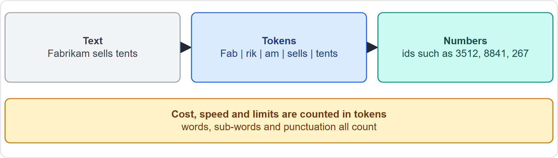
Tokens, continued
Module 2
From text to tokens to numbers: how a model reads a prompt
AI-901 Exam Prep | Microsoft Azure AI Fundamentals exam
Module 2: How Generative AI Models Work
7 / 21
Notes:
Tokens.
The figure shows this: From text to tokens to numbers: how a model reads a prompt.

Slide 8
The transformer and attention
Module 2
Modern language models use the transformer architecture.
A transformer has two blocks in its original form: an encoder (builds a representation of the input) and a decoder (generates the output). Many text generators use the decoder part.
The key idea is attention: for each token, the model looks at the tokens around it and decides how much each one matters, so the meaning of a word depends on its context ("bank" of a river or a bank for money).
Models are trained on huge amounts of text to predict the next token. To generate text, the model predicts one token, adds it to the input and predicts again, until it stops.
AI-901 Exam Prep | Microsoft Azure AI Fundamentals exam
Module 2: How Generative AI Models Work
8 / 21
Notes:
The transformer and attention.
Modern language models use the transformer architecture.
A transformer has two blocks in its original form: an encoder (builds a representation of the input) and a decoder (generates the output). Many text generators use the decoder part.
The key idea is attention: for each token, the model looks at the tokens around it and decides how much each one matters, so the meaning of a word depends on its context ("bank" of a river or a bank for money).
Models are trained on huge amounts of text to predict the next token. To generate text, the model predicts one token, adds it to the input and predicts again, until it stops.

Slide 9
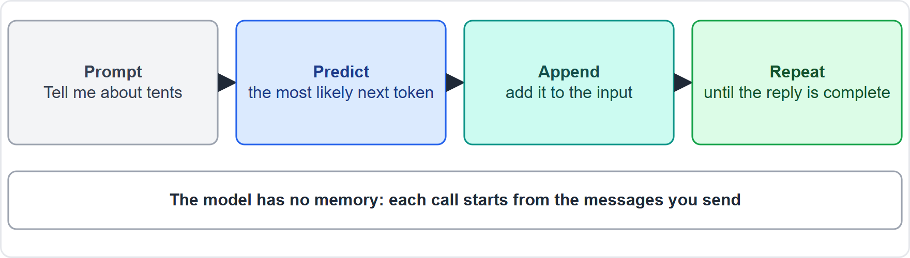
The transformer and attention, continued
Module 2
Predicting the next token again and again to write a reply
AI-901 Exam Prep | Microsoft Azure AI Fundamentals exam
Module 2: How Generative AI Models Work
9 / 21
Notes:
The transformer and attention.
The figure shows this: Predicting the next token again and again to write a reply.

Slide 10
Embeddings
Module 2
An embedding is a list (vector) of numbers that represents the meaning of a token or of a whole text.
Texts with similar meaning have embeddings that are close together.
Closeness is measured with cosine similarity, which compares the angle between two vectors.
Uses: semantic search (find documents by meaning, not exact words), recommendation, grouping, and giving a model relevant documents to answer from.
EXAM TIP "Find text with similar meaning" → embeddings and similarity. Plain keyword matching only finds the same words.
AI-901 Exam Prep | Microsoft Azure AI Fundamentals exam
Module 2: How Generative AI Models Work
10 / 21
Notes:
Embeddings.
An embedding is a list (vector) of numbers that represents the meaning of a token or of a whole text.
Texts with similar meaning have embeddings that are close together.
Closeness is measured with cosine similarity, which compares the angle between two vectors.
Uses: semantic search (find documents by meaning, not exact words), recommendation, grouping, and giving a model relevant documents to answer from.
Exam tip: "Find text with similar meaning" to embeddings and similarity. Plain keyword matching only finds the same words.
Exam tip: The model has no memory between calls: the application must send the earlier messages again.

Slide 11
The context window
Module 2
Every model has a context window: the maximum number of tokens it can handle at once, counting the prompt plus the response.
If the prompt is too long, or the requested output would pass the limit, the answer is cut off or the call fails.
A model has no memory between calls. For a conversation, the application sends the earlier messages again with each new question.
Large windows cost more tokens, so keep prompts focused.
AI-901 Exam Prep | Microsoft Azure AI Fundamentals exam
Module 2: How Generative AI Models Work
11 / 21
Notes:
The context window.
Every model has a context window: the maximum number of tokens it can handle at once, counting the prompt plus the response.
If the prompt is too long, or the requested output would pass the limit, the answer is cut off or the call fails.
A model has no memory between calls. For a conversation, the application sends the earlier messages again with each new question.
Large windows cost more tokens, so keep prompts focused.

Slide 12
What generative models can and cannot do
Module 2
Strength | Limit
Writes fluent text, summarizes, translates, answers questions, writes code | May produce confident wrong answers (hallucinations)
Follows instructions given in the prompt | Knowledge comes from training data and may be out of date
Works across many topics without retraining | Cannot check facts by itself unless it is given tools or data
Can be grounded with your own data to answer from it | Outputs can vary from one call to the next
Grounding means giving the model trusted data (documents, search results) in the prompt so it answers from them. [Beyond the study guide] for the full pattern, but the idea is likely to appear.
AI-901 Exam Prep | Microsoft Azure AI Fundamentals exam
Module 2: How Generative AI Models Work
12 / 21
Notes:
What generative models can and cannot do.
Writes fluent text, summarizes, translates, answers questions, writes code. May produce confident wrong answers (hallucinations).
Follows instructions given in the prompt. Knowledge comes from training data and may be out of date.
Works across many topics without retraining. Cannot check facts by itself unless it is given tools or data.
Can be grounded with your own data to answer from it. Outputs can vary from one call to the next.
Grounding means giving the model trusted data (documents, search results) in the prompt so it answers from them. for the full pattern, but the idea is likely to appear.

Slide 13
Practice Question 1
Module 2
Q1
Fabrikam Outdoors asks why its AI bill grows when users paste long documents. What is the unit that drives the cost?
A
Words
B
Characters
C
Pages
D
Tokens
AI-901 Exam Prep | Microsoft Azure AI Fundamentals exam
Module 2: How Generative AI Models Work
13 / 21
Notes:
Question one. Fabrikam Outdoors asks why its A I bill grows when users paste long documents. What is the unit that drives the cost? The four options are on the screen.
[PAUSE 10]
The answer is D: Tokens. Models read and generate tokens, and usage and limits are counted in tokens.

Slide 14
Practice Question 2
Module 2
Q2
Which idea lets a model decide how much each nearby word matters for the meaning of a word?
A
Attention
B
Compression
C
Encryption
D
Sampling
AI-901 Exam Prep | Microsoft Azure AI Fundamentals exam
Module 2: How Generative AI Models Work
14 / 21
Notes:
Question two. Which idea lets a model decide how much each nearby word matters for the meaning of a word? The four options are on the screen.
[PAUSE 10]
The answer is A: Attention. The attention layer examines each token and how it is influenced by the tokens around it.

Slide 15
Practice Question 3
Module 2
Q3
A team wants to find support articles with a similar meaning to a customer's question, even when the words differ. What should it use?
A
A keyword filter on exact words
B
Embeddings and similarity
C
A larger font in the search box
D
A spell checker for the articles
AI-901 Exam Prep | Microsoft Azure AI Fundamentals exam
Module 2: How Generative AI Models Work
15 / 21
Notes:
Question three. A team wants to find support articles with a similar meaning to a customer's question, even when the words differ. What should it use? The four options are on the screen.
[PAUSE 10]
The answer is B: Embeddings and similarity. Embeddings turn meaning into vectors, and similar vectors point to similar meaning.

Slide 16
Practice Question 4
Module 2
Q4
A chat application must keep the conversation. The model itself has no memory. What does the application do?
A
Nothing; the model remembers every user across all calls
B
It retrains the model after each question that a user asks
C
It sends the earlier messages again with each new request
D
It deletes the system message from every earlier request
AI-901 Exam Prep | Microsoft Azure AI Fundamentals exam
Module 2: How Generative AI Models Work
16 / 21
Notes:
Question four. A chat application must keep the conversation. The model itself has no memory. What does the application do? The four options are on the screen.
[PAUSE 10]
The answer is C: It sends the earlier messages again with each new request. Each call is separate, so the app includes the earlier messages (within the context window).

Slide 17
Practice Question 5
Module 2
Q5
What does the context window limit?
A
The number of users who can sign in at the same time
B
The number of Azure regions where the model runs
C
The number of tokens in the prompt plus the response
D
The number of images stored in the project
AI-901 Exam Prep | Microsoft Azure AI Fundamentals exam
Module 2: How Generative AI Models Work
17 / 21
Notes:
Question five. What does the context window limit? The four options are on the screen.
[PAUSE 10]
The answer is C: The number of tokens in the prompt plus the response. The context window is the maximum number of tokens the model can handle at once.

Slide 18
Practice Question 6
Module 2
Q6
A model states a wrong fact in a confident tone. What is this called?
A
Tokenization of the text
B
A hallucination
C
Embedding of the answer
D
Attention to nearby tokens
AI-901 Exam Prep | Microsoft Azure AI Fundamentals exam
Module 2: How Generative AI Models Work
18 / 21
Notes:
Question six. A model states a wrong fact in a confident tone. What is this called? The four options are on the screen.
[PAUSE 10]
The answer is B: A hallucination. A hallucination is a made-up or wrong answer that sounds confident.

Slide 19
Recall Check 1
Module 2
Q1. What is a token?
Q2. What does a language model learn to do during training?
Q3. What is an embedding?
AI-901 Exam Prep | Microsoft Azure AI Fundamentals exam
Module 2: How Generative AI Models Work
19 / 21
Notes:
Recall check one. Say each answer out loud before you listen to mine.
Question one. What is a token?
[PAUSE 5]
Answer: A piece of text (word, sub-word or punctuation) that the model reads, with a numeric identifier.
Question two. What does a language model learn to do during training?
[PAUSE 5]
Answer: Predict the next token.
Question three. What is an embedding?
[PAUSE 5]
Answer: A vector of numbers that represents the meaning of text.

Slide 20
Recall Check 2
Module 2
Q4. What is the context window?
Q5. What is an SLM?
Q6. What does grounding mean?
AI-901 Exam Prep | Microsoft Azure AI Fundamentals exam
Module 2: How Generative AI Models Work
20 / 21
Notes:
Recall check two. Say each answer out loud before you listen to mine.
Question four. What is the context window?
[PAUSE 5]
Answer: The maximum number of tokens for the prompt plus the response.
Question five. What is an S L M?
[PAUSE 5]
Answer: A small language model: more compact, cheaper and faster, less general than an L L M.
Question six. What does grounding mean?
[PAUSE 5]
Answer: Giving the model trusted data in the prompt so it answers from that data.

Slide 21
Module Recap
Module 2
1
Generative AI
2
Tokens
3
Transformer
creates new content from a prompt; LLMs for text, SLMs are smaller
words, sub-words, punctuation; numeric ids; cost and limits count tokens
encoder and decoder; attention weighs nearby tokens; trained to predict the next token
4
Embeddings
5
Context window
6
Limits
vectors of meaning; cosine similarity; semantic search
token limit for prompt plus response; no memory between calls
hallucinations, outdated knowledge; ground with trusted data
AI-901 Exam Prep | Microsoft Azure AI Fundamentals exam
Module 2: How Generative AI Models Work
21 / 21
Notes:
Here is the recap.
Generative A I: creates new content from a prompt; L L Ms for text, S L Ms are smaller.
Tokens: words, sub-words, punctuation; numeric ids; cost and limits count tokens.
Transformer: encoder and decoder; attention weighs nearby tokens; trained to predict the next token.
Embeddings: vectors of meaning; cosine similarity; semantic search.
Context window: token limit for prompt plus response; no memory between calls.
Limits: hallucinations, outdated knowledge; ground with trusted data.
In the next module, we continue the course.

