Slide 1
Module 3: Choosing Models, Deployments and Parameters
Identify an appropriate AI model, based on capabilities
AI-901 exam prep · Identify AI concepts and capabilities · 40 to 45% of the exam
AI-901 Exam Prep: Azure AI Fundamentals Study Course
Module 3
Notes:
Welcome to Module three: Choosing Models, Deployments and Parameters. It covers the exam area Identify A I concepts and capabilities.
Each part of this module comes from the study notes of the same name, so you can read the notes after you watch.

Slide 2
What You Will Learn
Module 3
Identify an appropriate AI model, based on capabilities
Identify appropriate model deployment options and configuration parameters
Practice with exam-style questions and a recall check
AI-901 Exam Prep | Microsoft Azure AI Fundamentals exam
Module 3: Choosing Models, Deployments and Parameters
2 / 22
Notes:
By the end of this module you will be able to do three things.
Identify an appropriate A I model, based on capabilities.
Identify appropriate model deployment options and configuration parameters.
Practice with exam-style questions and a recall check.

Slide 3
Where This Fits in the Exam
Module 3
EXAM CHECK-IN · Where this fits
Exam area: Identify AI concepts and capabilities (40–45%)
Exam format: a score of 700 on a scale of 1 to 1,000 passes; check the exam page for the time
Validated against: the official AI-901 study guide, current skills measured
AI-901 Exam Prep | Microsoft Azure AI Fundamentals exam
Module 3: Choosing Models, Deployments and Parameters
3 / 22
Notes:
Here is where this module sits in the exam.
Exam area: Identify A I concepts and capabilities (forty to forty-five percent).
Exam format: a score of seven hundred on a scale of one to one thousand passes; check the exam page for the time.
Validated against: the official A I nine oh one study guide, current skills measured.

Slide 4
The model catalog
Module 3
Category | Who hosts and sells it | Why you pick it
Foundry Models sold by Azure | Microsoft hosts and sells them under Microsoft Product Terms; billed through Azure | Deep Azure integration, guaranteed support, enterprise service levels
Foundry Models from partners and community | Partners and the community; billed through the Azure Marketplace | Specialized use cases and the newest ideas
AI-901 Exam Prep | Microsoft Azure AI Fundamentals exam
Module 3: Choosing Models, Deployments and Parameters
4 / 22
Notes:
The model catalog.
Microsoft Foundry has a model catalog with more than ten thousand models from Microsoft, Open A I, Anthropic, Meta and others. The catalog has two categories.
Foundry Models sold by Azure. Who hosts and sells it: Microsoft hosts and sells them under Microsoft Product Terms; billed through Azure. Why you pick it: Deep Azure integration, guaranteed support, enterprise service levels.
Foundry Models from partners and community. Who hosts and sells it: Partners and the community; billed through the Azure Marketplace. Why you pick it: Specialized use cases and the newest ideas.

Slide 5
Choose a model by capability
Module 3
Need | Kind of model | Notes
General chat, writing, summarizing, coding | Large language model (LLM) | Most capable, most costly
Simple, high-volume, low-cost or fast tasks | Small language model (SLM) | Cheaper and faster, less general
Hard multi-step problems: math, logic, planning | Reasoning model | Thinks before answering; slower; some settings are not supported
Understand images (and sometimes audio) in prompts | Multimodal model | Accepts more than text
Pick the model whose capability matches the task, then weigh cost and speed.
AI-901 Exam Prep | Microsoft Azure AI Fundamentals exam
Module 3: Choosing Models, Deployments and Parameters
5 / 22
Notes:
Choose a model by capability.
Pick the model whose capability matches the task, then weigh cost and speed.
General chat, writing, summarizing, coding. Kind of model: Large language model (L L M). Notes: Most capable, most costly.
Simple, high-volume, low-cost or fast tasks. Kind of model: Small language model (S L M). Notes: Cheaper and faster, less general.
Hard multi-step problems: math, logic, planning. Kind of model: Reasoning model. Notes: Thinks before answering; slower; some settings are not supported.
Understand images (and sometimes audio) in prompts. Kind of model: Multimodal model. Notes: Accepts more than text.

Slide 6
Choose a model by capability, continued
Module 3
Need | Kind of model | Notes
Create images from a text description | Image-generation model | Output is an image
Turn text into vectors for semantic search | Embedding model | Output is numbers, not text
Speech to text or text to speech | Speech model or Azure Speech | Module 5 and 10
EXAM TIP The exam asks "which kind of model" more than "which model name". Words to match: reasoning = multi-step logic; multimodal = images or audio in; embedding = similarity search; image generation = create pictures; SLM = cheap and fast.
AI-901 Exam Prep | Microsoft Azure AI Fundamentals exam
Module 3: Choosing Models, Deployments and Parameters
6 / 22
Notes:
Choose a model by capability.
Create images from a text description. Kind of model: Image-generation model. Notes: Output is an image.
Turn text into vectors for semantic search. Kind of model: Embedding model. Notes: Output is numbers, not text.
Speech to text or text to speech. Kind of model: Speech model or Azure Speech. Notes: Module five and ten.
Exam tip: The exam asks "which kind of model" more than "which model name". Words to match: reasoning equals multi-step logic; multimodal equals images or audio in; embedding equals similarity search; image generation equals create pictures; S L M equals cheap and fast.

Slide 7
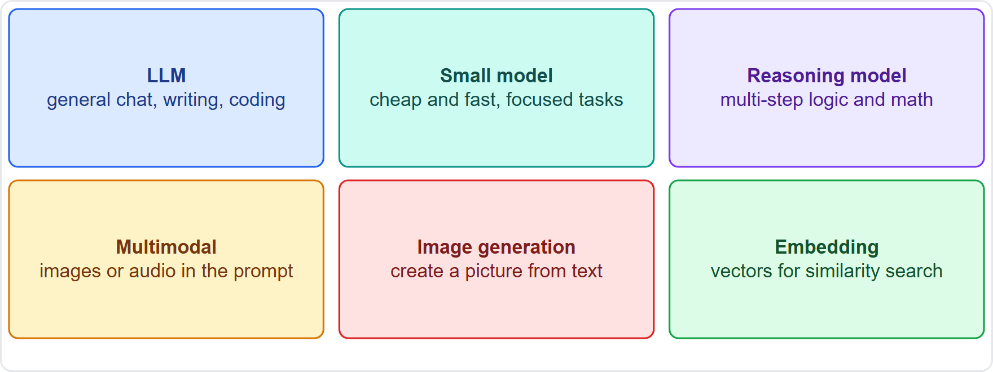
Choose a model by capability, continued
Module 3
Matching the task to the kind of model
AI-901 Exam Prep | Microsoft Azure AI Fundamentals exam
Module 3: Choosing Models, Deployments and Parameters
7 / 22
Notes:
Choose a model by capability.
The figure shows this: Matching the task to the kind of model.

Slide 8
Deployment options
Module 3
Category | Deployment types | Meaning
Standard (pay per token) | Global Standard, Data Zone Standard, Standard | You pay for the tokens you use. Global Standard can run in any Azure region and has the highest quota; Data Zone keeps processing in a data zone (US, EU or APAC); Standard stays within one Azure geography
Provisioned (reserved capacity) | Global, Data Zone and Regional Provisioned | You reserve capacity (throughput units) for steady, predictable, high volume
Before you use a model you deploy it. The deployment type decides where it runs, how you pay and how much traffic it can take.
AI-901 Exam Prep | Microsoft Azure AI Fundamentals exam
Module 3: Choosing Models, Deployments and Parameters
8 / 22
Notes:
Deployment options.
Before you use a model you deploy it. The deployment type decides where it runs, how you pay and how much traffic it can take.
Standard (pay per token). Deployment types: Global Standard, Data Zone Standard, Standard. Meaning: You pay for the tokens you use. Global Standard can run in any Azure region and has the highest quota; Data Zone keeps processing in a data zone (U S, E U or A P A C); Standard stays within one Azure geography.
Provisioned (reserved capacity). Deployment types: Global, Data Zone and Regional Provisioned. Meaning: You reserve capacity (throughput units) for steady, predictable, high volume.

Slide 9
Deployment options, continued
Module 3
Category | Deployment types | Meaning
Batch (asynchronous) | Global and Data Zone Batch | Discounted processing of large jobs that can wait (up to about 24 hours; Global Batch is described with a 50% discount)
Developer | Developer tier | Evaluating fine-tuned models only: 24-hour lifetime, no service level agreement
[Verify live] for current names, discounts and limits.
EXAM TIP "Start simple, pay per use" → Global Standard. "Predictable high volume, reserved capacity" → provisioned. "Large job, not urgent, cheaper" → batch. "Data must stay in the EU" → a Data Zone or regional type.
AI-901 Exam Prep | Microsoft Azure AI Fundamentals exam
Module 3: Choosing Models, Deployments and Parameters
9 / 22
Notes:
Deployment options.
Batch (asynchronous). Deployment types: Global and Data Zone Batch. Meaning: Discounted processing of large jobs that can wait (up to about twenty-four hours; Global Batch is described with a fifty percent discount).
Developer. Deployment types: Developer tier. Meaning: Evaluating fine-tuned models only: twenty-four-hour lifetime, no service level agreement.
for current names, discounts and limits.
Exam tip: "Start simple, pay per use" to Global Standard. "Predictable high volume, reserved capacity" to provisioned. "Large job, not urgent, cheaper" to batch. "Data must stay in the E U" to a Data Zone or regional type.

Slide 10
Configuration parameters
Module 3
Parameter | What it does | Typical use
temperature | Controls randomness. The range is 0 to 2. Low (for example 0.2) gives focused, predictable answers; high (for example 0.7 or more) gives more varied, creative answers | Low for facts and extraction; higher for ideas and stories
top_p | Another way to control randomness: the model picks only from the most likely tokens that add up to this probability. It is similar to temperature | Change temperature or top_p, not both
When you call a model you can set parameters that change how it answers.
AI-901 Exam Prep | Microsoft Azure AI Fundamentals exam
Module 3: Choosing Models, Deployments and Parameters
10 / 22
Notes:
Configuration parameters.
When you call a model you can set parameters that change how it answers.
temperature. What it does: Controls randomness. The range is zero to two. Low (for example zero point two) gives focused, predictable answers; high (for example zero point seven or more) gives more varied, creative answers. Typical use: Low for facts and extraction; higher for ideas and stories.
top p. What it does: Another way to control randomness: the model picks only from the most likely tokens that add up to this probability. It is similar to temperature. Typical use: Change temperature or top p, not both.

Slide 11
Configuration parameters, continued
Module 3
Parameter | What it does | Typical use
max tokens (max_completion_tokens for newer models) | The maximum number of tokens the model may generate in the answer | Cap cost and length; set it high enough for the expected answer or the reply is cut off (finish reason "length")
AI-901 Exam Prep | Microsoft Azure AI Fundamentals exam
Module 3: Choosing Models, Deployments and Parameters
11 / 22
Notes:
Configuration parameters.
max tokens ( max completion tokens for newer models). What it does: The maximum number of tokens the model may generate in the answer. Typical use: Cap cost and length; set it high enough for the expected answer or the reply is cut off (finish reason "length").

Slide 12
Configuration parameters, continued
Module 3
Reasoning models use max_completion_tokens instead of max_tokens, and do not support temperature, top_p or the penalty parameters.
The system message (module 6) is not a number but also shapes the answer.
EXAM TIP "More creative" → raise temperature. "Same answer every time, factual" → lower temperature. "Reply stops in the middle" → raise max tokens. "Reasoning model" → no temperature setting.
AI-901 Exam Prep | Microsoft Azure AI Fundamentals exam
Module 3: Choosing Models, Deployments and Parameters
12 / 22
Notes:
Configuration parameters.
Reasoning models use max completion tokens instead of max tokens, and do not support temperature, top p or the penalty parameters.
The system message (module six) is not a number but also shapes the answer.
Exam tip: "More creative" to raise temperature. "Same answer every time, factual" to lower temperature. "Reply stops in the middle" to raise max tokens. "Reasoning model" to no temperature setting.

Slide 13
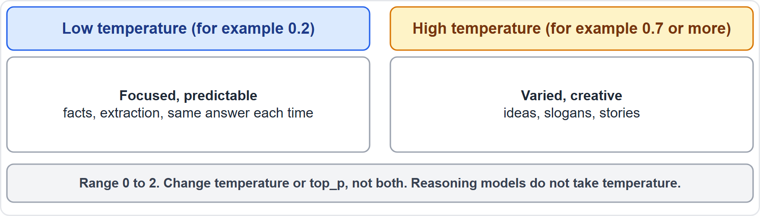
Configuration parameters, continued
Module 3
Low and high temperature: focused versus varied answers
AI-901 Exam Prep | Microsoft Azure AI Fundamentals exam
Module 3: Choosing Models, Deployments and Parameters
13 / 22
Notes:
Configuration parameters.
The figure shows this: Low and high temperature: focused versus varied answers.

Slide 14
Practice Question 1
Module 3
Q1
Fabrikam Outdoors needs a model that can describe photos that customers upload. Which kind of model fits?
A
An embedding model
B
A text-only small model
C
A multimodal model
D
A speech model
AI-901 Exam Prep | Microsoft Azure AI Fundamentals exam
Module 3: Choosing Models, Deployments and Parameters
14 / 22
Notes:
Question one. Fabrikam Outdoors needs a model that can describe photos that customers upload. Which kind of model fits? The four options are on the screen.
[PAUSE 10]
The answer is C: A multimodal model. A multimodal model accepts images (and sometimes audio) as part of the prompt.

Slide 15
Practice Question 2
Module 3
Q2
A team needs a very fast, low-cost model for simple labeling at high volume. Which kind of model fits best?
A
A reasoning model
B
An image-generation model
C
A provisioned throughput of the largest model only
D
A small language model
AI-901 Exam Prep | Microsoft Azure AI Fundamentals exam
Module 3: Choosing Models, Deployments and Parameters
15 / 22
Notes:
Question two. A team needs a very fast, low-cost model for simple labeling at high volume. Which kind of model fits best? The four options are on the screen.
[PAUSE 10]
The answer is D: A small language model. Small language models are cheaper and faster and are enough for focused tasks.

Slide 16
Practice Question 3
Module 3
Q3
A product team wants product descriptions that vary and sound creative. Which setting change helps?
A
Lower the temperature to 0
B
Lower max tokens to 1
C
Remove the system message
D
Raise the temperature
AI-901 Exam Prep | Microsoft Azure AI Fundamentals exam
Module 3: Choosing Models, Deployments and Parameters
16 / 22
Notes:
Question three. A product team wants product descriptions that vary and sound creative. Which setting change helps? The four options are on the screen.
[PAUSE 10]
The answer is D: Raise the temperature. A higher temperature gives more varied and creative output.

Slide 17
Practice Question 4
Module 3
Q4
A company wants to keep its prompts and responses processed in the EU. Which deployment idea fits?
A
A Data Zone deployment for the EU
B
The Developer tier for evaluation
C
A random Global deployment in any region
D
Batch only for overnight jobs
AI-901 Exam Prep | Microsoft Azure AI Fundamentals exam
Module 3: Choosing Models, Deployments and Parameters
17 / 22
Notes:
Question four. A company wants to keep its prompts and responses processed in the E U. Which deployment idea fits? The four options are on the screen.
[PAUSE 10]
The answer is A: A Data Zone deployment for the E U. Data Zone deployment types keep processing inside a data zone such as the E U.

Slide 18
Practice Question 5
Module 3
Q5
A reply from the model stops in the middle of a sentence and the finish reason is "length". What should be checked?
A
The temperature setting of the model
B
The max tokens (max_completion_tokens) setting
C
The model catalog category of the deployment
D
The name of the Azure subscription
AI-901 Exam Prep | Microsoft Azure AI Fundamentals exam
Module 3: Choosing Models, Deployments and Parameters
18 / 22
Notes:
Question five. A reply from the model stops in the middle of a sentence and the finish reason is "length". What should be checked? The four options are on the screen.
[PAUSE 10]
The answer is B: The max tokens (max completion tokens) setting. The output hit the token limit, so the maximum must be raised.

Slide 19
Practice Question 6
Module 3
Q6
A team plans a large overnight job that is not urgent and wants a lower price. Which deployment category fits?
A
Batch
B
Developer tier
C
Provisioned only
D
Interactive chat playground
AI-901 Exam Prep | Microsoft Azure AI Fundamentals exam
Module 3: Choosing Models, Deployments and Parameters
19 / 22
Notes:
Question six. A team plans a large overnight job that is not urgent and wants a lower price. Which deployment category fits? The four options are on the screen.
[PAUSE 10]
The answer is A: Batch. Batch processes large jobs asynchronously at a discount.

Slide 20
Recall Check 1
Module 3
Q1. Which two categories does the Foundry model catalog have?
Q2. Which deployment type is the usual starting point?
Q3. What does a low temperature do?
AI-901 Exam Prep | Microsoft Azure AI Fundamentals exam
Module 3: Choosing Models, Deployments and Parameters
20 / 22
Notes:
Recall check one. Say each answer out loud before you listen to mine.
Question one. Which two categories does the Foundry model catalog have?
[PAUSE 5]
Answer: Foundry Models sold by Azure, and Foundry Models from partners and community.
Question two. Which deployment type is the usual starting point?
[PAUSE 5]
Answer: Global Standard.
Question three. What does a low temperature do?
[PAUSE 5]
Answer: Gives more focused, predictable answers.

Slide 21
Recall Check 2
Module 3
Q4. Which two settings should you not change together?
Q5. What do reasoning models use instead of max_tokens?
Q6. Which kind of model creates vectors for similarity search?
AI-901 Exam Prep | Microsoft Azure AI Fundamentals exam
Module 3: Choosing Models, Deployments and Parameters
21 / 22
Notes:
Recall check two. Say each answer out loud before you listen to mine.
Question four. Which two settings should you not change together?
[PAUSE 5]
Answer: Temperature and top p.
Question five. What do reasoning models use instead of max tokens?
[PAUSE 5]
Answer: max completion tokens.
Question six. Which kind of model creates vectors for similarity search?
[PAUSE 5]
Answer: An embedding model.

Slide 22
Module Recap
Module 3
1
Catalog
2
Model kinds
3
Deployment
10,000+ models; sold by Azure vs partners and community
LLM, SLM, reasoning, multimodal, image generation, embedding
standard (pay per token, Global Standard first), provisioned (reserved), batch (discounted, asynchronous), developer (evaluation only)
4
Data location
5
Parameters
6
Reasoning models
Global = any region; Data Zone = US, EU or APAC; Standard and Regional = one geography
temperature 0 to 2 (low focused, high varied); top_p similar
max_completion_tokens; no temperature, top_p
AI-901 Exam Prep | Microsoft Azure AI Fundamentals exam
Module 3: Choosing Models, Deployments and Parameters
22 / 22
Notes:
Here is the recap.
Catalog: ten thousand plus models; sold by Azure versus partners and community.
Model kinds: L L M, S L M, reasoning, multimodal, image generation, embedding.
Deployment: standard (pay per token, Global Standard first), provisioned (reserved), batch (discounted, asynchronous), developer (evaluation only).
Data location: Global equals any region; Data Zone equals U S, E U or A P A C; Standard and Regional equals one geography.
Parameters: temperature zero to two (low focused, high varied); top p similar.
Reasoning models: max completion tokens; no temperature, top p.
In the next module, we continue the course.

