Slide 1
Module 6: Writing System and User Prompts
Create effective system and user prompts for generative AI models
AI-901 exam prep · Implement AI solutions by using Microsoft Foundry · 55 to 60% of the exam
AI-901 Exam Prep: Azure AI Fundamentals Study Course
Module 6
Notes:
Welcome to Module six: Writing System and User Prompts. It covers the exam area Implement A I solutions by using Microsoft Foundry.
Each part of this module comes from the study notes of the same name, so you can read the notes after you watch.

Slide 2
What You Will Learn
Module 6
Message roles
What goes in a system prompt
Writing an effective user prompt
The model has no memory
Safety and reliability in prompts
Practice with exam-style questions and a recall check
AI-901 Exam Prep | Microsoft Azure AI Fundamentals exam
Module 6: Writing System and User Prompts
2 / 21
Notes:
By the end of this module you will be able to do six things.
Message roles.
What goes in a system prompt.
Writing an effective user prompt.
The model has no memory.
Safety and reliability in prompts.
Practice with exam-style questions and a recall check.

Slide 3
Where This Fits in the Exam
Module 6
EXAM CHECK-IN · Where this fits
Exam area: Implement AI solutions by using Microsoft Foundry (55–60%)
Exam format: a score of 700 on a scale of 1 to 1,000 passes; check the exam page for the time
Validated against: the official AI-901 study guide, current skills measured
AI-901 Exam Prep | Microsoft Azure AI Fundamentals exam
Module 6: Writing System and User Prompts
3 / 21
Notes:
Here is where this module sits in the exam.
Exam area: Implement A I solutions by using Microsoft Foundry (fifty-five to sixty percent).
Exam format: a score of seven hundred on a scale of one to one thousand passes; check the exam page for the time.
Validated against: the official A I nine oh one study guide, current skills measured.

Slide 4
Message roles
Module 6
Role | Who writes it | Purpose
System | The developer | Sets the role, rules, tone and limits of the assistant for the whole conversation
User | The person using the app | The question or task for this turn
Assistant | The model | The reply; earlier replies are sent back as context
A request to a chat model is a list of messages. Each message has a role.
AI-901 Exam Prep | Microsoft Azure AI Fundamentals exam
Module 6: Writing System and User Prompts
4 / 21
Notes:
Message roles.
A request to a chat model is a list of messages. Each message has a role.
System. Who writes it: The developer. Purpose: Sets the role, rules, tone and limits of the assistant for the whole conversation.
User. Who writes it: The person using the app. Purpose: The question or task for this turn.
Assistant. Who writes it: The model. Purpose: The reply; earlier replies are sent back as context.

Slide 5
Message roles, continued
Module 6
The system message is optional, but include at least a basic one for the best results. In some APIs the system message is passed as instructions. [Beyond the study guide]
EXAM TIP System prompt = standing rules from the developer ("You are a polite support assistant for Fabrikam; answer only about our products"). User prompt = the question of the moment.
AI-901 Exam Prep | Microsoft Azure AI Fundamentals exam
Module 6: Writing System and User Prompts
5 / 21
Notes:
Message roles.
The system message is optional, but include at least a basic one for the best results. In some A P Is the system message is passed as instructions.
Exam tip: System prompt equals standing rules from the developer ("You are a polite support assistant for Fabrikam; answer only about our products"). User prompt equals the question of the moment.

Slide 6
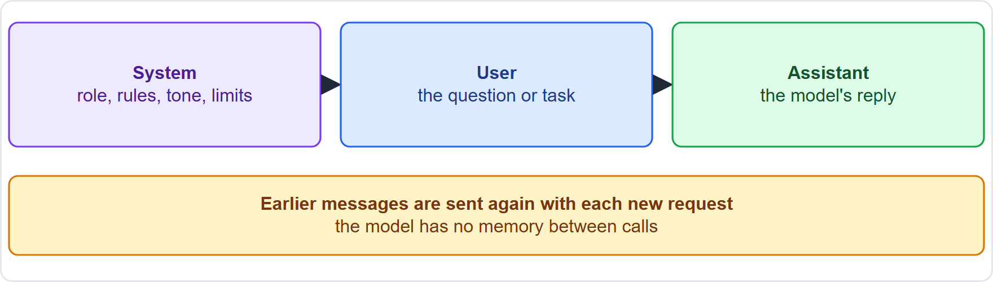
Message roles, continued
Module 6
System, user and assistant messages in one conversation
AI-901 Exam Prep | Microsoft Azure AI Fundamentals exam
Module 6: Writing System and User Prompts
6 / 21
Notes:
Message roles.
The figure shows this: System, user and assistant messages in one conversation.

Slide 7
What goes in a system prompt
Module 6
Element | Example
Role | "You are a travel assistant for Fabrikam Outdoors."
Scope | "Answer only questions about camping gear and our store."
Tone and style | "Be friendly and concise. Use plain English."
Format | "Reply with three bullet points." or "Return valid JSON."
Rules and safety | "If you do not know, say so. Never share personal data."
Examples | One or two sample question and answer pairs
AI-901 Exam Prep | Microsoft Azure AI Fundamentals exam
Module 6: Writing System and User Prompts
7 / 21
Notes:
What goes in a system prompt.
Role. "You are a travel assistant for Fabrikam Outdoors.".
Scope. "Answer only questions about camping gear and our store.".
Tone and style. "Be friendly and concise. Use plain English.".
Format. "Reply with three bullet points." or "Return valid Jason.".
Rules and safety. "If you do not know, say so. Never share personal data.".
Examples. One or two sample question and answer pairs.

Slide 8
Writing an effective user prompt
Module 6
Technique | Why it helps | Weak vs better
Be clear and specific | Less guessing | "Tell me about tents" → "List three features to compare when choosing a four-person tent."
Give context | The model only knows what is in the prompt | Add the audience, goal and data
State the format | Easier to use the output | "Answer as a table with two columns."
Give examples (few-shot) | Shows the pattern | Add sample input and output pairs
AI-901 Exam Prep | Microsoft Azure AI Fundamentals exam
Module 6: Writing System and User Prompts
8 / 21
Notes:
Writing an effective user prompt.
Be clear and specific. Why it helps: Less guessing. Weak versus better: "Tell me about tents" to "List three features to compare when choosing a four-person tent.".
Give context. Why it helps: The model only knows what is in the prompt. Weak versus better: Add the audience, goal and data.
State the format. Why it helps: Easier to use the output. Weak versus better: "Answer as a table with two columns.".
Give examples (few-shot). Why it helps: Shows the pattern. Weak versus better: Add sample input and output pairs.

Slide 9
Writing an effective user prompt, continued
Module 6
Technique | Why it helps | Weak vs better
Break a big task into steps | More reliable | "First list the issues, then rank them."
Set the length | Avoids rambling | "In under 50 words."
Provide the source text | Grounds the answer | "Using only the text below…"
Zero-shot means no examples; one-shot and few-shot give one or several examples. Few-shot examples are sent as user and assistant messages. Few-shot tricks are not recommended for reasoning models. [Verify live]
EXAM TIP Developer rules go in the system prompt; the person's question goes in the user prompt.
AI-901 Exam Prep | Microsoft Azure AI Fundamentals exam
Module 6: Writing System and User Prompts
9 / 21
Notes:
Writing an effective user prompt.
Break a big task into steps. Why it helps: More reliable. Weak versus better: "First list the issues, then rank them.".
Set the length. Why it helps: Avoids rambling. Weak versus better: "In under fifty words.".
Provide the source text. Why it helps: Grounds the answer. Weak versus better: "Using only the text below, ".
Zero-shot means no examples; one-shot and few-shot give one or several examples. Few-shot examples are sent as user and assistant messages. Few-shot tricks are not recommended for reasoning models.
Exam tip: Developer rules go in the system prompt; the person's question goes in the user prompt.

Slide 10
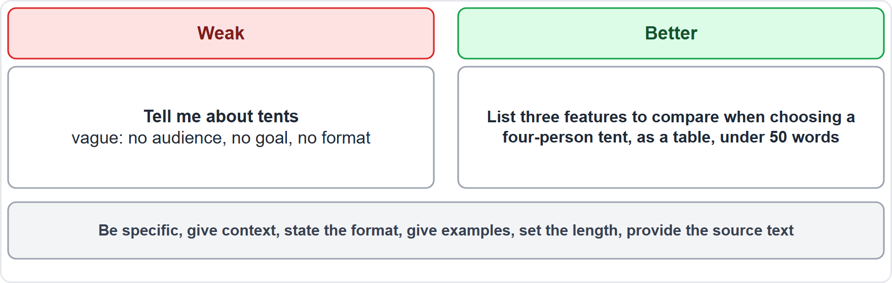
Writing an effective user prompt, continued
Module 6
A weak prompt and a better prompt compared
AI-901 Exam Prep | Microsoft Azure AI Fundamentals exam
Module 6: Writing System and User Prompts
10 / 21
Notes:
Writing an effective user prompt.
The figure shows this: A weak prompt and a better prompt compared.

Slide 11
The model has no memory
Module 6
The model does not remember earlier calls. For a conversation, the app sends the earlier messages again with each request, within the context window. Long chats cost more tokens.
AI-901 Exam Prep | Microsoft Azure AI Fundamentals exam
Module 6: Writing System and User Prompts
11 / 21
Notes:
The model has no memory.
The model does not remember earlier calls. For a conversation, the app sends the earlier messages again with each request, within the context window. Long chats cost more tokens.

Slide 12
Safety and reliability in prompts
Module 6
Tell the model what to do when it lacks information ("If the answer is not in the text, say 'I don't know'"). This reduces made-up answers.
Ground the answer in trusted text you provide.
Never put secrets or personal data in a prompt unless needed and permitted.
A user can try to override your rules with a prompt ("ignore the previous instructions"). This is prompt injection; keep rules in the system message and add platform safety settings. [Beyond the study guide]
EXAM TIP To make the model stay in a role and on topic → use the system prompt. To make output consistent in format → state the format and give examples. To make answers factual from your data → provide the data in the prompt.
AI-901 Exam Prep | Microsoft Azure AI Fundamentals exam
Module 6: Writing System and User Prompts
12 / 21
Notes:
Safety and reliability in prompts.
Tell the model what to do when it lacks information ("If the answer is not in the text, say 'I don't know'"). This reduces made-up answers.
Ground the answer in trusted text you provide.
Never put secrets or personal data in a prompt unless needed and permitted.
A user can try to override your rules with a prompt ("ignore the previous instructions"). This is prompt injection; keep rules in the system message and add platform safety settings.
Exam tip: To make the model stay in a role and on topic to use the system prompt. To make output consistent in format to state the format and give examples. To make answers factual from your data to provide the data in the prompt.

Slide 13
Practice Question 1
Module 6
Q1
Fabrikam Outdoors wants its chatbot always to answer politely and only about camping gear. Where should this rule go?
A
In every user message
B
In the model name
C
In the deployment region
D
In the system prompt
AI-901 Exam Prep | Microsoft Azure AI Fundamentals exam
Module 6: Writing System and User Prompts
13 / 21
Notes:
Question one. Fabrikam Outdoors wants its chatbot always to answer politely and only about camping gear. Where should this rule go? The four options are on the screen.
[PAUSE 10]
The answer is D: In the system prompt. The system prompt sets the standing role, scope and tone for the conversation.

Slide 14
Practice Question 2
Module 6
Q2
A team wants every answer returned as valid JSON with the same fields. Which approach helps most?
A
Ask the model to be creative with the layout
B
Raise the temperature and hope for the same layout
C
State the exact format and give an example in the prompt
D
Remove the system message to simplify the request
AI-901 Exam Prep | Microsoft Azure AI Fundamentals exam
Module 6: Writing System and User Prompts
14 / 21
Notes:
Question two. A team wants every answer returned as valid Jason with the same fields. Which approach helps most? The four options are on the screen.
[PAUSE 10]
The answer is C: State the exact format and give an example in the prompt. A clear format instruction with an example makes the output consistent.

Slide 15
Practice Question 3
Module 6
Q3
A prompt that contains two sample question and answer pairs before the real question is called what?
A
Zero-shot
B
A system image
C
A token limit
D
Few-shot
AI-901 Exam Prep | Microsoft Azure AI Fundamentals exam
Module 6: Writing System and User Prompts
15 / 21
Notes:
Question three. A prompt that contains two sample question and answer pairs before the real question is called what? The four options are on the screen.
[PAUSE 10]
The answer is D: Few-shot. Giving several examples in the prompt is few-shot prompting.

Slide 16
Practice Question 4
Module 6
Q4
A user asks about a policy that is not in the provided text. How should the system prompt tell the model to behave to reduce made-up answers?
A
Always guess an answer that sounds plausible
B
Use a higher temperature so answers sound confident
C
Say that it does not know when the answer is not in the text
D
Ignore the provided text and use general knowledge
AI-901 Exam Prep | Microsoft Azure AI Fundamentals exam
Module 6: Writing System and User Prompts
16 / 21
Notes:
Question four. A user asks about a policy that is not in the provided text. How should the system prompt tell the model to behave to reduce made-up answers? The four options are on the screen.
[PAUSE 10]
The answer is C: Say that it does not know when the answer is not in the text. Telling the model to admit when information is missing reduces hallucinations.

Slide 17
Practice Question 5
Module 6
Q5
Which message role holds the question a customer typed?
A
System
B
Assistant
C
User
D
Developer
AI-901 Exam Prep | Microsoft Azure AI Fundamentals exam
Module 6: Writing System and User Prompts
17 / 21
Notes:
Question five. Which message role holds the question a customer typed? The four options are on the screen.
[PAUSE 10]
The answer is C: User. The user role holds the question or task for the current turn.

Slide 18
Practice Question 6
Module 6
Q6
Why does a chat application send earlier messages with each new request?
A
To lower the cost of every request
B
To change the model between turns
C
The model has no memory between calls
D
To hide the system message from the user
AI-901 Exam Prep | Microsoft Azure AI Fundamentals exam
Module 6: Writing System and User Prompts
18 / 21
Notes:
Question six. Why does a chat application send earlier messages with each new request? The four options are on the screen.
[PAUSE 10]
The answer is C: The model has no memory between calls. Each call is independent, so earlier messages must be included.

Slide 19
Recall Check 1
Module 6
Q1. Name the three message roles.
Q2. What is the system prompt for?
Q3. What is few-shot prompting?
AI-901 Exam Prep | Microsoft Azure AI Fundamentals exam
Module 6: Writing System and User Prompts
19 / 21
Notes:
Recall check one. Say each answer out loud before you listen to mine.
Question one. Name the three message roles.
[PAUSE 5]
Answer: System, user and assistant.
Question two. What is the system prompt for?
[PAUSE 5]
Answer: Setting the assistant's role, rules, tone and limits.
Question three. What is few-shot prompting?
[PAUSE 5]
Answer: Giving a few examples of input and output in the prompt.

Slide 20
Recall Check 2
Module 6
Q4. What does grounding a prompt mean?
Q5. What is prompt injection?
Q6. Why keep prompts focused?
AI-901 Exam Prep | Microsoft Azure AI Fundamentals exam
Module 6: Writing System and User Prompts
20 / 21
Notes:
Recall check two. Say each answer out loud before you listen to mine.
Question four. What does grounding a prompt mean?
[PAUSE 5]
Answer: Providing trusted source text so the answer comes from it.
Question five. What is prompt injection?
[PAUSE 5]
Answer: A user prompt that tries to override the developer's rules.
Question six. Why keep prompts focused?
[PAUSE 5]
Answer: Tokens cost money and fill the context window.

Slide 21
Module Recap
Module 6
1
Roles
2
System prompt
3
User prompt
system (developer rules), user (the question), assistant (the reply)
role, scope, tone, format, rules, examples
clear, specific, context, format, steps, length, source text
4
Shots
5
No memory
6
Safety
zero-shot, one-shot, few-shot (examples as user and assistant messages)
resend earlier messages; context window limit
say "I don't know", ground answers, no secrets in prompts, beware prompt injection
AI-901 Exam Prep | Microsoft Azure AI Fundamentals exam
Module 6: Writing System and User Prompts
21 / 21
Notes:
Here is the recap.
Roles: system (developer rules), user (the question), assistant (the reply).
System prompt: role, scope, tone, format, rules, examples.
User prompt: clear, specific, context, format, steps, length, source text.
Shots: zero-shot, one-shot, few-shot (examples as user and assistant messages).
No memory: resend earlier messages; context window limit.
Safety: say "I don't know", ground answers, no secrets in prompts, beware prompt injection.
In the next module, we continue the course.

