Slide 1
Module 7: Microsoft Foundry: Resources, Models and the Portal
Deploy a model and interact with it in the Foundry portal
AI-901 exam prep · Implement AI solutions by using Microsoft Foundry · 55 to 60% of the exam
AI-901 Exam Prep: Azure AI Fundamentals Study Course
Module 7
Notes:
Welcome to Module seven: Microsoft Foundry: Resources, Models and the Portal. It covers the exam area Implement A I solutions by using Microsoft Foundry.
Each part of this module comes from the study notes of the same name, so you can read the notes after you watch.

Slide 2
What You Will Learn
Module 7
What Microsoft Foundry is
The Foundry portal
Deploy a model in the portal
Chat with the model: the playground
Practice with exam-style questions and a recall check
AI-901 Exam Prep | Microsoft Azure AI Fundamentals exam
Module 7
2 / 21
Notes:
By the end of this module you will be able to do five things.
What Microsoft Foundry is.
The Foundry portal.
Deploy a model in the portal.
Chat with the model: the playground.
Practice with exam-style questions and a recall check.

Slide 3
Where This Fits in the Exam
Module 7
EXAM CHECK-IN · Where this fits
Exam area: Implement AI solutions by using Microsoft Foundry (55–60%)
Exam format: a score of 700 on a scale of 1 to 1,000 passes; check the exam page for the time
Validated against: the official AI-901 study guide, current skills measured
AI-901 Exam Prep | Microsoft Azure AI Fundamentals exam
Module 7
3 / 21
Notes:
Here is where this module sits in the exam.
Exam area: Implement A I solutions by using Microsoft Foundry (fifty-five to sixty percent).
Exam format: a score of seven hundred on a scale of one to one thousand passes; check the exam page for the time.
Validated against: the official A I nine oh one study guide, current skills measured.

Slide 4
What Microsoft Foundry is
Module 7
Microsoft Foundry is Microsoft's platform to build AI agents, models and apps. It "unifies agents, models and tools under a single management grouping". [Old name] It was called Azure AI Foundry and, before that, Azure AI Studio; Azure AI Services became Foundry Tools.
AI-901 Exam Prep | Microsoft Azure AI Fundamentals exam
Module 7
4 / 21
Notes:
What Microsoft Foundry is.
Microsoft Foundry is Microsoft's platform to build A I agents, models and apps. It "unifies agents, models and tools under a single management grouping". It was called Azure A I Foundry and, before that, Azure A I Studio; Azure A I Services became Foundry Tools.

Slide 5
What Microsoft Foundry is, continued
Module 7
Piece | What it is
Foundry resource | The Azure resource that holds your AI setup (one resource, with projects)
Project | A place to organize your work: it contains models, agents and other resources your team uses
Model catalog | The list of models you can deploy
Foundry Tools | Prebuilt services: Language, Speech, Vision, Content Understanding
Foundry portal | The web portal (ai.azure.com) to deploy models, chat, build agents and manage the project
AI-901 Exam Prep | Microsoft Azure AI Fundamentals exam
Module 7
5 / 21
Notes:
What Microsoft Foundry is.
Foundry resource. The Azure resource that holds your A I setup (one resource, with projects).
Project. A place to organize your work: it contains models, agents and other resources your team uses.
Model catalog. The list of models you can deploy.
Foundry Tools. Prebuilt services: Language, Speech, Vision, Content Understanding.
Foundry portal. The web portal (ai.azure.com) to deploy models, chat, build agents and manage the project.

Slide 6
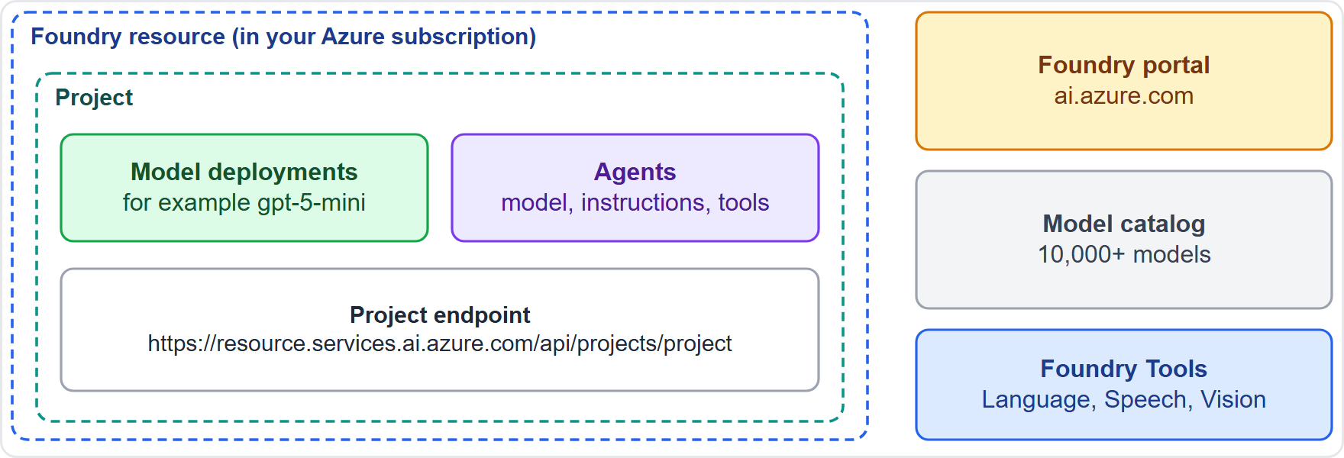
What Microsoft Foundry is, continued
Module 7
A Foundry resource contains projects; a project holds model deployments and agents
AI-901 Exam Prep | Microsoft Azure AI Fundamentals exam
Module 7
6 / 21
Notes:
What Microsoft Foundry is.
The figure shows this: A Foundry resource contains projects; a project holds model deployments and agents.

Slide 7
What Microsoft Foundry is, continued
Module 7
Each project has an endpoint that your code uses, in this form: https://<resource-name>.services.ai.azure.com/api/projects/<project-name>.
EXAM TIP Resource = the Azure container. Project = your workspace inside it, with the models and agents you use. Code connects to the project endpoint.
AI-901 Exam Prep | Microsoft Azure AI Fundamentals exam
Module 7
7 / 21
Notes:
What Microsoft Foundry is.
Each project has an endpoint that your code uses, in this form: H T T P S colon slash slash resource name dot services dot ai dot azure dot com slash api slash projects or project name.
Exam tip: Resource equals the Azure container. Project equals your workspace inside it, with the models and agents you use. Code connects to the project endpoint.

Slide 8
The Foundry portal
Module 7
Area | What you do there
Build | Catalog (model catalog), Models (your deployments), Agents
Manage | Project details, users and access
Playgrounds | Try a model or an agent without writing code
You need an Azure subscription and permission to create the resource. To let others work in the project, give them access under Manage. [Beyond the study guide]
AI-901 Exam Prep | Microsoft Azure AI Fundamentals exam
Module 7
8 / 21
Notes:
The Foundry portal.
The portal has a "New Foundry" experience. Main areas named in the quickstarts.
Build. Catalog (model catalog), Models (your deployments), Agents.
Manage. Project details, users and access.
Playgrounds. Try a model or an agent without writing code.
You need an Azure subscription and permission to create the resource. To let others work in the project, give them access under Manage.

Slide 9
Deploy a model in the portal
Module 7
Steps (as in the quickstart):
Open the portal and your project.
Go to Build → Catalog → Model catalog.
Search for a model (for example gpt-5-mini).
Select Deploy → Default settings (or custom settings).
Note the deployment name (for example gpt-5-mini).
AI-901 Exam Prep | Microsoft Azure AI Fundamentals exam
Module 7
9 / 21
Notes:
Deploy a model in the portal.
Steps (as in the quickstart).
Open the portal and your project.
Go to Build to Catalog to Model catalog.
Search for a model (for example G P T five mini ).
Select Deploy to Default settings (or custom settings).
Note the deployment name (for example G P T five mini ).

Slide 10
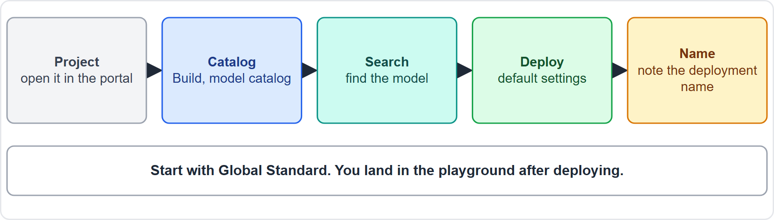
Deploy a model in the portal, continued
Module 7
Five portal steps from the catalog to a deployed model
AI-901 Exam Prep | Microsoft Azure AI Fundamentals exam
Module 7
10 / 21
Notes:
Deploy a model in the portal.
The figure shows this: Five portal steps from the catalog to a deployed model.

Slide 11
Deploy a model in the portal, continued
Module 7
The deployment is what your code and the playground call. It has a name, a model and a deployment type (Module 3).
For most workloads, start with Global Standard.
You are billed for what you use, so delete deployments you no longer need. [Beyond the study guide]
EXAM TIP The resource is the Azure container, the project is your workspace inside it, and code connects to the project endpoint.
AI-901 Exam Prep | Microsoft Azure AI Fundamentals exam
Module 7
11 / 21
Notes:
Deploy a model in the portal.
The deployment is what your code and the playground call. It has a name, a model and a deployment type (Module three).
For most workloads, start with Global Standard.
You are billed for what you use, so delete deployments you no longer need.
Exam tip: The resource is the Azure container, the project is your workspace inside it, and code connects to the project endpoint.

Slide 12
Chat with the model: the playground
Module 7
After you deploy, you land in the model playground.
Type messages and read replies: a chat you can try at once.
Edit the system prompt (Module 6).
Configure parameters: temperature, top_p, max tokens (Module 3).
Attach tools to test them: web search, file search, code interpreter.
Compare mode lets you test up to three models side by side.
Guardrails (content safety settings) can be adjusted. [Verify live]
There is also an agents playground for agents (Module 9).
EXAM TIP "Test a deployed model without writing code" → playground. "Compare two models on the same prompt" → compare mode. "Change how random the answers are" → temperature.
AI-901 Exam Prep | Microsoft Azure AI Fundamentals exam
Module 7
12 / 21
Notes:
Chat with the model: the playground.
After you deploy, you land in the model playground.
Type messages and read replies: a chat you can try at once.
Edit the system prompt (Module six).
Configure parameters: temperature, top p, max tokens (Module three).
Attach tools to test them: web search, file search, code interpreter.
Compare mode lets you test up to three models side by side.
Guardrails (content safety settings) can be adjusted.
There is also an agents playground for agents (Module nine).
Exam tip: "Test a deployed model without writing code" to playground. "Compare two models on the same prompt" to compare mode. "Change how random the answers are" to temperature.

Slide 13
Practice Question 1
Module 7
Q1
Fabrikam Outdoors wants a place that holds the models and agents its team uses for one solution. What should it create in Microsoft Foundry?
A
A project
B
A management group
C
A virtual network
D
A storage tier
AI-901 Exam Prep | Microsoft Azure AI Fundamentals exam
Module 7
13 / 21
Notes:
Question one. Fabrikam Outdoors wants a place that holds the models and agents its team uses for one solution. What should it create in Microsoft Foundry? The four options are on the screen.
[PAUSE 10]
The answer is A: A project. A Foundry project organizes the models, agents and other resources a team uses.

Slide 14
Practice Question 2
Module 7
Q2
A developer wants to try a deployed model with different system prompts before writing code. Where?
A
The Azure Policy page in the Azure portal
B
The billing page of the subscription
C
The model playground in the Foundry portal
D
The Azure CLI only, with no playground
AI-901 Exam Prep | Microsoft Azure AI Fundamentals exam
Module 7
14 / 21
Notes:
Question two. A developer wants to try a deployed model with different system prompts before writing code. Where? The four options are on the screen.
[PAUSE 10]
The answer is C: The model playground in the Foundry portal. The playground is for chatting with a deployed model and changing prompts and parameters.

Slide 15
Practice Question 3
Module 7
Q3
Which is the first step to find a model to deploy in the portal?
A
Go to Build, then the model catalog, and search for the model
B
Open Manage and delete the project to start fresh
C
Write a Python client first, before any deployment
D
Create a virtual machine to host the model
AI-901 Exam Prep | Microsoft Azure AI Fundamentals exam
Module 7
15 / 21
Notes:
Question three. Which is the first step to find a model to deploy in the portal? The four options are on the screen.
[PAUSE 10]
The answer is A: Go to Build, then the model catalog, and search for the model. Deployment starts in the model catalog under Build.

Slide 16
Practice Question 4
Module 7
Q4
Which value does application code use to connect to a Foundry project?
A
The subscription name only
B
The playground URL
C
The project endpoint
D
The tenant logo
AI-901 Exam Prep | Microsoft Azure AI Fundamentals exam
Module 7
16 / 21
Notes:
Question four. Which value does application code use to connect to a Foundry project? The four options are on the screen.
[PAUSE 10]
The answer is C: The project endpoint. Code connects through the project endpoint.

Slide 17
Practice Question 5
Module 7
Q5
What name did Microsoft Foundry have before?
A
Azure DevOps Services
B
Azure Advisor service
C
Azure AI Foundry
D
Azure Monitor service
AI-901 Exam Prep | Microsoft Azure AI Fundamentals exam
Module 7
17 / 21
Notes:
Question five. What name did Microsoft Foundry have before? The four options are on the screen.
[PAUSE 10]
The answer is C: Azure A I Foundry. Azure A I Foundry (and earlier Azure A I Studio) became Microsoft Foundry.

Slide 18
Practice Question 6
Module 7
Q6
Which feature lets a team test the same prompt against up to three models at once?
A
Compare mode
B
Resource locks
C
Cost analysis
D
Tags
AI-901 Exam Prep | Microsoft Azure AI Fundamentals exam
Module 7
18 / 21
Notes:
Question six. Which feature lets a team test the same prompt against up to three models at once? The four options are on the screen.
[PAUSE 10]
The answer is A: Compare mode. The playground has a compare mode for up to three models.

Slide 19
Recall Check 1
Module 7
Q1. What is the portal address for Foundry?
Q2. What does a Foundry project contain?
Q3. What is the deployment type to start with for most workloads?
AI-901 Exam Prep | Microsoft Azure AI Fundamentals exam
Module 7
19 / 21
Notes:
Recall check one. Say each answer out loud before you listen to mine.
Question one. What is the portal address for Foundry?
[PAUSE 5]
Answer: ai.azure.com.
Question two. What does a Foundry project contain?
[PAUSE 5]
Answer: Models, agents and other resources the team uses.
Question three. What is the deployment type to start with for most workloads?
[PAUSE 5]
Answer: Global Standard.

Slide 20
Recall Check 2
Module 7
Q4. What are the Build area's parts for your work?
Q5. What was Azure AI Services renamed?
Q6. What does the playground let you adjust?
AI-901 Exam Prep | Microsoft Azure AI Fundamentals exam
Module 7
20 / 21
Notes:
Recall check two. Say each answer out loud before you listen to mine.
Question four. What are the Build area's parts for your work?
[PAUSE 5]
Answer: Catalog, Models and Agents.
Question five. What was Azure A I Services renamed?
[PAUSE 5]
Answer: Foundry Tools.
Question six. What does the playground let you adjust?
[PAUSE 5]
Answer: System prompt, parameters such as temperature, tools and guardrails.

Slide 21
Module Recap
Module 7
1
Foundry
2
Resource and project
3
Portal
platform for agents, models, tools; formerly Azure AI Foundry and Azure AI Studio
ai.azure.com; Build (catalog, models, agents); Manage (project details, users)
resource holds projects; project holds models and agents; code uses the project endpoint
4
Deploy
5
Playground
Build, Catalog, search, Deploy, default settings, note the deployment name; start with Global Standard
chat, system prompt, parameters, tools, compare up to three models, guardrails
AI-901 Exam Prep | Microsoft Azure AI Fundamentals exam
Module 7
21 / 21
Notes:
Here is the recap.
Foundry: platform for agents, models, tools; formerly Azure A I Foundry and Azure A I Studio.
Resource and project: resource holds projects; project holds models and agents; code uses the project endpoint.
Portal: ai.azure.com; Build (catalog, models, agents); Manage (project details, users).
Deploy: Build, Catalog, search, Deploy, default settings, note the deployment name; start with Global Standard.
Playground: chat, system prompt, parameters, tools, compare up to three models, guardrails.
In the next module, we continue the course.

