Slide 1
Module 9: Agents in Foundry
Create and test a single-agent solution in the Foundry portal
AI-901 exam prep · Implement AI solutions by using Microsoft Foundry · 55 to 60% of the exam
AI-901 Exam Prep: Azure AI Fundamentals Study Course
Module 9
Notes:
Welcome to Module nine: Agents in Foundry. It covers the exam area Implement A I solutions by using Microsoft Foundry.
Each part of this module comes from the study notes of the same name, so you can read the notes after you watch.

Slide 2
What You Will Learn
Module 9
Create and test a single-agent solution in the Foundry portal
Create a lightweight client application for an agent
Practice with exam-style questions and a recall check
AI-901 Exam Prep | Microsoft Azure AI Fundamentals exam
Module 9: Agents in Foundry
2 / 21
Notes:
By the end of this module you will be able to do three things.
Create and test a single-agent solution in the Foundry portal.
Create a lightweight client application for an agent.
Practice with exam-style questions and a recall check.

Slide 3
Where This Fits in the Exam
Module 9
EXAM CHECK-IN · Where this fits
Exam area: Implement AI solutions by using Microsoft Foundry (55–60%)
Exam format: a score of 700 on a scale of 1 to 1,000 passes; check the exam page for the time
Validated against: the official AI-901 study guide, current skills measured
AI-901 Exam Prep | Microsoft Azure AI Fundamentals exam
Module 9: Agents in Foundry
3 / 21
Notes:
Here is where this module sits in the exam.
Exam area: Implement A I solutions by using Microsoft Foundry (fifty-five to sixty percent).
Exam format: a score of seven hundred on a scale of one to one thousand passes; check the exam page for the time.
Validated against: the official A I nine oh one study guide, current skills measured.

Slide 4
What a Foundry agent is
Module 9
Part | Meaning
Model | The deployed model that reasons
Instructions | The system prompt: the agent's role and behavior
Tools | What the agent can use to find information or act
A single agent is "a model paired with instructions and tools that can reason over a request and take action". Foundry Agent Service is "a managed platform for building, deploying and scaling AI agents".
Kinds of agent:
AI-901 Exam Prep | Microsoft Azure AI Fundamentals exam
Module 9: Agents in Foundry
4 / 21
Notes:
What a Foundry agent is.
A single agent is "a model paired with instructions and tools that can reason over a request and take action". Foundry Agent Service is "a managed platform for building, deploying and scaling A I agents".
Model. The deployed model that reasons.
Instructions. The system prompt: the agent's role and behavior.
Tools. What the agent can use to find information or act.
Kinds of agent.

Slide 5
What a Foundry agent is, continued
Module 9
Kind | Meaning
Prompt agent | Declaratively defined: you give model, instructions and tools; no hosting code
Voice-based prompt agent | A prompt agent for spoken conversations
Hosted agent | Your own code running in a container, managed by Foundry
EXAM TIP The exam's agent is the prompt agent: model + instructions + tools. Compare with a plain chat call: the agent adds tools and a managed conversation.
AI-901 Exam Prep | Microsoft Azure AI Fundamentals exam
Module 9: Agents in Foundry
5 / 21
Notes:
What a Foundry agent is.
Prompt agent. Declaratively defined: you give model, instructions and tools; no hosting code.
Voice-based prompt agent. A prompt agent for spoken conversations.
Hosted agent. Your own code running in a container, managed by Foundry.
Exam tip: The exam's agent is the prompt agent: model plus instructions plus tools. Compare with a plain chat call: the agent adds tools and a managed conversation.

Slide 6
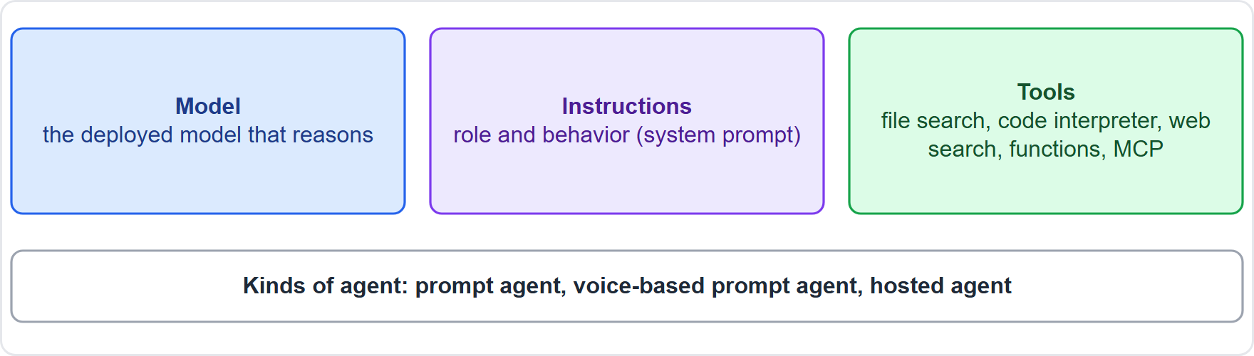
What a Foundry agent is, continued
Module 9
A Foundry agent: a model, instructions and tools
AI-901 Exam Prep | Microsoft Azure AI Fundamentals exam
Module 9: Agents in Foundry
6 / 21
Notes:
What a Foundry agent is.
The figure shows this: A Foundry agent: a model, instructions and tools.

Slide 7
Tools an agent can use
Module 9
Tool | What it gives the agent
File search | Find answers in files you upload
Azure AI Search | Search an index of your content
Web search (and grounding with Bing) | Fresh information from the web
Code interpreter | Write and run code, such as calculations or charts
Function calling | Call your own functions; your app runs them (client-side)
OpenAPI | Call a REST API described by an OpenAPI file
MCP (Model Context Protocol) | Connect to tools exposed by an MCP server
Agent-to-agent (A2A) | Work with another agent
AI-901 Exam Prep | Microsoft Azure AI Fundamentals exam
Module 9: Agents in Foundry
7 / 21
Notes:
Tools an agent can use.
File search. Find answers in files you upload.
Azure A I Search. Search an index of your content.
Web search (and grounding with Bing). Fresh information from the web.
Code interpreter. Write and run code, such as calculations or charts.
Function calling. Call your own functions; your app runs them (client-side).
Open A P I. Call a R E S T (representational state transfer) A P I described by an Open A P I file.
M C P (Model Context Protocol). Connect to tools exposed by an M C P server.
Agent-to-agent (A to A). Work with another agent.

Slide 8
Tools an agent can use, continued
Module 9
Tools are of two kinds: knowledge tools (find information: file search, web search, AI Search) and action tools (do something: code, functions, APIs). [Verify live] for the current list, because names change.
EXAM TIP "Answer from my uploaded documents" → file search. "Do calculations or draw a chart" → code interpreter. "Use today's web information" → web search. "Call my company's own function" → function calling.
AI-901 Exam Prep | Microsoft Azure AI Fundamentals exam
Module 9: Agents in Foundry
8 / 21
Notes:
Tools an agent can use.
Tools are of two kinds: knowledge tools (find information: file search, web search, A I Search) and action tools (do something: code, functions, A P Is). for the current list, because names change.
Exam tip: "Answer from my uploaded documents" to file search. "Do calculations or draw a chart" to code interpreter. "Use today's web information" to web search. "Call my company's own function" to function calling.

Slide 9
Create and test an agent in the portal
Module 9
Open your project in the portal.
In Build, choose Agents in the left pane.
Select Create agent and give it a name, for example MyAgent.
Add instructions, for example "You are a helpful writing assistant".
Choose the model deployment and add tools if needed.
Chat with the agent in the agents playground.
Ask a follow-up question to check that the agent keeps the conversation history.
AI-901 Exam Prep | Microsoft Azure AI Fundamentals exam
Module 9: Agents in Foundry
9 / 21
Notes:
Create and test an agent in the portal.
Open your project in the portal.
In Build, choose Agents in the left pane.
Select Create agent and give it a name, for example My Agent.
Add instructions, for example "You are a helpful writing assistant".
Choose the model deployment and add tools if needed.
Chat with the agent in the agents playground.
Ask a follow-up question to check that the agent keeps the conversation history.

Slide 10
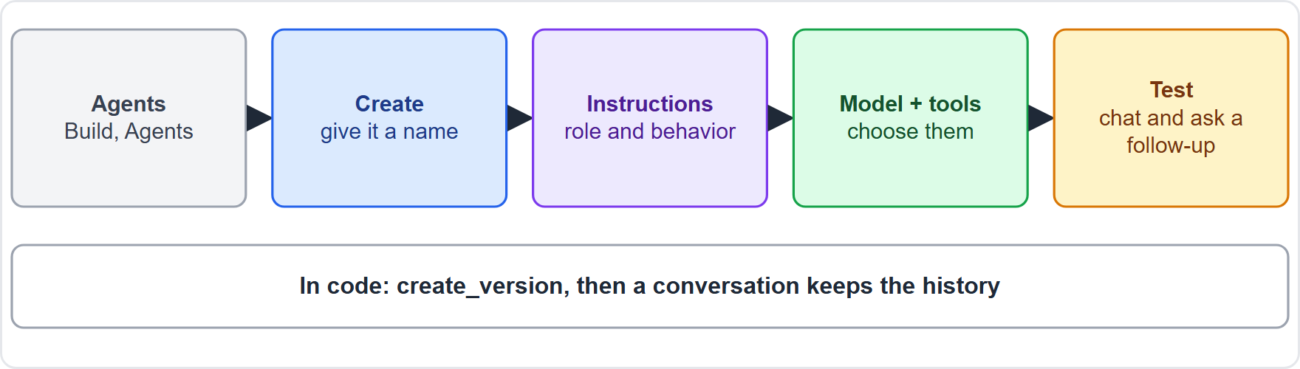
Create and test an agent in the portal, continued
Module 9
Create an agent: name, instructions, model, tools, then chat to test
AI-901 Exam Prep | Microsoft Azure AI Fundamentals exam
Module 9: Agents in Foundry
10 / 21
Notes:
Create and test an agent in the portal.
The figure shows this: Create an agent: name, instructions, model, tools, then chat to test.

Slide 11
Call the agent from a client application
Module 9
A lightweight client creates the agent (or uses an existing one), starts a conversation, and sends messages. This is the short program from the Microsoft quickstart.
PYTHON
from azure.identity import DefaultAzureCredential
from azure.ai.projects import AIProjectClient
from azure.ai.projects.models import PromptAgentDefinition
project = AIProjectClient(endpoint=FOUNDRY_PROJECT_ENDPOINT, credential=DefaultAzureCredential())
project.agents.create_version(
agent_name=FOUNDRY_AGENT_NAME,
definition=PromptAgentDefinition(
model="gpt-5-mini",
instructions="You are a helpful assistant that answers general questions",
),
)
openai = project.get_openai_client(agent_name=FOUNDRY_AGENT_NAME)
conversation = openai.conversations.create()
response = openai.responses.create(
conversation=conversation.id,
input="What is the size of France in square miles?",
)
print(response.output_text)
Example from the study note
AI-901 Exam Prep | Microsoft Azure AI Fundamentals exam
Module 9: Agents in Foundry
11 / 21
Notes:
Call the agent from a client application.
A lightweight client creates the agent (or uses an existing one), starts a conversation, and sends messages. This is the short program from the Microsoft quickstart.
The example is on the screen; read it line by line when you study.

Slide 12
Call the agent from a client application, continued
Module 9
Line | Meaning
project.agents.create_version(...) | Creates the agent, or a new version if it already exists
PromptAgentDefinition(model=..., instructions=...) | The definition: which model and which instructions
project.get_openai_client(agent_name=...) | A client bound to that agent
openai.conversations.create() | Starts a conversation that keeps the history
openai.responses.create(conversation=..., input=...) | Sends a message in that conversation
a second responses.create with the same conversation id | A follow-up question that knows the earlier answers
EXAM TIP The conversation id is what gives multi-turn memory to the agent. Without it, each request would be independent. Agent name picks the agent; model is the deployment it uses.
AI-901 Exam Prep | Microsoft Azure AI Fundamentals exam
Module 9: Agents in Foundry
12 / 21
Notes:
Call the agent from a client application.
project dot agents dot create version... Creates the agent, or a new version if it already exists.
Prompt Agent Definition model..., instructions... The definition: which model and which instructions.
project dot get openai client agent name... A client bound to that agent.
openai dot conversations dot create. Starts a conversation that keeps the history.
openai dot responses dot create conversation..., input... Sends a message in that conversation.
a second responses dot create with the same conversation id. A follow-up question that knows the earlier answers.
Exam tip: The conversation id is what gives multi-turn memory to the agent. Without it, each request would be independent. Agent name picks the agent; model is the deployment it uses.

Slide 13
Practice Question 1
Module 9
Q1
Fabrikam Outdoors wants an assistant that answers questions from a set of uploaded product manuals. Which agent tool fits?
A
File search
B
Code interpreter
C
Speech synthesis
D
Image generation
AI-901 Exam Prep | Microsoft Azure AI Fundamentals exam
Module 9: Agents in Foundry
13 / 21
Notes:
Question one. Fabrikam Outdoors wants an assistant that answers questions from a set of uploaded product manuals. Which agent tool fits? The four options are on the screen.
[PAUSE 10]
The answer is A: File search. File search lets the agent find answers in files you upload.

Slide 14
Practice Question 2
Module 9
Q2
Which three parts define a prompt agent?
A
Region, subscription, resource group
B
Model, instructions, tools
C
Token, context, embedding
D
Tags, locks, policies
AI-901 Exam Prep | Microsoft Azure AI Fundamentals exam
Module 9: Agents in Foundry
14 / 21
Notes:
Question two. Which three parts define a prompt agent? The four options are on the screen.
[PAUSE 10]
The answer is B: Model, instructions, tools. A prompt agent combines a model, instructions and tools.

Slide 15
Practice Question 3
Module 9
Q3
In the client program, what makes the agent remember the earlier question in a follow-up?
A
A higher temperature setting
B
A different project endpoint
C
A larger image in the prompt
D
Using the same conversation id
AI-901 Exam Prep | Microsoft Azure AI Fundamentals exam
Module 9: Agents in Foundry
15 / 21
Notes:
Question three. In the client program, what makes the agent remember the earlier question in a follow-up? The four options are on the screen.
[PAUSE 10]
The answer is D: Using the same conversation id. Messages sent in the same conversation keep the history.

Slide 16
Practice Question 4
Module 9
Q4
A developer runs create_version for an agent name that already exists. What happens?
A
A new version of that agent is created
B
The call always fails
C
The project is deleted
D
The model is retrained
AI-901 Exam Prep | Microsoft Azure AI Fundamentals exam
Module 9: Agents in Foundry
16 / 21
Notes:
Question four. A developer runs create version for an agent name that already exists. What happens? The four options are on the screen.
[PAUSE 10]
The answer is A: A new version of that agent is created. The call creates the agent, or a new version if it already exists.

Slide 17
Practice Question 5
Module 9
Q5
Where do you test an agent without writing code?
A
Azure Cost Management in the Azure portal
B
The Azure DNS blade in the Azure portal
C
The agents playground in the Foundry portal
D
A resource lock on the resource group
AI-901 Exam Prep | Microsoft Azure AI Fundamentals exam
Module 9: Agents in Foundry
17 / 21
Notes:
Question five. Where do you test an agent without writing code? The four options are on the screen.
[PAUSE 10]
The answer is C: The agents playground in the Foundry portal. You can chat with the agent in the portal and ask follow-up questions.

Slide 18
Practice Question 6
Module 9
Q6
An agent must run Python calculations and create a chart. Which tool fits?
A
Web search
B
File search
C
Code interpreter
D
Language detection
AI-901 Exam Prep | Microsoft Azure AI Fundamentals exam
Module 9: Agents in Foundry
18 / 21
Notes:
Question six. An agent must run Python calculations and create a chart. Which tool fits? The four options are on the screen.
[PAUSE 10]
The answer is C: Code interpreter. Code interpreter writes and runs code, for example for calculations and charts.

Slide 19
Recall Check 1
Module 9
Q1. What is a single agent?
Q2. Name the three kinds of Foundry agent.
Q3. Which tool runs code?
AI-901 Exam Prep | Microsoft Azure AI Fundamentals exam
Module 9: Agents in Foundry
19 / 21
Notes:
Recall check one. Say each answer out loud before you listen to mine.
Question one. What is a single agent?
[PAUSE 5]
Answer: A model paired with instructions and tools that can reason over a request and take action.
Question two. Name the three kinds of Foundry agent.
[PAUSE 5]
Answer: Prompt agents, voice-based prompt agents and hosted agents.
Question three. Which tool runs code?
[PAUSE 5]
Answer: Code interpreter.

Slide 20
Recall Check 2
Module 9
Q4. Which call creates an agent or a new version?
Q5. What keeps the history of a multi-turn chat with an agent?
Q6. Which area of the portal holds agents?
AI-901 Exam Prep | Microsoft Azure AI Fundamentals exam
Module 9: Agents in Foundry
20 / 21
Notes:
Recall check two. Say each answer out loud before you listen to mine.
Question four. Which call creates an agent or a new version?
[PAUSE 5]
Answer: project.agents.create version.
Question five. What keeps the history of a multi-turn chat with an agent?
[PAUSE 5]
Answer: The conversation.
Question six. Which area of the portal holds agents?
[PAUSE 5]
Answer: Build, then Agents.

Slide 21
Module Recap
Module 9
1
Agent
2
Kinds
3
Tools
model + instructions + tools; Foundry Agent Service manages it
prompt (declarative), voice-based prompt, hosted (your code in a container)
file search, AI Search, web search, code interpreter, function calling, OpenAPI, MCP, A2A
4
Portal
5
Client
Build, Agents, Create agent, name, instructions, model, tools, chat, follow-up
create_version(PromptAgentDefinition), get_openai_client(agent_name), conversations.create(), responses.create(conversation=...)
AI-901 Exam Prep | Microsoft Azure AI Fundamentals exam
Module 9: Agents in Foundry
21 / 21
Notes:
Here is the recap.
Agent: model plus instructions plus tools; Foundry Agent Service manages it.
Kinds: prompt (declarative), voice-based prompt, hosted (your code in a container).
Tools: file search, A I Search, web search, code interpreter, function calling, Open A P I, M C P, A to A.
Portal: Build, Agents, Create agent, name, instructions, model, tools, chat, follow-up.
Client: create version(Prompt Agent Definition), get openai client(agent name), conversations.create(), responses.create(conversation equals...).
In the next module, we continue the course.

