Slide 1
Module 1: Cloud Computing Concepts
Define cloud computing
AZ-900 exam prep · Describe cloud concepts · 25 to 30% of the exam
AZ-900 Exam Prep: Azure Fundamentals Study Course
Module 1
Notes:
Welcome to Module one: Cloud Computing Concepts. It covers the exam area Describe cloud concepts.
Each part of this module comes from the study notes of the same name, so you can read the notes after you watch.

Slide 2
What You Will Learn
Module 1
Define cloud computing
Describe the shared responsibility model
Define cloud models, including public, private, and hybrid
Identify appropriate use cases for each cloud model
Describe the consumption-based model
Compare cloud pricing models
Practice with exam-style questions and a recall check
AZ-900 Exam Prep | Microsoft Azure Fundamentals exam
Module 1: Cloud Computing Concepts
2 / 26
Notes:
By the end of this module you will be able to do seven things.
Define cloud computing.
Describe the shared responsibility model.
Define cloud models, including public, private, and hybrid.
Identify appropriate use cases for each cloud model.
Describe the consumption-based model.
Compare cloud pricing models.
Practice with exam-style questions and a recall check.

Slide 3
Where This Fits in the Exam
Module 1
EXAM CHECK-IN · Where this fits
Exam area: Describe cloud concepts (25–30%)
Exam format: 45 minutes; a score of 700 on a scale of 1 to 1,000 passes
Validated against: the official AZ-900 study guide, current skills measured
AZ-900 Exam Prep | Microsoft Azure Fundamentals exam
Module 1: Cloud Computing Concepts
3 / 26
Notes:
Here is where this module sits in the exam.
Exam area: Describe cloud concepts (twenty-five to thirty percent).
Exam format: forty-five minutes; a score of seven hundred on a scale of one to one thousand passes.
Validated against: the official A Z nine hundred study guide, current skills measured.

Slide 4
What cloud computing is
Module 1
Traditional datacenter | Cloud
You buy servers up front | You rent services on demand
You plan capacity for the peak | You scale up and down as needed
You run the building, power and hardware | The provider runs them
Capital spending | Operating spending
Cloud computing is the delivery of computing services (servers, storage, databases, networking, software, analytics and more) over the internet, from a provider's datacenters, so you rent what you need instead of buying and running your own hardware.
Azure is Microsoft's cloud platform. It runs in Microsoft datacenters around the world.
AZ-900 Exam Prep | Microsoft Azure Fundamentals exam
Module 1: Cloud Computing Concepts
4 / 26
Notes:
What cloud computing is.
Cloud computing is the delivery of computing services (servers, storage, databases, networking, software, analytics and more) over the internet, from a provider's datacenters, so you rent what you need instead of buying and running your own hardware.
You buy servers up front. You rent services on demand.
You plan capacity for the peak. You scale up and down as needed.
You run the building, power and hardware. The provider runs them.
Capital spending. Operating spending.
Azure is Microsoft's cloud platform. It runs in Microsoft datacenters around the world.

Slide 5
The shared responsibility model
Module 1
Layer | On-premises | IaaS | PaaS | SaaS
Information and data | You | You | You | You
Devices (mobile and PC) | You | You | You | You
Accounts and identities | You | You | You | You
Identity and directory infrastructure | You | You | Shared | Shared
Applications | You | You | Shared | Provider
Network controls | You | You | Shared | Provider
In the cloud the provider and the customer share the work of security and operations. The split depends on the service type (Module 3).
AZ-900 Exam Prep | Microsoft Azure Fundamentals exam
Module 1: Cloud Computing Concepts
5 / 26
Notes:
The shared responsibility model.
In the cloud the provider and the customer share the work of security and operations. The split depends on the service type (Module three).
Information and data. On-premises: You. I A A S: You. pass: You. sass: You.
Devices (mobile and P C). On-premises: You. I A A S: You. pass: You. sass: You.
Accounts and identities. On-premises: You. I A A S: You. pass: You. sass: You.
Identity and directory infrastructure. On-premises: You. I A A S: You. pass: Shared. sass: Shared.
Applications. On-premises: You. I A A S: You. pass: Shared. sass: Provider.
Network controls. On-premises: You. I A A S: You. pass: Shared. sass: Provider.

Slide 6
The shared responsibility model, continued
Module 1
Layer | On-premises | IaaS | PaaS | SaaS
Operating system | You | You | Provider | Provider
Physical hosts | You | Provider | Provider | Provider
Physical network | You | Provider | Provider | Provider
Physical datacenter | You | Provider | Provider | Provider
EXAM TIP Three things are always the customer's: your data, your devices and your accounts and identities. The physical datacenter, hosts and network are the provider's in every cloud model. The more managed the service (IaaS to PaaS to SaaS), the more the provider handles.
AZ-900 Exam Prep | Microsoft Azure Fundamentals exam
Module 1: Cloud Computing Concepts
6 / 26
Notes:
The shared responsibility model.
Operating system. On-premises: You. I A A S: You. pass: Provider. sass: Provider.
Physical hosts. On-premises: You. I A A S: Provider. pass: Provider. sass: Provider.
Physical network. On-premises: You. I A A S: Provider. pass: Provider. sass: Provider.
Physical datacenter. On-premises: You. I A A S: Provider. pass: Provider. sass: Provider.
Exam tip: Three things are always the customer's: your data, your devices and your accounts and identities. The physical datacenter, hosts and network are the provider's in every cloud model. The more managed the service (I A A S to pass to sass), the more the provider handles.

Slide 7
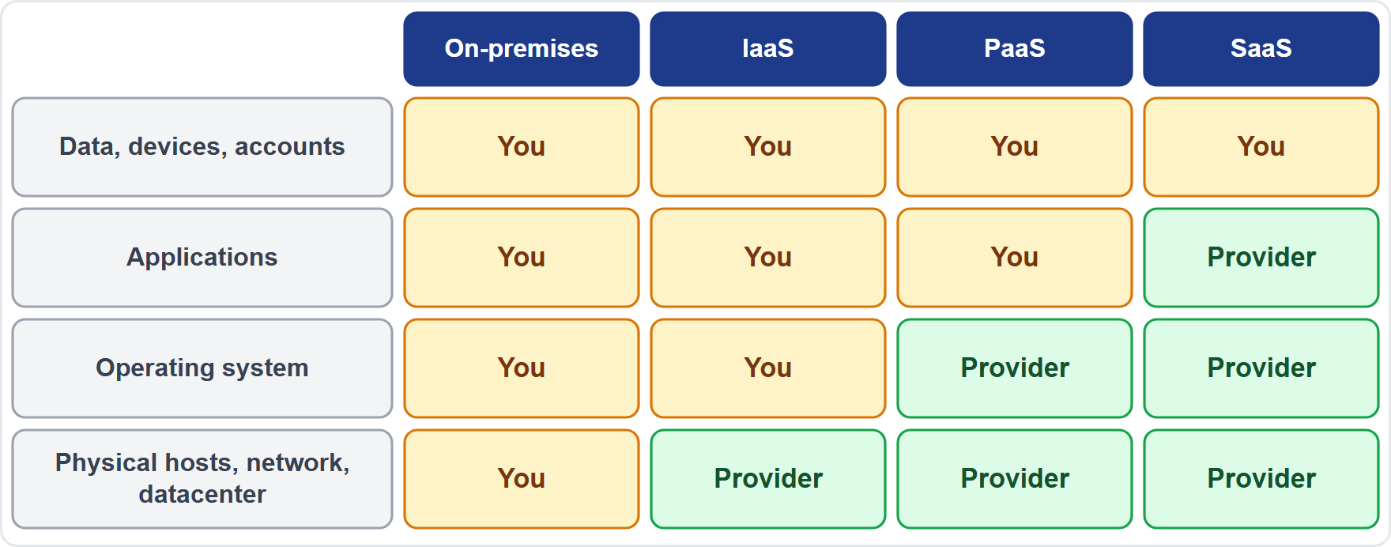
The shared responsibility model, continued
Module 1
The shared responsibility model across on-premises, IaaS, PaaS and SaaS
AZ-900 Exam Prep | Microsoft Azure Fundamentals exam
Module 1: Cloud Computing Concepts
7 / 26
Notes:
The shared responsibility model.
The figure shows this: The shared responsibility model across on-premises, I A A S, pass and sass.

Slide 8
Cloud models: public, private and hybrid
Module 1
Model | What it is | Who owns the hardware | Typical use
Public cloud | Services built on resources owned and run by a provider and shared by many customers (called tenants) | The provider | Fast start, no hardware to buy, pay as you go
AZ-900 Exam Prep | Microsoft Azure Fundamentals exam
Module 1: Cloud Computing Concepts
8 / 26
Notes:
Cloud models: public, private and hybrid.
Public cloud. What it is: Services built on resources owned and run by a provider and shared by many customers (called tenants). Who owns the hardware: The provider. Typical use: Fast start, no hardware to buy, pay as you go.

Slide 9
Cloud models: public, private and hybrid, continued
Module 1
Model | What it is | Who owns the hardware | Typical use
Private cloud | Cloud resources used by one organization, in its own datacenter or hosted for it | The organization (or a host for it) | Strict control or rules that need dedicated hardware
Hybrid cloud | A mix of public and private (on-premises) that work together | Both | Keep sensitive systems on-premises, use the cloud for growth
AZ-900 Exam Prep | Microsoft Azure Fundamentals exam
Module 1: Cloud Computing Concepts
9 / 26
Notes:
Cloud models: public, private and hybrid.
Private cloud. What it is: Cloud resources used by one organization, in its own datacenter or hosted for it. Who owns the hardware: The organization (or a host for it). Typical use: Strict control or rules that need dedicated hardware.
Hybrid cloud. What it is: A mix of public and private (on-premises) that work together. Who owns the hardware: Both. Typical use: Keep sensitive systems on-premises, use the cloud for growth.

Slide 10
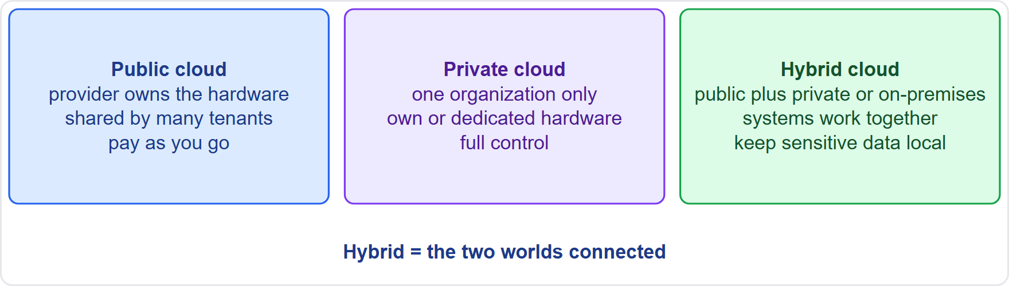
Cloud models: public, private and hybrid, continued
Module 1
Public, private and hybrid cloud compared
AZ-900 Exam Prep | Microsoft Azure Fundamentals exam
Module 1: Cloud Computing Concepts
10 / 26
Notes:
Cloud models: public, private and hybrid.
The figure shows this: Public, private and hybrid cloud compared.

Slide 11
Identify the use case
Module 1
Need in the question | Model
No upfront hardware spending, quick deployment | Public
Data must stay in a datacenter the organization controls, full control over hardware | Private
Some systems must stay on-premises, but extra capacity is wanted in the cloud | Hybrid
A legacy system cannot move, while new apps use the cloud | Hybrid
An app needs to burst to the cloud for a short peak | Hybrid
EXAM TIP Public cloud still keeps customers separate: shared hardware does not mean shared data. Azure Arc and Azure Stack products extend Azure services to on-premises and other places, which supports hybrid designs (Module 13).
AZ-900 Exam Prep | Microsoft Azure Fundamentals exam
Module 1: Cloud Computing Concepts
11 / 26
Notes:
Identify the use case.
No upfront hardware spending, quick deployment. Public.
Data must stay in a datacenter the organization controls, full control over hardware. Private.
Some systems must stay on-premises, but extra capacity is wanted in the cloud. Hybrid.
A legacy system cannot move, while new apps use the cloud. Hybrid.
An app needs to burst to the cloud for a short peak. Hybrid.
Exam tip: Public cloud still keeps customers separate: shared hardware does not mean shared data. Azure Arc and Azure Stack products extend Azure services to on-premises and other places, which supports hybrid designs (Module thirteen).

Slide 12
The consumption-based model
Module 1
In the consumption-based model you pay only for what you use, with no upfront cost and no long-term commitment required.
No need to buy hardware in advance.
Pay per hour, per minute, per second, per operation or per GB, depending on the service.
Stop using the service and the charges stop.
Cost follows the actual use, so a short peak does not require paying for peak capacity all year.
AZ-900 Exam Prep | Microsoft Azure Fundamentals exam
Module 1: Cloud Computing Concepts
12 / 26
Notes:
The consumption-based model.
In the consumption-based model you pay only for what you use, with no upfront cost and no long-term commitment required.
No need to buy hardware in advance.
Pay per hour, per minute, per second, per operation or per G B, depending on the service.
Stop using the service and the charges stop.
Cost follows the actual use, so a short peak does not require paying for peak capacity all year.

Slide 13
Cloud pricing models
Module 1
Model | How you pay | Good for
Capital expenditure (CapEx) | Large upfront purchase of assets (servers, buildings) that you own and depreciate | Traditional datacenters
Operational expenditure (OpEx) | Pay as you go for services, billed as an ongoing expense | Cloud, consumption-based
Pay-as-you-go | Standard rates, no commitment, billed for use | Unpredictable or short workloads
This skill asks you to compare how cloud costs are shaped.
AZ-900 Exam Prep | Microsoft Azure Fundamentals exam
Module 1: Cloud Computing Concepts
13 / 26
Notes:
Cloud pricing models.
This skill asks you to compare how cloud costs are shaped.
Capital expenditure (cap ex). How you pay: Large upfront purchase of assets (servers, buildings) that you own and depreciate. Good for: Traditional datacenters.
Operational expenditure (op ex). How you pay: Pay as you go for services, billed as an ongoing expense. Good for: Cloud, consumption-based.
Pay-as-you-go. How you pay: Standard rates, no commitment, billed for use. Good for: Unpredictable or short workloads.

Slide 14
Cloud pricing models, continued
Module 1
Model | How you pay | Good for
Reserved instances / savings plans [Beyond the study guide] | Commit to one or three years for a lower rate | Steady, predictable workloads
EXAM TIP CapEx is the old on-premises style (you buy), OpEx is the cloud style (you rent). The cloud shifts spending from CapEx to OpEx.
AZ-900 Exam Prep | Microsoft Azure Fundamentals exam
Module 1: Cloud Computing Concepts
14 / 26
Notes:
Cloud pricing models.
Reserved instances or savings plans. How you pay: Commit to one or three years for a lower rate. Good for: Steady, predictable workloads.
Exam tip: cap ex is the old on-premises style (you buy), op ex is the cloud style (you rent). The cloud shifts spending from cap ex to op ex.

Slide 15
Serverless
Module 1
Serverless computing lets you run code or services without managing servers. The servers still exist, but the provider manages them, scales them automatically and bills only while your code runs.
You focus on code or logic, not on virtual machines or operating systems.
Scaling is automatic, including down to zero use.
Examples on Azure: Azure Functions (run code in response to events) and Azure Logic Apps (workflows). [Beyond the study guide] for Logic Apps.
AZ-900 Exam Prep | Microsoft Azure Fundamentals exam
Module 1: Cloud Computing Concepts
15 / 26
Notes:
Serverless.
Serverless computing lets you run code or services without managing servers. The servers still exist, but the provider manages them, scales them automatically and bills only while your code runs.
You focus on code or logic, not on virtual machines or operating systems.
Scaling is automatic, including down to zero use.
Examples on Azure: Azure Functions (run code in response to events) and Azure Logic Apps (workflows). for Logic Apps.

Slide 16
Serverless, continued
Module 1
Serverless means | Serverless does not mean
No servers for you to manage | No servers exist
Pay for execution | Always free
Automatic scale | Fixed capacity
AZ-900 Exam Prep | Microsoft Azure Fundamentals exam
Module 1: Cloud Computing Concepts
16 / 26
Notes:
Serverless.
No servers for you to manage. No servers exist.
Pay for execution. Always free.
Automatic scale. Fixed capacity.

Slide 17
Practice Question 1
Module 1
Q1
Fabrikam Outdoors must keep customer records in a datacenter it fully controls, but wants to use Azure for a new web shop. Which cloud model fits?
A
Public cloud only
B
Private cloud only
C
Serverless
D
Hybrid cloud
AZ-900 Exam Prep | Microsoft Azure Fundamentals exam
Module 1: Cloud Computing Concepts
17 / 26
Notes:
Question one. Fabrikam Outdoors must keep customer records in a datacenter it fully controls, but wants to use Azure for a new web shop. Which cloud model fits? The four options are on the screen.
[PAUSE 10]
The answer is D: Hybrid cloud. Hybrid combines on-premises or private systems with public cloud services. Public only would move the records out; private only would not give the cloud benefits for the shop; serverless is a compute style, not a cloud model.

Slide 18
Practice Question 2
Module 1
Q2
Which responsibility always belongs to the customer, whatever the service type?
A
The physical datacenter
B
The physical network
C
The hypervisor on the physical hosts
D
The data and the accounts that access it
AZ-900 Exam Prep | Microsoft Azure Fundamentals exam
Module 1: Cloud Computing Concepts
18 / 26
Notes:
Question two. Which responsibility always belongs to the customer, whatever the service type? The four options are on the screen.
[PAUSE 10]
The answer is D: The data and the accounts that access it. Information and data, devices, and accounts and identities are always the customer's. The physical datacenter, hosts and network belong to the provider.

Slide 19
Practice Question 3
Module 1
Q3
A company wants to stop buying servers and pay monthly only for the capacity it uses. Which spending shift describes this?
A
From OpEx to CapEx
B
From CapEx to OpEx
C
From public to private
D
From hybrid to on-premises
AZ-900 Exam Prep | Microsoft Azure Fundamentals exam
Module 1: Cloud Computing Concepts
19 / 26
Notes:
Question three. A company wants to stop buying servers and pay monthly only for the capacity it uses. Which spending shift describes this? The four options are on the screen.
[PAUSE 10]
The answer is B: From cap ex to op ex. The cloud replaces large upfront capital purchases with ongoing operating expenses based on consumption.

Slide 20
Practice Question 4
Module 1
Q4
A team wants to run a small piece of code whenever a file arrives, with no virtual machines to manage and billing only while the code runs. Which approach is this?
A
Serverless computing
B
Private cloud
C
Capital expenditure
D
A dedicated physical server
AZ-900 Exam Prep | Microsoft Azure Fundamentals exam
Module 1: Cloud Computing Concepts
20 / 26
Notes:
Question four. A team wants to run a small piece of code whenever a file arrives, with no virtual machines to manage and billing only while the code runs. Which approach is this? The four options are on the screen.
[PAUSE 10]
The answer is A: Serverless computing. Serverless runs code on demand, scales automatically and bills for execution, without server management by the customer.

Slide 21
Practice Question 5
Module 1
Q5
Which statement about the public cloud is true?
A
Only one organization uses the hardware, and the customer owns it
B
The customer must buy the physical servers before using any service
C
It cannot be combined with on-premises systems in a hybrid design
D
Hardware is shared by many customers, but each customer's data stays separate
AZ-900 Exam Prep | Microsoft Azure Fundamentals exam
Module 1: Cloud Computing Concepts
21 / 26
Notes:
Question five. Which statement about the public cloud is true? The four options are on the screen.
[PAUSE 10]
The answer is D: Hardware is shared by many customers, but each customer's data stays separate. The provider owns the hardware and many tenants share it, with their data isolated. Public cloud can be part of a hybrid design.

Slide 22
Practice Question 6
Module 1
Q6
Under the consumption-based model, what happens when you stop using a service?
A
The usage charges stop
B
You still pay the full monthly price
C
You pay a penalty
D
The hardware is shipped to you
AZ-900 Exam Prep | Microsoft Azure Fundamentals exam
Module 1: Cloud Computing Concepts
22 / 26
Notes:
Question six. Under the consumption-based model, what happens when you stop using a service? The four options are on the screen.
[PAUSE 10]
The answer is A: The usage charges stop. You pay for what you use, so when use stops the usage charges stop. Some resources may still cost money while they exist, such as a stopped-but-allocated resource, so check the service.

Slide 23
Recall Check 1
Module 1
Q1. Define cloud computing in one sentence.
Q2. Which three things are always the customer's responsibility?
Q3. Which cloud model is used by one organization only?
AZ-900 Exam Prep | Microsoft Azure Fundamentals exam
Module 1: Cloud Computing Concepts
23 / 26
Notes:
Recall check one. Say each answer out loud before you listen to mine.
Question one. Define cloud computing in one sentence.
[PAUSE 5]
Answer: Delivery of computing services over the internet from a provider's datacenters, so you rent what you need.
Question two. Which three things are always the customer's responsibility?
[PAUSE 5]
Answer: Data, devices, and accounts and identities.
Question three. Which cloud model is used by one organization only?
[PAUSE 5]
Answer: Private cloud.

Slide 24
Recall Check 2
Module 1
Q4. Which model combines public cloud with on-premises systems?
Q5. CapEx or OpEx: which one is pay as you go?
Q6. What does serverless mean?
AZ-900 Exam Prep | Microsoft Azure Fundamentals exam
Module 1: Cloud Computing Concepts
24 / 26
Notes:
Recall check two. Say each answer out loud before you listen to mine.
Question four. Which model combines public cloud with on-premises systems?
[PAUSE 5]
Answer: Hybrid cloud.
Question five. cap ex or op ex: which one is pay as you go?
[PAUSE 5]
Answer: op ex (operational expenditure).
Question six. What does serverless mean?
[PAUSE 5]
Answer: You run code without managing servers; the provider scales and bills only for execution.

Slide 25
Recall Check 3
Module 1
Q7. In which model does the provider manage the operating system, but not your applications?
AZ-900 Exam Prep | Microsoft Azure Fundamentals exam
Module 1: Cloud Computing Concepts
25 / 26
Notes:
Recall check three. Say each answer out loud before you listen to mine.
Question seven. In which model does the provider manage the operating system, but not your applications?
[PAUSE 5]
Answer: pass (Module three).

Slide 26
Module Recap
Module 1
1
Cloud computing
2
Shared responsibility
3
Public
services over the internet, rented on demand
provider-owned, shared hardware, pay as you go
customer always owns data, devices, accounts
4
Private
5
Hybrid
6
Consumption-based
one organization, own or dedicated hardware
public plus private or on-premises together
pay only for what you use; no upfront cost
7
CapEx vs OpEx
8
Serverless
CapEx = buy upfront; OpEx = pay as you go (cloud)
no server management, automatic scale, pay per execution (Azure Functions)
AZ-900 Exam Prep | Microsoft Azure Fundamentals exam
Module 1: Cloud Computing Concepts
26 / 26
Notes:
Here is the recap.
Cloud computing: services over the internet, rented on demand.
Shared responsibility: customer always owns data, devices, accounts.
Public: provider-owned, shared hardware, pay as you go.
Private: one organization, own or dedicated hardware.
Hybrid: public plus private or on-premises together.
Consumption-based: pay only for what you use; no upfront cost.
cap ex versus op ex: cap ex equals buy upfront; op ex equals pay as you go (cloud).
Serverless: no server management, automatic scale, pay per execution (Azure Functions).
In the next module, we continue the course.

