Slide 1
Module 8: Azure Storage
Compare Azure Storage services
AZ-900 exam prep · Describe Azure architecture and services · 35 to 40% of the exam
AZ-900 Exam Prep: Azure Fundamentals Study Course
Module 8 · Part 1
Notes:
Welcome to Module eight: Azure Storage. It covers the exam area Describe Azure architecture and services.
Each part of this module comes from the study notes of the same name, so you can read the notes after you watch.

Slide 2
What You Will Learn
Part 1
Compare Azure Storage services
Describe storage tiers
Describe redundancy options
Describe storage account options and storage types
Identify options for moving files, including AzCopy, Azure Storage Explorer, and Azure File Sync
Describe migration options, including Azure Migrate and Azure Data Box
Practice with exam-style questions and a recall check
AZ-900 Exam Prep | Microsoft Azure Fundamentals exam
Module 8: Azure Storage
2 / 27
Notes:
By the end of this module you will be able to do seven things.
Compare Azure Storage services.
Describe storage tiers.
Describe redundancy options.
Describe storage account options and storage types.
Identify options for moving files, including Az Copy, Azure Storage Explorer, and Azure File Sync.
Describe migration options, including Azure Migrate and Azure Data Box.
Practice with exam-style questions and a recall check.

Slide 3
Where This Fits in the Exam
Part 1
EXAM CHECK-IN · Where this fits
Exam area: Describe Azure architecture and services (35–40%)
Exam format: 45 minutes; a score of 700 on a scale of 1 to 1,000 passes
Validated against: the official AZ-900 study guide, current skills measured
AZ-900 Exam Prep | Microsoft Azure Fundamentals exam
Module 8: Azure Storage
3 / 27
Notes:
Here is where this module sits in the exam.
Exam area: Describe Azure architecture and services (thirty-five to forty percent).
Exam format: forty-five minutes; a score of seven hundred on a scale of one to one thousand passes.
Validated against: the official A Z nine hundred study guide, current skills measured.

Slide 4
Storage accounts and the storage services
Part 1
Service | What it stores | Use it for
Azure Blob Storage | Unstructured data (objects): documents, images, video, backups, logs | Large amounts of files; serving content; backups; data lakes
Azure Files | Fully managed file shares (SMB and NFS) | Replace or extend on-premises file servers; shared drives; lift and shift
An Azure storage account is a container that holds your storage services under one globally unique name (3 to 24 lowercase letters and numbers). Data is encrypted at rest by default and is reached over HTTPS.
AZ-900 Exam Prep | Microsoft Azure Fundamentals exam
Module 8: Azure Storage
4 / 27
Notes:
Storage accounts and the storage services.
An Azure storage account is a container that holds your storage services under one globally unique name (three to twenty-four lowercase letters and numbers). Data is encrypted at rest by default and is reached over H T T P S.
Azure Blob Storage. What it stores: Unstructured data (objects): documents, images, video, backups, logs. Use it for: Large amounts of files; serving content; backups; data lakes.
Azure Files. What it stores: Fully managed file shares (S M B and N F S (Network File System)). Use it for: Replace or extend on-premises file servers; shared drives; lift and shift.

Slide 5
Storage accounts and the storage services, continued
Part 1
Service | What it stores | Use it for
Azure Queue Storage | Messages in a queue | Pass messages between app components, asynchronous work
Azure Table Storage | NoSQL key-attribute data (structured, no schema) | Flexible datasets such as user data or device information
Azure Disk Storage (managed disks) | Disks for virtual machines | OS and data disks for VMs
EXAM TIP Match the data type: files → Blob (objects) or Files (shares); messages → Queue; structured NoSQL → Table; VM disks → Disk. A "file share mapped like a network drive" → Azure Files.
AZ-900 Exam Prep | Microsoft Azure Fundamentals exam
Module 8: Azure Storage
5 / 27
Notes:
Storage accounts and the storage services.
Azure Queue Storage. What it stores: Messages in a queue. Use it for: Pass messages between app components, asynchronous work.
Azure Table Storage. What it stores: No sequel key-attribute data (structured, no schema). Use it for: Flexible datasets such as user data or device information.
Azure Disk Storage (managed disks). What it stores: Disks for virtual machines. Use it for: O S and data disks for V Ms.
Exam tip: Match the data type: files to Blob (objects) or Files (shares); messages to Queue; structured No sequel to Table; V M disks to Disk. A "file share mapped like a network drive" to Azure Files.

Slide 6
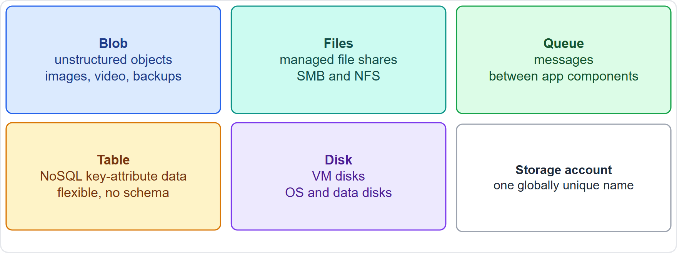
Storage accounts and the storage services, continued
Part 1
The Azure Storage services and their data types
AZ-900 Exam Prep | Microsoft Azure Fundamentals exam
Module 8: Azure Storage
6 / 27
Notes:
Storage accounts and the storage services.
The figure shows this: The Azure Storage services and their data types.

Slide 7
Storage access tiers (Blob Storage)
Part 1
Tier | Access | Storage cost | Access cost | Minimum stay | Notes
Hot | Frequent | Highest | Lowest | None | Online, active data
Cool | Infrequent | Lower | Higher | 30 days | Online, short-term backups
Cold | Rare | Lower still | Higher still | 90 days | Online
Archive | Almost never | Lowest | Highest | 180 days | Offline: data must be rehydrated (takes hours) before it can be read
Tiers trade storage cost against access cost and speed. You choose a tier by how often you read the data.
AZ-900 Exam Prep | Microsoft Azure Fundamentals exam
Module 8: Azure Storage
7 / 27
Notes:
Storage access tiers (Blob Storage).
Tiers trade storage cost against access cost and speed. You choose a tier by how often you read the data.
Hot. Access: Frequent. Storage cost: Highest. Access cost: Lowest. Minimum stay: None. Notes: Online, active data.
Cool. Access: Infrequent. Storage cost: Lower. Access cost: Higher. Minimum stay: thirty days. Notes: Online, short-term backups.
Cold. Access: Rare. Storage cost: Lower still. Access cost: Higher still. Minimum stay: ninety days. Notes: Online.
Archive. Access: Almost never. Storage cost: Lowest. Access cost: Highest. Minimum stay: one hundred eighty days. Notes: Offline: data must be rehydrated (takes hours) before it can be read.

Slide 8
Storage access tiers (Blob Storage), continued
Part 1
[Verify live] for minimum periods and prices. The Archive tier can only be set per blob, and data in Archive cannot be read directly.
EXAM TIP "Data accessed rarely, lowest storage cost, can wait hours to read" → Archive. "Frequently accessed" → Hot. The cheaper the storage, the more it costs to read.
AZ-900 Exam Prep | Microsoft Azure Fundamentals exam
Module 8: Azure Storage
8 / 27
Notes:
Storage access tiers (Blob Storage).
for minimum periods and prices. The Archive tier can only be set per blob, and data in Archive cannot be read directly.
Exam tip: "Data accessed rarely, lowest storage cost, can wait hours to read" to Archive. "Frequently accessed" to Hot. The cheaper the storage, the more it costs to read.

Slide 9
Redundancy options
Part 1
Option | Copies | Where | Protects from
LRS (locally redundant) | 3 | One datacenter in one region | Server rack or drive failure
ZRS (zone-redundant) | 3 | Three or more availability zones in one region | A datacenter (zone) failure
GRS (geo-redundant) | 6 | LRS in the primary region, plus LRS in a paired secondary region | A regional disaster
Azure keeps multiple copies of your data to protect against failures. You choose how far apart they are.
AZ-900 Exam Prep | Microsoft Azure Fundamentals exam
Module 8: Azure Storage
9 / 27
Notes:
Redundancy options.
Azure keeps multiple copies of your data to protect against failures. You choose how far apart they are.
L R S (locally redundant storage) (locally redundant). Copies: three. Where: One datacenter in one region. Protects from: Server rack or drive failure.
Z R S (zone-redundant storage) (zone-redundant). Copies: three. Where: Three or more availability zones in one region. Protects from: A datacenter (zone) failure.
G R S (geo-redundant storage) (geo-redundant). Copies: six. Where: L R S in the primary region, plus L R S in a paired secondary region. Protects from: A regional disaster.

Slide 10
Redundancy options, continued
Part 1
Option | Copies | Where | Protects from
GZRS (geo-zone-redundant) | 6 | ZRS in the primary region, plus LRS in a secondary region | Zone failure and regional disaster
RA-GRS / RA-GZRS | 6 | Same as GRS / GZRS, plus read access to the secondary | Regional disaster, with reads from the secondary
AZ-900 Exam Prep | Microsoft Azure Fundamentals exam
Module 8: Azure Storage
10 / 27
Notes:
Redundancy options.
G Z R S (geo-zone-redundant storage) (geo-zone-redundant). Copies: six. Where: Z R S in the primary region, plus L R S in a secondary region. Protects from: Zone failure and regional disaster.
R A G R S or R A G Z R S. Copies: six. Where: Same as G R S or G Z R S, plus read access to the secondary. Protects from: Regional disaster, with reads from the secondary.

Slide 11
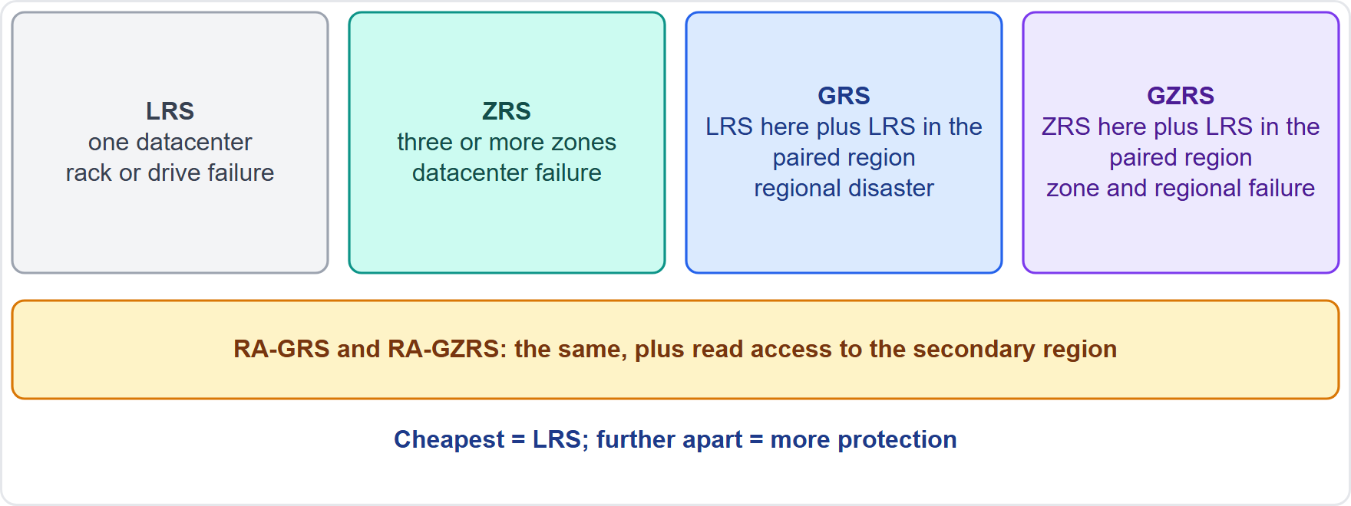
Redundancy options, continued
Part 1
Storage redundancy: LRS, ZRS, GRS and GZRS
AZ-900 Exam Prep | Microsoft Azure Fundamentals exam
Module 8: Azure Storage
11 / 27
Notes:
Redundancy options.
The figure shows this: Storage redundancy: L R S, Z R S, G R S and G Z R S.

Slide 12
Redundancy options, continued
Part 1
Local and zone options keep data in one region; geo options also copy it to a paired region.
The secondary of GRS/GZRS is not readable unless you choose the read-access (RA) variant, or a failover happens.
EXAM TIP Cheapest = LRS. Datacenter failure = ZRS. Regional disaster = GRS or GZRS. Read from the secondary = RA-. Copies in a different region always mean a geo option.
AZ-900 Exam Prep | Microsoft Azure Fundamentals exam
Module 8: Azure Storage
12 / 27
Notes:
Redundancy options.
Local and zone options keep data in one region; geo options also copy it to a paired region.
The secondary of G R S or G Z R S is not readable unless you choose the read-access (R A) variant, or a failover happens.
Exam tip: Cheapest equals L R S. Datacenter failure equals Z R S. Regional disaster equals G R S or G Z R S. Read from the secondary equals R A-. Copies in a different region always mean a geo option.

Slide 13
Storage account options
Part 1
Option | Choices
Performance | Standard (hard disk, general purpose) or Premium (solid state, low latency)
Account types | General-purpose v2 (the standard type for most scenarios: blobs, files, queues, tables); Premium accounts for block blobs, file shares or page blobs, for high-performance needs
Redundancy | LRS, ZRS, GRS, GZRS, and the read-access variants
Access tier (default) | Hot or Cool
Use Premium when the workload needs consistently low latency and high transaction rates.
AZ-900 Exam Prep | Microsoft Azure Fundamentals exam
Module 8: Azure Storage
13 / 27
Notes:
Storage account options.
Performance. Standard (hard disk, general purpose) or Premium (solid state, low latency).
Account types. General-purpose version two (the standard type for most scenarios: blobs, files, queues, tables); Premium accounts for block blobs, file shares or page blobs, for high-performance needs.
Redundancy. L R S, Z R S, G R S, G Z R S, and the read-access variants.
Access tier (default). Hot or Cool.
Use Premium when the workload needs consistently low latency and high transaction rates.

Slide 14
Moving files to and within Azure
Part 1
Tool | What it does | Notes
AzCopy | A command-line tool to copy blobs and files to or from a storage account | Good for scripts and large copies
Azure Storage Explorer | A graphical application to browse and manage storage accounts (blobs, files, queues, tables) | Runs on Windows, macOS and Linux
AZ-900 Exam Prep | Microsoft Azure Fundamentals exam
Module 8: Azure Storage
14 / 27
Notes:
Moving files to and within Azure.
Az Copy. What it does: A command-line tool to copy blobs and files to or from a storage account. Notes: Good for scripts and large copies.
Azure Storage Explorer. What it does: A graphical application to browse and manage storage accounts (blobs, files, queues, tables). Notes: Runs on Windows, mac O S and Linux.

Slide 15
Moving files to and within Azure, continued
Part 1
Tool | What it does | Notes
Azure File Sync | Syncs on-premises Windows file servers with Azure Files and caches frequently used files locally | Keeps the on-premises server as a fast cache while data lives in Azure
AZ-900 Exam Prep | Microsoft Azure Fundamentals exam
Module 8: Azure Storage
15 / 27
Notes:
Moving files to and within Azure.
Azure File Sync. What it does: Syncs on-premises Windows file servers with Azure Files and caches frequently used files locally. Notes: Keeps the on-premises server as a fast cache while data lives in Azure.

Slide 16
Migration options
Part 2
Option | What it does
Azure Migrate | A central hub of tools to discover, assess and migrate on-premises servers, databases, web apps and virtual desktops to Azure
Azure Data Box | A physical, ruggedized device Microsoft ships to you: you load data offline and send it back to be uploaded to Azure. Used for large amounts of data or slow networks (Data Box Disk, Data Box, Data Box Heavy)
EXAM TIP Servers and apps → Azure Migrate. Terabytes of data with limited bandwidth → Azure Data Box. Keep a local file server cache → Azure File Sync. Copy with a command → AzCopy. Click-and-browse tool → Storage Explorer.
AZ-900 Exam Prep | Microsoft Azure Fundamentals exam
Module 8: Azure Storage
16 / 27
Notes:
Migration options.
Azure Migrate. A central hub of tools to discover, assess and migrate on-premises servers, databases, web apps and virtual desktops to Azure.
Azure Data Box. A physical, ruggedized device Microsoft ships to you: you load data offline and send it back to be uploaded to Azure. Used for large amounts of data or slow networks (Data Box Disk, Data Box, Data Box Heavy).
Exam tip: Servers and apps to Azure Migrate. Terabytes of data with limited bandwidth to Azure Data Box. Keep a local file server cache to Azure File Sync. Copy with a command to Az Copy. Click-and-browse tool to Storage Explorer.

Slide 17
Practice Question 1
Part 2
Q1
Fabrikam Outdoors needs a shared network drive in Azure that on-premises servers can map using SMB. Which service fits?
A
Azure Blob Storage
B
Azure Queue Storage
C
Azure Files
D
Azure Table Storage
AZ-900 Exam Prep | Microsoft Azure Fundamentals exam
Module 8: Azure Storage
17 / 27
Notes:
Question one. Fabrikam Outdoors needs a shared network drive in Azure that on-premises servers can map using S M B (Server Message Block). Which service fits? The four options are on the screen.
[PAUSE 10]
The answer is C: Azure Files. Azure Files provides managed file shares using S M B (and N F S). Blob stores unstructured objects.

Slide 18
Practice Question 2
Part 2
Q2
Data must be kept for years, is almost never read, and the lowest storage cost matters more than read speed. Which tier fits?
A
Archive
B
Hot
C
Cool
D
Premium
AZ-900 Exam Prep | Microsoft Azure Fundamentals exam
Module 8: Azure Storage
18 / 27
Notes:
Question two. Data must be kept for years, is almost never read, and the lowest storage cost matters more than read speed. Which tier fits? The four options are on the screen.
[PAUSE 10]
The answer is A: Archive. Archive has the lowest storage cost; data is offline and must be rehydrated, which takes hours.

Slide 19
Practice Question 3
Part 2
Q3
A company needs its data copied to another region so it survives a regional disaster. Which redundancy option provides this?
A
LRS
B
GRS
C
ZRS
D
Hot
AZ-900 Exam Prep | Microsoft Azure Fundamentals exam
Module 8: Azure Storage
19 / 27
Notes:
Question three. A company needs its data copied to another region so it survives a regional disaster. Which redundancy option provides this? The four options are on the screen.
[PAUSE 10]
The answer is B: G R S. G R S (or G Z R S) copies data to a secondary region. L R S and Z R S stay in one region.

Slide 20
Practice Question 4
Part 2
Q4
A company must move 200 TB to Azure over a slow network. What is the best option?
A
AzCopy over the internet
B
Azure Storage Explorer
C
Azure Data Box
D
Azure DNS
AZ-900 Exam Prep | Microsoft Azure Fundamentals exam
Module 8: Azure Storage
20 / 27
Notes:
Question four. A company must move two hundred T B to Azure over a slow network. What is the best option? The four options are on the screen.
[PAUSE 10]
The answer is C: Azure Data Box. Data Box transports large data volumes offline on a physical device.

Slide 21
Practice Question 5
Part 2
Q5
Which tool synchronizes an on-premises Windows file server with Azure Files?
A
Azure Migrate
B
AzCopy
C
Azure Advisor
D
Azure File Sync
AZ-900 Exam Prep | Microsoft Azure Fundamentals exam
Module 8: Azure Storage
21 / 27
Notes:
Question five. Which tool synchronizes an on-premises Windows file server with Azure Files? The four options are on the screen.
[PAUSE 10]
The answer is D: Azure File Sync. Azure File Sync keeps file servers and Azure Files in sync with local caching.

Slide 22
Practice Question 6
Part 2
Q6
Which storage service holds messages that application components pass to each other?
A
Azure Table Storage
B
Azure Files
C
Azure Queue Storage
D
Azure Disk Storage
AZ-900 Exam Prep | Microsoft Azure Fundamentals exam
Module 8: Azure Storage
22 / 27
Notes:
Question six. Which storage service holds messages that application components pass to each other? The four options are on the screen.
[PAUSE 10]
The answer is C: Azure Queue Storage. Queue Storage stores messages for asynchronous communication.

Slide 23
Practice Question 7
Part 2
Q7
Which redundancy option protects against the loss of a single datacenter by spreading copies across availability zones?
A
LRS
B
Archive
C
Cool
D
ZRS
AZ-900 Exam Prep | Microsoft Azure Fundamentals exam
Module 8: Azure Storage
23 / 27
Notes:
Question seven. Which redundancy option protects against the loss of a single datacenter by spreading copies across availability zones? The four options are on the screen.
[PAUSE 10]
The answer is D: Z R S. Z R S keeps three copies in three zones of one region.

Slide 24
Recall Check 1
Part 2
Q1. Which storage service is for unstructured objects?
Q2. Name the four blob tiers.
Q3. Which tier is offline and needs rehydration?
AZ-900 Exam Prep | Microsoft Azure Fundamentals exam
Module 8: Azure Storage
24 / 27
Notes:
Recall check one. Say each answer out loud before you listen to mine.
Question one. Which storage service is for unstructured objects?
[PAUSE 5]
Answer: Azure Blob Storage.
Question two. Name the four blob tiers.
[PAUSE 5]
Answer: Hot, Cool, Cold and Archive.
Question three. Which tier is offline and needs rehydration?
[PAUSE 5]
Answer: Archive.

Slide 25
Recall Check 2
Part 2
Q4. How many copies do LRS and ZRS keep?
Q5. What does the RA prefix add to GRS?
Q6. AzCopy or Storage Explorer: which is command line?
AZ-900 Exam Prep | Microsoft Azure Fundamentals exam
Module 8: Azure Storage
25 / 27
Notes:
Recall check two. Say each answer out loud before you listen to mine.
Question four. How many copies do L R S and Z R S keep?
[PAUSE 5]
Answer: Three copies each (L R S in one datacenter, Z R S across three zones).
Question five. What does the R A prefix add to G R S?
[PAUSE 5]
Answer: Read access to the secondary region.
Question six. Az Copy or Storage Explorer: which is command line?
[PAUSE 5]
Answer: Az Copy.

Slide 26
Recall Check 3
Part 2
Q7. Which service discovers and assesses on-premises servers for migration?
AZ-900 Exam Prep | Microsoft Azure Fundamentals exam
Module 8: Azure Storage
26 / 27
Notes:
Recall check three. Say each answer out loud before you listen to mine.
Question seven. Which service discovers and assesses on-premises servers for migration?
[PAUSE 5]
Answer: Azure Migrate.

Slide 27
Module Recap
Part 2
1
Services
2
Tiers
3
Redundancy
Blob = objects; Files = SMB/NFS shares; Queue = messages; Table = NoSQL; Disk = VM disks
Hot (frequent) → Cool (30 days) → Cold (90 days) → Archive (180 days, offline, rehydrate)
LRS 3 copies one datacenter; ZRS three zones; GRS/GZRS add a paired region
4
Account
5
Move files
6
Migrate
standard general-purpose v2 for most; premium for low latency; globally unique name
AzCopy (command line); Storage Explorer (GUI); File Sync (on-premises file server cache)
Azure Migrate (servers, databases, apps); Data Box (offline, huge data)
AZ-900 Exam Prep | Microsoft Azure Fundamentals exam
Module 8: Azure Storage
27 / 27
Notes:
Here is the recap.
Services: Blob equals objects; Files equals S M B or N F S shares; Queue equals messages; Table equals No sequel; Disk equals V M disks.
Tiers: Hot (frequent) to Cool (thirty days) to Cold (ninety days) to Archive (one hundred eighty days, offline, rehydrate).
Redundancy: L R S three copies one datacenter; Z R S three zones; G R S or G Z R S add a paired region.
Account: standard general-purpose version two for most; premium for low latency; globally unique name.
Move files: Az Copy (command line); Storage Explorer (gooey); File Sync (on-premises file server cache).
Migrate: Azure Migrate (servers, databases, apps); Data Box (offline, huge data).
In the next module, we continue the course.

