Slide 1
Module 14: Monitoring Tools
Describe the purpose of Azure Advisor
AZ-900 exam prep · Describe Azure management and governance · 30 to 35% of the exam
AZ-900 Exam Prep: Azure Fundamentals Study Course
Module 14
Notes:
Welcome to Module fourteen: Monitoring Tools. It covers the exam area Describe Azure management and governance.
Each part of this module comes from the study notes of the same name, so you can read the notes after you watch.

Slide 2
What You Will Learn
Module 14
Describe the purpose of Azure Advisor
Describe Azure Service Health
Describe Azure Monitor, including Log Analytics, Azure Monitor alerts, and Azure Monitor Application Insights
Practice with exam-style questions and a recall check
AZ-900 Exam Prep | Microsoft Azure Fundamentals exam
Module 14: Monitoring Tools
2 / 23
Notes:
By the end of this module you will be able to do four things.
Describe the purpose of Azure Advisor.
Describe Azure Service Health.
Describe Azure Monitor, including Log Analytics, Azure Monitor alerts, and Azure Monitor Application Insights.
Practice with exam-style questions and a recall check.

Slide 3
Where This Fits in the Exam
Module 14
EXAM CHECK-IN · Where this fits
Exam area: Describe Azure management and governance (30–35%)
Exam format: 45 minutes; a score of 700 on a scale of 1 to 1,000 passes
Validated against: the official AZ-900 study guide, current skills measured
AZ-900 Exam Prep | Microsoft Azure Fundamentals exam
Module 14: Monitoring Tools
3 / 23
Notes:
Here is where this module sits in the exam.
Exam area: Describe Azure management and governance (thirty to thirty-five percent).
Exam format: forty-five minutes; a score of seven hundred on a scale of one to one thousand passes.
Validated against: the official A Z nine hundred study guide, current skills measured.

Slide 4
Three tools, three questions
Module 14
Tool | Question it answers | Looks at
Azure Advisor | "How can I improve my resources?" | Your configuration and usage
Azure Service Health | "Is Azure itself having a problem that affects me?" | The Azure platform and your regions and services
AZ-900 Exam Prep | Microsoft Azure Fundamentals exam
Module 14: Monitoring Tools
4 / 23
Notes:
Three tools, three questions.
Azure Advisor. Question it answers: "How can I improve my resources?". Looks at: Your configuration and usage.
Azure Service Health. Question it answers: "Is Azure itself having a problem that affects me?". Looks at: The Azure platform and your regions and services.

Slide 5
Three tools, three questions, continued
Module 14
Tool | Question it answers | Looks at
Azure Monitor | "What is happening in my resources and apps, and who should be told?" | Telemetry (metrics and logs) from your resources and applications
AZ-900 Exam Prep | Microsoft Azure Fundamentals exam
Module 14: Monitoring Tools
5 / 23
Notes:
Three tools, three questions.
Azure Monitor. Question it answers: "What is happening in my resources and apps, and who should be told?". Looks at: Telemetry (metrics and logs) from your resources and applications.

Slide 6
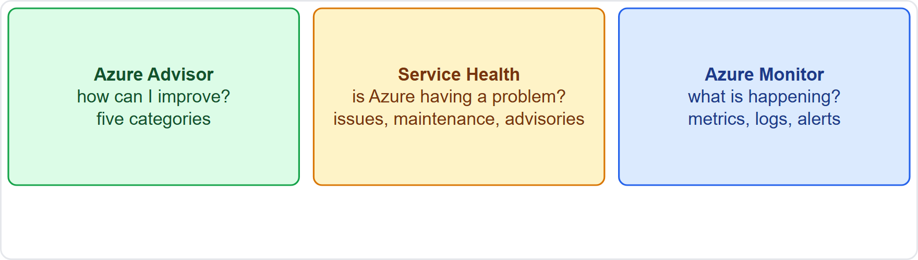
Three tools, three questions, continued
Module 14
Advisor, Service Health and Azure Monitor: what each one watches
AZ-900 Exam Prep | Microsoft Azure Fundamentals exam
Module 14: Monitoring Tools
6 / 23
Notes:
Three tools, three questions.
The figure shows this: Advisor, Service Health and Azure Monitor: what each one watches.

Slide 7
Azure Advisor
Module 14
Category | Example recommendation
Reliability | Use availability zones or backups for a VM
Security | Enable MFA, fix issues found by Defender for Cloud
Performance | Use a larger tier or add caching
Cost | Shut down or resize idle or underused VMs; buy a reservation
Operational excellence | Follow best practices for deployment and management
Azure Advisor is a free, personalized recommendation engine that analyzes your resource configuration and usage and suggests how to improve.
Recommendations have an impact level and often a fix button.
You can postpone or dismiss a recommendation and set alerts for new ones.
EXAM TIP "Get personalized recommendations to improve reliability, security, performance, cost and operational excellence" → Azure Advisor. It advises; it does not change anything on its own.
AZ-900 Exam Prep | Microsoft Azure Fundamentals exam
Module 14: Monitoring Tools
7 / 23
Notes:
Azure Advisor.
Azure Advisor is a free, personalized recommendation engine that analyzes your resource configuration and usage and suggests how to improve.
It gives recommendations in five categories.
Reliability. Use availability zones or backups for a V M.
Security. Enable M F A, fix issues found by Defender for Cloud.
Performance. Use a larger tier or add caching.
Cost. Shut down or resize idle or underused V Ms; buy a reservation.
Operational excellence. Follow best practices for deployment and management.
Recommendations have an impact level and often a fix button.
You can postpone or dismiss a recommendation and set alerts for new ones.
Exam tip: "Get personalized recommendations to improve reliability, security, performance, cost and operational excellence" to Azure Advisor. It advises; it does not change anything on its own.

Slide 8
Azure Service Health
Module 14
View | Meaning
Azure status | A global page of the overall health of Azure services and regions
Service Health | A personalized view of problems, planned maintenance and health advisories that affect the services and regions you use; you can set alerts
Resource Health | The health of one specific resource (for example a VM), including past incidents and guidance
AZ-900 Exam Prep | Microsoft Azure Fundamentals exam
Module 14: Monitoring Tools
8 / 23
Notes:
Azure Service Health.
Azure Service Health keeps you informed about Azure service issues and planned maintenance that affect your resources. It is made up of three views.
Azure status. A global page of the overall health of Azure services and regions.
Service Health. A personalized view of problems, planned maintenance and health advisories that affect the services and regions you use; you can set alerts.
Resource Health. The health of one specific resource (for example a V M), including past incidents and guidance.

Slide 9
Azure Service Health, continued
Module 14
Service Health covers three types of events: service issues (outages happening now), planned maintenance and health advisories (changes that may require your action, such as a retirement).
EXAM TIP A problem in Azure itself → Service Health. Is my one VM healthy? → Resource Health. A global status page → Azure status. Improve my own setup → Advisor.
AZ-900 Exam Prep | Microsoft Azure Fundamentals exam
Module 14: Monitoring Tools
9 / 23
Notes:
Azure Service Health.
Service Health covers three types of events: service issues (outages happening now), planned maintenance and health advisories (changes that may require your action, such as a retirement).
Exam tip: A problem in Azure itself to Service Health. Is my one V M healthy? to Resource Health. A global status page to Azure status. Improve my own setup to Advisor.

Slide 10
Azure Monitor
Module 14
Part | What it does
Data sources | Applications, operating systems, Azure resources, subscriptions and tenants
Data stores | Metrics (numbers over time, near real time) and logs (events and records)
Insights and analysis | Dashboards, workbooks and visualizations
Respond | Alerts, autoscale and automated actions
Azure Monitor is a comprehensive platform to collect, analyze and act on telemetry from Azure, on-premises and other clouds.
AZ-900 Exam Prep | Microsoft Azure Fundamentals exam
Module 14: Monitoring Tools
10 / 23
Notes:
Azure Monitor.
Azure Monitor is a comprehensive platform to collect, analyze and act on telemetry from Azure, on-premises and other clouds.
Data sources. Applications, operating systems, Azure resources, subscriptions and tenants.
Data stores. Metrics (numbers over time, near real time) and logs (events and records).
Insights and analysis. Dashboards, workbooks and visualizations.
Respond. Alerts, autoscale and automated actions.

Slide 11
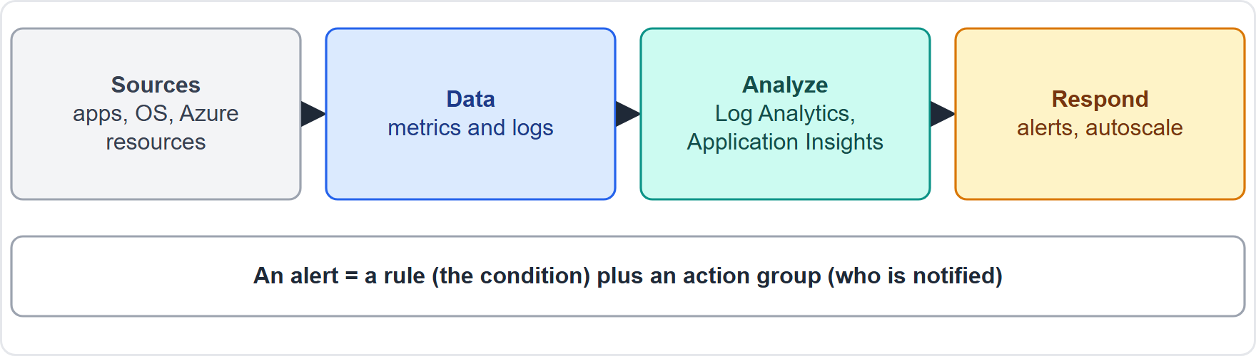
Azure Monitor, continued
Module 14
Azure Monitor: sources, data stores, analysis and response
AZ-900 Exam Prep | Microsoft Azure Fundamentals exam
Module 14: Monitoring Tools
11 / 23
Notes:
Azure Monitor.
The figure shows this: Azure Monitor: sources, data stores, analysis and response.

Slide 12
Log Analytics
Module 14
Log Analytics is the tool in the Azure portal for querying and analyzing log data stored in a Log Analytics workspace. You write queries in the Kusto Query Language (KQL) to search, filter and summarize logs, for example to find the errors that happened in the last hour.
AZ-900 Exam Prep | Microsoft Azure Fundamentals exam
Module 14: Monitoring Tools
12 / 23
Notes:
Log Analytics.
Log Analytics is the tool in the Azure portal for querying and analyzing log data stored in a Log Analytics workspace. You write queries in the Kusto Query Language to search, filter and summarize logs, for example to find the errors that happened in the last hour.

Slide 13
Azure Monitor alerts
Module 14
Part | Meaning
Alert rule | The condition to watch (a metric, a log query or an activity event)
Action group | Who or what is notified or triggered: email, SMS, push notification, voice, a webhook, a Logic App, a Function or an ITSM tool
Severity | How serious the alert is
Alerts notify you or run an action when a condition is met, such as CPU above 90% for 10 minutes or a certain log entry appearing.
AZ-900 Exam Prep | Microsoft Azure Fundamentals exam
Module 14: Monitoring Tools
13 / 23
Notes:
Azure Monitor alerts.
Alerts notify you or run an action when a condition is met, such as C P U above ninety percent for ten minutes or a certain log entry appearing.
Alert rule. The condition to watch (a metric, a log query or an activity event).
Action group. Who or what is notified or triggered: email, S M S, push notification, voice, a webhook, a Logic App, a Function or an I T S M (I T service management) tool.
Severity. How serious the alert is.

Slide 14
Application Insights
Module 14
Azure Monitor Application Insights is an application performance management (APM) feature that monitors live web applications.
It detects and diagnoses:
Request rates, response times and failure rates.
Exceptions and dependency problems (such as a slow database call).
Page views and user behavior.
Availability tests that check from different locations whether the app responds.
EXAM TIP Query logs with KQL → Log Analytics. Notify when a metric crosses a threshold → alerts. Monitor a web app's performance and exceptions → Application Insights.
AZ-900 Exam Prep | Microsoft Azure Fundamentals exam
Module 14: Monitoring Tools
14 / 23
Notes:
Application Insights.
Azure Monitor Application Insights is an application performance management (A P M) feature that monitors live web applications.
It detects and diagnoses.
Request rates, response times and failure rates.
Exceptions and dependency problems (such as a slow database call).
Page views and user behavior.
Availability tests that check from different locations whether the app responds.
Exam tip: Query logs with K Q L to Log Analytics. Notify when a metric crosses a threshold to alerts. Monitor a web app's performance and exceptions to Application Insights.

Slide 15
Practice Question 1
Module 14
Q1
Fabrikam Outdoors wants personalized recommendations to cut cost and improve reliability for its existing resources. Which service should it use?
A
Azure Service Health
B
Azure Policy
C
Azure Advisor
D
Azure Arc
AZ-900 Exam Prep | Microsoft Azure Fundamentals exam
Module 14: Monitoring Tools
15 / 23
Notes:
Question one. Fabrikam Outdoors wants personalized recommendations to cut cost and improve reliability for its existing resources. Which service should it use? The four options are on the screen.
[PAUSE 10]
The answer is C: Azure Advisor. Advisor analyzes configuration and usage and recommends improvements in five categories.

Slide 16
Practice Question 2
Module 14
Q2
An administrator wants to be notified when an Azure outage or planned maintenance affects the regions and services in use. Which service fits?
A
Azure Service Health
B
Azure Advisor
C
Azure Cost Management
D
Microsoft Purview
AZ-900 Exam Prep | Microsoft Azure Fundamentals exam
Module 14: Monitoring Tools
16 / 23
Notes:
Question two. An administrator wants to be notified when an Azure outage or planned maintenance affects the regions and services in use. Which service fits? The four options are on the screen.
[PAUSE 10]
The answer is A: Azure Service Health. Service Health gives personalized information about Azure service issues and planned maintenance.

Slide 17
Practice Question 3
Module 14
Q3
A team needs to write queries to find error entries in collected log data. Which feature fits?
A
Log Analytics
B
Azure Advisor
C
Resource locks
D
VNet peering
AZ-900 Exam Prep | Microsoft Azure Fundamentals exam
Module 14: Monitoring Tools
17 / 23
Notes:
Question three. A team needs to write queries to find error entries in collected log data. Which feature fits? The four options are on the screen.
[PAUSE 10]
The answer is A: Log Analytics. Log Analytics queries log data with K Q L in a workspace.

Slide 18
Practice Question 4
Module 14
Q4
A company wants an email sent when a VM's CPU stays above 90% for ten minutes. What should it configure?
A
A tag named CPU on the virtual machine
B
A management group for the virtual machines
C
An Azure Monitor alert with an action group
D
A delete lock on the virtual machine
AZ-900 Exam Prep | Microsoft Azure Fundamentals exam
Module 14: Monitoring Tools
18 / 23
Notes:
Question four. A company wants an email sent when a V M's C P U stays above ninety percent for ten minutes. What should it configure? The four options are on the screen.
[PAUSE 10]
The answer is C: An Azure Monitor alert with an action group. Alert rules watch conditions and action groups notify or act.

Slide 19
Practice Question 5
Module 14
Q5
Which feature monitors the response times, failures and exceptions of a live web application?
A
Azure Advisor recommendations
B
Azure Site Recovery for the web app
C
Azure DNS records for the web app
D
Azure Monitor Application Insights
AZ-900 Exam Prep | Microsoft Azure Fundamentals exam
Module 14: Monitoring Tools
19 / 23
Notes:
Question five. Which feature monitors the response times, failures and exceptions of a live web application? The four options are on the screen.
[PAUSE 10]
The answer is D: Azure Monitor Application Insights. Application Insights is application performance monitoring.

Slide 20
Practice Question 6
Module 14
Q6
Which Service Health view shows the health of one specific virtual machine?
A
Azure status
B
Cost analysis
C
Compliance score
D
Resource Health
AZ-900 Exam Prep | Microsoft Azure Fundamentals exam
Module 14: Monitoring Tools
20 / 23
Notes:
Question six. Which Service Health view shows the health of one specific virtual machine? The four options are on the screen.
[PAUSE 10]
The answer is D: Resource Health. Resource Health reports on an individual resource.

Slide 21
Recall Check 1
Module 14
Q1. Name the five Advisor categories.
Q2. What are the three types of Service Health events?
Q3. What language does Log Analytics use for queries?
AZ-900 Exam Prep | Microsoft Azure Fundamentals exam
Module 14: Monitoring Tools
21 / 23
Notes:
Recall check one. Say each answer out loud before you listen to mine.
Question one. Name the five Advisor categories.
[PAUSE 5]
Answer: Reliability, security, performance, cost, operational excellence.
Question two. What are the three types of Service Health events?
[PAUSE 5]
Answer: Service issues, planned maintenance, health advisories.
Question three. What language does Log Analytics use for queries?
[PAUSE 5]
Answer: Kusto Query Language.

Slide 22
Recall Check 2
Module 14
Q4. What two parts does an Azure Monitor alert use?
Q5. What does Application Insights monitor?
Q6. Which two data types does Azure Monitor store?
AZ-900 Exam Prep | Microsoft Azure Fundamentals exam
Module 14: Monitoring Tools
22 / 23
Notes:
Recall check two. Say each answer out loud before you listen to mine.
Question four. What two parts does an Azure Monitor alert use?
[PAUSE 5]
Answer: An alert rule (the condition) and an action group (who or what is notified).
Question five. What does Application Insights monitor?
[PAUSE 5]
Answer: Live web applications: requests, failures, exceptions, performance and availability.
Question six. Which two data types does Azure Monitor store?
[PAUSE 5]
Answer: Metrics and logs.

Slide 23
Module Recap
Module 14
1
Advisor
2
Service Health
3
Azure Monitor
free personalized recommendations: reliability, security, performance, cost, operational excellence
Azure platform issues, planned maintenance, health advisories for your regions and services
collect and analyze metrics and logs; alerts, dashboards, autoscale
4
Log Analytics
5
Alerts
6
Application Insights
query logs with KQL in a workspace
alert rule plus action group (email, SMS, webhook)
application performance monitoring for web apps
AZ-900 Exam Prep | Microsoft Azure Fundamentals exam
Module 14: Monitoring Tools
23 / 23
Notes:
Here is the recap.
Advisor: free personalized recommendations: reliability, security, performance, cost, operational excellence.
Service Health: Azure platform issues, planned maintenance, health advisories for your regions and services.
Azure Monitor: collect and analyze metrics and logs; alerts, dashboards, autoscale.
Log Analytics: query logs with K Q L in a workspace.
Alerts: alert rule plus action group (email, S M S, webhook).
Application Insights: application performance monitoring for web apps.
In the next module, we continue the course.

