Slide 1
Module 0: Course Introduction and Exam Orientation
What the exam is: 53 items, 120 minutes, a scaled score of 720 to
Course module · exam orientation and review
Claude Developer Foundations Exam Prep Masterclass
Module 0
Notes:
Welcome to Module zero: Course Introduction and Exam Orientation. This module covers exam orientation and the course map.
Each part of this module comes from the study notes of the same name, so you can read the notes after you watch.

Slide 2
What You Will Learn
Module 0
What the exam is: 53 items, 120 minutes, a scaled score of 720 to pass
The eight domains, their weights and the 26 skills behind them
The minimally qualified candidate the exam is written for
The developer decision rules that explain most correct answers
How the course is built and how to use it
Claude Developer Foundations Exam Prep | for the CCDV-F exam
Module 0: Course Introduction and Exam Orientation
2 / 20
Notes:
By the end of this module you will be able to do five things.
What the exam is: fifty-three items, one hundred twenty minutes, a scaled score of seven hundred twenty to pass.
The eight domains, their weights and the twenty-six skills behind them.
The minimally qualified candidate the exam is written for.
The developer decision rules that explain most correct answers.
How the course is built and how to use it.

Slide 3
Case Check-In: Tidewater Insurance
Module 0
CASE CHECK-IN · Tidewater Insurance
Throughout the course you follow Tidewater Insurance, a fictional insurer
Its developers build a claims assistant: it reads claim documents, looks up policies through tools, answers adjusters and must keep customer data safe
Each module solves one problem of this application; the questions use the same style as the exam
Claude Developer Foundations Exam Prep | for the CCDV-F exam
Module 0: Course Introduction and Exam Orientation
3 / 20
Notes:
Our running case is Tidewater Insurance. Tidewater Insurance.
Throughout the course you follow Tidewater Insurance, a fictional insurer.
Its developers build a claims assistant: it reads claim documents, looks up policies through tools, answers adjusters and must keep customer data safe.
Each module solves one problem of this application; the questions use the same style as the exam.

Slide 4
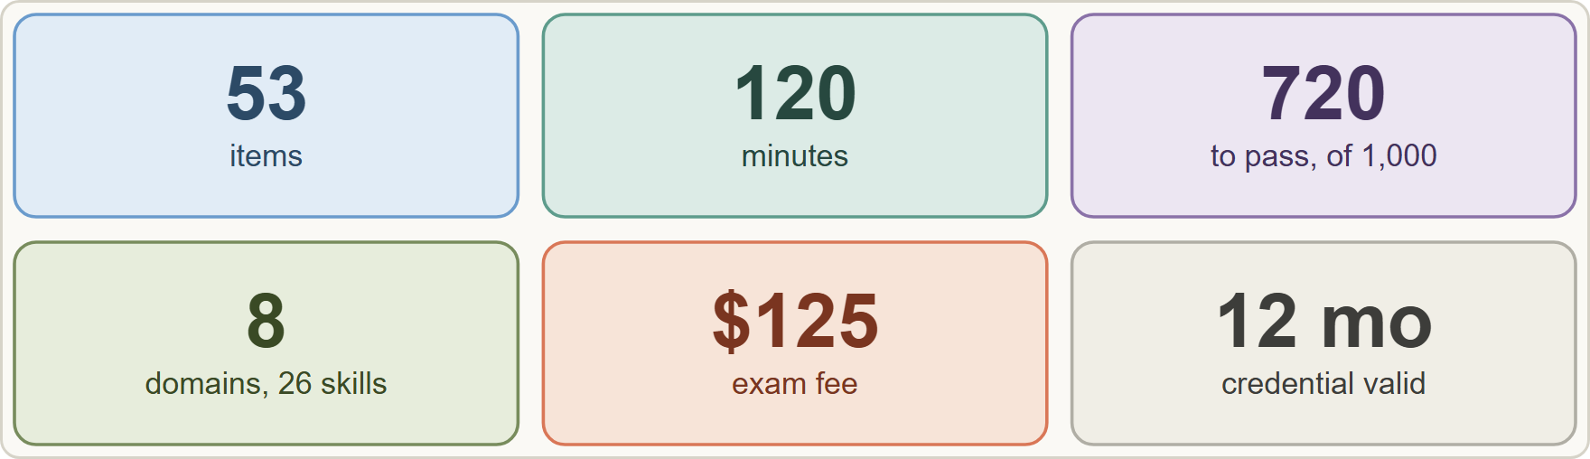
The Exam at a Glance
Module 0
The CCDV-F exam at a glance: 53 items, 120 minutes, scaled score 100 to 1,000 with 720 to pass, 8 domains, USD 125, valid 12 months
Claude Developer Foundations Exam Prep | for the CCDV-F exam
Module 0: Course Introduction and Exam Orientation
4 / 20
Notes:
The Exam at a Glance.
The figure shows this: The C C D V F exam at a glance: fifty-three items, one hundred twenty minutes, scaled score one hundred to one thousand with seven hundred twenty to pass, eight domains, U S D one hundred twenty-five, valid twelve months.

Slide 5
The Exam at a Glance, continued
DATES
Module 0
Fact | Value (guide v1.0, July 2026)
Credential / code | Claude Developer – Foundations / CCDV-F
Items | 53, multiple choice and multiple response; each item says how many answers to select
Time | 120 minutes (about 2 minutes 15 seconds per item)
Passing score | 720 on a scaled range of 100 to 1,000 (criterion-referenced: a fixed standard, not a ranking)
Fee | USD 125 per attempt
Delivery | Proctored by Pearson VUE: online or at a test center
Validity | 12 months from the date the credential is awarded
Claude Developer Foundations Exam Prep | for the CCDV-F exam
Module 0: Course Introduction and Exam Orientation
5 / 20
Notes:
The Exam at a Glance, continued.
Credential or code. Claude Developer to Foundations or C C D V F.
Items. fifty-three, multiple choice and multiple response; each item says how many answers to select.
Time. one hundred twenty minutes (about two minutes fifteen seconds per item).
Passing score. seven hundred twenty on a scaled range of one hundred to one thousand (criterion-referenced: a fixed standard, not a ranking).
Fee. U S D one hundred twenty-five per attempt.
Delivery. Proctored by Pearson V U E: online or at a test center.
Validity. twelve months from the date the credential is awarded.

Slide 6
The Exam at a Glance, continued
DATES
Module 0
Fact | Value (guide v1.0, July 2026)
Retakes | Wait 14 days after the first failed attempt, 30 after the second, 90 after the third; at most 4 attempts in a rolling 12 months; limits are per exam
Prerequisites | None are required; experience is recommended, and the credential is awarded on exam performance alone
Score report | Pass or fail, the scaled score, and the percent correct per domain (domain figures do not decide pass or fail)
Claude Developer Foundations Exam Prep | for the CCDV-F exam
Module 0: Course Introduction and Exam Orientation
6 / 20
Notes:
The Exam at a Glance, continued.
Retakes. Wait fourteen days after the first failed attempt, thirty after the second, ninety after the third; at most four attempts in a rolling twelve months; limits are per exam.
Prerequisites. None are required; experience is recommended, and the credential is awarded on exam performance alone.
Score report. Pass or fail, the scaled score, and the percent correct per domain (domain figures do not decide pass or fail).

Slide 7
The Exam at a Glance, continued
Module 0
Who can sit it [Verify live]. Exams are open to people at organizations in the Claude Partner Network who register with a company email. Others can take the free Anthropic Academy courses, which give completion certificates, not the credential. This course teaches the same knowledge to everyone.
EXAM TIP For a multiple-response item the stem says how many answers to select: read that number first, then choose exactly that many.
Claude Developer Foundations Exam Prep | for the CCDV-F exam
Module 0: Course Introduction and Exam Orientation
7 / 20
Notes:
The Exam at a Glance, continued.
Who can sit it. Exams are open to people at organizations in the Claude Partner Network who register with a company email. Others can take the free Anthropic Academy courses, which give completion certificates, not the credential. This course teaches the same knowledge to everyone.
Exam tip: For a multiple-response item the stem says how many answers to select: read that number first, then choose exactly that many.

Slide 8
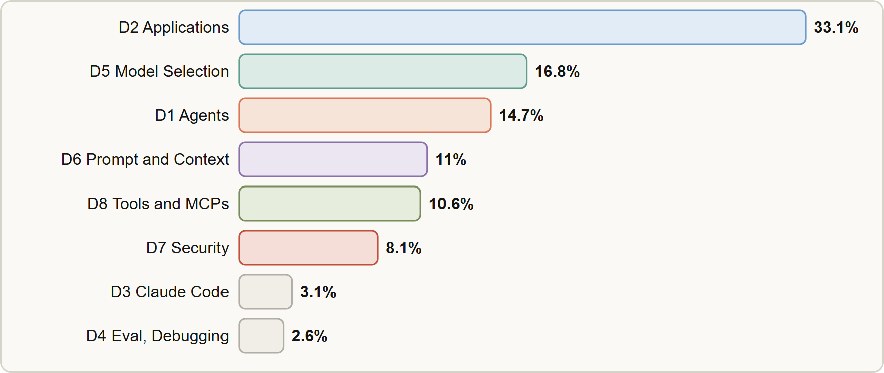
The Eight Domains
Module 0
Domain weights: D2 Applications and Integration 33.1, D5 Model Selection and Optimization 16.8, D1 Agents and Workflows 14.7, D6 Prompt and Context Engineering 11.0, D8 Tools and MCPs 10.6, D7 Security and Safety 8.1, D3 Claude Code 3.1, D4 Eval Testing and Debugging 2.6
Claude Developer Foundations Exam Prep | for the CCDV-F exam
Module 0: Course Introduction and Exam Orientation
8 / 20
Notes:
The Eight Domains.
The figure shows this: Domain weights: D two Applications and Integration thirty-three point one, D five Model Selection and Optimization sixteen point eight, D one Agents and Workflows fourteen point seven, D six Prompt and Context Engineering eleven point zero, D eight Tools and M C P s (Model Context Protocol) ten point six, D seven Security and Safety eight point one, D three Claude Code three point one, D four Eval Testing and Debugging two point six.

Slide 9
The Eight Domains, continued
Module 0
Domain | Weight | Skills (weight) | Modules
D2 Applications and Integration | 33.1% | Understanding Requirements 3.4 · Systems Life Cycle 2.8 · Claude API Mechanics 6.8 · Software Engineering Foundations 7.4 · Claude Application Design 8.6 · Configuration Management 4.1 | 1 to 4
D5 Model Selection and Optimization | 16.8% | LLM Fundamentals 5.2 · Technical Fundamentals 6.1 · Model Selection and Tradeoffs 2.7 · Cost and Token Management 2.8 | 7, 8
D1 Agents and Workflows | 14.7% | Agent Architecture 4.5 · Agent Construction with Claude 5.3 · Agent Patterns and Frameworks 4.9 | 5, 6
Claude Developer Foundations Exam Prep | for the CCDV-F exam
Module 0: Course Introduction and Exam Orientation
9 / 20
Notes:
The Eight Domains, continued.
D two Applications and Integration. Weight: thirty-three point one percent. Skills (weight): Understanding Requirements three point four, Systems Life Cycle two point eight, Claude A P I (application programming interface) Mechanics six point eight, Software Engineering Foundations seven point four, Claude Application Design eight point six, Configuration Management four point one. Modules: one to four.
D five Model Selection and Optimization. Weight: sixteen point eight percent. Skills (weight): L L M (large language model) Fundamentals five point two, Technical Fundamentals six point one, Model Selection and Tradeoffs two point seven, Cost and Token Management two point eight. Modules: seven, eight.
D one Agents and Workflows. Weight: fourteen point seven percent. Skills (weight): Agent Architecture four point five, Agent Construction with Claude five point three, Agent Patterns and Frameworks four point nine. Modules: five, six.

Slide 10
The Eight Domains, continued
Module 0
Domain | Weight | Skills (weight) | Modules
D6 Prompt and Context Engineering | 11.0% | Context Engineering 3.8 · Prompt Engineering 4.6 · Output Handling 2.6 | 9, 10
D8 Tools and MCPs | 10.6% | Tool Implementation 4.4 · MCP Server Development 2.1 · Agentic Customization 4.1 | 11, 12
D7 Security and Safety | 8.1% | AI Application Security 3.2 · Guardrails and Safe Deployment 2.3 · Claude Hooks 1.0 · Identity, Secrets and Key Management 1.6 | 13, 14
D3 Claude Code | 3.1% | Claude Code Operation 3.1 | 15
Claude Developer Foundations Exam Prep | for the CCDV-F exam
Module 0: Course Introduction and Exam Orientation
10 / 20
Notes:
The Eight Domains, continued.
D six Prompt and Context Engineering. Weight: eleven point zero percent. Skills (weight): Context Engineering three point eight, Prompt Engineering four point six, Output Handling two point six. Modules: nine, ten.
D eight Tools and M C P s. Weight: ten point six percent. Skills (weight): Tool Implementation four point four, M C P Server Development two point one, Agentic Customization four point one. Modules: eleven, twelve.
D seven Security and Safety. Weight: eight point one percent. Skills (weight): A I Application Security three point two, Guardrails and Safe Deployment two point three, Claude Hooks one point zero, Identity, Secrets and Key Management one point six. Modules: thirteen, fourteen.
D three Claude Code. Weight: three point one percent. Skills (weight): Claude Code Operation three point one. Modules: fifteen.

Slide 11
The Eight Domains, continued
Module 0
Domain | Weight | Skills (weight) | Modules
D4 Eval, Testing and Debugging | 2.6% | Debugging and Error Handling 2.6 | 16
Of 53 items, about 17 to 18 come from D2, 9 from D5, 8 from D1, 6 from D6, 6 from D8, 4 from D7, and 1 to 2 each from D3 and D4.
Weights are the approximate share of scored items. Each skill has a short description in the guide; items are written against it.
Study order by value: D2 (a third of the exam), then D5, D1, D6, D8 and D7; D3 and D4 together are under 6%.
EXAM TIP Spend study time in proportion to the weights: the Applications and Integration domain alone is worth about as much as Agents and Prompt and Context together.
Claude Developer Foundations Exam Prep | for the CCDV-F exam
Module 0: Course Introduction and Exam Orientation
11 / 20
Notes:
The Eight Domains, continued.
D four Eval, Testing and Debugging. Weight: two point six percent. Skills (weight): Debugging and Error Handling two point six. Modules: sixteen.
Of fifty-three items, about seventeen to eighteen come from D two, nine from D five, eight from D one, six from D six, six from D eight, four from D seven, and one to two each from D three and D four.
Weights are the approximate share of scored items. Each skill has a short description in the guide; items are written against it.
Study order by value: D two (a third of the exam), then D five, D one, D six, D eight and D seven; D three and D four together are under six percent.
Exam tip: Spend study time in proportion to the weights: the Applications and Integration domain alone is worth about as much as Agents and Prompt and Context together.

Slide 12
The Minimally Qualified Candidate
Module 0
The minimally qualified candidate (MQC) can:
build agents and workflows with the Claude Agent SDK and agentic frameworks
integrate Claude through the API and client SDKs, including streaming and error handling
operate Claude Code and author Skills, CLAUDE.md, settings.json and plugins
write effective prompts, apply context engineering, and validate output
design and run evals and debug failure modes
choose models, manage tokens, caching and batches
apply secure-by-design controls, including hooks, against prompt injection and destructive actions
build custom tools and MCP servers, and weigh built-in tools, custom tools, Skills and MCP
Claude Developer Foundations Exam Prep | for the CCDV-F exam
Module 0: Course Introduction and Exam Orientation
12 / 20
Notes:
The Minimally Qualified Candidate.
The minimally qualified candidate (M Q C) can.
build agents and workflows with the Claude Agent S D K (software development kit) and agentic frameworks.
integrate Claude through the A P I and client S D K s, including streaming and error handling.
operate Claude Code and author Skills, Claude dot M D, settings.json and plugins.
write effective prompts, apply context engineering, and validate output.
design and run evals and debug failure modes.
choose models, manage tokens, caching and batches.
apply secure-by-design controls, including hooks, against prompt injection and destructive actions.
build custom tools and M C P servers, and weigh built-in tools, custom tools, Skills and M C P.

Slide 13
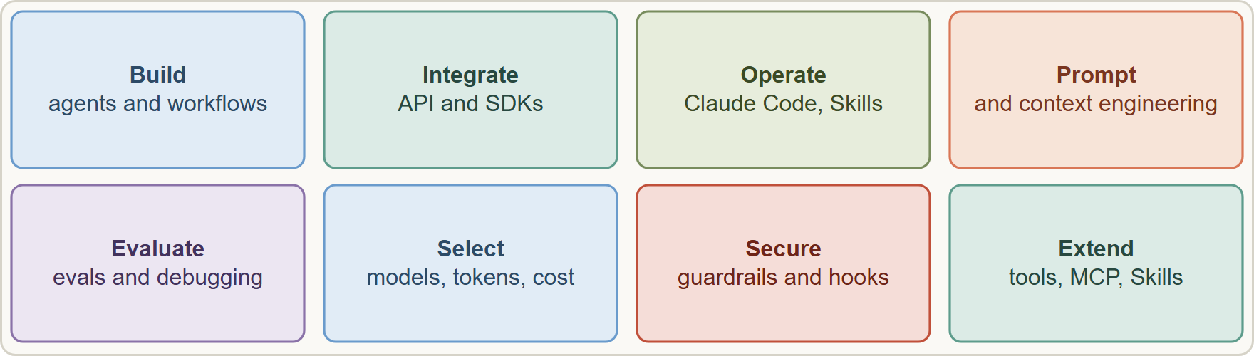
The Minimally Qualified Candidate, continued
Module 0
The minimally qualified candidate builds, integrates, operates, prompts, evaluates, selects models, secures and extends Claude applications
Claude Developer Foundations Exam Prep | for the CCDV-F exam
Module 0: Course Introduction and Exam Orientation
13 / 20
Notes:
The Minimally Qualified Candidate, continued.
The figure shows this: The minimally qualified candidate builds, integrates, operates, prompts, evaluates, selects models, secures and extends Claude applications.

Slide 14
Ten Decision Rules the Questions Reward
Module 0
Most items describe a requirement or a failure and ask for the best approach. The best answer usually follows one of these rules. Each later module shows them at work.
Claude Developer Foundations Exam Prep | for the CCDV-F exam
Module 0: Course Introduction and Exam Orientation
14 / 20
Notes:
Ten Decision Rules the Questions Reward.
Most items describe a requirement or a failure and ask for the best approach. The best answer usually follows one of these rules. Each later module shows them at work.

Slide 15
Ten Decision Rules the Questions Reward, continued
Module 0
# | Rule | Typical wrong answers
1 | Match the API to the latency need: synchronous for waiting users, batch for non-urgent bulk work | Parallel synchronous calls to save time or money
2 | Match the model to the task: the smallest model that meets the quality bar, with evals to prove it; step up when evals fail | "Always the largest model", "always the smallest"
3 | Cache stable prefixes; keep volatile text after them | Putting timestamps before the cached text
Claude Developer Foundations Exam Prep | for the CCDV-F exam
Module 0: Course Introduction and Exam Orientation
15 / 20
Notes:
Ten Decision Rules the Questions Reward, continued.
one. Rule: Match the A P I to the latency need: synchronous for waiting users, batch for non-urgent bulk work. Typical wrong answers: Parallel synchronous calls to save time or money.
two. Rule: Match the model to the task: the smallest model that meets the quality bar, with evals to prove it; step up when evals fail. Typical wrong answers: "Always the largest model", "always the smallest".
three. Rule: Cache stable prefixes; keep volatile text after them. Typical wrong answers: Putting timestamps before the cached text.

Slide 16
Ten Decision Rules the Questions Reward, continued
Module 0
# | Rule | Typical wrong answers
4 | Treat retrieved content as untrusted data, keep it apart from trusted instructions, and limit what injected text can do (least privilege, hooks) | Asking the user not to attack, changing temperature, bigger model
5 | Enforce hard rules in code (hooks, validation, permissions), not in prose | Stronger prompt wording
6 | Validate output: structured outputs and schemas, defensive parsing, skepticism toward confident text | Trusting the first answer
7 | Find where the failure lives (integration layer or model output) with traces before changing prompts | Rewriting the prompt for an HTTP error
Claude Developer Foundations Exam Prep | for the CCDV-F exam
Module 0: Course Introduction and Exam Orientation
16 / 20
Notes:
Ten Decision Rules the Questions Reward, continued.
four. Rule: Treat retrieved content as untrusted data, keep it apart from trusted instructions, and limit what injected text can do (least privilege, hooks). Typical wrong answers: Asking the user not to attack, changing temperature, bigger model.
five. Rule: Enforce hard rules in code (hooks, validation, permissions), not in prose. Typical wrong answers: Stronger prompt wording.
six. Rule: Validate output: structured outputs and schemas, defensive parsing, skepticism toward confident text. Typical wrong answers: Trusting the first answer.
seven. Rule: Find where the failure lives (integration layer or model output) with traces before changing prompts. Typical wrong answers: Rewriting the prompt for an H T T P error.

Slide 17
Ten Decision Rules the Questions Reward, continued
Module 0
# | Rule | Typical wrong answers
8 | Keep context small and relevant: prune tool output, compact, isolate in subagents | Sending the whole history forever
9 | Reuse through the right mechanism: MCP for shared external capabilities, Skills for procedures, custom tools for app-specific functions | Hard-coding logic in prompts
10 | Secrets stay out of code and prompts: secrets manager, environment variables, least-privilege keys, rotation | Keys in source or client-side code
EXAM TIP When two options both work, prefer the one that is enforced, measured, least-privileged and cost-aware.
Claude Developer Foundations Exam Prep | for the CCDV-F exam
Module 0: Course Introduction and Exam Orientation
17 / 20
Notes:
Ten Decision Rules the Questions Reward, continued.
eight. Rule: Keep context small and relevant: prune tool output, compact, isolate in subagents. Typical wrong answers: Sending the whole history forever.
nine. Rule: Reuse through the right mechanism: M C P for shared external capabilities, Skills for procedures, custom tools for app-specific functions. Typical wrong answers: Hard-coding logic in prompts.
ten. Rule: Secrets stay out of code and prompts: secrets manager, environment variables, least-privilege keys, rotation. Typical wrong answers: Keys in source or client-side code.
Exam tip: When two options both work, prefer the one that is enforced, measured, least-privileged and cost-aware.

Slide 18
How to Use This Course
Module 0
Order: read modules 1 to 16 in order (they follow the domains), then module 17 (recap) and 18 (technique).
Each module has the skills it covers, a case, tables, figures, Exam tips, scenario questions with explanations and a Quick Reference Card.
Build something. The guide recommends building and operating at least one Claude application that uses the API, one or more tools, basic prompt and context engineering, and simple security and evaluation practice.
Claude Developer Foundations Exam Prep | for the CCDV-F exam
Module 0: Course Introduction and Exam Orientation
18 / 20
Notes:
How to Use This Course.
Order: read modules one to sixteen in order (they follow the domains), then module seventeen (recap) and eighteen (technique).
Each module has the skills it covers, a case, tables, figures, Exam tips, scenario questions with explanations and a Quick Reference Card.
Build something. The guide recommends building and operating at least one Claude application that uses the A P I, one or more tools, basic prompt and context engineering, and simple security and evaluation practice.

Slide 19
How to Use This Course, continued
Module 0
Product details change fast. Boxes marked show current behavior (for example model IDs, thinking modes, cache rules). On the exam, answer as the guide teaches and check the official documentation for current details.
Independence. This course is independent study material; it is not affiliated with, endorsed by or sponsored by Anthropic or Pearson VUE. Read the official exam guide, the Certification Terms and Conditions and the Exam Policy before you register.
Claude Developer Foundations Exam Prep | for the CCDV-F exam
Module 0: Course Introduction and Exam Orientation
19 / 20
Notes:
How to Use This Course, continued.
Product details change fast. Boxes marked show current behavior (for example model I Ds, thinking modes, cache rules). On the exam, answer as the guide teaches and check the official documentation for current details.
Independence. This course is independent study material; it is not affiliated with, endorsed by or sponsored by Anthropic or Pearson V U E. Read the official exam guide, the Certification Terms and Conditions and the Exam Policy before you register.

Slide 20
Module Recap
Module 0
1
Exam
2
Domains
3
Skills
CCDV-F; 53 items; 120 min; pass 720 of 1,000; USD 125; valid 12 months
D2 33.1 · D5 16.8 · D1 14.7 · D6 11.0 · D8 10.6 · D7 8.1 · D3 3.1 · D4 2.6
26 in all
4
Prerequisites
5
Retakes
6
Ten rules
None required; experience recommended
14, 30, 90 days; max 4 per rolling 12 months
Match API to latency · match model to task · cache stable prefixes · untrusted content stays untrusted · enforce in code · validate output · locate the failure · keep context lean · reuse through the right mechanism · secrets out of code
Claude Developer Foundations Exam Prep | for the CCDV-F exam
Module 0: Course Introduction and Exam Orientation
20 / 20
Notes:
Here is the recap.
Exam: C C D V F; fifty-three items; one hundred twenty min; pass seven hundred twenty of one thousand; U S D one hundred twenty-five; valid twelve months.
Domains: D two thirty-three point one, D five sixteen point eight, D one fourteen point seven, D six eleven point zero, D eight ten point six, D seven eight point one, D three three point one, D four two point six.
Skills: twenty-six in all.
Prerequisites: None required; experience recommended.
Retakes: fourteen, thirty, ninety days; max four per rolling twelve months.
Ten rules: Match A P I to latency, match model to task, cache stable prefixes, untrusted content stays untrusted, enforce in code, validate output, locate the failure, keep context lean, reuse through the right mechanism, secrets out of code.
In the next module, we continue the course.

