Slide 1
Module 1: Requirements, Life Cycle and Software Engineering Foundations
Turning business requirements into functional, non-functional and infrastructure requirements for a Claude application
Domain 2 · Applications and Integration · Skills: Understanding Requirements, Systems Life Cycle, Software Engineering Foundations
Claude Developer Foundations Exam Prep Masterclass
Module 1 · Part 1
Notes:
Welcome to Module one: Requirements, Life Cycle and Software Engineering Foundations. This module covers the skills understanding requirements, systems life cycle, software engineering foundations.
Each part of this module comes from the study notes of the same name, so you can read the notes after you watch.

Slide 2
What You Will Learn
Part 1
Turning business requirements into functional, non-functional and infrastructure requirements for a Claude application
The systems life cycle for an LLM application, including evals, versioning and retirement
Software engineering foundations: REST APIs and JSON, asynchronous programming, version control, SDLC integration, code review, refactoring
Claude Developer Foundations Exam Prep | for the CCDV-F exam
Module 1
2 / 28
Notes:
By the end of this module you will be able to do three things.
Turning business requirements into functional, non-functional and infrastructure requirements for a Claude application.
The systems life cycle for an L L M (large language model) application, including evals, versioning and retirement.
Software engineering foundations: R E S T A P I s (application programming interface) and Jason (Java Script Object Notation), asynchronous programming, version control, S D L C integration, code review, refactoring.

Slide 3
Case Check-In: Tidewater Insurance Wants a Claims Assistant
Part 1
CASE CHECK-IN · Tidewater Insurance
Business goal: "Cut the time adjusters spend reading claim files"
Constraints: files hold personal data, adjusters wait for answers, and the budget is limited
Your job: turn that sentence into requirements a team can build and test
Claude Developer Foundations Exam Prep | for the CCDV-F exam
Module 1
3 / 28
Notes:
Our running case is Tidewater Insurance. Tidewater Insurance Wants a Claims Assistant.
Business goal: "Cut the time adjusters spend reading claim files".
Constraints: files hold personal data, adjusters wait for answers, and the budget is limited.
Your job: turn that sentence into requirements a team can build and test.

Slide 4
Understanding Requirements
Part 1
Kind | Question it answers | Claims assistant example
Functional | What must the system do? | Summarize a claim file, answer questions about a policy, cite the source page
Non-functional | How well, how fast, how safely, at what cost? | First answer in under 5 seconds, cost per claim under a limit, answers grounded in the file, PII protected
Infrastructure | Where and on what does it run? | Which API platform (first-party or a cloud provider), region and data residency, rate limits and capacity, secrets storage, logging
Requirements start from the business requirement and the solution architecture. Split them into three kinds:
Claude Developer Foundations Exam Prep | for the CCDV-F exam
Module 1
4 / 28
Notes:
Understanding Requirements.
Requirements start from the business requirement and the solution architecture. Split them into three kinds.
Functional. Question it answers: What must the system do? Claims assistant example: Summarize a claim file, answer questions about a policy, cite the source page.
Non-functional. Question it answers: How well, how fast, how safely, at what cost? Claims assistant example: First answer in under five seconds, cost per claim under a limit, answers grounded in the file, P I I protected.
Infrastructure. Question it answers: Where and on what does it run? Claims assistant example: Which A P I platform (first-party or a cloud provider), region and data residency, rate limits and capacity, secrets storage, logging.

Slide 5
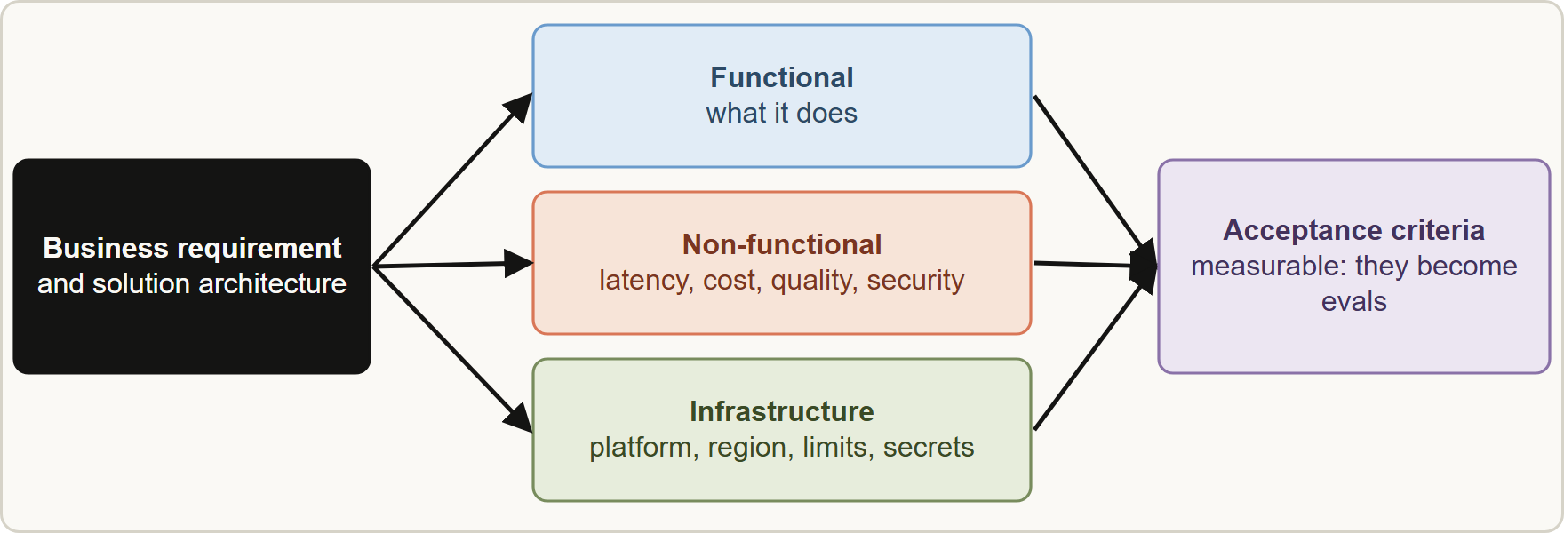
Understanding Requirements, continued
Part 1
Every requirement needs a measurable acceptance criterion (a number or a pass/fail check). Those criteria become your evals (Module 16).
The classic LLM trade-off is quality, latency and cost: you rarely maximize all three, so rank them from the requirement. Waiting users drive latency; overnight work drives cost.
Every requirement needs a measurable acceptance criterion (a number or a pass/fail check). Those criteria become your evals (Module 16).
The classic LLM trade-off is quality, latency and cost: you rarely maximize all three, so rank them from the requirement. Waiting users drive latency; overnight work drives cost.
Claude Developer Foundations Exam Prep | for the CCDV-F exam
Module 1
5 / 28
Notes:
Understanding Requirements, continued.
The figure shows this: From business requirement to functional, non-functional and infrastructure requirements, then to acceptance criteria that become evals.
Every requirement needs a measurable acceptance criterion (a number or a pass or fail check). Those criteria become your evals (Module sixteen).
The classic L L M trade-off is quality, latency and cost: you rarely maximize all three, so rank them from the requirement. Waiting users drive latency; overnight work drives cost.

Slide 6
Understanding Requirements, continued
Part 1
Requirements also decide the API choice (real-time or batch), the model tier and whether tools or retrieval are needed.
EXAM TIP In a requirement-driven question, underline the binding constraint (latency, cost, compliance, data residency) and choose the option that satisfies that constraint first.
Claude Developer Foundations Exam Prep | for the CCDV-F exam
Module 1
6 / 28
Notes:
Understanding Requirements, continued.
Requirements also decide the A P I choice (real-time or batch), the model tier and whether tools or retrieval are needed.
Exam tip: In a requirement-driven question, underline the binding constraint (latency, cost, compliance, data residency) and choose the option that satisfies that constraint first.
Exam tip: A requirement without a measurable acceptance criterion cannot become an eval, so it is not yet a requirement.

Slide 7
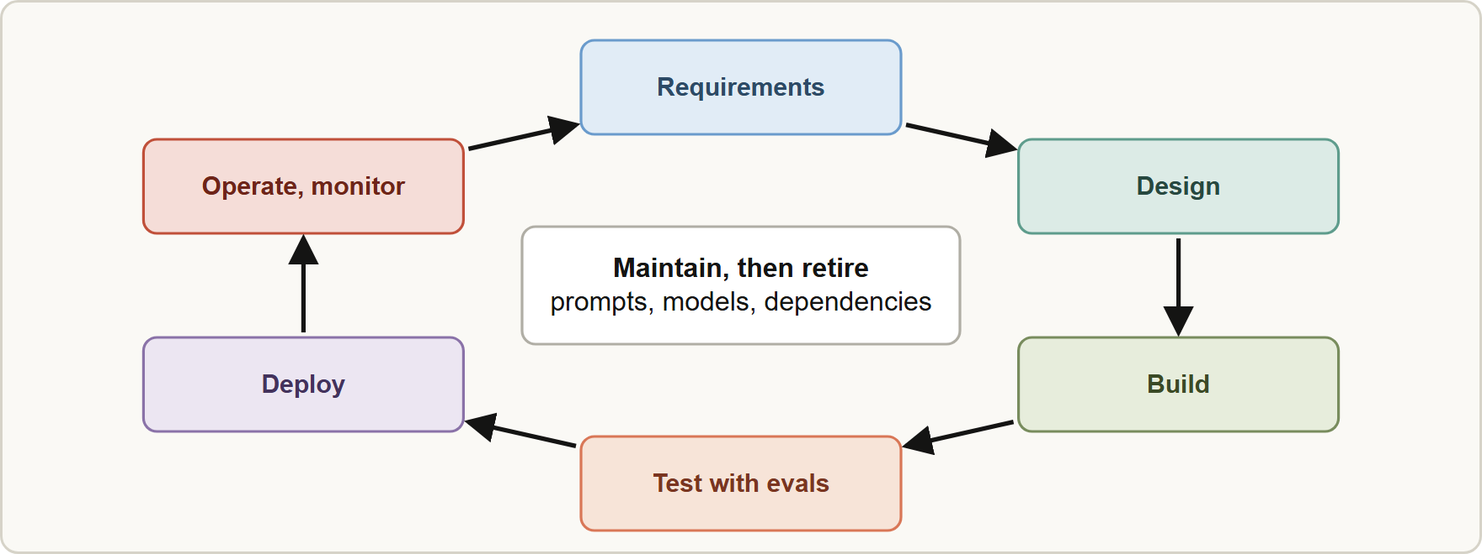
Systems Life Cycle
Part 1
The life cycle of a Claude application: requirements, design, build, test with evals, deploy, operate and monitor, maintain, retire, then back to requirements
Claude Developer Foundations Exam Prep | for the CCDV-F exam
Module 1
7 / 28
Notes:
Systems Life Cycle.
The figure shows this: The life cycle of a Claude application: requirements, design, build, test with evals, deploy, operate and monitor, maintain, retire, then back to requirements.

Slide 8
Systems Life Cycle, continued
Part 1
Phase | What changes for an LLM application
Requirements and design | Pick API, model, tools; write acceptance criteria
Build | Prompts, tools, schemas and configuration live in version control
Test | Evals with graded examples run on every change; unit tests for tool code
Deploy | Pin the model version; roll out gradually; feature-flag prompt changes
Operate | Monitor quality, latency, cost, error rates; log request IDs and traces
Maintain | Update prompts, dependencies and models; re-run evals; handle model retirement
Retire | Migrate before the model's retirement date; archive data
Prompts are code: version them, review them, test them, and roll them back.
Claude Developer Foundations Exam Prep | for the CCDV-F exam
Module 1
8 / 28
Notes:
Systems Life Cycle, continued.
Requirements and design. Pick A P I, model, tools; write acceptance criteria.
Build. Prompts, tools, schemas and configuration live in version control.
Test. Evals with graded examples run on every change; unit tests for tool code.
Deploy. Pin the model version; roll out gradually; feature-flag prompt changes.
Operate. Monitor quality, latency, cost, error rates; log request I Ds and traces.
Maintain. Update prompts, dependencies and models; re-run evals; handle model retirement.
Retire. Migrate before the model's retirement date; archive data.
Prompts are code: version them, review them, test them, and roll them back.

Slide 9
Systems Life Cycle, continued
Part 1
A model change is a release: re-run the evals before and after, because behavior can change between model versions (Module 8).
Claude Developer Foundations Exam Prep | for the CCDV-F exam
Module 1
9 / 28
Notes:
Systems Life Cycle, continued.
A model change is a release: re-run the evals before and after, because behavior can change between model versions (Module eight).

Slide 10
REST APIs and JSON
Part 1
The Claude API is a REST API over HTTPS with JSON request and response bodies. You send a POST with headers (API key, version) and a JSON body; the client SDKs wrap this.
Know the status code classes: 4xx means the request is wrong or not allowed (do not retry unchanged), 5xx or an overloaded response means a transient server condition (retry with backoff), 429 means a rate limit (honor retry-after).
Claude Developer Foundations Exam Prep | for the CCDV-F exam
Module 1
10 / 28
Notes:
R E S T A P I s and Jason.
The Claude A P I is a R E S T A P I over H T T P S with Jason request and response bodies. You send a P O S T with headers (A P I key, version) and a Jason body; the client S D K s (software development kit) wrap this.
Know the status code classes: four X X means the request is wrong or not allowed (do not retry unchanged), five X X or an overloaded response means a transient server condition (retry with backoff), four hundred twenty-nine means a rate limit (honor retry-after).

Slide 11
REST APIs and JSON, continued
Part 1
Idempotency: a retry must not repeat a side effect. A model call is safe to repeat; a tool that charges a card is not, so give tool actions an idempotency key.
Claude Developer Foundations Exam Prep | for the CCDV-F exam
Module 1
11 / 28
Notes:
R E S T A P I s and Jason, continued.
Idempotency: a retry must not repeat a side effect. A model call is safe to repeat; a tool that charges a card is not, so give tool actions an idempotency key.

Slide 12
Asynchronous programming
Part 1
Calls to Claude are slow (seconds), so use async I/O (async/await, an async client) to run many requests concurrently instead of one after another.
Bound the concurrency with a semaphore or a worker pool: too many parallel calls cause 429 errors (Module 3). Add exponential backoff with jitter for retries.
Streaming (server-sent events) shows text as it arrives and helps perceived latency; the code consumes events as an async stream.
Claude Developer Foundations Exam Prep | for the CCDV-F exam
Module 1
12 / 28
Notes:
Asynchronous programming.
Calls to Claude are slow (seconds), so use async I O (async or await, an async client) to run many requests concurrently instead of one after another.
Bound the concurrency with a semaphore or a worker pool: too many parallel calls cause four hundred twenty-nine errors (Module three). Add exponential backoff with jitter for retries.
Streaming (server-sent events) shows text as it arrives and helps perceived latency; the code consumes events as an async stream.

Slide 13
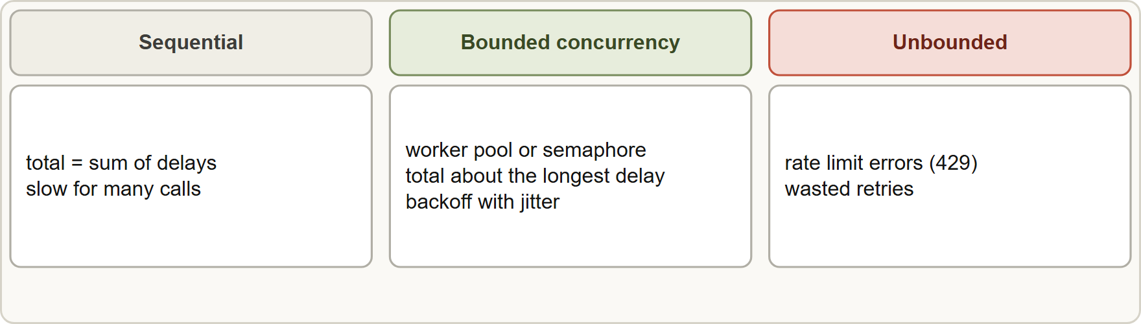
Asynchronous programming, continued
Part 1
Sequential calls add up; bounded concurrency overlaps them; unbounded concurrency hits rate limits
Claude Developer Foundations Exam Prep | for the CCDV-F exam
Module 1
13 / 28
Notes:
Asynchronous programming, continued.
The figure shows this: Sequential calls add up; bounded concurrency overlaps them; unbounded concurrency hits rate limits.

Slide 14
Version control, SDLC integration, code review, refactoring
Part 1
Practice | For Claude applications
Version control | Commit prompts, schemas, tool definitions and CLAUDE.md; never commit API keys; use branches and pull requests
SDLC integration | Run evals and tests in CI/CD; use Claude Code in pipelines (-p) for review and test generation
Code review | Review prompt and tool changes like code; use an independent Claude instance, not the one that wrote the change, for AI-assisted review
Small refactors | Direct edits with tests running; one change at a time
Claude Developer Foundations Exam Prep | for the CCDV-F exam
Module 1
14 / 28
Notes:
Version control, S D L C integration, code review, refactoring.
Version control. Commit prompts, schemas, tool definitions and Claude dot M D; never commit A P I keys; use branches and pull requests.
S D L C integration. Run evals and tests in C I C D (continuous integration and continuous delivery); use Claude Code in pipelines (dash p) for review and test generation.
Code review. Review prompt and tool changes like code; use an independent Claude instance, not the one that wrote the change, for A I-assisted review.
Small refactors. Direct edits with tests running; one change at a time.

Slide 15
Version control, SDLC integration, code review, refactoring, continued
Part 1
Practice | For Claude applications
Large refactors | Plan first (explore, then plan), write or keep tests, change in small verified steps, review diffs; use plan mode in Claude Code
EXAM TIP A refactor touching many files is made safe by tests first and small, verified steps, with a plan before edits.
Claude Developer Foundations Exam Prep | for the CCDV-F exam
Module 1
15 / 28
Notes:
Version control, S D L C integration, code review, refactoring, continued.
Large refactors. Plan first (explore, then plan), write or keep tests, change in small verified steps, review diffs; use plan mode in Claude Code.
Exam tip: A refactor touching many files is made safe by tests first and small, verified steps, with a plan before edits.

Slide 16
Module Recap
Part 2
1
Requirements
2
Acceptance criteria
3
Trade-off
Functional (what), non-functional (how well: latency, cost, quality, security), infrastructure (where: platform, region, limits, secrets)
Quality, latency, cost; the binding constraint decides
Measurable; they become evals
4
Life cycle
5
Prompts
6
REST/JSON
Requirements → design → build → test (evals) → deploy → operate → maintain → retire
Code: version, review, test, roll back; pin model versions
4xx do not retry unchanged; 5xx or overload retry with backoff; 429 honor retry-after
7
Async
8
Version control
9
Refactoring
Bounded concurrency, backoff with jitter, streaming for perceived latency
Commit prompts and config, never keys; PRs
Plan, tests first, small verified steps; independent review
Claude Developer Foundations Exam Prep | for the CCDV-F exam
Module 1
16 / 28
Notes:
Here is the recap.
Requirements: Functional (what), non-functional (how well: latency, cost, quality, security), infrastructure (where: platform, region, limits, secrets).
Acceptance criteria: Measurable; they become evals.
Trade-off: Quality, latency, cost; the binding constraint decides.
Life cycle: Requirements to design to build to test (evals) to deploy to operate to maintain to retire.
Prompts: Code: version, review, test, roll back; pin model versions.
R E S T or Jason: four X X do not retry unchanged; five X X or overload retry with backoff; four hundred twenty-nine honor retry-after.
Async: Bounded concurrency, backoff with jitter, streaming for perceived latency.
Version control: Commit prompts and config, never keys; P R s (pull request).
Refactoring: Plan, tests first, small verified steps; independent review.

Slide 17
Practice Question 1
Part 2
Q1
Tidewater's business goal is "faster answers for adjusters". Which statement is a measurable non-functional requirement?
A
The first token of an answer must appear within five seconds for 95 percent of requests
B
The assistant has a nice interface
C
The assistant should be helpful, friendly and pleasant to every person who uses it
D
The assistant uses Claude
Claude Developer Foundations Exam Prep | for the CCDV-F exam
Module 1
17 / 28
Notes:
Question one.
Tidewater's business goal is "faster answers for adjusters". Which statement is a measurable non-functional requirement?
The four options are on the screen.
[PAUSE 12]
The answer is A. A non-functional requirement states a measurable quality such as latency with a threshold; the others are vague or are design choices.

Slide 18
Practice Question 2
Part 2
Q2
A requirement says claim files must be processed only in a specific geographic region. Which kind of requirement is this, and what does it influence?
A
Functional; it changes the prompt
B
None; the API decides the region
C
Non-functional only; it has no technical effect on the system
D
Infrastructure; it influences the platform and region choice
Claude Developer Foundations Exam Prep | for the CCDV-F exam
Module 1
18 / 28
Notes:
Question two.
A requirement says claim files must be processed only in a specific geographic region. Which kind of requirement is this, and what does it influence?
The four options are on the screen.
[PAUSE 12]
The answer is D. Data residency is an infrastructure requirement that constrains where requests run.

Slide 19
Practice Question 3
Part 2
Q3
A team ranks its constraints: cost first, answers needed by the next morning, quality must be good. What does this point to?
A
Asynchronous (batch) processing with a model sized to the quality bar
B
Streaming with a high output limit
C
Parallel synchronous calls without limits
D
A real-time API with the largest model for every single claim, to be safe
Claude Developer Foundations Exam Prep | for the CCDV-F exam
Module 1
19 / 28
Notes:
Question three.
A team ranks its constraints: cost first, answers needed by the next morning, quality must be good. What does this point to?
The four options are on the screen.
[PAUSE 12]
The answer is A. Cost-first, latency-tolerant work fits batch processing; model size follows the quality bar proven by evals.

Slide 20
Practice Question 4
Part 2
Q4
Which life-cycle practice makes a prompt change safe to release?
A
Ask a colleague whether the new wording looks fine to them
B
Version the prompt, run the evals, and keep a rollback
C
Wait for users to report problems
D
Edit the prompt directly in production, then watch the feedback
Claude Developer Foundations Exam Prep | for the CCDV-F exam
Module 1
20 / 28
Notes:
Question four.
Which life-cycle practice makes a prompt change safe to release?
The four options are on the screen.
[PAUSE 12]
The answer is B. Prompts are code: version them and test them with evals before and after the change.

Slide 21
Practice Question 5
Part 2
Q5
A provider announces that the model your application uses will retire in six months. What should the team do?
A
Remove the model setting so the platform picks one automatically for us
B
Ignore it until the day of retirement
C
Plan a migration: test a newer model with the evals, adjust prompts, and release before the retirement date
D
Switch to the oldest available model, since it will never be retired
Claude Developer Foundations Exam Prep | for the CCDV-F exam
Module 1
21 / 28
Notes:
Question five.
A provider announces that the model your application uses will retire in six months. What should the team do?
The four options are on the screen.
[PAUSE 12]
The answer is C. A model change is a release; test it with evals and migrate before the date.

Slide 22
Practice Question 6
Part 2
Q6
An application sends 500 independent requests one after another and takes too long. What is the most effective improvement?
A
Use async I/O with bounded concurrency and backoff on rate limits
B
Use a longer timeout
C
Run all 500 requests at once without any limit on concurrency, retries or backoff
D
Remove the system prompt
Claude Developer Foundations Exam Prep | for the CCDV-F exam
Module 1
22 / 28
Notes:
Question six.
An application sends five hundred independent requests one after another and takes too long. What is the most effective improvement?
The four options are on the screen.
[PAUSE 12]
The answer is A. Concurrency overlaps the waiting time; bounding it and backing off avoids rate-limit errors.

Slide 23
Practice Question 7
Part 2
Q7
A tool that issues a refund fails with a network timeout, and the application retries it. What protects the customer?
A
A larger max_tokens
B
Nothing; retries are always safe because the model call is repeatable
C
An idempotency key so a repeat does not issue a second refund
D
Retrying faster
Claude Developer Foundations Exam Prep | for the CCDV-F exam
Module 1
23 / 28
Notes:
Question seven.
A tool that issues a refund fails with a network timeout, and the application retries it. What protects the customer?
The four options are on the screen.
[PAUSE 12]
The answer is C. Idempotency prevents a repeated side effect when a call is retried.

Slide 24
Practice Question 8
Part 2
Q8
A developer commits ANTHROPIC_API_KEY in a configuration file. What is the right action?
A
Encode it in base64
B
Rotate the key, remove it from history, and load it from a secrets manager
C
Shorten the key
D
Leave it as it is, because the repository is private and only the team can read the file
Claude Developer Foundations Exam Prep | for the CCDV-F exam
Module 1
24 / 28
Notes:
Question eight.
A developer commits A N T H R O P I C A P I K E Y in a configuration file. What is the right action?
The four options are on the screen.
[PAUSE 12]
The answer is B. A committed secret is compromised: rotate it and keep keys out of version control.

Slide 25
Practice Question 9
Part 2
Q9
A change touches 60 files across a service. Which approach is safest with Claude Code?
A
Edit all files in parallel without tests
B
Explore and plan first, keep tests passing, and apply the change in small verified steps with review
C
Ask for the whole change in one big step, then merge it without review or tests
D
Rewrite the service from scratch
Claude Developer Foundations Exam Prep | for the CCDV-F exam
Module 1
25 / 28
Notes:
Question nine.
A change touches sixty files across a service. Which approach is safest with Claude Code?
The four options are on the screen.
[PAUSE 12]
The answer is B. Large refactors need a plan, tests and small steps.

Slide 26
Practice Question 10
Part 2
Q10
Which TWO belong in a requirements list for the claims assistant? (Select TWO.)
A
A promise that the model never makes mistakes
B
A functional requirement: summarize a claim file and cite the source page
C
An infrastructure requirement: records must stay in one region and keys in a secrets manager
D
A mood for the logo
E
The font of the user interface
Claude Developer Foundations Exam Prep | for the CCDV-F exam
Module 1
26 / 28
Notes:
Question ten. Select two.
Which two belong in a requirements list for the claims assistant?
The five options are on the screen.
[PAUSE 15]
The answers are B and C. Functional and infrastructure requirements are concrete and testable; the other items are cosmetic or unachievable.

Slide 27
Practice Question 11
Part 2
Q11
Which TWO practices keep AI-assisted code review reliable? (Select TWO.)
A
Running tests and evals in CI alongside the review
B
Skipping review when the diff is small
C
Asking the generating session to approve its own change
D
Disabling the tests to speed things up
E
Reviewing with an independent instance that did not write the change
Claude Developer Foundations Exam Prep | for the CCDV-F exam
Module 1
27 / 28
Notes:
Question eleven. Select two.
Which two practices keep A I-assisted code review reliable?
The five options are on the screen.
[PAUSE 15]
The answers are A and E. An independent reviewer and automated tests catch what self-review misses.

Slide 28
Answers at a Glance
Part 2
Question | Answer | Why
Q1 | A | A non-functional requirement states a measurable quality such
Q2 | D | Data residency is an infrastructure requirement that constrains
Q3 | A | Cost-first, latency-tolerant work fits batch processing
Q4 | B | Prompts are code: version them and test them
Q5 | C | A model change is a release
Q6 | A | Concurrency overlaps the waiting time
Q7 | C | Idempotency prevents a repeated side effect when a
Q8 | B | A committed secret is compromised: rotate it and
Q9 | B | Large refactors need a plan
Q10 | B, C | Functional and infrastructure requirements are concrete and testable
Q11 | A, E | An independent reviewer and automated tests catch what
Claude Developer Foundations Exam Prep | for the CCDV-F exam
Module 1
28 / 28
Notes:
Here are all eleven answers. Question one: A. Question two: D. Question three: A. Question four: B. Question five: C. Question six: A. Question seven: C. Question eight: B. Question nine: B. Question ten: B and C. Question eleven: A and E.
In the next module, we continue the course.

