Slide 1
Module 2: The Messages API: Requests, Streaming and Multi-Format Input
The anatomy of a Messages API request and response
Domain 2 · Applications and Integration · Skills: Claude API Mechanics, part 1: messages, streaming, vision, Messages API data access patterns
Claude Developer Foundations Exam Prep Masterclass
Module 2
Notes:
Welcome to Module two: The Messages A P I: Requests, Streaming and Multi-Format Input. This module covers the skills claude a p i mechanics, part one: messages, streaming, vision, messages a p i data access patterns.
Each part of this module comes from the study notes of the same name, so you can read the notes after you watch.

Slide 2
What You Will Learn
Module 2
The anatomy of a Messages API request and response
Why the API is stateless and how multi-turn conversations work
Streaming: the event sequence and how to assemble the result
Multi-format input: images, PDFs and the Files API, with their limits
The usage fields and the stop_reason values
Claude Developer Foundations Exam Prep | for the CCDV-F exam
Module 2
2 / 27
Notes:
By the end of this module you will be able to do five things.
The anatomy of a Messages A P I (application programming interface) request and response.
Why the A P I is stateless and how multi-turn conversations work.
Streaming: the event sequence and how to assemble the result.
Multi-format input: images, P D F s and the Files A P I, with their limits.
The usage fields and the stop reason values.

Slide 3
Case Check-In: Tidewater's First Call
Module 2
CASE CHECK-IN · Tidewater Insurance
An adjuster asks: "Summarize claim 4471 and list any missing documents."
The developer sends the policy text and the claim notes to Claude and wants the answer in two seconds
The same adjuster then asks a follow-up question
Claude Developer Foundations Exam Prep | for the CCDV-F exam
Module 2
3 / 27
Notes:
Our running case is Tidewater Insurance. Tidewater's First Call.
An adjuster asks: "Summarize claim four thousand four hundred seventy-one and list any missing documents.".
The developer sends the policy text and the claim notes to Claude and wants the answer in two seconds.
The same adjuster then asks a follow-up question.

Slide 4
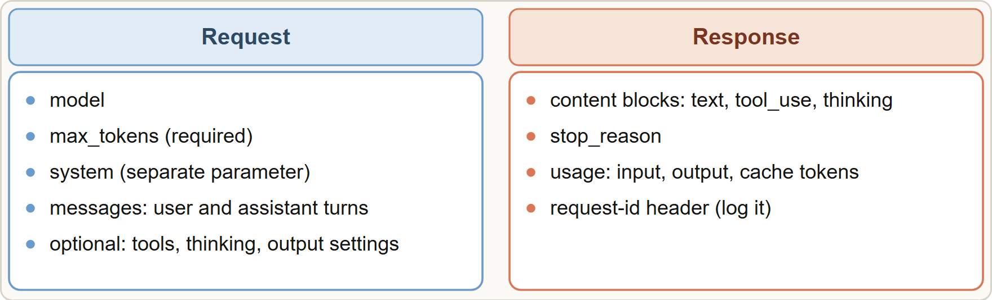
A Request and Its Response
Module 2
Messages API anatomy: the request carries model, max_tokens, system and messages; the response carries content blocks, stop_reason and usage
Claude Developer Foundations Exam Prep | for the CCDV-F exam
Module 2
4 / 27
Notes:
A Request and Its Response.
The figure shows this: Messages A P I anatomy: the request carries model, max tokens, system and messages; the response carries content blocks, stop reason and usage.

Slide 5
A Request and Its Response, continued
Module 2
Part | What to know
`model` | The model ID (a pinned snapshot on current models)
`max_tokens` | Required; a cap on the output length. If reached, the reply is cut off and stop_reason is max_tokens
`system` | A separate parameter for instructions and context; it is not a message role
`messages` | A list of user and assistant turns; content can be text or blocks (text, image, document, tool_use, tool_result)
Response `content` | A list of blocks: text, tool_use, thinking and others
`stop_reason` | end_turn, max_tokens, stop_sequence, tool_use, pause_turn, refusal
Claude Developer Foundations Exam Prep | for the CCDV-F exam
Module 2
5 / 27
Notes:
A Request and Its Response, continued.
model. The model I D (a pinned snapshot on current models).
max tokens. Required; a cap on the output length. If reached, the reply is cut off and stop reason is max tokens.
system. A separate parameter for instructions and context; it is not a message role.
messages. A list of user and assistant turns; content can be text or blocks (text, image, document, tool use, tool result).
Response content. A list of blocks: text, tool use, thinking and others.
stop reason. end turn, max tokens, stop sequence, tool use, pause turn, refusal.

Slide 6
A Request and Its Response, continued
Module 2
Part | What to know
`usage` | input_tokens, output_tokens, and the cache fields (Module 3); use it for cost tracking
Claude Developer Foundations Exam Prep | for the CCDV-F exam
Module 2
6 / 27
Notes:
A Request and Its Response, continued.
usage. input tokens, output tokens, and the cache fields (Module three); use it for cost tracking.

Slide 7
A Request and Its Response, continued
Module 2
PYTHON
response = client.messages.create(
model="claude-sonnet-5-5",
max_tokens=1024,
system="You summarize insurance claim files. Cite the source page.",
messages=[{"role": "user", "content": claim_text + "\n\nSummarize and list missing documents."}],
)
print(response.content[0].text, response.usage.output_tokens)
Example from the study note (names are examples)
Claude Developer Foundations Exam Prep | for the CCDV-F exam
Module 2
7 / 27
Notes:
A Request and Its Response, continued.
The example is on the screen; read it line by line when you study.

Slide 8
Stateless, so you resend the conversation
Module 2
The API remembers nothing between requests. For a follow-up question, send the whole conversation so far (earlier user and assistant turns) plus the new question.
The context window is everything the model can see in one request, including its own reply. It grows with every turn, so long conversations need management (Module 9).
Log the `request-id` response header of every call: it is the key for support and for tracing (Module 16).
EXAM TIP "The model forgot what the user said earlier" in an API application means the history was not sent again, not that the model is faulty.
Claude Developer Foundations Exam Prep | for the CCDV-F exam
Module 2
8 / 27
Notes:
Stateless, so you resend the conversation.
The A P I remembers nothing between requests. For a follow-up question, send the whole conversation so far (earlier user and assistant turns) plus the new question.
The context window is everything the model can see in one request, including its own reply. It grows with every turn, so long conversations need management (Module nine).
Log the request-id response header of every call: it is the key for support and for tracing (Module sixteen).
Exam tip: "The model forgot what the user said earlier" in an A P I application means the history was not sent again, not that the model is faulty.
Exam tip: The A P I is stateless: a follow-up that "forgot" earlier turns means the history was not resent.

Slide 9
Streaming
Module 2
With stream: true, the response arrives as server-sent events (SSE) so the user sees text while the model is still writing. It improves perceived latency; total time is about the same.
Claude Developer Foundations Exam Prep | for the CCDV-F exam
Module 2
9 / 27
Notes:
Streaming.
With stream: true, the response arrives as server-sent events (S S E) so the user sees text while the model is still writing. It improves perceived latency; total time is about the same.

Slide 10
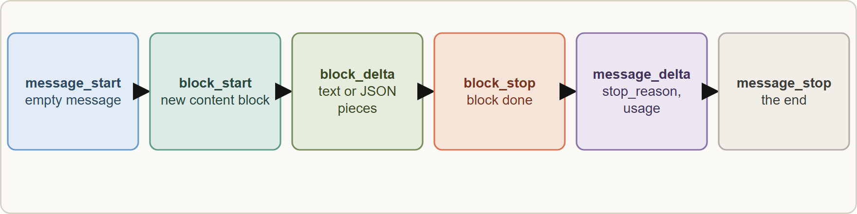
Streaming, continued
Module 2
The streaming event order: message_start, content blocks with deltas, message_delta, message_stop; pings and errors can appear in between
Claude Developer Foundations Exam Prep | for the CCDV-F exam
Module 2
10 / 27
Notes:
Streaming, continued.
The figure shows this: The streaming event order: message start, content blocks with deltas, message delta, message stop; pings and errors can appear in between.

Slide 11
Streaming, continued
Module 2
Event | Meaning
message_start | A message object with empty content
content_block_start / content_block_delta / content_block_stop | One content block: text arrives as `text_delta`, tool input as `input_json_delta` (partial JSON), thinking as `thinking_delta`
message_delta | Top-level changes: `stop_reason` and cumulative usage
message_stop | The end
ping | Keep-alive; ignore
error | The API can send an error mid-stream, for example overloaded_error
Assemble text by appending deltas. For a tool call, collect the partial JSON and parse it when the block stops, not before.
Handle an error event by retrying or reporting, keeping the partial output only if it is useful. A stream that ends without message_stop is incomplete.
Claude Developer Foundations Exam Prep | for the CCDV-F exam
Module 2
11 / 27
Notes:
Streaming, continued.
message start. A message object with empty content.
content block start or content block delta or content block stop. One content block: text arrives as text delta, tool input as input json delta (partial Jason (Java Script Object Notation)), thinking as thinking delta.
message delta. Top-level changes: stop reason and cumulative usage.
message stop. The end.
ping. Keep-alive; ignore.
error. The A P I can send an error mid-stream, for example overloaded error.
Assemble text by appending deltas. For a tool call, collect the partial Jason and parse it when the block stops, not before.
Handle an error event by retrying or reporting, keeping the partial output only if it is useful. A stream that ends without message stop is incomplete.

Slide 12
Streaming, continued
Module 2
Use streaming for chat and long outputs; for background jobs a normal call or a batch is simpler.
Claude Developer Foundations Exam Prep | for the CCDV-F exam
Module 2
12 / 27
Notes:
Streaming, continued.
Use streaming for chat and long outputs; for background jobs a normal call or a batch is simpler.

Slide 13
Multi-Format Input: Images and PDFs
Module 2
Input | How to provide it | Limits and notes
Image | Base64 in the request, a URL, or a `file_id` from the Files API (upload once, reference many times) | Up to 8000 by 8000 pixels per image; many images per request (up to 600) but the request size limit (128 MB on the first-party API) can be reached first; large images are resized and cost visual tokens; on Amazon Bedrock and Google-managed Vertex only base64 is available
Claude Developer Foundations Exam Prep | for the CCDV-F exam
Module 2
13 / 27
Notes:
Multi-Format Input: Images and P D F s.
Image. How to provide it: Base sixty-four in the request, a U R L (uniform resource locator), or a file id from the Files A P I (upload once, reference many times). Limits and notes: Up to eight thousand by eight thousand pixels per image; many images per request (up to six hundred) but the request size limit (one hundred twenty-eight megabytes on the first-party A P I) can be reached first; large images are resized and cost visual tokens; on Amazon Bedrock and Google-managed Vertex only base sixty-four is available.

Slide 14
Multi-Format Input: Images and PDFs, continued
Module 2
Input | How to provide it | Limits and notes
PDF | A document block (base64, URL or file) | Each page is converted to an image plus extracted text; up to 600 pages per request (100 when the context window is under 1M); dense PDFs can fill the context first
Text | Text blocks | Put long documents before the question; wrap them with clear tags
Claude Developer Foundations Exam Prep | for the CCDV-F exam
Module 2
14 / 27
Notes:
Multi-Format Input: Images and P D F s, continued.
P D F. How to provide it: A document block (base sixty-four, U R L or file). Limits and notes: Each page is converted to an image plus extracted text; up to six hundred pages per request (one hundred when the context window is under one million); dense P D F s can fill the context first.
Text. How to provide it: Text blocks. Limits and notes: Put long documents before the question; wrap them with clear tags.

Slide 15
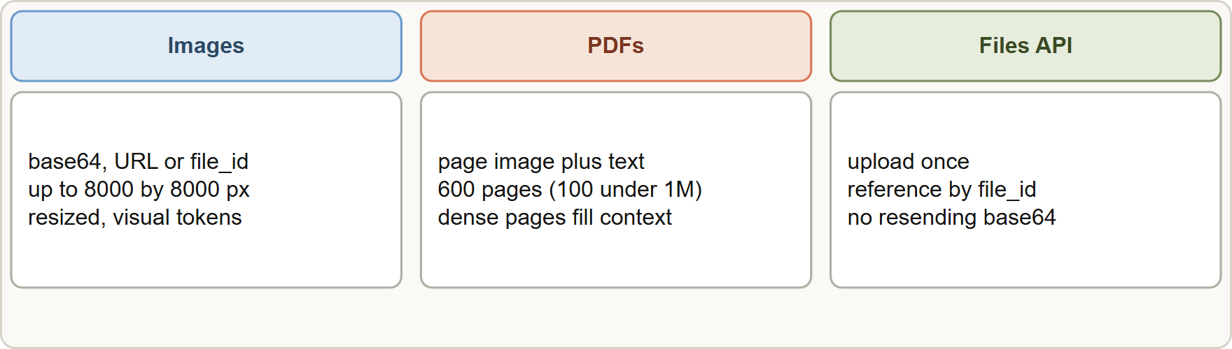
Multi-Format Input: Images and PDFs, continued
Module 2
Token cost of images and PDFs counts toward the context window and the bill; check with the token counting endpoint before sending large files.
Large or repeated files: use the Files API instead of resending base64 on every turn.
Token cost of images and PDFs counts toward the context window and the bill; check with the token counting endpoint before sending large files.
Large or repeated files: use the Files API instead of resending base64 on every turn.
Claude Developer Foundations Exam Prep | for the CCDV-F exam
Module 2
15 / 27
Notes:
Multi-Format Input: Images and P D F s, continued.
The figure shows this: Multi-format input: images and P D F s are content blocks in the user message; the Files A P I lets you upload once and reference many times.
Token cost of images and P D F s counts toward the context window and the bill; check with the token counting endpoint before sending large files.
Large or repeated files: use the Files A P I instead of resending base sixty-four on every turn.

Slide 16
Multi-Format Input: Images and PDFs, continued
DATES
Module 2
Quality tips: place images before the text instruction, make each image legible (resolution), and label multiple images.
Current documentation: 600 images or 600 PDF pages per request, 128 MB request limit, 8000 pixel maximum edge, file_id through the Files API. These limits and the supported formats change; check the vision and PDF pages. As of 8 November 2026.
EXAM TIP Large files and many images: check token cost and limits, and use the Files API to upload once and reference many times.
Claude Developer Foundations Exam Prep | for the CCDV-F exam
Module 2
16 / 27
Notes:
Multi-Format Input: Images and P D F s, continued.
Quality tips: place images before the text instruction, make each image legible (resolution), and label multiple images.
Current documentation: six hundred images or six hundred P D F pages per request, one hundred twenty-eight megabytes request limit, eight thousand pixel maximum edge, file id through the Files A P I. These limits and the supported formats change; check the vision and P D F pages. As of eight November two thousand twenty-six.
Exam tip: Large files and many images: check token cost and limits, and use the Files A P I to upload once and reference many times.

Slide 17
Module Recap
Module 2
1
Request
2
Response
3
Stateless
model, `max_tokens` (required), system (separate), messages (user and assistant), optional tools, thinking, output settings
content blocks, `stop_reason`, `usage`
Resend the history every request; log request-id
4
stop_reason
5
Streaming
6
Images
end_turn, max_tokens, stop_sequence, tool_use, pause_turn, refusal
SSE: message_start, block start/delta/stop, message_delta (cumulative usage), message_stop, ping, error
base64, URL or file_id; ≤ 8000×8000 px; resized; visual tokens; Bedrock base64 only
7
PDF
8
Files API
Page image + text; ≤ 600 pages (100 under a 1M window)
Upload once, reference many times
Claude Developer Foundations Exam Prep | for the CCDV-F exam
Module 2
17 / 27
Notes:
Here is the recap.
Request: model, max tokens (required), system (separate), messages (user and assistant), optional tools, thinking, output settings.
Response: content blocks, stop reason, usage.
Stateless: Resend the history every request; log request-id.
stop reason: end turn, max tokens, stop sequence, tool use, pause turn, refusal.
Streaming: S S E: message start, block start or delta or stop, message delta (cumulative usage), message stop, ping, error.
Images: base sixty-four, U R L or file id; at most eight thousand times eight thousand px; resized; visual tokens; Bedrock base sixty-four only.
P D F: Page image plus text; at most six hundred pages (one hundred under a one million window).
Files A P I: Upload once, reference many times.

Slide 18
Practice Question 1
Module 2
Q1
A chat application sends only the newest user message each turn, and Claude cannot answer follow-ups that refer to earlier turns. What is the cause and the fix?
A
The system parameter is empty; fill it
B
The model has no memory; resend the full history with each request
C
The temperature is too low; raise it
D
The model is too small to keep earlier turns; switch to a larger one
Claude Developer Foundations Exam Prep | for the CCDV-F exam
Module 2
18 / 27
Notes:
Question one.
A chat application sends only the newest user message each turn, and Claude cannot answer follow-ups that refer to earlier turns. What is the cause and the fix?
The four options are on the screen.
[PAUSE 12]
The answer is B. The A P I is stateless, so every request must carry the earlier turns.

Slide 19
Practice Question 2
Module 2
Q2
Which parameter is required in every Messages API request, besides the model and messages?
A
stop_sequences
B
system
C
temperature
D
max_tokens
Claude Developer Foundations Exam Prep | for the CCDV-F exam
Module 2
19 / 27
Notes:
Question two.
Which parameter is required in every Messages A P I request, besides the model and messages?
The four options are on the screen.
[PAUSE 12]
The answer is D. max tokens is required in every request because it caps the output length; the others are optional parameters.

Slide 20
Practice Question 3
Module 2
Q3
A response ends mid-sentence with stop_reason: "max_tokens". What happened?
A
The output hit the max_tokens limit; raise it or continue the turn
B
The model refused the request because the content broke a usage policy
C
The model finished normally
D
The network dropped
Claude Developer Foundations Exam Prep | for the CCDV-F exam
Module 2
20 / 27
Notes:
Question three.
A response ends mid-sentence with stop reason: "max tokens". What happened?
The four options are on the screen.
[PAUSE 12]
The answer is A. max tokens means the output limit was reached and the answer is incomplete.

Slide 21
Practice Question 4
Module 2
Q4
Where does the system prompt go in a Messages API request?
A
In the separate top-level system parameter
B
In a header
C
As the first message with role system
D
Inside the last user message only
Claude Developer Foundations Exam Prep | for the CCDV-F exam
Module 2
21 / 27
Notes:
Question four.
Where does the system prompt go in a Messages A P I request?
The four options are on the screen.
[PAUSE 12]
The answer is A. The system prompt is its own parameter; message roles are user and assistant.

Slide 22
Practice Question 5
Module 2
Q5
An assistant must show text as soon as it is generated. What should the developer enable?
A
Streaming with stream: true and text_delta events
B
Prompt caching of the stable instructions, so replies start sooner
C
A higher max_tokens
D
Batch processing
Claude Developer Foundations Exam Prep | for the CCDV-F exam
Module 2
22 / 27
Notes:
Question five.
An assistant must show text as soon as it is generated. What should the developer enable?
The four options are on the screen.
[PAUSE 12]
The answer is A. Streaming returns server-sent events so text can be shown incrementally.

Slide 23
Practice Question 6
Module 2
Q6
While streaming a tool call, the application tries to parse the tool input after the first input_json_delta and fails. What should it do?
A
Ignore tool calls in streams until the final message is complete
B
Switch the request to batch
C
Parse each fragment as complete JSON as soon as it arrives from the stream
D
Accumulate the partial JSON fragments and parse after the content block stops
Claude Developer Foundations Exam Prep | for the CCDV-F exam
Module 2
23 / 27
Notes:
Question six.
While streaming a tool call, the application tries to parse the tool input after the first input json delta and fails. What should it do?
The four options are on the screen.
[PAUSE 12]
The answer is D. Tool input arrives as partial Jason that is complete only at the end of the block.

Slide 24
Practice Question 7
Module 2
Q7
A request sends a 450-page PDF and fails or is truncated although it is under the page limit. What is a likely cause and remedy?
A
PDFs are not supported
B
The system parameter is too long for a request with a PDF attached
C
Dense pages used up the context first; split the document
D
The PDF must be converted to text by hand before it can be sent
Claude Developer Foundations Exam Prep | for the CCDV-F exam
Module 2
24 / 27
Notes:
Question seven.
A request sends a four hundred fifty-page P D F and fails or is truncated although it is under the page limit. What is a likely cause and remedy?
The four options are on the screen.
[PAUSE 12]
The answer is C. Each page costs text and image tokens, so dense P D F s can exhaust the context before the page limit.

Slide 25
Practice Question 8
Module 2
Q8
The same 20 MB image is needed in every turn of a long conversation. Which approach reduces overhead?
A
Paste its description into the system prompt only
B
Shrink it to 16 by 16 pixels
C
Upload it once with the Files API and reference it by file_id
D
Re-encode it as base64 and send it again in every single request that needs it
Claude Developer Foundations Exam Prep | for the CCDV-F exam
Module 2
25 / 27
Notes:
Question eight.
The same twenty megabytes image is needed in every turn of a long conversation. Which approach reduces overhead?
The four options are on the screen.
[PAUSE 12]
The answer is C. The Files A P I lets you upload once and reference many times.

Slide 26
Practice Question 9
Module 2
Q9
Which TWO statements about the Messages API are correct? (Select TWO.)
A
The conversation history must be sent again with each request
B
The system prompt is a message with role system
C
Streaming makes the total generation time much shorter
D
usage reports input and output tokens for cost tracking
E
The server stores the conversation between requests
Claude Developer Foundations Exam Prep | for the CCDV-F exam
Module 2
26 / 27
Notes:
Question nine. Select two.
Which two statements about the Messages A P I are correct?
The five options are on the screen.
[PAUSE 15]
The answers are A and D. The A P I is stateless and returns usage; streaming improves perceived latency, not total time.

Slide 27
Answers at a Glance
Module 2
Question | Answer | Why
Q1 | B | The API is stateless
Q2 | D | max_tokens is required in every request because it caps
Q3 | A | max_tokens means the output limit was reached and the
Q4 | A | The system prompt is its own parameter
Q5 | A | Streaming returns server-sent events so text can be shown
Q6 | D | Tool input arrives as partial JSON that is complete
Q7 | C | Each page costs text and image tokens
Q8 | C | The Files API lets you upload once and reference
Q9 | A, D | The API is stateless and returns usage
Claude Developer Foundations Exam Prep | for the CCDV-F exam
Module 2
27 / 27
Notes:
Here are all nine answers. Question one: B. Question two: D. Question three: A. Question four: A. Question five: A. Question six: D. Question seven: C. Question eight: C. Question nine: A and D.
In the next module, we continue the course.

