Slide 1
Module 3: Thinking, Caching, Batch, Platforms and API Errors
Thinking: adaptive and extended thinking, effort, fast mode, and what they cost
Domain 2 · Applications and Integration · Skills: Claude API Mechanics, part 2: thinking, caching, invoking Claude through third-party vendors, batch API use, realtime versus batch tradeoffs
Claude Developer Foundations Exam Prep Masterclass
Module 3 · Part 1
Notes:
Welcome to Module three: Thinking, Caching, Batch, Platforms and A P I Errors. This module covers the skills claude a p i mechanics, part two: thinking, caching, invoking claude through third-party vendors, batch a p i use, realtime versus batch tradeoffs.
Each part of this module comes from the study notes of the same name, so you can read the notes after you watch.

Slide 2
What You Will Learn
Part 1
Thinking
Prompt caching
Batch versus realtime
adaptive and extended thinking, effort, fast mode, and what they cost
what is cached, TTLs, minimums, prices and how to check a hit
when each fits, and how batches work
Third-party platforms
API errors and retries
Amazon Bedrock, Google Cloud, Microsoft Foundry
the status codes, rate limits, backoff and request IDs
Claude Developer Foundations Exam Prep | for the CCDV-F exam
Module 3
2 / 34
Notes:
By the end of this module you will be able to do five things.
Thinking: adaptive and extended thinking, effort, fast mode, and what they cost.
Prompt caching: what is cached, T T L s, minimums, prices and how to check a hit.
Batch versus realtime: when each fits, and how batches work.
Third-party platforms: Amazon Bedrock, Google Cloud, Microsoft Foundry.
A P I (application programming interface) errors and retries: the status codes, rate limits, backoff and request I Ds.

Slide 3
Case Check-In: Tidewater's Costly Answers
Part 1
CASE CHECK-IN · Tidewater Insurance
The claims assistant answers hard coverage questions well, but the monthly bill is high and some answers are slow
Most requests are simple lookups; a few need real reasoning
The team wants to spend reasoning only where it pays
Claude Developer Foundations Exam Prep | for the CCDV-F exam
Module 3
3 / 34
Notes:
Our running case is Tidewater Insurance. Tidewater's Costly Answers.
The claims assistant answers hard coverage questions well, but the monthly bill is high and some answers are slow.
Most requests are simple lookups; a few need real reasoning.
The team wants to spend reasoning only where it pays.

Slide 4
Thinking, Effort and Fast Mode
Part 1
Control | What it does | Notes
Adaptive thinking | The model decides how much to think, steered by effort | The mode on current models; no thinking field needed
Extended thinking | A fixed reasoning budget (budget_tokens) | Older manual mode; rejected with a 400 error on current models, so use adaptive thinking
Effort (output_config.effort) | low, medium, high, xhigh, max: how thorough and how many tokens | A behavioral signal, not a hard budget; lower effort = faster and cheaper for routine work
Claude Developer Foundations Exam Prep | for the CCDV-F exam
Module 3
4 / 34
Notes:
Thinking, Effort and Fast Mode.
Adaptive thinking. What it does: The model decides how much to think, steered by effort. Notes: The mode on current models; no thinking field needed.
Extended thinking. What it does: A fixed reasoning budget (budget tokens). Notes: Older manual mode; rejected with a four hundred error on current models, so use adaptive thinking.
Effort (output config.effort). What it does: low, medium, high, xhigh, max: how thorough and how many tokens. Notes: A behavioral signal, not a hard budget; lower effort equals faster and cheaper for routine work.

Slide 5
Thinking, Effort and Fast Mode, continued
Part 1
Control | What it does | Notes
Fast mode (speed: "fast") | Faster output (up to about 2.5 times) at premium pricing | For latency-critical work on supported models
Claude Developer Foundations Exam Prep | for the CCDV-F exam
Module 3
5 / 34
Notes:
Thinking, Effort and Fast Mode, continued.
Fast mode (speed: "fast"). What it does: Faster output (up to about two point five times) at premium pricing. Notes: For latency-critical work on supported models.

Slide 6
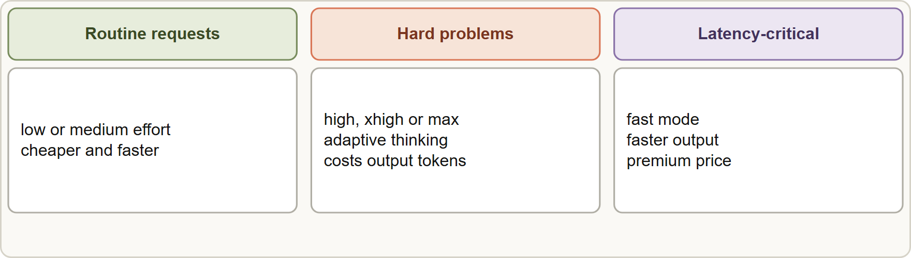
Thinking, Effort and Fast Mode, continued
Part 1
Thinking tokens are billed as output tokens and count toward max_tokens, even if the text is not shown. Thinking blocks carry a signature and the text is a summary, not the raw reasoning.
Thinking tokens are billed as output tokens and count toward max_tokens, even if the text is not shown. Thinking blocks carry a signature and the text is a summary, not the raw reasoning.
Claude Developer Foundations Exam Prep | for the CCDV-F exam
Module 3
6 / 34
Notes:
Thinking, Effort and Fast Mode, continued.
The figure shows this: Choosing reasoning: lower effort for routine work, higher effort for hard problems; thinking is billed as output and counts toward max tokens; fast mode buys speed at a premium.
Thinking tokens are billed as output tokens and count toward max tokens, even if the text is not shown. Thinking blocks carry a signature and the text is a summary, not the raw reasoning.

Slide 7
Thinking, Effort and Fast Mode, continued
Part 1
Higher effort raises quality, latency and cost; step down when evals show quality holds, step up when they do not (Module 8).
EXAM TIP "Reduce cost and latency on simple requests" → lower effort (or a smaller model); "reasoning quality too low on hard cases" → higher effort or a stronger model, checked with evals.
Claude Developer Foundations Exam Prep | for the CCDV-F exam
Module 3
7 / 34
Notes:
Thinking, Effort and Fast Mode, continued.
Higher effort raises quality, latency and cost; step down when evals show quality holds, step up when they do not (Module eight).
Exam tip: "Reduce cost and latency on simple requests" to lower effort (or a smaller model); "reasoning quality too low on hard cases" to higher effort or a stronger model, checked with evals.

Slide 8
Prompt Caching
Part 1
Caching lets the API reuse the processed prefix of a prompt across requests, which cuts cost and latency for repeated content such as a long system prompt, policy text or tool definitions.
Claude Developer Foundations Exam Prep | for the CCDV-F exam
Module 3
8 / 34
Notes:
Prompt Caching.
Caching lets the A P I reuse the processed prefix of a prompt across requests, which cuts cost and latency for repeated content such as a long system prompt, policy text or tool definitions.

Slide 9
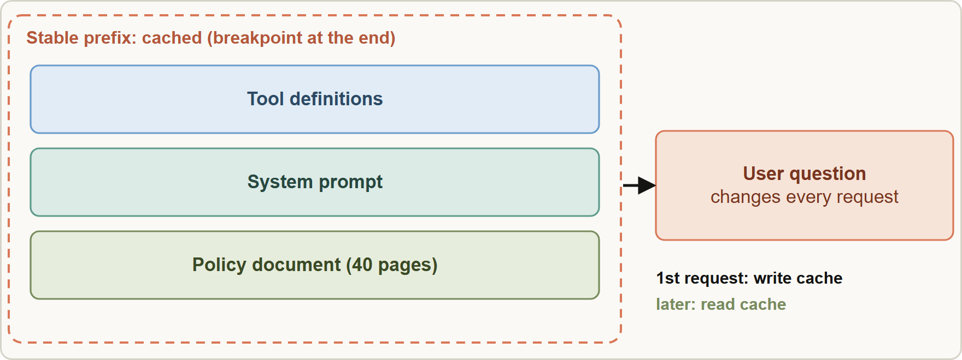
Prompt Caching, continued
Part 1
Caching: put stable content first and mark a breakpoint; later requests with the same prefix read from the cache
Claude Developer Foundations Exam Prep | for the CCDV-F exam
Module 3
9 / 34
Notes:
Prompt Caching, continued.
The figure shows this: Caching: put stable content first and mark a breakpoint; later requests with the same prefix read from the cache.

Slide 10
Prompt Caching, continued
Part 1
Fact | Detail
How | Automatic caching (one top-level cache_control; the breakpoint moves forward) or explicit breakpoints on content blocks (up to 4)
What is cached | The full prefix, in order: tools, then system, then messages. A change earlier in the prefix invalidates what follows
Lifetime | 5 minutes by default (refreshed on each hit); 1 hour optionally at a higher write price
Price | Cache write about 1.25x the base input price (5 minutes) or 2x (1 hour); cache read about 0.1x (even less on some models)
Claude Developer Foundations Exam Prep | for the CCDV-F exam
Module 3
10 / 34
Notes:
Prompt Caching, continued.
How. Automatic caching (one top-level cache control; the breakpoint moves forward) or explicit breakpoints on content blocks (up to four).
What is cached. The full prefix, in order: tools, then system, then messages. A change earlier in the prefix invalidates what follows.
Lifetime. five minutes by default (refreshed on each hit); one hour optionally at a higher write price.
Price. Cache write about one point two five times the base input price (five minutes) or two times (one hour); cache read about zero point one times (even less on some models).

Slide 11
Prompt Caching, continued
Part 1
Fact | Detail
Minimum size | A minimum prompt length applies (for example 512 tokens on current models); shorter prompts are not cached, with no error
Check it | The response usage shows `cache_creation_input_tokens` and `cache_read_input_tokens`
Design rule: stable text first, volatile text last. A timestamp or user name at the top of the prompt breaks the cache on every call.
Caching pays off when the same prefix is reused several times within the lifetime; a one-off prompt only pays the write cost.
Claude Developer Foundations Exam Prep | for the CCDV-F exam
Module 3
11 / 34
Notes:
Prompt Caching, continued.
Minimum size. A minimum prompt length applies (for example five hundred twelve tokens on current models); shorter prompts are not cached, with no error.
Check it. The response usage shows cache creation input tokens and cache read input tokens.
Design rule: stable text first, volatile text last. A timestamp or user name at the top of the prompt breaks the cache on every call.
Caching pays off when the same prefix is reused several times within the lifetime; a one-off prompt only pays the write cost.

Slide 12
Prompt Caching, continued
DATES
Part 1
Cached input tokens are not counted against the input tokens per minute rate limit the way uncached ones are.
Current documentation: minimums, multipliers (read 0.1x, 0.05x on Opus 5.5 and Sonnet 5.5, 0.025x on Fable 5.1) and TTL options. As of 8 November 2026.
Claude Developer Foundations Exam Prep | for the CCDV-F exam
Module 3
12 / 34
Notes:
Prompt Caching, continued.
Cached input tokens are not counted against the input tokens per minute rate limit the way uncached ones are.
Current documentation: minimums, multipliers (read zero point one times, zero point zero five times on Opus five point five and Sonnet five point five, zero point zero two five times on Fable five point one) and T T L options. As of eight November two thousand twenty-six.

Slide 13
Realtime Versus Batch
Part 1
 | Realtime (Messages API) | Message Batches API
Response | Immediate (seconds) | Asynchronous: most finish within about an hour, up to 24 hours, no latency guarantee
Price | Standard | 50% lower
Use for | Chat, interactive tools, blocking steps | Non-urgent bulk work: overnight reports, evaluations, bulk classification
Mechanics | One call, one answer | Create the batch, poll its status, read results by `custom_id` (a batch holds up to 100,000 requests or 256 MB; results stay available about 29 days)
Limits | Tool loops possible in your code | Each request is one model call: no tool round trip inside a request
Claude Developer Foundations Exam Prep | for the CCDV-F exam
Module 3
13 / 34
Notes:
Realtime Versus Batch.
Response. Realtime (Messages A P I): Immediate (seconds). Message Batches A P I: Asynchronous: most finish within about an hour, up to twenty-four hours, no latency guarantee.
Price. Realtime (Messages A P I): Standard. Message Batches A P I: fifty percent lower.
Use for. Realtime (Messages A P I): Chat, interactive tools, blocking steps. Message Batches A P I: Non-urgent bulk work: overnight reports, evaluations, bulk classification.
Mechanics. Realtime (Messages A P I): One call, one answer. Message Batches A P I: Create the batch, poll its status, read results by custom id (a batch holds up to one hundred thousand requests or two hundred fifty-six megabytes; results stay available about twenty-nine days).
Limits. Realtime (Messages A P I): Tool loops possible in your code. Message Batches A P I: Each request is one model call: no tool round trip inside a request.

Slide 14
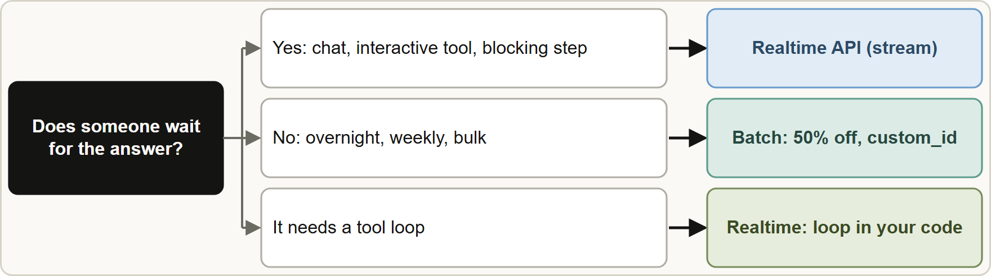
Realtime Versus Batch, continued
Part 1
Realtime when someone waits; batch when the work can wait and cost matters
EXAM TIP Tens of thousands of archived records, results not needed for days, cost is the concern → Message Batches API. Parallel realtime calls do not lower the per-token price, and a smaller model chosen only for price ignores quality.
Claude Developer Foundations Exam Prep | for the CCDV-F exam
Module 3
14 / 34
Notes:
Realtime Versus Batch, continued.
The figure shows this: Realtime when someone waits; batch when the work can wait and cost matters.
Exam tip: Tens of thousands of archived records, results not needed for days, cost is the concern to Message Batches A P I. Parallel realtime calls do not lower the per-token price, and a smaller model chosen only for price ignores quality.

Slide 15
Third-Party Platforms
Part 1
Claude is also available through Amazon Bedrock, Google Cloud (Claude models on Google Cloud), Microsoft Foundry and Claude Platform on AWS. Why use them: your existing cloud contract, billing, identity (IAM) and data-residency controls.
Claude Developer Foundations Exam Prep | for the CCDV-F exam
Module 3
15 / 34
Notes:
Third-Party Platforms.
Claude is also available through Amazon Bedrock, Google Cloud (Claude models on Google Cloud), Microsoft Foundry and Claude Platform on A W S. Why use them: your existing cloud contract, billing, identity (I A M) and data-residency controls.

Slide 16
Third-Party Platforms, continued
Part 1
Topic | What to know
Model IDs | Differ by platform (for example anthropic.claude-opus-5-5 on Bedrock; the Claude API ID on Google Cloud and Foundry)
Auth | The cloud provider's identity (IAM roles, service accounts), not an Anthropic API key
SDKs | The client SDKs have platform-specific clients with the same request shape
Features | Availability can lag or differ (for example images as base64 only on Bedrock); check the platform page
Lifecycle | Partner platforms set their own retirement dates
Claude Developer Foundations Exam Prep | for the CCDV-F exam
Module 3
16 / 34
Notes:
Third-Party Platforms, continued.
Model I Ds. Differ by platform (for example anthropic.claude-opus-five to five on Bedrock; the Claude A P I I D on Google Cloud and Foundry).
Auth. The cloud provider's identity (I A M roles, service accounts), not an Anthropic A P I key.
S D K s (software development kit). The client S D K s have platform-specific clients with the same request shape.
Features. Availability can lag or differ (for example images as base sixty-four only on Bedrock); check the platform page.
Lifecycle. Partner platforms set their own retirement dates.

Slide 17
Third-Party Platforms, continued
Part 1
Choose a platform from the requirements (Module 1): existing cloud commitment, residency, IAM integration. Use the first-party API when you need the newest features first.
Claude Developer Foundations Exam Prep | for the CCDV-F exam
Module 3
17 / 34
Notes:
Third-Party Platforms, continued.
Choose a platform from the requirements (Module one): existing cloud commitment, residency, I A M integration. Use the first-party A P I when you need the newest features first.

Slide 18
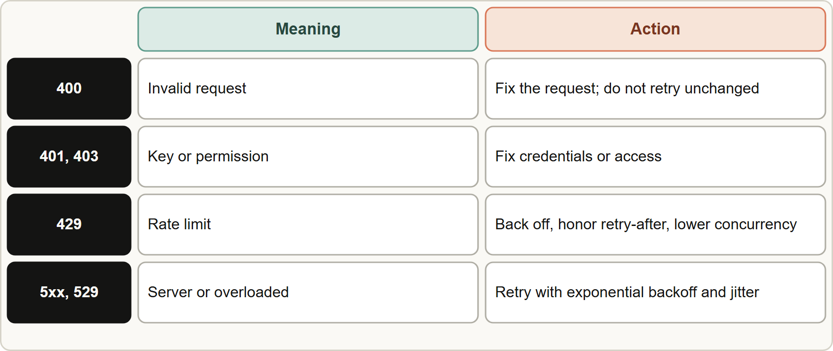
API Errors and Retries
Part 1
Fix the request for 4xx errors; retry with backoff for 429, 5xx and overloaded; honor retry-after
Claude Developer Foundations Exam Prep | for the CCDV-F exam
Module 3
18 / 34
Notes:
A P I Errors and Retries.
The figure shows this: Fix the request for four X X errors; retry with backoff for four hundred twenty-nine, five X X and overloaded; honor retry-after.

Slide 19
API Errors and Retries, continued
Part 1
Status | Meaning | Action
400 invalid request | Malformed request (bad parameter, unsupported combination) | Fix the request; do not retry unchanged
401 / 403 | Bad key / no permission | Fix credentials or access
404 / 413 | Not found / request too large | Fix the path or reduce the request
429 rate limit | Too many requests or tokens | Back off, honor `retry-after`, reduce concurrency
500 / 504 / overloaded | Server-side or transient | Retry with exponential backoff
Claude Developer Foundations Exam Prep | for the CCDV-F exam
Module 3
19 / 34
Notes:
A P I Errors and Retries, continued.
four hundred invalid request. Meaning: Malformed request (bad parameter, unsupported combination). Action: Fix the request; do not retry unchanged.
four hundred one or four hundred three. Meaning: Bad key or no permission. Action: Fix credentials or access.
four hundred four or four hundred thirteen. Meaning: Not found or request too large. Action: Fix the path or reduce the request.
four hundred twenty-nine rate limit. Meaning: Too many requests or tokens. Action: Back off, honor retry-after, reduce concurrency.
five hundred or five hundred four or overloaded. Meaning: Server-side or transient. Action: Retry with exponential backoff.

Slide 20
API Errors and Retries, continued
Part 2
Rate limits are measured in requests per minute, input tokens per minute and output tokens per minute, with a token-bucket that refills continuously; sharp increases in traffic can trigger acceleration limits, so ramp up gradually.
The official SDKs retry transient errors twice by default with exponential backoff; tune the retry count and timeouts.
Always log the `request-id`; an error can also arrive inside a stream (Module 2).
EXAM TIP 4xx: fix the request. 429: back off and honor retry-after. 5xx or overloaded: retry with exponential backoff.
Claude Developer Foundations Exam Prep | for the CCDV-F exam
Module 3
20 / 34
Notes:
A P I Errors and Retries, continued.
Rate limits are measured in requests per minute, input tokens per minute and output tokens per minute, with a token-bucket that refills continuously; sharp increases in traffic can trigger acceleration limits, so ramp up gradually.
The official S D K s retry transient errors twice by default with exponential backoff; tune the retry count and timeouts.
Always log the request-id; an error can also arrive inside a stream (Module two).
Exam tip: four X X: fix the request. four hundred twenty-nine: back off and honor retry-after. five X X or overloaded: retry with exponential backoff.

Slide 21
Module Recap
Part 2
1
Thinking
2
Effort
3
Fast mode
Adaptive by default; manual budget_tokens mode rejected on current models
low · medium · high · xhigh · max; lower = cheaper and faster
speed: "fast": faster output at premium price
4
Caching
5
Batch
6
Realtime vs batch
Stable prefix first; 5 min (or 1 h); write ~1.25x, read ~0.1x; minimum size
50% cheaper; up to 24 h; custom_id; poll; no mid-request tool loop
Someone waits → realtime; can wait and cost matters → batch
7
Platforms
8
Errors
Bedrock, Google Cloud, Foundry, Claude Platform on AWS: cloud IAM, different IDs and features
4xx fix the request; 429 back off and honor retry-after; 5xx/overloaded retry with exponential backoff
Claude Developer Foundations Exam Prep | for the CCDV-F exam
Module 3
21 / 34
Notes:
Here is the recap.
Thinking: Adaptive by default; manual budget tokens mode rejected on current models.
Effort: low, medium, high, xhigh, max; lower equals cheaper and faster.
Fast mode: speed: "fast": faster output at premium price.
Caching: Stable prefix first; five min (or one h); write about one point two five times, read about zero point one times; minimum size.
Batch: fifty percent cheaper; up to twenty-four h; custom id; poll; no mid-request tool loop.
Realtime versus batch: Someone waits to realtime; can wait and cost matters to batch.
Platforms: Bedrock, Google Cloud, Foundry, Claude Platform on A W S: cloud I A M, different I Ds and features.
Errors: four X X fix the request; four hundred twenty-nine back off and honor retry-after; five X X or overloaded retry with exponential backoff.

Slide 22
Practice Question 1
Part 2
Q1
Tidewater wants to re-tag 80,000 archived claim emails for a quarterly audit that is due in a week; cost is the main concern and nobody waits on individual results. What fits best?
A
Pick the largest model for every email to be safe
B
Send 80,000 realtime requests in parallel so the audit finishes sooner
C
Submit them through the Batches API and read results by custom_id
D
Stream each request to reduce the waiting time
Claude Developer Foundations Exam Prep | for the CCDV-F exam
Module 3
22 / 34
Notes:
Question one.
Tidewater wants to re-tag eighty thousand archived claim emails for a quarterly audit that is due in a week; cost is the main concern and nobody waits on individual results. What fits best?
The four options are on the screen.
[PAUSE 12]
The answer is C. Latency-tolerant bulk work at lower cost is what batches are for; parallel realtime calls do not cut the per-token price.

Slide 23
Practice Question 2
Part 2
Q2
The assistant sends the same 40-page policy text with every question, and requests are slow and costly. What is the best change?
A
Increase max_tokens
B
Put the question first and the policy last so that the policy can change
C
Cache the stable prefix (the policy) with cache_control and put the question last
D
Remove the policy from the prompt
Claude Developer Foundations Exam Prep | for the CCDV-F exam
Module 3
23 / 34
Notes:
Question two.
The assistant sends the same forty-page policy text with every question, and requests are slow and costly. What is the best change?
The four options are on the screen.
[PAUSE 12]
The answer is C. A stable prefix with a cache breakpoint is reused at a fraction of the cost and latency.

Slide 24
Practice Question 3
Part 2
Q3
A developer put the current time in the first line of the system prompt, and the cache hit rate is zero. Why?
A
The cache lifetime is only one second, so nothing survives between calls
B
The cache only works for images
C
The prefix changes on every request, so nothing matches the cached prefix
D
Timestamps are not allowed in prompts
Claude Developer Foundations Exam Prep | for the CCDV-F exam
Module 3
24 / 34
Notes:
Question three.
A developer put the current time in the first line of the system prompt, and the cache hit rate is zero. Why?
The four options are on the screen.
[PAUSE 12]
The answer is C. Any change early in the prefix invalidates the cache; volatile text must come last.

Slide 25
Practice Question 4
Part 2
Q4
How can a developer verify that a request used the cache?
A
Read the HTTP status code
B
The API sends a notification email whenever a cache entry is used
C
Compare response times by eye
D
The cache fields in usage show writes and reads
Claude Developer Foundations Exam Prep | for the CCDV-F exam
Module 3
25 / 34
Notes:
Question four.
How can a developer verify that a request used the cache?
The four options are on the screen.
[PAUSE 12]
The answer is D. The usage fields report cache writes and reads.

Slide 26
Practice Question 5
Part 2
Q5
A prompt marked for caching is shorter than the model's minimum cacheable length. What happens?
A
It is processed normally, without caching and without an error
B
A 400 error is returned because the prompt is below the minimum length
C
The cache is created anyway
D
The request is rejected
Claude Developer Foundations Exam Prep | for the CCDV-F exam
Module 3
26 / 34
Notes:
Question five.
A prompt marked for caching is shorter than the model's minimum cacheable length. What happens?
The four options are on the screen.
[PAUSE 12]
The answer is A. Prompts below the minimum are not cached, silently.

Slide 27
Practice Question 6
Part 2
Q6
A request returns HTTP 429 with a retry-after header. What should the client do?
A
Switch to a bigger model
B
Wait the indicated time, back off exponentially and lower concurrency
C
Retry immediately in a tight loop, again and again, until the request finally goes through
D
Drop the request permanently
Claude Developer Foundations Exam Prep | for the CCDV-F exam
Module 3
27 / 34
Notes:
Question six.
A request returns H T T P four hundred twenty-nine with a retry-after header. What should the client do?
The four options are on the screen.
[PAUSE 12]
The answer is B. A rate limit calls for waiting, backoff and fewer concurrent calls.

Slide 28
Practice Question 7
Part 2
Q7
A request returns 400 because of an unsupported parameter combination. What is the right response?
A
Fix the request, since a 400 will not succeed unchanged
B
Retry the same request with backoff
C
Wait one hour and then send the very same request again, unchanged
D
Contact billing
Claude Developer Foundations Exam Prep | for the CCDV-F exam
Module 3
28 / 34
Notes:
Question seven.
A request returns four hundred because of an unsupported parameter combination. What is the right response?
The four options are on the screen.
[PAUSE 12]
The answer is A. Client errors need a corrected request, not a retry.

Slide 29
Practice Question 8
Part 2
Q8
A company already runs on a cloud provider and needs Claude under its existing IAM and billing. What should it consider?
A
It is not possible to use Claude outside the first-party API
B
Copy the first-party API key into the cloud account
C
Claude through that provider's platform, accepting its model IDs and feature differences
D
Use the provider's own model names with the first-party endpoint and the cloud's credentials
Claude Developer Foundations Exam Prep | for the CCDV-F exam
Module 3
29 / 34
Notes:
Question eight.
A company already runs on a cloud provider and needs Claude under its existing I A M and billing. What should it consider?
The four options are on the screen.
[PAUSE 12]
The answer is C. Claude is offered through major clouds with the cloud's identity and billing; I Ds and feature availability differ.

Slide 30
Practice Question 9
Part 2
Q9
Simple lookups and hard coverage questions use the same high-effort setting, so costs are high. What is a sound improvement?
A
Use fast mode for every request so that every answer arrives as quickly as possible
B
Disable the system prompt
C
Use lower effort (or a smaller model) for simple requests, verified with evals
D
Set effort to max everywhere
Claude Developer Foundations Exam Prep | for the CCDV-F exam
Module 3
30 / 34
Notes:
Question nine.
Simple lookups and hard coverage questions use the same high-effort setting, so costs are high. What is a sound improvement?
The four options are on the screen.
[PAUSE 12]
The answer is C. Reasoning should be spent where it improves results, and evals confirm the quality holds.

Slide 31
Practice Question 10
Part 2
Q10
A developer sets a fixed budget_tokens for thinking on a current model and gets a 400 error. What is the likely cause?
A
Thinking needs batch mode
B
budget_tokens must be larger than max_tokens for the request to be accepted
C
The API key is wrong
D
Manual extended thinking is not accepted on current models; use adaptive thinking with effort
Claude Developer Foundations Exam Prep | for the CCDV-F exam
Module 3
31 / 34
Notes:
Question ten.
A developer sets a fixed budget tokens for thinking on a current model and gets a four hundred error. What is the likely cause?
The four options are on the screen.
[PAUSE 12]
The answer is D. Current models use adaptive thinking; the manual budget mode is rejected.

Slide 32
Practice Question 11
Part 2
Q11
Which TWO statements about prompt caching are correct? (Select TWO.)
A
Caching removes the need for a system prompt
B
Cache reads cost less than normal input tokens
C
Stable content should come first and changing content last
D
Any text can be placed first because caching ignores order
E
Cached prompts never expire
Claude Developer Foundations Exam Prep | for the CCDV-F exam
Module 3
32 / 34
Notes:
Question eleven. Select two.
Which two statements about prompt caching are correct?
The five options are on the screen.
[PAUSE 15]
The answers are B and C. The prefix must match, and reads are priced well below normal input; entries expire after their lifetime.

Slide 33
Practice Question 12
Part 2
Q12
Which TWO are appropriate for the Message Batches API? (Select TWO.)
A
A blocking approval check
B
A nightly evaluation run over a test set
C
A step inside a live tool loop that needs the tool result at once
D
A chat reply that an adjuster is waiting for
E
A weekly bulk re-classification of archived claims
Claude Developer Foundations Exam Prep | for the CCDV-F exam
Module 3
33 / 34
Notes:
Question twelve. Select two.
Which two are appropriate for the Message Batches A P I?
The five options are on the screen.
[PAUSE 15]
The answers are B and E. Batches suit non-urgent bulk jobs; anything a person or a loop waits on needs realtime.

Slide 34
Answers at a Glance
Part 2
Question | Answer | Why
Q1 | C | Latency-tolerant bulk work at lower cost is
Q2 | C | A stable prefix with a cache breakpoint
Q3 | C | Any change early in the prefix invalidates
Q4 | D | The usage fields report cache writes and
Q5 | A | Prompts below the minimum are not cached
Q6 | B | A rate limit calls for waiting
Q7 | A | Client errors need a corrected request
Q8 | C | Claude is offered through major clouds with
Q9 | C | Reasoning should be spent where it improves
Q10 | D | Current models use adaptive thinking
Q11 | B, C | The prefix must match
Q12 | B, E | Batches suit non-urgent bulk jobs
Claude Developer Foundations Exam Prep | for the CCDV-F exam
Module 3
34 / 34
Notes:
Here are all twelve answers. Question one: C. Question two: C. Question three: C. Question four: D. Question five: A. Question six: B. Question seven: A. Question eight: C. Question nine: C. Question ten: D. Question eleven: B and C. Question twelve: B and E.
In the next module, we continue the course.

