Slide 1
Module 4: Claude Application Design and Configuration Management
How Claude interprets instructions across interfaces: Claude Code, Desktop, claude.ai, the API and SDKs
Domain 2 · Applications and Integration · Skills: Claude Application Design, Configuration Management
Claude Developer Foundations Exam Prep Masterclass
Module 4
Notes:
Welcome to Module four: Claude Application Design and Configuration Management. This module covers the skills claude application design, configuration management.
Each part of this module comes from the study notes of the same name, so you can read the notes after you watch.

Slide 2
What You Will Learn
Module 4
How Claude interprets instructions across interfaces: Claude Code, Desktop, claude.ai, the API and SDKs
Content boundaries, schema design, session hygiene and plugin management
Configuration management: CLAUDE.md, settings.json, model version pinning, prompt versioning and plugin dependencies
Claude Developer Foundations Exam Prep | for the CCDV-F exam
Module 4
2 / 24
Notes:
By the end of this module you will be able to do three things.
How Claude interprets instructions across interfaces: Claude Code, Desktop, claude.ai, the A P I (application programming interface) and S D K s (software development kit).
Content boundaries, schema design, session hygiene and plugin management.
Configuration management: Claude dot M D, settings.json, model version pinning, prompt versioning and plugin dependencies.

Slide 3
Case Check-In: Tidewater's Prompt Behaves Differently
Module 4
CASE CHECK-IN · Tidewater Insurance
A developer tests the claims prompt in the claude.ai chat and it works well
The same text pasted into the API gives a different style and misses a rule
In Claude Code a teammate gets yet another answer
Claude Developer Foundations Exam Prep | for the CCDV-F exam
Module 4
3 / 24
Notes:
Our running case is Tidewater Insurance. Tidewater's Prompt Behaves Differently.
A developer tests the claims prompt in the claude.ai chat and it works well.
The same text pasted into the A P I gives a different style and misses a rule.
In Claude Code a teammate gets yet another answer.

Slide 4
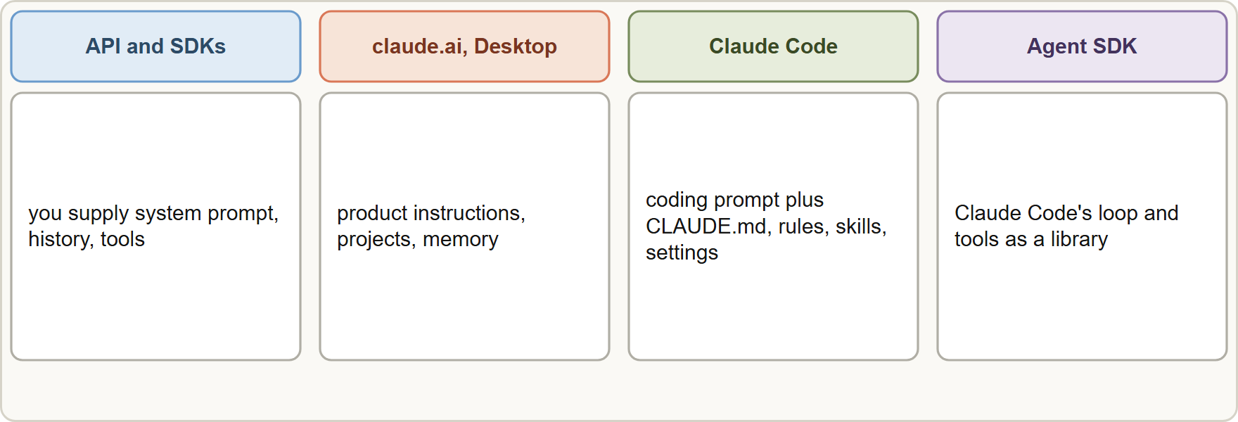
The same words, different interfaces
Module 4
Where instructions come from in each interface: you supply everything in the API; the apps and Claude Code add their own instructions and features
Claude Developer Foundations Exam Prep | for the CCDV-F exam
Module 4
4 / 24
Notes:
The same words, different interfaces.
The figure shows this: Where instructions come from in each interface: you supply everything in the A P I; the apps and Claude Code add their own instructions and features.

Slide 5
The same words, different interfaces, continued
Module 4
Interface | Who supplies the instructions and tools
API / client SDKs | You: the system prompt, the history, the tools. Nothing else is added
claude.ai and Desktop | Anthropic adds product instructions, features and optional project or user preferences
Claude Code | Anthropic's coding system prompt plus your CLAUDE.md, rules, skills, settings and tools
Agent SDK | The agent loop and built-in tools of Claude Code as a library, configured in your code
Test in the interface you ship. A prompt tuned in a chat app is not automatically right for the API, because the chat app adds its own context.
Claude Developer Foundations Exam Prep | for the CCDV-F exam
Module 4
5 / 24
Notes:
The same words, different interfaces, continued.
A P I or client S D K s. You: the system prompt, the history, the tools. Nothing else is added.
claude.ai and Desktop. Anthropic adds product instructions, features and optional project or user preferences.
Claude Code. Anthropic's coding system prompt plus your Claude dot M D, rules, skills, settings and tools.
Agent S D K. The agent loop and built-in tools of Claude Code as a library, configured in your code.
Test in the interface you ship. A prompt tuned in a chat app is not automatically right for the A P I, because the chat app adds its own context.

Slide 6
The same words, different interfaces, continued
Module 4
Instructions do not travel between interfaces: project instructions in claude.ai, a system prompt in the API and CLAUDE.md in Claude Code are separate places.
Claude Developer Foundations Exam Prep | for the CCDV-F exam
Module 4
6 / 24
Notes:
The same words, different interfaces, continued.
Instructions do not travel between interfaces: project instructions in claude.ai, a system prompt in the A P I and Claude dot M D in Claude Code are separate places.

Slide 7
Content boundaries and schemas
Module 4
Separate instructions from data. Put rules in the system prompt and wrap documents and user text in clear tags, so the model knows what is data and what is an instruction (Module 13).
Set boundaries for what the assistant should do and refuse (scope, PII handling, no legal advice) and say how to refuse.
Schema design (for tools and structured output): clear descriptions, required versus optional fields, enums for fixed sets, nullable fields when data may be missing, and a version for schemas that other systems consume.
Claude Developer Foundations Exam Prep | for the CCDV-F exam
Module 4
7 / 24
Notes:
Content boundaries and schemas.
Separate instructions from data. Put rules in the system prompt and wrap documents and user text in clear tags, so the model knows what is data and what is an instruction (Module thirteen).
Set boundaries for what the assistant should do and refuse (scope, P I I handling, no legal advice) and say how to refuse.
Schema design (for tools and structured output): clear descriptions, required versus optional fields, enums for fixed sets, nullable fields when data may be missing, and a version for schemas that other systems consume.

Slide 8
Session hygiene
Module 4
Practice | Why
One task per session | Unrelated history is noise and can mislead
Start fresh (or clear) when switching tasks | Stale context causes drift
Compact or summarize long sessions | Keeps context lean (Module 9)
Do not leave secrets or private data in a shared session | Avoids leakage
Claude Developer Foundations Exam Prep | for the CCDV-F exam
Module 4
8 / 24
Notes:
Session hygiene.
One task per session. Unrelated history is noise and can mislead.
Start fresh (or clear) when switching tasks. Stale context causes drift.
Compact or summarize long sessions. Keeps context lean (Module nine).
Do not leave secrets or private data in a shared session. Avoids leakage.

Slide 9
Plugin management
Module 4
A plugin packages skills, agents, hooks and MCP servers as one unit installed from a marketplace; it has a manifest (.claude-plugin/plugin.json).
Manage plugins deliberately: install only trusted sources, review what a plugin adds (it can run hooks and tools), enable it per project, and remember each plugin adds context cost.
EXAM TIP "Works in the chat app, differs in the API" → the interfaces supply different instructions and context; recreate the needed instructions in the API request.
Claude Developer Foundations Exam Prep | for the CCDV-F exam
Module 4
9 / 24
Notes:
Plugin management.
A plugin packages skills, agents, hooks and M C P (Model Context Protocol) servers as one unit installed from a marketplace; it has a manifest (.claude-plugin or plugin.json).
Manage plugins deliberately: install only trusted sources, review what a plugin adds (it can run hooks and tools), enable it per project, and remember each plugin adds context cost.
Exam tip: "Works in the chat app, differs in the A P I" to the interfaces supply different instructions and context; recreate the needed instructions in the A P I request.

Slide 10
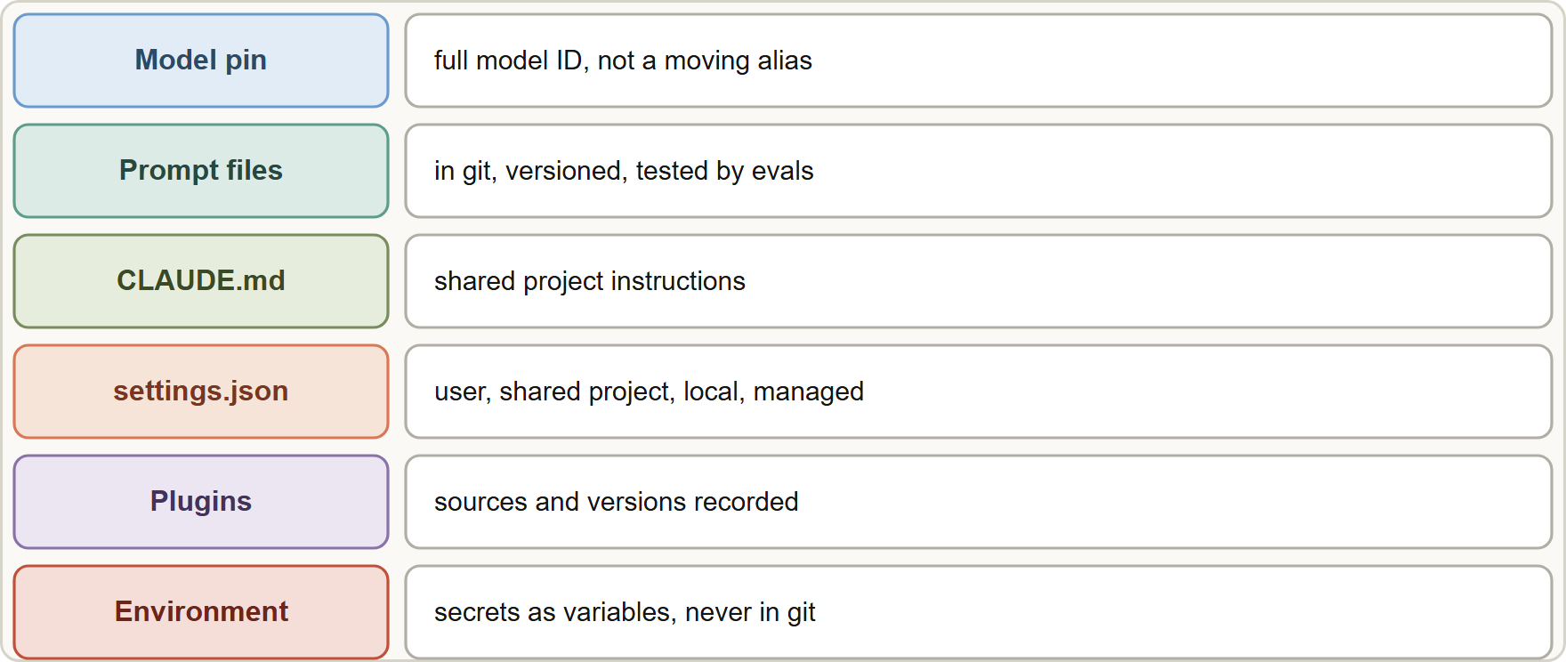
Configuration Management
Module 4
Layers of configuration for a Claude application: model pin, versioned prompts, CLAUDE.md, settings.json, plugins and environment variables
Claude Developer Foundations Exam Prep | for the CCDV-F exam
Module 4
10 / 24
Notes:
Configuration Management.
The figure shows this: Layers of configuration for a Claude application: model pin, versioned prompts, Claude dot M D, settings.json, plugins and environment variables.

Slide 11
Configuration Management, continued
Module 4
Item | What to know
`CLAUDE.md` | Persistent instructions for Claude Code: user, project (shared) and directory levels; commit the project file
`settings.json` | User ~/.claude/settings.json (all your projects); shared project .claude/settings.json (commit it: team permissions, hooks, plugins, env); project local .claude/settings.local.json (kept out of git); managed settings from the organization
Model version pinning | Use the full model ID (for example claude-sonnet-5-5) instead of an alias that moves; in Claude Code use the full name or ANTHROPIC_DEFAULT_*_MODEL variables. Current model IDs are pinned snapshots
Claude Developer Foundations Exam Prep | for the CCDV-F exam
Module 4
11 / 24
Notes:
Configuration Management, continued.
Claude dot M D. Persistent instructions for Claude Code: user, project (shared) and directory levels; commit the project file.
settings.json. User about or dot Claude settings.json (all your projects); shared project dot Claude settings.json (commit it: team permissions, hooks, plugins, env); project local dot Claude settings.local.json (kept out of git); managed settings from the organization.
Model version pinning. Use the full model I D (for example claude-sonnet-five to five) instead of an alias that moves; in Claude Code use the full name or the Anthropic default model variables. Current model I Ds are pinned snapshots.

Slide 12
Configuration Management, continued
Module 4
Item | What to know
Prompt versioning | Keep prompts in files under version control, give them a version, record changes, test with evals, roll back if quality drops
Plugin dependencies | Record plugin sources and versions, and update on purpose, because a plugin update changes behavior
Why pin: an alias or "latest" can change behavior without a code change, and your evals stop being comparable. Pin, then upgrade on purpose after running evals.
Shared versus personal: put team rules in the committed project file; keep personal overrides in the local file or the user file.
Claude Developer Foundations Exam Prep | for the CCDV-F exam
Module 4
12 / 24
Notes:
Configuration Management, continued.
Prompt versioning. Keep prompts in files under version control, give them a version, record changes, test with evals, roll back if quality drops.
Plugin dependencies. Record plugin sources and versions, and update on purpose, because a plugin update changes behavior.
Why pin: an alias or "latest" can change behavior without a code change, and your evals stop being comparable. Pin, then upgrade on purpose after running evals.
Shared versus personal: put team rules in the committed project file; keep personal overrides in the local file or the user file.

Slide 13
Configuration Management, continued
DATES
Module 4
Claude Code model aliases (opus, sonnet, haiku, fable, best, opusplan) follow the newest version for your provider and update over time; to pin, use the full model name or the matching environment variable. As of 8 November 2026.
EXAM TIP Reproducible behavior needs a pinned model, a versioned prompt and a committed settings file; "latest" and personal settings break reproducibility.
Claude Developer Foundations Exam Prep | for the CCDV-F exam
Module 4
13 / 24
Notes:
Configuration Management, continued.
Claude Code model aliases (opus, sonnet, haiku, fable, best, opusplan) follow the newest version for your provider and update over time; to pin, use the full model name or the matching environment variable. As of eight November two thousand twenty-six.
Exam tip: Reproducible behavior needs a pinned model, a versioned prompt and a committed settings file; "latest" and personal settings break reproducibility.
Exam tip: Prompts, schemas and settings are code: commit them, review them, test them with evals and roll them back when quality drops.

Slide 14
Module Recap
Module 4
1
Interfaces
2
Boundaries
3
Schemas
API = only what you send; apps and Claude Code add their own instructions and features
Rules in system; data tagged; say how to refuse; PII scope
Descriptions, required/optional, enums, nullable, version
4
Session hygiene
5
Plugins
6
settings.json
One task per session, fresh start, compact, no secrets in shared sessions
Skills + agents + hooks + MCP in one unit; trusted sources; context cost; per-project
User · shared project (commit) · project local (not committed) · managed
7
Pinning
8
Prompt versioning
Full model ID (pinned snapshot) or ANTHROPIC_DEFAULT_*_MODEL; aliases move
Files in git, version, evals, rollback
Claude Developer Foundations Exam Prep | for the CCDV-F exam
Module 4
14 / 24
Notes:
Here is the recap.
Interfaces: A P I equals only what you send; apps and Claude Code add their own instructions and features.
Boundaries: Rules in system; data tagged; say how to refuse; P I I scope.
Schemas: Descriptions, required or optional, enums, nullable, version.
Session hygiene: One task per session, fresh start, compact, no secrets in shared sessions.
Plugins: Skills plus agents plus hooks plus M C P in one unit; trusted sources; context cost; per-project.
settings.json: User, shared project (commit), project local (not committed), managed.
Pinning: Full model I D (pinned snapshot) or the Anthropic default model; aliases move.
Prompt versioning: Files in git, version, evals, rollback.

Slide 15
Practice Question 1
Module 4
Q1
A prompt works in the claude.ai chat but behaves differently through the API. What is the most likely reason?
A
The model is a different size
B
The API ignores system prompts
C
The API uses a different programming language than the chat application does
D
The chat app adds its own instructions and context that the API lacks
Claude Developer Foundations Exam Prep | for the CCDV-F exam
Module 4
15 / 24
Notes:
Question one.
A prompt works in the claude.ai chat but behaves differently through the A P I. What is the most likely reason?
The four options are on the screen.
[PAUSE 12]
The answer is D. Interfaces supply different instructions and features; the A P I contains only what you send.

Slide 16
Practice Question 2
Module 4
Q2
A team wants every developer to get the same permission rules and hooks in Claude Code. Where should they put them?
A
In a chat message
B
In each developer's own ~/.claude/settings.json on their personal machine
C
In .claude/settings.local.json
D
In the committed .claude/settings.json of the project
Claude Developer Foundations Exam Prep | for the CCDV-F exam
Module 4
16 / 24
Notes:
Question two.
A team wants every developer to get the same permission rules and hooks in Claude Code. Where should they put them?
The four options are on the screen.
[PAUSE 12]
The answer is D. The shared project settings file reaches teammates through version control.

Slide 17
Practice Question 3
Module 4
Q3
A developer wants a personal override for one project that must not be committed. Where does it belong?
A
.claude/settings.local.json
B
The managed settings
C
CLAUDE.md at the project root
D
.claude/settings.json
Claude Developer Foundations Exam Prep | for the CCDV-F exam
Module 4
17 / 24
Notes:
Question three.
A developer wants a personal override for one project that must not be committed. Where does it belong?
The four options are on the screen.
[PAUSE 12]
The answer is A. The local settings file applies to you in that project and stays out of git.

Slide 18
Practice Question 4
Module 4
Q4
An application relies on a moving model alias instead of a full model ID, and its answers drift after the alias moves to a newer version. What is the best practice?
A
Leave the alias and add more prompt text
B
Switch aliases daily
C
Pin the full model ID, re-run evals, and upgrade deliberately
D
Disable evals
Claude Developer Foundations Exam Prep | for the CCDV-F exam
Module 4
18 / 24
Notes:
Question four.
An application relies on a moving model alias instead of a full model I D, and its answers drift after the alias moves to a newer version. What is the best practice?
The four options are on the screen.
[PAUSE 12]
The answer is C. A pinned I D keeps behavior reproducible until you choose to upgrade.

Slide 19
Practice Question 5
Module 4
Q5
Where should the claims prompt live so changes are reviewable and reversible?
A
In the model's weights
B
In a versioned file in git, tested by evals before every release
C
Only inside the production database, edited live whenever someone has a better idea
D
In a developer's notes app
Claude Developer Foundations Exam Prep | for the CCDV-F exam
Module 4
19 / 24
Notes:
Question five.
Where should the claims prompt live so changes are reviewable and reversible?
The four options are on the screen.
[PAUSE 12]
The answer is B. Prompts are code: version, review, test and roll back.

Slide 20
Practice Question 6
Module 4
Q6
Which describes good session hygiene?
A
One long session that is reused for every task during the whole week
B
Pasting the whole repository into every session
C
Never clearing context
D
A fresh session per task, compacting long ones, and no secrets in shared sessions
Claude Developer Foundations Exam Prep | for the CCDV-F exam
Module 4
20 / 24
Notes:
Question six.
Which describes good session hygiene?
The four options are on the screen.
[PAUSE 12]
The answer is D. Focused sessions, with compaction for long ones, avoid stale and misleading context in the window.

Slide 21
Practice Question 7
Module 4
Q7
A team installs a plugin from an unknown source because it looks useful. What is the concern?
A
Plugins only change the colors of the terminal and nothing else about behavior
B
Plugins are always read-only
C
Plugins cannot be disabled
D
A plugin can add hooks, tools and MCP servers, so untrusted ones are risky
Claude Developer Foundations Exam Prep | for the CCDV-F exam
Module 4
21 / 24
Notes:
Question seven.
A team installs a plugin from an unknown source because it looks useful. What is the concern?
The four options are on the screen.
[PAUSE 12]
The answer is D. Plugins package executable components; install trusted sources and review what they add.

Slide 22
Practice Question 8
Module 4
Q8
A schema for claim data will be used by three other systems. What should the developer do?
A
Change field names whenever convenient, as long as the producing application still runs correctly
B
Use clear descriptions, required and optional fields, enums, nullable fields and a version
C
Keep the schema undocumented
D
Make every field free text
Claude Developer Foundations Exam Prep | for the CCDV-F exam
Module 4
22 / 24
Notes:
Question eight.
A schema for claim data will be used by three other systems. What should the developer do?
The four options are on the screen.
[PAUSE 12]
The answer is B. Systems that consume the data need a stable, documented and versioned contract so changes do not break them.

Slide 23
Practice Question 9
Module 4
Q9
Which TWO belong in the committed project configuration of a Claude Code repository? (Select TWO.)
A
Local overrides that only one engineer needs
B
Each person's private experiments
C
A developer's personal API key
D
Shared project instructions in CLAUDE.md
E
Team permission rules and hooks in .claude/settings.json
Claude Developer Foundations Exam Prep | for the CCDV-F exam
Module 4
23 / 24
Notes:
Question nine. Select two.
Which two belong in the committed project configuration of a Claude Code repository?
The five options are on the screen.
[PAUSE 15]
The answers are D and E. Shared settings and instructions are committed; keys and personal overrides are not.

Slide 24
Answers at a Glance
Module 4
Question | Answer | Why
Q1 | D | Interfaces supply different instructions and features
Q2 | D | The shared project settings file reaches teammates through version
Q3 | A | The local settings file applies to you in that
Q4 | C | A pinned ID keeps behavior reproducible until you choose
Q5 | B | Prompts are code: version, review, test and roll back
Q6 | D | Focused sessions, with compaction for long ones, avoid stale
Q7 | D | Plugins package executable components
Q8 | B | Systems that consume the data need a stable
Q9 | D, E | Shared settings and instructions are committed
Claude Developer Foundations Exam Prep | for the CCDV-F exam
Module 4
24 / 24
Notes:
Here are all nine answers. Question one: D. Question two: D. Question three: A. Question four: C. Question five: B. Question six: D. Question seven: D. Question eight: B. Question nine: D and E.
In the next module, we continue the course.

