Slide 1
Module 5: Agent Architecture and Patterns
Workflow versus agent: the decision criteria
Domain 1 · Agents and Workflows · Skills: Agent Architecture, Agent Patterns and Frameworks
Claude Developer Foundations Exam Prep Masterclass
Module 5
Notes:
Welcome to Module five: Agent Architecture and Patterns. This module covers the skills agent architecture, agent patterns and frameworks.
Each part of this module comes from the study notes of the same name, so you can read the notes after you watch.

Slide 2
What You Will Learn
Module 5
Workflow versus agent: the decision criteria
Manager and supervisor hierarchies and the role of subagents
The common agent patterns: tool-use loop, subagents, memory, context-window management
The common workflow patterns: chaining, routing, parallelization, orchestrator-workers, evaluator-optimizer
Agentic frameworks (Strands, LangGraph, PydanticAI) and when to use one
Claude Developer Foundations Exam Prep | for the CCDV-F exam
Module 5: Agent Architecture and Patterns
2 / 25
Notes:
By the end of this module you will be able to do five things.
Workflow versus agent: the decision criteria.
Manager and supervisor hierarchies and the role of subagents.
The common agent patterns: tool-use loop, subagents, memory, context-window management.
The common workflow patterns: chaining, routing, parallelization, orchestrator-workers, evaluator-optimizer.
Agentic frameworks (Strands, Lang Graph, Pydantic A I) and when to use one.

Slide 3
Case Check-In: Tidewater Automates Claim Intake
Module 5
CASE CHECK-IN · Tidewater Insurance
Step list today: read the claim email, extract the policy number, check coverage, draft a reply
Some claims are odd: missing data, several policies, unclear damage
The team asks: "Do we need an agent, or just a workflow?"
Claude Developer Foundations Exam Prep | for the CCDV-F exam
Module 5: Agent Architecture and Patterns
3 / 25
Notes:
Our running case is Tidewater Insurance. Tidewater Automates Claim Intake.
Step list today: read the claim email, extract the policy number, check coverage, draft a reply.
Some claims are odd: missing data, several policies, unclear damage.
The team asks: "Do we need an agent, or just a workflow?".

Slide 4
Workflow or Agent?
Module 5
 | Workflow | Agent
Control | Your code defines the path (fixed or branching steps) | The model decides the next step in a loop with tools
Predictability | High: same steps, testable, cheaper | Lower: flexible, harder to test
Fits | Well-understood tasks with known steps | Open-ended tasks where the steps depend on what is found
Cost and latency | Lower, bounded | Higher, variable (many model calls)
Claude Developer Foundations Exam Prep | for the CCDV-F exam
Module 5: Agent Architecture and Patterns
4 / 25
Notes:
Workflow or Agent?
Control. Workflow: Your code defines the path (fixed or branching steps). Agent: The model decides the next step in a loop with tools.
Predictability. Workflow: High: same steps, testable, cheaper. Agent: Lower: flexible, harder to test.
Fits. Workflow: Well-understood tasks with known steps. Agent: Open-ended tasks where the steps depend on what is found.
Cost and latency. Workflow: Lower, bounded. Agent: Higher, variable (many model calls).

Slide 5
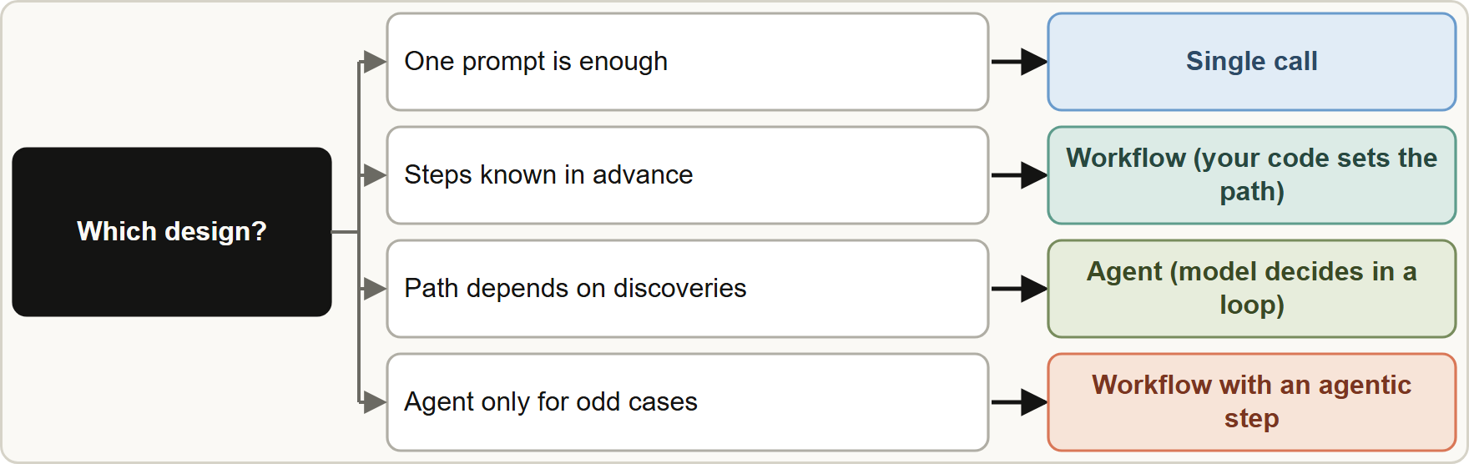
Workflow or Agent?, continued
Module 5
Decision criteria: predictability of the steps, complexity, cost and latency budget, tolerance for errors, and need for auditing.
Start with the simplest thing that works: one good prompt, then a workflow, then an agent. Add autonomy only when the simpler design fails the evals.
Decision criteria: predictability of the steps, complexity, cost and latency budget, tolerance for errors, and need for auditing.
Start with the simplest thing that works: one good prompt, then a workflow, then an agent. Add autonomy only when the simpler design fails the evals.
Claude Developer Foundations Exam Prep | for the CCDV-F exam
Module 5: Agent Architecture and Patterns
5 / 25
Notes:
Workflow or Agent?, continued.
The figure shows this: Start simple: a single call if it is enough, a workflow if the steps are known, an agent only when the path depends on what the task reveals.
Decision criteria: predictability of the steps, complexity, cost and latency budget, tolerance for errors, and need for auditing.
Start with the simplest thing that works: one good prompt, then a workflow, then an agent. Add autonomy only when the simpler design fails the evals.

Slide 6
Workflow or Agent?, continued
Module 5
Many real systems are workflows with one agentic step (for example a fixed intake pipeline that hands odd cases to an agent).
EXAM TIP "Steps are known and must be reliable and cheap" → workflow. "The path depends on what the task discovers" → agent.
Claude Developer Foundations Exam Prep | for the CCDV-F exam
Module 5: Agent Architecture and Patterns
6 / 25
Notes:
Workflow or Agent?, continued.
Many real systems are workflows with one agentic step (for example a fixed intake pipeline that hands odd cases to an agent).
Exam tip: "Steps are known and must be reliable and cheap" to workflow. "The path depends on what the task discovers" to agent.

Slide 7
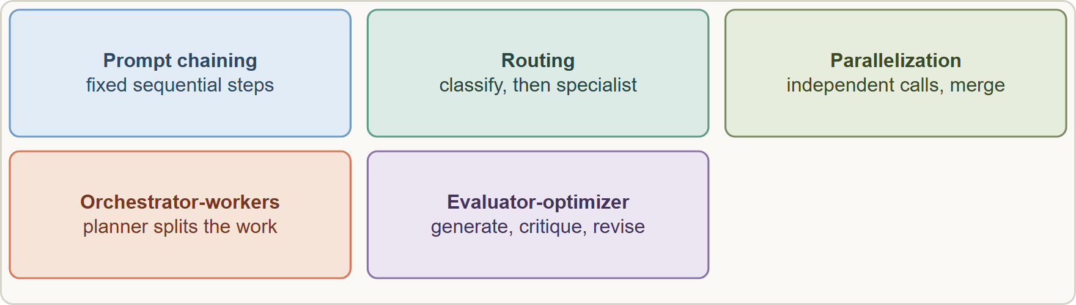
Workflow Patterns
Module 5
Five workflow patterns: chaining, routing, parallelization, orchestrator-workers and evaluator-optimizer
Claude Developer Foundations Exam Prep | for the CCDV-F exam
Module 5: Agent Architecture and Patterns
7 / 25
Notes:
Workflow Patterns.
The figure shows this: Five workflow patterns: chaining, routing, parallelization, orchestrator-workers and evaluator-optimizer.

Slide 8
Workflow Patterns, continued
Module 5
Pattern | Use it when | Claims example
Prompt chaining | A task splits into fixed sequential steps | Extract fields, then check coverage, then draft the reply
Routing | Inputs fall into categories that need different handling | Route "auto" and "property" claims to different prompts or models
Parallelization | Independent subtasks, or the same task several times for confidence | Review ten documents at once; vote on a coverage decision
Orchestrator-workers | The subtasks cannot be predicted in advance | A planner splits a large claim file into parts for workers
Claude Developer Foundations Exam Prep | for the CCDV-F exam
Module 5: Agent Architecture and Patterns
8 / 25
Notes:
Workflow Patterns, continued.
Prompt chaining. Use it when: A task splits into fixed sequential steps. Claims example: Extract fields, then check coverage, then draft the reply.
Routing. Use it when: Inputs fall into categories that need different handling. Claims example: Route "auto" and "property" claims to different prompts or models.
Parallelization. Use it when: Independent subtasks, or the same task several times for confidence. Claims example: Review ten documents at once; vote on a coverage decision.
Orchestrator-workers. Use it when: The subtasks cannot be predicted in advance. Claims example: A planner splits a large claim file into parts for workers.

Slide 9
Workflow Patterns, continued
Module 5
Pattern | Use it when | Claims example
Evaluator-optimizer | A clear quality criterion exists and iteration improves the result | Draft a reply, critique it against a checklist, revise
EXAM TIP A fixed pipeline with one hard case is usually a workflow with an agentic step, not a fully autonomous agent.
Claude Developer Foundations Exam Prep | for the CCDV-F exam
Module 5: Agent Architecture and Patterns
9 / 25
Notes:
Workflow Patterns, continued.
Evaluator-optimizer. Use it when: A clear quality criterion exists and iteration improves the result. Claims example: Draft a reply, critique it against a checklist, revise.
Exam tip: A fixed pipeline with one hard case is usually a workflow with an agentic step, not a fully autonomous agent.

Slide 10
Agent Architecture: Loops, Supervisors and Subagents
Module 5
Tool-use loop (the core agent pattern): send the request, the model returns tool_use, your code runs the tool and returns the result, repeat until end_turn (see the loop in the Architect course; here it is a pattern to recognize).
Manager or supervisor hierarchy: a supervisor agent breaks a goal into tasks, delegates to subagents, collects results and decides what is next.
Claude Developer Foundations Exam Prep | for the CCDV-F exam
Module 5: Agent Architecture and Patterns
10 / 25
Notes:
Agent Architecture: Loops, Supervisors and Subagents.
Tool-use loop (the core agent pattern): send the request, the model returns tool use, your code runs the tool and returns the result, repeat until end turn (see the loop in the Architect course; here it is a pattern to recognize).
Manager or supervisor hierarchy: a supervisor agent breaks a goal into tasks, delegates to subagents, collects results and decides what is next.

Slide 11
Agent Architecture: Loops, Supervisors and Subagents, continued
Module 5
Why subagents improve task execution:; Context isolation: verbose work stays in the subagent's own context window; only a summary returns; Specialization: a focused prompt and a small tool set per role; Parallelism: independent subagents run at the same time
Memory: short-term is the conversation in the context window; long-term is stored outside the model (files, a database, a memory tool) and loaded when relevant.
Context-window management: prune tool output, summarize or compact, delegate to subagents (Module 9).
Claude Developer Foundations Exam Prep | for the CCDV-F exam
Module 5: Agent Architecture and Patterns
11 / 25
Notes:
Agent Architecture: Loops, Supervisors and Subagents, continued.
Why subagents improve task execution:; Context isolation: verbose work stays in the subagent's own context window; only a summary returns; Specialization: a focused prompt and a small tool set per role; Parallelism: independent subagents run at the same time.
Memory: short-term is the conversation in the context window; long-term is stored outside the model (files, a database, a memory tool) and loaded when relevant.
Context-window management: prune tool output, summarize or compact, delegate to subagents (Module nine).

Slide 12
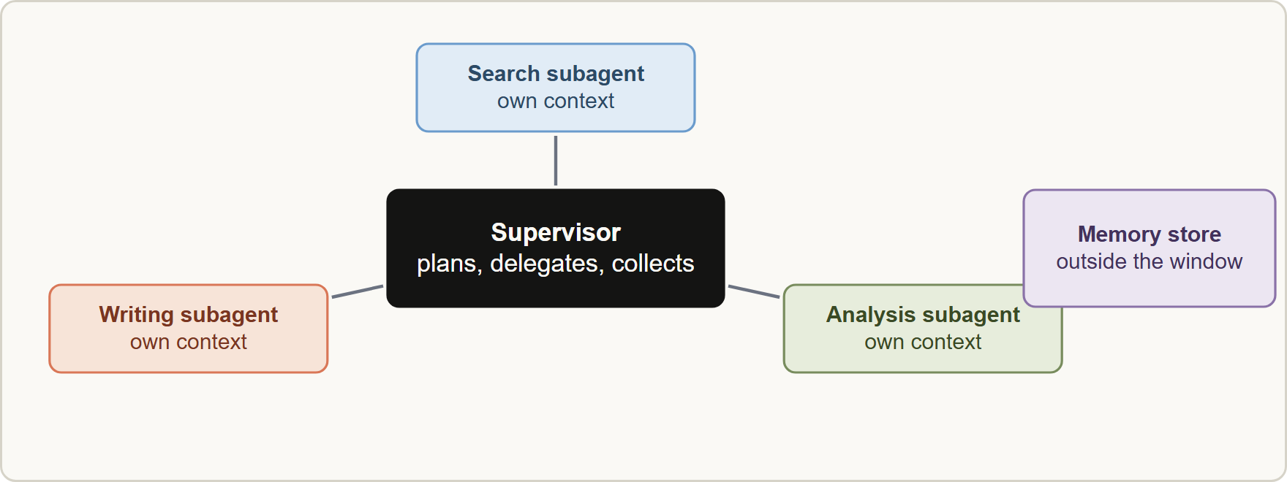
Agent Architecture: Loops, Supervisors and Subagents, continued
Module 5
A supervisor delegates to specialist subagents with isolated context; summaries return; long-term memory lives outside the context window
Claude Developer Foundations Exam Prep | for the CCDV-F exam
Module 5: Agent Architecture and Patterns
12 / 25
Notes:
Agent Architecture: Loops, Supervisors and Subagents, continued.
The figure shows this: A supervisor delegates to specialist subagents with isolated context; summaries return; long-term memory lives outside the context window.

Slide 13
Agentic Frameworks
Module 5
Framework | What it is | Typical reason to choose it
Claude Agent SDK | The agent loop and tools behind Claude Code, as a library | You want Claude's own harness: tools, subagents, hooks, sessions
Strands Agents | A model-driven agent framework (strong AWS integration) | Building agents with tools on AWS with little code
LangGraph | Stateful graphs of nodes and edges for multi-step workflows | Explicit control flow, branching, persistence and human-in-the-loop steps
PydanticAI | An agent framework built around typed, validated outputs (Pydantic models) | Strongly typed structured outputs and validation
Claude Developer Foundations Exam Prep | for the CCDV-F exam
Module 5: Agent Architecture and Patterns
13 / 25
Notes:
Agentic Frameworks.
Claude Agent S D K (software development kit). What it is: The agent loop and tools behind Claude Code, as a library. Typical reason to choose it: You want Claude's own harness: tools, subagents, hooks, sessions.
Strands Agents. What it is: A model-driven agent framework (strong A W S integration). Typical reason to choose it: Building agents with tools on A W S with little code.
Lang Graph. What it is: Stateful graphs of nodes and edges for multi-step workflows. Typical reason to choose it: Explicit control flow, branching, persistence and human-in-the-loop steps.
Pydantic A I. What it is: An agent framework built around typed, validated outputs (Pydantic models). Typical reason to choose it: Strongly typed structured outputs and validation.

Slide 14
Agentic Frameworks, continued
Module 5
Framework or direct API? A framework gives faster development, patterns and state handling; the cost is abstraction (you see less of the prompts and calls), extra dependencies and the need to understand what runs underneath. Use the plain API for simple flows and when you need full control.
Whatever you pick, you still need evals, logging and guardrails; a framework does not replace them.
EXAM TIP Pick a framework for the specific capability it offers (state graph, typed output, Claude's own harness); do not pick one just because it is popular.
Claude Developer Foundations Exam Prep | for the CCDV-F exam
Module 5: Agent Architecture and Patterns
14 / 25
Notes:
Agentic Frameworks, continued.
Framework or direct A P I (application programming interface)? A framework gives faster development, patterns and state handling; the cost is abstraction (you see less of the prompts and calls), extra dependencies and the need to understand what runs underneath. Use the plain A P I for simple flows and when you need full control.
Whatever you pick, you still need evals, logging and guardrails; a framework does not replace them.
Exam tip: Pick a framework for the specific capability it offers (state graph, typed output, Claude's own harness); do not pick one just because it is popular.

Slide 15
Module Recap
Module 5
1
Workflow vs agent
2
Choose
3
Workflow patterns
Workflow = your code sets the path; agent = the model decides in a loop
Known steps → workflow; open-ended → agent; start simple
Chaining · routing · parallelization · orchestrator-workers · evaluator-optimizer
4
Subagents
5
Memory
6
Frameworks
Context isolation · specialization · parallelism; summaries return
Short-term = context window; long-term = external store
Claude Agent SDK · Strands · LangGraph (stateful graphs) · PydanticAI (typed outputs)
7
Framework tradeoff
Speed and patterns vs abstraction and dependencies; evals still required
Claude Developer Foundations Exam Prep | for the CCDV-F exam
Module 5: Agent Architecture and Patterns
15 / 25
Notes:
Here is the recap.
Workflow versus agent: Workflow equals your code sets the path; agent equals the model decides in a loop.
Choose: Known steps to workflow; open-ended to agent; start simple.
Workflow patterns: Chaining, routing, parallelization, orchestrator-workers, evaluator-optimizer.
Subagents: Context isolation, specialization, parallelism; summaries return.
Memory: Short-term equals context window; long-term equals external store.
Frameworks: Claude Agent S D K, Strands, Lang Graph (stateful graphs), Pydantic A I (typed outputs).
Framework tradeoff: Speed and patterns versus abstraction and dependencies; evals still required.

Slide 16
Practice Question 1
Module 5
Q1
The steps of Tidewater's invoice check are always the same: extract fields, validate totals, write a summary. Reliability and low cost matter. What fits best?
A
A single huge prompt with no validation
B
A fully autonomous agent with every tool and no fixed steps
C
A supervisor with ten subagents
D
A workflow (prompt chain) with fixed steps
Claude Developer Foundations Exam Prep | for the CCDV-F exam
Module 5: Agent Architecture and Patterns
16 / 25
Notes:
Question one.
The steps of Tidewater's invoice check are always the same: extract fields, validate totals, write a summary. Reliability and low cost matter. What fits best?
The four options are on the screen.
[PAUSE 12]
The answer is D. Known, fixed steps call for a workflow, which is more predictable and cheaper than an agent.

Slide 17
Practice Question 2
Module 5
Q2
An investigation task has no fixed steps: what to check next depends on what the previous check found. Which design suits it?
A
A cron job
B
A hard-coded sequence of five prompts
C
A single prompt with all facts pasted in
D
An agent that decides the next step in a tool-use loop
Claude Developer Foundations Exam Prep | for the CCDV-F exam
Module 5: Agent Architecture and Patterns
17 / 25
Notes:
Question two.
An investigation task has no fixed steps: what to check next depends on what the previous check found. Which design suits it?
The four options are on the screen.
[PAUSE 12]
The answer is D. When the path depends on discoveries, the model must choose the next step.

Slide 18
Practice Question 3
Module 5
Q3
Incoming claims fall into auto, property and liability categories, each needing a different prompt. Which pattern fits?
A
Routing: classify, then send to the matching handler
B
Evaluator-optimizer
C
Parallelization of the same prompt over every claim at once
D
Prompt chaining only
Claude Developer Foundations Exam Prep | for the CCDV-F exam
Module 5: Agent Architecture and Patterns
18 / 25
Notes:
Question three.
Incoming claims fall into auto, property and liability categories, each needing a different prompt. Which pattern fits?
The four options are on the screen.
[PAUSE 12]
The answer is A. Routing sends inputs of different types to specialized handling.

Slide 19
Practice Question 4
Module 5
Q4
A developer wants an answer drafted, then critiqued against a checklist and revised until it passes. Which pattern is this?
A
Orchestrator-workers
B
Routing
C
Evaluator-optimizer
D
Parallelization
Claude Developer Foundations Exam Prep | for the CCDV-F exam
Module 5: Agent Architecture and Patterns
19 / 25
Notes:
Question four.
A developer wants an answer drafted, then critiqued against a checklist and revised until it passes. Which pattern is this?
The four options are on the screen.
[PAUSE 12]
The answer is C. Generate, evaluate against criteria, and iterate is the evaluator-optimizer pattern.

Slide 20
Practice Question 5
Module 5
Q5
A large claim file must be split into parts that cannot be known ahead of time, each handled by a worker. Which pattern is this?
A
Routing the claim to a specialist handler by category
B
Orchestrator-workers
C
Prompt chaining
D
A single call
Claude Developer Foundations Exam Prep | for the CCDV-F exam
Module 5: Agent Architecture and Patterns
20 / 25
Notes:
Question five.
A large claim file must be split into parts that cannot be known ahead of time, each handled by a worker. Which pattern is this?
The four options are on the screen.
[PAUSE 12]
The answer is B. An orchestrator plans dynamic subtasks and delegates them to workers.

Slide 21
Practice Question 6
Module 5
Q6
Why use subagents in a supervisor design?
A
Subagents share one context window
B
Each has its own context window and focused tools; only summaries return
C
Subagents are free of charge
D
Subagents remove the need for evals because every subagent tests its own work
Claude Developer Foundations Exam Prep | for the CCDV-F exam
Module 5: Agent Architecture and Patterns
21 / 25
Notes:
Question six.
Why use subagents in a supervisor design?
The four options are on the screen.
[PAUSE 12]
The answer is B. Isolation, specialization and parallelism improve task execution and keep the supervisor's context small.

Slide 22
Practice Question 7
Module 5
Q7
An agent must remember customer preferences across many sessions. What is the right place for long-term memory?
A
The system prompt, edited by hand every day by the team that runs the agent
B
A store outside the model (files, a database or a memory tool) loaded when relevant
C
Only the context window
D
The model's weights
Claude Developer Foundations Exam Prep | for the CCDV-F exam
Module 5: Agent Architecture and Patterns
22 / 25
Notes:
Question seven.
An agent must remember customer preferences across many sessions. What is the right place for long-term memory?
The four options are on the screen.
[PAUSE 12]
The answer is B. Context windows are per request; durable memory belongs in external storage.

Slide 23
Practice Question 8
Module 5
Q8
A team needs explicit state, branching and human approval steps in a multi-step workflow. Which kind of framework fits?
A
A spreadsheet
B
No framework is ever suitable
C
A stateful graph framework such as LangGraph
D
A framework that hides all control flow
Claude Developer Foundations Exam Prep | for the CCDV-F exam
Module 5: Agent Architecture and Patterns
23 / 25
Notes:
Question eight.
A team needs explicit state, branching and human approval steps in a multi-step workflow. Which kind of framework fits?
The four options are on the screen.
[PAUSE 12]
The answer is C. Stateful graph frameworks model nodes, edges and persisted state explicitly.

Slide 24
Practice Question 9
Module 5
Q9
Which TWO are good reasons to prefer the plain API over a framework? (Select TWO.)
A
The flow is simple and you want full control of prompts and calls
B
A framework is always cheaper to run
C
Frameworks guarantee correct answers
D
You want to avoid extra dependencies
E
Frameworks make evals unnecessary
Claude Developer Foundations Exam Prep | for the CCDV-F exam
Module 5: Agent Architecture and Patterns
24 / 25
Notes:
Question nine. Select two.
Which two are good reasons to prefer the plain A P I over a framework?
The five options are on the screen.
[PAUSE 15]
The answers are A and D. Simple flows and a small dependency footprint favor the plain A P I; frameworks do not remove the need for evals or guarantee correctness.

Slide 25
Answers at a Glance
Module 5
Question | Answer | Why
Q1 | D | Known, fixed steps call for a workflow, which is
Q2 | D | When the path depends on discoveries
Q3 | A | Routing sends inputs of different types to specialized handling
Q4 | C | Generate, evaluate against criteria, and iterate is the evaluator-optimizer
Q5 | B | An orchestrator plans dynamic subtasks and delegates them to
Q6 | B | Isolation, specialization and parallelism improve task execution and keep
Q7 | B | Context windows are per request
Q8 | C | Stateful graph frameworks model nodes
Q9 | A, D | Simple flows and a small dependency footprint favor the
Claude Developer Foundations Exam Prep | for the CCDV-F exam
Module 5: Agent Architecture and Patterns
25 / 25
Notes:
Here are all nine answers. Question one: D. Question two: D. Question three: A. Question four: C. Question five: B. Question six: B. Question seven: B. Question eight: C. Question nine: A and D.
In the next module, we continue the course.

