Slide 1
Module 6: Building Agents: Agent SDK, Custom Loops, Managed Agents and Hooks
Three ways to construct an agent: a custom loop on the API, the Claude
Domain 1 · Agents and Workflows · Skills: Agent Construction with Claude
Claude Developer Foundations Exam Prep Masterclass
Module 6
Notes:
Welcome to Module six: Building Agents: Agent S D K, Custom Loops, Managed Agents and Hooks. This module covers the skills agent construction with claude.
Each part of this module comes from the study notes of the same name, so you can read the notes after you watch.

Slide 2
What You Will Learn
Module 6
Three ways to construct an agent: a custom loop on the API, the Claude Agent SDK, and Claude Managed Agents
What a harness is and what it must do
Deployment models: self-hosted versus Anthropic-hosted
Hooks for deterministic actions
Safety limits for runaway agents
Claude Developer Foundations Exam Prep | for the CCDV-F exam
Module 6
2 / 25
Notes:
By the end of this module you will be able to do five things.
Three ways to construct an agent: a custom loop on the A P I (application programming interface), the Claude Agent S D K (software development kit), and Claude Managed Agents.
What a harness is and what it must do.
Deployment models: self-hosted versus Anthropic-hosted.
Hooks for deterministic actions.
Safety limits for runaway agents.

Slide 3
Case Check-In: Tidewater's Overnight Investigator
Module 6
CASE CHECK-IN · Tidewater Insurance
The team wants an agent that investigates suspicious claims for hours, reads files, runs checks and writes a report
Requirements: compliance (data stays in Tidewater's cloud), audit logs, and a small team with little time for infrastructure
Claude Developer Foundations Exam Prep | for the CCDV-F exam
Module 6
3 / 25
Notes:
Our running case is Tidewater Insurance. Tidewater's Overnight Investigator.
The team wants an agent that investigates suspicious claims for hours, reads files, runs checks and writes a report.
Requirements: compliance (data stays in Tidewater's cloud), audit logs, and a small team with little time for infrastructure.

Slide 4
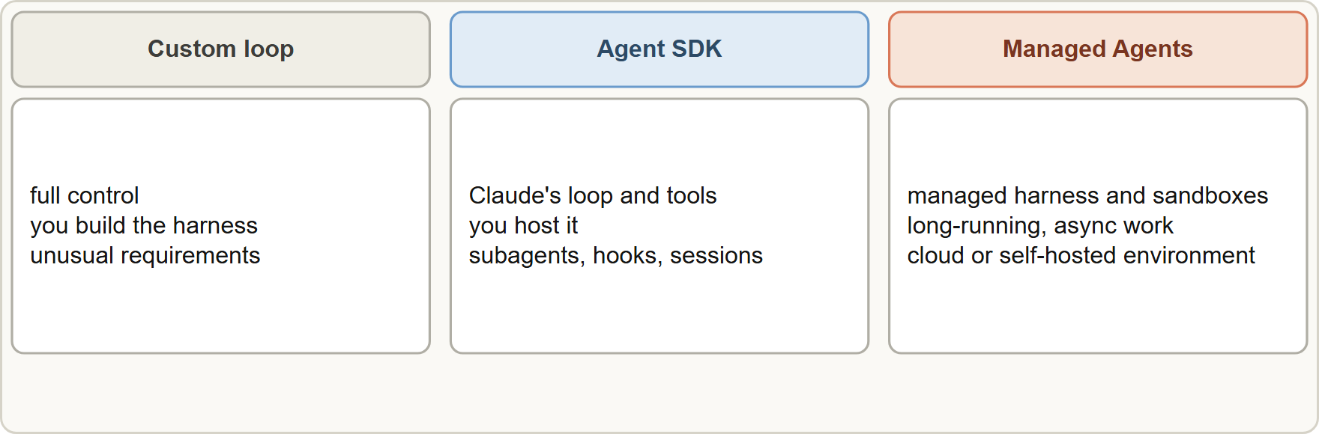
Choosing How to Build
Module 6
Three ways to build an agent: your own loop on the Messages API, the Agent SDK as a library you host, or Claude Managed Agents with a managed harness
Claude Developer Foundations Exam Prep | for the CCDV-F exam
Module 6
4 / 25
Notes:
Choosing How to Build.
The figure shows this: Three ways to build an agent: your own loop on the Messages A P I, the Agent S D K as a library you host, or Claude Managed Agents with a managed harness.

Slide 5
Choosing How to Build, continued
Module 6
Option | What you get | You provide | Choose it when
Custom loop on the Messages API | Direct model access, fine-grained control | The loop, tool execution, context management, retries, permissions, logging | Unusual requirements, or you must control every call
Claude Agent SDK | The same agent loop and built-in tools as Claude Code, as a Python or TypeScript library, with subagents, hooks, sessions and permissions | Hosting and operations | You want a proven harness but control over where it runs
Claude Developer Foundations Exam Prep | for the CCDV-F exam
Module 6
5 / 25
Notes:
Choosing How to Build, continued.
Custom loop on the Messages A P I. What you get: Direct model access, fine-grained control. You provide: The loop, tool execution, context management, retries, permissions, logging. Choose it when: Unusual requirements, or you must control every call.
Claude Agent S D K. What you get: The same agent loop and built-in tools as Claude Code, as a Python or Type Script library, with subagents, hooks, sessions and permissions. You provide: Hosting and operations. Choose it when: You want a proven harness but control over where it runs.

Slide 6
Choosing How to Build, continued
Module 6
Option | What you get | You provide | Choose it when
Claude Managed Agents (beta) | A pre-built agent harness on managed infrastructure with sandboxes, built-in prompt caching and compaction | Agent definition and application integration | Long-running or asynchronous work with little infrastructure effort
EXAM TIP "Long-running, asynchronous, minimal infrastructure" → Managed Agents. "Own the loop and every call" → custom loop. "Claude's harness, hosted by us" → Agent SDK.
Claude Developer Foundations Exam Prep | for the CCDV-F exam
Module 6
6 / 25
Notes:
Choosing How to Build, continued.
Claude Managed Agents (beta). What you get: A pre-built agent harness on managed infrastructure with sandboxes, built-in prompt caching and compaction. You provide: Agent definition and application integration. Choose it when: Long-running or asynchronous work with little infrastructure effort.
Exam tip: "Long-running, asynchronous, minimal infrastructure" to Managed Agents. "Own the loop and every call" to custom loop. "Claude's harness, hosted by us" to Agent S D K.

Slide 7
The harness
Module 6
The harness is everything around the model: the loop, tool execution, permissions, context management (pruning, compaction), retries and limits, logging, and session state. Building your own harness gives control but costs effort and risk; the SDK and Managed Agents supply one.
Claude Developer Foundations Exam Prep | for the CCDV-F exam
Module 6
7 / 25
Notes:
The harness.
The harness is everything around the model: the loop, tool execution, permissions, context management (pruning, compaction), retries and limits, logging, and session state. Building your own harness gives control but costs effort and risk; the S D K and Managed Agents supply one.

Slide 8
Agent SDK Essentials
Module 6
PYTHON
options = ClaudeAgentOptions(
allowed_tools=["Read", "Grep", "Glob"], # tools that need no approval prompt
max_turns=20, # safety limit on the loop
hooks={"PreToolUse": [HookMatcher(matcher="Bash", hooks=[block_dangerous])]},
)
async for message in query(prompt="Review claim 4471 for fraud signals", options=options):
...
Example from the study note (names are examples)
Claude Developer Foundations Exam Prep | for the CCDV-F exam
Module 6
8 / 25
Notes:
Agent S D K Essentials.
The example is on the screen; read it line by line when you study.

Slide 9
Agent SDK Essentials, continued
Module 6
Built-in tools (Read, Write, Edit, Bash, Grep, Glob, web tools) and custom tools or MCP servers can be added; subagents are defined in code or files.
The loop ends when the model replies with no tool calls; a result message carries the outcome (success or a limit such as maximum turns or budget).
Permissions: allow lists, deny lists and permission modes control what runs without approval.
Sessions can be resumed or forked (see the Architect course for detail).
EXAM TIP Ask who should run the harness: you (custom loop or Agent SDK) or Anthropic (Managed Agents), then weigh control against effort.
Claude Developer Foundations Exam Prep | for the CCDV-F exam
Module 6
9 / 25
Notes:
Agent S D K Essentials, continued.
Built-in tools (Read, Write, Edit, Bash, Grep, Glob, web tools) and custom tools or M C P (Model Context Protocol) servers can be added; subagents are defined in code or files.
The loop ends when the model replies with no tool calls; a result message carries the outcome (success or a limit such as maximum turns or budget).
Permissions: allow lists, deny lists and permission modes control what runs without approval.
Sessions can be resumed or forked (see the Architect course for detail).
Exam tip: Ask who should run the harness: you (custom loop or Agent S D K) or Anthropic (Managed Agents), then weigh control against effort.

Slide 10
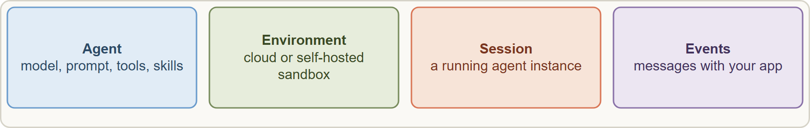
Managed Agents and Deployment Models
Module 6
Managed Agents in four concepts: Agent, Environment, Session and Events
Claude Developer Foundations Exam Prep | for the CCDV-F exam
Module 6
10 / 25
Notes:
Managed Agents and Deployment Models.
The figure shows this: Managed Agents in four concepts: Agent, Environment, Session and Events.

Slide 11
Managed Agents and Deployment Models, continued
Module 6
Concept | What it is
Agent | The model, system prompt, tools, MCP servers and skills
Environment | Where sessions run: an Anthropic-managed cloud sandbox, or a self-hosted sandbox on your infrastructure
Session | A running agent instance doing a task
Events | The messages between your application and the agent (user turns, tool results, status updates)
Self-hosted versus Anthropic-hosted: an Anthropic-managed sandbox minimizes infrastructure work; a self-hosted sandbox keeps execution in your own environment for compliance or data-residency needs.
Managed Agents provide caching and compaction in the harness. Sessions are stateful and their transcripts persist until you delete them.
Claude Developer Foundations Exam Prep | for the CCDV-F exam
Module 6
11 / 25
Notes:
Managed Agents and Deployment Models, continued.
Agent. The model, system prompt, tools, M C P servers and skills.
Environment. Where sessions run: an Anthropic-managed cloud sandbox, or a self-hosted sandbox on your infrastructure.
Session. A running agent instance doing a task.
Events. The messages between your application and the agent (user turns, tool results, status updates).
Self-hosted versus Anthropic-hosted: an Anthropic-managed sandbox minimizes infrastructure work; a self-hosted sandbox keeps execution in your own environment for compliance or data-residency needs.
Managed Agents provide caching and compaction in the harness. Sessions are stateful and their transcripts persist until you delete them.

Slide 12
Managed Agents and Deployment Models, continued
DATES
Module 6
Claude Managed Agents is a beta feature on the Claude API (and available with some differences on partner platforms). Check the overview page for current models, platforms and limits. As of 8 November 2026.
Claude Developer Foundations Exam Prep | for the CCDV-F exam
Module 6
12 / 25
Notes:
Managed Agents and Deployment Models, continued.
Claude Managed Agents is a beta feature on the Claude A P I (and available with some differences on partner platforms). Check the overview page for current models, platforms and limits. As of eight November two thousand twenty-six.

Slide 13
Hooks and Safety Limits
Module 6
Hooks are code that runs at fixed points of the agent loop, outside the model: before a tool runs (PreToolUse: allow, deny or rewrite), after a tool returns (PostToolUse: log, transform), on prompt submit, on stop and more.
Use hooks for deterministic actions: block destructive commands, enforce policy, redact secrets from tool output, write an audit log. Prompts alone cannot guarantee these.
Safety limits for runaway agents: maximum turns, budget caps, timeouts, allow and deny lists, and sandboxing.
Claude Developer Foundations Exam Prep | for the CCDV-F exam
Module 6
13 / 25
Notes:
Hooks and Safety Limits.
Hooks are code that runs at fixed points of the agent loop, outside the model: before a tool runs (Pre Tool Use: allow, deny or rewrite), after a tool returns (Post Tool Use: log, transform), on prompt submit, on stop and more.
Use hooks for deterministic actions: block destructive commands, enforce policy, redact secrets from tool output, write an audit log. Prompts alone cannot guarantee these.
Safety limits for runaway agents: maximum turns, budget caps, timeouts, allow and deny lists, and sandboxing.

Slide 14
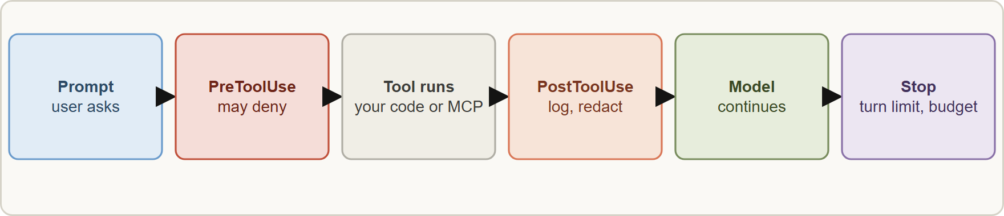
Hooks and Safety Limits, continued
Module 6
Hooks act at fixed points of the loop and give deterministic guarantees; limits cap turns, budget and time
EXAM TIP A rule that must always hold (never run a destructive command, never log a secret) is a hook or permission rule, not a prompt sentence.
Claude Developer Foundations Exam Prep | for the CCDV-F exam
Module 6
14 / 25
Notes:
Hooks and Safety Limits, continued.
The figure shows this: Hooks act at fixed points of the loop and give deterministic guarantees; limits cap turns, budget and time.
Exam tip: A rule that must always hold (never run a destructive command, never log a secret) is a hook or permission rule, not a prompt sentence.

Slide 15
Module Recap
Module 6
1
Build options
2
Harness
3
Managed Agents
Custom loop (full control) · Agent SDK (Claude's harness as a library) · Managed Agents (managed harness, long-running work)
Loop, tool execution, permissions, context management, retries, logging, state
Agent · Environment (cloud or self-hosted sandbox) · Session · Events; beta
4
Hosting
5
Hooks
6
Limits
Anthropic-managed = least effort; self-hosted = compliance and residency
PreToolUse (allow, deny, rewrite), PostToolUse (log, transform); deterministic
Max turns, budget, timeouts, permissions, sandboxing
Claude Developer Foundations Exam Prep | for the CCDV-F exam
Module 6
15 / 25
Notes:
Here is the recap.
Build options: Custom loop (full control), Agent S D K (Claude's harness as a library), Managed Agents (managed harness, long-running work).
Harness: Loop, tool execution, permissions, context management, retries, logging, state.
Managed Agents: Agent, Environment (cloud or self-hosted sandbox), Session, Events; beta.
Hosting: Anthropic-managed equals least effort; self-hosted equals compliance and residency.
Hooks: Pre Tool Use (allow, deny, rewrite), Post Tool Use (log, transform); deterministic.
Limits: Max turns, budget, timeouts, permissions, sandboxing.

Slide 16
Practice Question 1
Module 6
Q1
Tidewater needs an agent that works for hours asynchronously with very little infrastructure effort. Which option fits best?
A
A browser extension
B
Claude Managed Agents
C
A custom loop with your own sandbox, queue and state store
D
A single synchronous Messages API call
Claude Developer Foundations Exam Prep | for the CCDV-F exam
Module 6
16 / 25
Notes:
Question one.
Tidewater needs an agent that works for hours asynchronously with very little infrastructure effort. Which option fits best?
The four options are on the screen.
[PAUSE 12]
The answer is B. Managed Agents provide a ready harness and sandboxes for long-running, asynchronous work.

Slide 17
Practice Question 2
Module 6
Q2
A team must keep agent code execution inside its own cloud for compliance. Which deployment model fits?
A
Running the agent on a developer laptop that stays inside the office
B
A self-hosted sandbox environment for the agent
C
Any Anthropic-managed cloud sandbox
D
Disabling tools
Claude Developer Foundations Exam Prep | for the CCDV-F exam
Module 6
17 / 25
Notes:
Question two.
A team must keep agent code execution inside its own cloud for compliance. Which deployment model fits?
The four options are on the screen.
[PAUSE 12]
The answer is B. Self-hosted sandboxes run on your infrastructure for compliance and residency needs.

Slide 18
Practice Question 3
Module 6
Q3
What does the Claude Agent SDK give a developer?
A
A way to train models
B
A replacement for evals
C
A hosted web interface only, with no way to run your own code
D
The agent loop and tools of Claude Code as a library you host
Claude Developer Foundations Exam Prep | for the CCDV-F exam
Module 6
18 / 25
Notes:
Question three.
What does the Claude Agent S D K give a developer?
The four options are on the screen.
[PAUSE 12]
The answer is D. The S D K packages Claude's own harness as a Python or Type Script library.

Slide 19
Practice Question 4
Module 6
Q4
Which task is best handled by a hook rather than a prompt instruction?
A
Suggesting a good length for the summary that the agent writes at the end
B
Choosing synonyms
C
Preventing the agent from running rm -rf on shared storage under any circumstances
D
Asking for a friendly tone
Claude Developer Foundations Exam Prep | for the CCDV-F exam
Module 6
19 / 25
Notes:
Question four.
Which task is best handled by a hook rather than a prompt instruction?
The four options are on the screen.
[PAUSE 12]
The answer is C. A destructive-action guarantee needs deterministic enforcement outside the model.

Slide 20
Practice Question 5
Module 6
Q5
An agent occasionally loops far too long and costs rise. Which controls help most?
A
A much longer system prompt that tells the agent to stop looping
B
A higher temperature
C
More tools
D
A maximum-turns limit, a budget cap and timeouts
Claude Developer Foundations Exam Prep | for the CCDV-F exam
Module 6
20 / 25
Notes:
Question five.
An agent occasionally loops far too long and costs rise. Which controls help most?
The four options are on the screen.
[PAUSE 12]
The answer is D. Limits cap runaway behavior regardless of what the model decides.

Slide 21
Practice Question 6
Module 6
Q6
What belongs to the harness of an agent?
A
Only the prompt text, because the model does everything else by itself
B
Only the model weights
C
Only the user interface
D
The loop, tool execution, permissions, context management, retries and logging
Claude Developer Foundations Exam Prep | for the CCDV-F exam
Module 6
21 / 25
Notes:
Question six.
What belongs to the harness of an agent?
The four options are on the screen.
[PAUSE 12]
The answer is D. The harness is everything around the model that makes it work as an agent.

Slide 22
Practice Question 7
Module 6
Q7
In Managed Agents, which concept defines where sessions run?
A
Events, the messages sent between the app and the agent
B
Prompt
C
Schema
D
Environment
Claude Developer Foundations Exam Prep | for the CCDV-F exam
Module 6
22 / 25
Notes:
Question seven.
In Managed Agents, which concept defines where sessions run?
The four options are on the screen.
[PAUSE 12]
The answer is D. The environment is the cloud or self-hosted sandbox in which sessions execute.

Slide 23
Practice Question 8
Module 6
Q8
Why might a team build a custom loop on the Messages API instead of using the SDK?
A
Custom loops are always cheaper
B
It needs fine-grained control over every call and loop step
C
The SDK cannot call tools, so a custom loop is the only way to use them
D
Custom loops need no testing
Claude Developer Foundations Exam Prep | for the CCDV-F exam
Module 6
23 / 25
Notes:
Question eight.
Why might a team build a custom loop on the Messages A P I instead of using the S D K?
The four options are on the screen.
[PAUSE 12]
The answer is B. A custom loop trades effort for full control.

Slide 24
Practice Question 9
Module 6
Q9
Which TWO are valid uses of hooks in an agent? (Select TWO.)
A
Guarantee the model's reasoning is correct
B
Redact secrets from tool output before the model sees it
C
Remove the need for permissions
D
Block tool calls that match a destructive pattern
E
Replace the model with a smaller one automatically
Claude Developer Foundations Exam Prep | for the CCDV-F exam
Module 6
24 / 25
Notes:
Question nine. Select two.
Which two are valid uses of hooks in an agent?
The five options are on the screen.
[PAUSE 15]
The answers are B and D. Hooks intercept calls and results deterministically; they do not choose models, guarantee reasoning or replace permissions.

Slide 25
Answers at a Glance
Module 6
Question | Answer | Why
Q1 | B | Managed Agents provide a ready harness and sandboxes for
Q2 | B | Self-hosted sandboxes run on your infrastructure for compliance and
Q3 | D | The SDK packages Claude's own harness as a Python
Q4 | C | A destructive-action guarantee needs deterministic enforcement outside the model
Q5 | D | Limits cap runaway behavior regardless of what the model
Q6 | D | The harness is everything around the model that makes
Q7 | D | The environment is the cloud or self-hosted sandbox in
Q8 | B | A custom loop trades effort for full control
Q9 | B, D | Hooks intercept calls and results deterministically
Claude Developer Foundations Exam Prep | for the CCDV-F exam
Module 6
25 / 25
Notes:
Here are all nine answers. Question one: B. Question two: B. Question three: D. Question four: C. Question five: D. Question six: D. Question seven: D. Question eight: B. Question nine: B and D.
In the next module, we continue the course.

