Slide 1
Module 7: LLM and Technical Fundamentals
LLM basics: tokens, context windows, sampling, non-determinism, next-token generation
Domain 5 · Model Selection and Optimization · Skills: LLM Fundamentals, Technical Fundamentals
Claude Developer Foundations Exam Prep Masterclass
Module 7 · Part 1
Notes:
Welcome to Module seven: L L M and Technical Fundamentals. This module covers the skills l l m fundamentals, technical fundamentals.
Each part of this module comes from the study notes of the same name, so you can read the notes after you watch.

Slide 2
What You Will Learn
Part 1
LLM basics
Model options
tokens, context windows, sampling, non-determinism, next-token generation
fast mode, adaptive and extended thinking, effort levels
Fundamental prompting techniques
Technical fundamentals
zero-shot, single-shot, multi-shot
SDKs that wrap REST APIs, streaming and websockets
Claude Developer Foundations Exam Prep | for the CCDV-F exam
Module 7: LLM and Technical Fundamentals
2 / 27
Notes:
By the end of this module you will be able to do four things.
L L M (large language model) basics: tokens, context windows, sampling, non-determinism, next-token generation.
Model options: fast mode, adaptive and extended thinking, effort levels.
Fundamental prompting techniques: zero-shot, single-shot, multi-shot.
Technical fundamentals: S D K s (software development kit) that wrap R E S T A P I s (application programming interface), streaming and websockets.

Slide 3
Case Check-In: Tidewater Meets Strange Behavior
Part 1
CASE CHECK-IN · Tidewater Insurance
The assistant gave two slightly different answers to the same question
A long claim file made it cut off a list in the middle of a sentence
A developer asks: "Is it broken?"
Claude Developer Foundations Exam Prep | for the CCDV-F exam
Module 7: LLM and Technical Fundamentals
3 / 27
Notes:
Our running case is Tidewater Insurance. Tidewater Meets Strange Behavior.
The assistant gave two slightly different answers to the same question.
A long claim file made it cut off a list in the middle of a sentence.
A developer asks: "Is it broken?".

Slide 4
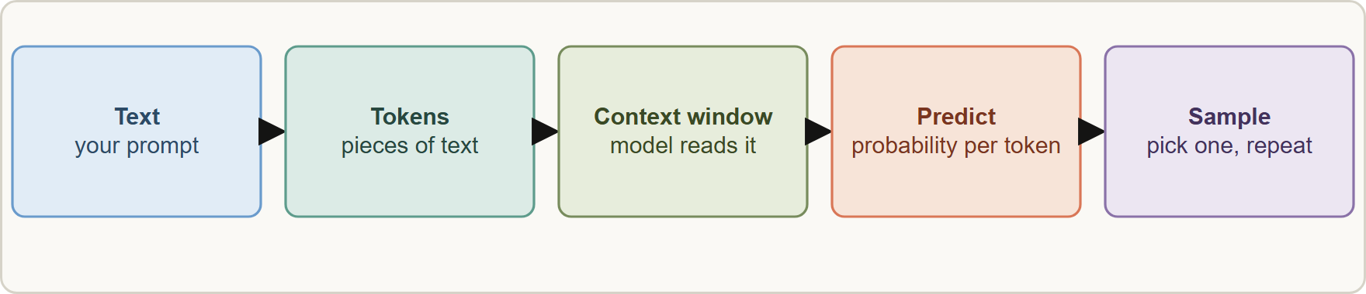
How an LLM Works (the Parts the Exam Needs)
Part 1
How generation works: text becomes tokens, the model predicts the next token from the context, one token is sampled, and the loop repeats until the end or max_tokens
Claude Developer Foundations Exam Prep | for the CCDV-F exam
Module 7: LLM and Technical Fundamentals
4 / 27
Notes:
How an L L M Works (the Parts the Exam Needs).
The figure shows this: How generation works: text becomes tokens, the model predicts the next token from the context, one token is sampled, and the loop repeats until the end or max tokens.

Slide 5
How an LLM Works (the Parts the Exam Needs), continued
Part 1
Concept | What to know
Token | A piece of text (a word, part of a word or punctuation). Models read, produce and bill in tokens; a token is not a word (a rough rule is about three quarters of a word of English per token)
Context window | The maximum tokens the model can consider in one request, input plus output; current models offer up to 1 million tokens
`max_tokens` | A cap on the output only; if reached, the reply is cut off (stop_reason: max_tokens)
Claude Developer Foundations Exam Prep | for the CCDV-F exam
Module 7: LLM and Technical Fundamentals
5 / 27
Notes:
How an L L M Works (the Parts the Exam Needs), continued.
Token. A piece of text (a word, part of a word or punctuation). Models read, produce and bill in tokens; a token is not a word (a rough rule is about three quarters of a word of English per token).
Context window. The maximum tokens the model can consider in one request, input plus output; current models offer up to one million tokens.
max tokens. A cap on the output only; if reached, the reply is cut off (stop reason: max tokens).

Slide 6
How an LLM Works (the Parts the Exam Needs), continued
Part 1
Concept | What to know
Next-token generation | The model predicts a probability for every possible next token, one is chosen, appended, and the process repeats
Sampling | How the next token is chosen from the probabilities (temperature, top-p, top-k control randomness)
Non-determinism | The same prompt can give different wording each time; do not expect byte-identical output
Hallucination | Fluent text that is not grounded in the input or facts; reduce with grounding, citations and validation
Claude Developer Foundations Exam Prep | for the CCDV-F exam
Module 7: LLM and Technical Fundamentals
6 / 27
Notes:
How an L L M Works (the Parts the Exam Needs), continued.
Next-token generation. The model predicts a probability for every possible next token, one is chosen, appended, and the process repeats.
Sampling. How the next token is chosen from the probabilities (temperature, top-p, top-k control randomness).
Non-determinism. The same prompt can give different wording each time; do not expect byte-identical output.
Hallucination. Fluent text that is not grounded in the input or facts; reduce with grounding, citations and validation.

Slide 7
How an LLM Works (the Parts the Exam Needs), continued
Part 1
Why answers differ: sampling is random by design, and small changes in the prompt or context shift the probabilities. For repeatable behavior, constrain the output (structured output, clear instructions, evals) rather than hope for identical text.
Why output was cut off: a long reply reached `max_tokens`; raise the cap or ask for a shorter answer (not a bug).
Claude Developer Foundations Exam Prep | for the CCDV-F exam
Module 7: LLM and Technical Fundamentals
7 / 27
Notes:
How an L L M Works (the Parts the Exam Needs), continued.
Why answers differ: sampling is random by design, and small changes in the prompt or context shift the probabilities. For repeatable behavior, constrain the output (structured output, clear instructions, evals) rather than hope for identical text.
Why output was cut off: a long reply reached max tokens; raise the cap or ask for a shorter answer (not a bug).

Slide 8
How an LLM Works (the Parts the Exam Needs), continued
DATES
Part 1
On current models the sampling parameters `temperature`, `top_p` and `top_k` are not supported: a non-default value returns a 400 error. Guide behavior with prompting and effort instead. On older models they could be set (low temperature for more consistent, high for more varied output). As of 8 November 2026.
EXAM TIP Questions about "making output more random or more consistent" test the concept (sampling and non-determinism); on current models the practical levers are prompt design, structured output and effort.
Claude Developer Foundations Exam Prep | for the CCDV-F exam
Module 7: LLM and Technical Fundamentals
8 / 27
Notes:
How an L L M Works (the Parts the Exam Needs), continued.
On current models the sampling parameters temperature, top p and top k are not supported: a non-default value returns a four hundred error. Guide behavior with prompting and effort instead. On older models they could be set (low temperature for more consistent, high for more varied output). As of eight November two thousand twenty-six.
Exam tip: Questions about "making output more random or more consistent" test the concept (sampling and non-determinism); on current models the practical levers are prompt design, structured output and effort.

Slide 9
Model Options: Thinking, Effort and Fast Mode
Part 1
Option | What it changes | Trade-off
Adaptive thinking | The model decides how much to reason before answering | Better on hard problems; thinking tokens cost output price and time
Extended thinking | A manual reasoning budget on older models | Rejected on current models
Effort | low to max: overall thoroughness and token use | Higher = better quality and slower, costlier
Fast mode | Faster output at a premium price on supported models | Pay more for speed
(The request parameters are in Module 3; here you need to know what each is for.)
Claude Developer Foundations Exam Prep | for the CCDV-F exam
Module 7: LLM and Technical Fundamentals
9 / 27
Notes:
Model Options: Thinking, Effort and Fast Mode.
Adaptive thinking. What it changes: The model decides how much to reason before answering. Trade-off: Better on hard problems; thinking tokens cost output price and time.
Extended thinking. What it changes: A manual reasoning budget on older models. Trade-off: Rejected on current models.
Effort. What it changes: low to max: overall thoroughness and token use. Trade-off: Higher equals better quality and slower, costlier.
Fast mode. What it changes: Faster output at a premium price on supported models. Trade-off: Pay more for speed.
(The request parameters are in Module three; here you need to know what each is for.).

Slide 10
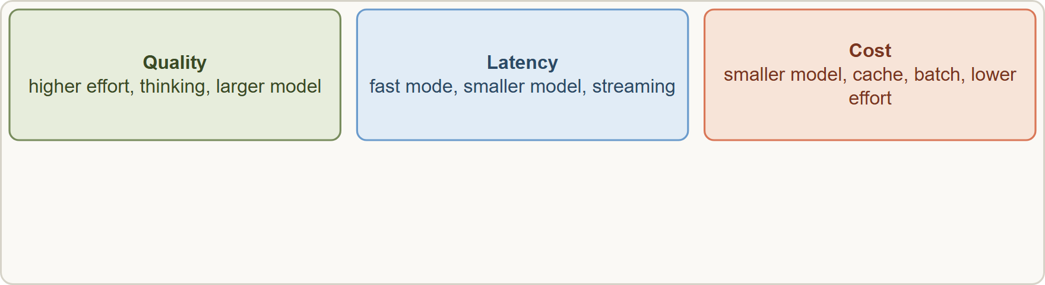
Model Options: Thinking, Effort and Fast Mode, continued
Part 1
Every option moves quality, latency and cost: higher effort and thinking buy quality, fast mode buys speed, smaller models buy price and speed
EXAM TIP Effort and thinking trade quality for cost and latency; fast mode trades price for speed.
Claude Developer Foundations Exam Prep | for the CCDV-F exam
Module 7: LLM and Technical Fundamentals
10 / 27
Notes:
Model Options: Thinking, Effort and Fast Mode, continued.
The figure shows this: Every option moves quality, latency and cost: higher effort and thinking buy quality, fast mode buys speed, smaller models buy price and speed.
Exam tip: Effort and thinking trade quality for cost and latency; fast mode trades price for speed.

Slide 11
Fundamental Prompting Techniques
Part 1
Technique | What it is | Use it when
Zero-shot | Instructions only, no examples | The task is simple and well described
Single-shot (one-shot) | One example of input and output | You need to show the format or style
Multi-shot (few-shot) | Several examples, including tricky cases | Consistency matters or the task is ambiguous; examples teach the pattern better than long rules
Examples should be diverse and representative, include edge cases, and match the exact output format you want.
Claude Developer Foundations Exam Prep | for the CCDV-F exam
Module 7: LLM and Technical Fundamentals
11 / 27
Notes:
Fundamental Prompting Techniques.
Zero-shot. What it is: Instructions only, no examples. Use it when: The task is simple and well described.
Single-shot (one-shot). What it is: One example of input and output. Use it when: You need to show the format or style.
Multi-shot (few-shot). What it is: Several examples, including tricky cases. Use it when: Consistency matters or the task is ambiguous; examples teach the pattern better than long rules.
Examples should be diverse and representative, include edge cases, and match the exact output format you want.

Slide 12
Technical Fundamentals
Part 1
SDKs wrap REST APIs. The official Python and TypeScript SDKs build the HTTP request, add headers, parse JSON, retry transient errors, and offer streaming helpers. You can call the REST endpoint directly, but the SDK saves effort and handles retries.
Authentication is an API key sent with the request (the SDK reads ANTHROPIC_API_KEY); cloud platforms use their own identity (Module 3).
Streaming uses server-sent events (SSE) over HTTP: one-way, server to client, simple through proxies. Websockets are a two-way, persistent connection used by some real-time products; know the difference: SSE is one-way text streaming, websockets are full-duplex.
Claude Developer Foundations Exam Prep | for the CCDV-F exam
Module 7: LLM and Technical Fundamentals
12 / 27
Notes:
Technical Fundamentals.
S D K s wrap R E S T A P I s. The official Python and Type Script S D K s build the H T T P request, add headers, parse Jason (Java Script Object Notation), retry transient errors, and offer streaming helpers. You can call the R E S T endpoint directly, but the S D K saves effort and handles retries.
Authentication is an A P I key sent with the request (the S D K reads A N T H R O P I C A P I K E Y); cloud platforms use their own identity (Module three).
Streaming uses server-sent events (S S E) over H T T P: one-way, server to client, simple through proxies. Websockets are a two-way, persistent connection used by some real-time products; know the difference: S S E is one-way text streaming, websockets are full-duplex.

Slide 13
Technical Fundamentals, continued
Part 1
Timeouts and retries: set client timeouts that fit long generations; use exponential backoff; make retries safe (Module 1).
Context management is an application job (Module 9): the API does not trim your history for you.
Claude Developer Foundations Exam Prep | for the CCDV-F exam
Module 7: LLM and Technical Fundamentals
13 / 27
Notes:
Technical Fundamentals, continued.
Timeouts and retries: set client timeouts that fit long generations; use exponential backoff; make retries safe (Module one).
Context management is an application job (Module nine): the A P I does not trim your history for you.

Slide 14
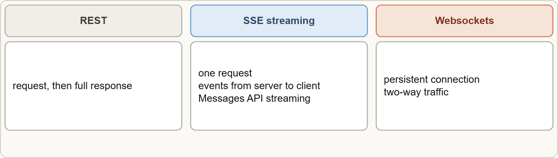
Technical Fundamentals, continued
Part 2
REST returns a full response; SSE streams events one way; websockets keep a two-way connection open
EXAM TIP SSE streams one way over HTTP (the Messages API streaming); websockets keep a two-way connection.
Claude Developer Foundations Exam Prep | for the CCDV-F exam
Module 7: LLM and Technical Fundamentals
14 / 27
Notes:
Technical Fundamentals, continued.
The figure shows this: R E S T returns a full response; S S E streams events one way; websockets keep a two-way connection open.
Exam tip: S S E streams one way over H T T P (the Messages A P I streaming); websockets keep a two-way connection.

Slide 15
Module Recap
Part 2
1
Token
2
Context window
3
max_tokens
Piece of text; basis of limits and billing
Max tokens in one request (input + output); up to 1M on current models
Output cap; hitting it truncates
4
Generation
5
Non-determinism
6
Sampling params
Next-token prediction, one token at a time, sampled
Same prompt can vary; constrain with structure and evals
temperature, top_p, top_k: concept; not supported on current models (400 error)
7
Model options
8
Shots
9
Transport
Adaptive thinking · effort (low … max) · fast mode (speed at a premium)
Zero-shot (instructions) · single-shot (one example) · multi-shot (several, with edge cases)
SDKs wrap REST; SSE = one-way stream; websockets = two-way connection
Claude Developer Foundations Exam Prep | for the CCDV-F exam
Module 7: LLM and Technical Fundamentals
15 / 27
Notes:
Here is the recap.
Token: Piece of text; basis of limits and billing.
Context window: Max tokens in one request (input plus output); up to one million on current models.
max tokens: Output cap; hitting it truncates.
Generation: Next-token prediction, one token at a time, sampled.
Non-determinism: Same prompt can vary; constrain with structure and evals.
Sampling params: temperature, top p, top k: concept; not supported on current models (four hundred error).
Model options: Adaptive thinking, effort (low, max), fast mode (speed at a premium).
Shots: Zero-shot (instructions), single-shot (one example), multi-shot (several, with edge cases).
Transport: S D K s wrap R E S T; S S E equals one-way stream; websockets equals two-way connection.

Slide 16
Practice Question 1
Part 2
Q1
A developer sends the same prompt twice and gets two slightly different answers. What does this show?
A
The context window is full, so the model starts to drop earlier turns
B
The API key expired
C
Output generation is sampled, so wording can vary between runs
D
The API is broken
Claude Developer Foundations Exam Prep | for the CCDV-F exam
Module 7: LLM and Technical Fundamentals
16 / 27
Notes:
Question one.
A developer sends the same prompt twice and gets two slightly different answers. What does this show?
The four options are on the screen.
[PAUSE 12]
The answer is C. Next-token sampling makes outputs non-deterministic; use constraints and evals for consistency.

Slide 17
Practice Question 2
Part 2
Q2
A reply stops mid-sentence and stop_reason is max_tokens. What is the right interpretation?
A
The model refused
B
The output reached the max_tokens cap and was truncated
C
The context window of the model is too small for the prompt
D
The prompt contained an error
Claude Developer Foundations Exam Prep | for the CCDV-F exam
Module 7: LLM and Technical Fundamentals
17 / 27
Notes:
Question two.
A reply stops mid-sentence and stop reason is max tokens. What is the right interpretation?
The four options are on the screen.
[PAUSE 12]
The answer is B. max tokens limits output; reaching it truncates the answer.

Slide 18
Practice Question 3
Part 2
Q3
What is a token?
A
A piece of text, such as a word or part of a word, that models read, produce and bill in
B
A characters-per-second measure of how quickly the model writes its reply
C
Always exactly one word
D
A security credential
Claude Developer Foundations Exam Prep | for the CCDV-F exam
Module 7: LLM and Technical Fundamentals
18 / 27
Notes:
Question three.
What is a token?
The four options are on the screen.
[PAUSE 12]
The answer is A. Tokens are the units of text for context limits and pricing.

Slide 19
Practice Question 4
Part 2
Q4
What does the context window limit?
A
The number of API keys
B
The total tokens the model considers in one request, including its output
C
The size of the files on disk
D
Only the length of the model's reply and nothing about the size of the input
Claude Developer Foundations Exam Prep | for the CCDV-F exam
Module 7: LLM and Technical Fundamentals
19 / 27
Notes:
Question four.
What does the context window limit?
The four options are on the screen.
[PAUSE 12]
The answer is B. The window covers input plus output for the request.

Slide 20
Practice Question 5
Part 2
Q5
A developer wants to show the model the exact output layout with one worked example. Which technique is this?
A
Streaming
B
Zero-shot
C
Fine-tuning
D
Single-shot
Claude Developer Foundations Exam Prep | for the CCDV-F exam
Module 7: LLM and Technical Fundamentals
20 / 27
Notes:
Question five.
A developer wants to show the model the exact output layout with one worked example. Which technique is this?
The four options are on the screen.
[PAUSE 12]
The answer is D. One input and output example is single-shot prompting.

Slide 21
Practice Question 6
Part 2
Q6
Which task most benefits from multi-shot prompting?
A
Asking for the current time
B
An ambiguous classification with edge cases where consistency matters
C
A trivial arithmetic question that any single instruction already answers
D
A request for a poem
Claude Developer Foundations Exam Prep | for the CCDV-F exam
Module 7: LLM and Technical Fundamentals
21 / 27
Notes:
Question six.
Which task most benefits from multi-shot prompting?
The four options are on the screen.
[PAUSE 12]
The answer is B. Several diverse examples teach the pattern and edge-case handling.

Slide 22
Practice Question 7
Part 2
Q7
What is the practical difference between SSE and websockets?
A
They are identical
B
SSE is one-way server-to-client streaming; websockets are two-way
C
SSE is two-way and persistent; websockets are one-way and short-lived
D
SSE needs no network
Claude Developer Foundations Exam Prep | for the CCDV-F exam
Module 7: LLM and Technical Fundamentals
22 / 27
Notes:
Question seven.
What is the practical difference between S S E and websockets?
The four options are on the screen.
[PAUSE 12]
The answer is B. The Messages A P I streams over S S E; websockets are full-duplex.

Slide 23
Practice Question 8
Part 2
Q8
Why use an official SDK instead of raw HTTP calls?
A
SDKs make the model smarter and more accurate on hard tasks than raw HTTP
B
It wraps the REST API, handles headers, parsing, streaming helpers and retries of transient errors
C
Raw HTTP is not possible
D
SDKs remove rate limits
Claude Developer Foundations Exam Prep | for the CCDV-F exam
Module 7: LLM and Technical Fundamentals
23 / 27
Notes:
Question eight.
Why use an official S D K instead of raw H T T P calls?
The four options are on the screen.
[PAUSE 12]
The answer is B. S D K s reduce boilerplate and add retry and streaming support.

Slide 24
Practice Question 9
Part 2
Q9
A developer tries to set temperature on a current model and gets a 400 error. What should they do?
A
Remove the parameter and guide behavior with prompts, structure and effort
B
Switch to an older model family that still accepts it and keep the same code
C
Contact billing
D
Retry with a higher temperature
Claude Developer Foundations Exam Prep | for the CCDV-F exam
Module 7: LLM and Technical Fundamentals
24 / 27
Notes:
Question nine.
A developer tries to set temperature on a current model and gets a four hundred error. What should they do?
The four options are on the screen.
[PAUSE 12]
The answer is A. Current models do not accept non-default sampling parameters.

Slide 25
Practice Question 10
Part 2
Q10
Which TWO statements about generation are correct? (Select TWO.)
A
Identical prompts always return identical text
B
A larger context window removes the need to manage context
C
The model predicts the next token one at a time from the context
D
Hallucinations can be reduced with grounding and validation
E
Tokens are always whole words
Claude Developer Foundations Exam Prep | for the CCDV-F exam
Module 7: LLM and Technical Fundamentals
25 / 27
Notes:
Question ten. Select two.
Which two statements about generation are correct?
The five options are on the screen.
[PAUSE 15]
The answers are C and D. Generation is next-token prediction, and grounding and validation reduce hallucination; outputs vary and tokens are not words.

Slide 26
Practice Question 11
Part 2
Q11
Which TWO describe fast mode and effort correctly? (Select TWO.)
A
Effort changes the model's context window size
B
Lower effort usually reduces cost and latency with some capability loss
C
Fast mode is free
D
Fast mode delivers faster output at premium pricing
E
Effort is a strict token budget
Claude Developer Foundations Exam Prep | for the CCDV-F exam
Module 7: LLM and Technical Fundamentals
26 / 27
Notes:
Question eleven. Select two.
Which two describe fast mode and effort correctly?
The five options are on the screen.
[PAUSE 15]
The answers are B and D. Fast mode buys speed at a premium and effort is a behavioral signal that trades quality for cost and latency.

Slide 27
Answers at a Glance
Part 2
Question | Answer | Why
Q1 | C | Next-token sampling makes outputs non-deterministic
Q2 | B | max_tokens limits output; reaching it truncates the answer
Q3 | A | Tokens are the units of text for context
Q4 | B | The window covers input plus output for the
Q5 | D | One input and output example is single-shot prompting
Q6 | B | Several diverse examples teach the pattern and edge-case
Q7 | B | The Messages API streams over SSE
Q8 | B | SDKs reduce boilerplate and add retry and streaming
Q9 | A | Current models do not accept non-default sampling parameters
Q10 | C, D | Generation is next-token prediction
Q11 | B, D | Fast mode buys speed at a premium and
Claude Developer Foundations Exam Prep | for the CCDV-F exam
Module 7: LLM and Technical Fundamentals
27 / 27
Notes:
Here are all eleven answers. Question one: C. Question two: B. Question three: A. Question four: B. Question five: D. Question six: B. Question seven: B. Question eight: B. Question nine: A. Question ten: C and D. Question eleven: B and D.
In the next module, we continue the course.

