Slide 1
Module 8: Model Selection, Cost and Token Management
Opus, Sonnet and Haiku use cases, and the larger model above them
Domain 5 · Model Selection and Optimization · Skills: Model Selection and Tradeoffs, Cost and Token Management
Claude Developer Foundations Exam Prep Masterclass
Module 8
Notes:
Welcome to Module eight: Model Selection, Cost and Token Management. This module covers the skills model selection and tradeoffs, cost and token management.
Each part of this module comes from the study notes of the same name, so you can read the notes after you watch.

Slide 2
What You Will Learn
Module 8
Opus, Sonnet and Haiku use cases, and the larger model above them
The quality, latency and cost trade-off, and routing
Breaking behavior changes across model releases
Token tracking, cost modeling and the main cost levers: caching, batch, effort, pruning
Claude Developer Foundations Exam Prep | for the CCDV-F exam
Module 8: Model Selection, Cost and Token Management
2 / 24
Notes:
By the end of this module you will be able to do four things.
Opus, Sonnet and Haiku use cases, and the larger model above them.
The quality, latency and cost trade-off, and routing.
Breaking behavior changes across model releases.
Token tracking, cost modeling and the main cost levers: caching, batch, effort, pruning.

Slide 3
Case Check-In: Tidewater Picks Models
Module 8
CASE CHECK-IN · Tidewater Insurance
Three jobs: classify every incoming email (millions a month), answer adjuster questions, and investigate complex fraud cases
One model for everything would be either too weak or too expensive
Claude Developer Foundations Exam Prep | for the CCDV-F exam
Module 8: Model Selection, Cost and Token Management
3 / 24
Notes:
Our running case is Tidewater Insurance. Tidewater Picks Models.
Three jobs: classify every incoming email (millions a month), answer adjuster questions, and investigate complex fraud cases.
One model for everything would be either too weak or too expensive.

Slide 4
Choosing a Model
Module 8
Tier (current lineup) | Strength | Typical use
Haiku (for example Claude Haiku 5.5) | Fastest and cheapest | High-volume, latency-sensitive work: classification, routing, screening, simple extraction
Sonnet (Claude Sonnet 5.5) | Best balance of speed and intelligence | Most interactive applications, coding assistants, everyday agents
Opus (Claude Opus 5.5) | Strong on long-running agentic and knowledge work | Complex coding, multi-step agents, hard analysis; a good default when unsure
Fable (Claude Fable 5.1) | Highest capability, slower and costlier | The hardest reasoning and long-horizon agentic tasks, when Opus at high effort still falls short
Claude Developer Foundations Exam Prep | for the CCDV-F exam
Module 8: Model Selection, Cost and Token Management
4 / 24
Notes:
Choosing a Model.
Haiku (for example Claude Haiku five point five). Strength: Fastest and cheapest. Typical use: High-volume, latency-sensitive work: classification, routing, screening, simple extraction.
Sonnet (Claude Sonnet five point five). Strength: Best balance of speed and intelligence. Typical use: Most interactive applications, coding assistants, everyday agents.
Opus (Claude Opus five point five). Strength: Strong on long-running agentic and knowledge work. Typical use: Complex coding, multi-step agents, hard analysis; a good default when unsure.
Fable (Claude Fable five point one). Strength: Highest capability, slower and costlier. Typical use: The hardest reasoning and long-horizon agentic tasks, when Opus at high effort still falls short.

Slide 5
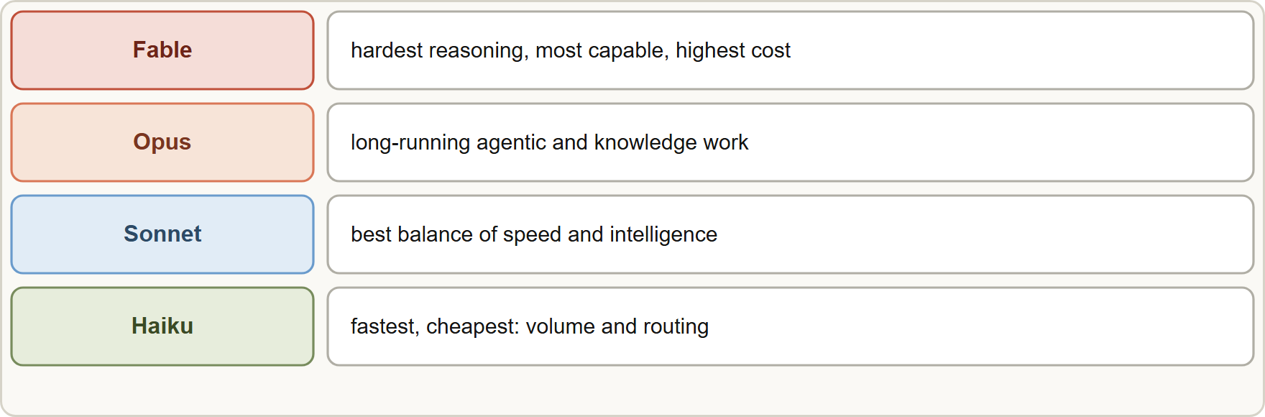
Choosing a Model, continued
Module 8
Method: define the quality bar with evals (Module 16), try the smallest model, move up only when evals fail, and move down when a cheaper model still passes.
Route by difficulty (cascade): a cheap model handles the easy bulk; escalate hard or low-confidence cases to a stronger model.
Method: define the quality bar with evals (Module 16), try the smallest model, move up only when evals fail, and move down when a cheaper model still passes.
Route by difficulty (cascade): a cheap model handles the easy bulk; escalate hard or low-confidence cases to a stronger model.
Claude Developer Foundations Exam Prep | for the CCDV-F exam
Module 8: Model Selection, Cost and Token Management
5 / 24
Notes:
Choosing a Model, continued.
The figure shows this: Pick the smallest tier that meets the quality bar: Haiku for volume, Sonnet for balance, Opus for long agentic work, Fable for the hardest tasks.
Method: define the quality bar with evals (Module sixteen), try the smallest model, move up only when evals fail, and move down when a cheaper model still passes.
Route by difficulty (cascade): a cheap model handles the easy bulk; escalate hard or low-confidence cases to a stronger model.

Slide 6
Choosing a Model, continued
DATES
Module 8
Adaptive thinking support and effort differ by model; check the model page (Module 3).
"Always the largest model" and "always the smallest model" are both wrong answers: the right model is the cheapest that meets the measured requirement.
Current lineup and prices (per million tokens, input / output): Fable 5.1 $10 / $50, Opus 5.5 $4 / $20, Sonnet 5.5 $2 / $10, Haiku 5.5 from $0.10 / $0.50; all with a 1M-token context window and up to 128K output tokens. Model names, tiers and prices change; read the models overview. As of 8 November 2026.
Claude Developer Foundations Exam Prep | for the CCDV-F exam
Module 8: Model Selection, Cost and Token Management
6 / 24
Notes:
Choosing a Model, continued.
Adaptive thinking support and effort differ by model; check the model page (Module three).
"Always the largest model" and "always the smallest model" are both wrong answers: the right model is the cheapest that meets the measured requirement.
Current lineup and prices (per million tokens, input or output): Fable five point one ten dollars or fifty dollars Opus five point five four dollars or twenty dollars Sonnet five point five two dollars or ten dollars Haiku five point five from zero dollars and ten cents or zero dollars and fifty cents; all with a one million token context window and up to one hundred twenty-eight thousand output tokens. Model names, tiers and prices change; read the models overview. As of eight November two thousand twenty-six.

Slide 7
Breaking behavior changes across releases
Module 8
New models can change behavior even with the same prompt, and some parameters are removed or restricted. Examples on current models: manual extended thinking is rejected (use adaptive thinking), sampling parameters are not accepted, and forced tool use is not supported on some models.
Therefore: pin the model, read the migration guide before switching, re-run evals on the new model, and roll out gradually.
Models are retired on published dates; plan migrations early (Module 1).
EXAM TIP "Upgrade to the newest model" is a release: read the migration notes, re-run evals, adjust prompts and parameters, then deploy.
Claude Developer Foundations Exam Prep | for the CCDV-F exam
Module 8: Model Selection, Cost and Token Management
7 / 24
Notes:
Breaking behavior changes across releases.
New models can change behavior even with the same prompt, and some parameters are removed or restricted. Examples on current models: manual extended thinking is rejected (use adaptive thinking), sampling parameters are not accepted, and forced tool use is not supported on some models.
Therefore: pin the model, read the migration guide before switching, re-run evals on the new model, and roll out gradually.
Models are retired on published dates; plan migrations early (Module one).
Exam tip: "Upgrade to the newest model" is a release: read the migration notes, re-run evals, adjust prompts and parameters, then deploy.
Exam tip: Pick the smallest model that passes your evals; "always the largest" and "always the smallest" are both wrong.

Slide 8
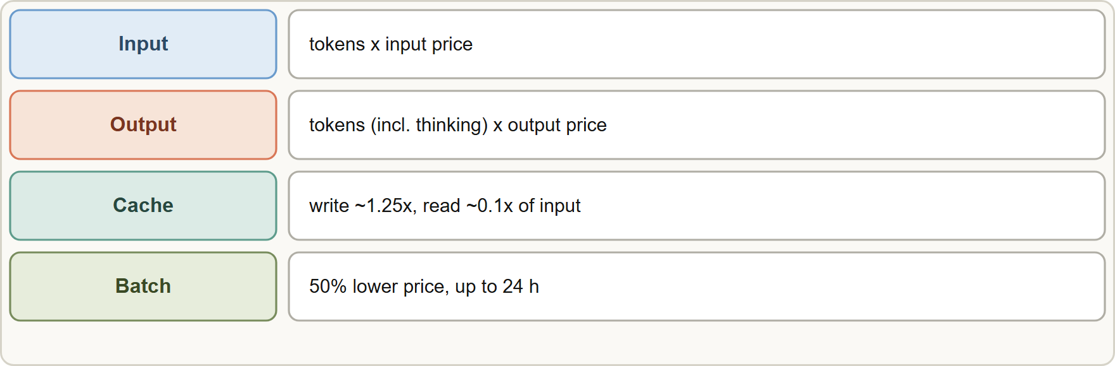
Know what you spend
Module 8
Track usage from the usage field of every response (input, output, cache creation and cache read tokens) and aggregate by feature, user and model. Output tokens cost more than input tokens, and thinking tokens are output tokens.
Track usage from the usage field of every response (input, output, cache creation and cache read tokens) and aggregate by feature, user and model. Output tokens cost more than input tokens, and thinking tokens are output tokens.
Claude Developer Foundations Exam Prep | for the CCDV-F exam
Module 8: Model Selection, Cost and Token Management
8 / 24
Notes:
Know what you spend.
The figure shows this: Cost per request: input, output (including thinking), and cache tokens at their own prices; batch halves the price.
Track usage from the usage field of every response (input, output, cache creation and cache read tokens) and aggregate by feature, user and model. Output tokens cost more than input tokens, and thinking tokens are output tokens.

Slide 9
Know what you spend, continued
Module 8
Estimate before sending with the token counting endpoint (an estimate) to budget, route and set limits.
Cost modeling: estimate tokens per request × requests per month × price, for each model; add caching and batch effects; compare options before building.
Example (illustrative): 1 million requests a month, 800 input and 150 output tokens each, on a model priced $2 input and $10 output per million: input 800M tokens = $1,600, output 150M tokens = $1,500, total about $3,100 a month; with a cached 600-token prefix read at a fraction of the input price the input cost falls sharply.
Claude Developer Foundations Exam Prep | for the CCDV-F exam
Module 8: Model Selection, Cost and Token Management
9 / 24
Notes:
Know what you spend, continued.
Estimate before sending with the token counting endpoint (an estimate) to budget, route and set limits.
Cost modeling: estimate tokens per request times requests per month times price, for each model; add caching and batch effects; compare options before building.
Example (illustrative): one million requests a month, eight hundred input and one hundred fifty output tokens each, on a model priced two dollars input and ten dollars output per million: input eight hundred million tokens equals one thousand six hundred dollars output one hundred fifty million tokens equals one thousand five hundred dollars total about three thousand one hundred dollars a month; with a cached six hundred-token prefix read at a fraction of the input price the input cost falls sharply.

Slide 10
The cost levers
Module 8
Lever | Effect | Watch out for
Smaller model / routing | Lower price and latency | Quality: prove with evals
Prompt caching | Cache reads cost a fraction of input; faster | Only stable prefixes; minimum length; TTL
Cache check-pointing (breakpoints) | Cache the growing conversation prefix at chosen points | Up to 4 breakpoints; order matters
Batch API | 50% lower price | Up to 24 h; not for waiting users
Lower effort | Fewer thinking and output tokens | Capability loss on hard tasks
Prune context | Fewer input tokens: trim tool output, compact, drop stale history | Do not drop needed facts
Claude Developer Foundations Exam Prep | for the CCDV-F exam
Module 8: Model Selection, Cost and Token Management
10 / 24
Notes:
The cost levers.
Smaller model or routing. Effect: Lower price and latency. Watch out for: Quality: prove with evals.
Prompt caching. Effect: Cache reads cost a fraction of input; faster. Watch out for: Only stable prefixes; minimum length; T T L.
Cache check-pointing (breakpoints). Effect: Cache the growing conversation prefix at chosen points. Watch out for: Up to four breakpoints; order matters.
Batch A P I (application programming interface). Effect: fifty percent lower price. Watch out for: Up to twenty-four h; not for waiting users.
Lower effort. Effect: Fewer thinking and output tokens. Watch out for: Capability loss on hard tasks.
Prune context. Effect: Fewer input tokens: trim tool output, compact, drop stale history. Watch out for: Do not drop needed facts.

Slide 11
The cost levers, continued
Module 8
Lever | Effect | Watch out for
Limit output | Concise instructions, sensible max_tokens, structured output | Truncation if too low
Claude Developer Foundations Exam Prep | for the CCDV-F exam
Module 8: Model Selection, Cost and Token Management
11 / 24
Notes:
The cost levers, continued.
Limit output. Effect: Concise instructions, sensible max tokens, structured output. Watch out for: Truncation if too low.

Slide 12
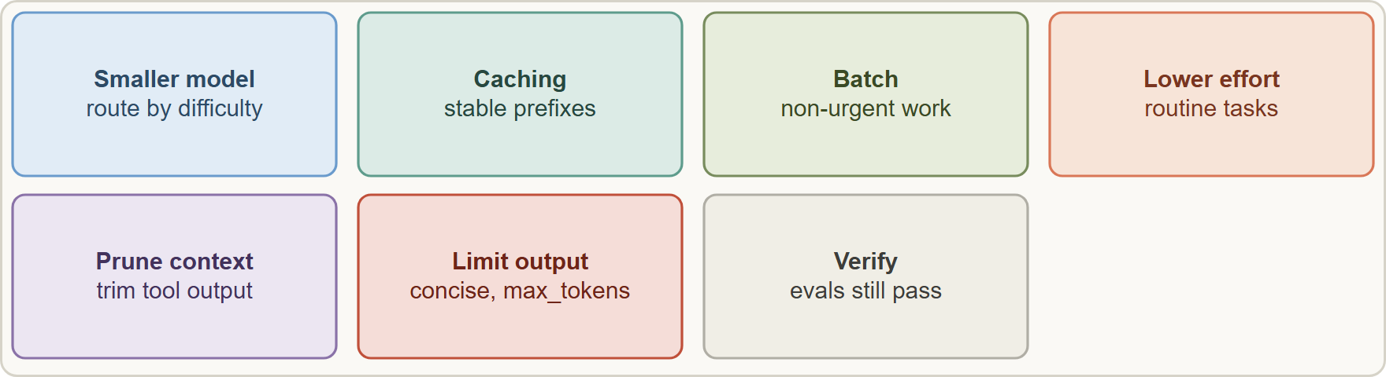
The cost levers, continued
Module 8
Cost levers and their trade-offs: every saving needs a check that quality still passes the evals
EXAM TIP Reduce cost without breaking quality: pick the lever that matches the workload (cache repeated prefixes, batch the non-urgent work, route easy cases to a small model) and verify with evals.
Claude Developer Foundations Exam Prep | for the CCDV-F exam
Module 8: Model Selection, Cost and Token Management
12 / 24
Notes:
The cost levers, continued.
The figure shows this: Cost levers and their trade-offs: every saving needs a check that quality still passes the evals.
Exam tip: Reduce cost without breaking quality: pick the lever that matches the workload (cache repeated prefixes, batch the non-urgent work, route easy cases to a small model) and verify with evals.

Slide 13
Module Recap
Module 8
1
Tiers
2
Method
3
Routing
Haiku fastest and cheapest (volume) · Sonnet balance · Opus long agentic work (good default) · Fable hardest tasks
Evals set the bar; smallest model that passes; step up only when evals fail
Cheap model for the bulk, escalate hard cases
4
Releases
5
Track
6
Cost
Pin the model; read migration notes; re-run evals; params can change
usage fields; token counting endpoint (estimate)
Output > input price; thinking = output; cache write ~1.25x, read ~0.1x; batch −50%
7
Levers
Smaller model · caching and breakpoints · batch · lower effort · prune context · limit output
Claude Developer Foundations Exam Prep | for the CCDV-F exam
Module 8: Model Selection, Cost and Token Management
13 / 24
Notes:
Here is the recap.
Tiers: Haiku fastest and cheapest (volume), Sonnet balance, Opus long agentic work (good default), Fable hardest tasks.
Method: Evals set the bar; smallest model that passes; step up only when evals fail.
Routing: Cheap model for the bulk, escalate hard cases.
Releases: Pin the model; read migration notes; re-run evals; params can change.
Track: usage fields; token counting endpoint (estimate).
Cost: Output greater than input price; thinking equals output; cache write about one point two five times, read about zero point one times; batch −fifty percent.
Levers: Smaller model, caching and breakpoints, batch, lower effort, prune context, limit output.

Slide 14
Practice Question 1
Module 8
Q1
Tidewater must label millions of incoming emails quickly and cheaply with a simple category set. Which model choice fits?
A
No model; guess by length
B
The most capable and most expensive model for every email, to be safe
C
A small, fast model such as Haiku, checked against an eval set
D
A random model per email
Claude Developer Foundations Exam Prep | for the CCDV-F exam
Module 8: Model Selection, Cost and Token Management
14 / 24
Notes:
Question one.
Tidewater must label millions of incoming emails quickly and cheaply with a simple category set. Which model choice fits?
The four options are on the screen.
[PAUSE 12]
The answer is C. High-volume, simple, latency-sensitive tasks fit the fastest, cheapest tier once evals show the quality is sufficient.

Slide 15
Practice Question 2
Module 8
Q2
A team always uses the largest model and the bill is high. Evals show a mid-tier model passes. What should they do?
A
Switch to the smallest model without testing
B
Keep the largest model for safety, whatever the quality bar or the cost may be
C
Remove the evals
D
Move to the cheaper model that meets the quality bar, and keep monitoring
Claude Developer Foundations Exam Prep | for the CCDV-F exam
Module 8: Model Selection, Cost and Token Management
15 / 24
Notes:
Question two.
A team always uses the largest model and the bill is high. Evals show a mid-tier model passes. What should they do?
The four options are on the screen.
[PAUSE 12]
The answer is D. Choose the cheapest model that meets the measured requirement.

Slide 16
Practice Question 3
Module 8
Q3
A system uses a cheap model for most requests and a stronger model only when confidence is low. What is this pattern?
A
Fine-tuning
B
Prompt caching of the shared instructions
C
Batching
D
Routing (a cascade) by difficulty
Claude Developer Foundations Exam Prep | for the CCDV-F exam
Module 8: Model Selection, Cost and Token Management
16 / 24
Notes:
Question three.
A system uses a cheap model for most requests and a stronger model only when confidence is low. What is this pattern?
The four options are on the screen.
[PAUSE 12]
The answer is D. Routing sends easy cases to a small model and escalates hard ones.

Slide 17
Practice Question 4
Module 8
Q4
A developer upgrades the model name in production and answers change unexpectedly, and a parameter now returns an error. What should have been done?
A
Increase max_tokens
B
Read the migration guide, re-run evals, adjust prompts, then release gradually
C
Nothing, because an upgrade never changes behavior or removes a parameter from the API
D
Disable logging
Claude Developer Foundations Exam Prep | for the CCDV-F exam
Module 8: Model Selection, Cost and Token Management
17 / 24
Notes:
Question four.
A developer upgrades the model name in production and answers change unexpectedly, and a parameter now returns an error. What should have been done?
The four options are on the screen.
[PAUSE 12]
The answer is B. Model changes can alter behavior and remove parameters; treat them as releases.

Slide 18
Practice Question 5
Module 8
Q5
Where can a developer see how many tokens a request actually used?
A
In the usage field of the response
B
In the model's name
C
In the HTTP method
D
Only on the monthly invoice
Claude Developer Foundations Exam Prep | for the CCDV-F exam
Module 8: Model Selection, Cost and Token Management
18 / 24
Notes:
Question five.
Where can a developer see how many tokens a request actually used?
The four options are on the screen.
[PAUSE 12]
The answer is A. The response usage reports input, output and cache tokens for tracking.

Slide 19
Practice Question 6
Module 8
Q6
A developer wants to estimate the input size of a large prompt before sending it. What helps?
A
The token counting endpoint, which returns an estimate
B
Asking the model
C
Sending the request and checking the invoice at the end of the month
D
Counting words by hand and assuming exact equality
Claude Developer Foundations Exam Prep | for the CCDV-F exam
Module 8: Model Selection, Cost and Token Management
19 / 24
Notes:
Question six.
A developer wants to estimate the input size of a large prompt before sending it. What helps?
The four options are on the screen.
[PAUSE 12]
The answer is A. Token counting estimates input tokens so you can budget and route.

Slide 20
Practice Question 7
Module 8
Q7
Output tokens are priced higher than input tokens. Which change is the most direct way to reduce output cost?
A
Ask for concise answers, use structured output, and set a sensible max_tokens
B
Add a longer system prompt
C
Add more examples to the prompt
D
Increase the effort level
Claude Developer Foundations Exam Prep | for the CCDV-F exam
Module 8: Model Selection, Cost and Token Management
20 / 24
Notes:
Question seven.
Output tokens are priced higher than input tokens. Which change is the most direct way to reduce output cost?
The four options are on the screen.
[PAUSE 12]
The answer is A. Shorter, structured output lowers the more expensive tokens.

Slide 21
Practice Question 8
Module 8
Q8
An application resends the same 20,000-token policy text in every request. Which lever reduces its cost most?
A
Removing the policy
B
Prompt caching of the stable prefix
C
A higher temperature
D
Using batch for live chat
Claude Developer Foundations Exam Prep | for the CCDV-F exam
Module 8: Model Selection, Cost and Token Management
21 / 24
Notes:
Question eight.
An application resends the same twenty thousand-token policy text in every request. Which lever reduces its cost most?
The four options are on the screen.
[PAUSE 12]
The answer is B. Cache reads of a repeated prefix cost a fraction of normal input and are faster.

Slide 22
Practice Question 9
Module 8
Q9
Which TWO describe good model selection practice? (Select TWO.)
A
Always choose the largest model
B
Never change a model once chosen
C
Re-run evals when switching models
D
Choose the model by its name alone
E
Define the quality bar with evals and choose the cheapest model that meets it
Claude Developer Foundations Exam Prep | for the CCDV-F exam
Module 8: Model Selection, Cost and Token Management
22 / 24
Notes:
Question nine. Select two.
Which two describe good model selection practice?
The five options are on the screen.
[PAUSE 15]
The answers are C and E. Evals define "good enough" and must be repeated on each model change.

Slide 23
Practice Question 10
Module 8
Q10
Which TWO levers reduce cost for the nightly bulk re-tagging of old claims? (Select TWO.)
A
Use fast mode for speed
B
Use the most expensive model at maximum effort
C
Route easy items to a smaller model that passes the evals
D
Submit it as a batch for the lower price
E
Disable the evals
Claude Developer Foundations Exam Prep | for the CCDV-F exam
Module 8: Model Selection, Cost and Token Management
23 / 24
Notes:
Question ten. Select two.
Which two levers reduce cost for the nightly bulk re-tagging of old claims?
The five options are on the screen.
[PAUSE 15]
The answers are C and D. Non-urgent bulk work suits batch pricing and routing to a cheaper model.

Slide 24
Answers at a Glance
Module 8
Question | Answer | Why
Q1 | C | High-volume, simple, latency-sensitive tasks fit the fastest, cheapest
Q2 | D | Choose the cheapest model that meets the measured
Q3 | D | Routing sends easy cases to a small model
Q4 | B | Model changes can alter behavior and remove parameters
Q5 | A | The response usage reports input
Q6 | A | Token counting estimates input tokens so you can
Q7 | A | Shorter, structured output lowers the more expensive tokens
Q8 | B | Cache reads of a repeated prefix cost a
Q9 | C, E | Evals define "good enough" and must be repeated
Q10 | C, D | Non-urgent bulk work suits batch pricing and routing
Claude Developer Foundations Exam Prep | for the CCDV-F exam
Module 8: Model Selection, Cost and Token Management
24 / 24
Notes:
Here are all ten answers. Question one: C. Question two: D. Question three: D. Question four: B. Question five: A. Question six: A. Question seven: A. Question eight: B. Question nine: C and E. Question ten: C and D.
In the next module, we continue the course.

