Slide 1
Module 9: Context Engineering
Context engineering: deciding what goes into the context window, in what order, and for
Domain 6 · Prompt and Context Engineering · Skills: Context Engineering
Claude Developer Foundations Exam Prep Masterclass
Module 9
Notes:
Welcome to Module nine: Context Engineering. This module covers the skills context engineering.
Each part of this module comes from the study notes of the same name, so you can read the notes after you watch.

Slide 2
What You Will Learn
Module 9
Context engineering: deciding what goes into the context window, in what order, and for how long
Preventing context drift and bloat: tool output pruning and compaction
Context isolation with subagents or multi-step workflows
Memory outside the window
Claude Developer Foundations Exam Prep | for the CCDV-F exam
Module 9: Context Engineering
2 / 18
Notes:
By the end of this module you will be able to do four things.
Context engineering: deciding what goes into the context window, in what order, and for how long.
Preventing context drift and bloat: tool output pruning and compaction.
Context isolation with subagents or multi-step workflows.
Memory outside the window.

Slide 3
Case Check-In: Tidewater's Assistant Gets Confused Late in the Day
Module 9
CASE CHECK-IN · Tidewater Insurance
Adjusters keep one long session open all day
Each question pulls in large policy lookups and 40-field claim records
By afternoon the assistant repeats itself, ignores early instructions and costs more per question
Claude Developer Foundations Exam Prep | for the CCDV-F exam
Module 9: Context Engineering
3 / 18
Notes:
Our running case is Tidewater Insurance. Tidewater's Assistant Gets Confused Late in the Day.
Adjusters keep one long session open all day.
Each question pulls in large policy lookups and forty-field claim records.
By afternoon the assistant repeats itself, ignores early instructions and costs more per question.

Slide 4
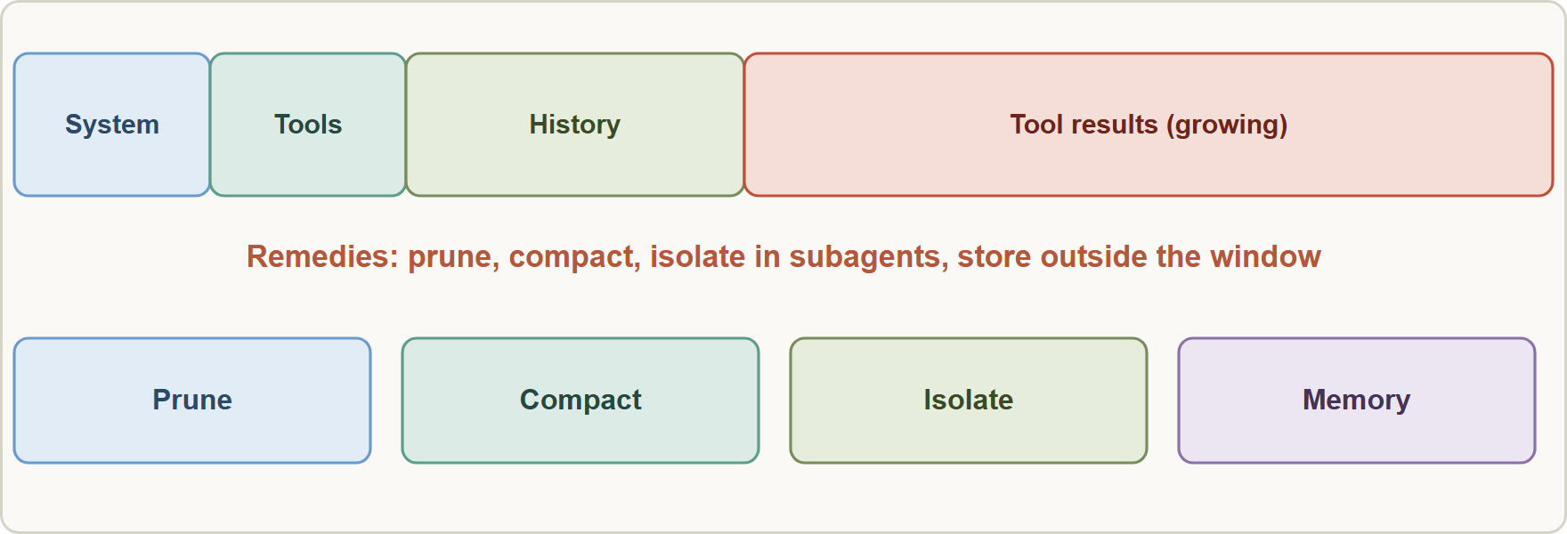
The Context Is a Budget
Module 9
Everything in the window competes for attention: system prompt, instructions, tool definitions, history, documents and tool results. More is not better; relevant and well ordered is better.
Context drift: the model gradually loses track of early instructions or facts as the window fills with later material.
Everything in the window competes for attention: system prompt, instructions, tool definitions, history, documents and tool results. More is not better; relevant and well ordered is better.
Context drift: the model gradually loses track of early instructions or facts as the window fills with later material.
Claude Developer Foundations Exam Prep | for the CCDV-F exam
Module 9: Context Engineering
4 / 18
Notes:
The Context Is a Budget.
The figure shows this: The context window is a budget: tool results and history grow until they crowd out what matters; prune, compact, isolate and store outside.
Everything in the window competes for attention: system prompt, instructions, tool definitions, history, documents and tool results. More is not better; relevant and well ordered is better.
Context drift: the model gradually loses track of early instructions or facts as the window fills with later material.

Slide 5
The Context Is a Budget, continued
Module 9
Context bloat: tokens spent on irrelevant content (verbose tool output, stale history) raise cost and latency and lower quality.
EXAM TIP Context problems (drift, repetition, rising cost) are fixed by managing the context, not by buying a bigger window.
Claude Developer Foundations Exam Prep | for the CCDV-F exam
Module 9: Context Engineering
5 / 18
Notes:
The Context Is a Budget, continued.
Context bloat: tokens spent on irrelevant content (verbose tool output, stale history) raise cost and latency and lower quality.
Exam tip: Context problems (drift, repetition, rising cost) are fixed by managing the context, not by buying a bigger window.

Slide 6
Techniques
Module 9
Technique | What it does | Use when
Tool output pruning | Trim tool results to the fields that matter before they enter the context; or clear old tool results (context editing) | A tool returns far more than the next step needs
Compaction (summarization) | Replace older turns with a summary (server-side compaction, or your own summarizing call) | A long conversation nears the limit
Context isolation | Do verbose work in a subagent or a separate step and bring back a short result | Exploration, search or analysis would flood the main context
Claude Developer Foundations Exam Prep | for the CCDV-F exam
Module 9: Context Engineering
6 / 18
Notes:
Techniques.
Tool output pruning. What it does: Trim tool results to the fields that matter before they enter the context; or clear old tool results (context editing). Use when: A tool returns far more than the next step needs.
Compaction (summarization). What it does: Replace older turns with a summary (server-side compaction, or your own summarizing call). Use when: A long conversation nears the limit.
Context isolation. What it does: Do verbose work in a subagent or a separate step and bring back a short result. Use when: Exploration, search or analysis would flood the main context.

Slide 7
Techniques, continued
Module 9
Technique | What it does | Use when
Multi-step workflows | Break work into steps, each with only the context it needs | A single huge prompt is slow, costly and hard to debug
External memory | Save key facts to files or a store and load them when relevant (a memory tool) | Facts must survive beyond the window or across sessions
Retrieval just in time | Fetch documents when needed instead of loading everything up front | Large corpora
Ordering | Put long documents first and the question and instructions last; keep stable content before volatile content (caching) | Long-context prompts
Claude Developer Foundations Exam Prep | for the CCDV-F exam
Module 9: Context Engineering
7 / 18
Notes:
Techniques, continued.
Multi-step workflows. What it does: Break work into steps, each with only the context it needs. Use when: A single huge prompt is slow, costly and hard to debug.
External memory. What it does: Save key facts to files or a store and load them when relevant (a memory tool). Use when: Facts must survive beyond the window or across sessions.
Retrieval just in time. What it does: Fetch documents when needed instead of loading everything up front. Use when: Large corpora.
Ordering. What it does: Put long documents first and the question and instructions last; keep stable content before volatile content (caching). Use when: Long-context prompts.

Slide 8
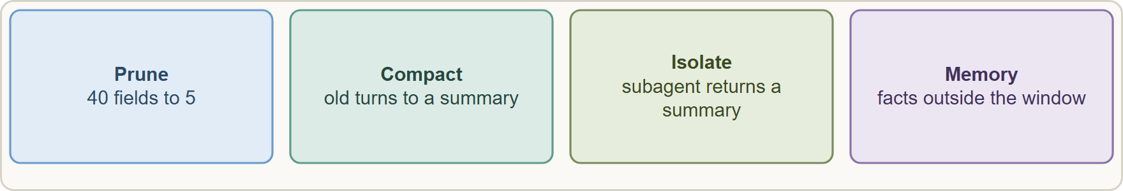
Techniques, continued
Module 9
Compaction risks: a summary can lose exact numbers, dates and commitments. Keep such facts in a separate persistent block that is re-sent each turn, and test what the summary preserves.
Do not drop what the next step needs; prune by relevance, not just by age.
Compaction risks: a summary can lose exact numbers, dates and commitments. Keep such facts in a separate persistent block that is re-sent each turn, and test what the summary preserves.
Do not drop what the next step needs; prune by relevance, not just by age.
Claude Developer Foundations Exam Prep | for the CCDV-F exam
Module 9: Context Engineering
8 / 18
Notes:
Techniques, continued.
The figure shows this: Prune tool output, compact old turns, isolate verbose work in subagents, and keep durable facts in external memory.
Compaction risks: a summary can lose exact numbers, dates and commitments. Keep such facts in a separate persistent block that is re-sent each turn, and test what the summary preserves.
Do not drop what the next step needs; prune by relevance, not just by age.

Slide 9
Techniques, continued
DATES
Module 9
Session hygiene helps: a fresh session per task is the cheapest context management (Module 4).
The API offers server-side compaction (beta) for long conversations and context editing to clear old tool results; models differ in whether they track their remaining context. As of 8 November 2026.
EXAM TIP Symptoms of drift and bloat (ignores early rules, repeats itself, slow and costly) point to pruning, compaction, isolation or a fresh session, not to a bigger model.
Claude Developer Foundations Exam Prep | for the CCDV-F exam
Module 9: Context Engineering
9 / 18
Notes:
Techniques, continued.
Session hygiene helps: a fresh session per task is the cheapest context management (Module four).
The A P I (application programming interface) offers server-side compaction (beta) for long conversations and context editing to clear old tool results; models differ in whether they track their remaining context. As of eight November two thousand twenty-six.
Exam tip: Symptoms of drift and bloat (ignores early rules, repeats itself, slow and costly) point to pruning, compaction, isolation or a fresh session, not to a bigger model.
Exam tip: Exact figures and commitments must not pass through a summary: keep them in a separate persistent block.

Slide 10
Module Recap
Module 9
1
Context
2
Drift / bloat
3
Pruning
A budget: everything competes for attention, cost and latency
Early rules ignored, repetition / irrelevant tokens, higher cost
Trim or clear tool results; keep only fields the next step needs
4
Compaction
5
Isolation
6
Memory
Summarize older turns; keep exact facts in a separate block
Subagents or separate steps return short results
External files or store; load when relevant
7
Ordering
8
Hygiene
Long documents first, question last; stable before volatile
Fresh session per task
Claude Developer Foundations Exam Prep | for the CCDV-F exam
Module 9: Context Engineering
10 / 18
Notes:
Here is the recap.
Context: A budget: everything competes for attention, cost and latency.
Drift or bloat: Early rules ignored, repetition or irrelevant tokens, higher cost.
Pruning: Trim or clear tool results; keep only fields the next step needs.
Compaction: Summarize older turns; keep exact facts in a separate block.
Isolation: Subagents or separate steps return short results.
Memory: External files or store; load when relevant.
Ordering: Long documents first, question last; stable before volatile.
Hygiene: Fresh session per task.

Slide 11
Practice Question 1
Module 9
Q1
Late in a long session the assistant ignores early instructions and each answer is slower and costlier. What is the most direct improvement?
A
Turn off the system prompt so that it cannot be ignored any more
B
Increase max_tokens
C
Switch to a larger model
D
Prune tool output, compact older turns, or start a fresh session
Claude Developer Foundations Exam Prep | for the CCDV-F exam
Module 9: Context Engineering
11 / 18
Notes:
Question one.
Late in a long session the assistant ignores early instructions and each answer is slower and costlier. What is the most direct improvement?
The four options are on the screen.
[PAUSE 12]
The answer is D. Drift and bloat come from a crowded context; reduce and reorganize what the model has to carry.

Slide 12
Practice Question 2
Module 9
Q2
A tool returns 40 fields per claim, but only five matter for the next step. What should the developer do?
A
Ask the model to ignore the rest
B
Disable the tool
C
Trim the result to the relevant fields before it enters the context
D
Pass the full record each time, including fields the model never needs
Claude Developer Foundations Exam Prep | for the CCDV-F exam
Module 9: Context Engineering
12 / 18
Notes:
Question two.
A tool returns forty fields per claim, but only five matter for the next step. What should the developer do?
The four options are on the screen.
[PAUSE 12]
The answer is C. Tool output pruning keeps the window lean without losing what the next step needs.

Slide 13
Practice Question 3
Module 9
Q3
A long conversation will soon exceed the context window. Which technique replaces older turns with a shorter version?
A
Compaction by summarizing earlier turns
B
Raising the temperature so the model needs less context
C
Batch processing
D
Streaming
Claude Developer Foundations Exam Prep | for the CCDV-F exam
Module 9: Context Engineering
13 / 18
Notes:
Question three.
A long conversation will soon exceed the context window. Which technique replaces older turns with a shorter version?
The four options are on the screen.
[PAUSE 12]
The answer is A. Compaction summarizes older history into a shorter form, which frees room in the window for new turns.

Slide 14
Practice Question 4
Module 9
Q4
After compaction the assistant forgets an exact deductible amount a customer stated earlier. What is the best remedy?
A
Delete the conversation
B
Summarize more aggressively
C
Ask the customer to repeat all of the earlier details again at the start of every single turn
D
Keep exact figures in a facts block that is re-sent every turn, outside the summary
Claude Developer Foundations Exam Prep | for the CCDV-F exam
Module 9: Context Engineering
14 / 18
Notes:
Question four.
After compaction the assistant forgets an exact deductible amount a customer stated earlier. What is the best remedy?
The four options are on the screen.
[PAUSE 12]
The answer is D. Critical exact facts should not pass through summarization.

Slide 15
Practice Question 5
Module 9
Q5
An exploration task reads dozens of files and would flood the main conversation. What is a good design?
A
Use a larger window and hope
B
Have a subagent explore in its own context and return a short summary
C
Skip the exploration
D
Paste every file into the main context so the model has everything at once
Claude Developer Foundations Exam Prep | for the CCDV-F exam
Module 9: Context Engineering
15 / 18
Notes:
Question five.
An exploration task reads dozens of files and would flood the main conversation. What is a good design?
The four options are on the screen.
[PAUSE 12]
The answer is B. Isolation keeps verbose work out of the main context.

Slide 16
Practice Question 6
Module 9
Q6
For a prompt with a long contract and a question about it, how should the content be ordered?
A
The long document first, then the question and instructions
B
Order does not matter at all, so any layout works equally well
C
The question first, then the contract placed after it near the end
D
The question in the middle of the document
Claude Developer Foundations Exam Prep | for the CCDV-F exam
Module 9: Context Engineering
16 / 18
Notes:
Question six.
For a prompt with a long contract and a question about it, how should the content be ordered?
The four options are on the screen.
[PAUSE 12]
The answer is A. Putting long material first and the query last generally improves results.

Slide 17
Practice Question 7
Module 9
Q7
Which TWO belong to good context engineering? (Select TWO.)
A
Keep every tool result forever
B
Load documents only when needed instead of all up front
C
Put volatile text before stable text in a cached prompt
D
Save durable facts outside the window and load them when relevant
E
Never summarize anything
Claude Developer Foundations Exam Prep | for the CCDV-F exam
Module 9: Context Engineering
17 / 18
Notes:
Question seven. Select two.
Which two belong to good context engineering?
The five options are on the screen.
[PAUSE 15]
The answers are B and D. Retrieve just in time and use external memory; keep stable text first for caching.

Slide 18
Answers at a Glance
Module 9
Question | Answer | Why
Q1 | D | Drift and bloat come from a crowded context
Q2 | C | Tool output pruning keeps the window lean without losing what the next
Q3 | A | Compaction summarizes older history into a shorter form
Q4 | D | Critical exact facts should not pass through summarization
Q5 | B | Isolation keeps verbose work out of the main context
Q6 | A | Putting long material first and the query last generally improves results
Q7 | B, D | Retrieve just in time and use external memory
Claude Developer Foundations Exam Prep | for the CCDV-F exam
Module 9: Context Engineering
18 / 18
Notes:
Here are all seven answers. Question one: D. Question two: C. Question three: A. Question four: D. Question five: B. Question six: A. Question seven: B and D.
In the next module, we continue the course.

