Slide 1
Module 11: Tool Implementation
Tool use and function calling: the round trip from definition to result
Domain 8 · Tools and MCPs · Skills: Tool Implementation
Claude Developer Foundations Exam Prep Masterclass
Module 11
Notes:
Welcome to Module eleven: Tool Implementation. This module covers the skills tool implementation.
Each part of this module comes from the study notes of the same name, so you can read the notes after you watch.

Slide 2
What You Will Learn
Module 11
Tool use and function calling: the round trip from definition to result
Writing tool descriptions and schemas
Error handling in tools
Patterns: harness dispatch, client-side versus server-side tools, approval patterns
Tool set construction best practices
Claude Developer Foundations Exam Prep | for the CCDV-F exam
Module 11: Tool Implementation
2 / 22
Notes:
By the end of this module you will be able to do five things.
Tool use and function calling: the round trip from definition to result.
Writing tool descriptions and schemas.
Error handling in tools.
Patterns: harness dispatch, client-side versus server-side tools, approval patterns.
Tool set construction best practices.

Slide 3
Case Check-In: Tidewater Connects the Policy System
Module 11
CASE CHECK-IN · Tidewater Insurance
The assistant must look up policies, check claim status and open a payment request
These actions live in Tidewater's internal systems: Claude cannot reach them on its own
Claude Developer Foundations Exam Prep | for the CCDV-F exam
Module 11: Tool Implementation
3 / 22
Notes:
Our running case is Tidewater Insurance. Tidewater Connects the Policy System.
The assistant must look up policies, check claim status and open a payment request.
These actions live in Tidewater's internal systems: Claude cannot reach them on its own.

Slide 4
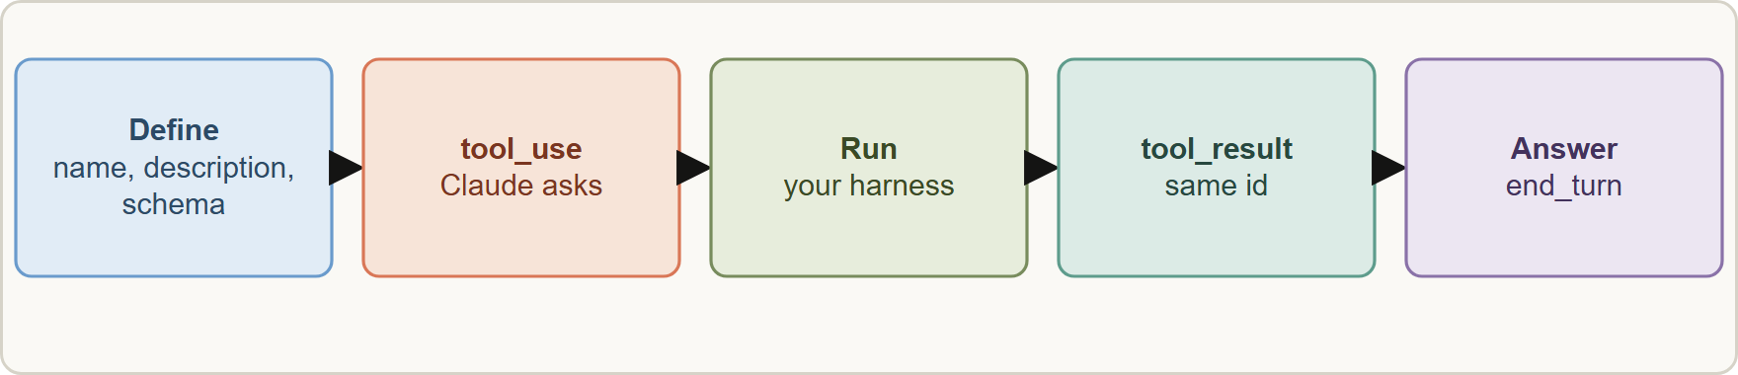
The Tool Round Trip
Module 11
The tool round trip: definitions go in, Claude returns tool_use, your code runs the function, the tool_result goes back, Claude answers
Claude Developer Foundations Exam Prep | for the CCDV-F exam
Module 11: Tool Implementation
4 / 22
Notes:
The Tool Round Trip.
The figure shows this: The tool round trip: definitions go in, Claude returns tool use, your code runs the function, the tool result goes back, Claude answers.

Slide 5
The Tool Round Trip, continued
Module 11
Step | What happens
Define | Each tool has a `name`, a `description` and an `input_schema` (JSON Schema)
Call | Claude decides to use a tool and returns a `tool_use` block (name, id, input); stop_reason is "tool_use"
Run | Your harness validates the input and runs the function (this is the dispatch: map tool name to code)
Return | Send a `tool_result` (matching tool_use_id) in the next user message
Continue | Claude reads the result and answers or calls another tool; stop on end_turn
Claude Developer Foundations Exam Prep | for the CCDV-F exam
Module 11: Tool Implementation
5 / 22
Notes:
The Tool Round Trip, continued.
Define. Each tool has a name, a description and an input schema (Jason Schema).
Call. Claude decides to use a tool and returns a tool use block (name, id, input); stop reason is "tool use".
Run. Your harness validates the input and runs the function (this is the dispatch: map tool name to code).
Return. Send a tool result (matching tool use id) in the next user message.
Continue. Claude reads the result and answers or calls another tool; stop on end turn.

Slide 6
The Tool Round Trip, continued
Module 11
JSON
{
"name": "get_policy",
"description": "Returns coverage limits, deductible and status for ONE policy. Input: a policy number like TW-204518. Use for policy questions; use lookup_claim for claim status.",
"input_schema": {
"type": "object",
"properties": { "policy_number": { "type": "string", "pattern": "^TW-[0-9]{6}$" } },
"required": ["policy_number"]
}
}
Example from the study note (names are examples)
Claude Developer Foundations Exam Prep | for the CCDV-F exam
Module 11: Tool Implementation
6 / 22
Notes:
The Tool Round Trip, continued.
The example is on the screen; read it line by line when you study.

Slide 7
The Tool Round Trip, continued
DATES
Module 11
Claude can request several tools at once (parallel tool calls); return all results together. tool_choice controls whether a tool must be called (auto, any, a named tool, none).
Descriptions drive selection: say what the tool does, its inputs, when to use it and when not to; precise schemas (patterns, enums) prevent bad input.
Forced tool use (tool_choice of any or a named tool) is not supported on some current models; see the define-tools page for alternatives such as strict tool use. As of 8 November 2026.
EXAM TIP The model's tool arguments are untrusted input: validate them in your harness before running anything.
Claude Developer Foundations Exam Prep | for the CCDV-F exam
Module 11: Tool Implementation
7 / 22
Notes:
The Tool Round Trip, continued.
Claude can request several tools at once (parallel tool calls); return all results together. tool choice controls whether a tool must be called (auto, any, a named tool, none).
Descriptions drive selection: say what the tool does, its inputs, when to use it and when not to; precise schemas (patterns, enums) prevent bad input.
Forced tool use (tool choice of any or a named tool) is not supported on some current models; see the define-tools page for alternatives such as strict tool use. As of eight November two thousand twenty-six.
Exam tip: The model's tool arguments are untrusted input: validate them in your harness before running anything.

Slide 8
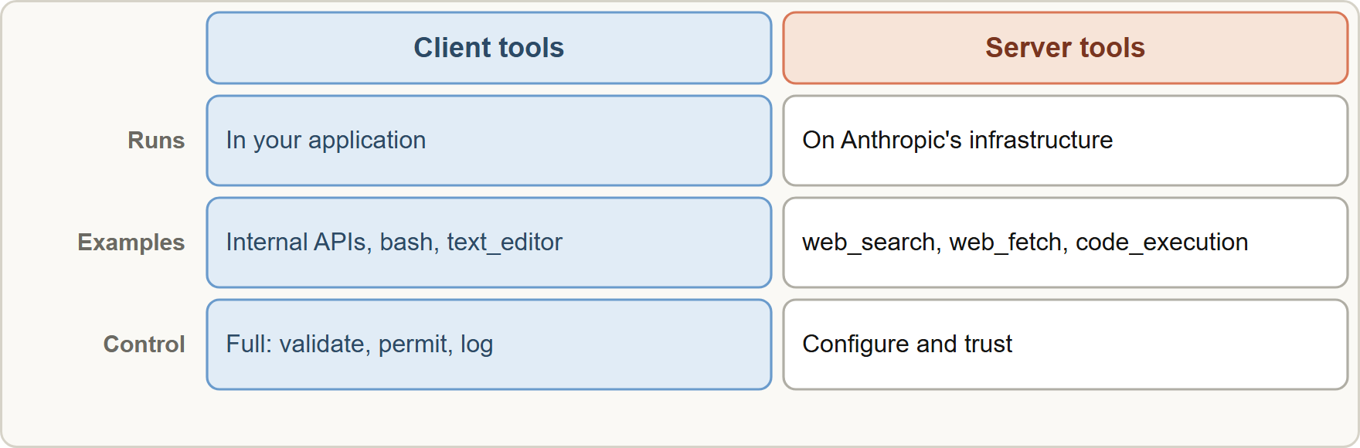
Client-Side Versus Server-Side Tools
Module 11
Where the code runs: client tools run in your application; server tools run on Anthropic's infrastructure
Claude Developer Foundations Exam Prep | for the CCDV-F exam
Module 11: Tool Implementation
8 / 22
Notes:
Client-Side Versus Server-Side Tools.
The figure shows this: Where the code runs: client tools run in your application; server tools run on Anthropic's infrastructure.

Slide 9
Client-Side Versus Server-Side Tools, continued
Module 11
 | Client tools | Server tools
Runs | In your application | On Anthropic's infrastructure
Examples | Your internal APIs; bash and text_editor (Anthropic-defined schemas, your execution) | web_search, web_fetch, code_execution, tool_search
Flow | tool_use → you run it → tool_result | You see results directly; no execution on your side
Control | Full: validation, permissions, logging | Less: configure and trust the platform
Use for | Internal systems, private data, side effects | General capabilities that need no access to your systems
EXAM TIP Internal systems and private data call for client tools; server tools suit general capabilities such as web search.
Claude Developer Foundations Exam Prep | for the CCDV-F exam
Module 11: Tool Implementation
9 / 22
Notes:
Client-Side Versus Server-Side Tools, continued.
Runs. Client tools: In your application. Server tools: On Anthropic's infrastructure.
Examples. Client tools: Your internal A P I s (application programming interface); bash and text editor (Anthropic-defined schemas, your execution). Server tools: web search, web fetch, code execution, tool search.
Flow. Client tools: tool use to you run it to tool result. Server tools: You see results directly; no execution on your side.
Control. Client tools: Full: validation, permissions, logging. Server tools: Less: configure and trust the platform.
Use for. Client tools: Internal systems, private data, side effects. Server tools: General capabilities that need no access to your systems.
Exam tip: Internal systems and private data call for client tools; server tools suit general capabilities such as web search.

Slide 10
Error Handling, Dispatch and Approval
Module 11
Return errors to the model in the tool_result with `is_error: true` and a clear message (what failed, whether to retry, what to try instead). An exception that crashes the harness gives the model nothing to recover from.
Validate input before running (types, ranges, authorization of the caller, not just the model's request). The model's arguments are untrusted input.
Timeouts and idempotency: bound tool runtime; give side-effecting tools an idempotency key so retries are safe.
Prune results: return only the fields needed (Module 9).
Claude Developer Foundations Exam Prep | for the CCDV-F exam
Module 11: Tool Implementation
10 / 22
Notes:
Error Handling, Dispatch and Approval.
Return errors to the model in the tool result with is error: true and a clear message (what failed, whether to retry, what to try instead). An exception that crashes the harness gives the model nothing to recover from.
Validate input before running (types, ranges, authorization of the caller, not just the model's request). The model's arguments are untrusted input.
Timeouts and idempotency: bound tool runtime; give side-effecting tools an idempotency key so retries are safe.
Prune results: return only the fields needed (Module nine).

Slide 11
Approval patterns
Module 11
Pattern | When
Auto-approve | Read-only, low-risk tools
Human confirmation | Sensitive or irreversible actions (payments, deletions, emails)
Policy/permission rules and hooks | Deterministic allow, deny or ask by tool and arguments
Dry run then commit | Show what would change; apply after approval
Claude Developer Foundations Exam Prep | for the CCDV-F exam
Module 11: Tool Implementation
11 / 22
Notes:
Approval patterns.
Auto-approve. Read-only, low-risk tools.
Human confirmation. Sensitive or irreversible actions (payments, deletions, emails).
Policy or permission rules and hooks. Deterministic allow, deny or ask by tool and arguments.
Dry run then commit. Show what would change; apply after approval.

Slide 12
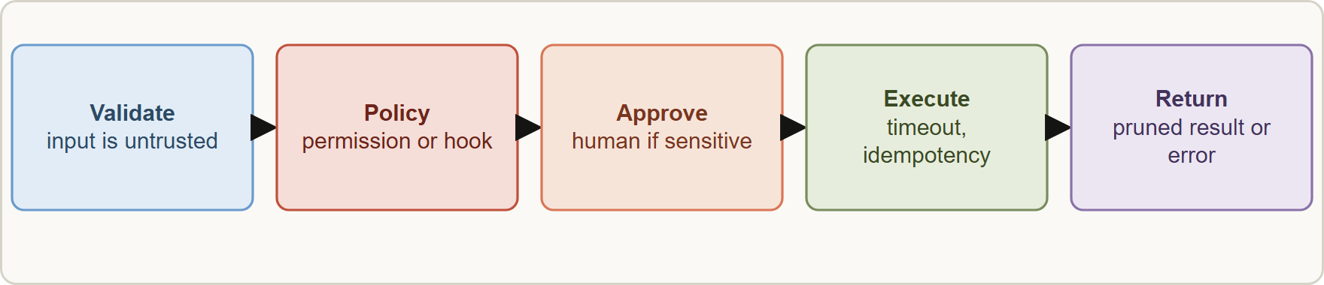
Approval patterns, continued
Module 11
A safe tool call path: validate, check policy, ask a human when needed, execute, prune the result, return structured errors
Claude Developer Foundations Exam Prep | for the CCDV-F exam
Module 11: Tool Implementation
12 / 22
Notes:
Approval patterns, continued.
The figure shows this: A safe tool call path: validate, check policy, ask a human when needed, execute, prune the result, return structured errors.

Slide 13
Building a Good Tool Set
Module 11
Practice | Why
Few, distinct tools | Too many or overlapping tools degrade selection
Clear names and boundary-stating descriptions | The description is the main selection signal
One purpose per tool with a precise schema | Reliable use and testing
Consistent naming and error format | Predictable behavior
Return concise, relevant results | Saves context
Least privilege | A tool exposes only what it needs; separate read and write tools
Test tool selection with ambiguous requests | Catches misrouting early
EXAM TIP Wrong tool chosen or misused → improve the description and schema first; sensitive action → approval gate plus validation in code, not a prompt sentence.
Claude Developer Foundations Exam Prep | for the CCDV-F exam
Module 11: Tool Implementation
13 / 22
Notes:
Building a Good Tool Set.
Few, distinct tools. Too many or overlapping tools degrade selection.
Clear names and boundary-stating descriptions. The description is the main selection signal.
One purpose per tool with a precise schema. Reliable use and testing.
Consistent naming and error format. Predictable behavior.
Return concise, relevant results. Saves context.
Least privilege. A tool exposes only what it needs; separate read and write tools.
Test tool selection with ambiguous requests. Catches misrouting early.
Exam tip: Wrong tool chosen or misused to improve the description and schema first; sensitive action to approval gate plus validation in code, not a prompt sentence.

Slide 14
Module Recap
Module 11
1
Definition
2
Round trip
3
Dispatch
name, description, input_schema
tool_use (stop_reason: tool_use) → run → tool_result (same id) → continue until end_turn
Harness maps tool name to code; validate input; model arguments are untrusted
4
Client vs server
5
Errors
6
Approval
Client tools run in your app (internal systems)
tool_result with is_error: true and a useful message; timeouts; idempotency
Auto for read-only; human confirmation or hooks for sensitive actions
7
Tool set
Few, distinct, well described, least privilege, concise results
Claude Developer Foundations Exam Prep | for the CCDV-F exam
Module 11: Tool Implementation
14 / 22
Notes:
Here is the recap.
Definition: name, description, input schema.
Round trip: tool use (stop reason: tool use) to run to tool result (same id) to continue until end turn.
Dispatch: Harness maps tool name to code; validate input; model arguments are untrusted.
Client versus server: Client tools run in your app (internal systems).
Errors: tool result with is error: true and a useful message; timeouts; idempotency.
Approval: Auto for read-only; human confirmation or hooks for sensitive actions.
Tool set: Few, distinct, well described, least privilege, concise results.

Slide 15
Practice Question 1
Module 11
Q1
Claude must call Tidewater's internal claims API. Where does the API call actually run?
A
On Anthropic's servers automatically, as part of the model response
B
Inside the model, which executes the code by itself
C
In the user's browser only
D
In the developer's harness: the app runs the function after a tool_use request
Claude Developer Foundations Exam Prep | for the CCDV-F exam
Module 11: Tool Implementation
15 / 22
Notes:
Question one.
Claude must call Tidewater's internal claims A P I. Where does the A P I call actually run?
The four options are on the screen.
[PAUSE 12]
The answer is D. For client tools the application executes the function and returns a tool result.

Slide 16
Practice Question 2
Module 11
Q2
Which is a server tool?
A
A shell script that runs on your own laptop and calls a service
B
A database query that is written in your own application code
C
A custom get_policy function
D
web_search, which runs on Anthropic's servers
Claude Developer Foundations Exam Prep | for the CCDV-F exam
Module 11: Tool Implementation
16 / 22
Notes:
Question two.
Which is a server tool?
The four options are on the screen.
[PAUSE 12]
The answer is D. Server tools such as web search and code execution run on Anthropic's infrastructure.

Slide 17
Practice Question 3
Module 11
Q3
A tool call arrives with stop_reason: "tool_use". What must the application do next?
A
Ignore it
B
End the conversation and show the user the raw tool request
C
Rerun the request without tools to get a plain text answer
D
Run the tool and return a tool_result with the same tool_use_id
Claude Developer Foundations Exam Prep | for the CCDV-F exam
Module 11: Tool Implementation
17 / 22
Notes:
Question three.
A tool call arrives with stop reason: "tool use". What must the application do next?
The four options are on the screen.
[PAUSE 12]
The answer is D. The loop continues by returning the result for the specific call.

Slide 18
Practice Question 4
Module 11
Q4
A tool fails with a timeout. What should the harness return to Claude?
A
A random value so that the loop keeps going
B
An empty success
C
A tool_result with is_error: true and a clear message
D
Nothing, and crash the whole application
Claude Developer Foundations Exam Prep | for the CCDV-F exam
Module 11: Tool Implementation
18 / 22
Notes:
Question four.
A tool fails with a timeout. What should the harness return to Claude?
The four options are on the screen.
[PAUSE 12]
The answer is C. Structured errors let the model recover; crashes and fake successes hide the failure.

Slide 19
Practice Question 5
Module 11
Q5
Claude keeps choosing get_customer when the user asks about a policy, because both descriptions are three words long. What is the best first step?
A
Rewrite descriptions with purpose, inputs, examples and boundaries
B
Merge all of the tools into one large general tool
C
Switch models
D
Add a separate routing classifier before every call
Claude Developer Foundations Exam Prep | for the CCDV-F exam
Module 11: Tool Implementation
19 / 22
Notes:
Question five.
Claude keeps choosing get customer when the user asks about a policy, because both descriptions are three words long. What is the best first step?
The four options are on the screen.
[PAUSE 12]
The answer is A. Descriptions are the primary selection signal; improve them before adding infrastructure.

Slide 20
Practice Question 6
Module 11
Q6
A tool initiates payments. Which control is most appropriate?
A
Human confirmation and code validation, with an idempotency key
B
Letting the model decide silently whether to pay
C
Running it twice for safety, in case the first run fails
D
A prompt sentence saying "be careful"
Claude Developer Foundations Exam Prep | for the CCDV-F exam
Module 11: Tool Implementation
20 / 22
Notes:
Question six.
A tool initiates payments. Which control is most appropriate?
The four options are on the screen.
[PAUSE 12]
The answer is A. Sensitive actions need enforced approval and safe retry behavior.

Slide 21
Practice Question 7
Module 11
Q7
Which TWO describe good tool set design? (Select TWO.)
A
Many overlapping tools so the model has choices
B
Returning only the fields the next step needs
C
Exposing write access to every tool
D
One tool that does everything with a free-text mode argument
E
Few, distinct tools with clear boundary-stating descriptions
Claude Developer Foundations Exam Prep | for the CCDV-F exam
Module 11: Tool Implementation
21 / 22
Notes:
Question seven. Select two.
Which two describe good tool set design?
The five options are on the screen.
[PAUSE 15]
The answers are B and E. Distinct, well described tools and concise results improve selection and keep context small.

Slide 22
Answers at a Glance
Module 11
Question | Answer | Why
Q1 | D | For client tools the application executes the function and returns a tool_result
Q2 | D | Server tools such as web search and code execution run on Anthropic's
Q3 | D | The loop continues by returning the result for the specific call
Q4 | C | Structured errors let the model recover
Q5 | A | Descriptions are the primary selection signal
Q6 | A | Sensitive actions need enforced approval and safe retry behavior
Q7 | B, E | Distinct, well described tools and concise results improve selection and keep context
Claude Developer Foundations Exam Prep | for the CCDV-F exam
Module 11: Tool Implementation
22 / 22
Notes:
Here are all seven answers. Question one: D. Question two: D. Question three: D. Question four: C. Question five: A. Question six: A. Question seven: B and E.
In the next module, we continue the course.

