Slide 1
Module 12: MCP Servers and Agentic Customization
The Model Context Protocol (MCP): client and server roles, and the three server primitives
Domain 8 · Tools and MCPs · Skills: MCP Server Development, Agentic Customization
Claude Developer Foundations Exam Prep Masterclass
Module 12
Notes:
Welcome to Module twelve: M C P Servers and Agentic Customization. This module covers the skills m c p server development, agentic customization.
Each part of this module comes from the study notes of the same name, so you can read the notes after you watch.

Slide 2
What You Will Learn
Module 12
The Model Context Protocol (MCP): client and server roles, and the three server primitives
Authoring an MCP server, transports (stdio, HTTP), logging rules, deployment and integration
Agentic customization: choosing among built-in tools, custom tools, Skills and MCP
Claude Developer Foundations Exam Prep | for the CCDV-F exam
Module 12: MCP Servers and Agentic Customization
2 / 24
Notes:
By the end of this module you will be able to do three things.
The Model Context Protocol (M C P): client and server roles, and the three server primitives.
Authoring an M C P (Model Context Protocol) server, transports (stdio, H T T P), logging rules, deployment and integration.
Agentic customization: choosing among built-in tools, custom tools, Skills and M C P.

Slide 3
Case Check-In: Tidewater Shares Its Policy System
Module 12
CASE CHECK-IN · Tidewater Insurance
Three Claude applications need the same policy lookup: the claims assistant, a Claude Code workflow for engineers, and an Agent SDK back-office agent
The policy team wants to maintain the integration in one place
Claude Developer Foundations Exam Prep | for the CCDV-F exam
Module 12: MCP Servers and Agentic Customization
3 / 24
Notes:
Our running case is Tidewater Insurance. Tidewater Shares Its Policy System.
Three Claude applications need the same policy lookup: the claims assistant, a Claude Code workflow for engineers, and an Agent S D K (software development kit) back-office agent.
The policy team wants to maintain the integration in one place.

Slide 4
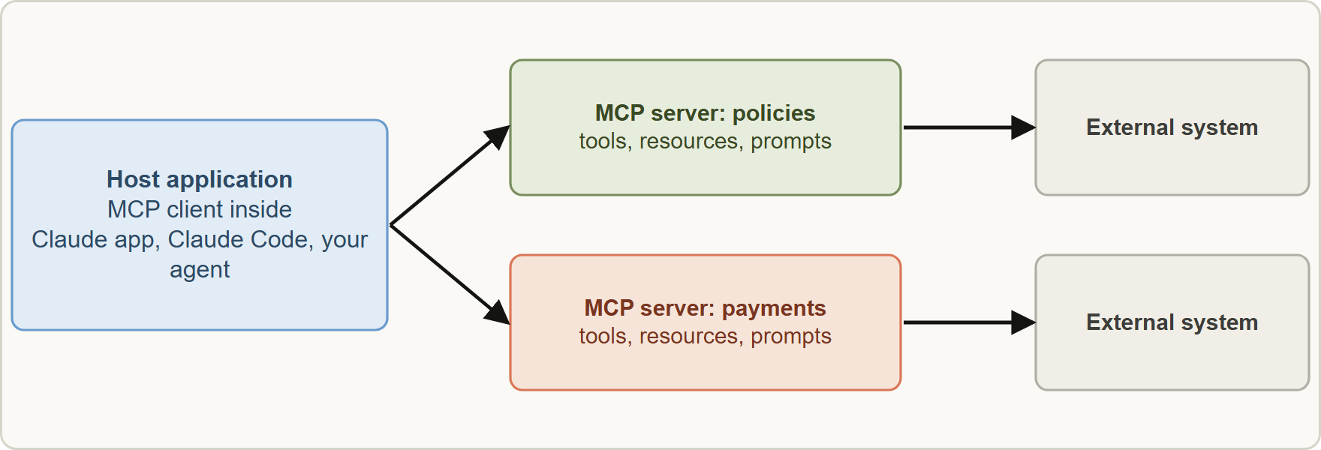
MCP Server Development
Module 12
MCP: the host's client connects to servers; each server exposes tools, resources and prompts for an external system
Claude Developer Foundations Exam Prep | for the CCDV-F exam
Module 12: MCP Servers and Agentic Customization
4 / 24
Notes:
M C P Server Development.
The figure shows this: M C P: the host's client connects to servers; each server exposes tools, resources and prompts for an external system.

Slide 5
MCP Server Development, continued
Module 12
Primitive | What it is | Example
Tools | Functions the model can call (with user or host approval) | get_policy, create_payment_request
Resources | File-like data that clients can read | A policy PDF, a schema, an API response
Prompts | Pre-written templates that help users do a task | "Review a claim" template
Roles: the host (the application) runs an MCP client that connects to MCP servers. A server wraps an external system once, and any MCP-capable application can use it.
Claude Developer Foundations Exam Prep | for the CCDV-F exam
Module 12: MCP Servers and Agentic Customization
5 / 24
Notes:
M C P Server Development, continued.
Tools. What it is: Functions the model can call (with user or host approval). Example: get policy, create payment request.
Resources. What it is: File-like data that clients can read. Example: A policy P D F, a schema, an A P I (application programming interface) response.
Prompts. What it is: Pre-written templates that help users do a task. Example: "Review a claim" template.
Roles: the host (the application) runs an M C P client that connects to M C P servers. A server wraps an external system once, and any M C P-capable application can use it.

Slide 6
MCP Server Development, continued
Module 12
Authoring: use an official SDK (for example Python or TypeScript); tool definitions can be generated from type hints and docstrings (a decorator such as @mcp.tool()); then run the server with a transport.
Claude Developer Foundations Exam Prep | for the CCDV-F exam
Module 12: MCP Servers and Agentic Customization
6 / 24
Notes:
M C P Server Development, continued.
Authoring: use an official S D K (for example Python or Type Script); tool definitions can be generated from type hints and docstrings (a decorator such as @mcp.tool()); then run the server with a transport.

Slide 7
MCP Server Development, continued
Module 12
PYTHON
mcp = FastMCP("tidewater-policy")
@mcp.tool()
async def get_policy(policy_number: str) -> str:
"""Return coverage limits, deductible and status for ONE policy (format TW-204518)."""
...
mcp.run(transport="stdio")
Example from the study note (names are examples)
Claude Developer Foundations Exam Prep | for the CCDV-F exam
Module 12: MCP Servers and Agentic Customization
7 / 24
Notes:
M C P Server Development, continued.
The example is on the screen; read it line by line when you study.

Slide 8
Transports and logging
Module 12
Transport | How it works | Use for
stdio | The client launches the server as a local subprocess and exchanges JSON-RPC messages over stdin and stdout | Local tools for one user or machine
HTTP (streamable HTTP) | The server runs as a network service; clients connect over HTTP | Remote, shared, independently deployed servers
Never write to stdout in a stdio server. Standard output carries the protocol messages, so a stray print() corrupts them and breaks the server. Log to stderr (or a file) with a logging library.
Claude Developer Foundations Exam Prep | for the CCDV-F exam
Module 12: MCP Servers and Agentic Customization
8 / 24
Notes:
Transports and logging.
stdio. How it works: The client launches the server as a local subprocess and exchanges Jason (Java Script Object Notation)-R P C messages over stdin and stdout. Use for: Local tools for one user or machine.
H T T P (streamable H T T P). How it works: The server runs as a network service; clients connect over H T T P. Use for: Remote, shared, independently deployed servers.
Never write to stdout in a stdio server. Standard output carries the protocol messages, so a stray print() corrupts them and breaks the server. Log to stderr (or a file) with a logging library.

Slide 9
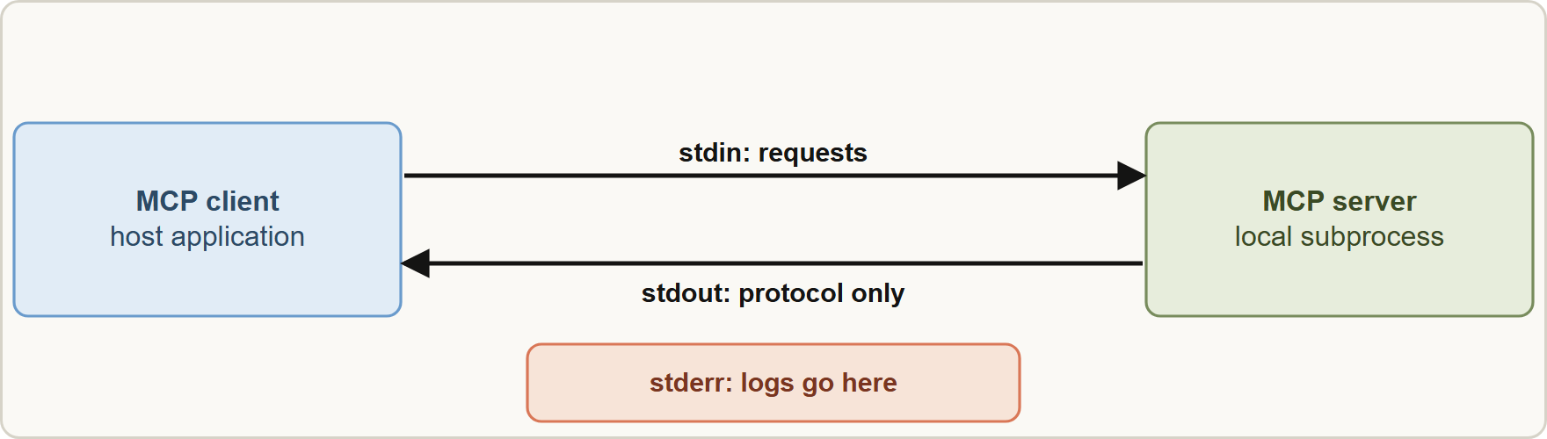
Transports and logging, continued
Module 12
In a stdio MCP server, stdout belongs to the protocol: log to stderr
Claude Developer Foundations Exam Prep | for the CCDV-F exam
Module 12: MCP Servers and Agentic Customization
9 / 24
Notes:
Transports and logging, continued.
The figure shows this: In a stdio M C P server, stdout belongs to the protocol: log to stderr.

Slide 10
Deploying and integrating
Module 12
Claude Code
Your own applications
Share and maintain once
add servers in project `.mcp.json` (shared) or user configuration, with credentials from environment variables; local servers use stdio, remote ones HTTP.
a server fixes the integration problem for many applications; version it and test its tools like any API.
use an MCP client library or the platform's MCP support to discover the server's tools and pass them to the model.
EXAM TIP A capability needed by several Claude applications and maintained independently is an MCP server. A print() in a stdio server breaks it: log to stderr.
Claude Developer Foundations Exam Prep | for the CCDV-F exam
Module 12: MCP Servers and Agentic Customization
10 / 24
Notes:
Deploying and integrating.
Claude Code: add servers in project dot M C P dot Jason (shared) or user configuration, with credentials from environment variables; local servers use stdio, remote ones H T T P.
Your own applications: use an M C P client library or the platform's M C P support to discover the server's tools and pass them to the model.
Share and maintain once: a server fixes the integration problem for many applications; version it and test its tools like any A P I.
Exam tip: A capability needed by several Claude applications and maintained independently is an M C P server. A print() in a stdio server breaks it: log to stderr.
Exam tip: Ask what is missing: access (tool or M C P), a procedure (Skill) or a common operation (built-in tool).

Slide 11
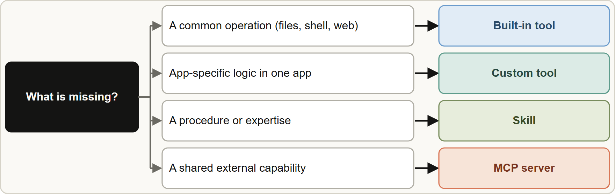
Agentic Customization: Which Mechanism?
Module 12
Choose the extension mechanism: built-in tools for common operations, custom tools for one app, Skills for procedures, MCP for shared external capabilities
Claude Developer Foundations Exam Prep | for the CCDV-F exam
Module 12: MCP Servers and Agentic Customization
11 / 24
Notes:
Agentic Customization: Which Mechanism?
The figure shows this: Choose the extension mechanism: built-in tools for common operations, custom tools for one app, Skills for procedures, M C P for shared external capabilities.

Slide 12
Agentic Customization: Which Mechanism?, continued
Module 12
Mechanism | What it is | Choose it when | Trade-off
Built-in tools | Provided by the platform (Read, Write, Edit, Bash, Grep, Glob, web tools) | The need is common: files, shell, search, web | Nothing to build; limited to what is provided
Custom tools | Functions you define and run in one application | App-specific logic with tight control | You build, test and run them; not reusable elsewhere
Skills | Folders with instructions, and optional scripts and resources, loaded on demand | Procedures and expertise (a review checklist, a report format, a workflow) | Teaches how, does not give new access; progressive loading keeps context small
Claude Developer Foundations Exam Prep | for the CCDV-F exam
Module 12: MCP Servers and Agentic Customization
12 / 24
Notes:
Agentic Customization: Which Mechanism?, continued.
Built-in tools. What it is: Provided by the platform (Read, Write, Edit, Bash, Grep, Glob, web tools). Choose it when: The need is common: files, shell, search, web. Trade-off: Nothing to build; limited to what is provided.
Custom tools. What it is: Functions you define and run in one application. Choose it when: App-specific logic with tight control. Trade-off: You build, test and run them; not reusable elsewhere.
Skills. What it is: Folders with instructions, and optional scripts and resources, loaded on demand. Choose it when: Procedures and expertise (a review checklist, a report format, a workflow). Trade-off: Teaches how, does not give new access; progressive loading keeps context small.

Slide 13
Agentic Customization: Which Mechanism?, continued
Module 12
Mechanism | What it is | Choose it when | Trade-off
MCP servers | Shared, independently maintained servers exposing tools, resources and prompts | A capability many applications need, or an external system to integrate | More to deploy and secure; extra connection and tool-definition context
Claude Developer Foundations Exam Prep | for the CCDV-F exam
Module 12: MCP Servers and Agentic Customization
13 / 24
Notes:
Agentic Customization: Which Mechanism?, continued.
M C P servers. What it is: Shared, independently maintained servers exposing tools, resources and prompts. Choose it when: A capability many applications need, or an external system to integrate. Trade-off: More to deploy and secure; extra connection and tool-definition context.

Slide 14
How Skills load (progressive disclosure)
Module 12
Metadata (name and description) is always loaded so Claude knows the Skill exists and when to use it.
The instructions (SKILL.md body) are loaded when the Skill is triggered.
Resources and scripts are loaded only as needed; scripts run through the shell, so their code does not enter the context.
Claude Developer Foundations Exam Prep | for the CCDV-F exam
Module 12: MCP Servers and Agentic Customization
14 / 24
Notes:
How Skills load (progressive disclosure).
Metadata (name and description) is always loaded so Claude knows the Skill exists and when to use it.
The instructions (Skill dot M D body) are loaded when the Skill is triggered.
Resources and scripts are loaded only as needed; scripts run through the shell, so their code does not enter the context.

Slide 15
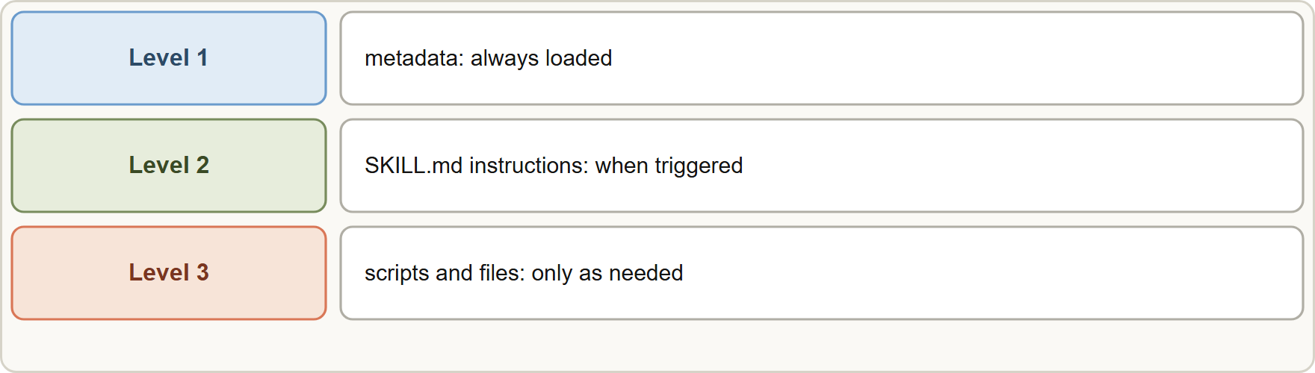
How Skills load (progressive disclosure), continued
Module 12
Combine them: an MCP server gives access, a Skill gives the procedure for using it well, and built-in tools cover the common steps.
Combine them: an MCP server gives access, a Skill gives the procedure for using it well, and built-in tools cover the common steps.
EXAM TIP Ask what is missing: access to a system (tool or MCP), knowledge of a procedure (Skill), or a common operation (built-in tool). Pick the mechanism that supplies exactly that.
Claude Developer Foundations Exam Prep | for the CCDV-F exam
Module 12: MCP Servers and Agentic Customization
15 / 24
Notes:
How Skills load (progressive disclosure), continued.
The figure shows this: Skills load in stages: metadata first, instructions when triggered, resources and scripts only as needed.
Combine them: an M C P server gives access, a Skill gives the procedure for using it well, and built-in tools cover the common steps.
Exam tip: Ask what is missing: access to a system (tool or M C P), knowledge of a procedure (Skill), or a common operation (built-in tool). Pick the mechanism that supplies exactly that.

Slide 16
Module Recap
Module 12
1
MCP roles
2
Primitives
3
Authoring
Host with MCP client ↔ MCP server
Tools (functions) · resources (readable data) · prompts (templates)
Official SDKs; tools from type hints and docstrings; mcp.run(transport="stdio")
4
Transports
5
Logging
6
Integrate
stdio (local subprocess, JSON-RPC on stdin/stdout) · HTTP (remote service)
Never stdout in stdio servers; log to stderr
.mcp.json (project) or user config; credentials from env vars
7
Choose
8
Skills
Built-in = common ops · custom tool = one app · Skill = procedure · MCP = shared external capability
Metadata always · SKILL.md when triggered · resources and scripts as needed
Claude Developer Foundations Exam Prep | for the CCDV-F exam
Module 12: MCP Servers and Agentic Customization
16 / 24
Notes:
Here is the recap.
M C P roles: Host with M C P client and M C P server.
Primitives: Tools (functions), resources (readable data), prompts (templates).
Authoring: Official S D K s; tools from type hints and docstrings; mcp.run(transport equals "stdio").
Transports: stdio (local subprocess, Jason-R P C on stdin or stdout), H T T P (remote service).
Logging: Never stdout in stdio servers; log to stderr.
Integrate: dot M C P dot Jason (project) or user config; credentials from env vars.
Choose: Built-in equals common ops, custom tool equals one app, Skill equals procedure, M C P equals shared external capability.
Skills: Metadata always, Skill dot M D when triggered, resources and scripts as needed.

Slide 17
Practice Question 1
Module 12
Q1
Three Claude applications need the same internal HR lookup, maintained by the HR team independently. What fits best?
A
Paste HR data into every prompt
B
Copy the lookup code into each application's system prompt
C
An MCP server that exposes the lookup as a shared tool
D
A built-in tool, which can reach any internal system
Claude Developer Foundations Exam Prep | for the CCDV-F exam
Module 12: MCP Servers and Agentic Customization
17 / 24
Notes:
Question one.
Three Claude applications need the same internal H R lookup, maintained by the H R team independently. What fits best?
The four options are on the screen.
[PAUSE 12]
The answer is C. M C P gives a reusable integration that the H R team can maintain independently for every application.

Slide 18
Practice Question 2
Module 12
Q2
An MCP stdio server stops working after a developer adds print("debug") statements. Why?
A
The client rejects anything that is written to stderr
B
stdio servers must not produce any output at all
C
Python cannot print in servers
D
Stdout carries the protocol, so extra prints corrupt it
Claude Developer Foundations Exam Prep | for the CCDV-F exam
Module 12: MCP Servers and Agentic Customization
18 / 24
Notes:
Question two.
An M C P stdio server stops working after a developer adds print("debug") statements. Why?
The four options are on the screen.
[PAUSE 12]
The answer is D. Stdio servers must keep stdout for protocol messages and log to stderr.

Slide 19
Practice Question 3
Module 12
Q3
Which are the three primitives an MCP server can expose?
A
Models, tokens and keys that are issued by the provider
B
Tools, resources and prompts
C
Agents, hooks and plugins
D
Streams, batches and caches
Claude Developer Foundations Exam Prep | for the CCDV-F exam
Module 12: MCP Servers and Agentic Customization
19 / 24
Notes:
Question three.
Which are the three primitives an M C P server can expose?
The four options are on the screen.
[PAUSE 12]
The answer is B. Servers expose tools (functions), resources (readable data) and prompts (templates).

Slide 20
Practice Question 4
Module 12
Q4
A team needs Claude to follow its claim-review checklist and output format every time it is relevant, with no new system access. What fits best?
A
A new MCP server that exposes one more tool to the model
B
A custom billing tool
C
A Skill that packages the procedure
D
A larger model
Claude Developer Foundations Exam Prep | for the CCDV-F exam
Module 12: MCP Servers and Agentic Customization
20 / 24
Notes:
Question four.
A team needs Claude to follow its claim-review checklist and output format every time it is relevant, with no new system access. What fits best?
The four options are on the screen.
[PAUSE 12]
The answer is C. Skills teach procedures and expertise on demand; they do not add access.

Slide 21
Practice Question 5
Module 12
Q5
What does progressive disclosure mean for Skills?
A
Skills load only after the model runs into errors
B
Skills stay hidden from the model until the user asks
C
Everything is loaded at startup into the context window
D
Metadata always loads; instructions load when triggered; resources as needed
Claude Developer Foundations Exam Prep | for the CCDV-F exam
Module 12: MCP Servers and Agentic Customization
21 / 24
Notes:
Question five.
What does progressive disclosure mean for Skills?
The four options are on the screen.
[PAUSE 12]
The answer is D. Staged loading keeps the context small until a Skill is needed.

Slide 22
Practice Question 6
Module 12
Q6
A function is needed by one application only and must run entirely in that application's code. Which mechanism fits?
A
A built-in tool that the platform provides to every application
B
A custom tool defined in that application
C
An MCP server for the whole company, run by a separate team
D
A Skill
Claude Developer Foundations Exam Prep | for the CCDV-F exam
Module 12: MCP Servers and Agentic Customization
22 / 24
Notes:
Question six.
A function is needed by one application only and must run entirely in that application's code. Which mechanism fits?
The four options are on the screen.
[PAUSE 12]
The answer is B. App-specific logic belongs in a custom tool unless reuse justifies a server.

Slide 23
Practice Question 7
Module 12
Q7
Which TWO statements about MCP transports are correct? (Select TWO.)
A
A remote shared server is typically reached over HTTP
B
stdio servers should log to stdout
C
HTTP servers cannot expose tools
D
A stdio server runs as a local subprocess and communicates over stdin and stdout
E
Transports change which primitives exist
Claude Developer Foundations Exam Prep | for the CCDV-F exam
Module 12: MCP Servers and Agentic Customization
23 / 24
Notes:
Question seven. Select two.
Which two statements about M C P transports are correct?
The five options are on the screen.
[PAUSE 15]
The answers are A and D. Local servers use stdio and remote ones use H T T P; stdio logs belong on stderr.

Slide 24
Answers at a Glance
Module 12
Question | Answer | Why
Q1 | C | MCP gives a reusable integration that the HR team can maintain independently
Q2 | D | Stdio servers must keep stdout for protocol messages and log to stderr
Q3 | B | Servers expose tools (functions), resources (readable data) and prompts (templates)
Q4 | C | Skills teach procedures and expertise on demand
Q5 | D | Staged loading keeps the context small until a Skill is needed
Q6 | B | App-specific logic belongs in a custom tool unless reuse justifies a server
Q7 | A, D | Local servers use stdio and remote ones use HTTP
Claude Developer Foundations Exam Prep | for the CCDV-F exam
Module 12: MCP Servers and Agentic Customization
24 / 24
Notes:
Here are all seven answers. Question one: C. Question two: D. Question three: B. Question four: C. Question five: D. Question six: B. Question seven: A and D.
In the next module, we continue the course.

