Slide 1
Module 15: Claude Code Operation
The core components: Rules, Skills, Commands, Agents and Agent Memory
Domain 3 · Claude Code · Skills: Claude Code Operation
Claude Developer Foundations Exam Prep Masterclass
Module 15
Notes:
Welcome to Module fifteen: Claude Code Operation. This module covers the skills claude code operation.
Each part of this module comes from the study notes of the same name, so you can read the notes after you watch.

Slide 2
What You Will Learn
Module 15
The core components: Rules, Skills, Commands, Agents and Agent Memory
Features: session management, slash commands, headless, streaming and auto mode
The CLAUDE.md hierarchy, repository initialization and settings.json
Claude Developer Foundations Exam Prep | for the CCDV-F exam
Module 15: Claude Code Operation
2 / 18
Notes:
By the end of this module you will be able to do three things.
The core components: Rules, Skills, Commands, Agents and Agent Memory.
Features: session management, slash commands, headless, streaming and auto mode.
The Claude dot M D hierarchy, repository initialization and settings.json.

Slide 3
Case Check-In: Tidewater Rolls Out Claude Code
Module 15
CASE CHECK-IN · Tidewater Insurance
Fifty engineers will use Claude Code on the claims platform
The lead wants shared standards, reusable workflows, specialist helpers, and safe automation
Claude Developer Foundations Exam Prep | for the CCDV-F exam
Module 15: Claude Code Operation
3 / 18
Notes:
Our running case is Tidewater Insurance. Tidewater Rolls Out Claude Code.
Fifty engineers will use Claude Code on the claims platform.
The lead wants shared standards, reusable workflows, specialist helpers, and safe automation.

Slide 4
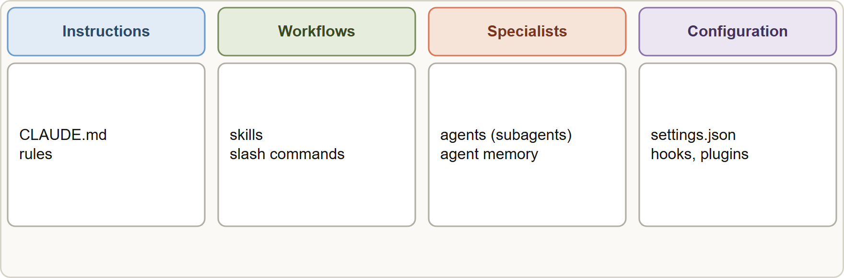
Core Components
Module 15
Claude Code components: instructions (CLAUDE.md, rules), workflows (skills, commands), specialists (agents) and configuration (settings.json)
Claude Developer Foundations Exam Prep | for the CCDV-F exam
Module 15: Claude Code Operation
4 / 18
Notes:
Core Components.
The figure shows this: Claude Code components: instructions (Claude dot M D, rules), workflows (skills, commands), specialists (agents) and configuration (settings.json).

Slide 5
Core Components, continued
Module 15
Component | What it is | Where it lives
CLAUDE.md | Persistent instructions loaded at session start | User ~/.claude/CLAUDE.md, project CLAUDE.md or .claude/CLAUDE.md (shared), subdirectories
Rules | Topic files, optionally scoped to paths with a glob | .claude/rules/*.md
Skills | On-demand procedures (SKILL.md with frontmatter) | .claude/skills/<name>/ or ~/.claude/skills/
Commands | /name shortcuts; custom commands are markdown files | .claude/commands/ (shared) or ~/.claude/commands/ (personal); now merged into skills
Agents | Subagents defined as markdown with frontmatter: own context, tools and optional memory | .claude/agents/ or ~/.claude/agents/
Claude Developer Foundations Exam Prep | for the CCDV-F exam
Module 15: Claude Code Operation
5 / 18
Notes:
Core Components, continued.
Claude dot M D. What it is: Persistent instructions loaded at session start. Where it lives: User home dot Claude, Claude dot M D, project Claude dot M D or the dot Claude Claude dot M D file (shared), subdirectories.
Rules. What it is: Topic files, optionally scoped to paths with a glob. Where it lives: the markdown files in the dot Claude rules folder.
Skills. What it is: On-demand procedures (Skill dot M D with frontmatter). Where it lives: the dot Claude skills folder less than name greater than or or home dot Claude skills.
Commands. What it is: or name shortcuts; custom commands are markdown files. Where it lives: the dot Claude commands folder (shared) or home dot Claude commands (personal); now merged into skills.
Agents. What it is: Subagents defined as markdown with frontmatter: own context, tools and optional memory. Where it lives: the dot Claude agents folder or about or the dot Claude agents folder.

Slide 6
Core Components, continued
Module 15
Component | What it is | Where it lives
Agent memory | Knowledge a subagent keeps across sessions (user, project or local scope); also auto memory: notes Claude writes itself from your corrections | Memory directories managed by Claude Code
`settings.json` | Permissions, hooks, environment, plugins, model | User, shared project, project local, managed
Claude Developer Foundations Exam Prep | for the CCDV-F exam
Module 15: Claude Code Operation
6 / 18
Notes:
Core Components, continued.
Agent memory. What it is: Knowledge a subagent keeps across sessions (user, project or local scope); also auto memory: notes Claude writes itself from your corrections. Where it lives: Memory directories managed by Claude Code.
settings.json. What it is: Permissions, hooks, environment, plugins, model. Where it lives: User, shared project, project local, managed.

Slide 7
The CLAUDE.md hierarchy
Module 15
User level: personal, not shared. Project level: shared through version control. Directory level: applies to work in that folder. Files are combined, not overridden; keep them short and specific.
`/init` analyzes the repository and creates a starting CLAUDE.md (build and test commands, conventions); review and edit it. `/memory` shows which memory files are loaded.
Repository initialization checklist: run /init, commit the project CLAUDE.md, add shared .claude/settings.json (permissions, hooks), add rules, skills and commands the team needs, and keep personal overrides in local files.
EXAM TIP Team standards belong in the committed project CLAUDE.md and .claude/settings.json, not in a user file.
Claude Developer Foundations Exam Prep | for the CCDV-F exam
Module 15: Claude Code Operation
7 / 18
Notes:
The Claude dot M D hierarchy.
User level: personal, not shared. Project level: shared through version control. Directory level: applies to work in that folder. Files are combined, not overridden; keep them short and specific.
slash init analyzes the repository and creates a starting Claude dot M D (build and test commands, conventions); review and edit it. slash memory shows which memory files are loaded.
Repository initialization checklist: run slash init, commit the project Claude dot M D, add shared dot Claude settings.json (permissions, hooks), add rules, skills and commands the team needs, and keep personal overrides in local files.
Exam tip: Team standards belong in the committed project Claude dot M D and dot Claude settings.json, not in a user file.

Slide 8
Features
Module 15
Feature | What to know
Session management | Sessions are saved: continue the latest (--continue), resume one by ID or name (--resume <name>, name with -n), fork to try another path (--fork-session); /clear starts fresh; /compact frees context
Slash commands | Built-in (/init, /memory, /compact, /model, /permissions and more) and custom ones from markdown files
Headless mode | `claude -p "prompt"` runs non-interactively and exits: for scripts and CI; add --output-format json (and --json-schema) for structured output
Streaming mode | --output-format stream-json emits newline-delimited JSON events as they happen, for programs that show progress
Claude Developer Foundations Exam Prep | for the CCDV-F exam
Module 15: Claude Code Operation
8 / 18
Notes:
Features.
Session management. Sessions are saved: continue the latest (dash dash continue), resume one by I D or name (dash dash resume less than name greater than, name with dash n), fork to try another path (dash dash fork session); slash clear starts fresh; slash compact frees context.
Slash commands. Built-in (slash init, slash memory, slash compact, or model, or permissions and more) and custom ones from markdown files.
Headless mode. claude dash p "prompt" runs non-interactively and exits: for scripts and C I; add dash dash output format json (and dash dash json schema) for structured output.
Streaming mode. dash dash output format stream-json emits newline-delimited Jason (Java Script Object Notation) events as they happen, for programs that show progress.

Slide 9
Features, continued
Module 15
Feature | What to know
Permission modes | default (ask), acceptEdits, plan (read-only exploration), auto (a classifier reviews actions and allows or blocks them), dontAsk, bypassPermissions (isolated environments only)
Claude Developer Foundations Exam Prep | for the CCDV-F exam
Module 15: Claude Code Operation
9 / 18
Notes:
Features, continued.
Permission modes. default (ask), accept Edits, plan (read-only exploration), auto (a classifier reviews actions and allows or blocks them), dont Ask, bypass Permissions (isolated environments only).

Slide 10
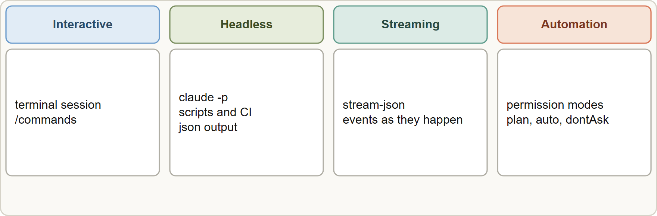
Features, continued
Module 15
Auto mode reduces prompts for autonomous runs while a classifier still reviews risky actions; bypassPermissions removes checks and belongs only in isolated environments.
In CI use `-p`, give context through CLAUDE.md, pre-approve needed tools with `--allowedTools`, and prefer limits such as --max-turns.
Auto mode reduces prompts for autonomous runs while a classifier still reviews risky actions; bypassPermissions removes checks and belongs only in isolated environments.
In CI use `-p`, give context through CLAUDE.md, pre-approve needed tools with `--allowedTools`, and prefer limits such as --max-turns.
Claude Developer Foundations Exam Prep | for the CCDV-F exam
Module 15: Claude Code Operation
10 / 18
Notes:
Features, continued.
The figure shows this: Run modes: interactive, headless (dash p), streaming (stream-json) and automation with permission modes.
Auto mode reduces prompts for autonomous runs while a classifier still reviews risky actions; bypass Permissions removes checks and belongs only in isolated environments.
In C I use dash p, give context through Claude dot M D, pre-approve needed tools with dash dash allowed Tools, and prefer limits such as dash dash max turns.

Slide 11
Features, continued
DATES
Module 15
Flags and modes evolve (for example --bare skips auto-discovery of CLAUDE.md, hooks and MCP servers for scripted runs). As of 8 November 2026.
EXAM TIP Shared project standards go in the committed project CLAUDE.md and `.claude/settings.json`; a script or CI job uses `claude -p`; a progress UI uses `stream-json`.
Claude Developer Foundations Exam Prep | for the CCDV-F exam
Module 15: Claude Code Operation
11 / 18
Notes:
Features, continued.
Flags and modes evolve (for example dash dash bare skips auto-discovery of Claude dot M D, hooks and M C P (Model Context Protocol) servers for scripted runs). As of eight November two thousand twenty-six.
Exam tip: Shared project standards go in the committed project Claude dot M D and dot Claude settings.json; a script or C I job uses claude dash p; a progress U I uses stream-json.
Exam tip: Headless (dash p) is for scripts and C I; streaming Jason is for programs that show progress.

Slide 12
Module Recap
Module 15
1
Components
2
CLAUDE.md
3
Sessions
CLAUDE.md · rules · skills · commands (now skills) · agents (subagents) · agent memory · settings.json
User (personal) · project (shared) · directory; combined; /init creates; /memory inspects
--continue, --resume <name>, -n to name, --fork-session, /clear, /compact
4
Headless
5
Streaming
6
Permission modes
claude -p; --output-format json; --json-schema
--output-format stream-json
default · acceptEdits · plan · auto (classifier) · dontAsk · bypassPermissions (isolated only)
7
Init checklist
/init, commit CLAUDE.md and settings, add rules, skills, commands
Claude Developer Foundations Exam Prep | for the CCDV-F exam
Module 15: Claude Code Operation
12 / 18
Notes:
Here is the recap.
Components: Claude dot M D, rules, skills, commands (now skills), agents (subagents), agent memory, settings.json.
Claude dot M D: User (personal), project (shared), directory; combined; slash init creates; slash memory inspects.
Sessions: dash dash continue, dash dash resume less than name greater than, dash n to name, dash dash fork session, slash clear, slash compact.
Headless: claude dash p; dash dash output format json; dash dash json schema.
Streaming: dash dash output format stream-json.
Permission modes: default, accept Edits, plan, auto (classifier), dont Ask, bypass Permissions (isolated only).
Init checklist: slash init, commit Claude dot M D and settings, add rules, skills, commands.

Slide 13
Practice Question 1
Module 15
Q1
A new teammate does not get the team's coding standards in Claude Code. Where were the standards most likely placed?
A
In the project's .claude/rules/
B
In one developer's user-level ~/.claude/CLAUDE.md, not the committed file
C
In the repository's CLAUDE.md
D
In .claude/settings.json
Claude Developer Foundations Exam Prep | for the CCDV-F exam
Module 15: Claude Code Operation
13 / 18
Notes:
Question one.
A new teammate does not get the team's coding standards in Claude Code. Where were the standards most likely placed?
The four options are on the screen.
[PAUSE 12]
The answer is B. User-level files are personal; project-level files travel with the repository.

Slide 14
Practice Question 2
Module 15
Q2
What does /init do?
A
Analyzes the repository and creates a starting CLAUDE.md
B
Deletes the session and all of the notes that it contains
C
Installs a plugin
D
Switches the model to the next larger tier for the rest of the session
Claude Developer Foundations Exam Prep | for the CCDV-F exam
Module 15: Claude Code Operation
14 / 18
Notes:
Question two.
What does slash init do?
The four options are on the screen.
[PAUSE 12]
The answer is A. slash init drafts the project instructions for you to review and commit.

Slide 15
Practice Question 3
Module 15
Q3
A pipeline must run Claude Code without waiting for input. Which option fits?
A
Plan mode
B
A browser session
C
claude -p "prompt"
D
Interactive mode with a long timeout
Claude Developer Foundations Exam Prep | for the CCDV-F exam
Module 15: Claude Code Operation
15 / 18
Notes:
Question three.
A pipeline must run Claude Code without waiting for input. Which option fits?
The four options are on the screen.
[PAUSE 12]
The answer is C. The dash p flag runs Claude Code non-interactively, prints the result and exits, which is what scripts need.

Slide 16
Practice Question 4
Module 15
Q4
A program wants real-time progress events from a Claude Code run. Which output format fits?
A
No output
B
A screenshot
C
Plain text only
D
stream-json
Claude Developer Foundations Exam Prep | for the CCDV-F exam
Module 15: Claude Code Operation
16 / 18
Notes:
Question four.
A program wants real-time progress events from a Claude Code run. Which output format fits?
The four options are on the screen.
[PAUSE 12]
The answer is D. Streaming Jason emits newline-delimited events as they happen, so a program can show progress.

Slide 17
Practice Question 5
Module 15
Q5
Which TWO statements about Claude Code components are correct? (Select TWO.)
A
Subagents are defined as markdown files with their own context and tools
B
Project-level CLAUDE.md is shared through version control
C
Slash commands cannot be customized
D
Skills are always loaded in full at startup
E
bypassPermissions is recommended for everyday laptops
Claude Developer Foundations Exam Prep | for the CCDV-F exam
Module 15: Claude Code Operation
17 / 18
Notes:
Question five. Select two.
Which two statements about Claude Code components are correct?
The five options are on the screen.
[PAUSE 15]
The answers are A and B. Subagents and committed project instructions are core components; bypass mode is for isolated environments.

Slide 18
Answers at a Glance
Module 15
Question | Answer | Why
Q1 | B | User-level files are personal
Q2 | A | /init drafts the project instructions for you to review and commit
Q3 | C | The -p flag runs Claude Code non-interactively
Q4 | D | Streaming JSON emits newline-delimited events as they happen, so a program can show progress
Q5 | A, B | Subagents and committed project instructions are core components
Claude Developer Foundations Exam Prep | for the CCDV-F exam
Module 15: Claude Code Operation
18 / 18
Notes:
Here are all five answers. Question one: B. Question two: A. Question three: C. Question four: D. Question five: A and B.
In the next module, we continue the course.

