Slide 1
Module 16: Debugging, Evals and Error Handling
Identifying error types and choosing a recovery strategy
Domain 4 · Eval, Testing, and Debugging · Skills: Debugging and Error Handling
Claude Developer Foundations Exam Prep Masterclass
Module 16
Notes:
Welcome to Module sixteen: Debugging, Evals and Error Handling. This module covers the skills debugging and error handling.
Each part of this module comes from the study notes of the same name, so you can read the notes after you watch.

Slide 2
What You Will Learn
Module 16
Identifying error types and choosing a recovery strategy
Trace analysis to find failure modes
Isolating the origin of a problem: integration layer or model output
Evals: success criteria, design principles and grading
Claude Developer Foundations Exam Prep | for the CCDV-F exam
Module 16: Debugging, Evals and Error Handling
2 / 20
Notes:
By the end of this module you will be able to do four things.
Identifying error types and choosing a recovery strategy.
Trace analysis to find failure modes.
Isolating the origin of a problem: integration layer or model output.
Evals: success criteria, design principles and grading.

Slide 3
Case Check-In: Tidewater's Assistant "Stopped Working"
Module 16
CASE CHECK-IN · Tidewater Insurance
Complaint 1: "No answers at all since this morning"
Complaint 2: "Answers are wrong about deductibles for some policies"
Complaint 3: "Some replies are cut off"
Claude Developer Foundations Exam Prep | for the CCDV-F exam
Module 16: Debugging, Evals and Error Handling
3 / 20
Notes:
Our running case is Tidewater Insurance. Tidewater's Assistant "Stopped Working".
Complaint one: "No answers at all since this morning".
Complaint two: "Answers are wrong about deductibles for some policies".
Complaint three: "Some replies are cut off".

Slide 4
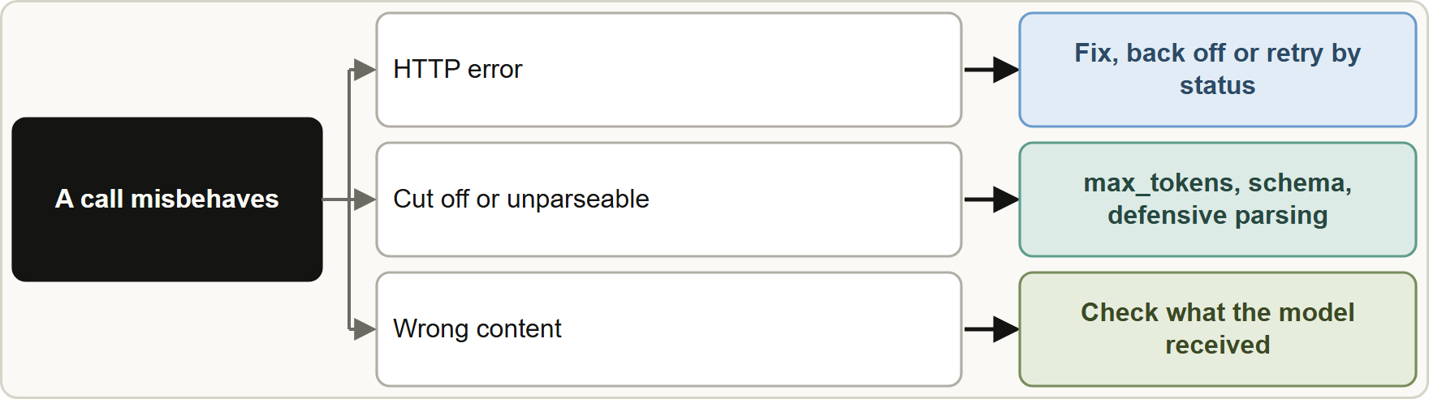
Step 1: classify the failure
Module 16
Triage: first the HTTP result, then completeness and parsing, then content quality
Claude Developer Foundations Exam Prep | for the CCDV-F exam
Module 16: Debugging, Evals and Error Handling
4 / 20
Notes:
Step one: classify the failure.
The figure shows this: Triage: first the H T T P result, then completeness and parsing, then content quality.

Slide 5
Step 1: classify the failure, continued
Module 16
Symptom | Likely origin | Recovery
4xx (400, 401, 403, 404, 413) | Integration: bad request, key, permission, size | Fix the request or configuration; retrying unchanged will not help
429 | Rate limit | Back off, honor retry-after, lower concurrency, spread load
5xx, timeout, overloaded | Transient platform condition | Retry with exponential backoff and jitter; fall back or queue
`stop_reason: max_tokens` / cut-off text | Output limit | Raise max_tokens, ask for shorter output, or continue
JSON fails to parse / schema violation | Output format | Structured output, defensive parsing, retry with the error
Tool errors | Tool or its inputs | Fix the tool; return clear is_error results
Claude Developer Foundations Exam Prep | for the CCDV-F exam
Module 16: Debugging, Evals and Error Handling
5 / 20
Notes:
Step one: classify the failure, continued.
four X X (four hundred, four hundred one, four hundred three, four hundred four, four hundred thirteen). Likely origin: Integration: bad request, key, permission, size. Recovery: Fix the request or configuration; retrying unchanged will not help.
four hundred twenty-nine. Likely origin: Rate limit. Recovery: Back off, honor retry-after, lower concurrency, spread load.
five X X, timeout, overloaded. Likely origin: Transient platform condition. Recovery: Retry with exponential backoff and jitter; fall back or queue.
stop reason: max tokens or cut-off text. Likely origin: Output limit. Recovery: Raise max tokens, ask for shorter output, or continue.
Jason (Java Script Object Notation) fails to parse or schema violation. Likely origin: Output format. Recovery: Structured output, defensive parsing, retry with the error.
Tool errors. Likely origin: Tool or its inputs. Recovery: Fix the tool; return clear is error results.

Slide 6
Step 1: classify the failure, continued
Module 16
Symptom | Likely origin | Recovery
Plausible but wrong content | Model output: prompt, context or data | Check the input the model actually saw; grounding, examples, evals
Slow or costly | Context bloat, model or effort too high | Prune context, cache, route, lower effort
Claude Developer Foundations Exam Prep | for the CCDV-F exam
Module 16: Debugging, Evals and Error Handling
6 / 20
Notes:
Step one: classify the failure, continued.
Plausible but wrong content. Likely origin: Model output: prompt, context or data. Recovery: Check the input the model actually saw; grounding, examples, evals.
Slow or costly. Likely origin: Context bloat, model or effort too high. Recovery: Prune context, cache, route, lower effort.

Slide 7
Step 2: use traces
Module 16
Log for every call: request ID, model, parameters, the full prompt actually sent (with sensitive data masked), tool calls and results, usage, stop_reason, latency and the final output.
Trace analysis reads these records end to end to see where the chain went wrong: wrong context retrieved, a tool returned bad data, the prompt dropped a rule, or the parser rejected a valid reply.
Claude Developer Foundations Exam Prep | for the CCDV-F exam
Module 16: Debugging, Evals and Error Handling
7 / 20
Notes:
Step two: use traces.
Log for every call: request I D, model, parameters, the full prompt actually sent (with sensitive data masked), tool calls and results, usage, stop reason, latency and the final output.
Trace analysis reads these records end to end to see where the chain went wrong: wrong context retrieved, a tool returned bad data, the prompt dropped a rule, or the parser rejected a valid reply.

Slide 8
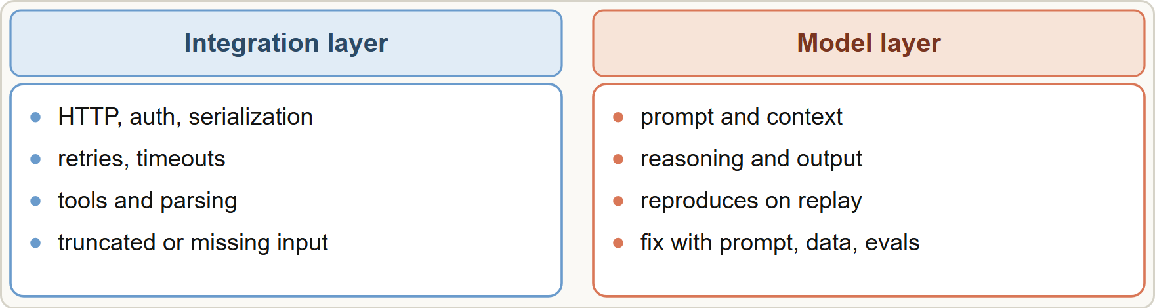
Step 3: isolate the origin
Module 16
Replay the exact request (same prompt, context and parameters). If the bad output reproduces, the cause is the prompt, context or model behavior; if the request itself was malformed or lost data on the way (a truncated history, a missing document, wrong serialization), the cause is the integration layer.
Replay the exact request (same prompt, context and parameters). If the bad output reproduces, the cause is the prompt, context or model behavior; if the request itself was malformed or lost data on the way (a truncated history, a missing document, wrong serialization), the cause is the integration layer.
Claude Developer Foundations Exam Prep | for the CCDV-F exam
Module 16: Debugging, Evals and Error Handling
8 / 20
Notes:
Step three: isolate the origin.
The figure shows this: Separate the integration layer from the model output: replay the exact request, check what the model received, and test each layer on its own.
Replay the exact request (same prompt, context and parameters). If the bad output reproduces, the cause is the prompt, context or model behavior; if the request itself was malformed or lost data on the way (a truncated history, a missing document, wrong serialization), the cause is the integration layer.

Slide 9
Step 3: isolate the origin, continued
Module 16
Check what the model actually received: most "model mistakes" turn out to be missing, stale or truncated input.
Change one variable at a time and compare.
EXAM TIP "Wrong answers" are often wrong or missing input. Look at the logged prompt and tool results before rewriting the prompt or switching models.
Claude Developer Foundations Exam Prep | for the CCDV-F exam
Module 16: Debugging, Evals and Error Handling
9 / 20
Notes:
Step three: isolate the origin, continued.
Check what the model actually received: most "model mistakes" turn out to be missing, stale or truncated input.
Change one variable at a time and compare.
Exam tip: "Wrong answers" are often wrong or missing input. Look at the logged prompt and tool results before rewriting the prompt or switching models.
Exam tip: Check what the model actually received (the logged prompt and tool results) before changing the prompt or the model.

Slide 10
Evals
Module 16
An eval is a repeatable test that measures quality on representative inputs. Without evals you cannot tell whether a prompt, model or setting change helped or hurt.
Claude Developer Foundations Exam Prep | for the CCDV-F exam
Module 16: Debugging, Evals and Error Handling
10 / 20
Notes:
Evals.
An eval is a repeatable test that measures quality on representative inputs. Without evals you cannot tell whether a prompt, model or setting change helped or hurt.

Slide 11
Evals, continued
Module 16
Part | What to know
Success criteria | Define them first and make them measurable: task fidelity, consistency, latency, cost, safety
Design principles | Task-specific (mirror real inputs, include edge cases), automate where possible, volume over perfect quality (many automatically graded cases beat few hand-graded ones)
Grading | Code-based (exact or string match: fastest, most reliable); human (best nuance, slow and costly); LLM-based (fast and scalable for complex judgments: needs a clear rubric, a specific output such as correct or incorrect, optional reasoning, and a reliability check first)
Claude Developer Foundations Exam Prep | for the CCDV-F exam
Module 16: Debugging, Evals and Error Handling
11 / 20
Notes:
Evals, continued.
Success criteria. Define them first and make them measurable: task fidelity, consistency, latency, cost, safety.
Design principles. Task-specific (mirror real inputs, include edge cases), automate where possible, volume over perfect quality (many automatically graded cases beat few hand-graded ones).
Grading. Code-based (exact or string match: fastest, most reliable); human (best nuance, slow and costly); L L M (large language model)-based (fast and scalable for complex judgments: needs a clear rubric, a specific output such as correct or incorrect, optional reasoning, and a reliability check first).

Slide 12
Evals, continued
Module 16
Part | What to know
Use | Run on every change (prompt, model, tool, config), in CI; track regressions; keep a set of past failures as regression tests
Claude Developer Foundations Exam Prep | for the CCDV-F exam
Module 16: Debugging, Evals and Error Handling
12 / 20
Notes:
Evals, continued.
Use. Run on every change (prompt, model, tool, config), in C I; track regressions; keep a set of past failures as regression tests.

Slide 13
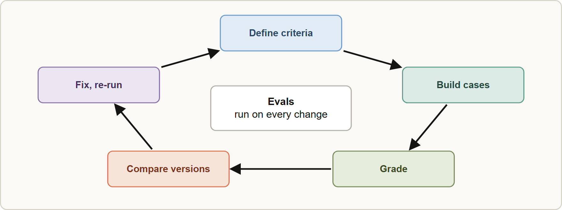
Evals, continued
Module 16
The eval loop: define success, build cases, grade, compare versions, fix and re-run
EXAM TIP Choose the grading method by need: exact answers → code-based; open-ended quality → LLM-based with a rubric (validated against human judgment); final high-stakes calibration → human review.
Claude Developer Foundations Exam Prep | for the CCDV-F exam
Module 16: Debugging, Evals and Error Handling
13 / 20
Notes:
Evals, continued.
The figure shows this: The eval loop: define success, build cases, grade, compare versions, fix and re-run.
Exam tip: Choose the grading method by need: exact answers to code-based; open-ended quality to L L M-based with a rubric (validated against human judgment); final high-stakes calibration to human review.

Slide 14
Module Recap
Module 16
1
4xx
2
429
3
5xx / overloaded / timeout
Fix the request; do not retry unchanged
Back off, retry-after, lower concurrency
Retry with exponential backoff and jitter
4
max_tokens
5
Parsing
6
Wrong content
Cut-off output: raise limit or continue
Structured output, defensive parsing, retry with error
Check what the model saw (prompt, context, tool data) first
7
Traces
8
Isolate
9
Evals
Request ID, prompt, tools, usage, stop_reason, latency (mask sensitive data)
Replay the exact request; integration layer vs model output
Criteria first; task-specific with edge cases; automate; code, human or LLM grading; run on every change
Claude Developer Foundations Exam Prep | for the CCDV-F exam
Module 16: Debugging, Evals and Error Handling
14 / 20
Notes:
Here is the recap.
four X X: Fix the request; do not retry unchanged.
four hundred twenty-nine: Back off, retry-after, lower concurrency.
five X X or overloaded or timeout: Retry with exponential backoff and jitter.
max tokens: Cut-off output: raise limit or continue.
Parsing: Structured output, defensive parsing, retry with error.
Wrong content: Check what the model saw (prompt, context, tool data) first.
Traces: Request I D, prompt, tools, usage, stop reason, latency (mask sensitive data).
Isolate: Replay the exact request; integration layer versus model output.
Evals: Criteria first; task-specific with edge cases; automate; code, human or L L M grading; run on every change.

Slide 15
Practice Question 1
Module 16
Q1
Requests suddenly return HTTP 401. What should the team do?
A
Check the key or credentials; retrying unchanged will not help
B
Raise max_tokens
C
Switch models
D
Retry with exponential backoff until the request works
Claude Developer Foundations Exam Prep | for the CCDV-F exam
Module 16: Debugging, Evals and Error Handling
15 / 20
Notes:
Question one.
Requests suddenly return H T T P four hundred one. What should the team do?
The four options are on the screen.
[PAUSE 12]
The answer is A. four X X authentication errors need a configuration fix, not retries.

Slide 16
Practice Question 2
Module 16
Q2
During peak hours some calls return 429 with retry-after. What is the best response?
A
Back off for the indicated time and reduce concurrency
B
Disable retries
C
Retry instantly in a tight loop until it works
D
Ignore the errors
Claude Developer Foundations Exam Prep | for the CCDV-F exam
Module 16: Debugging, Evals and Error Handling
16 / 20
Notes:
Question two.
During peak hours some calls return four hundred twenty-nine with retry-after. What is the best response?
The four options are on the screen.
[PAUSE 12]
The answer is A. Rate limits call for waiting and lower request rates.

Slide 17
Practice Question 3
Module 16
Q3
An intermittent 529 overloaded response appears. What recovery fits?
A
Reduce temperature in case that helps the service
B
Rewrite the prompt in case it is too long
C
Retry with exponential backoff and jitter, then fall back or queue
D
Treat it as a permanent failure after one try
Claude Developer Foundations Exam Prep | for the CCDV-F exam
Module 16: Debugging, Evals and Error Handling
17 / 20
Notes:
Question three.
An intermittent five hundred twenty-nine overloaded response appears. What recovery fits?
The four options are on the screen.
[PAUSE 12]
The answer is C. Overload is transient; backoff and fallback handle it.

Slide 18
Practice Question 4
Module 16
Q4
Answers about deductibles are wrong for some policies. The logged prompt shows the policy text was truncated before it reached Claude. Where is the origin?
A
The user's browser, which sent the question in the wrong format
B
The integration layer that truncated the input, not the model
C
The API rate limit, which stopped some of the requests from running
D
The model's weights
Claude Developer Foundations Exam Prep | for the CCDV-F exam
Module 16: Debugging, Evals and Error Handling
18 / 20
Notes:
Question four.
Answers about deductibles are wrong for some policies. The logged prompt shows the policy text was truncated before it reached Claude. Where is the origin?
The four options are on the screen.
[PAUSE 12]
The answer is B. The model never saw the needed text; fixing the data path fixes the answer.

Slide 19
Practice Question 5
Module 16
Q5
Which TWO belong in a useful trace of each model call? (Select TWO.)
A
Only the user's name
B
Nothing, to protect privacy entirely
C
usage, stop_reason and latency
D
The request ID and the exact prompt, tool calls and results sent
E
Only the final answer text
Claude Developer Foundations Exam Prep | for the CCDV-F exam
Module 16: Debugging, Evals and Error Handling
19 / 20
Notes:
Question five. Select two.
Which two belong in a useful trace of each model call?
The five options are on the screen.
[PAUSE 15]
The answers are C and D. End-to-end traces with identifiers, inputs, usage and stop reasons allow failure analysis (with sensitive data masked).

Slide 20
Answers at a Glance
Module 16
Question | Answer | Why
Q1 | A | 4xx authentication errors need a configuration fix, not retries
Q2 | A | Rate limits call for waiting and lower request rates
Q3 | C | Overload is transient; backoff and fallback handle it
Q4 | B | The model never saw the needed text
Q5 | C, D | End-to-end traces with identifiers
Claude Developer Foundations Exam Prep | for the CCDV-F exam
Module 16: Debugging, Evals and Error Handling
20 / 20
Notes:
Here are all five answers. Question one: A. Question two: A. Question three: C. Question four: B. Question five: C and D.
In the next module, we continue the course.

