Slide 1
Instruction Level Parallelism

Slide 2
Ideal Processor
Instrs. | Cycle 1 | Cycle 2 | Cycle 3 | Cycle 4 | Cycle 5
add R1,R2,R3 | F | D | EX (R2+R3) |  | WB (R1)
sub R4,R1,R5 | F | D | EX (R1-R5) |  | WB
add R6,R7,R8 | F | D | EX |  | WB
mul R5,R8,R9 | F | D | EX |  | WB
mul R4,R8,R9 | F | D | EX |  | WB
CPI=1/infinity (almost equal to zero)

Slide 3
Ideal Processor
Problem
Read the registers the same time
2nd instruction wont be executed correctly
Check
Which one can execute and which one cannot execute in the same cycle

Slide 4
The Execute Stage
Problem occurs in the execute stage
Dependence from I1 to I2
It is able to forward the instruction in the next cycle but not in the same cycle
 | EXEC
I1
I2
I3
I4

Slide 5
Time line for Execute Cycle
±

Slide 6
Time line for Execute Cycle
±
Result is calculated some where here

Slide 7
Time line for Execute Cycle
±
Result is calculated some where here
The Calculated result can't be transmitted backwards

Slide 8
Including Stalls
Solution: we have to stall
 | EXEC
I1 | I1
I2 | stall
I3 | I3
I4 | I4
I5 | I5
If I3, I4, I5 don’t have any dependencies with I1 or between them they still can execute
2 cycles executing 5 instructions
CPI=2/5=0.4
Instead of 0.2

Slide 9
Conclusion
So if we have a lot of instructions we will have a lot of dependencies and we won’t have a CPI of zero even if we have infinite no. of execution unit.

Slide 10
RAW Dependencies
Raw dependencies:
Delays that ideal processors are going to have
ILP is somewhat larger than zero even for an ideal processor

Slide 11
Raw Dependencies
1st cycle I1 & I3
2nd cycle I2 & I4
3rd cycle I5
I1
I2
I3
I4
I5
3 cycles executing 5 instructions
CPI=3/5=0.6
Instead of 0.2

Slide 12
Raw Dependencies
If we have this dependency as well then?
I1
I2
I3
I4
I5

Slide 13
Raw Dependencies
The RAW dependency is going to determine what is the possible CPI
Even if the processor can do everything ideally, i.e. it can fetch any no. of instructions, it can decode and read registers for infinite instructions, it can execute infinite instructions but still……………………
CPI is 0 if a very large no. of instructions with no dependencies

Slide 14
WAW Dependence
 | 5 | 6 | 7
R1=…. | EXE | MEM | WB (R1)
R4=… | …. | EXE | MEM | WB(R4)
R7=… | EXE | MEM | WB (R7)
R8=… | EXE | MEM | WB (R8)
R4=… | EXE | MEM | WB (R4)

Slide 15
WAW Dependence
Solution
 | 5 | 6 | 7
add R1,R2,R3 | EXE | MEM | WB (R1)
sub R4,R1 R5 | …. | EXE | MEM | WB(R4)
add R7,R8,R9 | EXE | MEM | WB (R7)
mul R10,R11,R12 | EXE | MEM | WB (R8)
mul R4, R11, R12 | EXE | MEM | WB (R4) | --------- | Write the result here

Slide 16
WAW Dependence
Problem
The result is written in wrong order
Solution
Stall

Slide 17
Dependency
5-Stages (Fetch, RR, EXE, MEM, WR)
Forwarding
10 instructions in each stage
So in 5 cycles it is going to execute all 10 instructions
If we have 20 instructions it would complete them in 6 cycles

Slide 18
Dependency
 | EXE | WB
MUL R2, R2, R2 | 3 | 5
ADD R1, R1, R2 | 4 | 6
MUL R3, R3, R3 | 3 | 5
ADD R1, R1, R3 | 5 | 7
MUL R4, R4, R4 | 3 | 5
ADD R1, R1, R4 | 6 | 8

Slide 19
Removing False Dependency
RAW (TRUE)
WAR (FALSE)
WAW (FALSE)
Solution:
Duplicating Register Values

Slide 20
Removing False Dependency
 | C 100 | C 101 | C 102 | C 103
R1=R2+R3 | EXE
R4=R1-R5 |  | EXE | MEM | WR
R3=R4+1 |  |  | EXE
R4=R8-R9 | EXE | MEM | WR

Slide 21
Removing False Dependency
Store all values of R4 and when an instruction wants R4 pass it to the one that is before it
Multiple versions of each register

Slide 22
Register Renaming
Architectural registers
Physical register
Register Renaming:
Rewrite Programs using physical register

Slide 23
Register Allocation Table (RAT)
Table that says which physical register has value for which architectural register

Slide 24
RAT Example
0 | P0
1 | P1
2 | P2
3 | P3
4 | P4
5 | P5
6 | P6
ADD R1, R2, R3
___________
SUB R4, R1,R5
___________
XOR R6, R7, R8
___________
MUL R5,R8,R9
___________
ADD R4, R8, R9
___________

Slide 25
RAT Example
0 | P0
1 | P1, P17
2 | P2
3 | P3
4 | P4, P18, P21
5 | P5, P20
6 | P6, P19
ADD R1, R2, R3
ADD P17, P2, P3
SUB R4, R1,R5
SUB P18, P17, P5
XOR R6, R7, R8
XOR P19, P7, P8
MUL R5,R8,R9
MUL P20, P8, P9
ADD R4, R8, R9
ADD P21, P8, P9

Slide 26
RAT Example
RAT
Fetched | Renamed
MUL R2, R2, R2
ADD R1, R1, R2
MUL R2, R4, R4
ADD R3, R3, R2
MUL R2, R6, R6
ADD R5, R5, R2
R1 | P0
R2 | P1
R3 | P2
R4 | P3
R5 | P4
R6 | P5

Slide 27
RAT Example
RAT
Fetched | Renamed
MUL R2, R2, R2 | MUL P7, P2, P2
ADD R1, R1, R2 | ADD P8, P1, P7
MUL R2, R4, R4 | MUL P9, P4,P4
ADD R3, R3, R2 | ADD P10, P3, P9
MUL R2, R6, R6 | MUL P11, P6, P6
ADD R5, R5, R2 | ADD P12, P5, P11
R1 | P1-P8
R2 | P2-P7-P9-P11
R3 | P3-P10
R4 | P4
R5 | P5-P12
R6 | P6

Slide 28
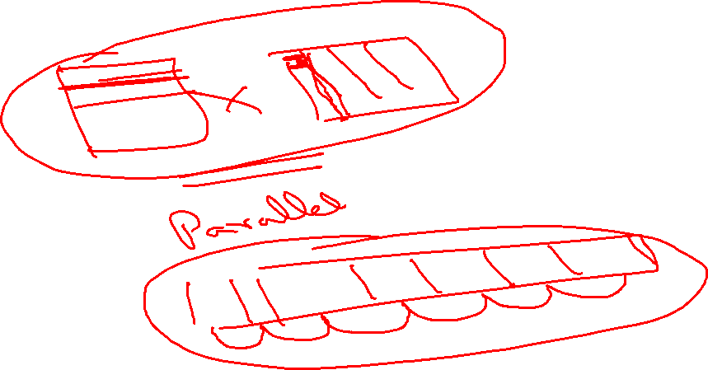

Slide 29
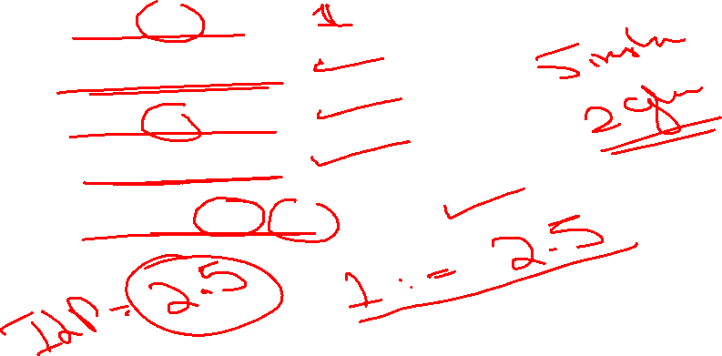
ILP Example
ILP is the property of the program
ADD P10, P2, P3
XOR P6, P7, P8
MUL P5, P8, P9
ADD P4, P8, P9
SUB P11, P10, P5

Slide 30
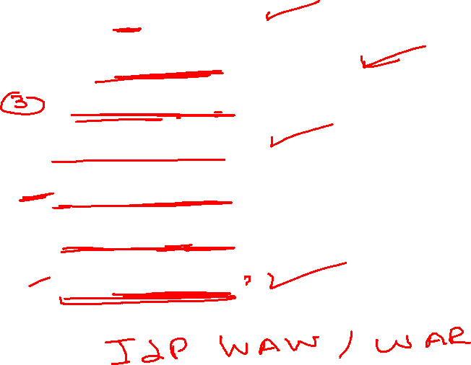
ILP Example
ADD R1, R1, R1
ADD R2, R2,R1
ADD R3, R2, R1
ADD R6,R7,R8
ADD R8, R3, R7
ADD R1, R1, R1
ADD R1, R7, R7

Slide 31
ILP vs IPC
Processor
2 issue
Out of order
1 mul, 1 add/sub/xor
Instructions
ADD R1, R2, R3
SUB R4, R1,R5
XOR R6, R7, R8
MUL R5,R8,R9
ADD R4, R8, R9

Slide 32
ILP vs IPC
Processor
2 issue
Out of order
1 mul, 2 add/sub/xor
Instructions
ADD R1, R2, R3
SUB R4, R1,R5
XOR R6, R7, R8
MUL R5,R8,R9
ADD R4, R8, R9

Slide 33
ILP vs IPC
Processor
3 issue
in order
3 ALUs
Instructions
ADD R1, R2, R3
ADD R2, R3,R4
ADD R3, R1, R2
ADD R7,R8,R9
ADD R1, R7, R7
ADD R1, R4, R5

