Slide 1

Recurrent Neural Networks
Presentation 5

Slide 2
OUTLINE
Introduction
History
Architecture
Types and Applications
Major limitations and solutions
Practical example

Slide 3
Introduction
A Neural Network consists of different layers connected to each other, working on the structure and function of a human brain.
It learns from huge volumes of data and uses complex algorithms to train a neural net.
RNN works on the principle of saving the output of a particular layer and feeding this back to the input in order to predict the output of the layer.

Slide 4
Introduction
Wait a sec!
It sounds familiar right?
We already discussed CNNs and ANNs!
So what changed?

Slide 5
Introduction
It turns out CNNs have major limitations!
Cannot handle sequential data.
Can’t model relationship between instances, desirable in many applications such as video processing.
Considers only the current input.
Can’t handle variable size inputs and outputs, desirable in many applications such as video processing, text processing and speech processing.
Cannot memorize previous inputs.
Only bounded context in handle, not suitable for certain applications such as video and speech processing.

Slide 6
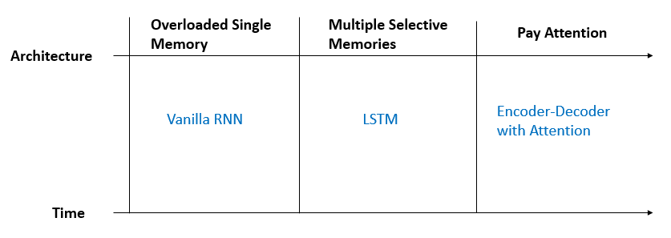
History
The concept of RNN was brought up in 1986. And the famous LSTM architecture was invented in 1997.
The number of well-known architectures of RNN is much less than that from CNN.
As the famous saying “A picture is worth a thousand words” implies, images have much more information and space to maneuver, so it is no surprise that the evolution history of RNN is not as colorful.
We categorize the history into 3 phases, which are Overloaded Single Memory for Vanilla RNN, Multiple Gate Memories for LSTM and Pay Attention for Encoder-Decoder architecture with RNN respectively.

Slide 7
Architecture
The nodes in different layers of the neural network are compressed to form a single layer of recurrent neural networks.
A, B, and C are the parameters of the network.

Slide 8
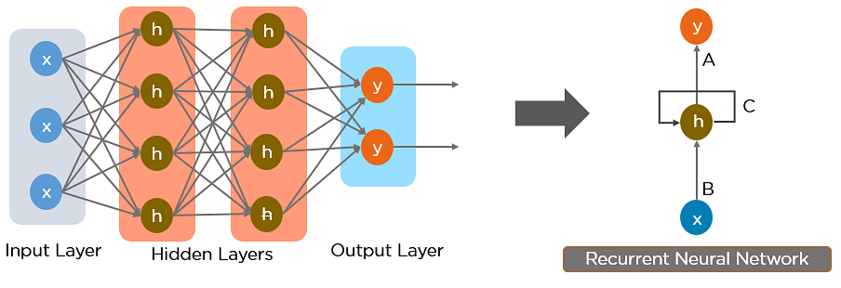
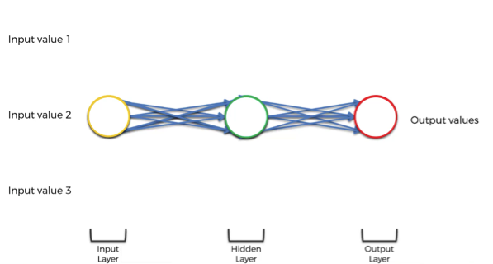
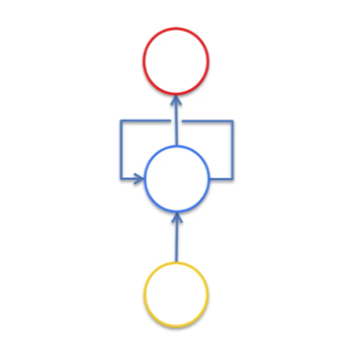
architecture
Squashing the network. The layers are still there but think of it as if we’re looking from underneath this neural network.
In Recurrent Neural networks, the information cycles through a loop to the middle hidden layer.

Slide 9
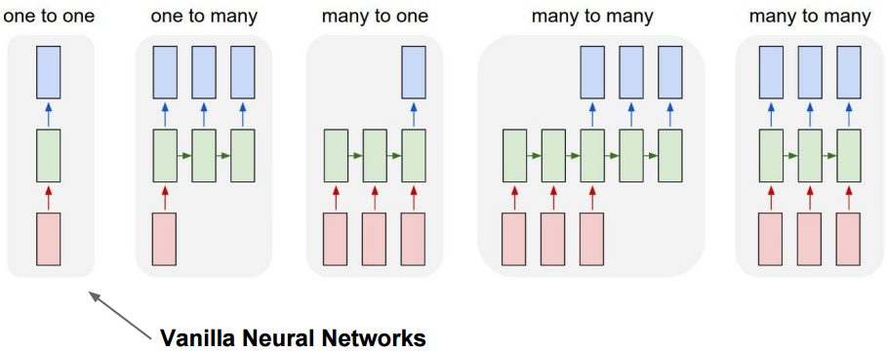
Typical RNNs Applications

Slide 10
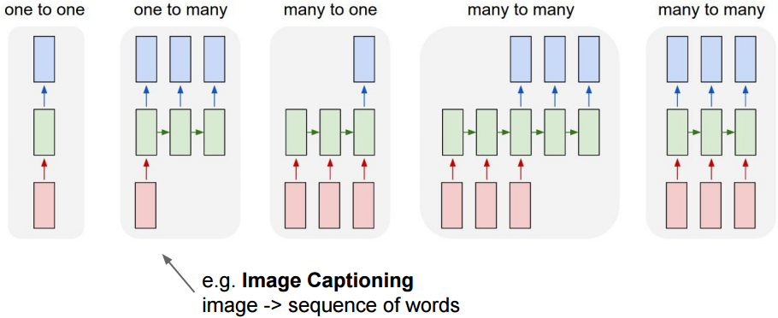
Typical RNNs Applications

Slide 11
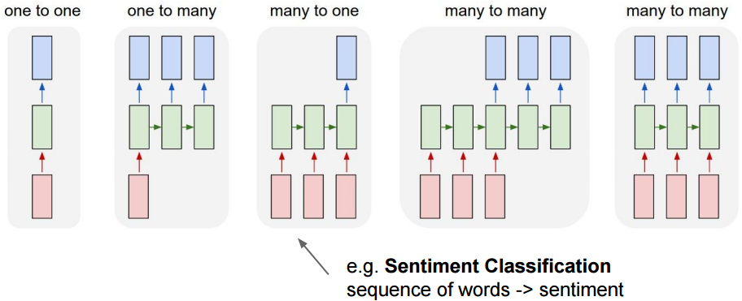
Typical RNNs Applications

Slide 12
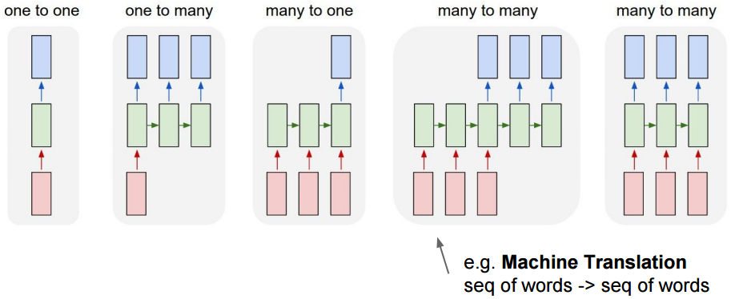
Typical RNNs Applications

Slide 13
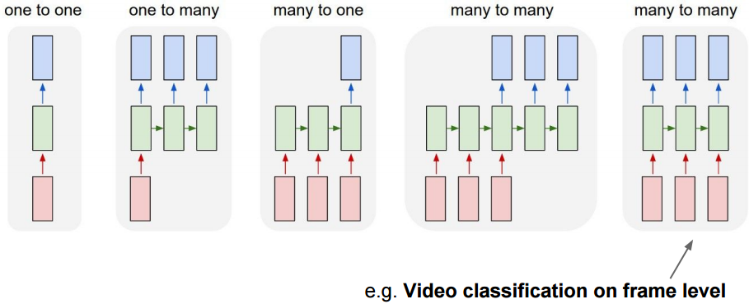
Typical RNNs Applications

Slide 14
Limitations
Key Characteristic of RNNs
To connect previous information to the present task, e.g. previous video frames might help the understanding of the present frame
Drawback
RNN are useful to use the past information when the gap between the relevant information and the place that it’s needed is small, e.g. “the clouds are in the sky”
RNN is enabled to handle applications that require longer context, e.g. “I grew up in Pakistan… I speak fluent Urdu.”
Why?
Vanishing gradient problem (VGP)

Slide 15
Limitations
Key Characteristic of RNNs
To connect previous information to the present task, e.g. previous video frames might help the understanding of the present frame
Drawback
Recurrent Neural Networks enable you to model time-dependent and sequential data problems, such as stock market prediction, machine translation, and text generation. You will find, however, RNN is hard to train.
Why?
Vanishing gradient problem (VGP)

Slide 16
Limitations
Key Characteristic of RNNs
To connect previous information to the present task, e.g. previous video frames might help the understanding of the present frame
Drawback
Recurrent Neural Networks enable you to model time-dependent and sequential data problems, such as stock market prediction, machine translation, and text generation. You will find, however, RNN is hard to train.
Why?
Vanishing gradient problem (VGP)

Slide 17
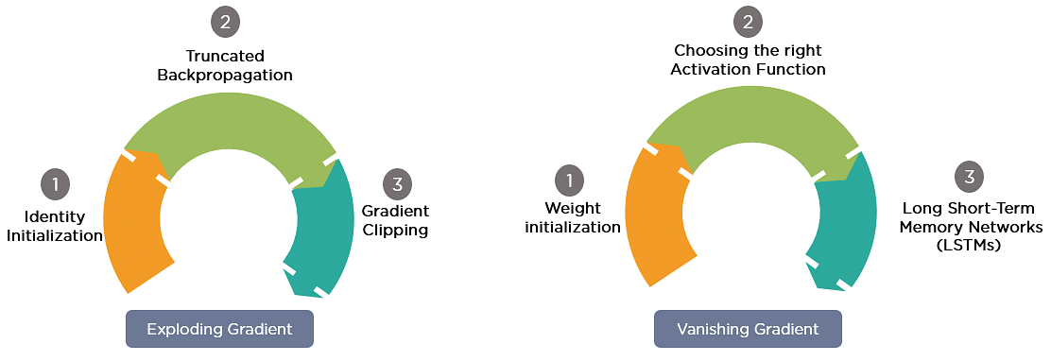
Gradient Problem Solutions
The gradients carry information used in the RNN, and when the gradient becomes too small, the parameter updates become insignificant. This makes the learning of long data sequences difficult.
While training a neural network, if the slope tends to grow exponentially instead of decaying, this is called an Exploding Gradient.

Slide 18
Long Short Term Memory (LSTM)
Hochreiter & Schmidhuber (1997) solved the problem of getting an RNN to remember things for a long time (like hundreds of time steps).
They designed a memory cell using logistic and linear units with multiplicative interactions.
Information gets into the cell whenever its “write” gate is on.
The information stays in the cell so long as its “keep” gate is on.
Information can be read from the cell by turning on its “read” gate.

Slide 19
Basic Architecture of LSTM Unit
keep gate
To preserve information for a long time in the activities of an RNN, a memory cell is used.
The cell maintains its state by activating keep gate (i.e. by setting value of keep gate = 1).
Information is stored in the cell by activating its write gate.
Information is retrieved by activating the read gate.
The network learn values of gates by back-propagate error through these gates.
Gates are sigmoid (or logistic) functions, we can learn there weights
1.73
write gate
read gate
input from rest of RNN
output to rest of RNN

Slide 20
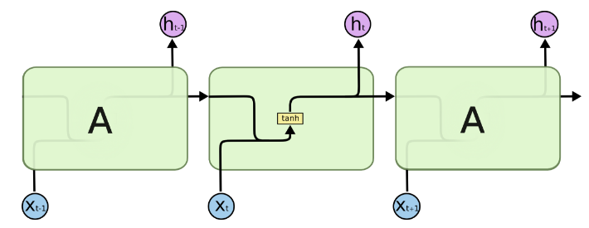
Understanding LSTM Architecture
Repeated blocks in RNNs

Slide 21
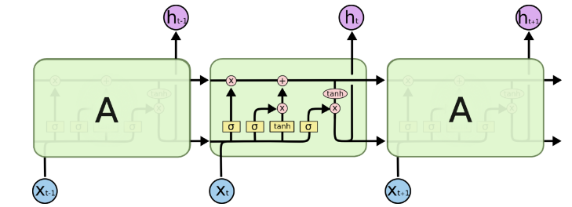

Understanding LSTM Architecture
Instead of having a single neural network layer, there are four, interacting in a very special way.
Repeated blocks in LSTMs
Notes:
Instead of having a single neural network layer, there are four, interacting in a very special way

Slide 22
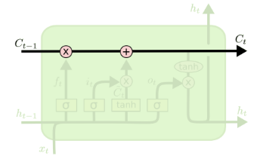
Understanding LSTM Architecture
Cell state
The key to LSTMs is the cell state, the horizontal line running through the top of the diagram.
The cell state is kind of like a conveyor belt. It runs straight down the entire chain, with only some minor linear interactions.
It’s very easy for information to just flow along it unchanged
A unit of LSTMs
Notes:
The key to LSTMs is the cell state, the horizontal line running through the top of the diagram.
The cell state is kind of like a conveyor belt. It runs straight down the entire chain, with only some minor linear interactions. It’s very easy for information to just flow along it unchanged

Slide 23
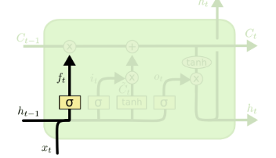

Understanding LSTM Architecture

Slide 24
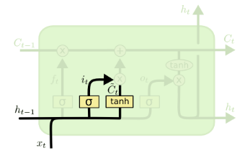

Understanding LSTM Architecture

Slide 25
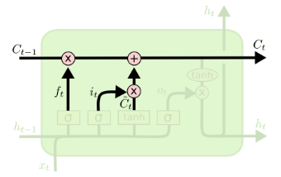

Understanding LSTM Architecture

Slide 26
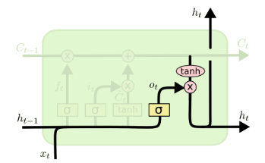

Understanding LSTM Architecture

Slide 27
Practical Example
The IMDb Movie Reviews dataset is a binary sentiment analysis dataset consisting of 50,000 reviews from the Internet Movie Database (IMDb) labeled as positive or negative.
The dataset contains an even number of positive and negative reviews.

