Slide 1
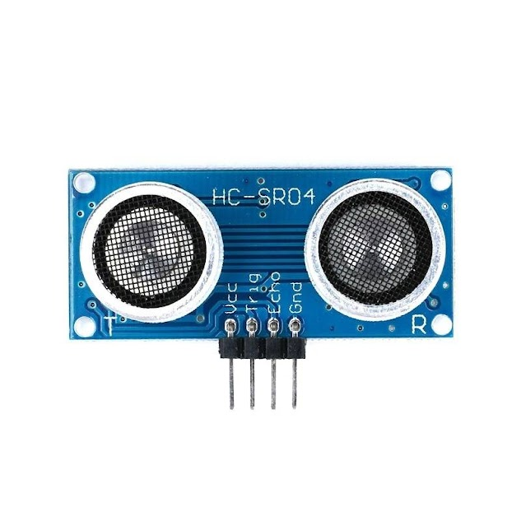
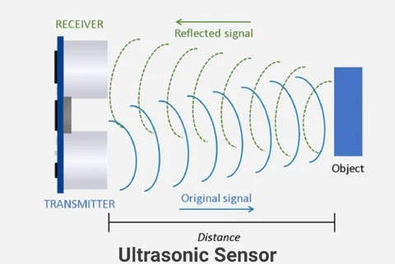

Slide 2

Transmitter → Trigger (trigPin)
Receiver → Echo (echoPin)
digitalWrite(trigPin, HIGH); activates the sensor.
delayMicroseconds(10); maintains the HIGH signal for 10 microseconds.
digitalWrite(trigPin, LOW); stops the trigger pulse.
delayMicroseconds(2); ensures a clean LOW-to-HIGH transition.
The Arduino pulseIn() function reads the duration of a pulse (either HIGH or LOW) on a specified pin, returning the pulse length in microseconds
NewPing sonar(trigPin, echoPin, MAX_DISTANCE); // Create a NewPing object
NewPing → This is the class from the NewPing library that we use to create an ultrasonic sensor object.
sonar(trigPin, echoPin, MAX_DISTANCE); → Creates an object named sonar with:
trigPin → The pin used to send the ultrasonic pulse (transmitter).
echoPin → The pin used to receive the reflected pulse (receiver).
MAX_DISTANCE → The maximum distance (in cm) to measure.
Speed of sound in air ≈ 343 m/s (or 0.0343 cm/µs).

