Slide 1
6.3 Project Task 5: Video Presentation Master of Science in Data Science Program, Bellevue University DSC640-T302 Data Presentation & Visualization (2245-1)
Name : Rajib Samanta Professor: Catherine Williams June 1st, 2024

Slide 2
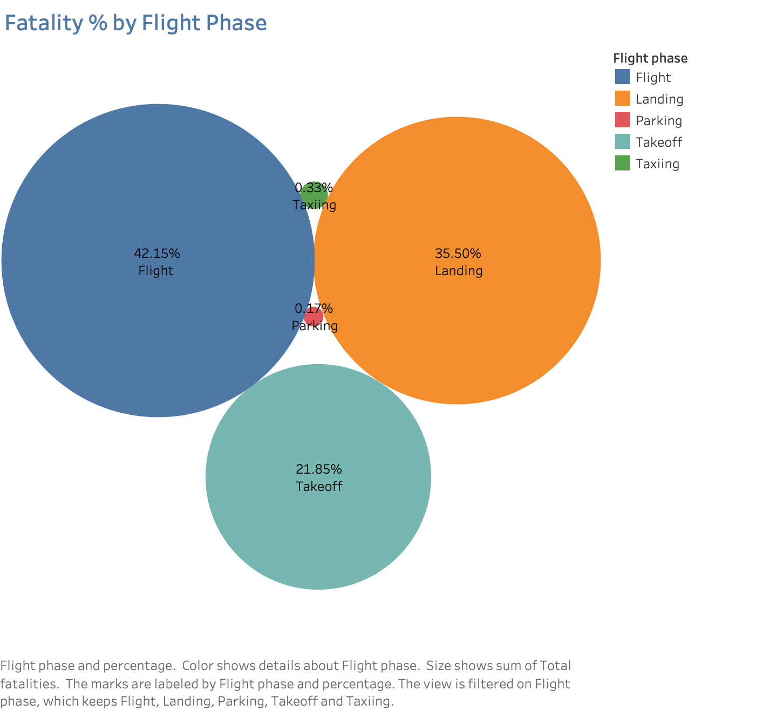
57% accident occur during take-of/landing

Slide 3
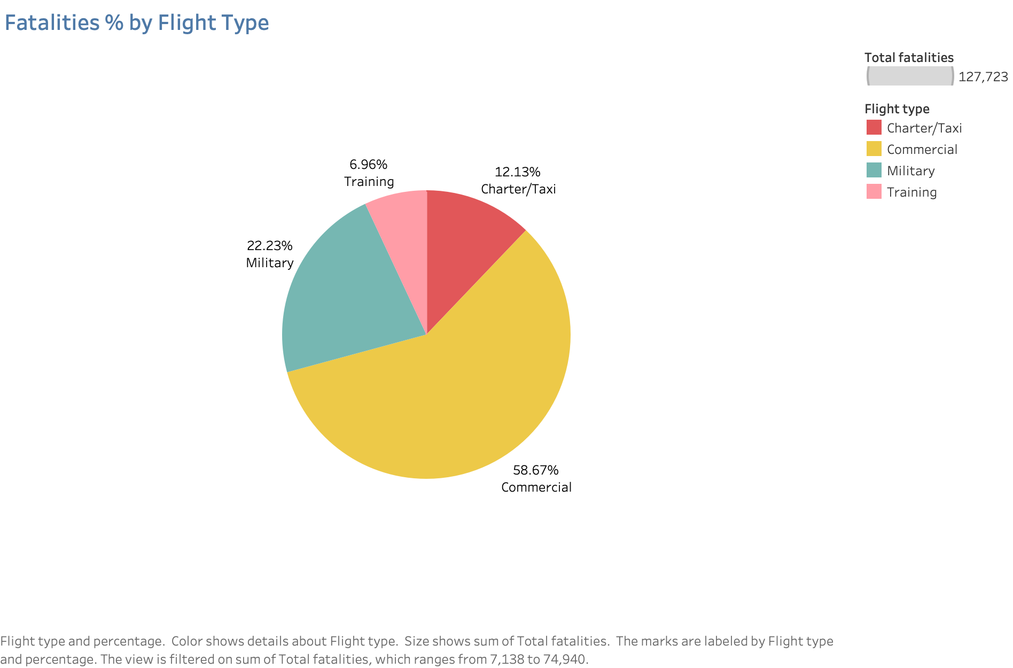
29% fatalities happen for military & Training

Slide 4
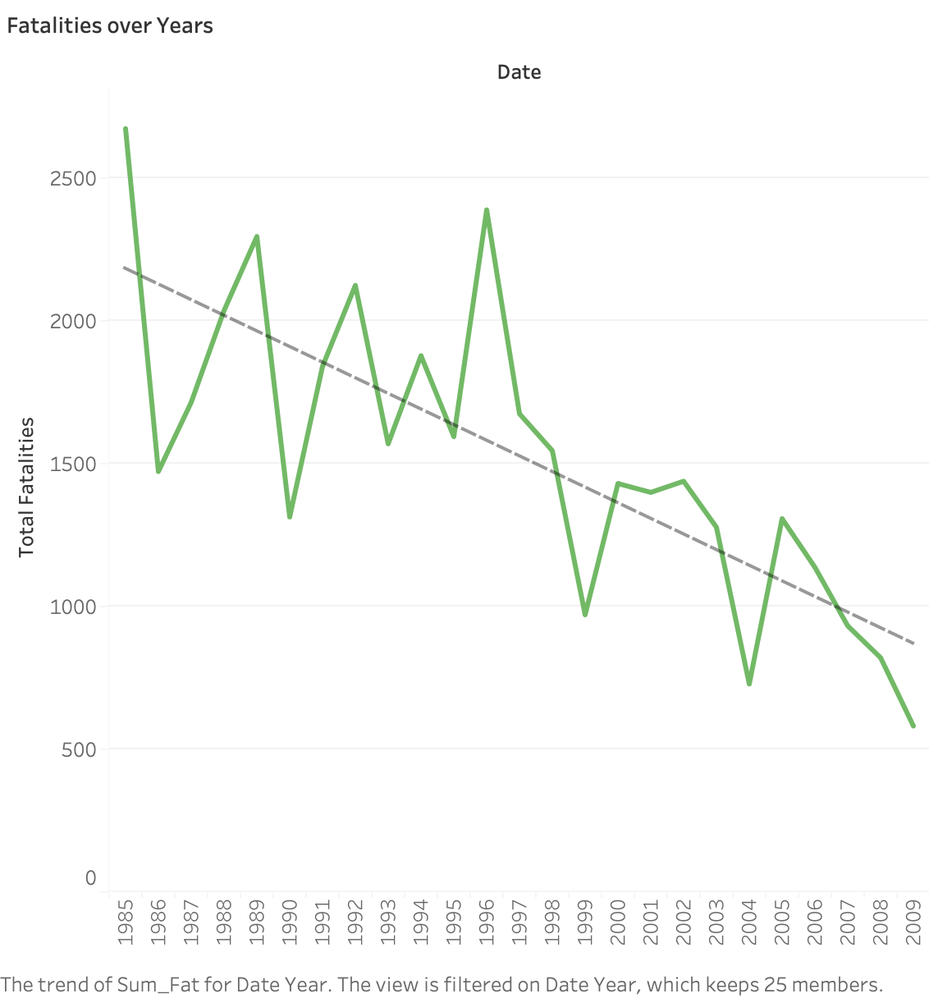
79%
79% Fatality drop from 1985 to 2009

Slide 5
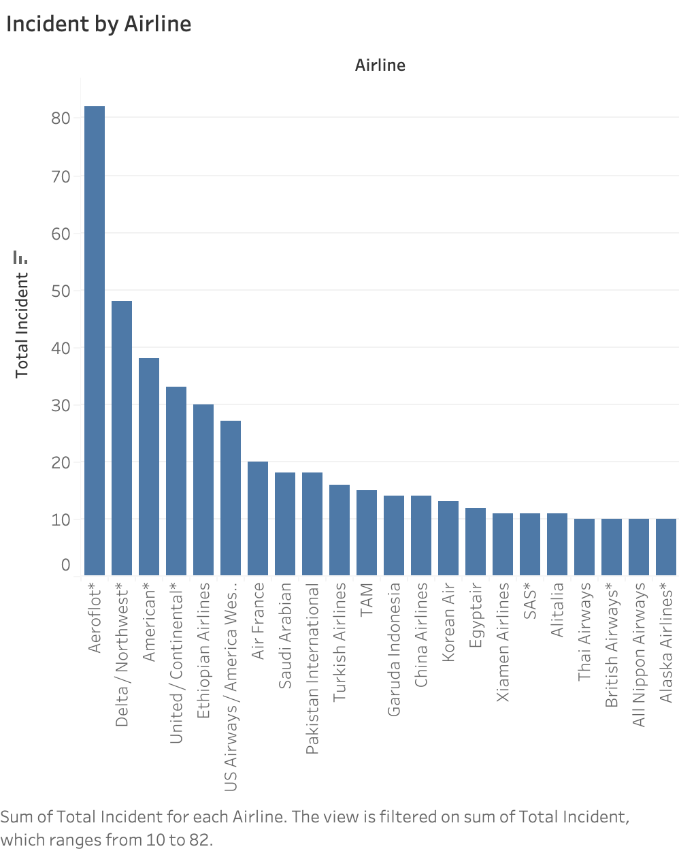
Aeroflot & Delta had most fatal accidents

Slide 6
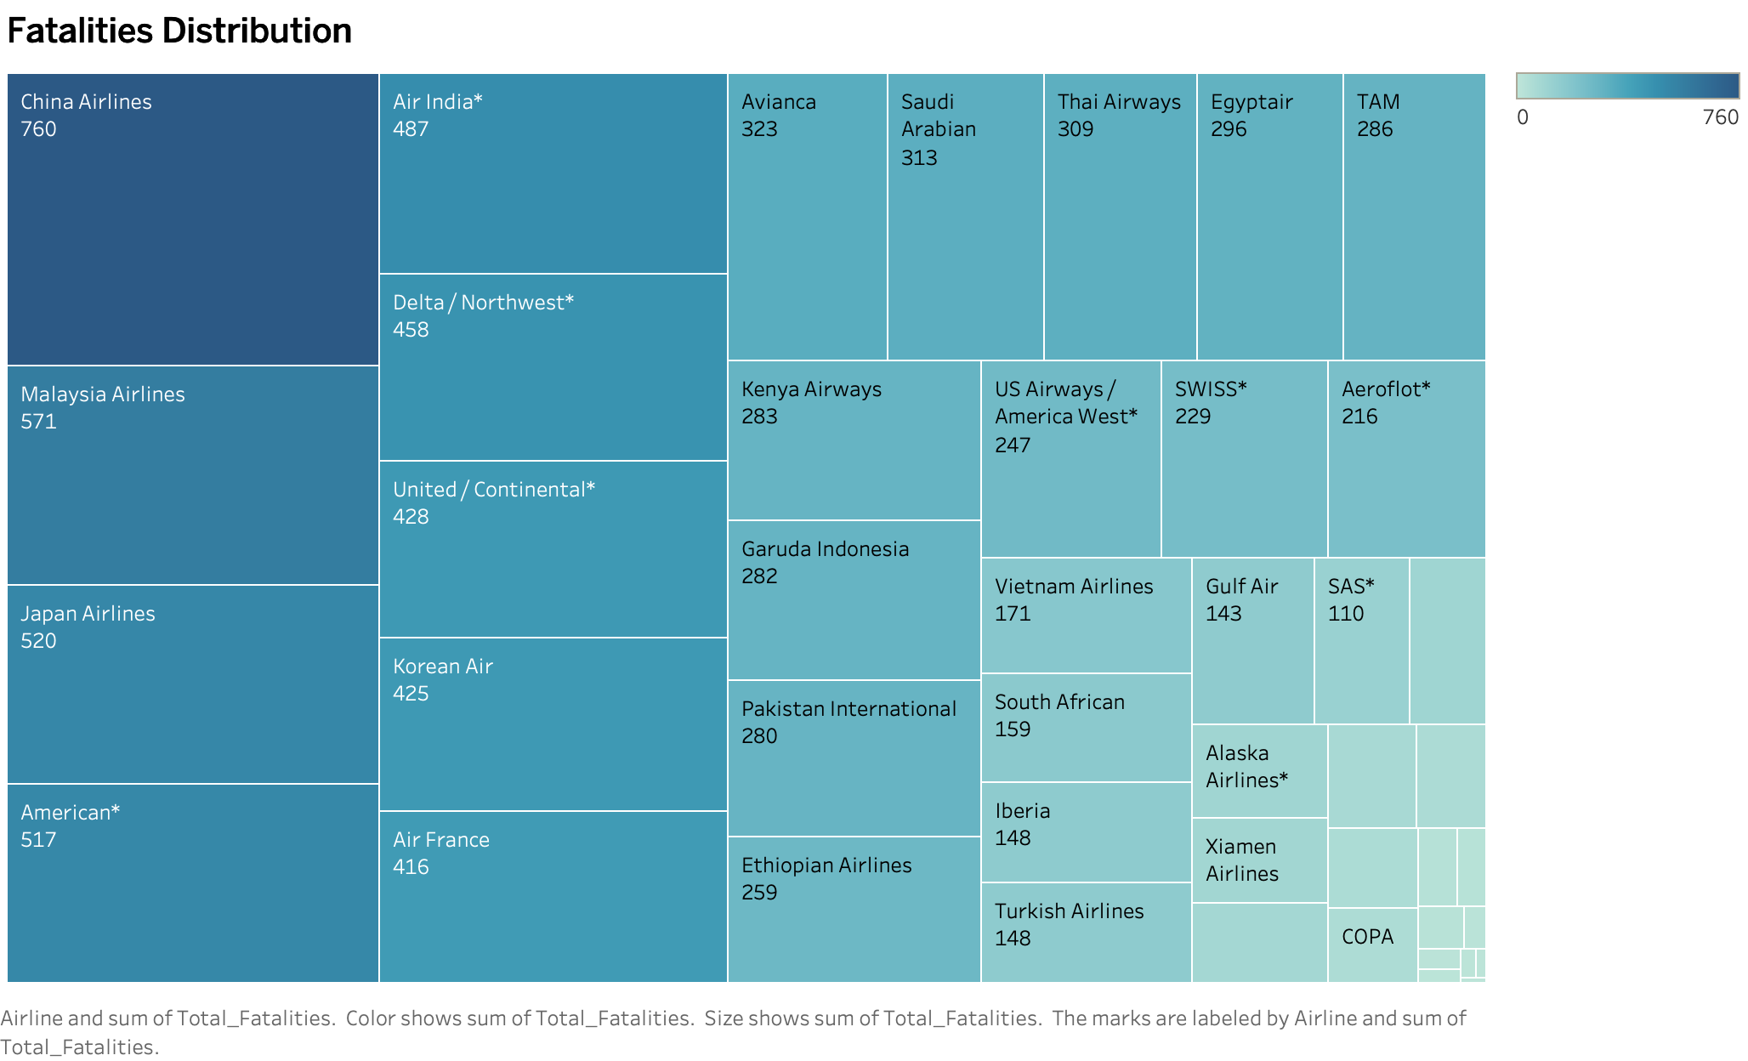
China & Malaysia Airline reported max no. of accidents

Slide 7
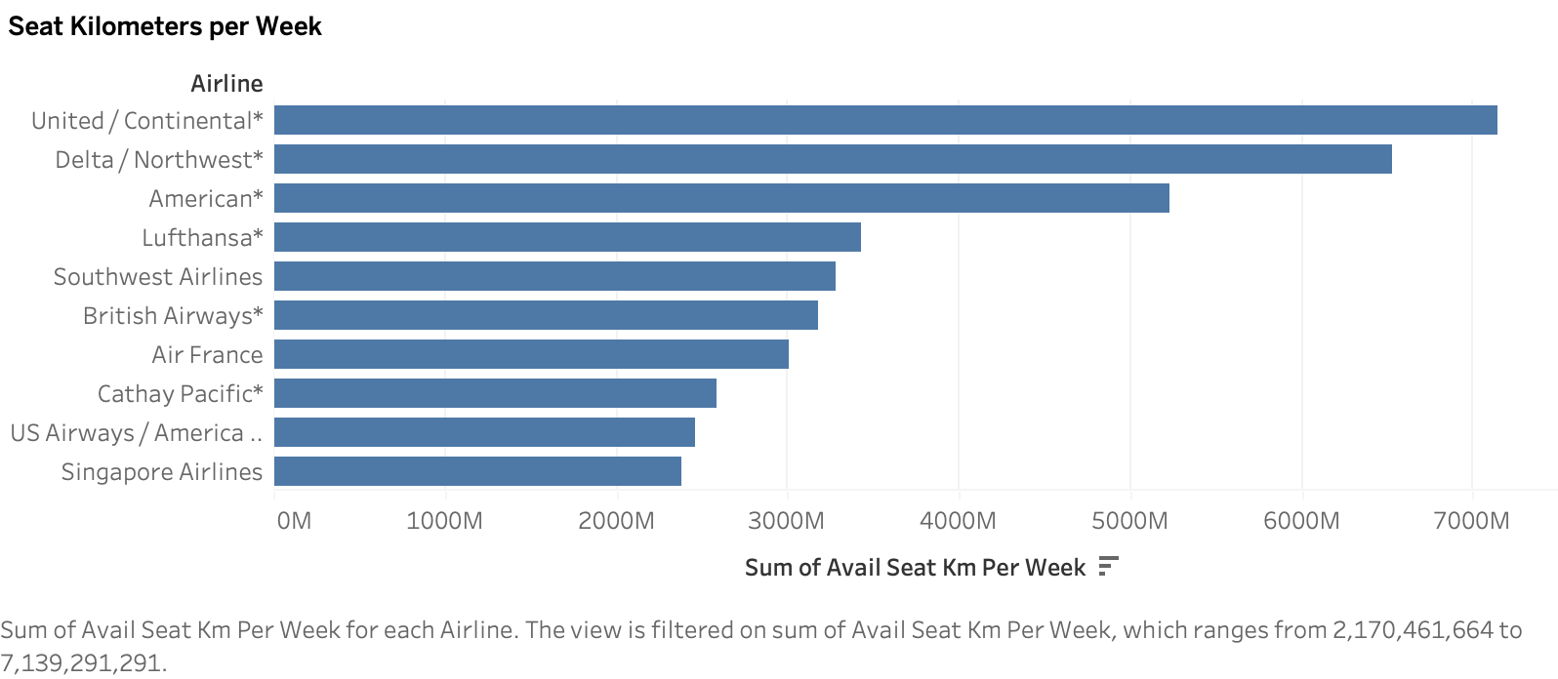
United & Delta have more coverage

Slide 8
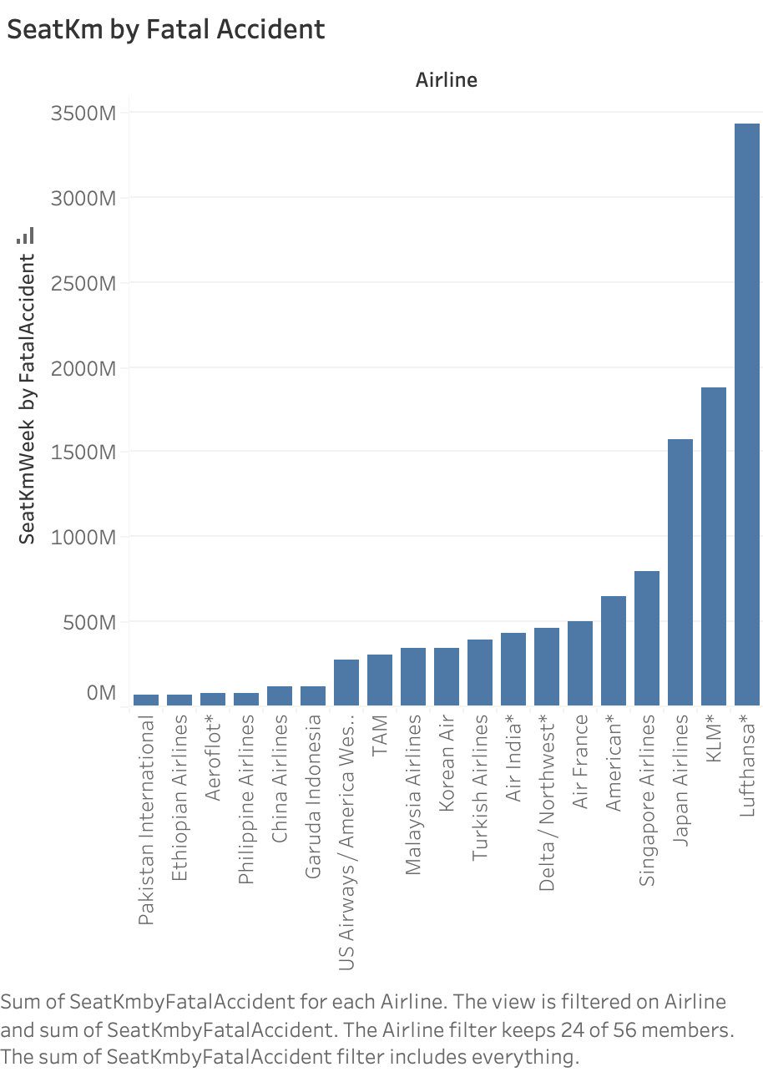
Lufthansa is the safest Airline

