Slide 1
CarPool Application
III (03 Cr. Hrs.)
1630
2016
01-07-2020
Shoaib Malik
161120 | Usama Rao
161132 | Sami Ahmad Malik
Naila Hussain
Imran Ihsan

Slide 2


Table of Contents
Introduction
Literature Review
Methodology
Design
Results
Testing
Conclusion
Project Demo

Slide 3
Introduction
Our FYP is a Carpool application which is a ride sharing application designed only for university students.
Vehicle owning students can share their rides with other students for traveling to and from their institutes and earn money.

Slide 4
Goals and Objectives
Cost Effective:
Much Cheaper than Cab services.
Ease of getting ride: Riders are easy approachable. Which reduces the tension of finding and catching of local transport right on time.
Fewer Cars on the road will have reduced fuel consumption which will make environment Eco-friendly

Slide 5
Literature Review
Many carpoolings applications and websites have been developed around the world. Following are some examples of carpooling systems around the globe:
Websites
New Zealand: https://www.asa.ac.nz/carpool
Algeria: www.nroho.com, www.m3aya.com, www.nsogo.net
Europe: BlaBlaCar.com, carpooling.com, GoMore.com
France: covoiturage.fr
USA: car.ma, www.rdvouz.com
World: Outpost.travel, joinntravel.com, www.letsride.in

Slide 6
Literature Review
Mobile Applications
New Zealand: ASA
Algeria: YAssir, Nsogo, AMIR
World: Uber, sRide, RideShare,
USA: Uber, Lyft
France: Karos, Wever, BlaBlaCar, OuiHop

Slide 7
Carpooling Types
Regular
Occasional
Eventual

Slide 8
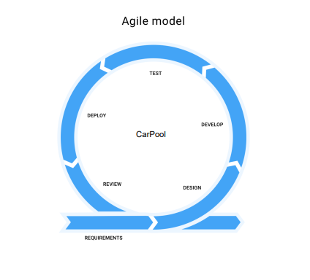
Methodology

Slide 9
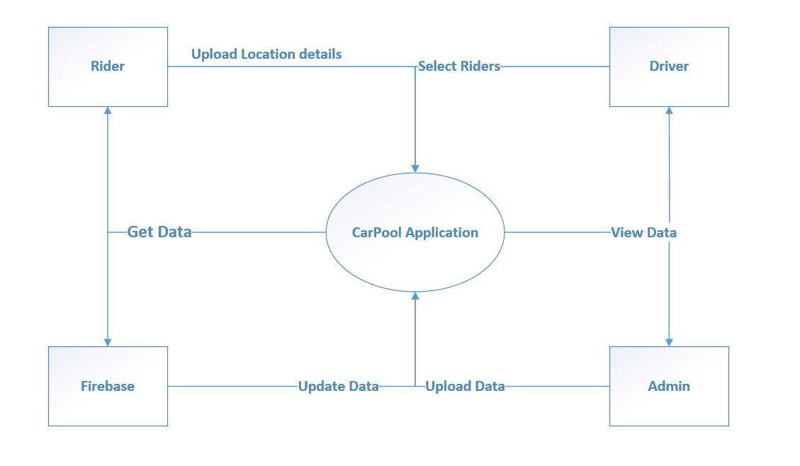
Design
Context Diagram

Slide 10
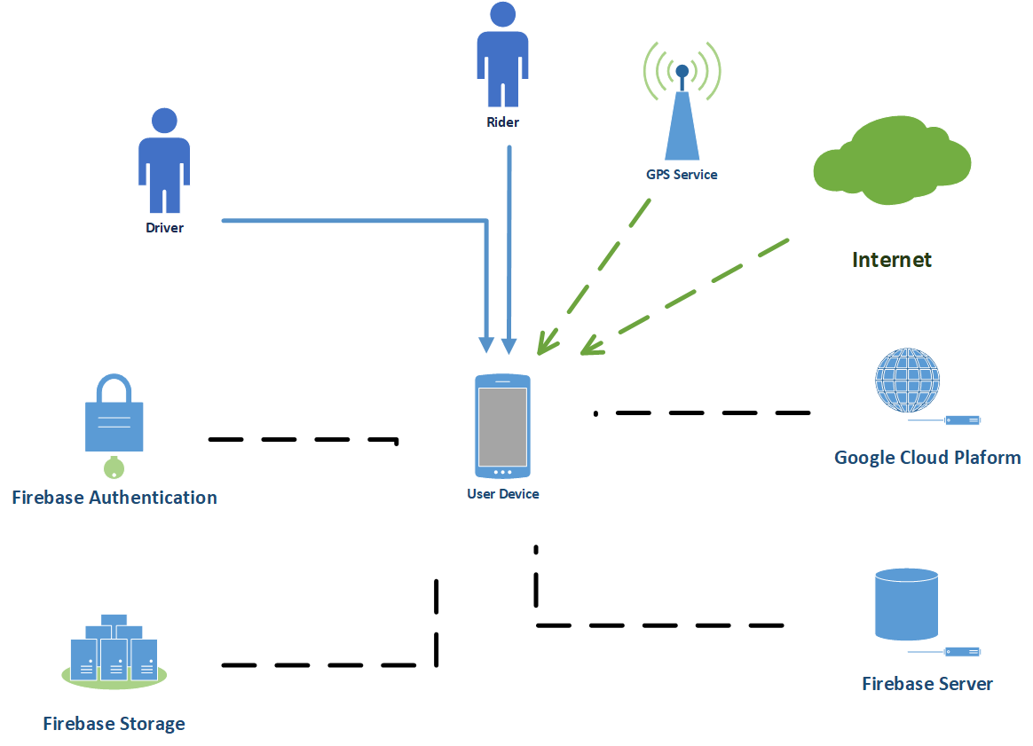
Design
System Architecture

Slide 11
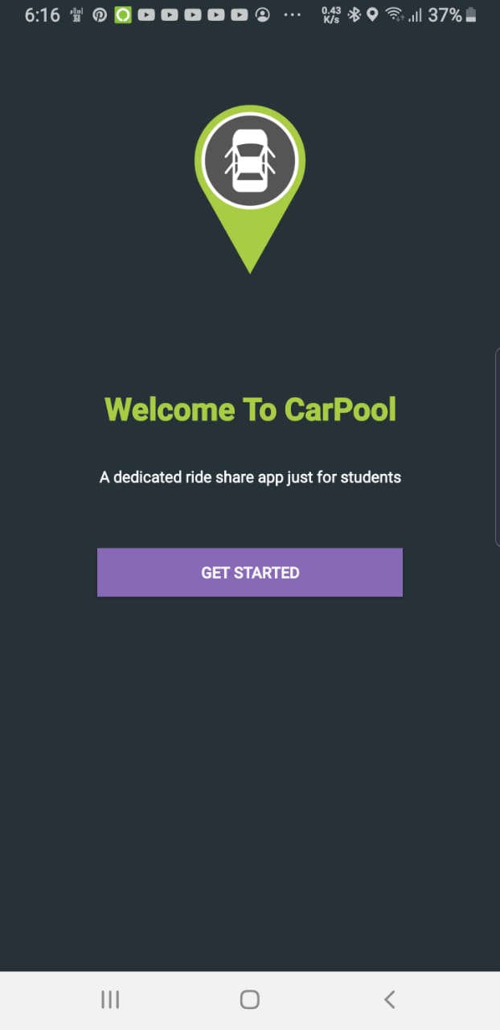
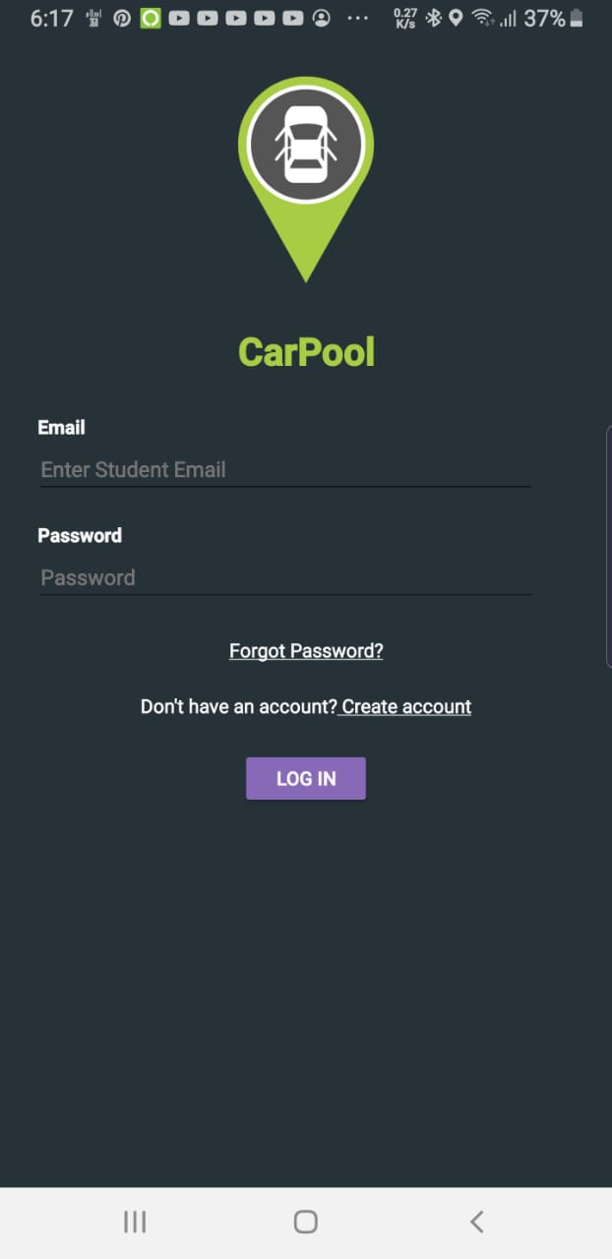
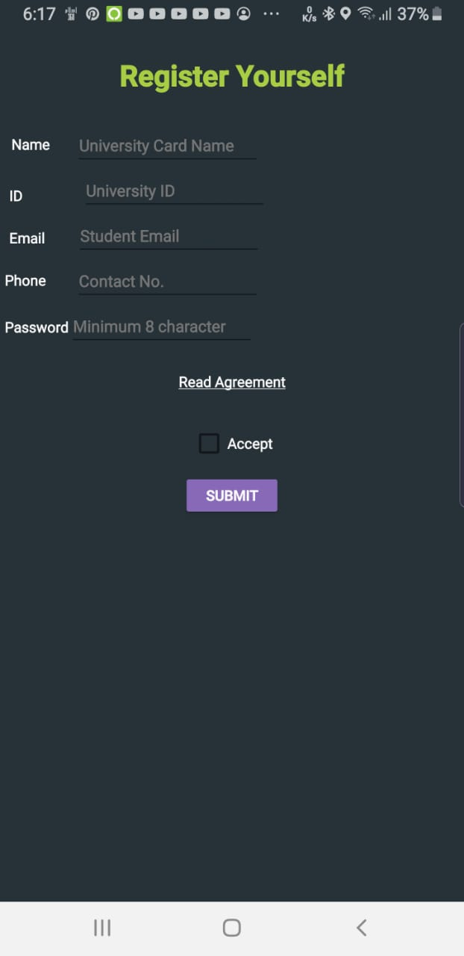
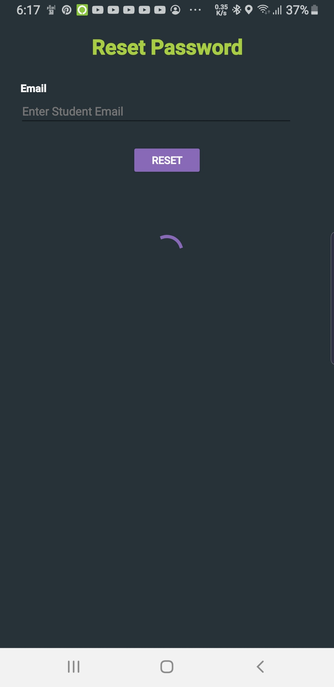
Results
Table 36: Usability Testing

Slide 12
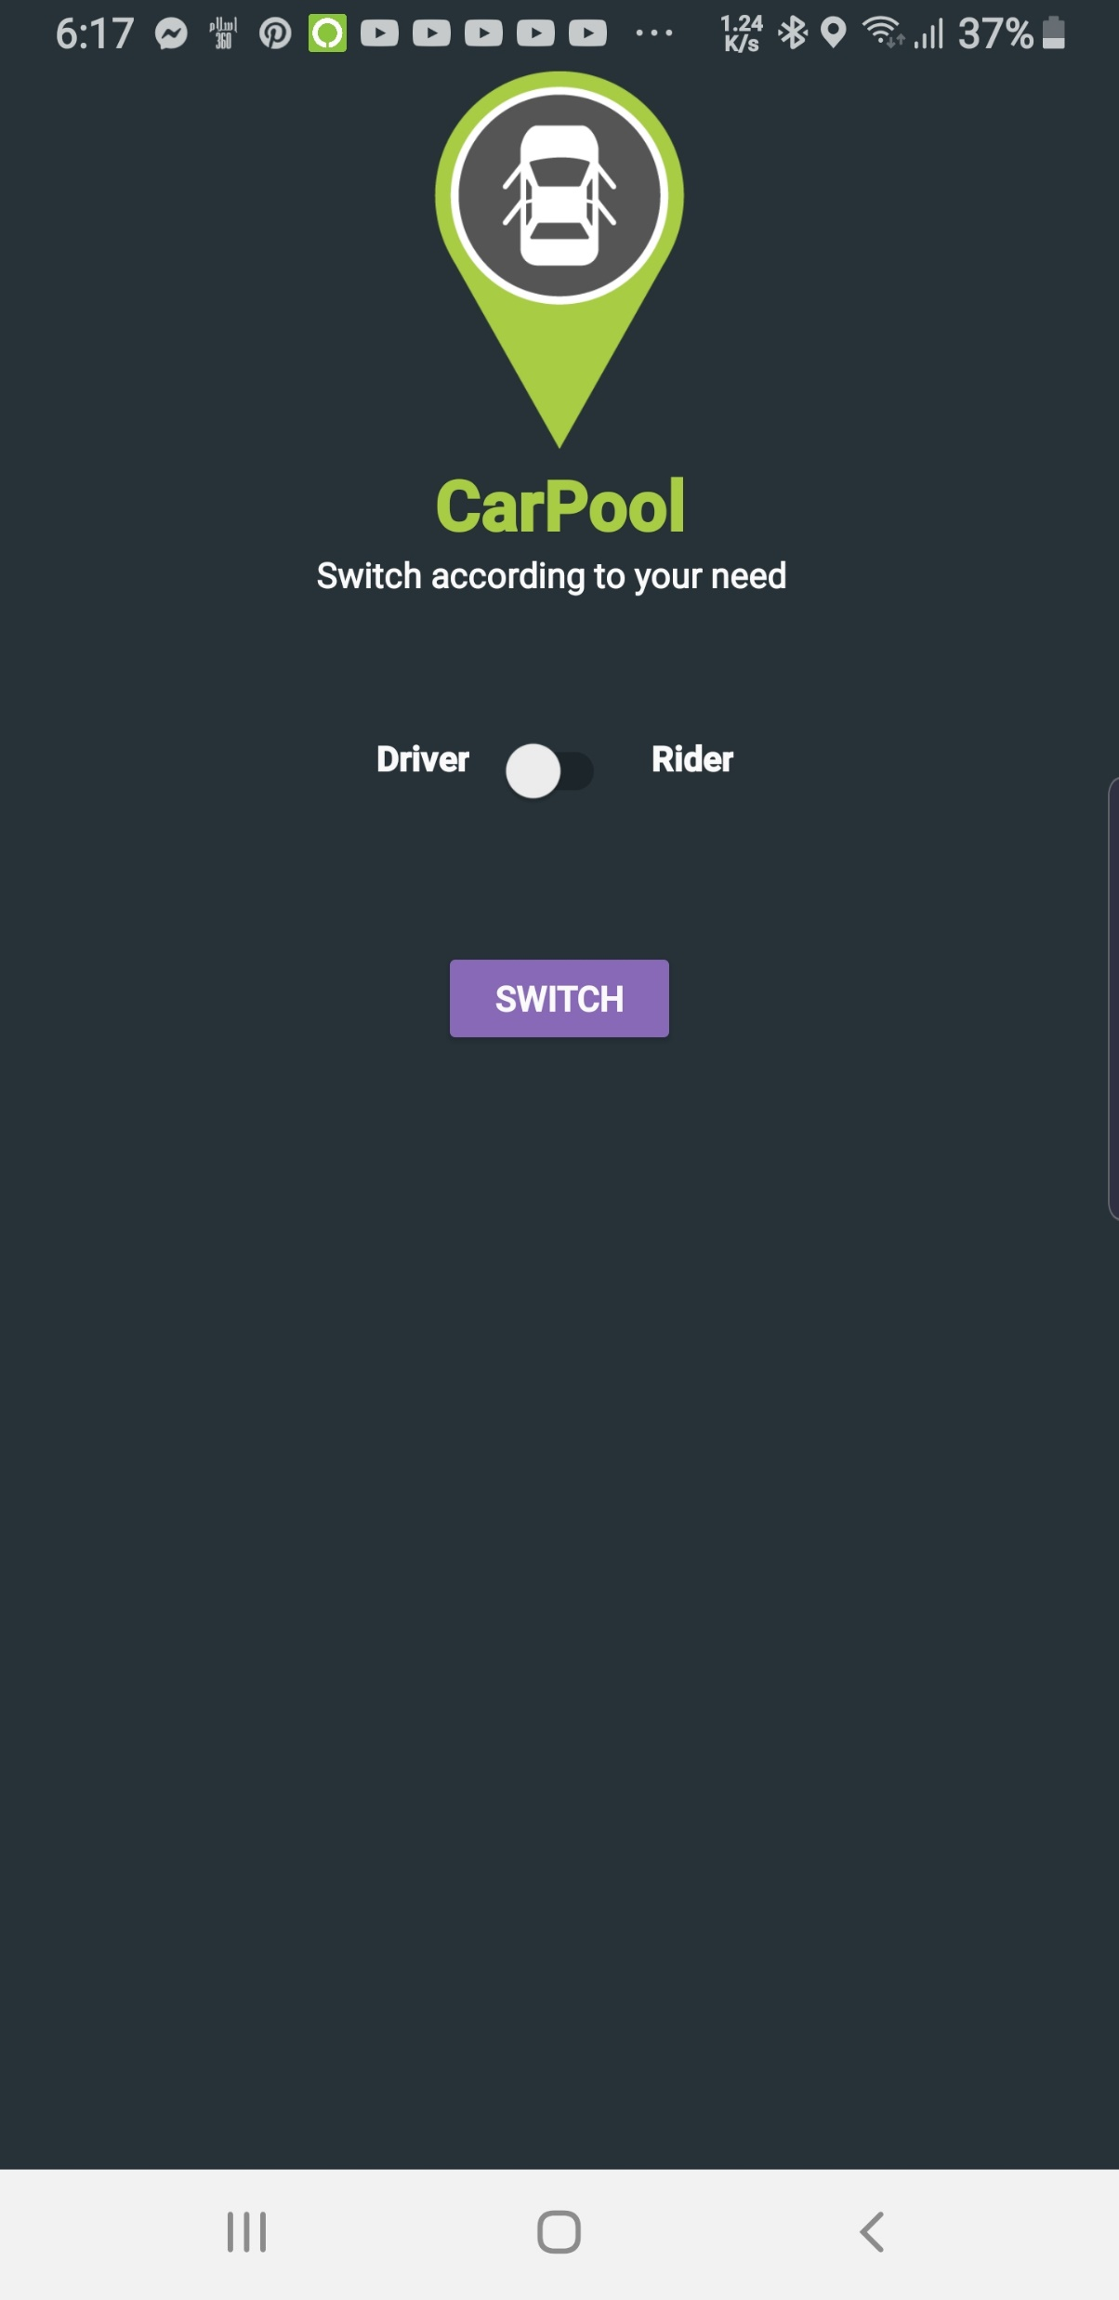
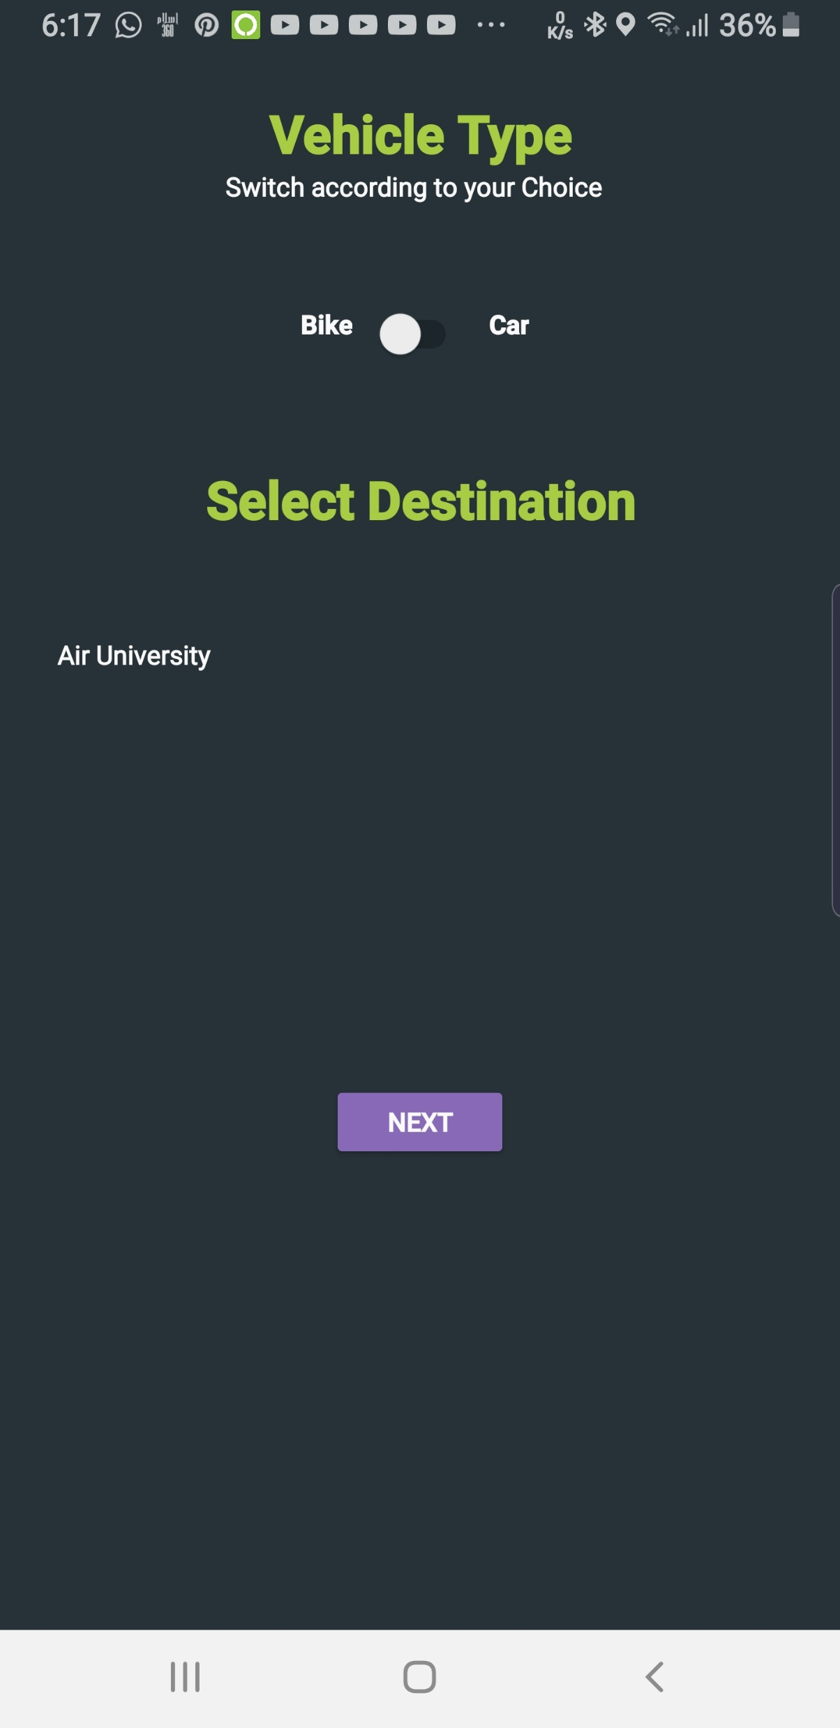
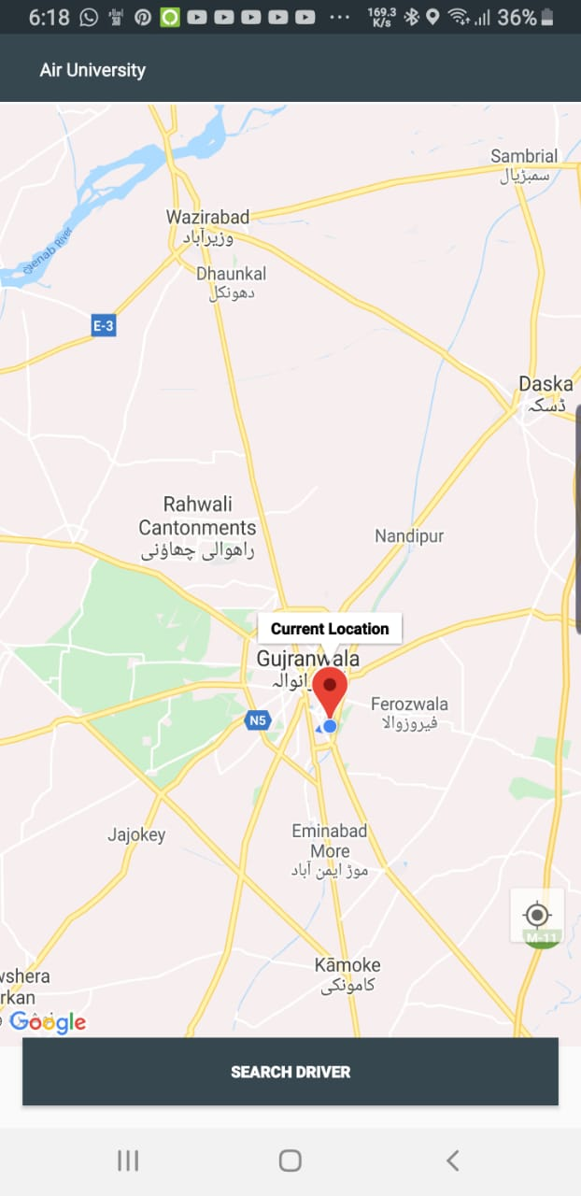
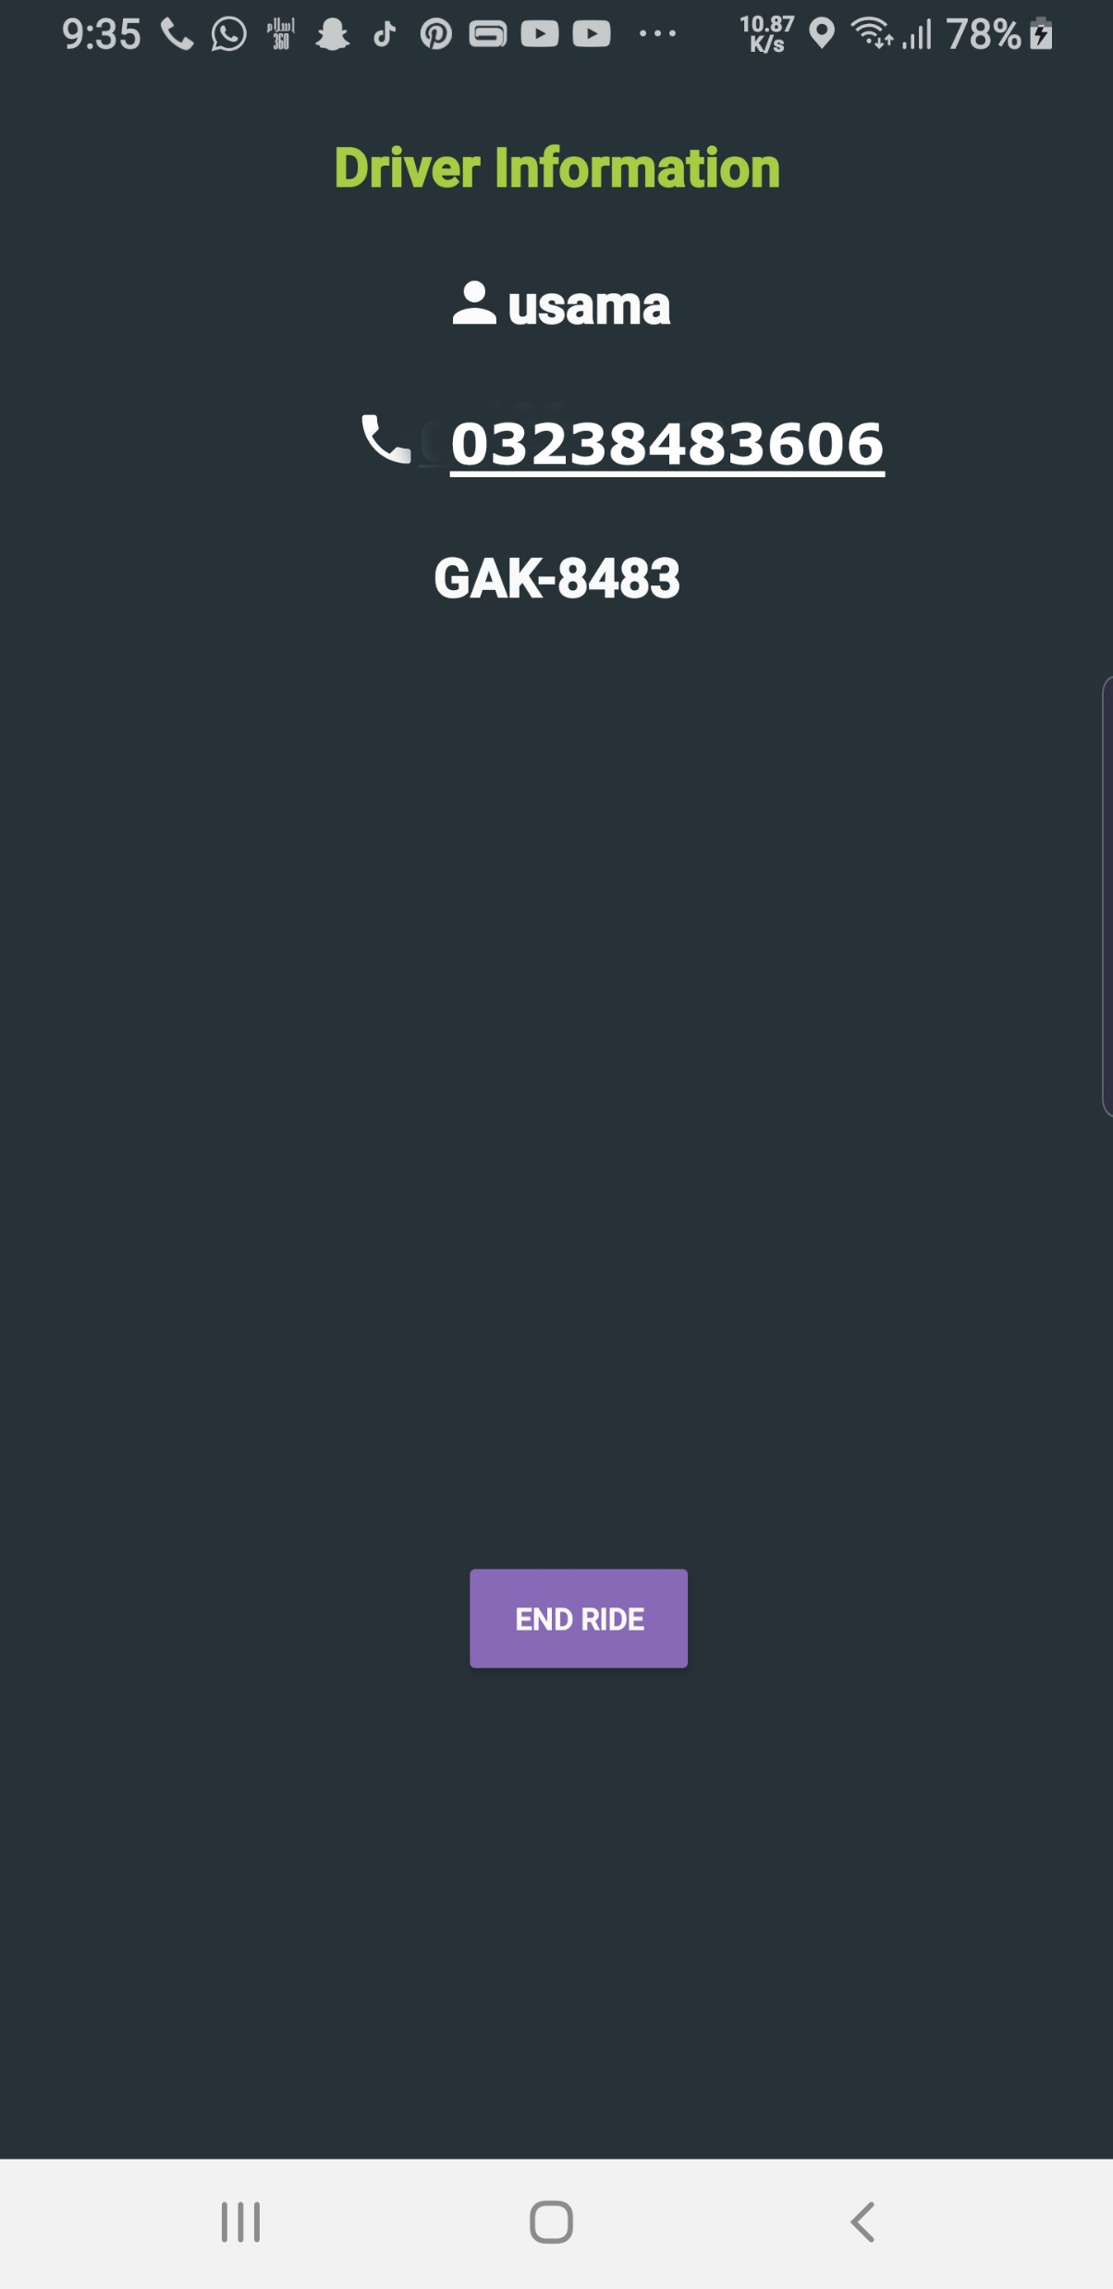
Results
Table 36: Usability Testing

Slide 13
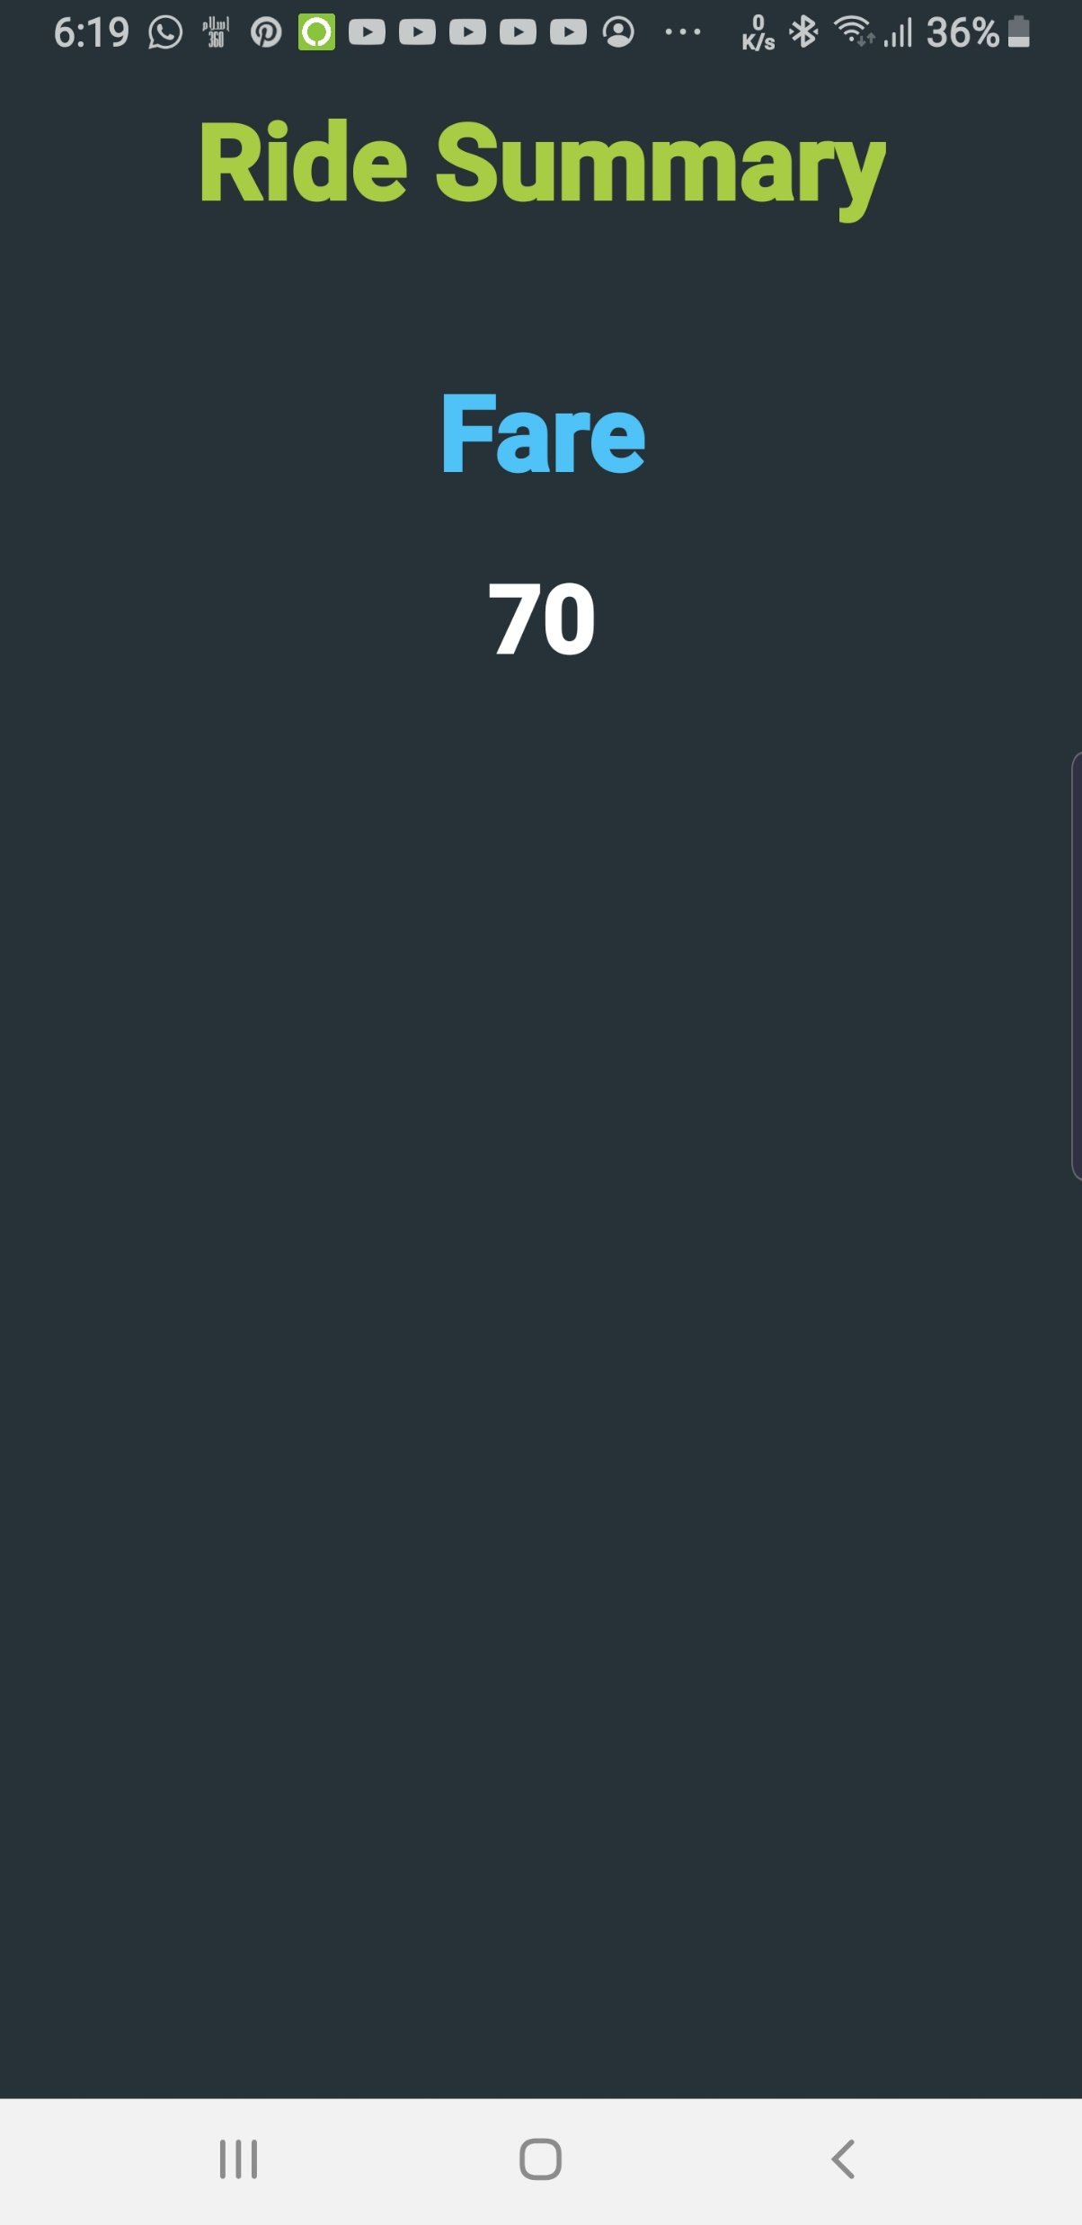
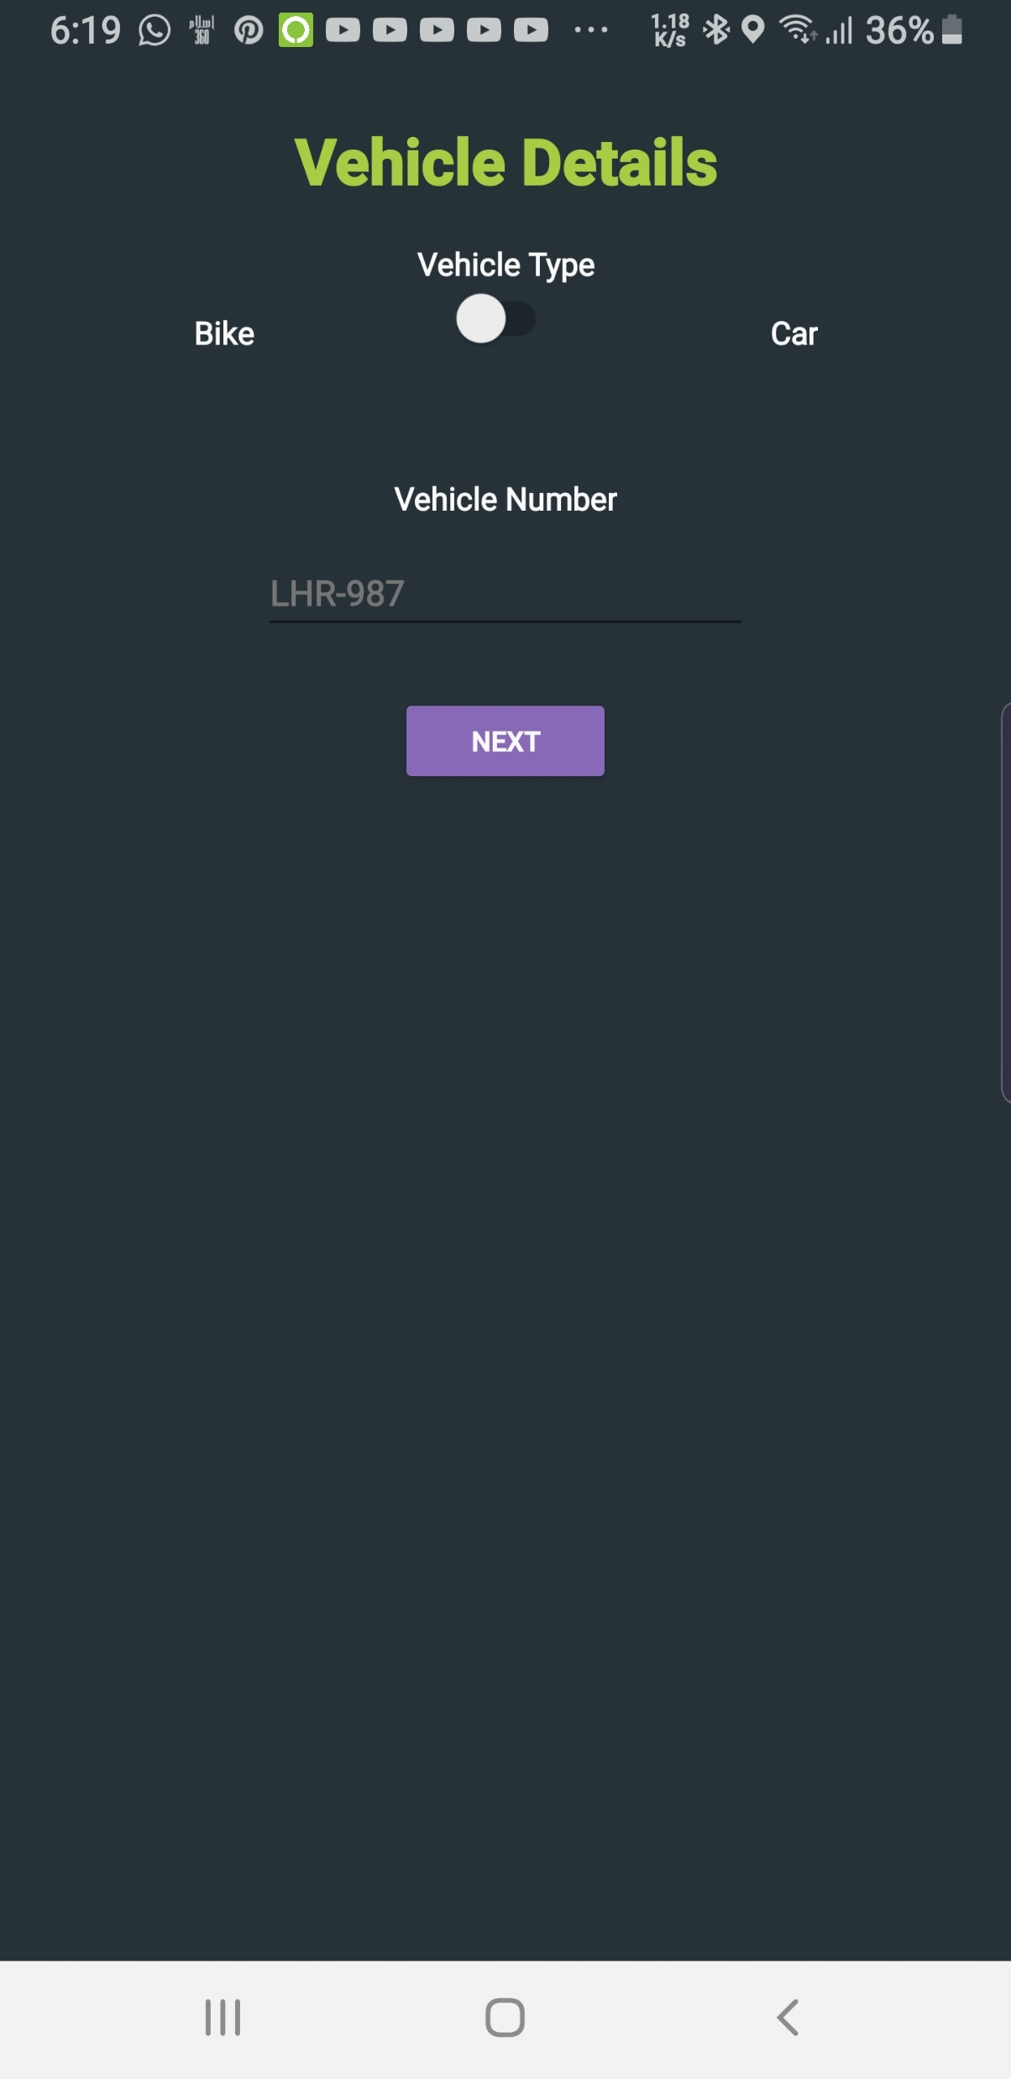
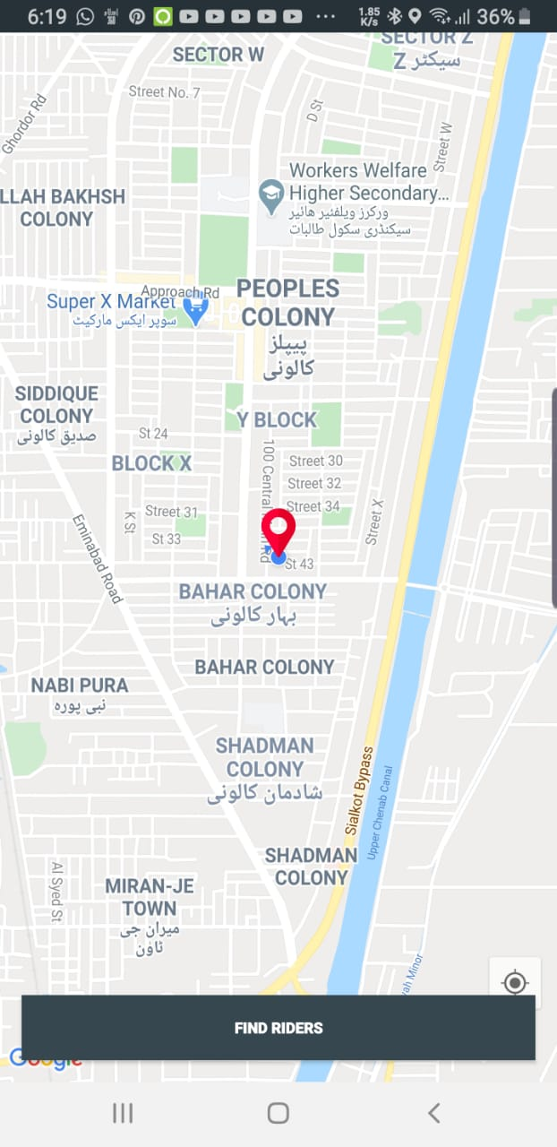
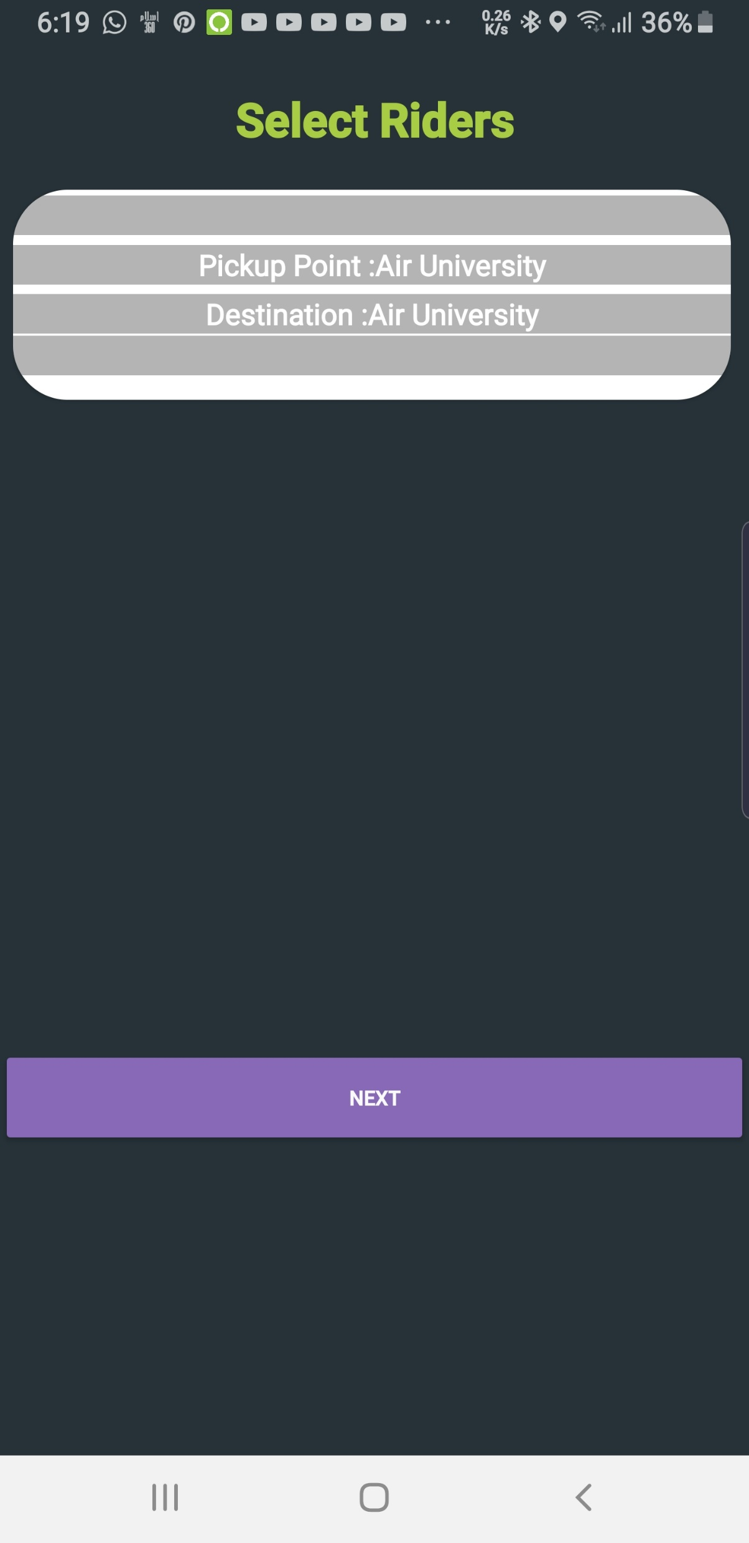
Results
Table 36: Usability Testing

Slide 14
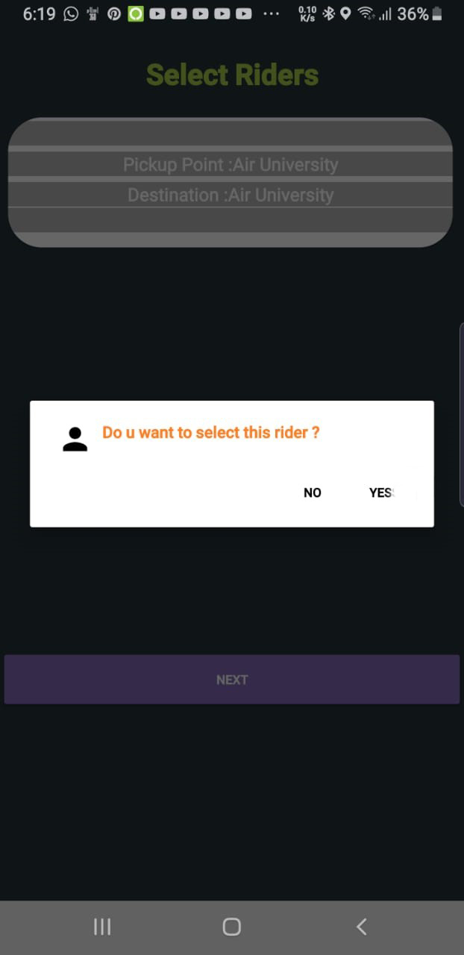
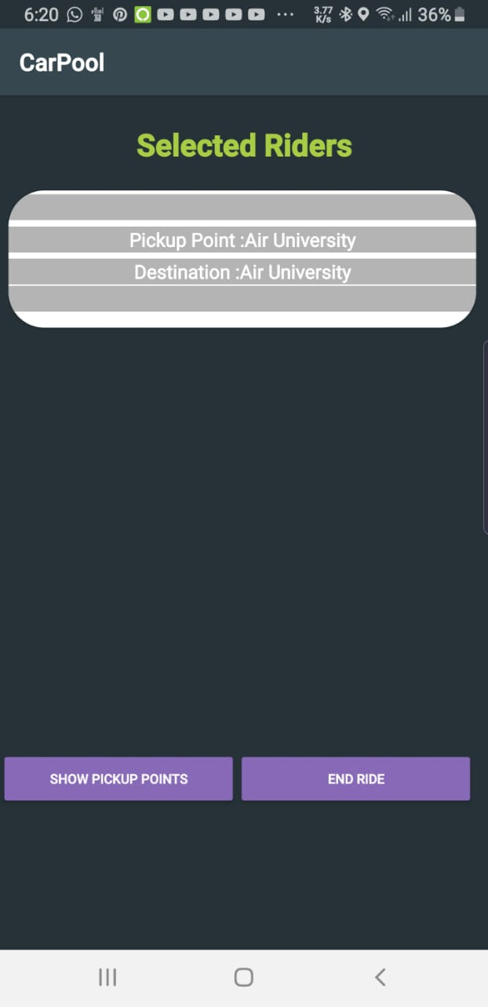
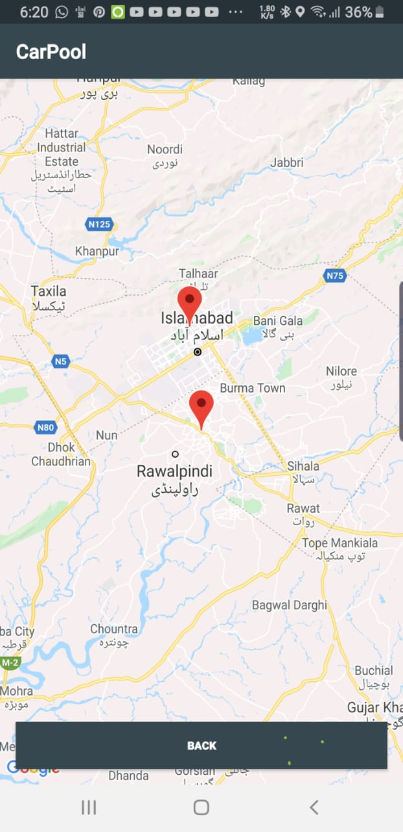
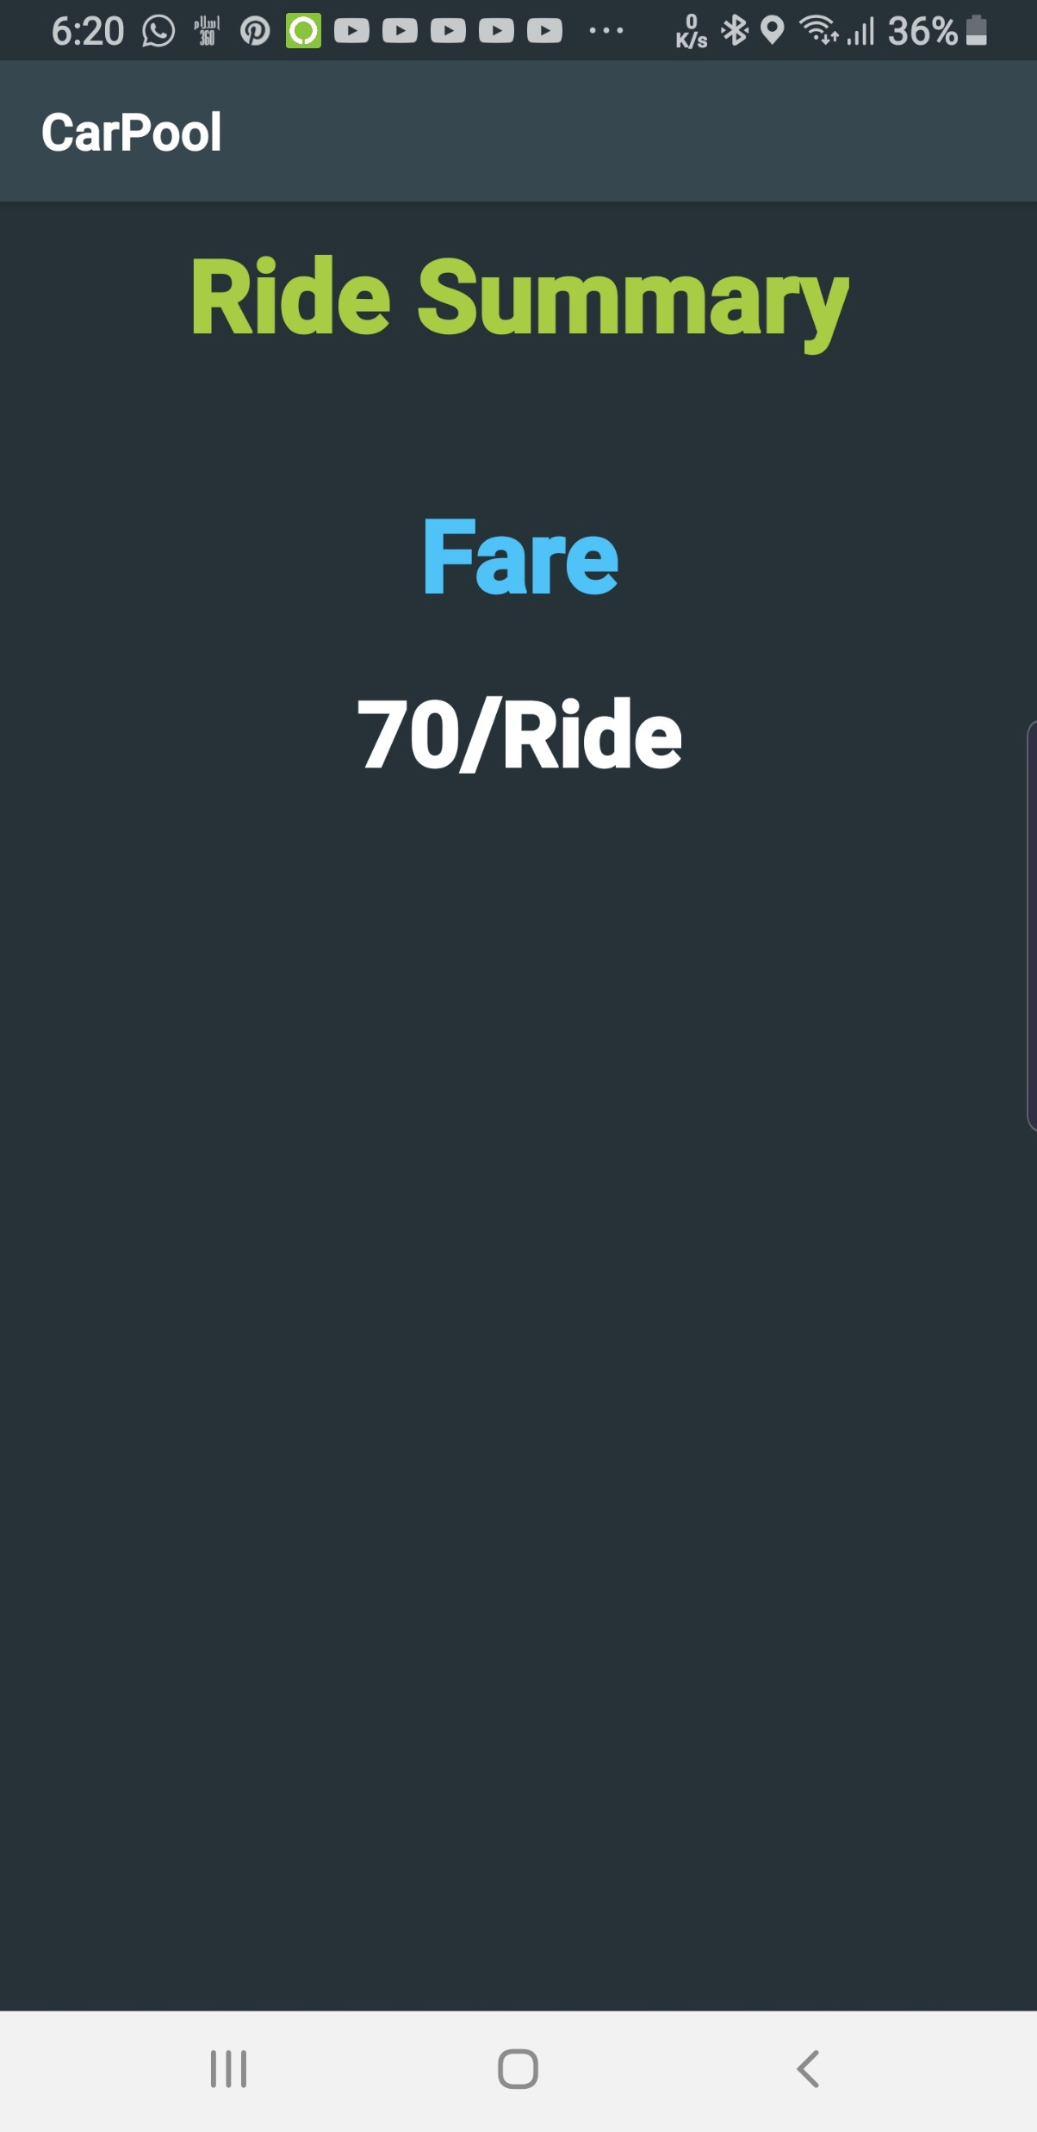
Results
Table 36: Usability Testing

Slide 15
Testing
Graphical user interface testing
User interface testing
Usability Testing
Software performance testing
Compatibility testing
Exception handling
Security testing
Installation testing

Slide 16
User Interface Testing
Check the color and size of buttons on the home screens of different users.
Make sure that icons pixels won’t fall when the app would be opened on different screen sizes.
Ensure the ripple effect working on all buttons.
Is text visible on smaller screens?
Buttons must be separated by some distance so the user won’t press the wrong button.

Slide 17
Usability Testing
Table 36: Usability Testing
Check if user is registered on CarPool.
Forgot Password?
Login to Carpool application.
Select “driver” user type.
Check if driver can select riders.
Check if driver can see pick up points of selected riders.
Drop off riders on different location.
Ride summary display.
Select “rider” user type.
Notify details of driver to rider.
Show summary of ride to rider.

Slide 18
Performance Testing
Table 36: Usability Testing
To check if the app works smoothly when multiple riders are selected by a driver.
Check the speed of the app after registration of multiple accounts.
To check firebase cloud speed.

Slide 19
Compatibility Testing
Table 36: Usability Testing
To check if the location of the user keeps on updating when user is moving.
Ensure the readability of text on different screens.
Check if push notifications work on different mobile devices.

Slide 20
Exception Handling
Table 36: Usability Testing
Only university email format required for signup; Invalid email won’t be accepted.
If email is not verified, the user won’t be able to sign in the app.
An invalid phone number is not allowed.
Users not allowed to enter the same email twice.
The app won’t crash if user do not allow location permission.
Users can’t edit roll number or email after signup.
Only selected riders will be notified by driver details.

Slide 21
Security Testing
Table 36: Usability Testing
Eliminate the risk of password leakage when someone tries to guess the password of the user.
Prevention of a denial of service attack by an attacker.
Reduce the risk of SQL injection.
Validate an attacker from accessing sensitive data.
Analyze the vulnerability of file system interactions.

Slide 22
Installation Testing
Table 36: Usability Testing
Installed the app on different android versions starting from 4.4 to 9.0.
Checked if app is installed with all resources.
Tried to uninstall the app from the android phone.

Slide 23
Conclusion
Table 36: Usability Testing
The implementation from a concept to a real application was extremely challenging but it was very eﬀective and full of experience.
We have implemented all functional and non-functional needs and some of the optional needs.
From design to backend features, everything is checked.
This implementation was deﬁnitely helpful to our career, since implementing a concept into a real application gives us good knowledge of the development environment.

Slide 24
Project Demo
Table 36: Usability Testing

