Slide 1
BarMaster
Group member
Student 1
Student 2

Slide 2
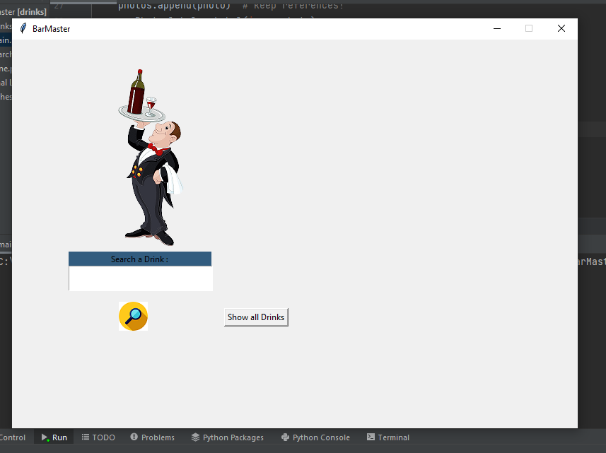
Techlonogy
Python 3.10
Python 3.10.0 is the newest major release of the Python programming language, and it contains many new features and optimizations.
Tkinter
Python provides the standard library Tkinter for creating
the graphical user interface for desktop based applications

Slide 3
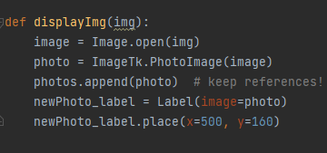
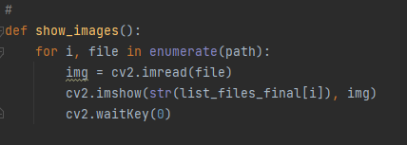
Continue….
Pillow
Pillow is a Python Imaging Library (PIL), which adds support for opening, manipulating, and saving images
Cv2
cv2 is the module import name for opencv-python,
"Unofficial pre-built CPU-only OpenCV
packages for Python"

Slide 4
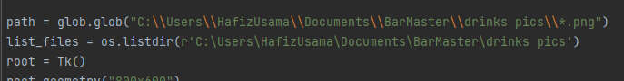
Continue….
Glob
glob (short for global) is used to return all file paths that match a specific pattern. We can use glob to search for a specific file pattern
OS
The OS module in Python provides functions for interacting with the operating system. OS comes under Python's standard utility modules

Slide 5

IDE….
Pycharm
PyCharm is an integrated development environment used in computer programming, specifically for the Python programming language. It is developed by the Czech company JetBrains

Slide 6
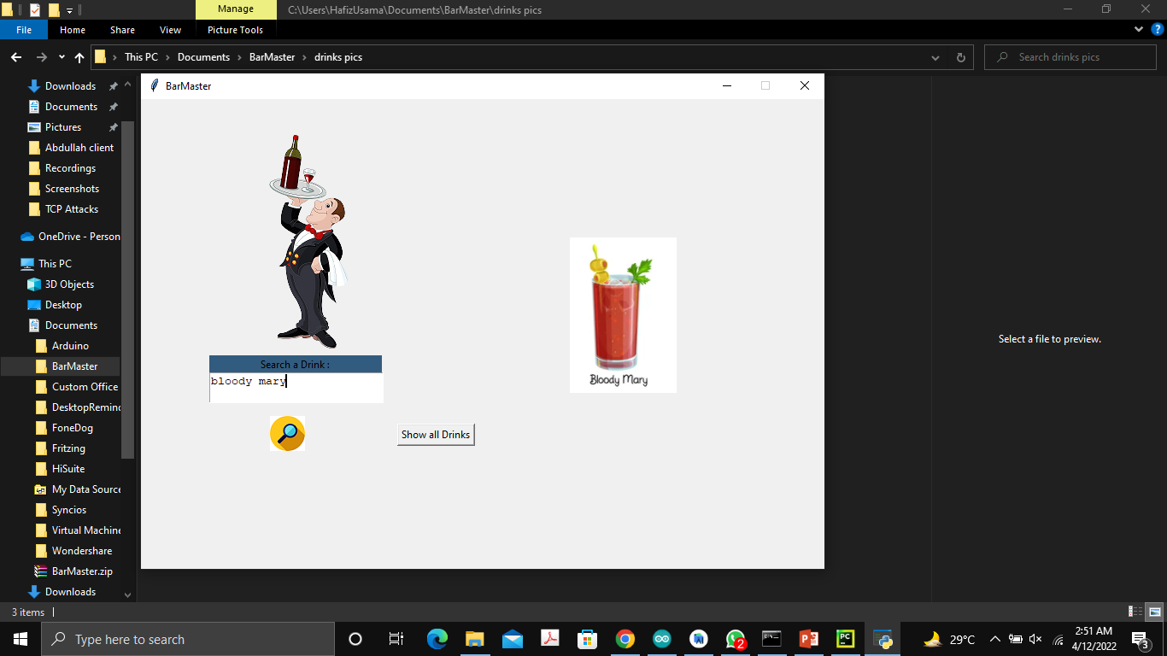
Final Application
Search Button
search the drink in bar
Show all drink Button
show all available drink in bar

