Slide 1
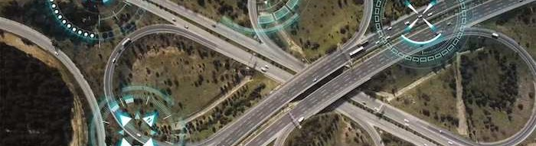
Enhancing Road Safety: Lane Guard for Vehicles

Slide 2

Introduction
Automation in every aspect of life.
Advanced Driver-Assistance System (ADAS) for autonomous vehicles.
Importance of Lane Line Detection using Computer
Vision.Implementation of a
lane detection system using OpenCV.

Slide 3

Lane Departure Prevention
Lane Guard technology utilizes advanced sensors to detect lane departure and provides real-time alerts to the driver. By assisting in maintaining the correct lane position, it significantly reduces the risk of collisions due to unintentional lane changes.

Slide 4

Enhanced Driver Awareness
Lane Guard enhances driver awareness by providing visual and audible warnings when the vehicle deviates from its designated lane. This proactive approach empowers drivers to take corrective action, thereby improving overall safety on the road.

Slide 5
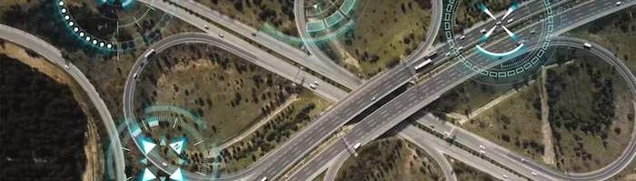
Adaptive Technology
The Lane Guard system employs adaptive technology to accommodate various road conditions and driving scenarios. It can effectively operate in urban environments, highways, and challenging weather conditions, ensuring consistent performance across different settings.

Slide 6
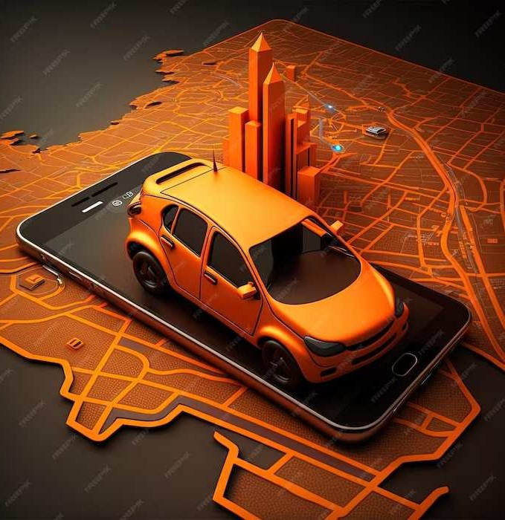
Cost-Effective Implementation
Implementing Lane Guard technology is a cost-effective measure for vehicle manufacturers and ﬂeet operators. Its integration can be seamlessly incorporated into new vehicle designs or retrofitted to existing ﬂeets, offering long-term safety benefits.

Slide 7

Regulatory Compliance
Lane Guard systems align with regulatory standards and safety mandates, contributing to overall compliance with road safety regulations. This ensures that vehicles equipped with Lane Guard technology meet the necessary safety requirements.

Slide 8
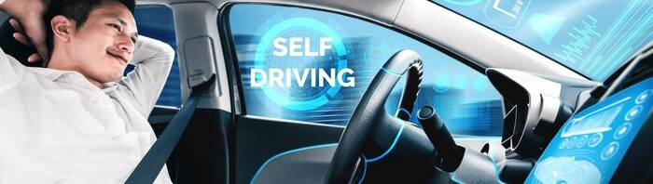
User Feedback and Acceptance
User feedback and acceptance of Lane Guard technology have been positive, with drivers acknowledging its role in enhancing road safety. The user-friendly nature of the system has led to widespread adoption and support within the automotive community.

Slide 9
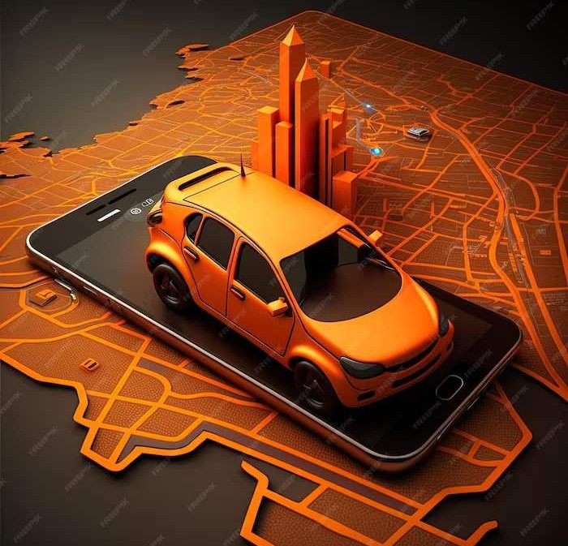
Conclusion
Lane Guard technology represents a significant advancement in enhancing road safety for vehicles. Its proactive approach in preventing lane departure and improving driver awareness contributes to a safer and more secure driving environment for all road users.

Slide 10
Thanks!
Do you have any questions?
youremail@email.com
+00 000 000 000
www.yourwebsite.com Street X, City X - 0000
@yourusername

