Slide 1

Suspect Face Sketch Using Textual Description
Group Members
Farhan Abbasi (20P-0044)
Usama Yazdani (20P-0598)
Project Supervisor
Ms. Sara Rehmat

Slide 2
Introduction
Our Project “Suspect Face Sketch using Textual Description” aims to bridge the gap between textual descriptions of suspects and their visual representations by developing an advanced system capable of generating accurate facial sketches. With the potential to revolutionize the way law enforcement agencies approach suspect identification.
2

Slide 3
Literature Review
3

Slide 4
Sr No | Year | Basic Idea | Methodology | Result | Limitation | Future Work Suggestion
[1] | 2023 | Text to sketch synthesis using adversarial network | Generative Adversarial Networks ( GANs) | The proposed method achieved an Inception Score of 1.438 ± 0.049, outperforming other state-of-the-art techniques. | The Frechet Inception Distance of 65.29 is also a good score, but it is not as closely correlated with human perception of image quality as the Inception Score. | Refining the training process and enhancing the quality of the generated sketches.
[2] | 2022 | Text-based Attribute Manipulation for Face Sketch Synthesis | It adopts text-driven attribute manipulation using the Contrastive Language-Image Pre-Training (CLIP) model. | The paper provides extensive qualitative and quantitative experiments conducted on the CUHK Face Sketch Dataset (CUFS) to evaluate the effectiveness of the SketchCLIP method. | Quality of Input Sketches: The method’s effectiveness relies on the quality of the input face sketches. If the initial sketches are of low quality or resolution, the results may not be as satisfactory. It would be challenging to use this approach with very rough or abstract sketches. | The intra-modality fine-tuning module can be further optimized to enhance the quality of modified face sketches and reduce any remaining distortions
4

Slide 5
Sr No | Year | Basic Idea | Methodology | Result | Limitation | Future Work Suggestion
[3] | 2018 | Learning Face Sketch from Facial Attribute Text | The authors synthesize vivid face sketches using Stagewise-GAN. They evaluate the effectiveness of their approach through user study, face retrieval performance with synthesized sketch, and quantitative results. | The authors evaluated the effectiveness of their approach through user study, face retrieval performance with synthesized sketch, and quantitative results. | The paper does not address the challenge of synthesizing high-quality face sketches due to the ambiguity and complexity of text description. | Explore methods to address the challenge of synthesizing high-quality face sketches from text descriptions, considering the ambiguity and complexity of the text.
5

Slide 6
Problem Statement
The current process of generating suspect sketches from textual descriptions in criminal investigations is often time-consuming and prone to inaccuracies. Inaccurate sketches can lead to wrongful arrests, while delays in sketch generation can allow suspects to evade capture.
6

Slide 7
Proposed Solution
Developing a system that takes facial features as a description and generates a realistic face sketch to bridge the gap between textual descriptions and visual representations of suspects.
7

Slide 8
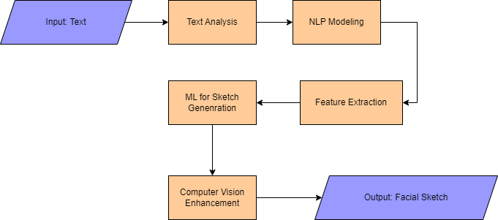
Methadology
8

Slide 9
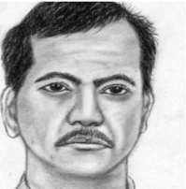
Comparative Study
Facial Sketch Drawn By A Sketch Artist
A man has a inverted triangle face with short hair. He has a pair of big narrow eyes, with dense thin and arched eyebrows.His mouth is thick and narrow, with a medium short nose and his ears are normal.He hasn't glasses and beard.
Attributes given by a witness
Artist Made Sketch
9

Slide 10
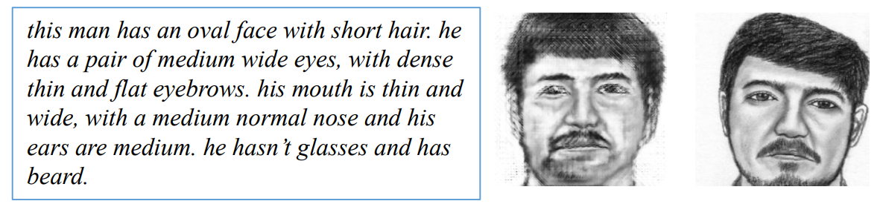
Comparative Study
2018 Sketch Model
Facial Attributes
Synthesized Sketch
Artist Made Sketch
10

Slide 11
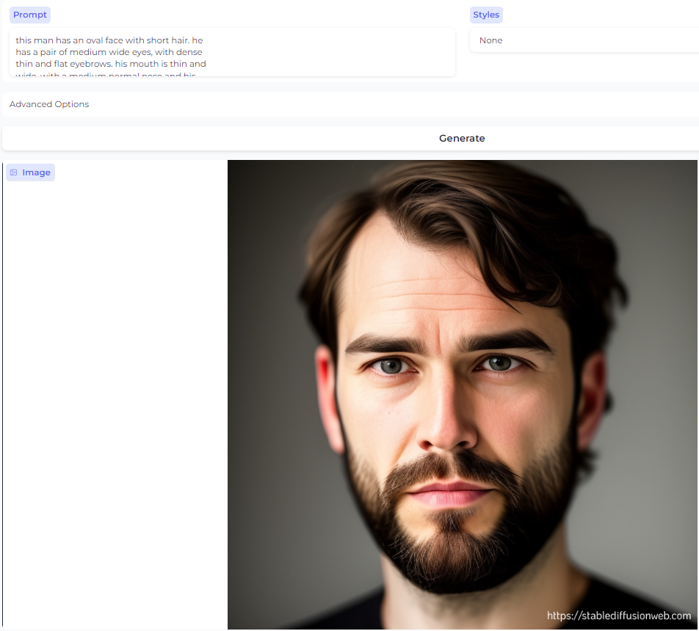
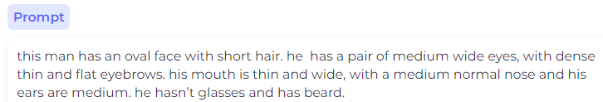
Comparative Study
Facial Attributes Given To Stable Diffusion Model
11

Slide 12
Motivation
Enhancing law enforcement capabilities
Reducing wrongful arrests and protecting innocent individuals
Accelerating investigations for public safety
Leveraging advanced technology ( NLP, GANs , CV) for problem-solving
Encouraging witness engagement and reliable testimonies
12

Slide 13
Scope of the project
Use of NLP models for textual description interpretation.
Implementation of machine learning algorithms for sketch generation.
Application of computer vision techniques for sketch enhancement.
Creation of a user-friendly web based interface.
.
13

Slide 14
Goals
Develop a functional system for generating facial sketches from textual descriptions.
Improve the accuracy of generated suspect sketches by making required changes according to the suspect requirement.
Enhance the efficiency of the sketch generation process.
14

Slide 15
Timeline For FYP-I
FYP-I | WEEKS
 | 1 | 2 | 3 | 4 | 5 | 6 | 7 | 8 | 9 | 10 | 11 | 12 | 13 | 14 | 15 | 16
Literature Review
Dataset Collection and Preprocessing
NLP Model Development
Machine Learning Model Development
Initial Model Testing
Documentation
15

Slide 16
Timeline For FYP-II
FYP-II | WEEKS
 | 1 | 2 | 3 | 4 | 5 | 6 | 7 | 8 | 9 | 10 | 11 | 12 | 13 | 14 | 15 | 16
Computer Vision Integration
GUI Integration
Final Testing and Validaion
Documentation
16

Slide 17
Expected Result
We will try to produce these results:
Sketch Generation Model
A man has a inverted triangle face with short hair. He has a pair of big narrow eyes, with dense thin and arched eyebrows.His mouth is thick and narrow, with a medium short nose and his ears are normal.He hasn't glasses and beard.
Input text
Our Proposed Model
Expected Output
17

Slide 18
Team Work
Idea Selection: Farhan And Usama
Literature Review: Usama Yazdani
Slide Preparation: Farhan Abbasi
18

Slide 19
References
[1] Y. Wang, L. Chang, Y. Cheng, L. Jin, and others, "Text2Sketch: Learning Face Sketch from Facial Attribute Text," in *Proceedings of the IEEE International Conference on Computer Vision (ICCV)*, Oct. 2018, pp. 669-673. doi:10.1109/ICCV.2018.00078.
[2] J. E. Martis, S. M. Shetty, M. R. Pradhan, U. Desai, and B. Acharya, "Text-to-Sketch Synthesis via Adversarial Network," in CMC, 2023, vol.76, no.1 Published: 09 June 2023
[3] M. Dong, C. Peng, D. Liu, Y. Zheng, N. Wang, and X. Gao, "SketchCLIP: Text-based Attribute Manipulation for Face Sketch Synthesis," in *Proceedings of 2022 IEEE International Joint Conference on Biometrics (IJCB) | 978-1-6654-6394-2/22/$31.00 ©2022 IEEE
19

Slide 20
Thank You ☺

