Slide 1

Suspect Face Sketch Using Textual Description
Group Members
Farhan Abbasi (20P-0044)
Usama Yazdani (20P-0598)
Project Supervisor
Dr. Waqas Ali

Slide 2
Content
Introduction
Problem Statement
Use Case Diagram
Swimlane Diagram
System Design
Flow Diagram
LSTM Architecture
Coding Convention
Goals Achieved
Future Work
Teamwork
Timeline
References
Code Demo
2

Slide 3
Introduction
Suspect Face Sketch Using Textual Description
Bridge the gap between textual descriptions and visual representations
Accurate synthesis of facial sketches
Faster identification of suspects

Slide 4
Problem Statement
The current process of generating suspect sketches from textual descriptions in criminal investigations is often time-consuming and prone to inaccuracies. Inaccurate sketches can lead to wrongful arrests, while delays in sketch generation can allow suspects to evade capture.
4

Slide 5
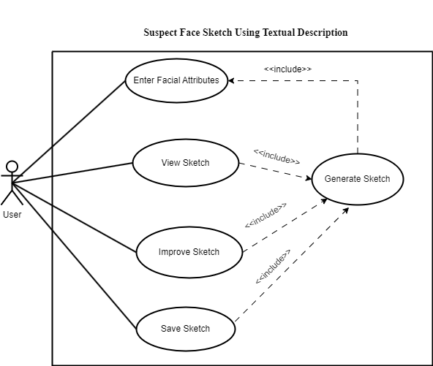
Use Case Diagram
Fig 1. System Use Case
5

Slide 6
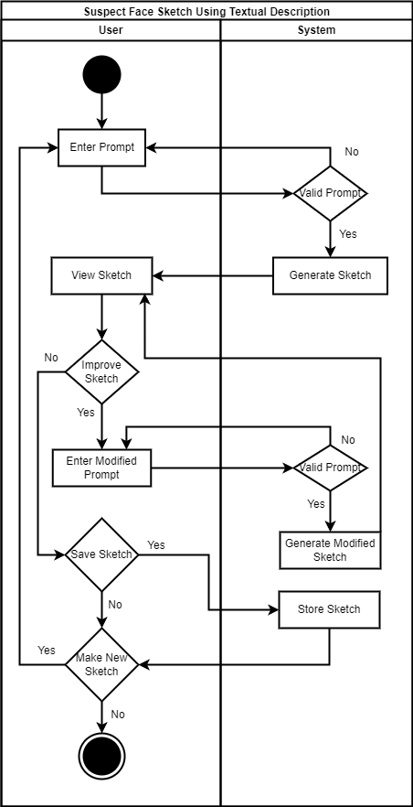
Swimlane Diagram
Fig 2. Swimlane Diagram
6

Slide 7
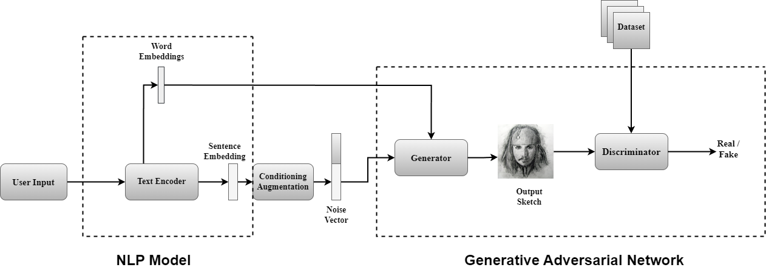
System Design
Fig 3. Proposed Architecture

Slide 8
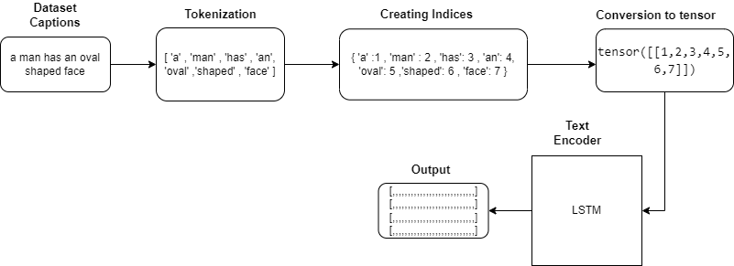
Flow Diagram
Fig 4. Generic flow of work

Slide 9
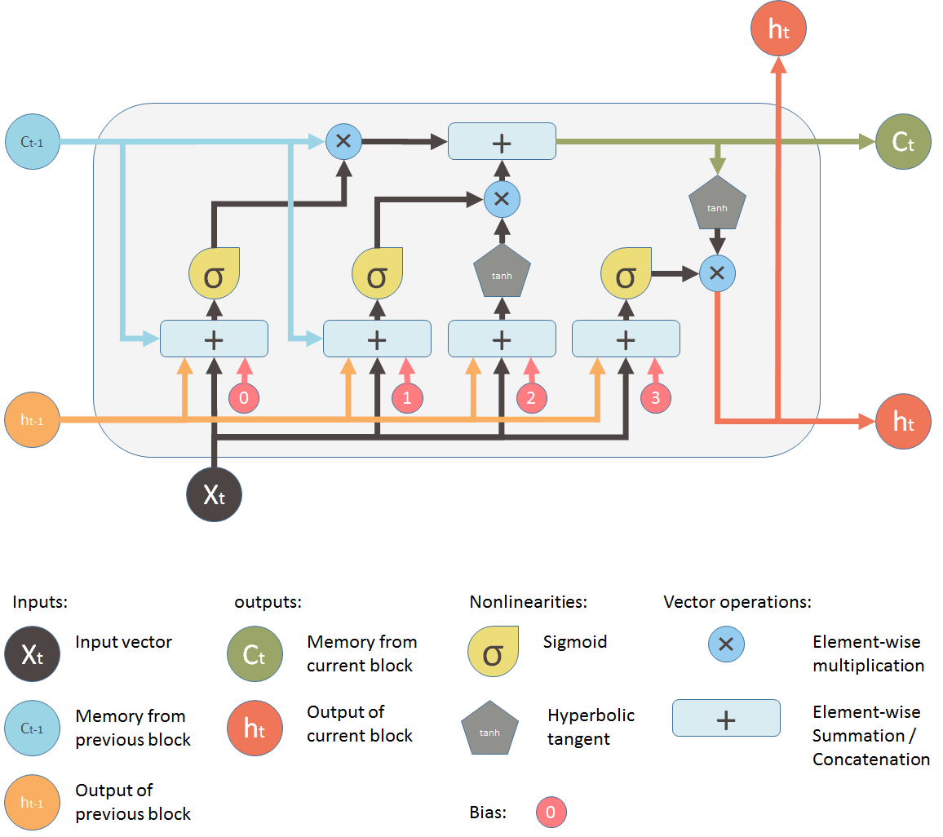
LSTM Architecture
Fig 1. LSTM Architecture [1]

Slide 10
Coding Convention
Object Oriented Programming
Data Structures
Meaningful Variable Naming

Slide 11
Goals Achieved
LSTM Encoder Model
Embedding Generation
Documentation and Code Structure

Slide 12
Future Work
GAN Model
Data Training
Webpage Integration

Slide 13
Team Work
Farhan Abbasi :
Documentation
Research
Load data set and Tokenization
Slides
Usama Yazdani:
Vocabulary
LSTM
Research
Poster

Slide 14
Timeline For FYP-I
FYP-I | WEEKS
 | 1 | 2 | 3 | 4 | 5 | 6 | 7 | 8 | 9 | 10 | 11 | 12 | 13 | 14 | 15 | 16
Literature Review
Dataset Collection
NLP Model Development
Initial Model Testing
Documentation
14

Slide 15
Timeline For FYP-II
FYP-II | WEEKS
 | 1 | 2 | 3 | 4 | 5 | 6 | 7 | 8 | 9 | 10 | 11 | 12 | 13 | 14 | 15 | 16
ML Model Development
GUI Integration
Final Testing and Validation
Documentation
15

Slide 16
References
[1] Yan, S. (2016, March 14). Understanding LSTM and its diagrams. ML Review. Retrieved from [https://blog.mlreview.com/understanding-lstm-and-its-diagrams-37e2f46f1714]
16

Slide 17
DEMO

Slide 18
Thank you☺

